Slide 1
Concordia Dual Credit Program Orientation for Students
Ben Stellwagen, Director of Dual Credit
benjamin.stellwagen@cune.edu
402-643-7414
Jane Heinicke, Administrative Assistant
jane.heinicke@cune.edu
402-643-7480
Notes:
Hello, and welcome to Concordia University's Dual Credit Program. My name is Ben Stellwagen, I’m the director of Dual Credit here, I work closely with my wonderful administrative assistant, Jane Heinicke. Our contact information is included if you have any questions when this presentation is done. We’re happy to help and would love to hear from you!

Slide 2
Step 1
Application for Admission
What you need to know:
Go to the Dual Credit website (www.cune.edu/dualcredit)
Click on “Admission and Registration”
Click on “Create an Account and Apply”
Complete and SUBMIT the form
Only ONE application per Academic Year!
1. Application for Admission
2. Course Registration
Registration Time Limits
3. Tuition Payment
Notes:
Much like having to apply to your high school before registering for classes, it will take two steps to join the Dual Credit program—apply for admission and register for courses. The first thing you need to do is to complete an application for admission. The dual credit website, listed on this slide, will explain how to create an account and apply. You complete this application just once each academic year. Even if you took Dual Credit classes last year, you will need to apply again this year. The next few slides will show you what the pages look like.

Slide 3
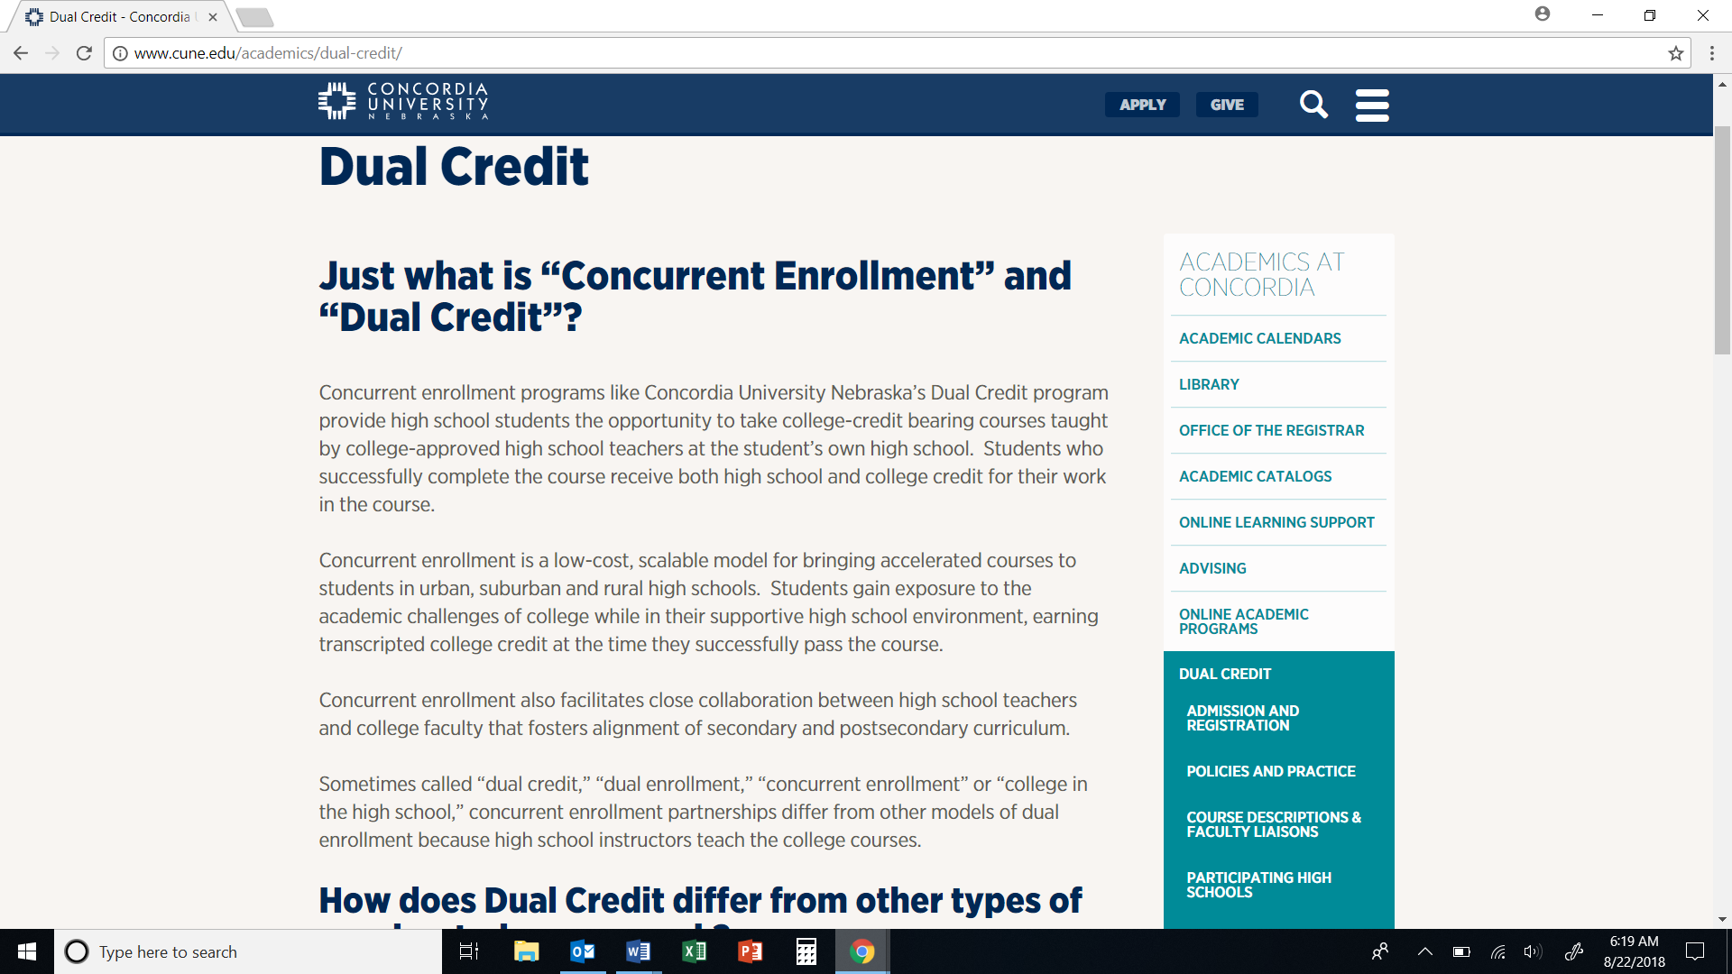
Notes:
This is the dual credit website, www.cune.edu/dualcredit. Dual credit is spelled without spaces. The button for admission and registration is in the list to the right. Click on it.

Slide 4
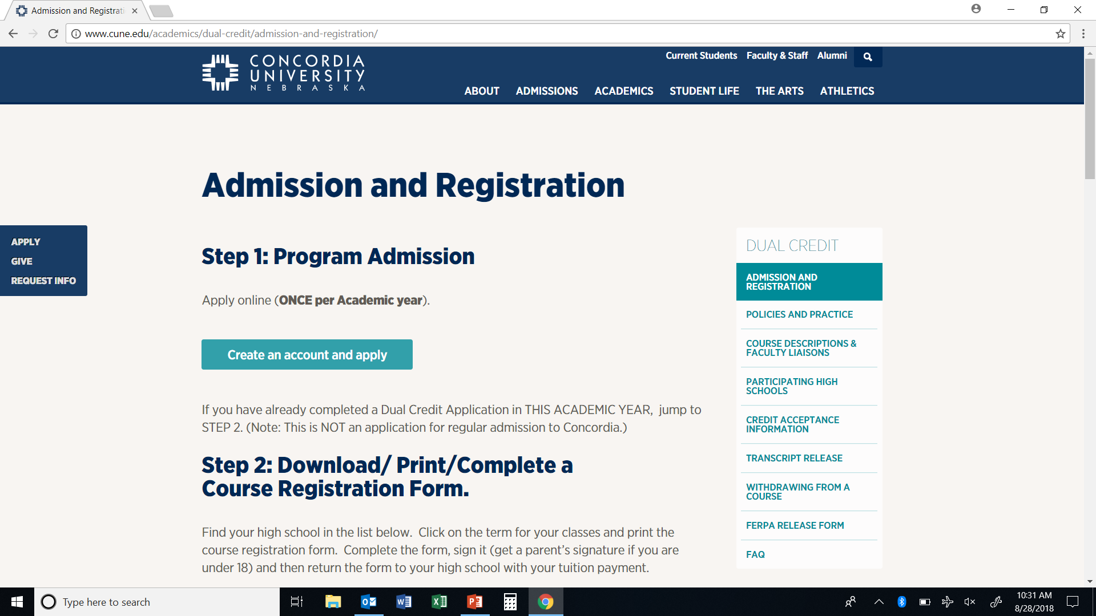
Notes:
Click on the button, “Create an account and apply.”

Slide 5
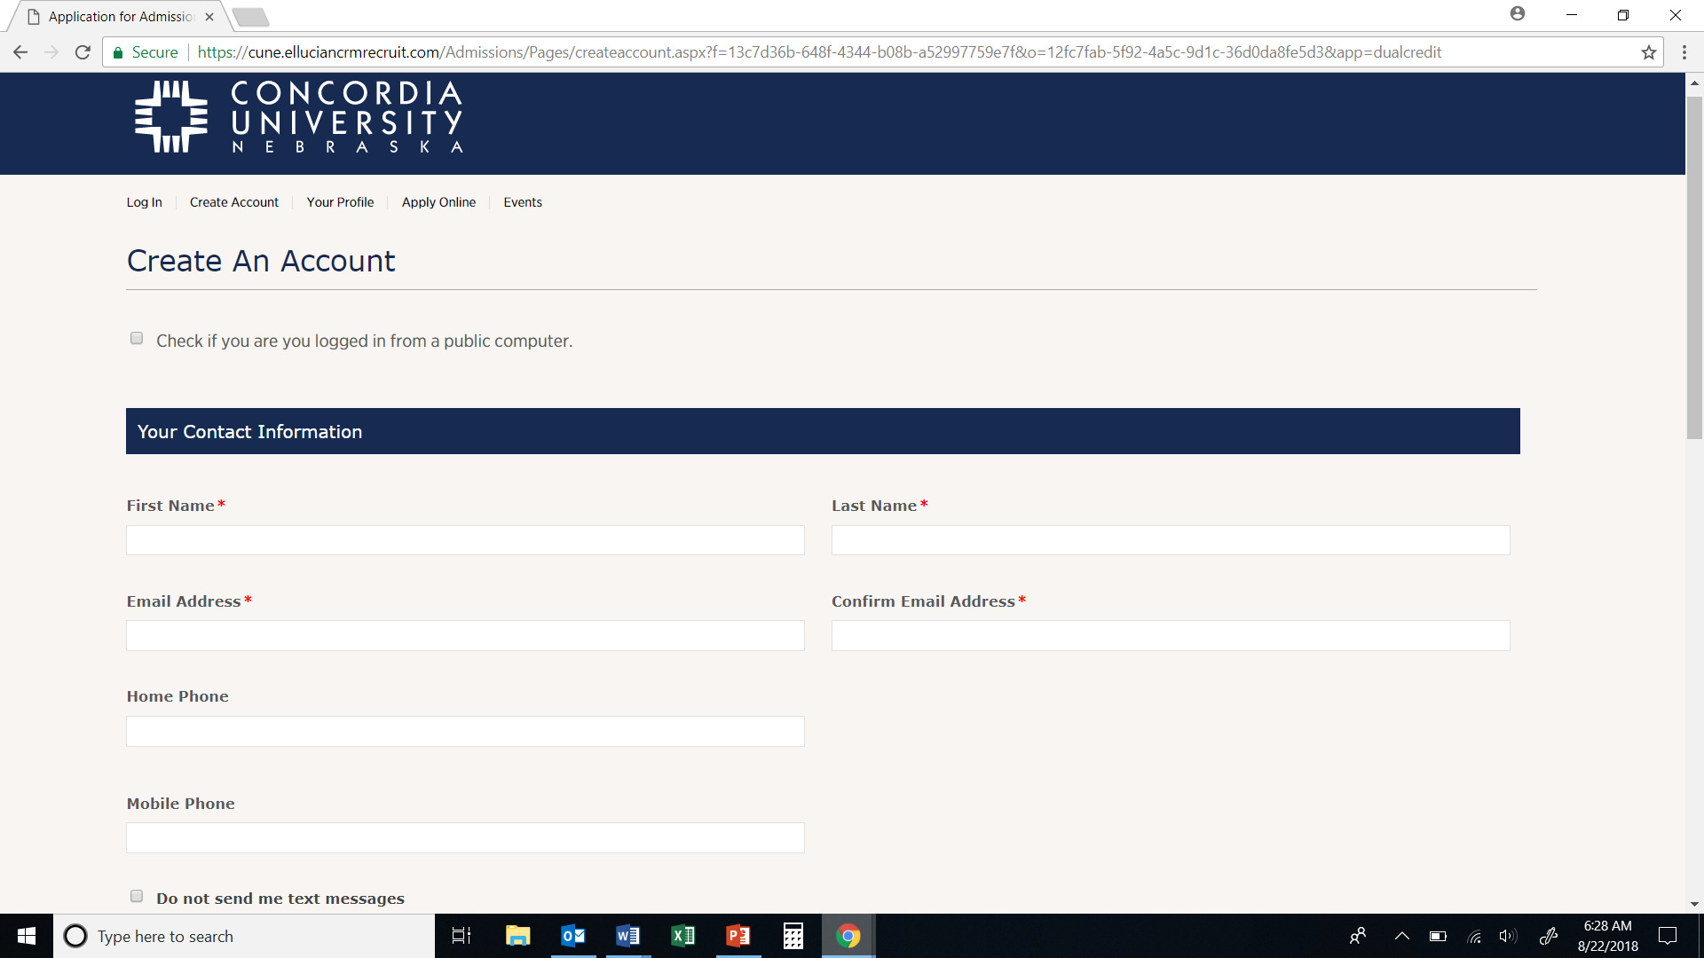
Create an account by filling out the form.
Your email address will be your username.
Completing all fields now will save time later.
Notes:
This page will allow you to create your CUNE account. Fill out the form. Your email address will be your username. Even though some fields are not required, completing them all now will save time later.

Slide 6
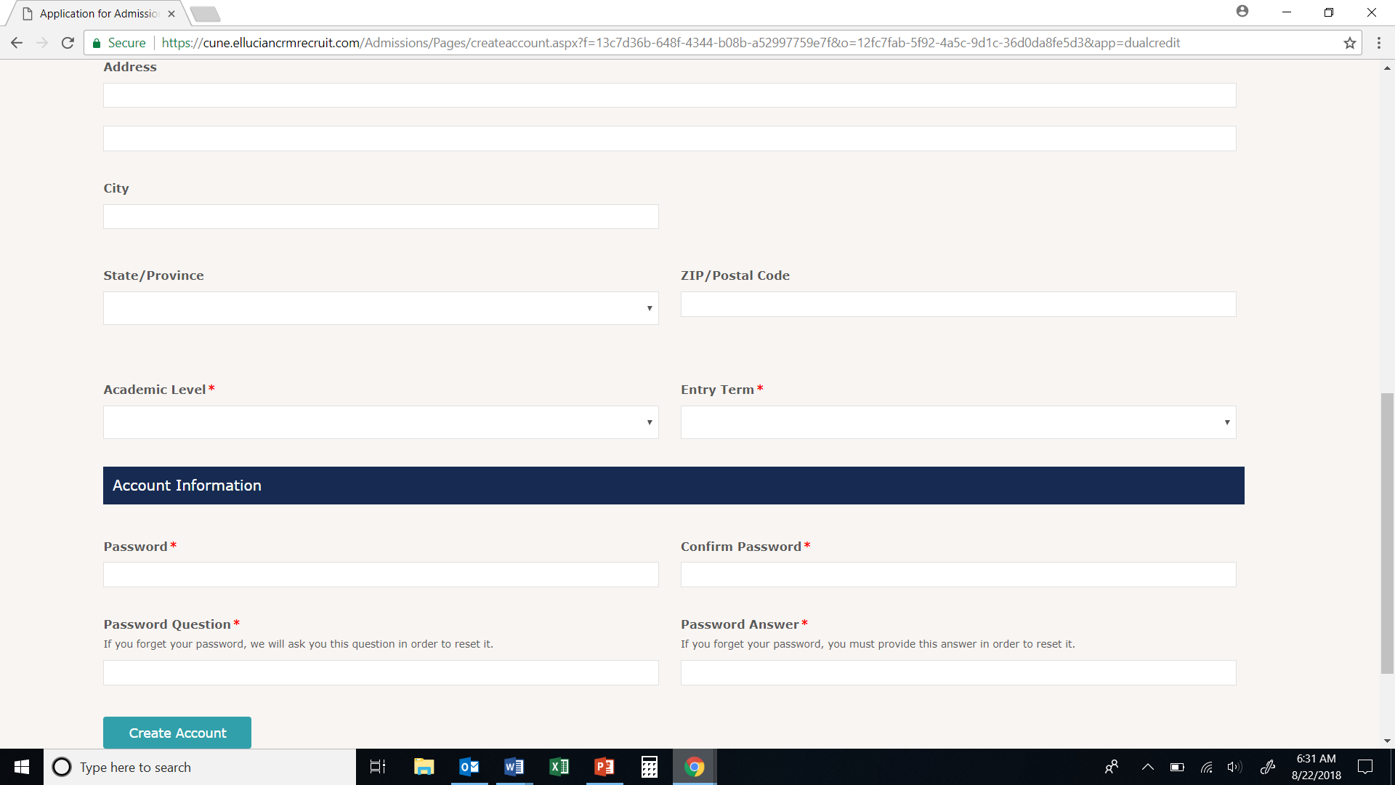
Academic Level = Dual Credit - Entry Term = Current Term
Write down your Password
Click on “Create Account”
Notes:
There are a few notes here for specific questions. The Academic Level is Dual Credit, and your entry term is the current one. Write down your password, because you may need it later to access your account, especially if you have to come back to finish an application. Then click “create account,” but please be patient! The computer will be building your application, which may take a few seconds.

Slide 7
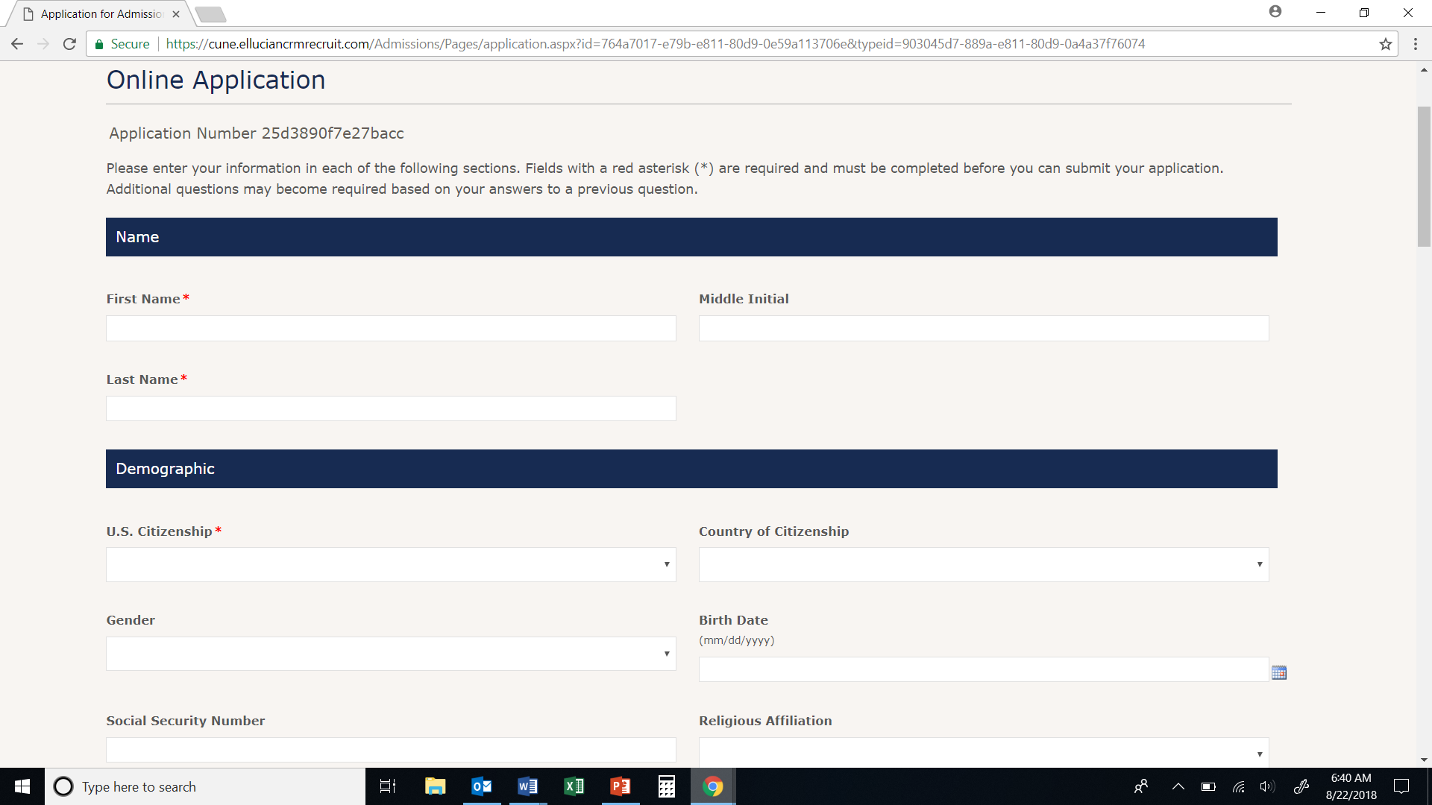
Entering fields now saves time later.
SSN requires a string of digits, no hyphens.
Notes:
After you clicked “Create an Account,” your online application should appear. The next four slides will walk you through it. Please be precise, especially with formatting fields. For instance, social security number requires a string of digits, no hyphens. Birth date uses slashes, not hyphens. A later slide will show you how to get back to this application if you somehow leave it or lose information.

Slide 8
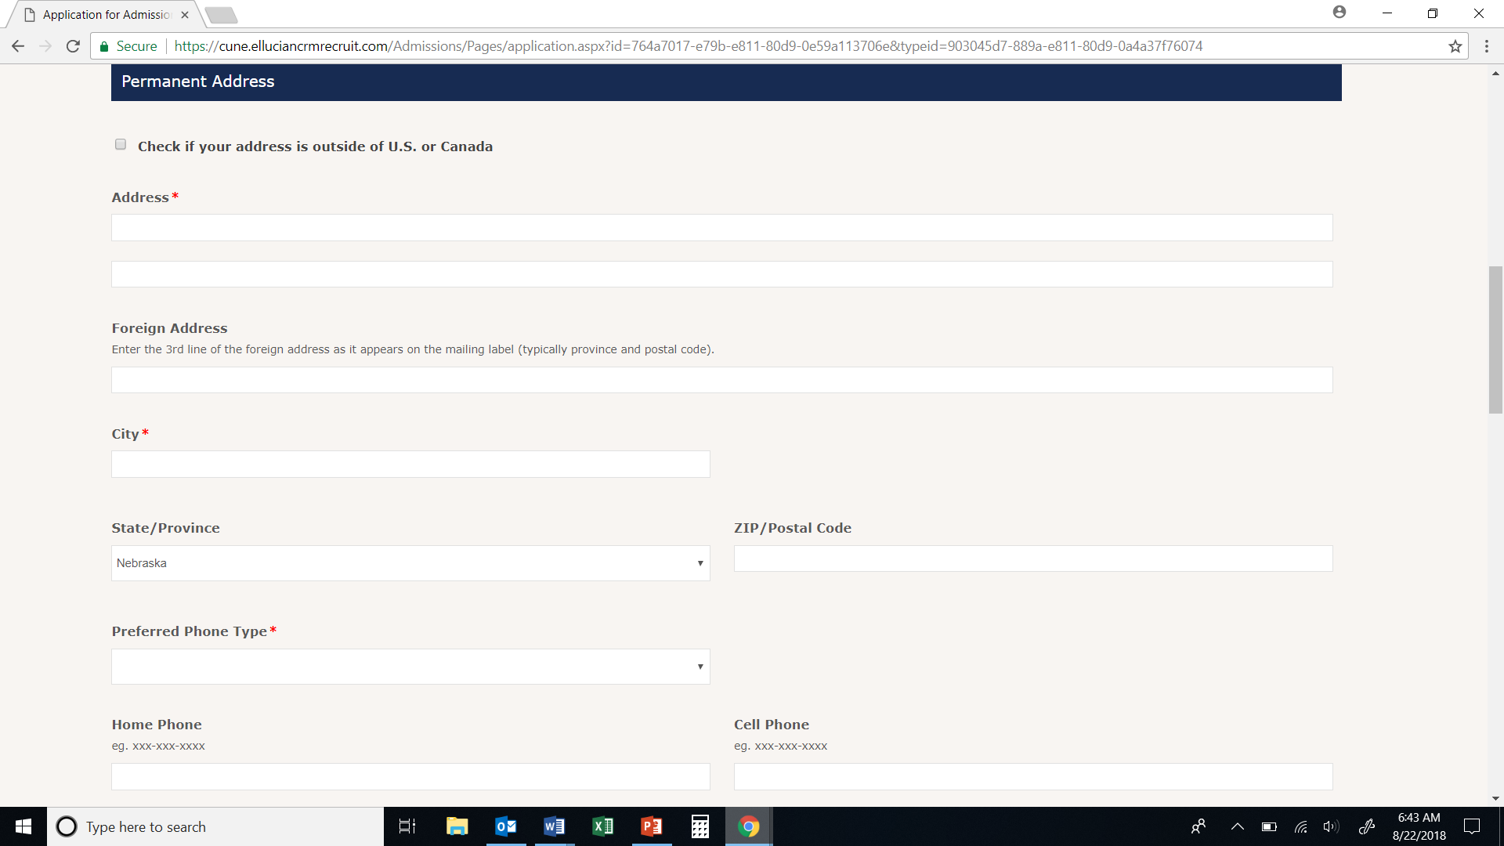
This section should be largely complete from creating your account.
Check to make sure.
Notes:
Please check this section, which should have largely been populated from the account information you entered earlier. You’ll need to select a preferred phone type and then make sure that a number is included in the appropriate box. Phone numbers use hyphens, no parentheses.

Slide 9
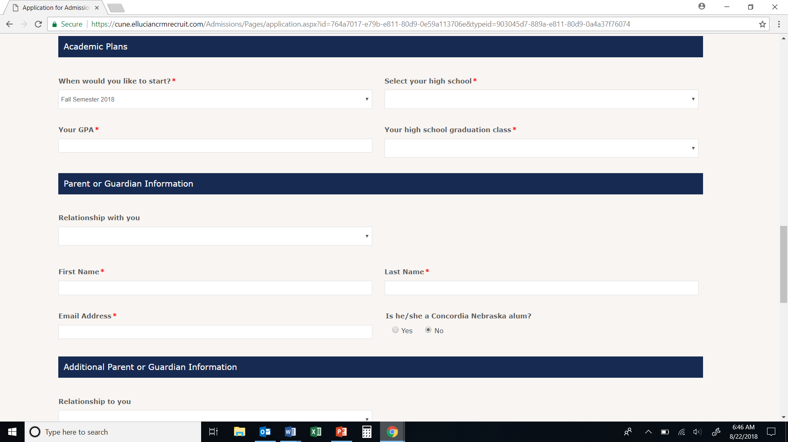
Start: Current Term
Select your high school
GPA will be verified by your school.
At least one parent/guardian info required.
Notes:
You’ll be starting during the current term. Please select your high school from the dropdown menu—be careful: because some of our schools have the same name, you’ll want to make sure that the location is correct, too. Your GPA will be verified by your school office, so enter this as accurately as possible. And I imagine that your high school graduation class is a great source of pride, so I suspect you’ll get that right!

Slide 10
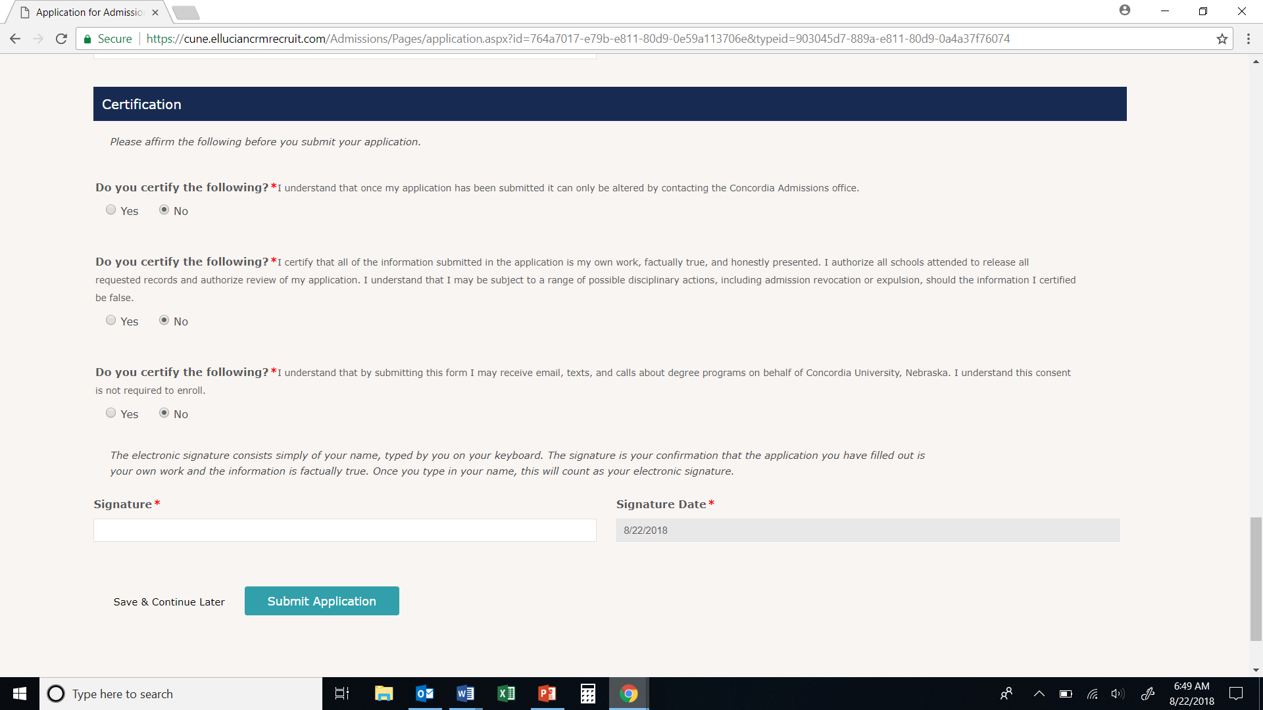
Answer all three certifications.
Type your name to sign.
Click “Submit Application.”
Notes:
After that, please answer all three certifications, type your name to sign, and click “submit application.” You should see a page that says it was successfully submitted, and you’ll be all done with the application step. The second step will be to fill out the registration form, but the next couple slides will show you how to get back to this application if you get re-routed or encounter errors.

Slide 11
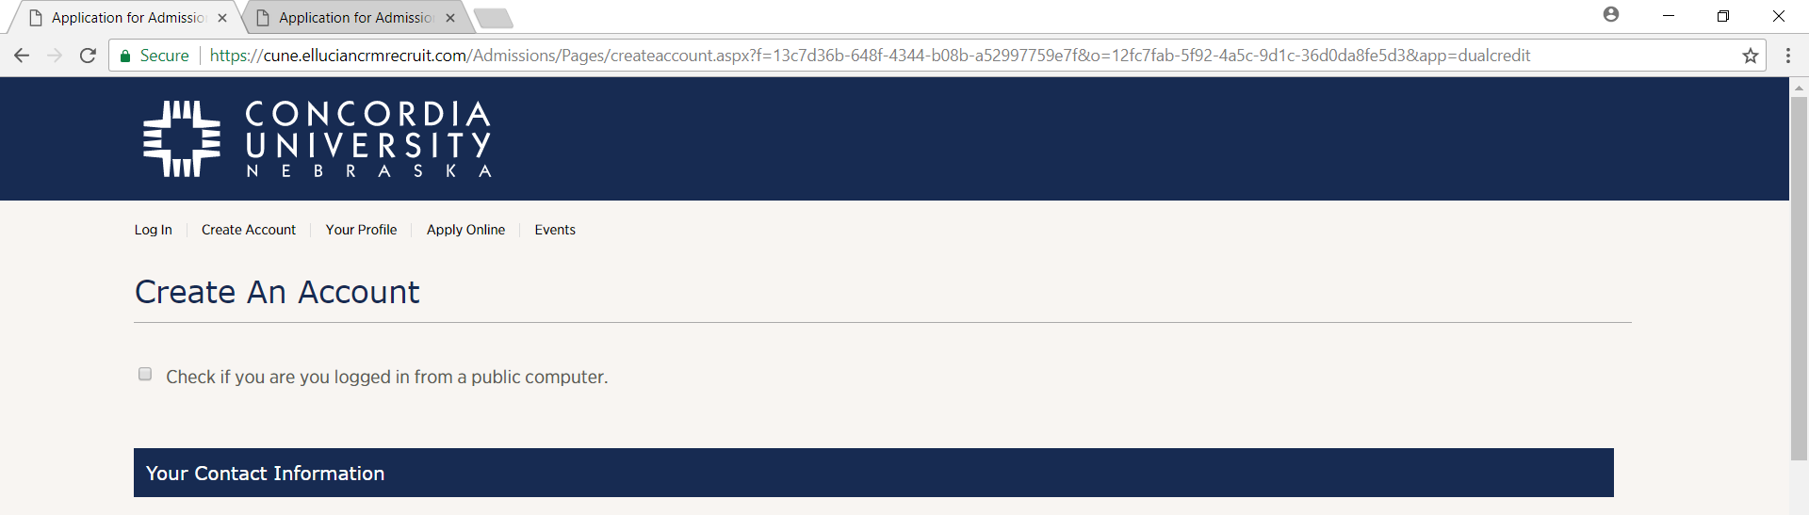
How do I get back to the application?
Direct link:
https://cune.elluciancrmrecruit.com/Admissions/Pages/Login.aspx
Or navigate there:
1. Application for Admission
2. Course Registration
Registration Time Limits
3. Tuition Payment
Go to www.cune.edu/dualcredit
Click on “Admission and Registration”
Click on “Create an Account and Apply”
On the top row, click on “Log In”
Notes:
How do I get back to the application? Fear not, for this presentation is with you! We understand that various issues may come up, including accidentally closing the application or needing to stop part-way through. The next three slides give you instructions on how to get back to your application so you can complete it successfully. … First, since the direct sequence from creating an account to your application was broken, you’ll need to log back in. You can do so by going directly to the link above. Or, if you’re on the dual credit website, you can navigate there with the instructions you see.

Slide 12
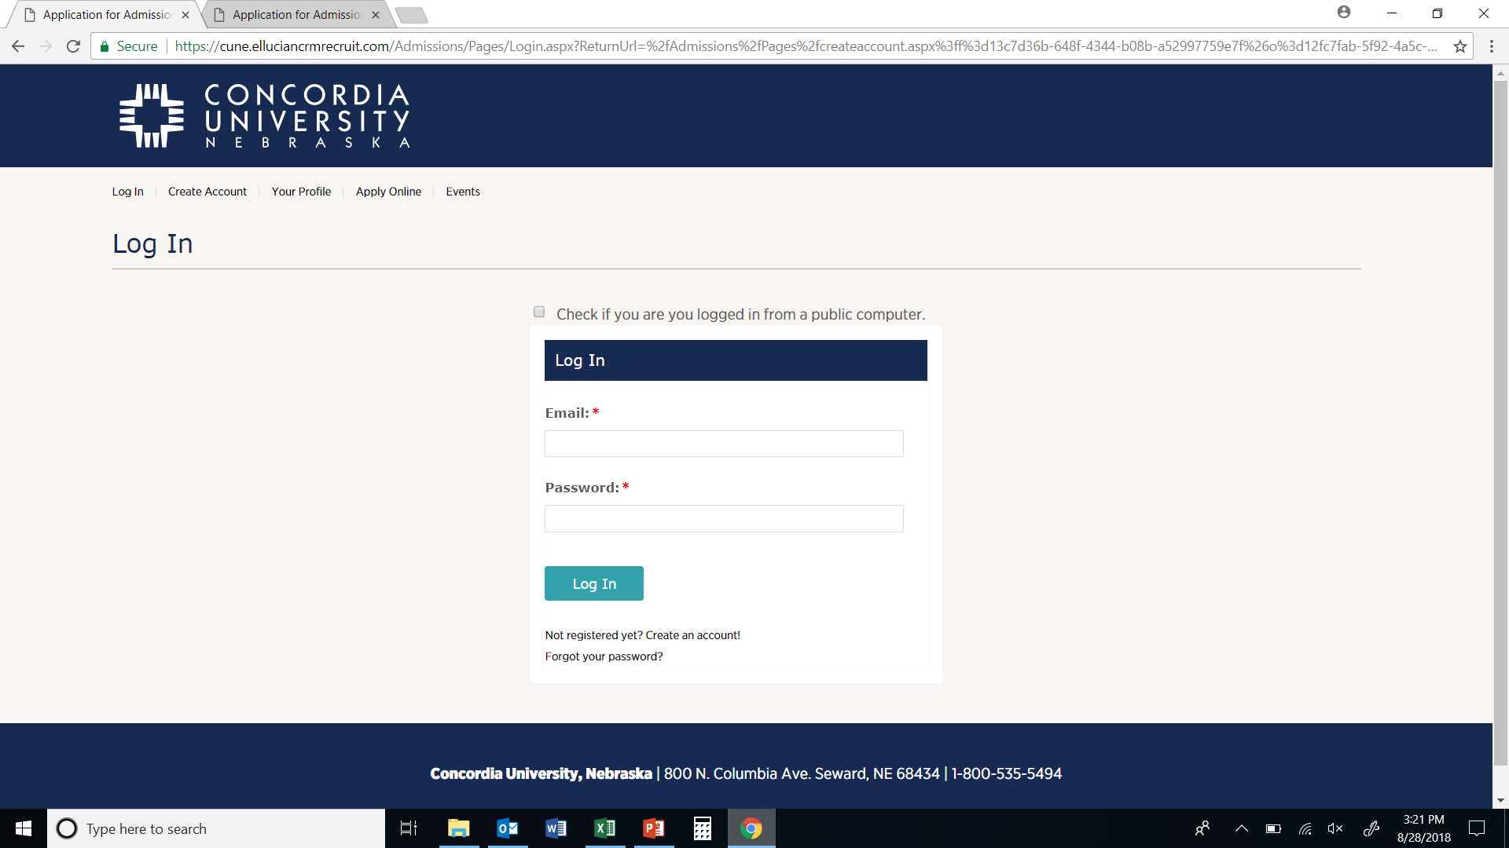
You should be back to this page.
Use your email and password to login.
*** IF you have to reset your password or validate your email account, be sure to click on the most recent email you received to do so.
Notes:
Whether you used the direct link or navigated there through the website, you should get back to this page. Now, log in with the email and password you used to create the account. Please note: if you have to reset your password or account for any reason, please be sure you’re using the most recent email with instructions on how to do so. Even though it looks like the same information, if you got duplicate emails and you use an earlier version, the process won’t work.

Slide 13
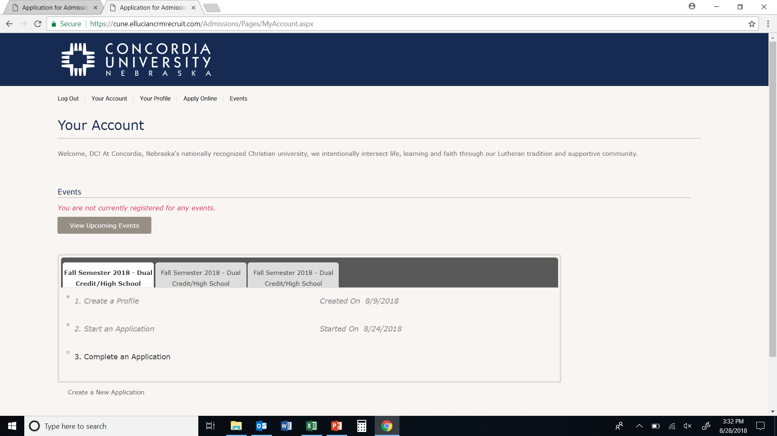
Notes:
After logging back in, you should see a screen that resembles this one. I have highlighted the two most likely places you’ll want to go. Clicking “Complete an Application” should take you back to where you left off on the application. If you haven’t started one, this screen should still allow you to do so. Clicking on the “Apply Online” button at the very top would start the entire application over from scratch. If you use that option, please be sure to click on the “Dual Credit” button on the next screen for the appropriate application.

Slide 14
Step 2: Course Registration
- Go to www.cune.edu/dualcredit and click on the “Admission and Registration” button.
- Download the correct registration form!
1. Application for Admission
2. Course Registration
Registration Time Limits
3. Tuition Payment
You may have to scroll down to choose your school and the correct term.
Download and print the form.
Complete ONE form for ALL classes for this term. YOU and your parent will sign it.
Notes:
After you complete and submit the application for admission, the next step is to get a registration form for your school. You only have three weeks to get this form, complete it, and get it back to the school. Your school office should be able to help you with this process, as well.

Slide 15
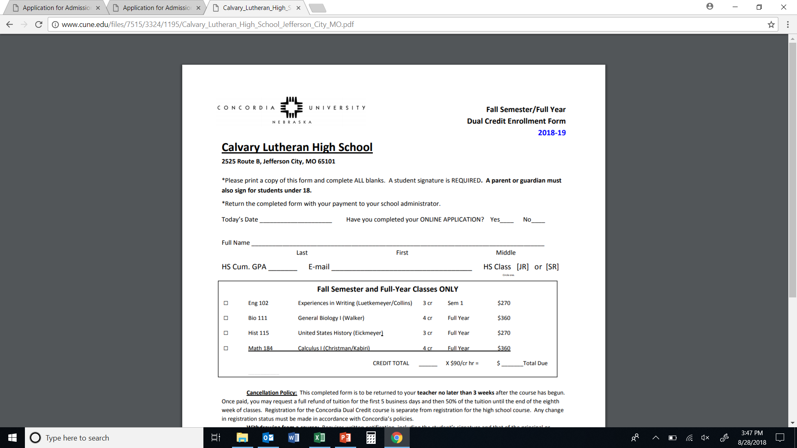
Date, Name, Etc.
Fill in Cum. GPA
Your H.S. will verify it.
Check ALL classes you’ll take.
Calculate the total due
Notes:
Your form should look something like this one. You use the same form for all of the classes that you are taking that start this term. Please make sure to select at least one class—we don’t know which course you’re planning to take unless you indicate it on this registration form.

Slide 16
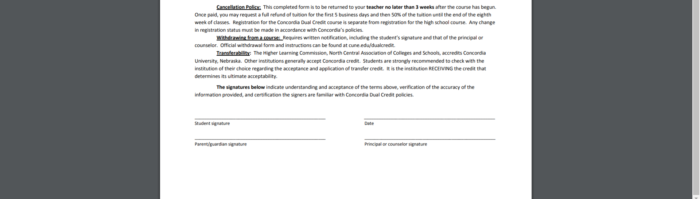
Student signs and dates the form.
A parent or guardian signs the form if the student is under 18 years old.
Then, turn in the form and your payment to your high school office.
Notes:
The bottom of your form should look something like this one. After you and your parent or guardian have signed, please return this form and your payment to your high school office.

Slide 17
Tuition Payment
Use the registration form to calculate payment.
Tuition is $90 per hour.
3 credit class = $270
4 credit class = $360
Make payable to your high school.
Return the tuition to your school with registration form.
1. Application for Admission
2. Course Registration
Registration Time Limits
3. Tuition Payment
Notes:
Tuition is listed on the registration form. Note that payment is made to your high school. Once rosters have been verified, Concordia will send a bill for tuition to your school.

Slide 18
Questions?
Contact Ben Stellwagen or Jane Heinicke if you have any questions.
benjamin.stellwagen@cune.edu 402-643-7414
jane.heinicke@cune.edu 402-643-7480
dualcredit@cune.edu
Notes:
If you have any problems at all in the application and registration process, please contact us. We hope that this presentation will help minimize problems, and we are happy to help get your questions answered. You may reach us personally by email or phone, or send an email to our dual credit account, and we’ll assist you as soon as possible.

Slide 19
Dual Credit Application and Registration
Go to www.cune.edu/dualcredit
Click on “Admission and Registration”
Click on “Create an Account and Apply”
Fill out the form.
Your email address will be your username later.
Completing all fields now will save time later.
Academic Level = Dual Credit
Entry Term = current term
Write down your password
Click “Create Account”
The Application
Permanent address is likely complete from when you created the account, but check to make sure.
Academic Plans
When would you like to start?
High school: select correct name and location
GPA will be verified by the school office. Be accurate!
Info for at least one parent/guardian is required.
Answer the certifications, sign, and submit.
Registration Form (pdf found on website)
Today’s date
Name, GPA, Email, Class
Check ALL classes
You will register for 2nd semester classes in January.
Total credits determines total due
Payment: remit to school along with registration form
benjamin.stellwagen@cune.edu
jane.heinicke@cune.edu
Notes:
This slide is a review of the application and registration process. You might print out a copy (slide 24) to have alongside you as you complete the steps.

Slide 20
Notes:
And finally, our goal is to help you get a good start in college so you can develop your God-given talents and “Go Higher” personally and academically! Thank you for your participation in Concordia Dual Credit. We are honored to join you in the process! And have a wonderful school year!

