Slide 1
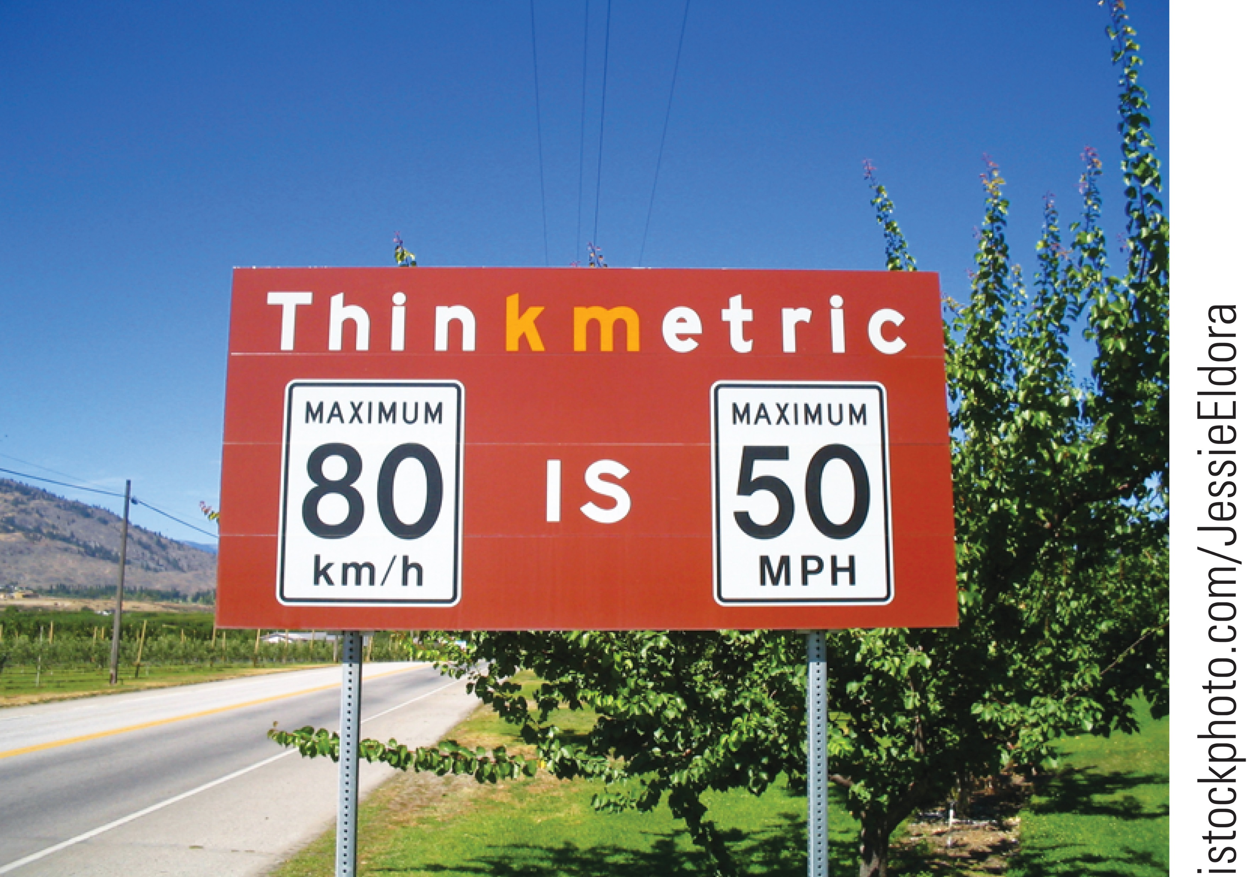

Topic 1: Units, Trigonometry, and Vectors
College Physics, 11e
Raymond A. Serway;
Chris Vuille
Notes:
Figure 1.3 The speed limit is given in both kilometers per hour and miles per hour on this road sign. How accurate is the conversion?

Slide 2
Reading Question 1-1
Which of the following would serve as the best time standard?
the rotation of Earth upon its axis
the vibration of a Cs-133 atom
a grandfather clock
the buzzing of a mosquito

Slide 3
Reading Question 1-1
Which of the following would serve as the best time standard?
the rotation of Earth upon its axis
the vibration of a Cs-133 atom
a grandfather clock
the buzzing of a mosquito

Slide 4
Reading Question 1-2
Suppose that you measure the position of a chair using a meter stick and you record the distance of the center of the seat from the wall. Which of the following measurements is the most reasonable?
1.043 860 564 2 m
1.043 860 m
1 m
1.04 m

Slide 5
Reading Question 1-2
Suppose that you measure the position of a chair using a meter stick and you record the distance of the center of the seat from the wall. Which of the following measurements is the most reasonable?
1.043 860 564 2 m
1.043 860 m
1 m
1.04 m

Slide 6
Reading Question 1-3
Which of the following statements is correct?
If an equation is dimensionally correct it must be true and if it is not dimensionally correct it may be true.
If an equation is dimensionally correct it may be true and if an equation is not dimensionally correct it may be true.
If an equation is dimensionally correct it may be true and if it is not dimensionally correct then it cannot be true.
If an equation is dimensionally correct it must be true and if an equation is not dimensionally correct it cannot be true.

Slide 7
Reading Question 1-3
Which of the following statements is correct?
If an equation is dimensionally correct it must be true and if it is not dimensionally correct it may be true.
If an equation is dimensionally correct it may be true and if an equation is not dimensionally correct it may be true.
If an equation is dimensionally correct it may be true and if it is not dimensionally correct then it cannot be true.
If an equation is dimensionally correct it must be true and if an equation is not dimensionally correct it cannot be true.

Slide 8
Reading Question 1-4
Which of the following expresses 5.2 × 10^{–5} s correctly using the metric prefixes given?
520 ks
0.52 ms
52 μs
52 ns

Slide 9
Reading Question 1-4
Which of the following expresses 5.2 × 10^{–5} s correctly using the metric prefixes given?
520 ks
0.52 ms
52 μs
52 ns

Slide 10
Reading Question 1-5
Suppose that two quantities, A and B, have different dimensions. Determine which of the following arithmetic operations could be physically meaningful.
(i) A + B
(ii) A/B
(iii) B – A
(iv) AB
(iv) only
(ii) only
(i) and (iii)
(ii) and (iv)

Slide 11
Reading Question 1-5
Suppose that two quantities, A and B, have different dimensions. Determine which of the following arithmetic operations could be physically meaningful.
(i) A + B
(ii) A/B
(iii) B – A
(iv) AB
(iv) only
(ii) only
(i) and (iii)
(ii) and (iv)

Slide 12
Chapter Discussion
Topic 1: Units, Trigonometry, and Vectors
Notes:
Why study physics? The goal of physics is to provide an understanding of the physical world by developing theories based on experiments. Physical theories describe how a physical system works, and make predictions about the system which can be verified through observations and experiments. Theories are not absolute; every theory is a work in progress. Often theories are expressed mathematically. It has been said that mathematics is the language of science.
The basic laws of physics involve such physical quantities as force, velocity, volume, and acceleration, all of which can be described in terms of more fundamental quantities. It is conventional to use the quantities of length (L), mass (M), and time (T) as the base quantities; all other physical quantities can be constructed from these three.

Slide 13
Length
Notes:
In 1799 in France, the standard unit of length became the meter. It was defined as one ten-millionth of the distance from the equator to the North Pole. Up until 1960, the official length of the meter was the distance between two lines on a specific bar of platinum–iridium alloy stored under controlled conditions. In 1960 the meter was defined as 1,650,763.73 wavelengths of orange-red light emitted from a krypton-86 lamp. In October of 1983, the meter was redefined as the distance traveled by light in vacuum during a time interval of 1 over 299,792,458 of a second. This latest definition establishes the speed of light at 299,792,458 meters per second.
The table on the left gives some approximate length values, so you can get an idea of the length scales we will be dealing with in this class. The table on the right shows the prefixes used with SI units, their values, and their abbreviations. You should be familiar with many of these, and also with scientific notation. For a review, check Appendix A in your textbook.

Slide 14
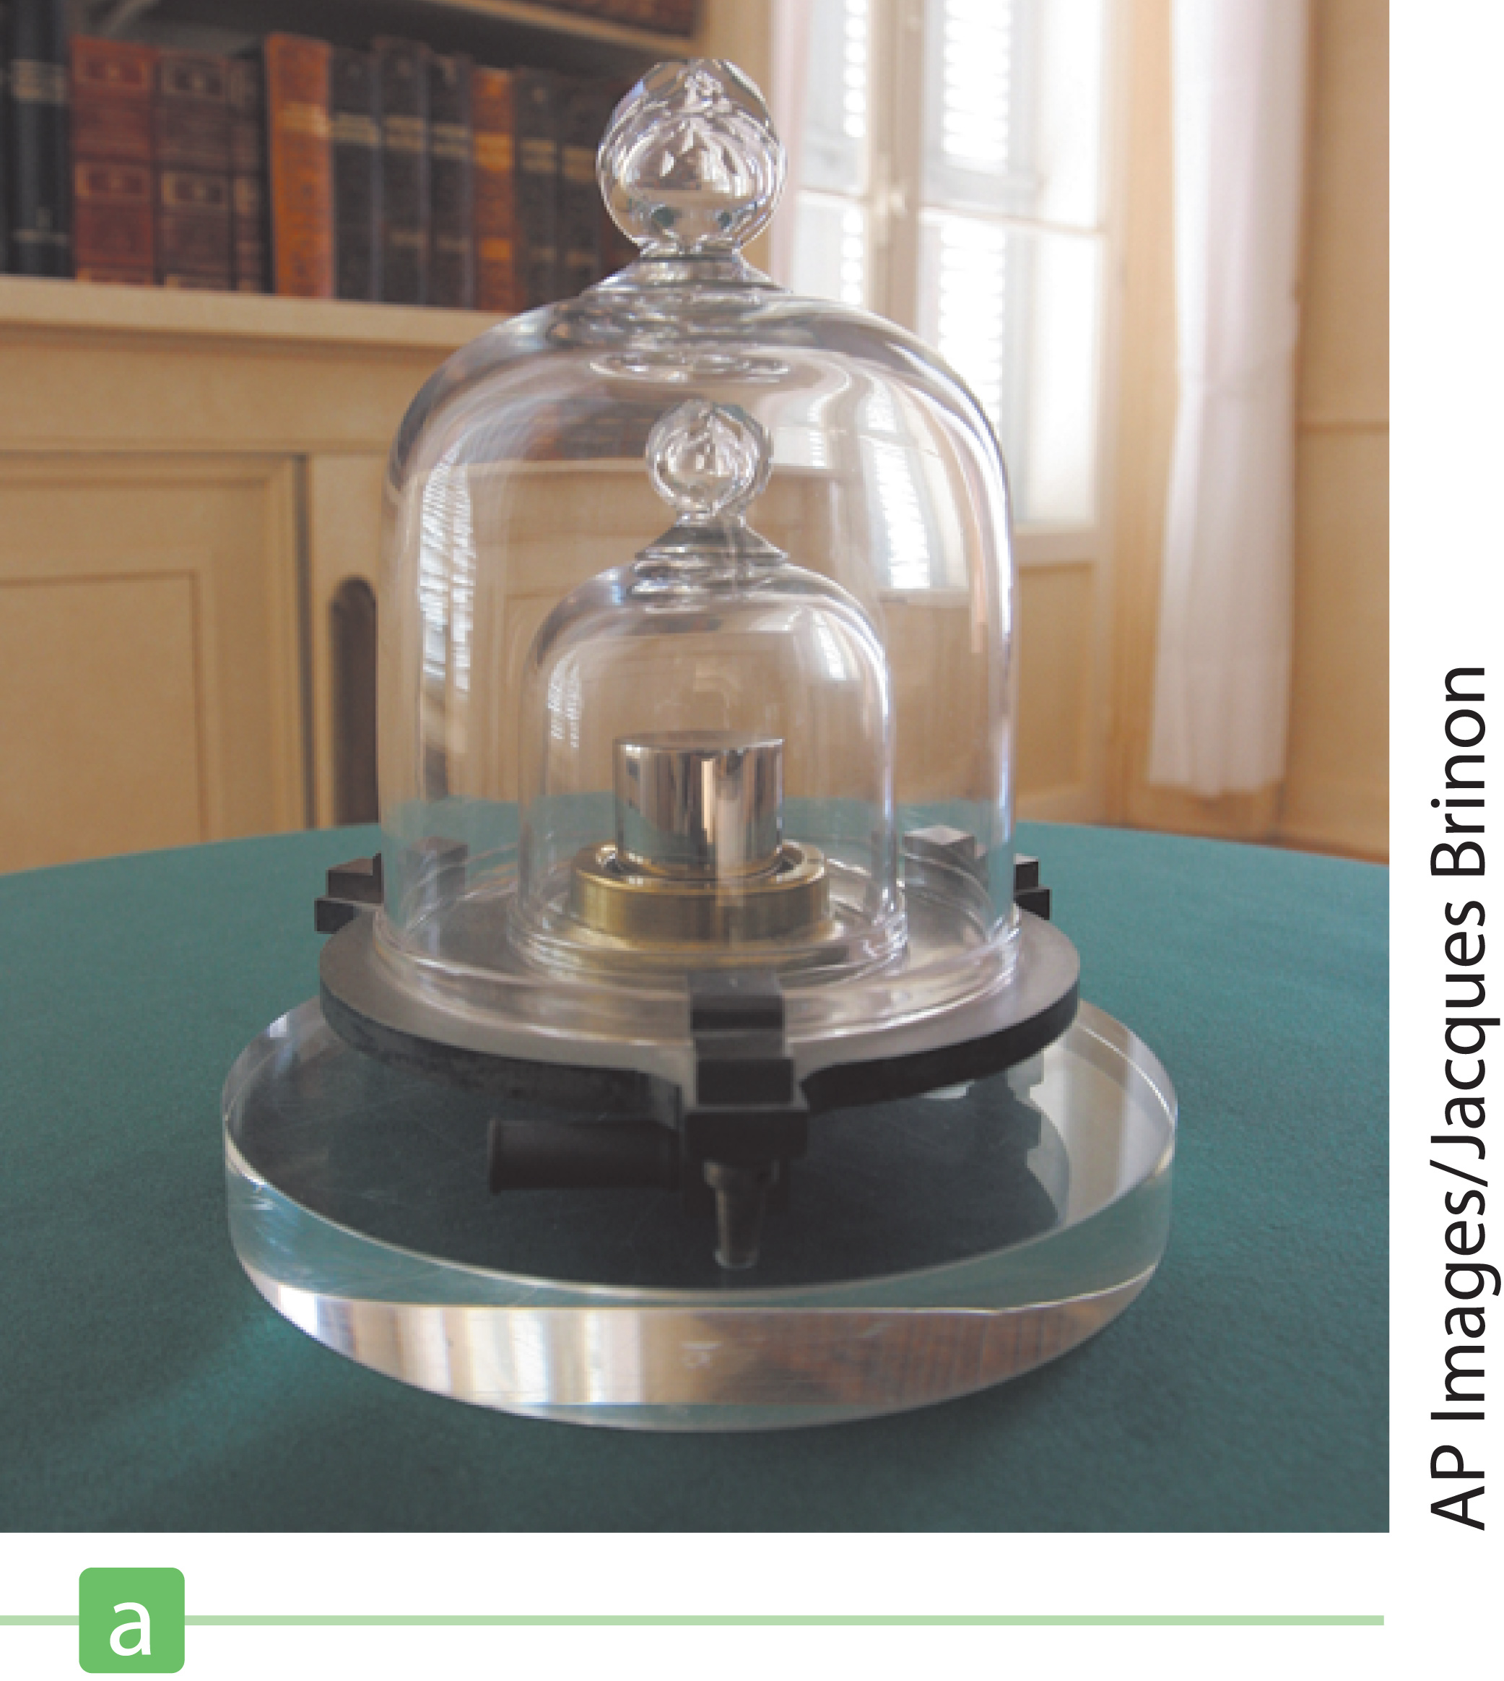
Mass
Notes:
Figure 1.1 (a) International Prototype of the Kilogram, an accurate copy of the International Standard Kilogram kept at Sèvres, France, is housed under a double bell jar in a vault at the National Institute of Standards and Technology.
The SI unit of mass is the kilogram. A kilogram is defined as the mass of a specific platinum–iridium alloy cylinder kept at the International Bureau of Weights and Measures at Sèvres, France, similar to the one shown in the figure. Mass is a quantity used to measure the resistance to a change in the motion of an object. It’s more difficult to cause a change in the motion of an object with a large mass than an object with a small mass.
The table gives the approximate values of different masses, from the observable Universe to an electron.

Slide 15
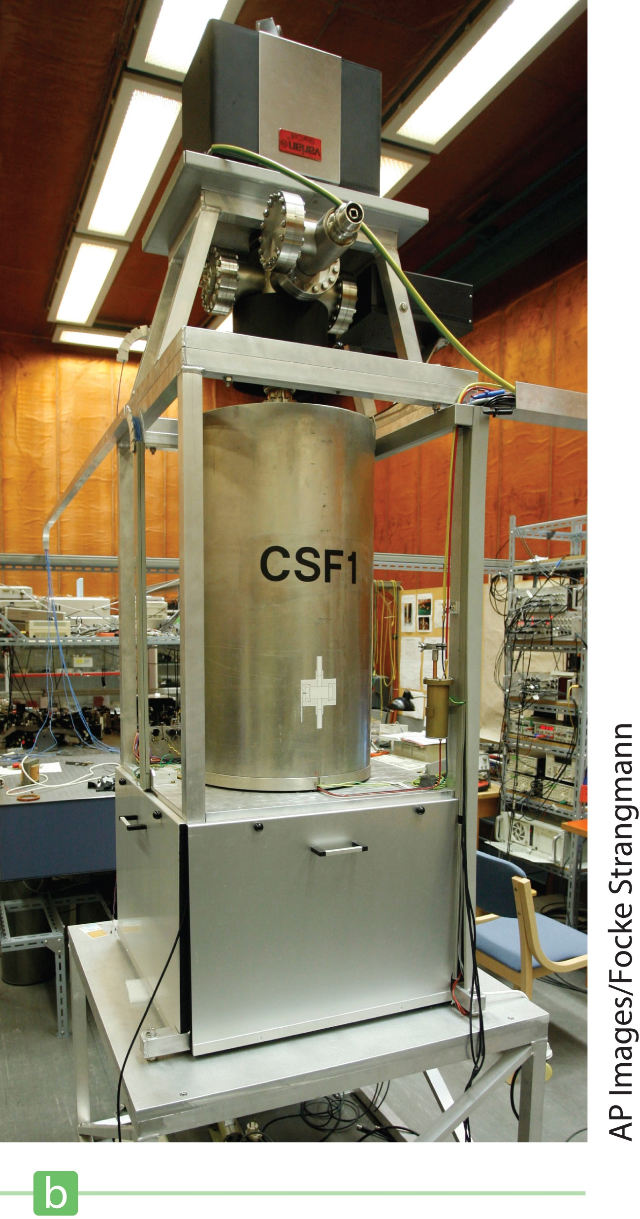
Time
Notes:
Figure 1.1 (b) A cesium fountain atomic clock. The clock will neither gain nor lose a second in 20 million years.
The basic unit of time is the second. Historically, this was defined in terms of the time between successive appearances of the Sun at the highest point it reaches in the sky each day, called a solar day, or (1/60)(1/60)(1/24) = 1/86,400 of the average solar day. In 1967 the second was redefined in terms of an atomic clock, which uses the characteristic frequency of the light emitted from the cesium-133 atom as its “reference clock.” The second is now defined as 9,192,631,700 times the period of oscillation of radiation from the cesium atom. The newest type of cesium atomic clock is shown in the figure.
The table on the right shows some approximate time intervals.
Systems of units commonly used in physics are the SI, which we just talked about. The units of length, mass, and time for this system are the meter (m), kilogram (kg), and second (s). There is also a system called the cgs, or Gaussian, system, in which the units of length, mass, and time are the centimeter (cm), gram (g), and second. You are probably familiar with the U.S. customary system, in which the units of length, mass, and time are the foot (ft), slug, and second.
SI units are almost universally accepted in science and industry and will be used throughout this course, with limited use of Gaussian and U.S. customary units.

Slide 16
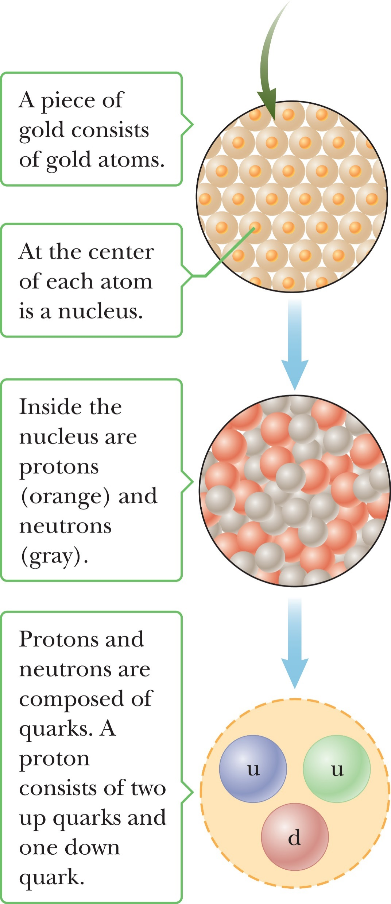
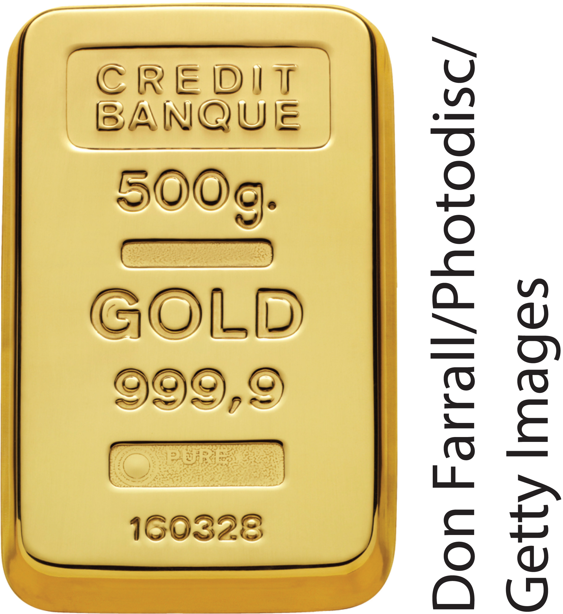
The Building Blocks of Matter
Visual
Notes:
Figure 1.2 Levels of organization in matter.
Take a look at the figure on the left, which shows a bar of gold. Now imagine that the bar is cut in half. Both halves are still gold, right? We say the two resulting pieces retain their chemical identity. But what happens if the pieces of the cube are cut again and again, indefinitely?
Leucippus and Democritus were Greek philosophers who lived around the 5th century BCE, who speculated that we can’t cut something to smaller and smaller pieces. Instead, they reasoned the process ultimately would end when it produced a particle that could no longer be cut. In Greek, atomos means “not sliceable”, and this is where the word “atom” comes from. It was once believed to be the smallest particle of matter. The top right image shows the gold atoms in our bar. We now know the atom is composed of more elementary particles. For example, inside the nucleus of the gold atoms are protons and neutrons, as shown in the middle right figure. Even these are made up of particles, called quarks. We’ll talk more about these in a few minutes.

Slide 17
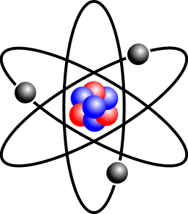
The Building Blocks of Matter
Notes:
Figure Model of atom resembling solar system
In the early 1900s scientists discovered the nucleus. Nearly a century ago the Danish physicist Niels Bohr proposed a model of the atom which resembled a miniature solar system, with a dense, positively charged nucleus occupying the position of the Sun and negatively charged electrons orbiting like planets. This model worked pretty well for hydrogen, the simplest atom, but failed to explain many details of atomic structure.
By the 1930s scientists had determined that the nucleus is made up of protons and neutrons. The proton is nature’s most common carrier of positive charge, equal in magnitude but opposite in sign to the charge on the electron. A neutron has no charge and has a mass about equal to that of a proton. The number of protons in a nucleus determines what the element is. For instance, an atom with only one proton in its nucleus is hydrogen. It doesn’t matter how many neutrons are there. One proton in the nucleus means it is a hydrogen nucleus. Two protons in the nucleus means it is a helium nucleus. Different numbers of neutrons correspond to different isotopes. Except for hydrogen, all atomic nuclei contain neutrons, which, together with the protons, interact through the strong nuclear force, which counteracts the repulsive electrical force of the protons.
Image credit:
https://commons.wikimedia.org/wiki/Atom#/media/File:Stylised_Lithium_Atom.png
CC BY-SA 3.0, https://commons.wikimedia.org/w/index.php?curid=295612
This file is licensed under the Creative Commons Attribution-Share Alike 3.0 Unported license.
[Public domain], via Wikimedia Commons

Slide 18
The Building Blocks of Matter
Notes:
Take a look at the size of a hydrogen atom and compare it to the size of a proton, which is the nucleus of a hydrogen atom. The proton is one hundred thousand times smaller. If the proton were the size of a Ping-Pong ball, the electron would be a tiny speck about the size of a bacterium, orbiting the proton a kilometer away! Other atoms are similarly constructed. So there is a surprising amount of empty space in ordinary matter.

Slide 19
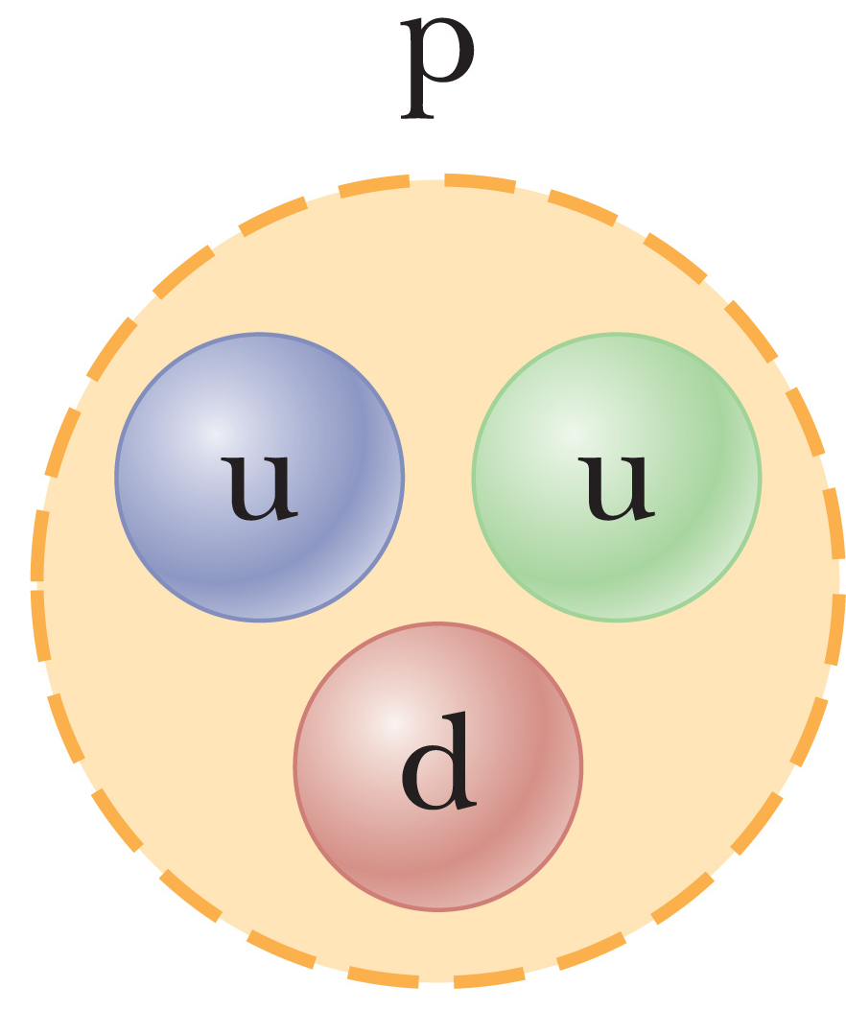
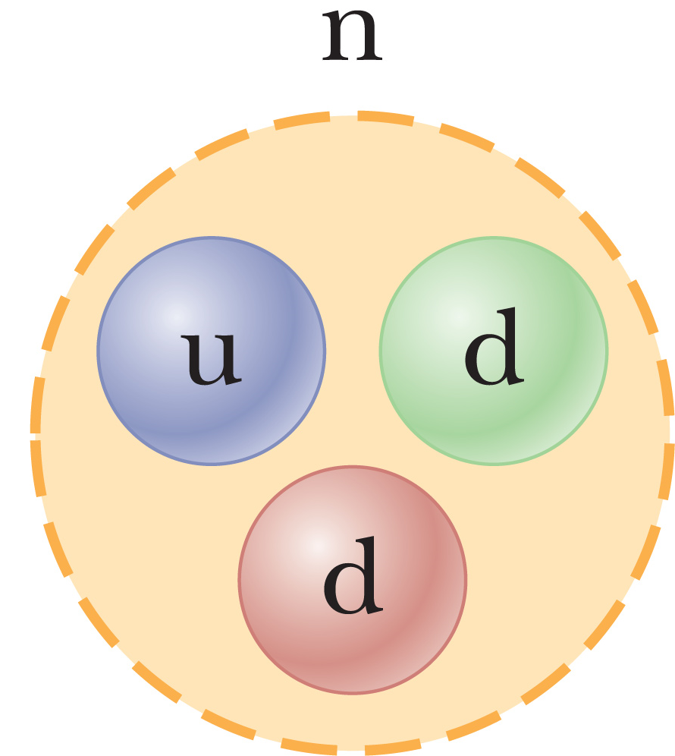
The Building Blocks of Matter
Notes:
Figure Quark composition of proton and neutron
As we just saw, protons and neutrons aren’t the smallest particles. They are composed of more fundamental particles called quarks. There are six quarks: named up, down, strange, charm, bottom, and top. The up, charm, and top quarks each carry a charge equal to plus two-thirds that of the proton, and the down, strange, and bottom quarks each carry a charge equal to minus one-third the proton charge. The proton consists of two up quarks and one down quark, which gives the correct charge for the proton, +1. The neutron is composed of two down quarks and one up quark and has a net charge of zero.
The up and down quarks are sufficient to describe all normal matter, so the existence of the other four quarks, which have been indirectly observed in high-energy experiments, is something of a mystery.

Slide 20
Dimensions
Notes:
In physics the word dimension denotes the physical nature of a quantity. The distance between two points, for example, can be measured in feet, meters, or furlongs, which are different ways of expressing the dimension of length. The symbols used in this section to specify the dimensions of length, mass, and time are capital L, M, and T.
Take a look at the table. The dimensions of velocity, which has units of meters divided by seconds, or meters per second, is L over T. And the dimensions of area is L squared.
When we are looking for the dimensions of a physical quantity, we use brackets. [click to show equation] Here’s an example. Velocity, as we just discussed, has dimensions length over time.
Throughout this course we will be dealing with mathematical expressions that relate different physical quantities. One way to analyze such expressions is called dimensional analysis. Dimensional analysis uses the fact that dimensions can be treated as algebraic quantities. For example, adding masses to lengths makes no sense, so it follows that quantities can be added or subtracted only if they have the same dimensions. If the terms on the opposite sides of an equation have the same dimensions, then that equation may be correct, although correctness can’t be guaranteed on the basis of dimensions alone. However, if the opposite sides of an equation have different dimensions, you can be sure the equation is wrong. Dimensional analysis is a nice way to check your work. And it can be used to develop insight into the relationships between physical quantities.

Slide 21
Dimensional Analysis
Notes:
Let’s look at an example. What kind of relationships are there between distance, acceleration, velocity, and time? Distance, which is often symbolized by x, has dimensions of length. Time, t, has dimensions of time, obviously. Velocity, as we just saw, has dimensions length over time, and is symbolized by v. Acceleration, symbolized by a, has dimensions of length divided by time squared.
So using dimensional analysis, we can write this. [click to show equation] From this result we can speculate that velocity is equal to acceleration multiplied by time, [click to show equation] and this is true for the special case of an object motion with constant acceleration starting from rest.
Let’s look at another example. [click to show equation] From this, you might think that distance is equal to acceleration times time, but there is a factor of one-half that we couldn’t deduce from dimensional analysis alone. [click to show equation] The correct expression is x equals ½at².

Slide 22
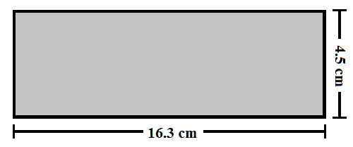
Uncertainty in Measurement and Significant Figures
Notes:
All measurements have uncertainties associated with them, and the accuracy of a measurement depends on the sensitivity of the apparatus, the skill of the person carrying out the measurement, and the number of times the measurement is repeated. Once the measurements, along with their uncertainties, are known, we will often need to perform calculations with these measurements. In this course will use a method called significant figures, which is used to indicate the approximate number of digits that should be retained at the end of a calculation.
As an example, imagine you measure the area of a rectangular plate with a meter stick, and the accuracy you can measure a length is plus or minus 0.1 centimeters. If your measurement of the length of the plate is 16.3 cm, you can only claim it lies somewhere between 16.2 cm and 16.4 cm. In this case, we say the measured value has three significant figures.
If you measure the plate’s width to be 4.5 cm, the actual value lies between 4.4 cm and 4.6 cm. This measured value has only two significant figures.
Now let’s find the area of the plate, which is length time width. To account for the uncertainties in our area, we use the rule that in multiplying or dividing two or more quantities, the number of significant figures in the final result is the same as the number of significant figures in the least accurate of the factors being combined, where least accurate means having the lowest number of significant figures.
In this case, the number of significant figures in the length is 3, and the number of significant figures in the width is 2, so our product should have 2 significant figures. When we multiply, [click to show equation] our answer is 73.35 square centimeters, so we will need to round this to 2 significant figures. Our final answer is 73 centimeters squared.

Slide 23
Uncertainty in Measurement and Significant Figures
Notes:
Zeros may or may not be significant figures. Zeros used to position the decimal point in such numbers as 0.03 and 0.0075 are not considered significant figures. So 0.03 has one significant figure, and 0.0075 has two.

Slide 24
Uncertainty in Measurement and Significant Figures
Notes:
What about the case where zeros are placed after other digits in a whole number? Let’s say we measure the mass of an object to be 1500 grams. Are the zeros place holders, or are they significant? As it is written, there is no way to know for sure. A way around this is to use scientific notation, [click to show equation] which removes the ambiguity.

Slide 25
Uncertainty in Measurement and Significant Figures
Notes:
Any zeros written after a decimal point are considered significant. For example, 3.00, 30.0, and 300. have three significant figures, whereas 300 has only one. In our book, most of the numerical examples and end-of-topic problems will yield answers having two or three significant figures.

Slide 26
Uncertainty in Measurement and Significant Figures
Addition:
Subtraction:
Notes:
For addition and subtraction, look at the number of decimal places in the quantities involved rather than on the number of significant figures. When numbers are added or subtracted, the number of decimal places in the result should equal the smallest number of decimal places of any term.
Let’s find the sum of the numbers given. Our result is 128.35, but 123 has no decimal places, and 5.35 has two. We consider the number with the least amount of decimal places, in this case zero, so we round our answer to the nearest whole number.
Let’s try a subtraction problem. [click to show equation] In this case, our given numbers each have three decimal places, as does the result, so we leave it as is.

Slide 27
Uncertainty in Measurement and Significant Figures
Notes:
When performing multiple calculations, there can be discrepancies in the results introduced by the rounding process and the algebraic order in which steps are carried out. Let’s look at an example. This calculation can be performed in three different orders.
In Method 1, [click to show equations] the multiplication is done first, then the division.
In Method 2, [click to show equation] the division is done first, followed by multiplication.
In Method 3, [click to show equation] the first number is divided, then multiplied by the second.
As you can see, the results are slightly different, but such minor discrepancies are to be expected, because the last significant digit is only one representative from a range of possible values, depending on experimental uncertainty.
In this book, the worked examples report intermediate results to the proper number of significant figures, and only those digits are carried forward. In the problem sets, though, it is a good idea to keep extra significant figures until the end.

Slide 28
Unit Conversions for Physical Quantities
Notes:
It is sometimes necessary to convert from one unit to another. Shown are the conversion factors between the SI and U.S. customary systems for units of length.
Units can be treated as algebraic quantities that can “cancel” each other. We can make a fraction with the conversion that will cancel the units we don’t want.
Let’s look at an example. [click to show equation] We want to convert inches to centimeters. We can write our conversion fraction so that centimeters, the unit we want, is on top, and inches, the unit we want to cancel, is on the bottom.
Multiplying [click to show equation] gives us our result in centimeters.

Slide 29
Estimates and Order-of-Magnitude Calculations
Order-of-magnitude estimate:
within a factor of 10
Notes:
Sometimes getting an exact answer to a calculation is very difficult, or might even be impossible, either for mathematical reasons or because limited information is available. Estimates can give us useful approximate answers that can help us decide if a more precise calculation is necessary, and they can also serve as a partial check if the exact calculations are actually carried out. For example, let’s say we are performing a calculation and expect the result to be a large number. If we instead get a small number, we should check for errors.
For many problems, knowing the approximate value of a quantity—within a factor of 10 or so—is sufficient. This approximate value is called an order-of-magnitude estimate, and requires finding the power of 10 that is closest to the actual value of the quantity.
For example, we can think of 75 kilograms as about 10², where the tilde symbol can be read as “is on the order of” or “is approximately”.
When making estimates, you can take considerable liberties, like letting π be about 1. For a less crude estimate, you can let π be about 3.

Slide 30
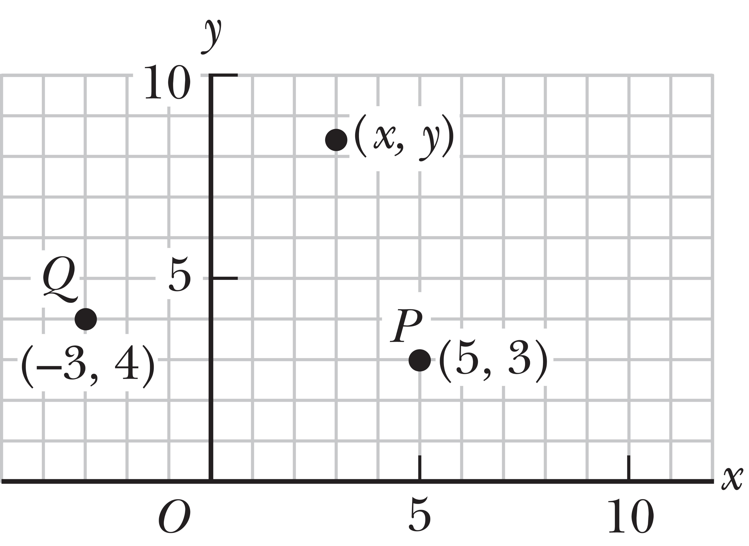
Coordinate Systems
Notes:
Figure 1.5 Designation of points in a two-dimensional Cartesian coordinate system. Every point is labeled with coordinates (x, y).
We will often be dealing with locations in space, so we need to define a coordinate system. A point on a line can be located with one coordinate, a point in a plane with two coordinates, and a point in space with three.
A coordinate system used to specify locations in space consists of:
A fixed reference point O, called the origin
A set of specified axes, or directions, with an appropriate scale and labels on the axes
Instructions on labeling a point in space relative to the origin and axes
You are probably familiar with the coordinate system shown on the slide, called the Cartesian coordinate system, or sometimes called the rectangular coordinate system.
An arbitrary point in this system is labeled with the coordinates (x, y). For example, the point P in the figure has coordinates (5, 3). If we start at the origin O, we can reach P by moving 5 meters horizontally to the right and then 3 meters vertically upward.
Point Q has coordinates (–3, 4), which corresponds to going 3 meters horizontally to the left of the origin and 4 meters vertically upward from there. Positive x is usually selected as right of the origin and positive y upward from the origin.

Slide 31
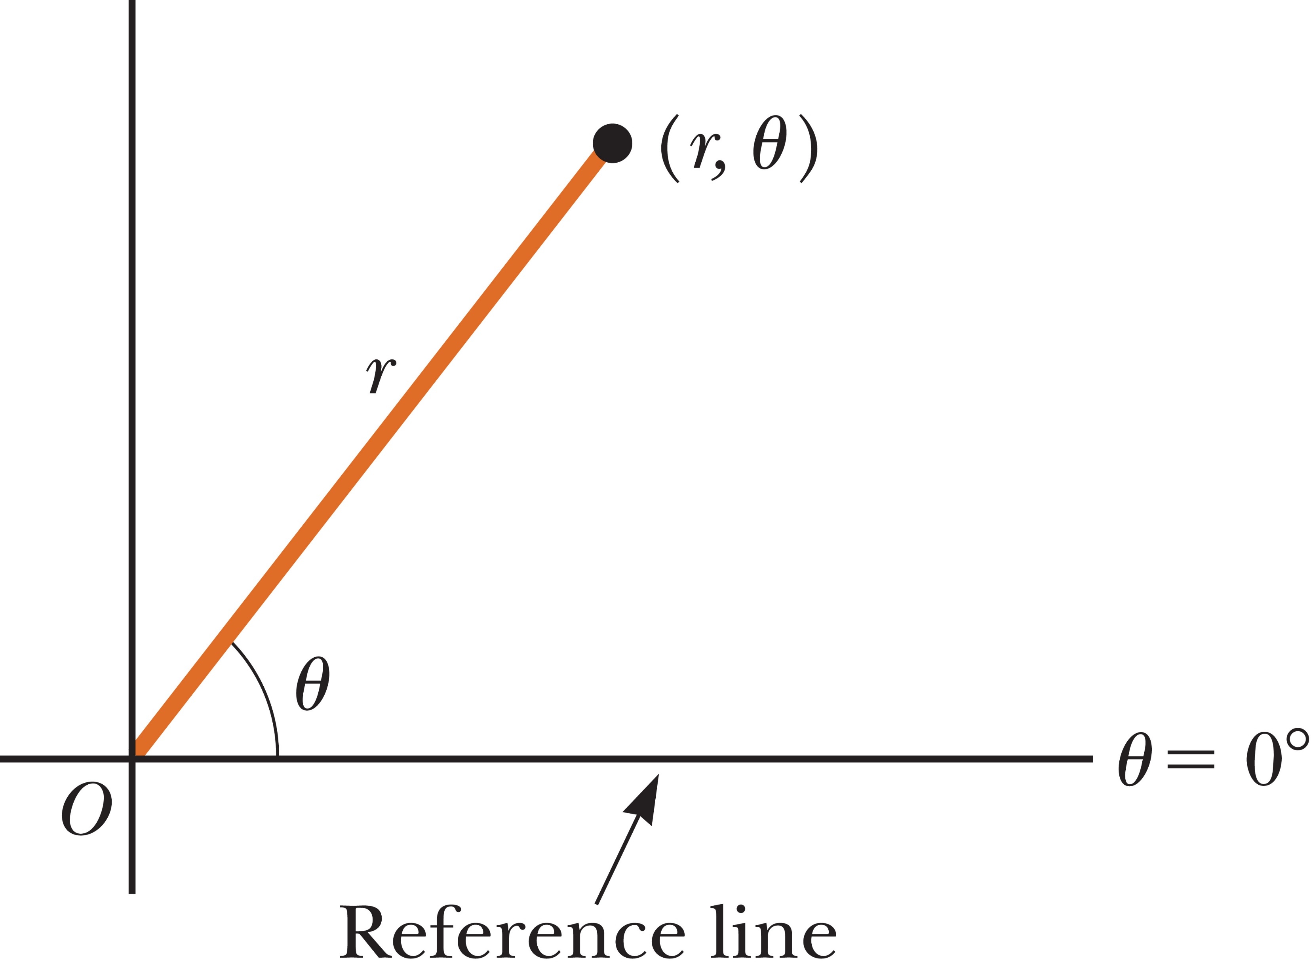
Coordinate Systems
Notes:
Figure 1.6 The plane polar coordinates of a point are represented by the distance r and the angle θ, where θ is measured counterclockwise from the positive x-axis.
Another coordinate system is shown here. In this coordinate system, an origin O and a reference line are selected as shown. A point is then specified by the distance r from the origin to the point and by the angle θ between the reference line and a line drawn from the origin to the point. The standard reference line is usually selected to be the positive x-axis of a Cartesian coordinate system. The angle θ is considered positive when measured counterclockwise from the reference line and negative when measured clockwise.
For example, if a point is specified by the polar coordinates 3 m and 60°, we locate this point by moving out 3 m from the origin at an angle of 60° above, or counterclockwise from, the reference line.

Slide 32
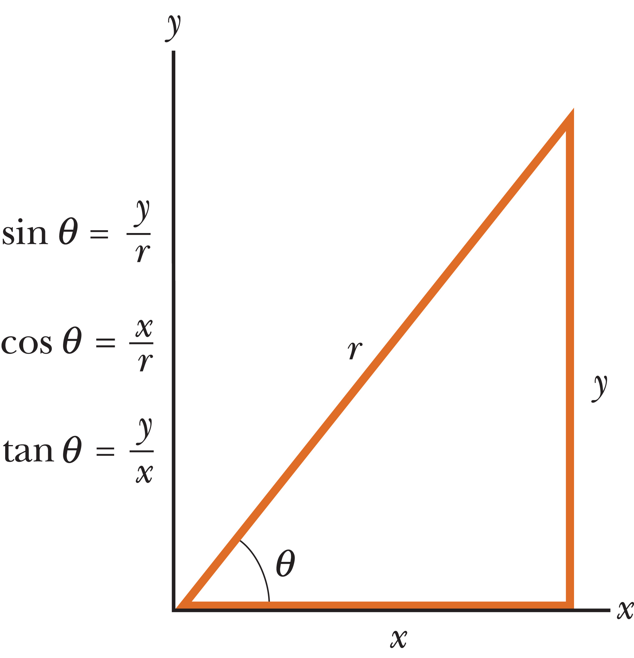
Trigonometry Review
Notes:
Figure 1.7 Certain trigonometric functions of a right triangle.
Let’s take a look at the right triangle in the figure. Side y is opposite the angle θ, side x is adjacent to the angle, and side r is the hypotenuse.
The basic trig functions are the ratios of the lengths of the sides of the triangle, as listed on the right of the slide.
The Pythagorean theorem [click to show equation] is another important relationship in right-triangle geometry.

Slide 33
Trigonometry Review
Notes:
You will often need to find the values of inverse relationships.
As an example, let’s say you know that the sine of an angle is 0.866, and you want to know the angle. A shorthand way of writing this is shown, where sine raised to the minus 1 is the inverse of the sine function. Try this calculation with your calculators to be sure you get the correct result—60 degrees. Your calculator should be in degree mode.
In general, make sure your calculator setting is in the angle measure you are working in—degrees or radians.
Let’s try another example. [click to show equation] The inverse tangent of 0.4 is 21.8 degrees.
Something to be aware of: the inverse tangent function can return only values between –90° and +90°, so when an angle is in the second or third quadrant, you’ll need to add 180° to the answer in the calculator window

Slide 34

Vectors
Notes:
Figure 1.10 A vector such as velocity has a magnitude, shown on the race car’s speedometer, and a direction, straight out through the race car’s front windshield. The mass of the car is a scalar quantity, as is the volume of gasoline in its fuel tank.
The physical quantities we will study fall into two main categories. One type, known as a scalar quantity, can be completely described by a single number (with appropriate units) giving its magnitude or size. Common scalars are mass, temperature, volume, and speed.
For example, a car’s speed can be completely described by noting the number on its speedometer. A basketball’s mass can be specified by measuring a single number with a scale.
The other type of quantity, known as a vector quantity, has both a magnitude and a direction. Velocity is a common vector quantity with a magnitude specifying how fast an object is moving and a direction specifying the direction of travel. Take a look at the photo in the slide. The speedometer shows how fast the race car is going, and the direction is straight out through the car’s windshield.

Slide 35
Vectors
A vector quantity is characterized by having both a magnitude and a direction
A scalar quantity has magnitude, but no direction
Notes:
In our text, symbols for scalar quantities are shown in italics, for example m for mass and T for temperature.
Symbols for vector quantities are usually shown in bold with an arrow above the letter, as you can see in the slide. V is for velocity.
The magnitude of a vector is a scalar quantity indicating its length and is shown in italics. For example, the scalar v indicates the magnitude of vector v.
In general, a vector quantity is characterized by having both a magnitude and a direction. By contrast, a scalar quantity has magnitude, but no direction.
Scalar quantities can be manipulated with the rules of ordinary arithmetic, but vectors have their own rules for addition, subtraction, and multiplication.

Slide 36
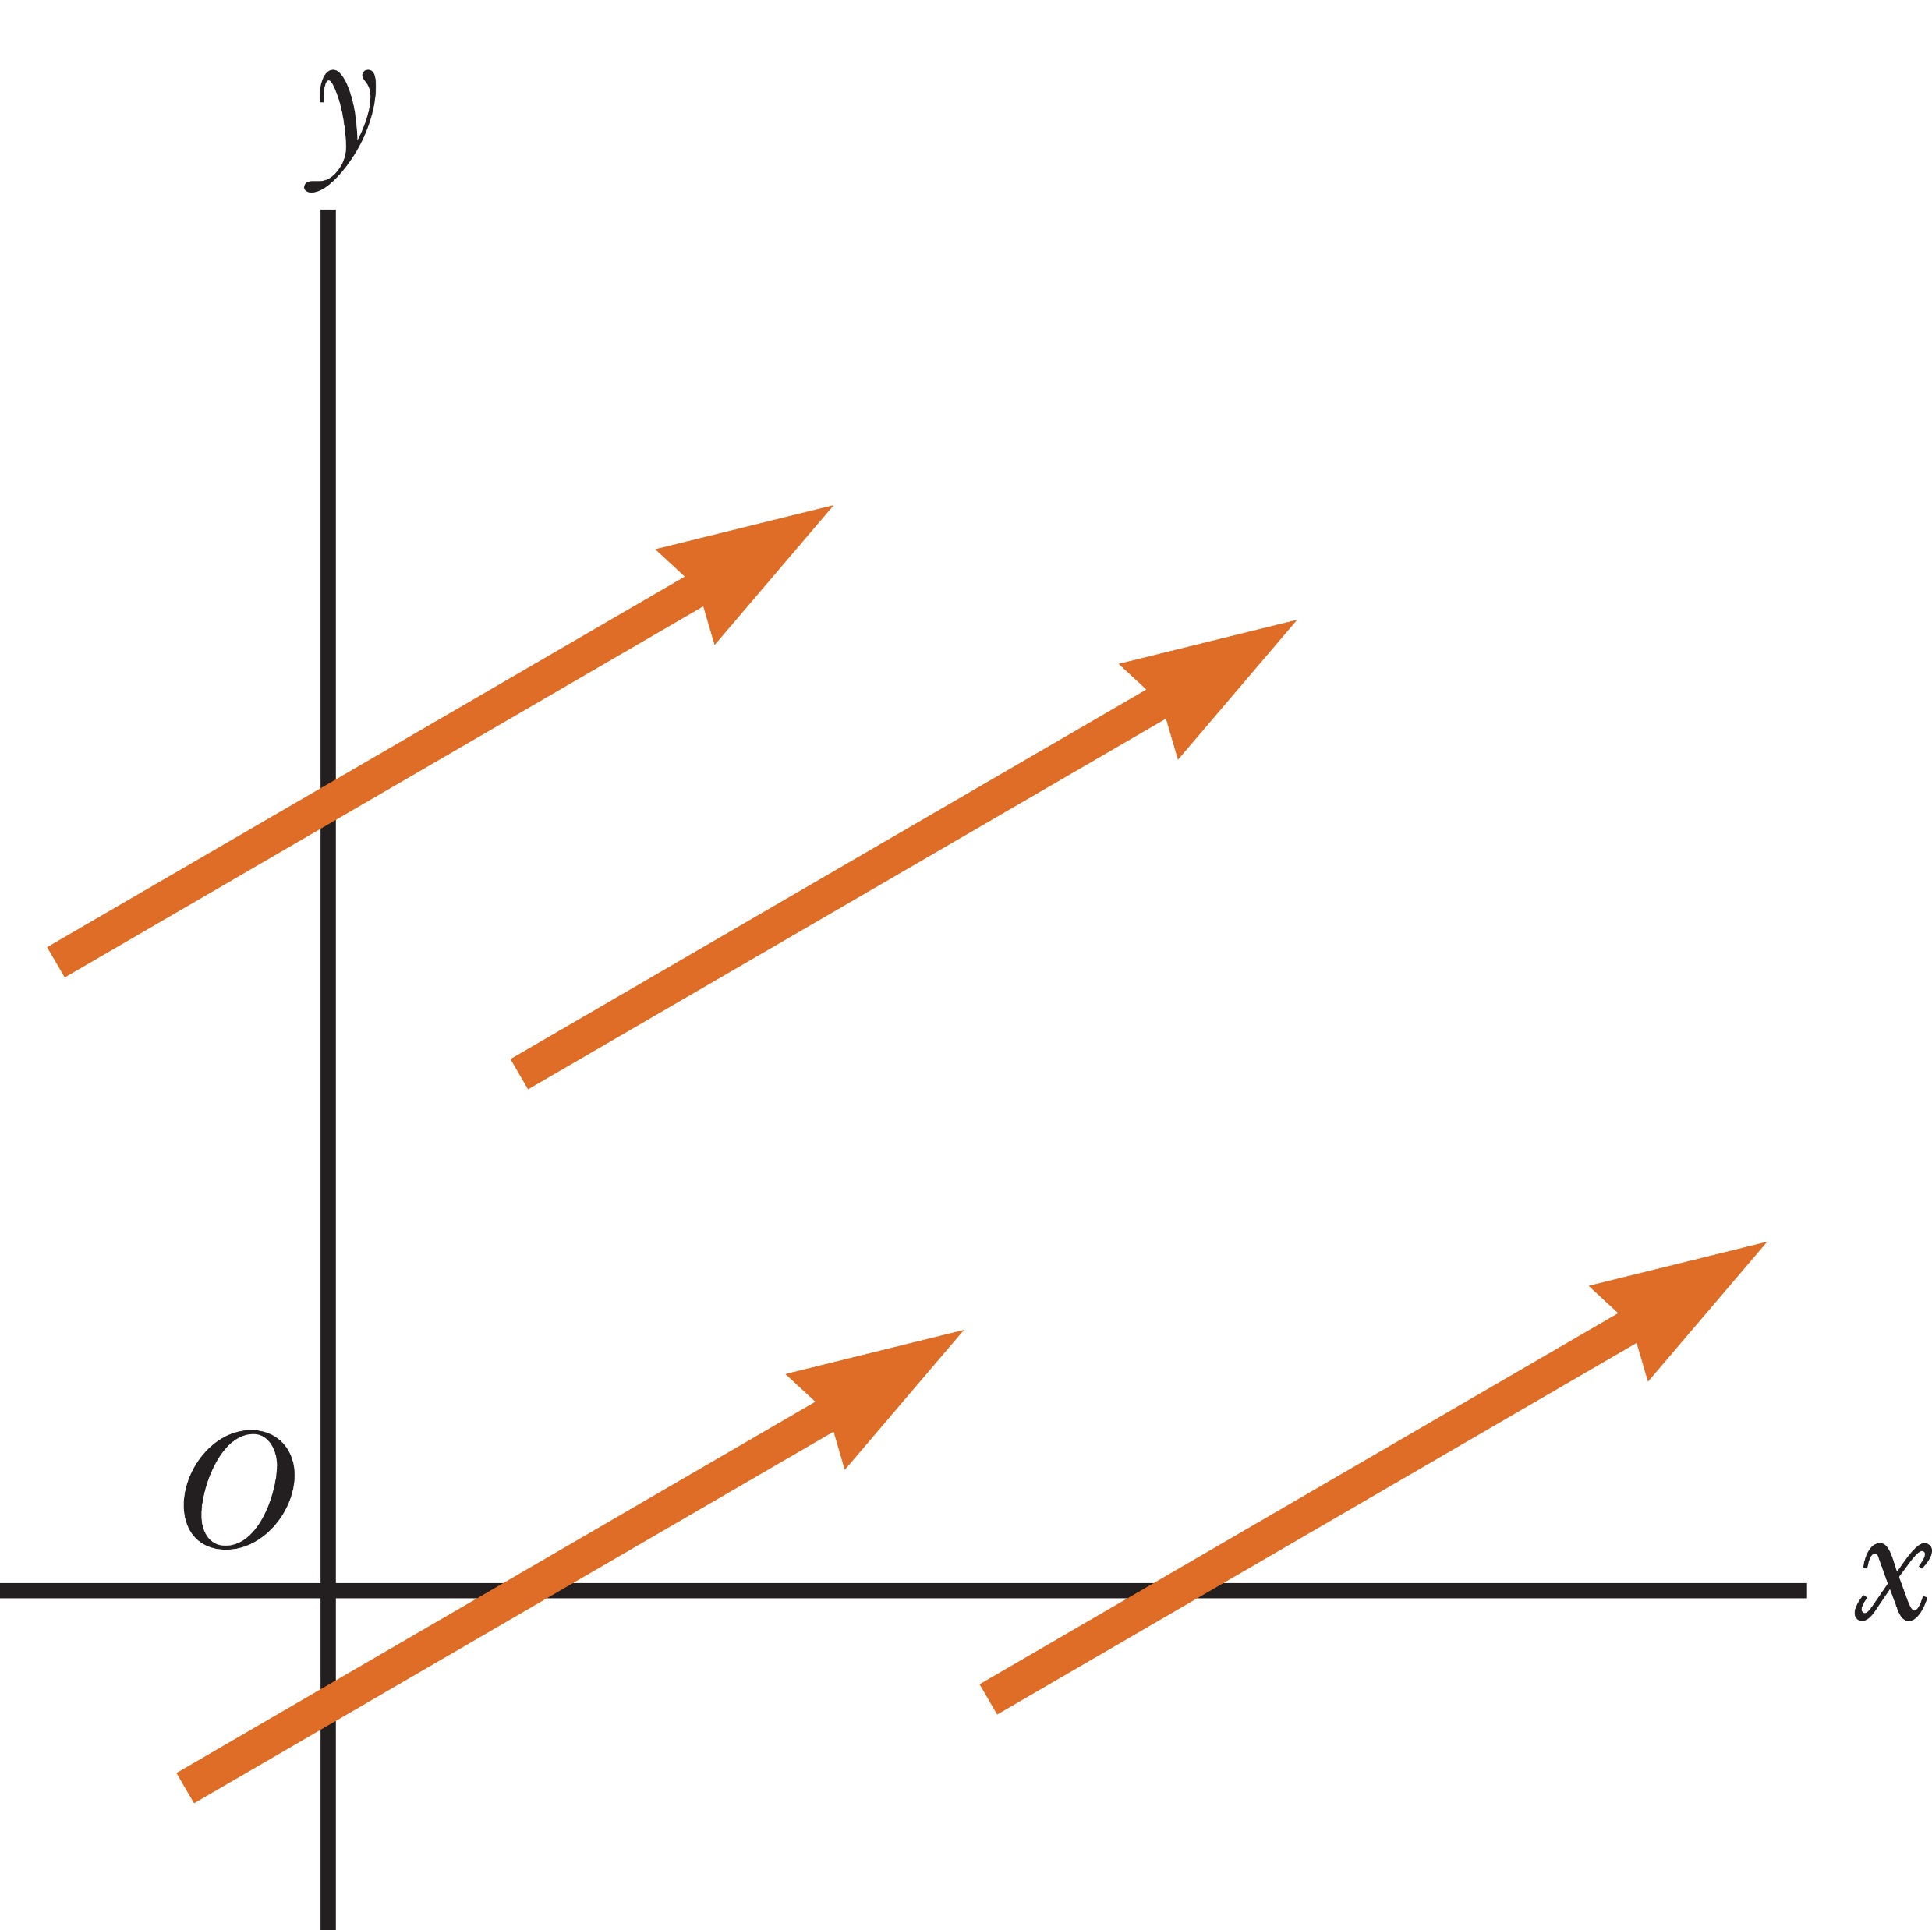
Equality of two Vectors
Notes:
Figure 1.11 These four vectors are equal because they have equal lengths and point in the same direction.
Two vectors A and B are equal if they have the same magnitude and the same direction. They don’t need to be located at the same point in space. The four vectors shown in the figure are equal. Moving a vector from one point in space to another doesn’t change its magnitude or its direction.

Slide 37
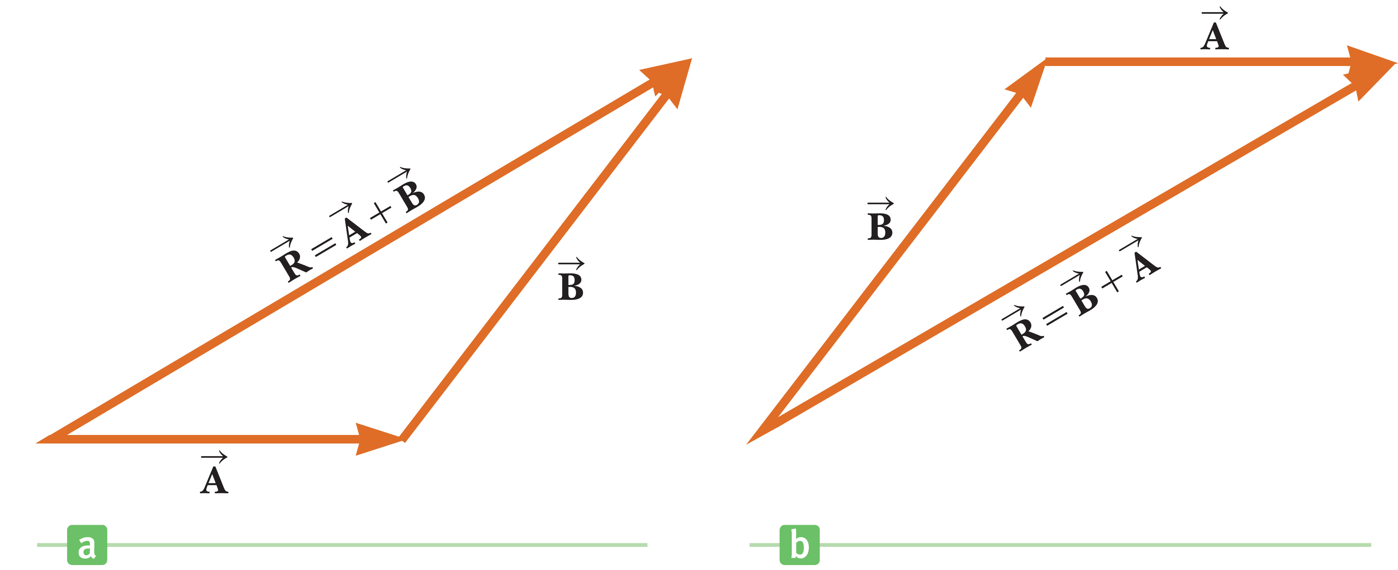
Adding Vectors
Notes:
Figure 1.12 (a) When vector B is added to vector A, the vector sum R S is the vector that runs from the tail of A to the tip of B. (b) Here the resultant runs from the tail of B to the tip of A. These constructions prove that A + B = B + A.
When two or more vectors are added, they must all have the same units. It doesn’t make sense to add a velocity vector, with units of meters per second, to a displacement vector, with units of meters. Scalars obey the same rule. It would be meaningless to add temperatures to volumes or masses to time intervals.
Vectors can be added in two ways: geometrically or algebraically. Let’s look at the geometric method first. To add vector B to vector A geometrically, first draw A on a piece of graph paper to some scale, such as 1 cm = 1 m, so that its direction is specified relative to a coordinate system. Then draw vector B to the same scale with the tail of B starting at the tip of A, as you can see in the figure on the left. Vector B must be drawn along the direction that makes the proper angle relative to vector A. The resultant vector R is the sum of vectors A and B and is the vector drawn from the tail of A to the tip of B. This procedure is called the triangle method of addition.
Since vector addition is commutative, the order of addition isn’t important. That means you can also add the two vectors as shown in the figure on the right. The resultant vector is the same.

Slide 38
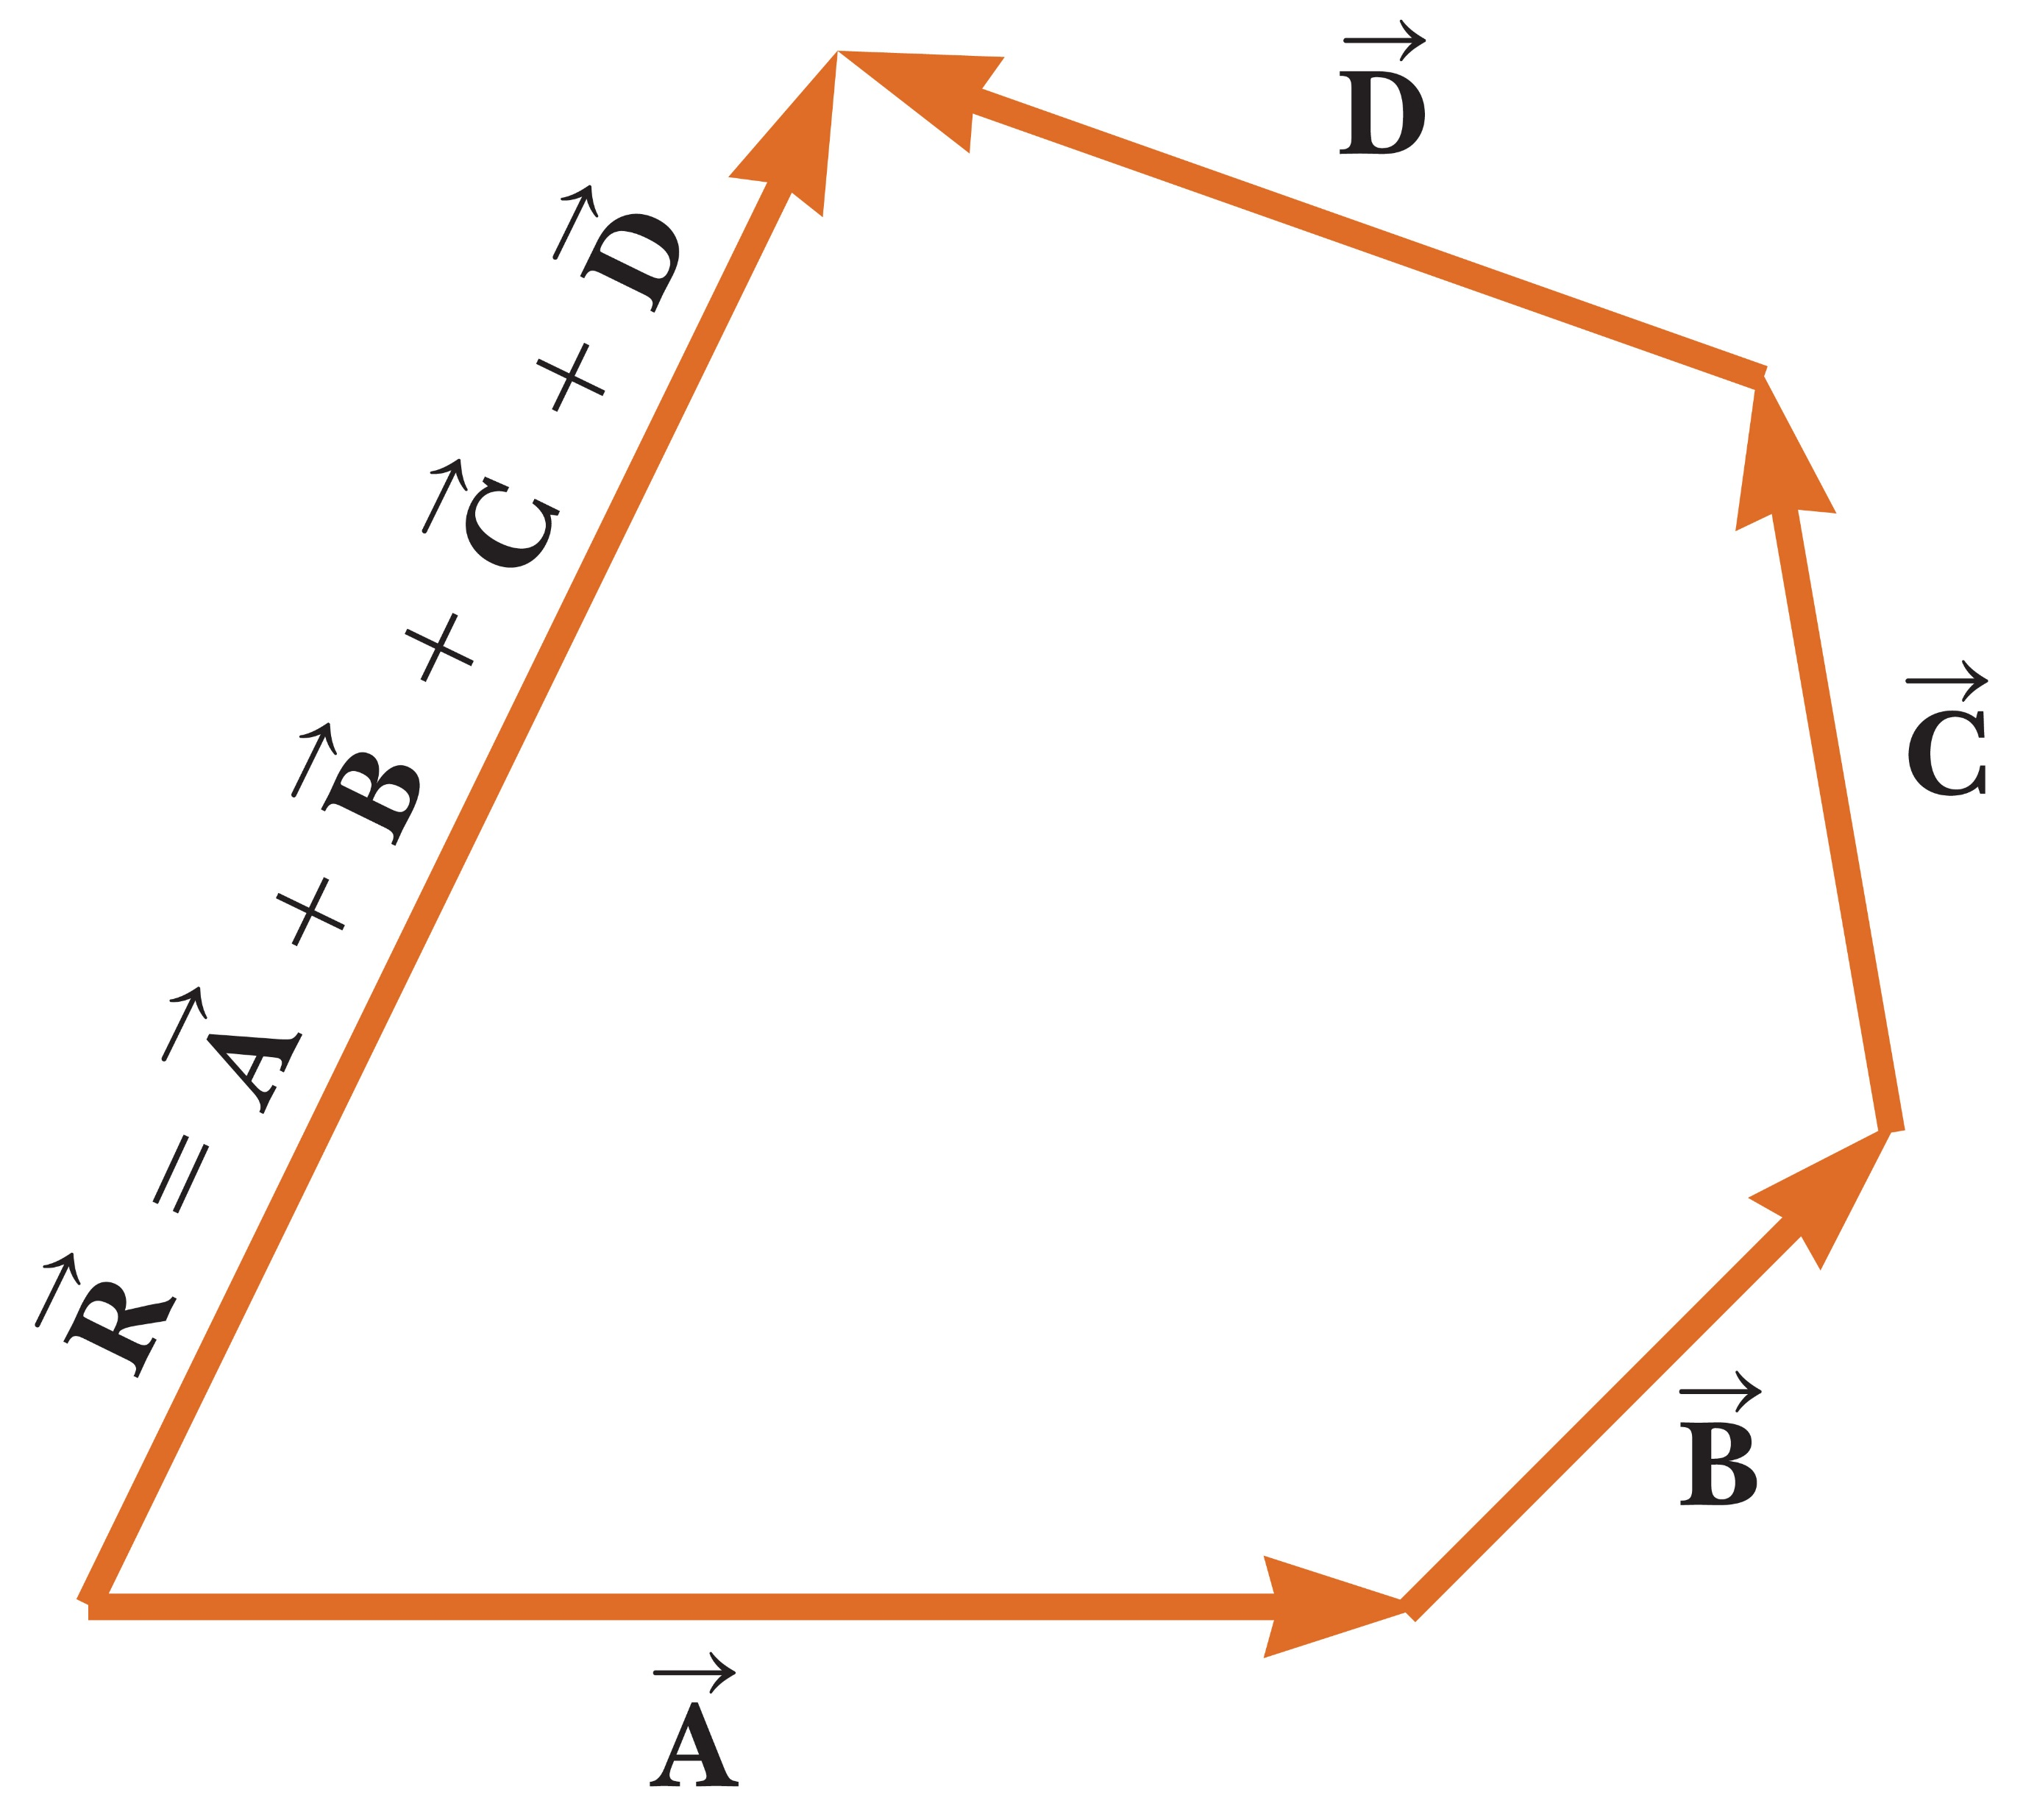
Adding Vectors
Notes:
Figure 1.13 A geometric construction for summing four vectors. The resultant vector R is the vector that completes the polygon.
The same approach can be used to add multiple vectors, as you can see in the figure.

Slide 39
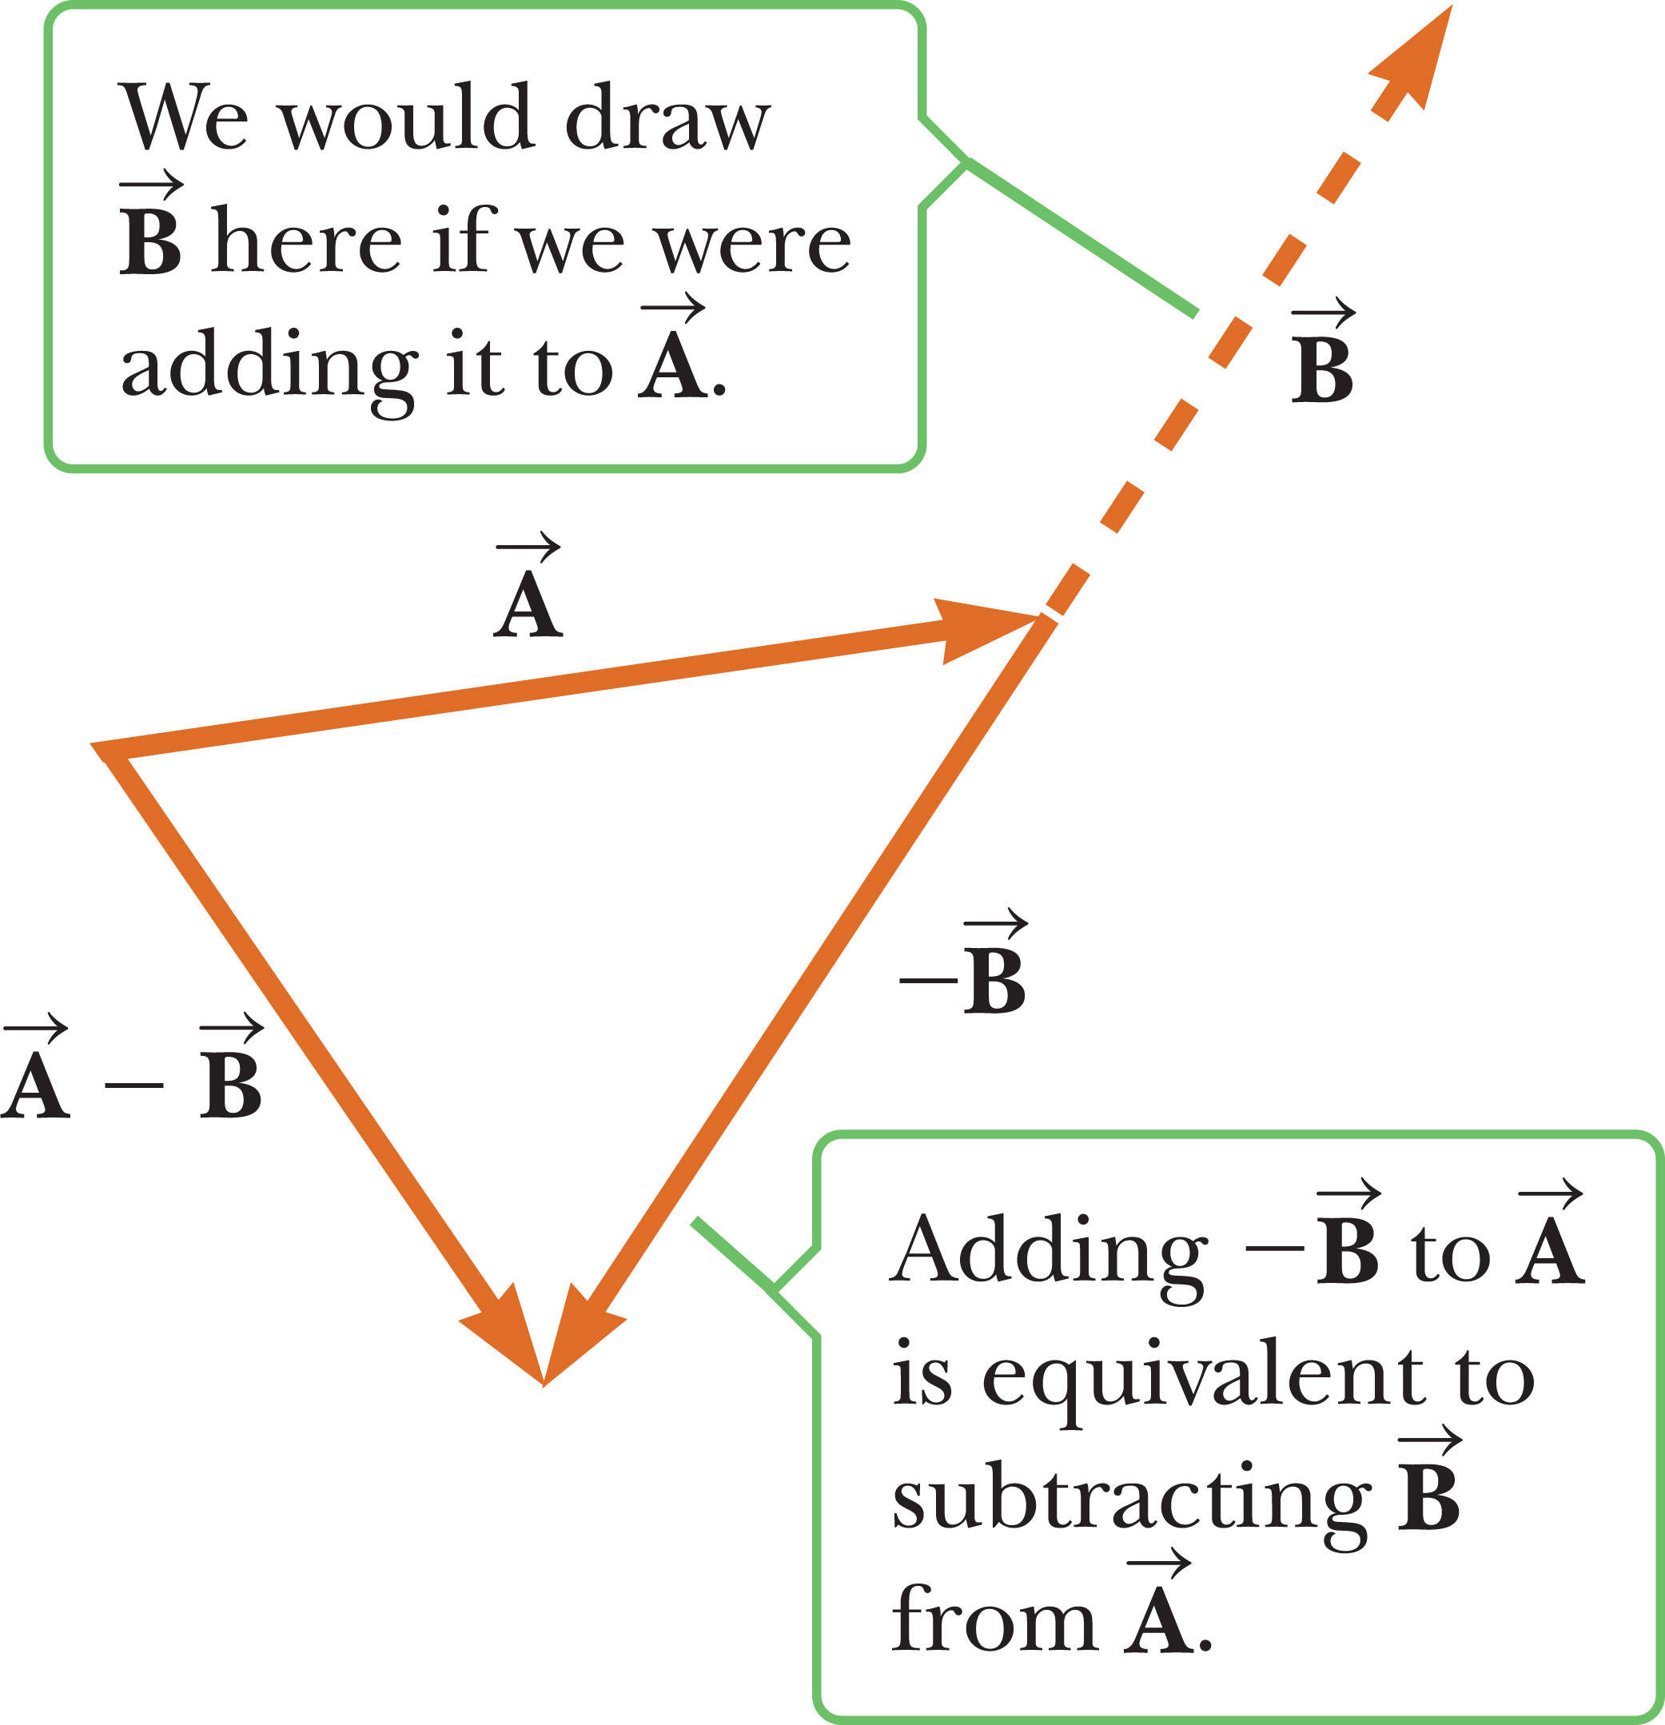
Subtracting Vectors
Notes:
Figure 1.14 This construction shows how to subtract vector B from vector A. The vector –B has the same magnitude as the vector B but points in the opposite direction.
Let’s define the negative of a vector. Consider vector A. The negative of vector A is the vector that gives zero when added to A. That means that A and –A have the same magnitude but opposite directions.
We can use this idea when we subtract vectors, which is really just a special case of vector addition. You can see that A minus B is A plus negative B. Graphically, it is the same as vector addition, but we use –B, as you can see in the figure.

Slide 40
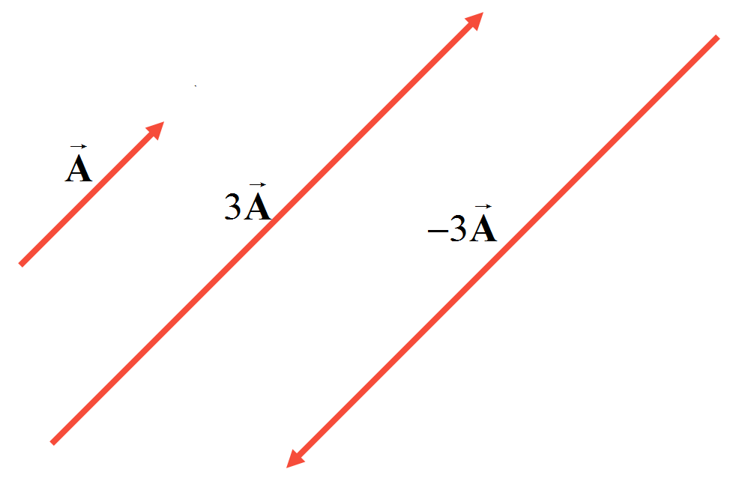
Multiplying or Dividing a Vector by a Scalar
Notes:
Figure Examples of multiplying a vector by a scalar
Multiplying or dividing a vector by a scalar gives a vector. For example, if vector A is multiplied by the scalar number 3, the result, written 3A, is a vector with a magnitude three times that of A and pointing in the same direction. If we multiply vector A by the scalar –3, the result is –3A, a vector with a magnitude three times that of A and pointing in the opposite direction (because of the negative sign).

Slide 41

Think – Pair – Share
14.4 and 4
12 and 9
20 and 4
None of these.
Notes:
Take a moment to consider your response, then talk it over with your neighbor. We’ll discuss it as a group in a couple of minutes.
Answer: 20 and 4
Reasoning: The maximum resultant vector is when the two vectors are parallel, then 12 + 8 = 20. The minimum is when the two vectors are antiparallel, so 12 – 8 = 4.

Slide 42
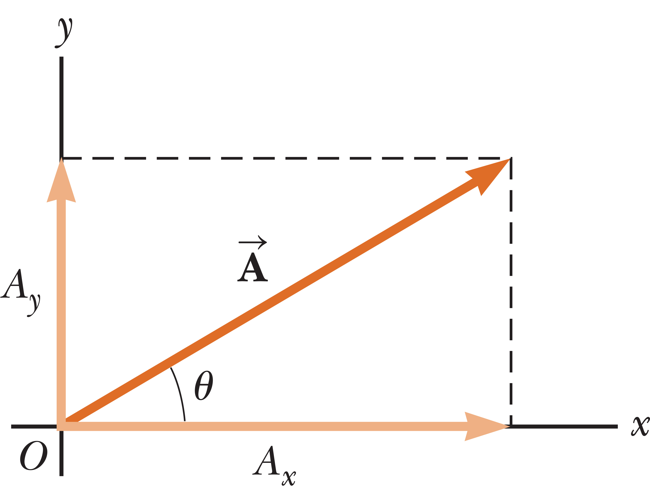
Components of a Vector
Notes:
Figure 1.16 Any vector A lying in the xy-plane can be represented by its rectangular components A_{x} and A_{y}.
Let’s take a look at vector A drawn on a rectangular coordinate system. Notice that if we draw a horizontal dashed line from the y-axis to the tip of vector A, and a vertical line from the tip to the x-axis, we have created projections of the vector onto the x and y axes. These projections are called components. Any vector can be completely described by its components.
In this example, you can see that vector A can be described as the sum of two vectors: A_{x}, parallel to the x-axis, and A_{y}, parallel to the y-axis.
The projection of A along the x-axis, A_{x}, is called the x-component of A, and the projection of A along the y-axis, A_{y}, is called the y-component of A. These components can be either positive or negative numbers with units.

Slide 43
Components of a Vector
Notes:
From the definition of sine and cosine, we can write the relationships shown.
Notice that the components form two sides of a right triangle with a hypotenuse of magnitude A. [click to show equation] So we can also write a relationship using the Pythagorean theorem.

Slide 44
Components of a Vector
Notes:
If you want to solve for the angle θ, take the inverse tangent. But beware, this formula gives the right answer for theta only half the time!
The inverse tangent function returns values only from –90° to +90°, so the answer in your calculator window will only be correct if the vector happens to lie in the first or fourth quadrant. If it lies in the second or third quadrant, adding 180° to the number in the calculator window will always give the right answer.

Slide 45
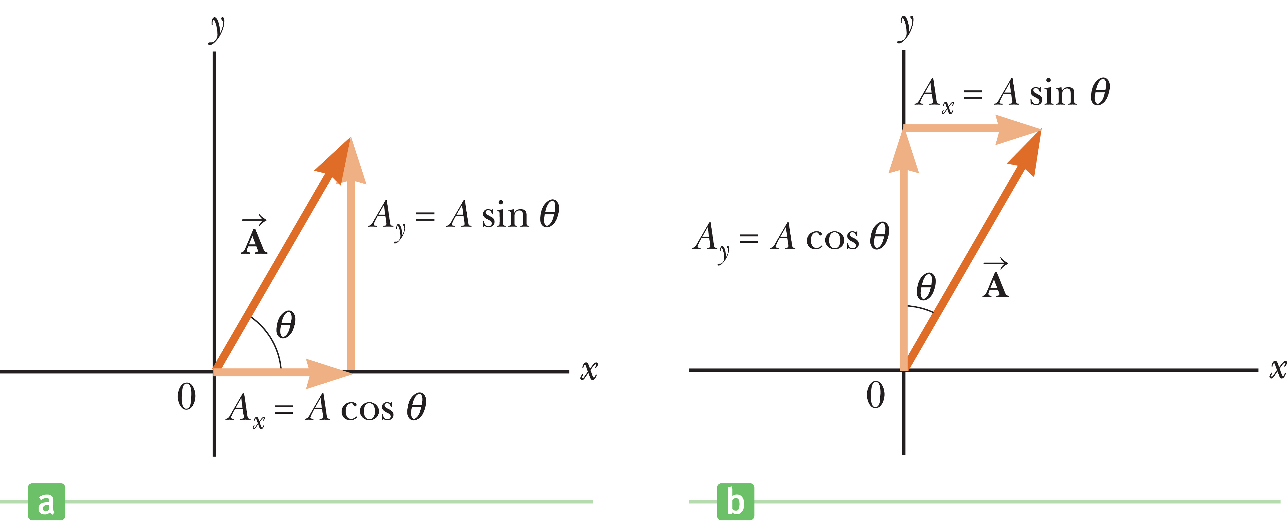
Components of a Vector
Notes:
Figure 1.17 The angle θ need not always be defined from the positive x-axis.
Sometimes the angle θ can be defined with respect to another axis, as shown in the figure on the right. In general, pick the most convenient way to express the components of a vector. Sometimes it’s easier to express the components in a coordinate system having axes that are not horizontal and vertical, but are still perpendicular to each other. Let the situation guide you.

Slide 46
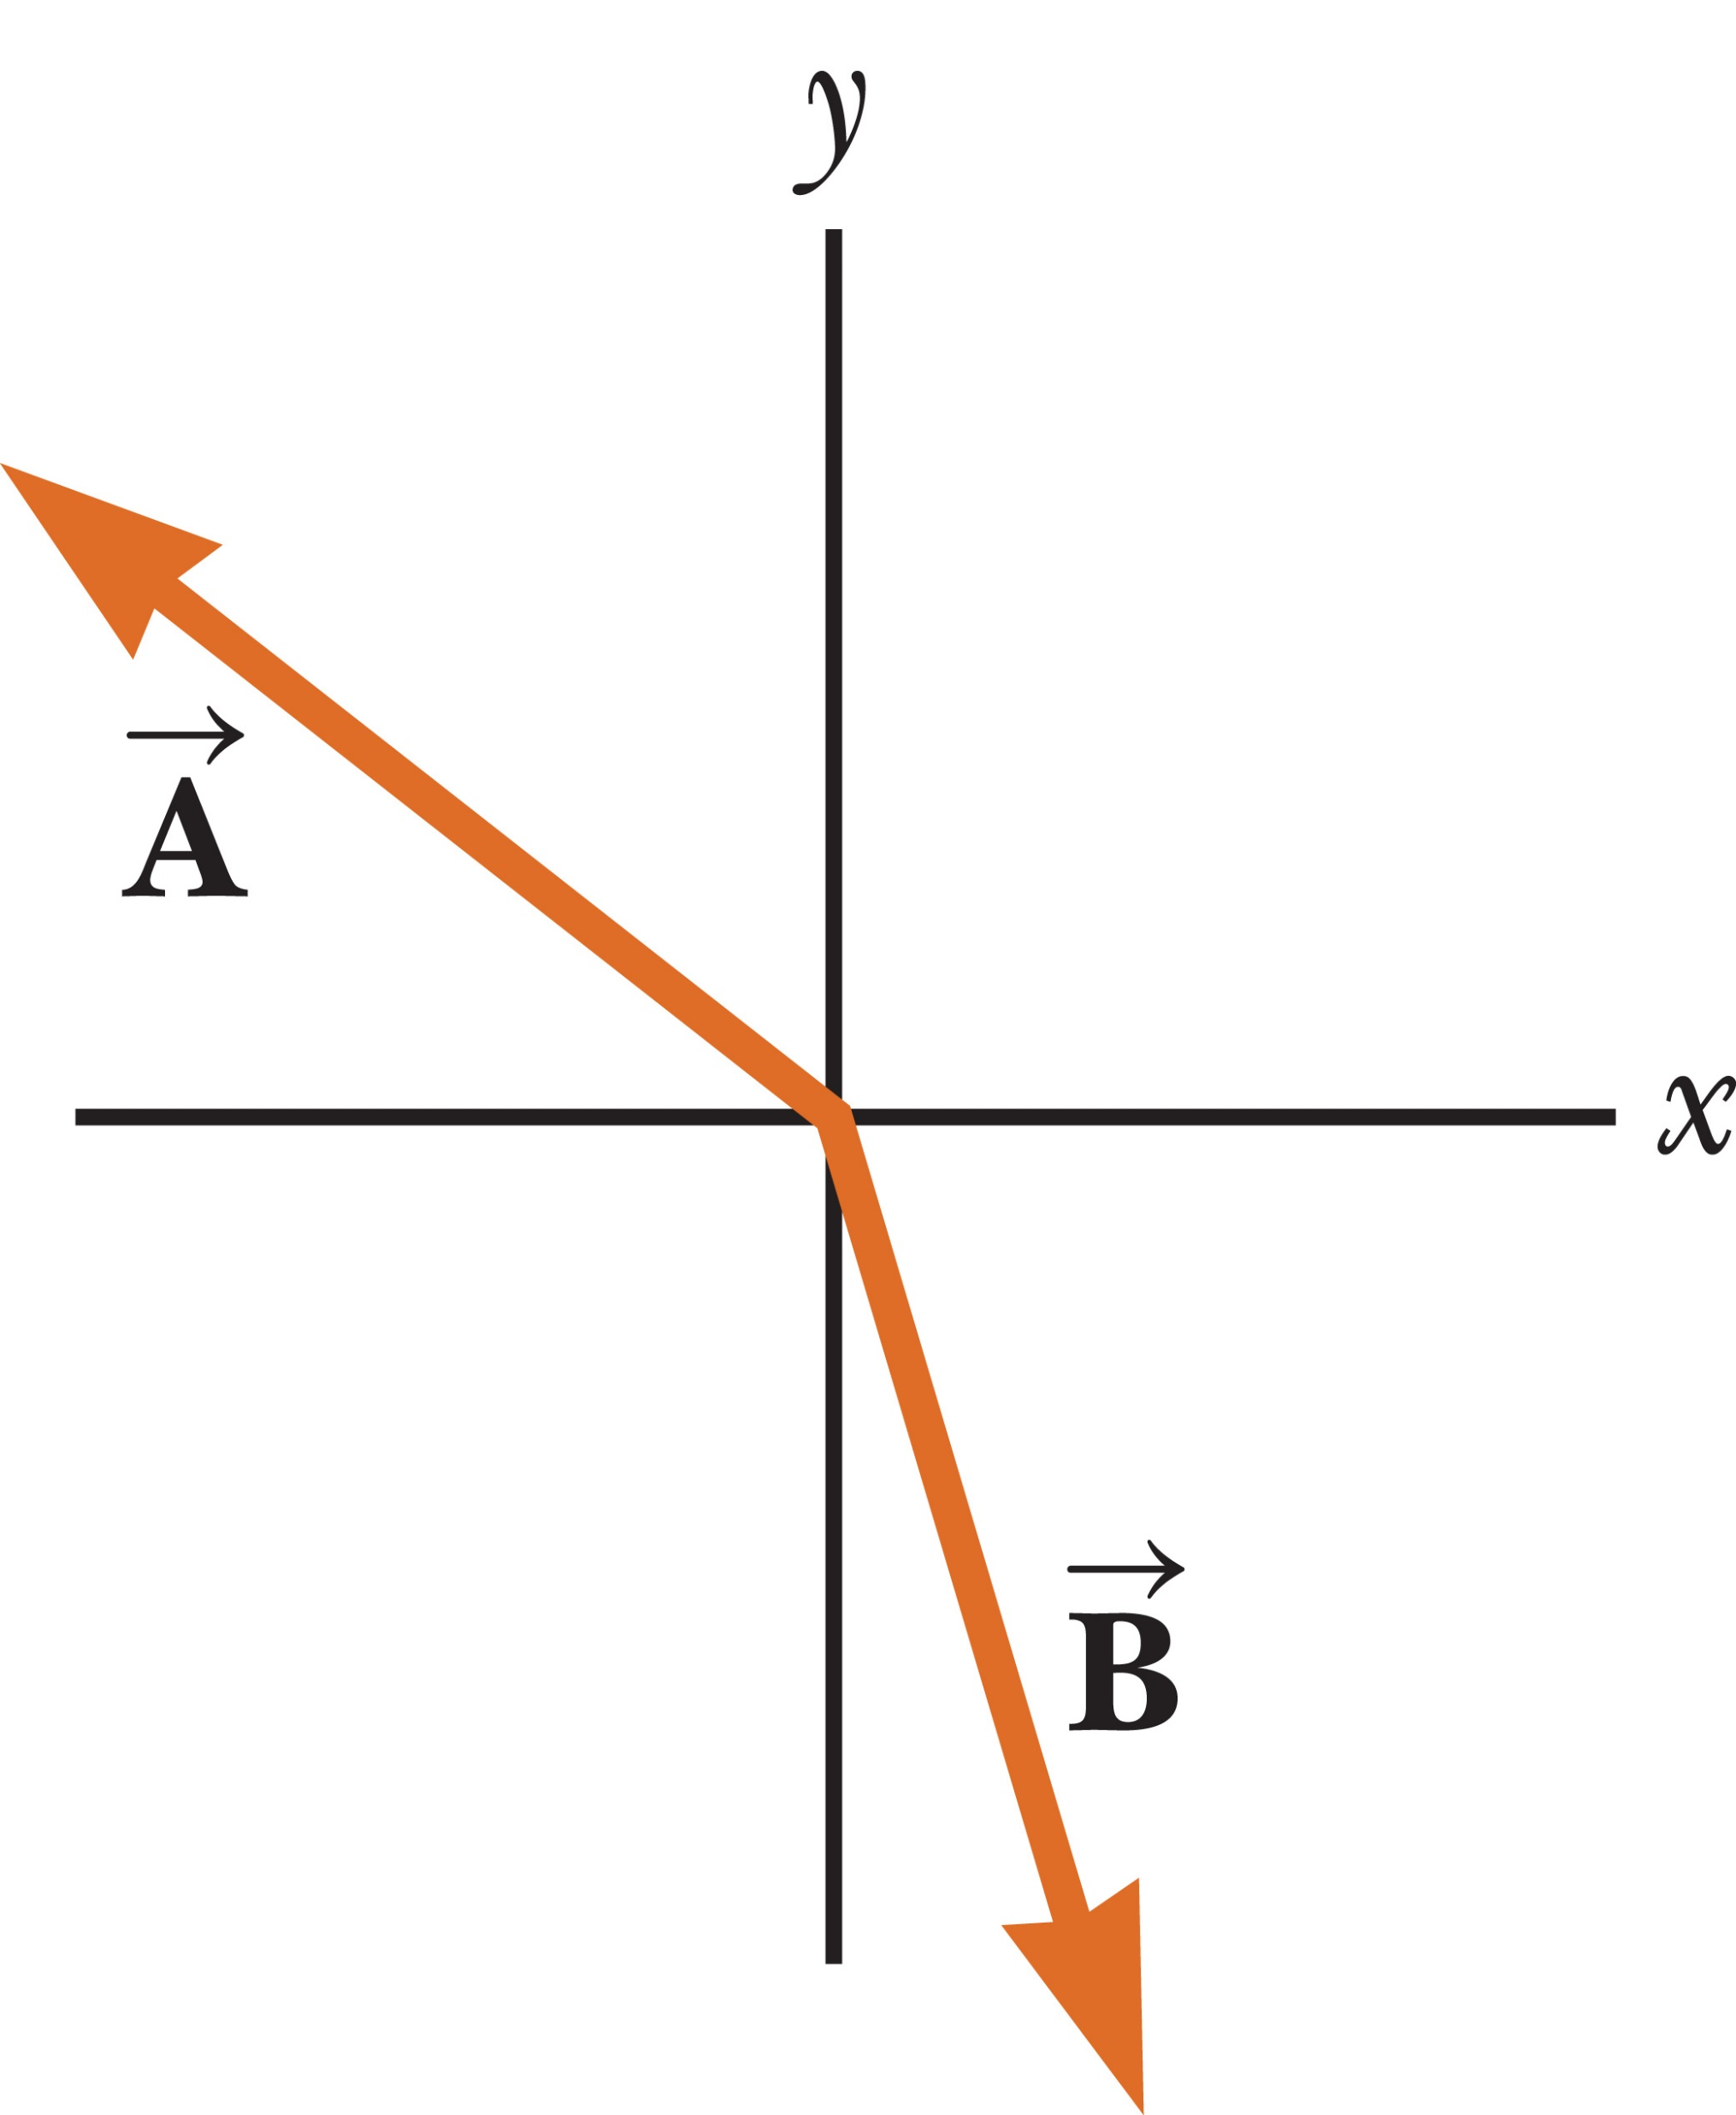
Think – Pair – Share
Notes:
Think about your answer, discuss it with a classmate, and be ready to share your thoughts with the group in a few minutes.
Answer:
Vector A: x-component negative; y-component positive
Vector B: x-component positive; y-component negative
Resultant: x-component negative; y-component negative
Reasoning: Components of a vector are the projections of that vector on the x- and y-axes.

Slide 47
Think – Pair – Share
Which vector has an angle with respect to the positive x-axis that is in the range of the inverse tangent function?
Notes:
Take a moment to consider your answer, run it by your neighbor to see if you both agree, and we’ll talk about it in a minute or two.
Answer: Vector B
Reasoning: The range of the inverse tangent function includes only the first and fourth quadrants (i.e., angles in the range −π/2 < θ < π/2). Only vector B has an orientation in this range.

Slide 48
Adding Vectors Algebraically
Notes:
Most often you will need to add vectors algebraically, in terms of their components. In this method, you simply add the x-components and the y-components separately.
Take a look at the example. R is the resultant vector, and the x-component of R is the sum of the x-components of A and B. Similarly, the y-component of R is the sum of the y-components of A and B.
Vector subtraction can be accomplished using the same method.
It’s a good idea to make a rough sketch when adding or subtracting vectors, in order to get an approximate geometric solution to check your work.

Slide 49

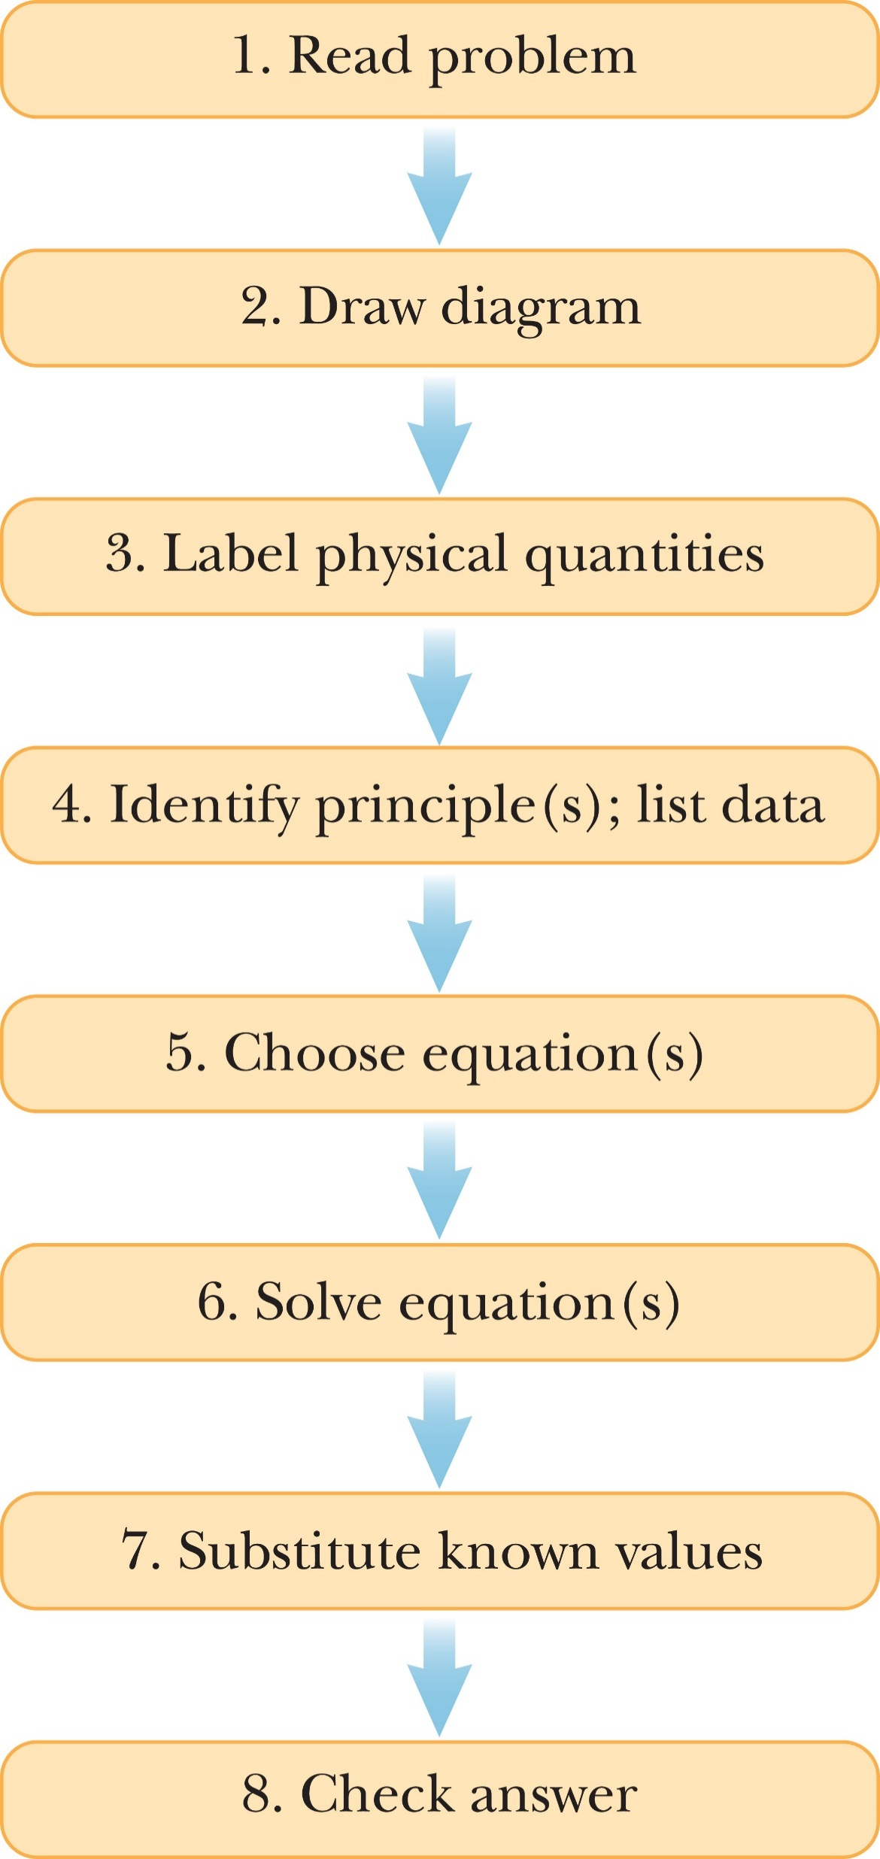
Problem-Solving Strategy
Notes:
Figure 1.22 A guide to problem solving.
The figure illustrates useful suggestions on how to approach and solve physics problems.
First, look at the problem:
1. Read the problem carefully at least twice. Be sure you understand the nature of the problem before proceeding further.
2. Draw a diagram while rereading the problem.
3. Label all physical quantities in the diagram, using letters that remind you what the quantity is, for example, use m for mass. Choose a coordinate system and label it.
Next comes your strategy:
4. Identify physical principles, the knowns and unknowns, and list them. Put circles around the unknowns. There must be as many equations as there are unknowns. There can be more, but there can’t be fewer.
5. Equations, the relationships between the labeled physical quantities, should be written down next. Naturally, the selected equations should be consistent with the physical principles identified in the previous step.
Now for the solution:
6. Solve the set of equations for the unknown quantities in terms of the knowns. Do this algebraically, without substituting values until the next step, except where terms are zero.
7. Substitute the known values, together with their units. Obtain a numerical value with units for each unknown.
Finally:
8. Check your answer. Think about these questions: Do the units match? Is the answer reasonable? Does the plus or minus sign make sense? Is your answer consistent with an order-of-magnitude estimate?
Try to use this process, or a modified version, for every problem you tackle in this course.
Another thing to consider: it is usually a good idea to solve a problem symbolically first, then plug in values. Once numbers are substituted it’s harder to understand relationships and easier to make mistakes.

Slide 50
Topic summary
Topic 1: Units, Trigonometry, and Vectors

Slide 51
Topic Summary
Standards of Length, Mass, and Time
The Building Blocks of Matter
Dimensional Analysis
Notes:
Standards of Length, Mass, and Time
The physical quantities in the study of mechanics can be expressed in terms of three fundamental quantities: length, mass, and time, which have the SI units meters (m), kilograms (kg), and seconds (s), respectively.
The Building Blocks of Matter
Matter is made of atoms, which in turn are made up of a relatively small nucleus of protons and neutrons within a cloud of electrons. Protons and neutrons are composed of still smaller particles, called quarks.
Dimensional Analysis
Dimensional analysis can be used to check equations and to assist in deriving them. When the dimensions on both sides of the equation agree, the equation is often correct up to a numerical factor. When the dimensions don’t agree, the equation must be wrong

Slide 52
Topic Summary
Uncertainty in Measurement and Significant Figures
Unit Conversions for Physical Quantities
Estimates and Order-of-Magnitude Calculations
Notes:
Uncertainty in Measurement and Significant Figures
No physical quantity can be determined with complete accuracy. The concept of significant figures affords a basic method of handling these uncertainties. A significant figure is a reliably known digit, other than a zero used to locate the decimal point. The two rules of significant figures are:
1. When multiplying or dividing using two or more quantities, the result should have the same number of significant figures as the quantity having the fewest significant figures.
2. When quantities are added or subtracted, the number of decimal places in the result should be the same as in the quantity with the fewest decimal places. Use of scientific notation can avoid ambiguity in significant figures. In rounding, if the last digit dropped is less than 5, simply drop the digit; otherwise, raise the last retained digit by one.
Unit Conversions for Physical Quantities
Units in physics equations must always be consistent. In solving a physics problem, it’s best to start with consistent units, using the table of conversion factors on the front endsheets of the textbook as necessary. Converting units is a matter of multiplying the given quantity by a fraction, with one unit in the numerator and its equivalent in the other units in the denominator, arranged so the unwanted units in the given quantity are canceled out in favor of the desired units.
Estimates and Order-of-Magnitude Calculations
Sometimes it’s useful to find an approximate answer to a question, either because the math is difficult or because information is incomplete. A quick estimate can also be used to check a more detailed calculation. In an order-of-magnitude calculation, each value is replaced by the closest power of ten, which sometimes must be guessed or estimated when the value is unknown. The computation is then carried out. For quick estimates involving known values, each value can first be rounded to one significant figure.

Slide 53


Topic Summary
Coordinate Systems
Notes:
Coordinate Systems
The Cartesian coordinate system consists of two perpendicular axes, usually called the x-axis and y-axis, with each axis labeled with all numbers from negative infinity to positive infinity. Points are located by specifying the x- and y-values. Polar coordinates consist of a radial coordinate r, which is the distance from the origin, and an angular coordinate theta, which is the angular displacement from the positive x-axis.

Slide 54
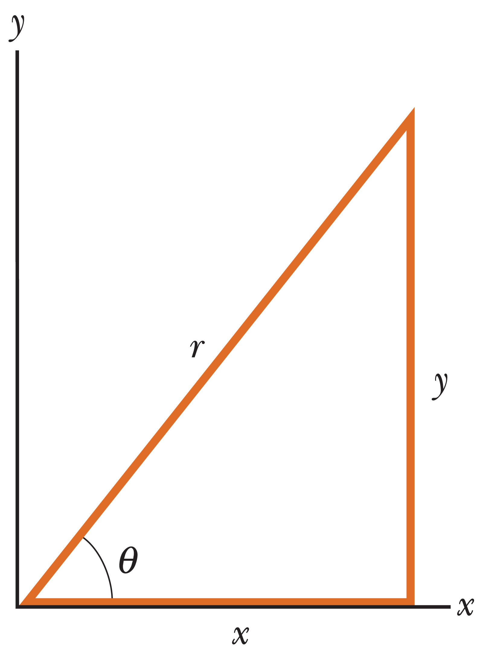
Topic Summary
Trigonometry Review
Notes:
Trigonometry Review
The three most basic trigonometric functions of a right triangle are the sine, cosine, and tangent, defined as shown. The Pythagorean theorem is an important relationship between the lengths of the sides of a right triangle, where r is the hypotenuse of the triangle and x and y are the other two sides.

Slide 55
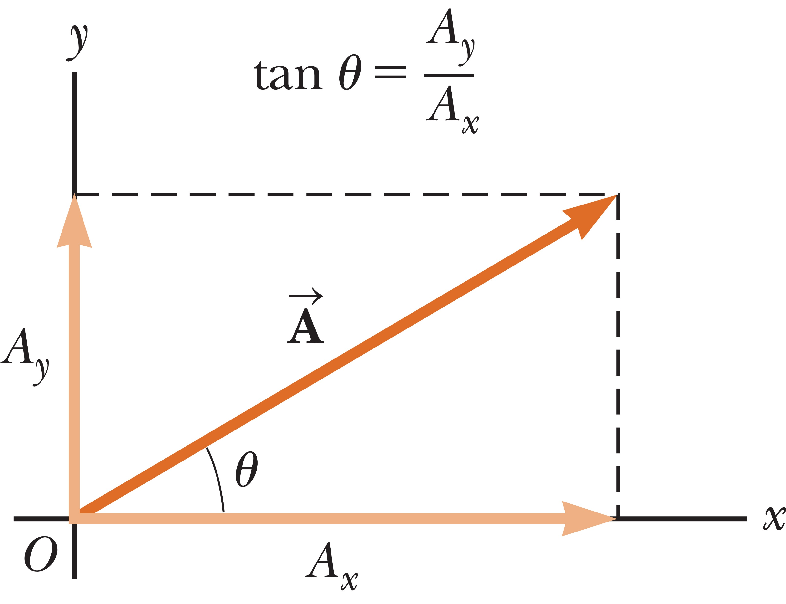
Topic Summary
Vectors
Components of a Vector
Notes:
Vectors
A scalar quantity has a magnitude but no direction; a vector quantity has both magnitude and direction. Two vectors A and B can be added geometrically with the triangle method. The two vectors are drawn to scale on graph paper, with the tail of the second vector located at the tip of the first. The resultant vector is the vector drawn from the tail of the first vector to the tip of the second.
The negative of a vector A is a vector with the same magnitude as A, but pointing in the opposite direction. A vector can be multiplied by a scalar, changing its magnitude, and its direction if the scalar is negative.
Components of a Vector
A vector A can be split into two components, one pointing in the x-direction and the other in the y-direction. These components form two sides of a right triangle having a hypotenuse with magnitude A and are given by the equations shown.
The magnitude and direction of vector A are related to its components through the Pythagorean theorem and the definition of the tangent. Remember the inverse tangent equation gives the correct vector angle only for vectors with –90° to +90°. If the vector has a negative x-component, 180° must be added to the answer in the calculator window.
If vector R is the sum of vectors A and B, then the components of the resultant vector R are the sum of the components of the two vectors, as shown.

