Slide 1
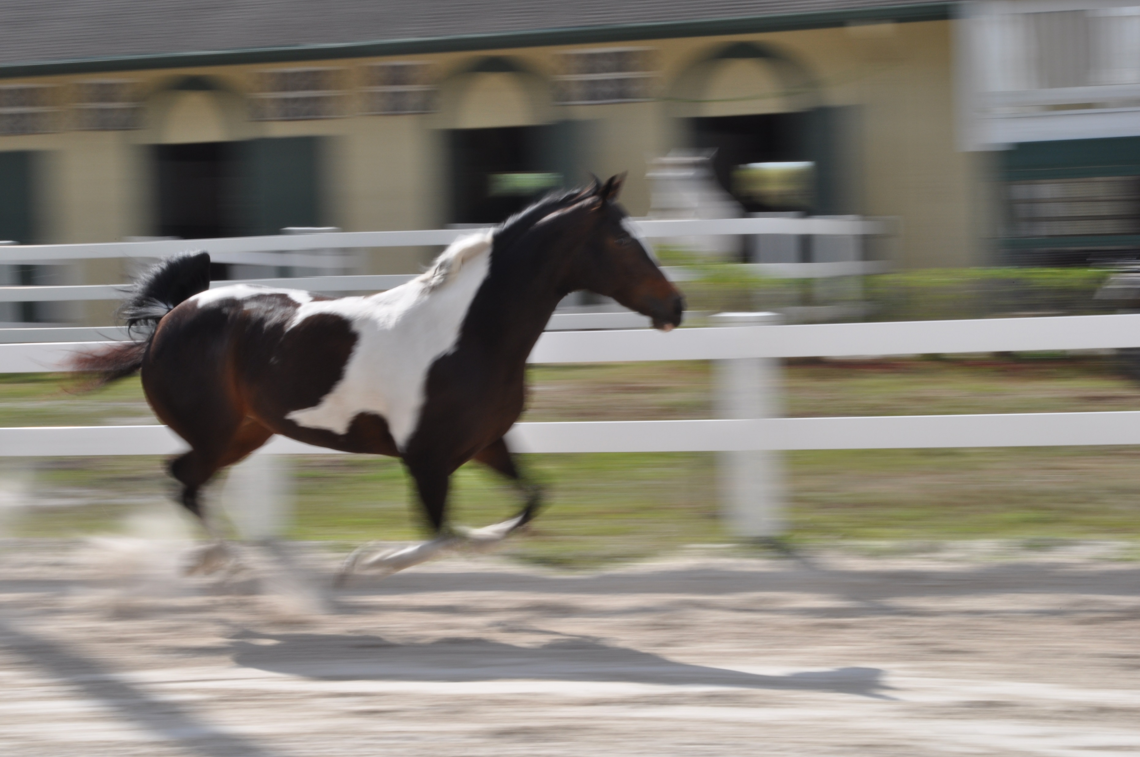

Topic 2: Motion in One Dimension
College Physics, 11e
Raymond A. Serway;
Chris Vuille
Notes:
Figure Running horse
Image credit:
https://commons.wikimedia.org/wiki/File%3ANancy_camera_lesson%2C_action_pics_013.jpg
By NancyHeise (Own work) [CC0], via Wikimedia Commons
This file is licensed under the Creative Commons Attribution-Share Alike 3.0 Unported license. [Public domain]

Slide 2
Reading Question 2-1
Let's say that during a thunderstorm you measure the time lag between the flash and the thunderclap to be 3 seconds. If the speed of sound is about 340 m/s, which of the following is the best estimate of your distance to the lightening bolt?
about 3 km
about 0.3 km
about 1 km
about 10 km

Slide 3
Reading Question 2-1
Let's say that during a thunderstorm you measure the time lag between the flash and the thunderclap to be 3 seconds. If the speed of sound is about 340 m/s, which of the following is the best estimate of your distance to the lightening bolt?
about 3 km
about 0.3 km
about 1 km
about 10 km

Slide 4
Reading Question 2-2
Under which of the following conditions is the magnitude of the average velocity of a particle moving in one dimension smaller than the average speed over the time interval?
A particle moves in the +x direction and then reverses the direction of its motion.
A particle moves in the –x direction without reversing.
There are no conditions for which this is true.
A particle moves in the +x direction without reversing.

Slide 5
Reading Question 2-2
Under which of the following conditions is the magnitude of the average velocity of a particle moving in one dimension smaller than the average speed over the time interval?
A particle moves in the +x direction and then reverses the direction of its motion.
A particle moves in the –x direction without reversing.
There are no conditions for which this is true.
A particle moves in the +x direction without reversing.

Slide 6
Reading Question 2-3
If a car is traveling eastward and slowing down, what is the direction of the acceleration on the car that causes it to slow down?
No acceleration is required to slow the car.
eastward
westward
None of these choices is correct.

Slide 7
Reading Question 2-3
If a car is traveling eastward and slowing down, what is the direction of the acceleration on the car that causes it to slow down?
No acceleration is required to slow the car.
eastward
westward
None of these choices is correct.

Slide 8
Reading Question 2-4
Which of the following is true?
A moving car with constant acceleration can never stop and stay stopped.
If a car is traveling eastward, its acceleration is eastward.
If a car is slowing down, its acceleration must be negative.
If a car is speeding up, its acceleration must be greater than zero.

Slide 9
Reading Question 2-4
Which of the following is true?
A moving car with constant acceleration can never stop and stay stopped.
If a car is traveling eastward, its acceleration is eastward.
If a car is slowing down, its acceleration must be negative.
If a car is speeding up, its acceleration must be greater than zero.

Slide 10
Reading Question 2-5
The velocity and acceleration of an object
must have the same sign.
can have opposite signs.
must both be zero simultaneously; one cannot be zero and the other nonzero.
must have opposite signs.

Slide 11
Reading Question 2-5
The velocity and acceleration of an object
must have the same sign.
can have opposite signs.
must both be zero simultaneously; one cannot be zero and the other nonzero.
must have opposite signs.

Slide 12
Reading Question 2-6
The equations of kinematics, which are given in the table,
cannot be used if the acceleration is equal to zero.
cannot be used if the acceleration varies with time.
can be used in any situation.
None of these choices are correct.

Slide 13
Reading Question 2-6
The equations of kinematics, which are given in the table,
cannot be used if the acceleration is equal to zero.
cannot be used if the acceleration varies with time.
can be used in any situation.
None of these choices are correct.

Slide 14
TOPIC Discussion
Topic 2: Motion in One Dimension
Notes:
The study of motion, force, and mass is called dynamics. The focus on motion without regard to its cause is called kinematics. For this topic we will be looking at kinematics in one dimension, which means motion along a straight line. Motion involves the concepts of displacement, velocity, and acceleration.
The study of motion is an ancient one. People of ancient Sumeria and Egypt were interested in understanding the motions of celestial bodies. Systematic studies of the sky were conducted by the Greeks from about 300 BCE to 300 AD. Humans at this time, and in fact up to the 17th century, in general believed in a geocentric model, that is, Earth was the center of the Universe. This model was eventually replaced by the heliocentric model, thanks in part to the work by the Polish astronomer Nicolaus Copernicus. In 1609, Galileo Galilei became one of the first people to make astronomical observations with a telescope. His observations convinced him that the heliocentric model was correct. His quantitative study of motion formed the foundation of Newton’s revolutionary work in the next century.

Slide 15
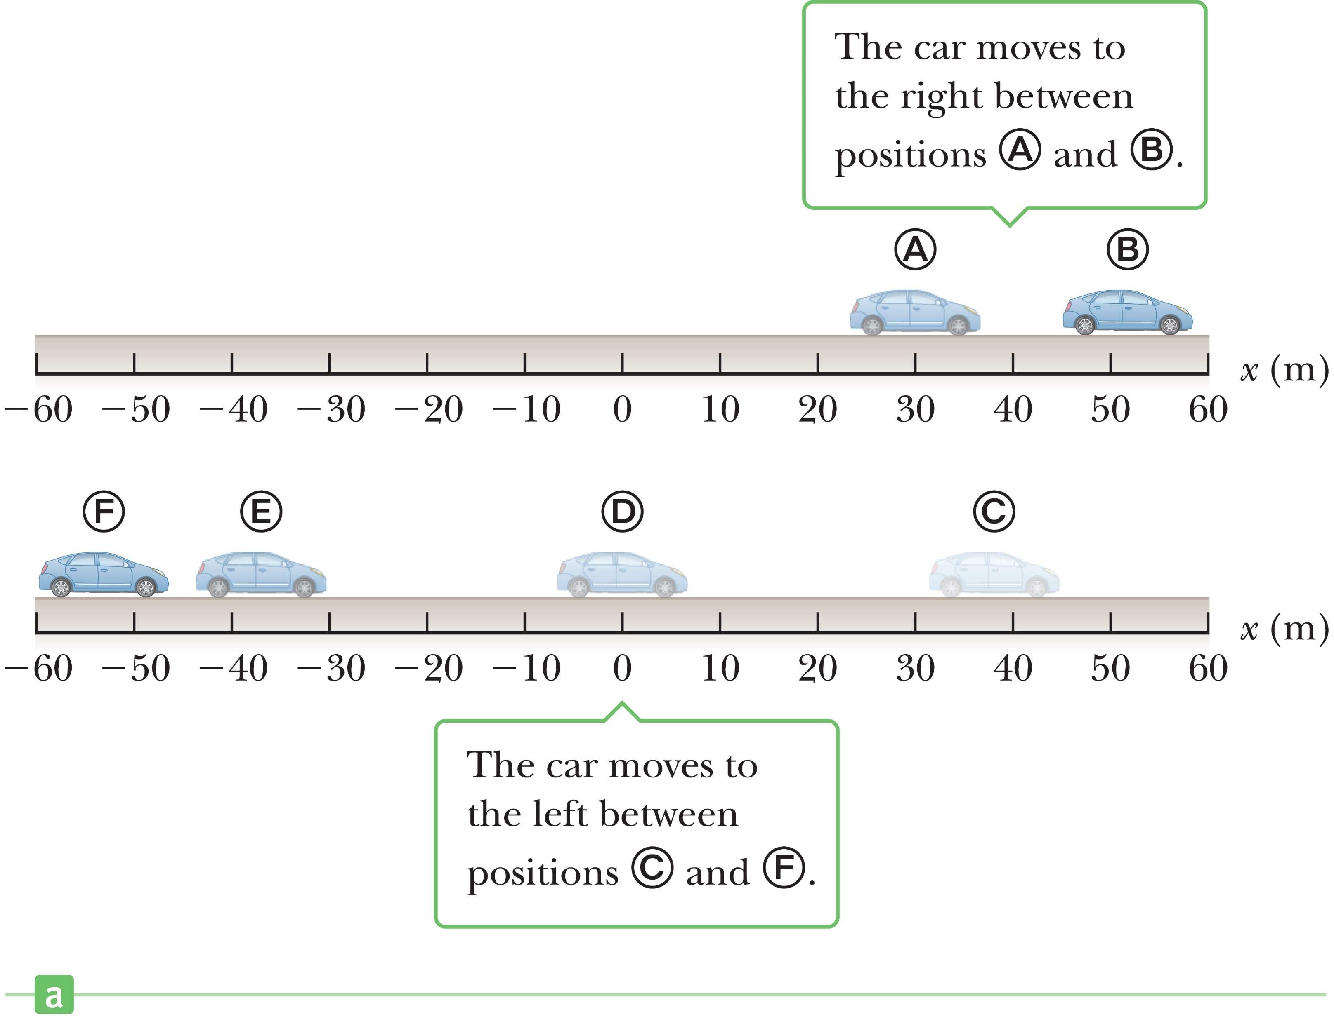
Displacement
Notes:
Figure 2.2 (a) A car moves back and forth along a straight line taken to be the x-axis. Because we are interested only in the car’s translational motion, we can model it as a particle.
When an object moves, its position changes from one place in space and time to another. When we describe motion it is helpful to use a coordinate system and a specified origin. A frame of reference is a choice of coordinate axes that defines the starting point for measuring any quantity, which is an essential first step in solving virtually any problem in mechanics. Take a look at the figure. The car is moving along the x-axis. The coordinates of the car at any time describe its position in space and, more importantly, its displacement at some given time of interest.
The displacement, Δx, of an object is defined as its change in position and is given by the equation shown. [click to show equation] In this equation x_{i} is the coordinate of the object’s initial position, where i stands for initial, and x_{f} is the coordinate of the object’s final position, where f stands for final. We use the Greek letter delta to represent a change in a physical quantity.
The equation tells us that Δx is positive if x_{f} is greater than x_{i} , and negative if x_{f} is less than x_{i} .

Slide 16
Displacement
Notes:
Let’s look at the figure again. If the car moves from point A to point B so that the initial position is 30 m and the final position is 52 m, the displacement is +22 m.

Slide 17
Displacement
Notes:
If the car moves from point C to point F, then the initial position is 38 m, the final position is –53 m, and the displacement is –91 m.
A positive answer indicates a displacement in the positive x-direction, and a negative answer indicates a displacement in the negative x-direction.

Slide 18
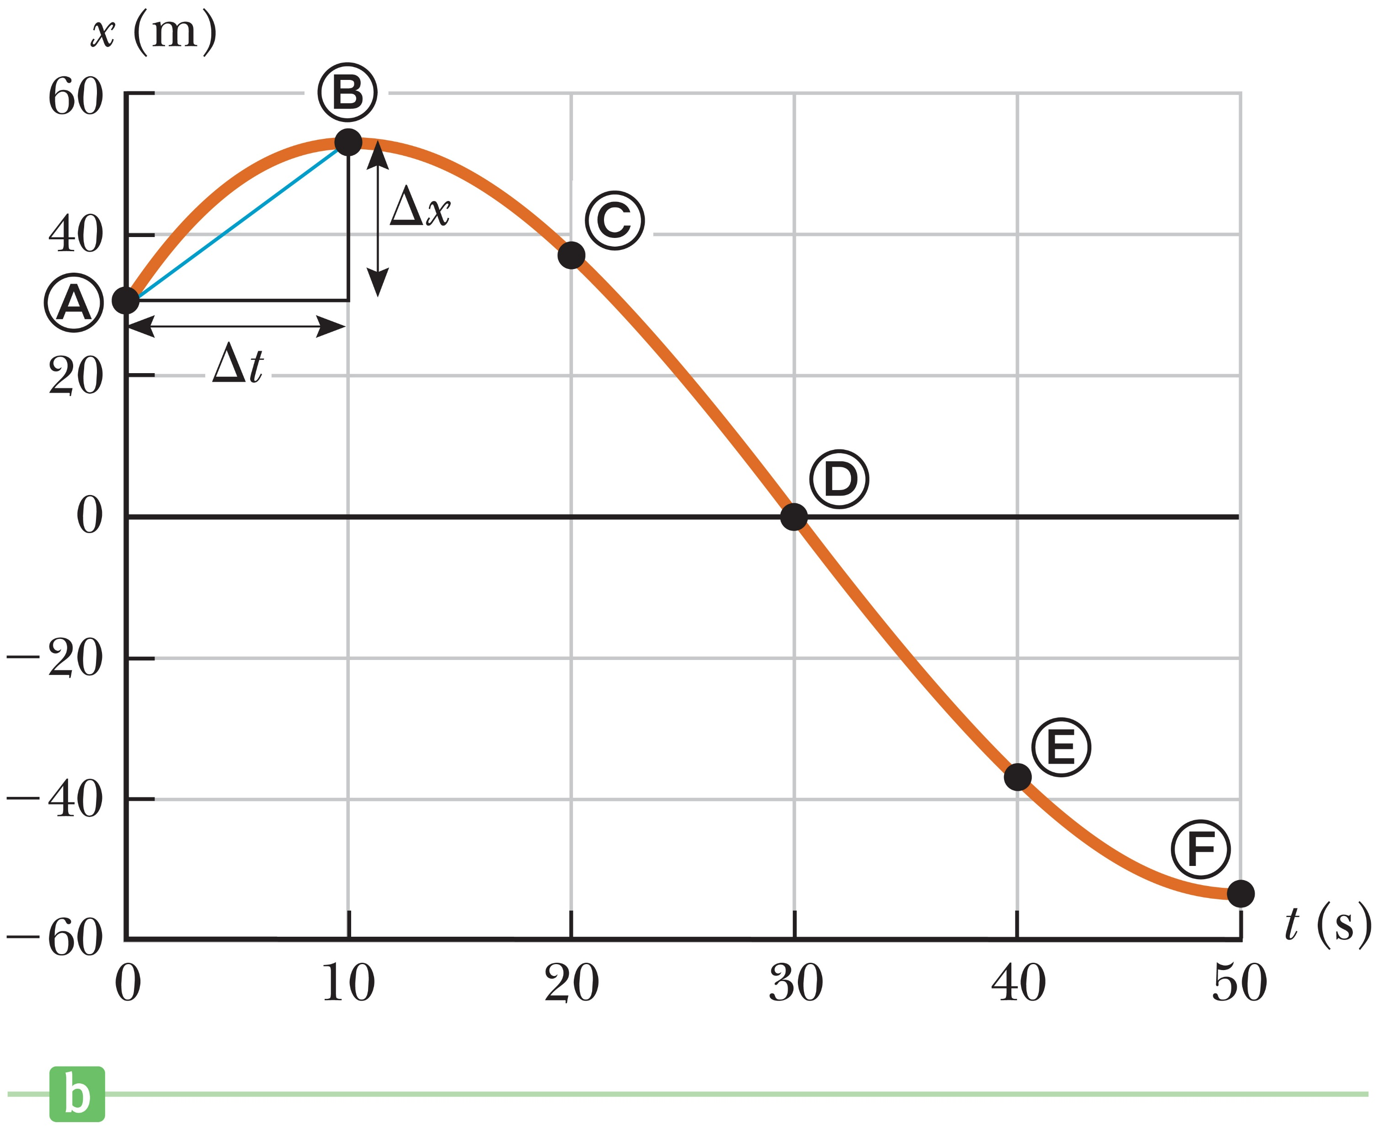
Displacement
Notes:
Figure 2.2 (b) Graph of position vs. time for the motion of the “particle.”
The figure shows a graph of the car’s position as a function of time. Displacement is a vector—it has magnitude and direction. Velocity and acceleration are also vectors.
Remember that we usually represent a vector by using boldface type with an arrow over the top. For this topic, we know that the motion is in one dimension, so it isn’t necessary to use this convention. Plus or minus signs are enough to indicate direction.
In our everyday language, you can hear people use the words speed and velocity interchangeably. But in physics, speed is a scalar quantity, having only magnitude, and velocity is a vector, having both magnitude and direction.
Why is velocity be a vector? Imagine if you want to get to a town 70 km away in an hour’s time. It’s not enough to drive at a speed of 70 km/h; you must travel in the correct direction as well. Pretty obvious, right? But you can see that velocity gives more information than speed.

Slide 19
Velocity
Notes:
The average speed of an object over a given time interval is the length of the path it travels divided by the total elapsed time. We can also write this equation symbolically. [click to show equation] Here v represents the average speed, d represents the path length, and t represents the elapsed time during the motion.

Slide 20
Velocity
Notes:
Let’s look at an example. The straight-line distance from Atlanta, Georgia, to St. Petersburg, Florida is about 500 miles. If someone drives a car that distance in 10 h, the car’s average speed is 500 miles divided by 10 hours or 50 miles per hour. It doesn’t matter if the driver’s speed changes during the trip. The driver could run into traffic and have to slow down or stop along the way, or drive faster for part of the trip. The average speed is still the same.
But, let’s say the driver makes a side trip to Jacksonville, Florida, which might add 100 miles to the path length, [click to show equations] so now the car’s average speed is 60 miles per hour.
Distance is the length of a straight line joining two points, and path length is the length of the actual path traversed between two points.

Slide 21
Velocity
Notes:
Average velocity is a vector quantity, which has a magnitude and a direction. Let’s look at our figure again. Let the car’s position be x_{i} at some time t_{i} and x_{f} at a later time t_{f} . In the time interval Δt = t_{f} – t_{i}, the displacement of the car is Δx = x_{f} – x_{i}.
The average velocity during a time interval Δt is [click to show equation] the displacement Δx divided by Δt.
Average speed is always positive, but the average velocity of an object in one dimension can be either positive or negative, depending on the sign of the displacement.
In the top figure, the average velocity of the car is positive, because it starts at point A and ends at point B. A plus sign indicates motion to the right along the x-axis.
In the bottom figure, the average velocity of the car is negative, because it starts at C and ends at F. A minus sign indicates motion to the left along the x-axis.

Slide 22
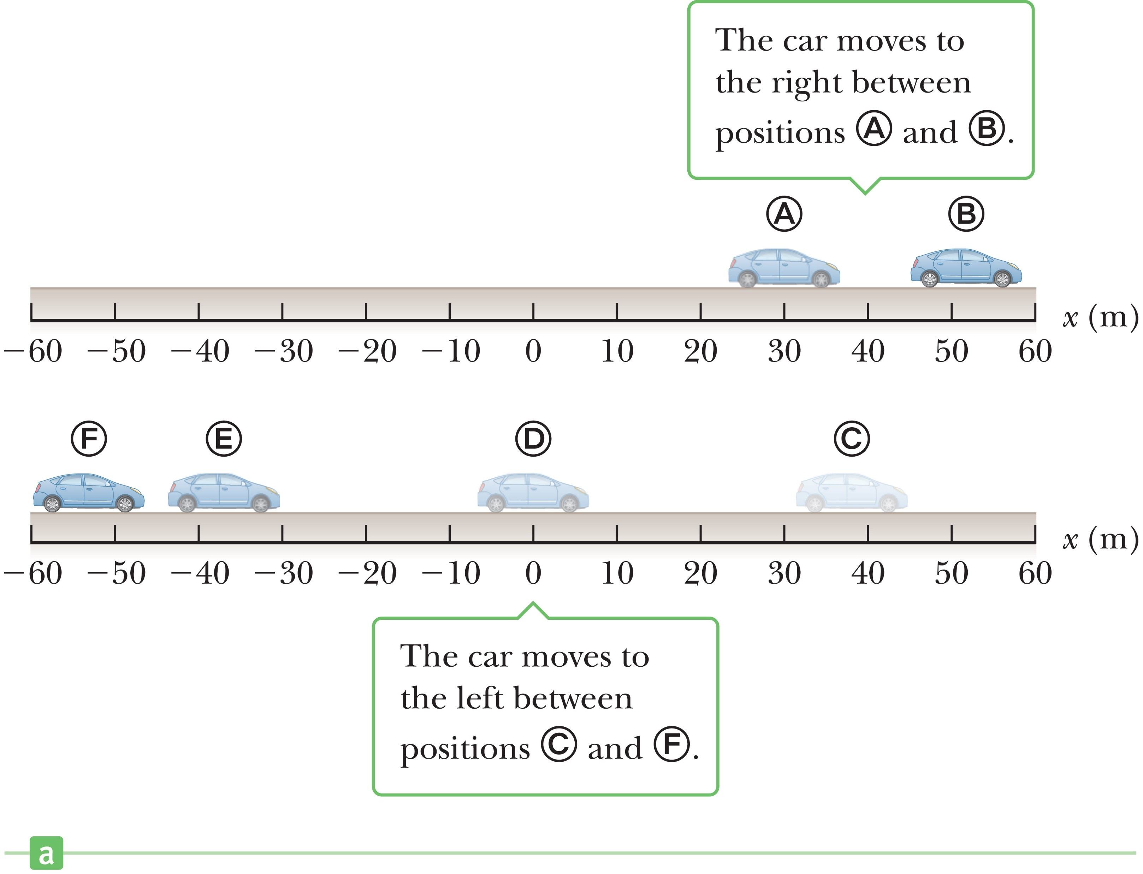
Velocity
Notes:
Take a look at the data in the table giving us the position of the car at different times. Let’s find the average velocity in the time interval from point A to point B, using our definition of average velocity.
[click to show equation] We simply put in the values for the initial and final positions and times, and solve.

Slide 23
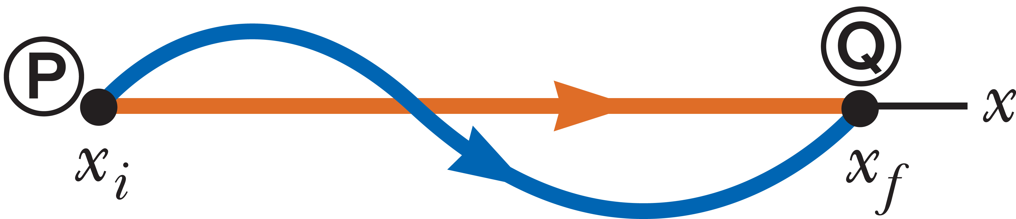
Velocity
velocities are equal; speeds are different
Notes:
Figure 2.3 A drag race viewed from a stationary blimp. One car follows the rust-colored straight-line path from P to Q, and a second car follows the blue curved path.
Imagine we’re watching a drag race from a stationary blimp. The paths of a car are depicted in the figure. In one run we see a car follow the straight-line path, shown in orange, from P to Q during the time interval Δt, and in a second run a car follows the curved path, shown in blue, during the same interval.
The two cars had the same average velocity because they had the same displacement during the same time interval. The car taking the curved route traveled a greater path length and had the higher average speed.

Slide 24

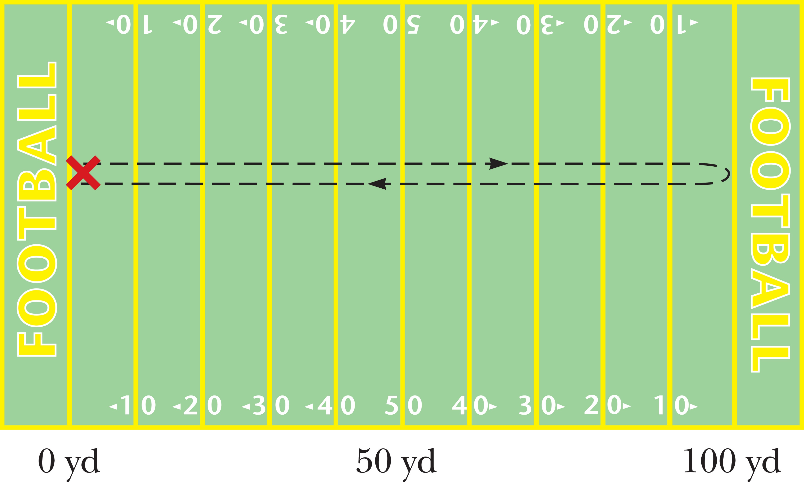
Think – Pair – Share
The figure below shows the unusual path of a confused football player. After receiving a kickoff at his own goal, he runs downfield to within inches of a touchdown, then reverses direction and races back until he’s tackled at the exact location where he first caught the ball. During this run, which took 25 s, what is the path length he travels?
100 yd
200 yd
0.00 yd
It is more than 100 yd, but you must know the exact path to say exactly.
Notes:
Figure 2.4 The path followed by a confused football player.
Take a few minutes to determine your answers, then talk it over with your neighbor. We’ll discuss it as a group in a couple of minutes.
Answer: 200 yd
Reasoning: The path length is the total distance the player runs, 200 yd.

Slide 25
Think – Pair – Share
What was the player’s displacement?
100 yd
200 yd
0.00 yd
It is more than 100 yd, but you must know the exact path to say exactly.
Notes:
Think about it, share your thoughts with another classmate, and in a minute we’ll all talk it through together.
Answer: 0.00 yd
Reasoning: The displacement is zero, because the player ends up at his starting position.

Slide 26
Think – Pair – Share
During the player’s run, which took 25 s, what is his average velocity in the x-direction?
100 yd/s
25.0 yd/s
8.00 yd/s
0.00 yd/s
Notes:
Figure out your answer, share it with your neighbor, and see what they say. We’ll talk it through as a big group in about two minutes.
Answer: 8.00 yd/s
Reasoning: The path length is the total distance the player runs, 200 yd, so the average speed is the path length divided by the total time: 200 yd ÷ 25 s = 8 yd/s.

Slide 27
Think – Pair – Share
During the player’s run, which took 25 s, what is his average velocity in the x-direction?
100 yd/s
25.0 yd/s
8.00 yd/s
0.00 yd/s
Notes:
Think about it yourself, talk it over with a classmate, and then we’ll hear from you in a minute.
Answer: 0.00 yd/s
Reasoning: The displacement is zero, because the player ends up at his starting position, so the average velocity is also zero.

Slide 28
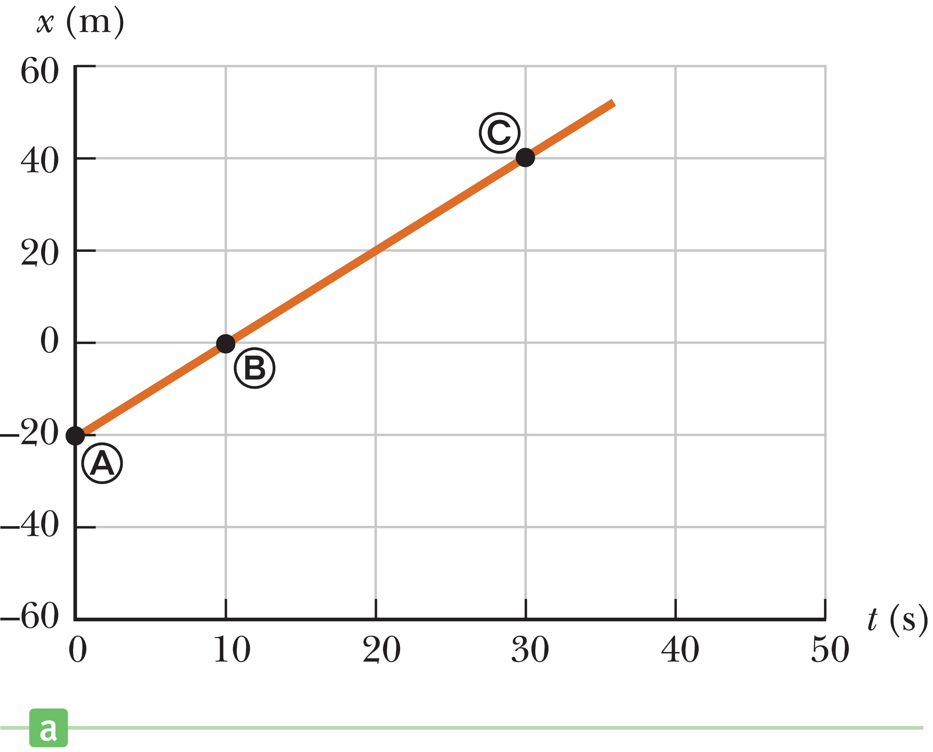
Graphical Interpretation of Velocity
Notes:
Figure 2.5 (a) Position vs. time graph for the motion of a car moving along the x-axis at constant velocity.
Imagine a car moves along the x-axis from A to B to C. We can plot the positions of these points as a function of the time elapsed since the start of the motion. The result is the position versus time graph shown.
In this instance, the graph is a straight line because the car is moving at constant velocity, which means the same displacement Δx occurs in each time interval Δt, so the average velocity is always the same and is equal to Δx over Δt.

Slide 29
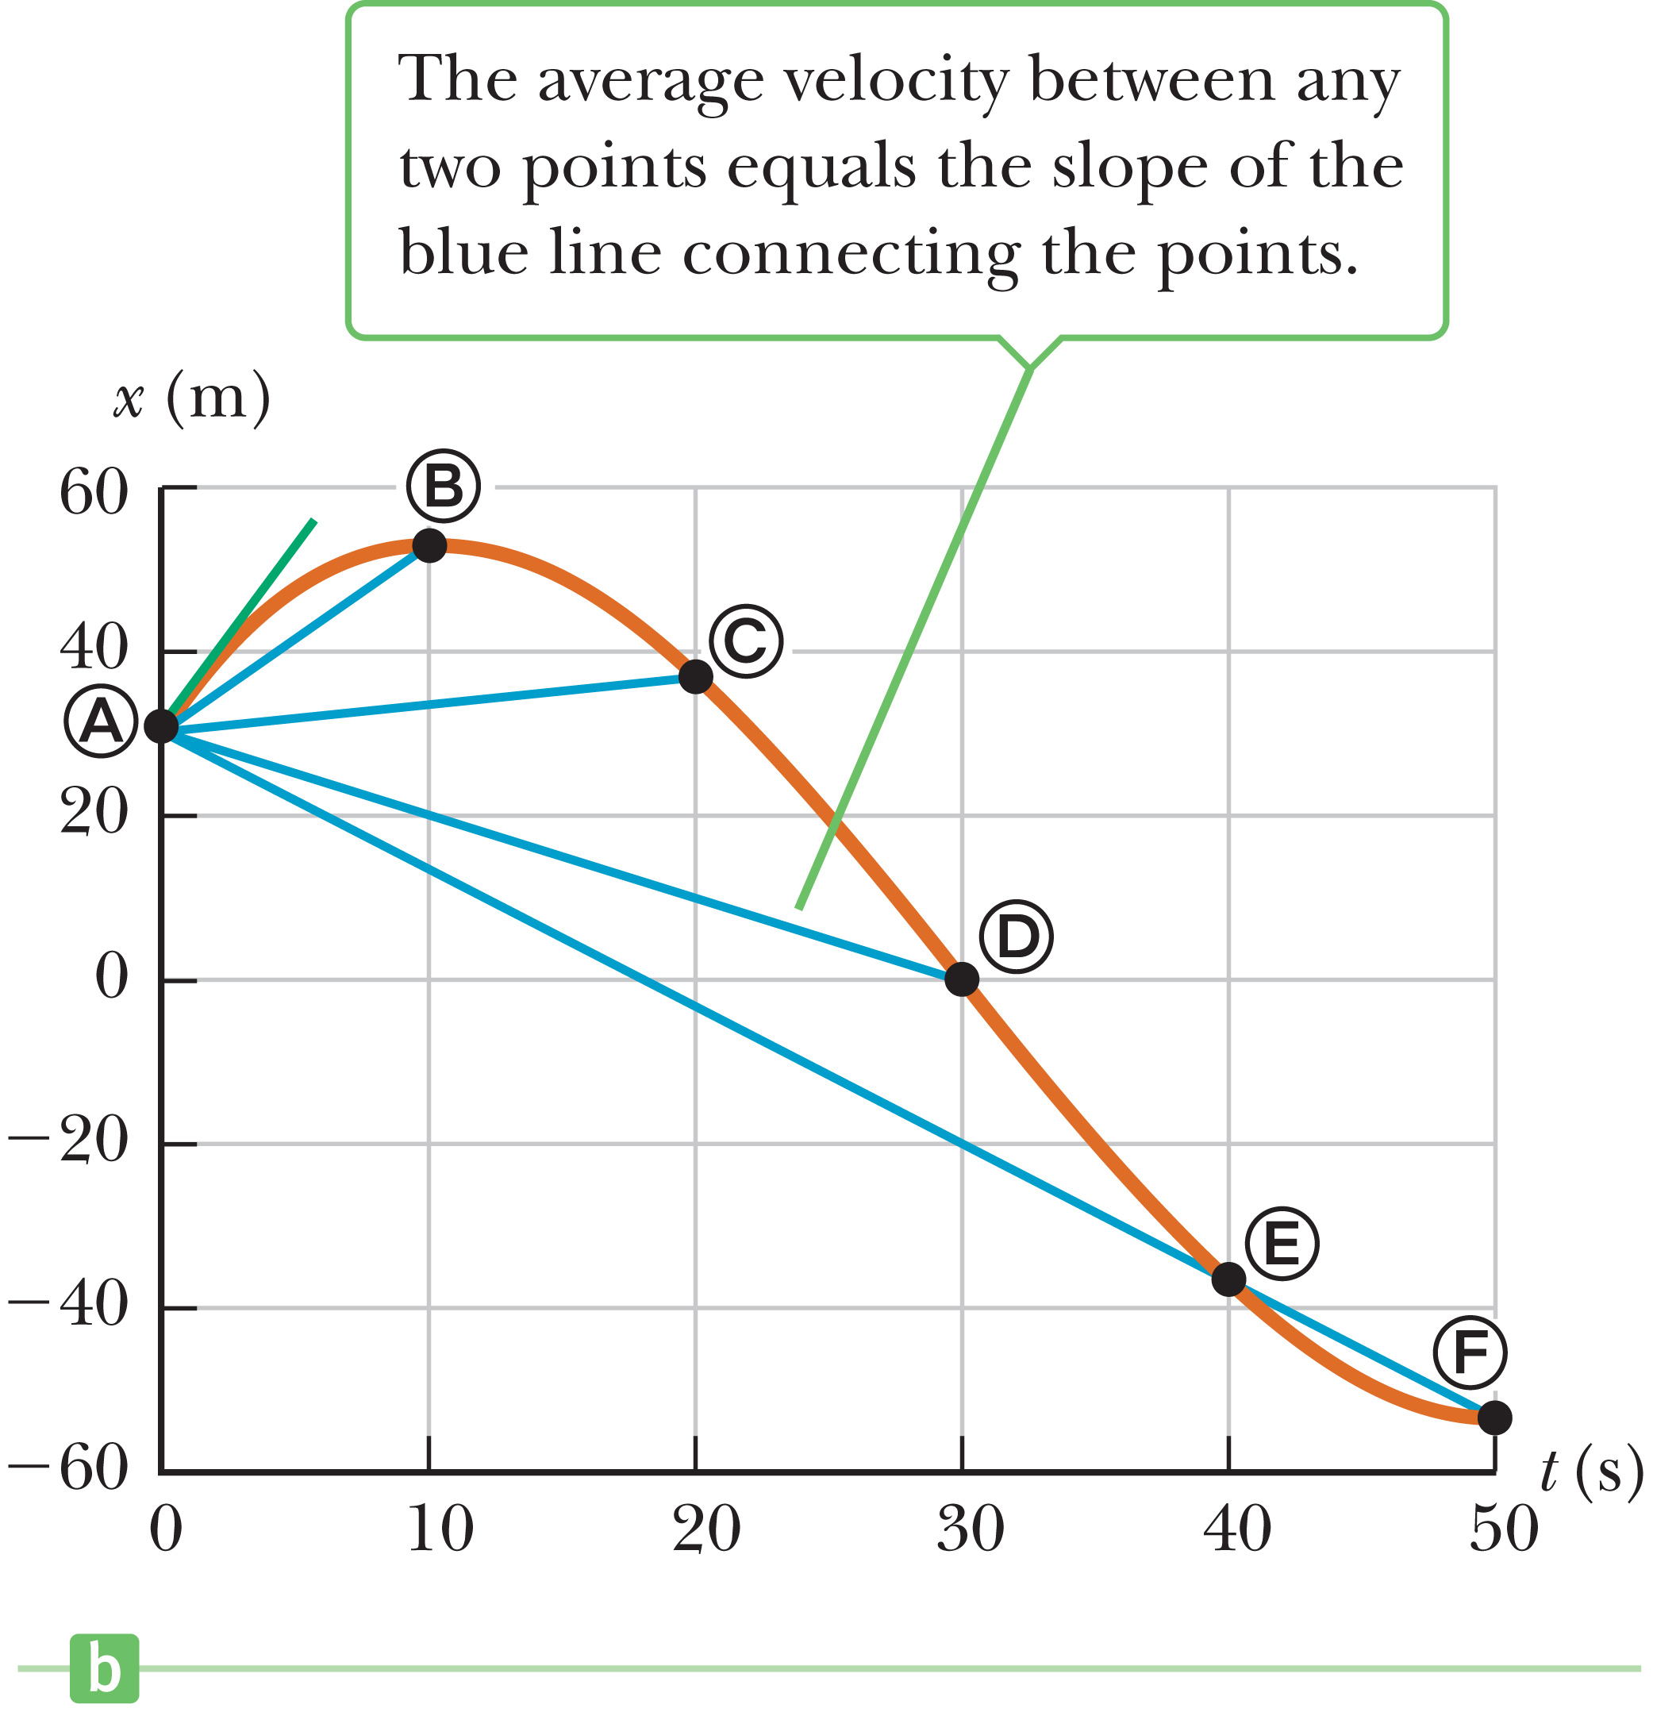
Graphical Interpretation of Velocity
Average velocity = slope of straight line joining the initial and final points on position-vs.-time graph
Notes:
Figure 2.5 (b) Position vs. time graph for the motion of a car with changing velocity, using the data in Table 2.1.
This figure shows a graph of the data in the table. Here, the position-versus-time graph is not a straight line because the velocity of the car is changing.
We can still draw a straight line between any two points, and the slope of that line is the average velocity Δx over Δt for that particular time interval.
In general, [click to show text] the average velocity of an object during the time interval Δt is equal to the slope of the straight line joining the initial and final points on a graph of the object’s position versus time.

Slide 30
Graphical Interpretation of Velocity
Notes:
From the data in the table and the graph, you can see that the car first moves in the positive x-direction as it travels from A to B, reaches a position of 52 m at time t = 10 s, then reverses direction and heads backwards. In the first 10 s of its motion, as the car travels from A to B, its average velocity is 2.2 m/s, which we found earlier. In the first 40 seconds, the car goes from A to E. let’s calculate its displacement. [click to show equation] In this case, it is –67 m. So the average velocity in this interval, which equals the slope of the blue line from A to E, can be calculated using our equation. [click to show equation] The result is –1.7 m/s.
In general, there will be a different average velocity between any distinct pair of points.

Slide 31
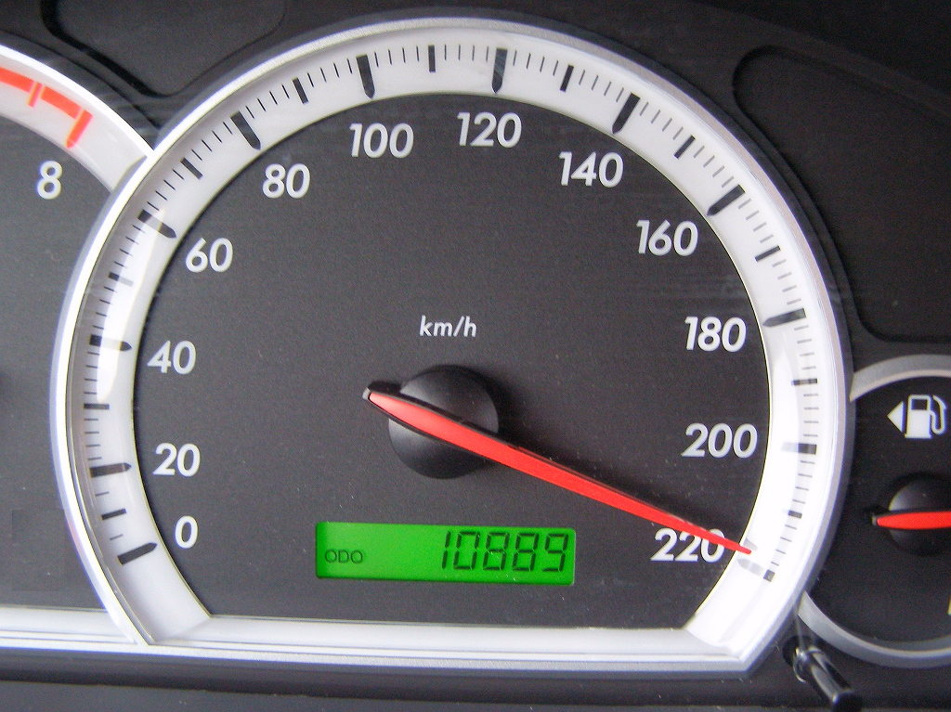
Instantaneous Velocity
Notes:
Figure Speedometer
If you are on a car trip, you might speed up or slow down because of traffic or road conditions. Average speed doesn’t give us this information. If you want to know the speed and direction you are driving at a particular instant, you want the car’s instantaneous velocity.
When you drive from one point to another, the average velocity is computed over an interval of time, but the magnitude of instantaneous velocity can be read on your car’s speedometer, as shown in the figure here.
The instantaneous velocity v [click to show equation] is the limit of the average velocity as the time interval Δt becomes infinitesimally small.
The notation here means that the ratio Δx over Δt is repeatedly evaluated for smaller and smaller time intervals. As Δt gets extremely close to zero, the ratio gets closer and closer to a fixed number, which is defined as the instantaneous velocity.
Image credit:
https://commons.wikimedia.org/wiki/File%3ASpeedometer_(kmh).JPG
By Bluescan sv.wiki (Own work) [Public domain], via Wikimedia Commons

Slide 32
Instantaneous Velocity
Notes:
The data in the table on the left show the positions of a car at specific instances in time. We can use this data to construct the table on the right.
Let’s do a sample calculation. [click to show equation] In the interval from 1 second to 3 seconds, the displacement is 5.25 m minus 5.00 m. Our average velocity is 23.8 m/s.
As the time interval gets smaller, the average velocity more closely approaches the instantaneous velocity.
[click to show equation] Using the final interval of only 0.01 s, we calculate that the average velocity is 47 m/s. Since this is a very short time interval, the actual instantaneous velocity is probably very close to this average velocity.

Slide 33
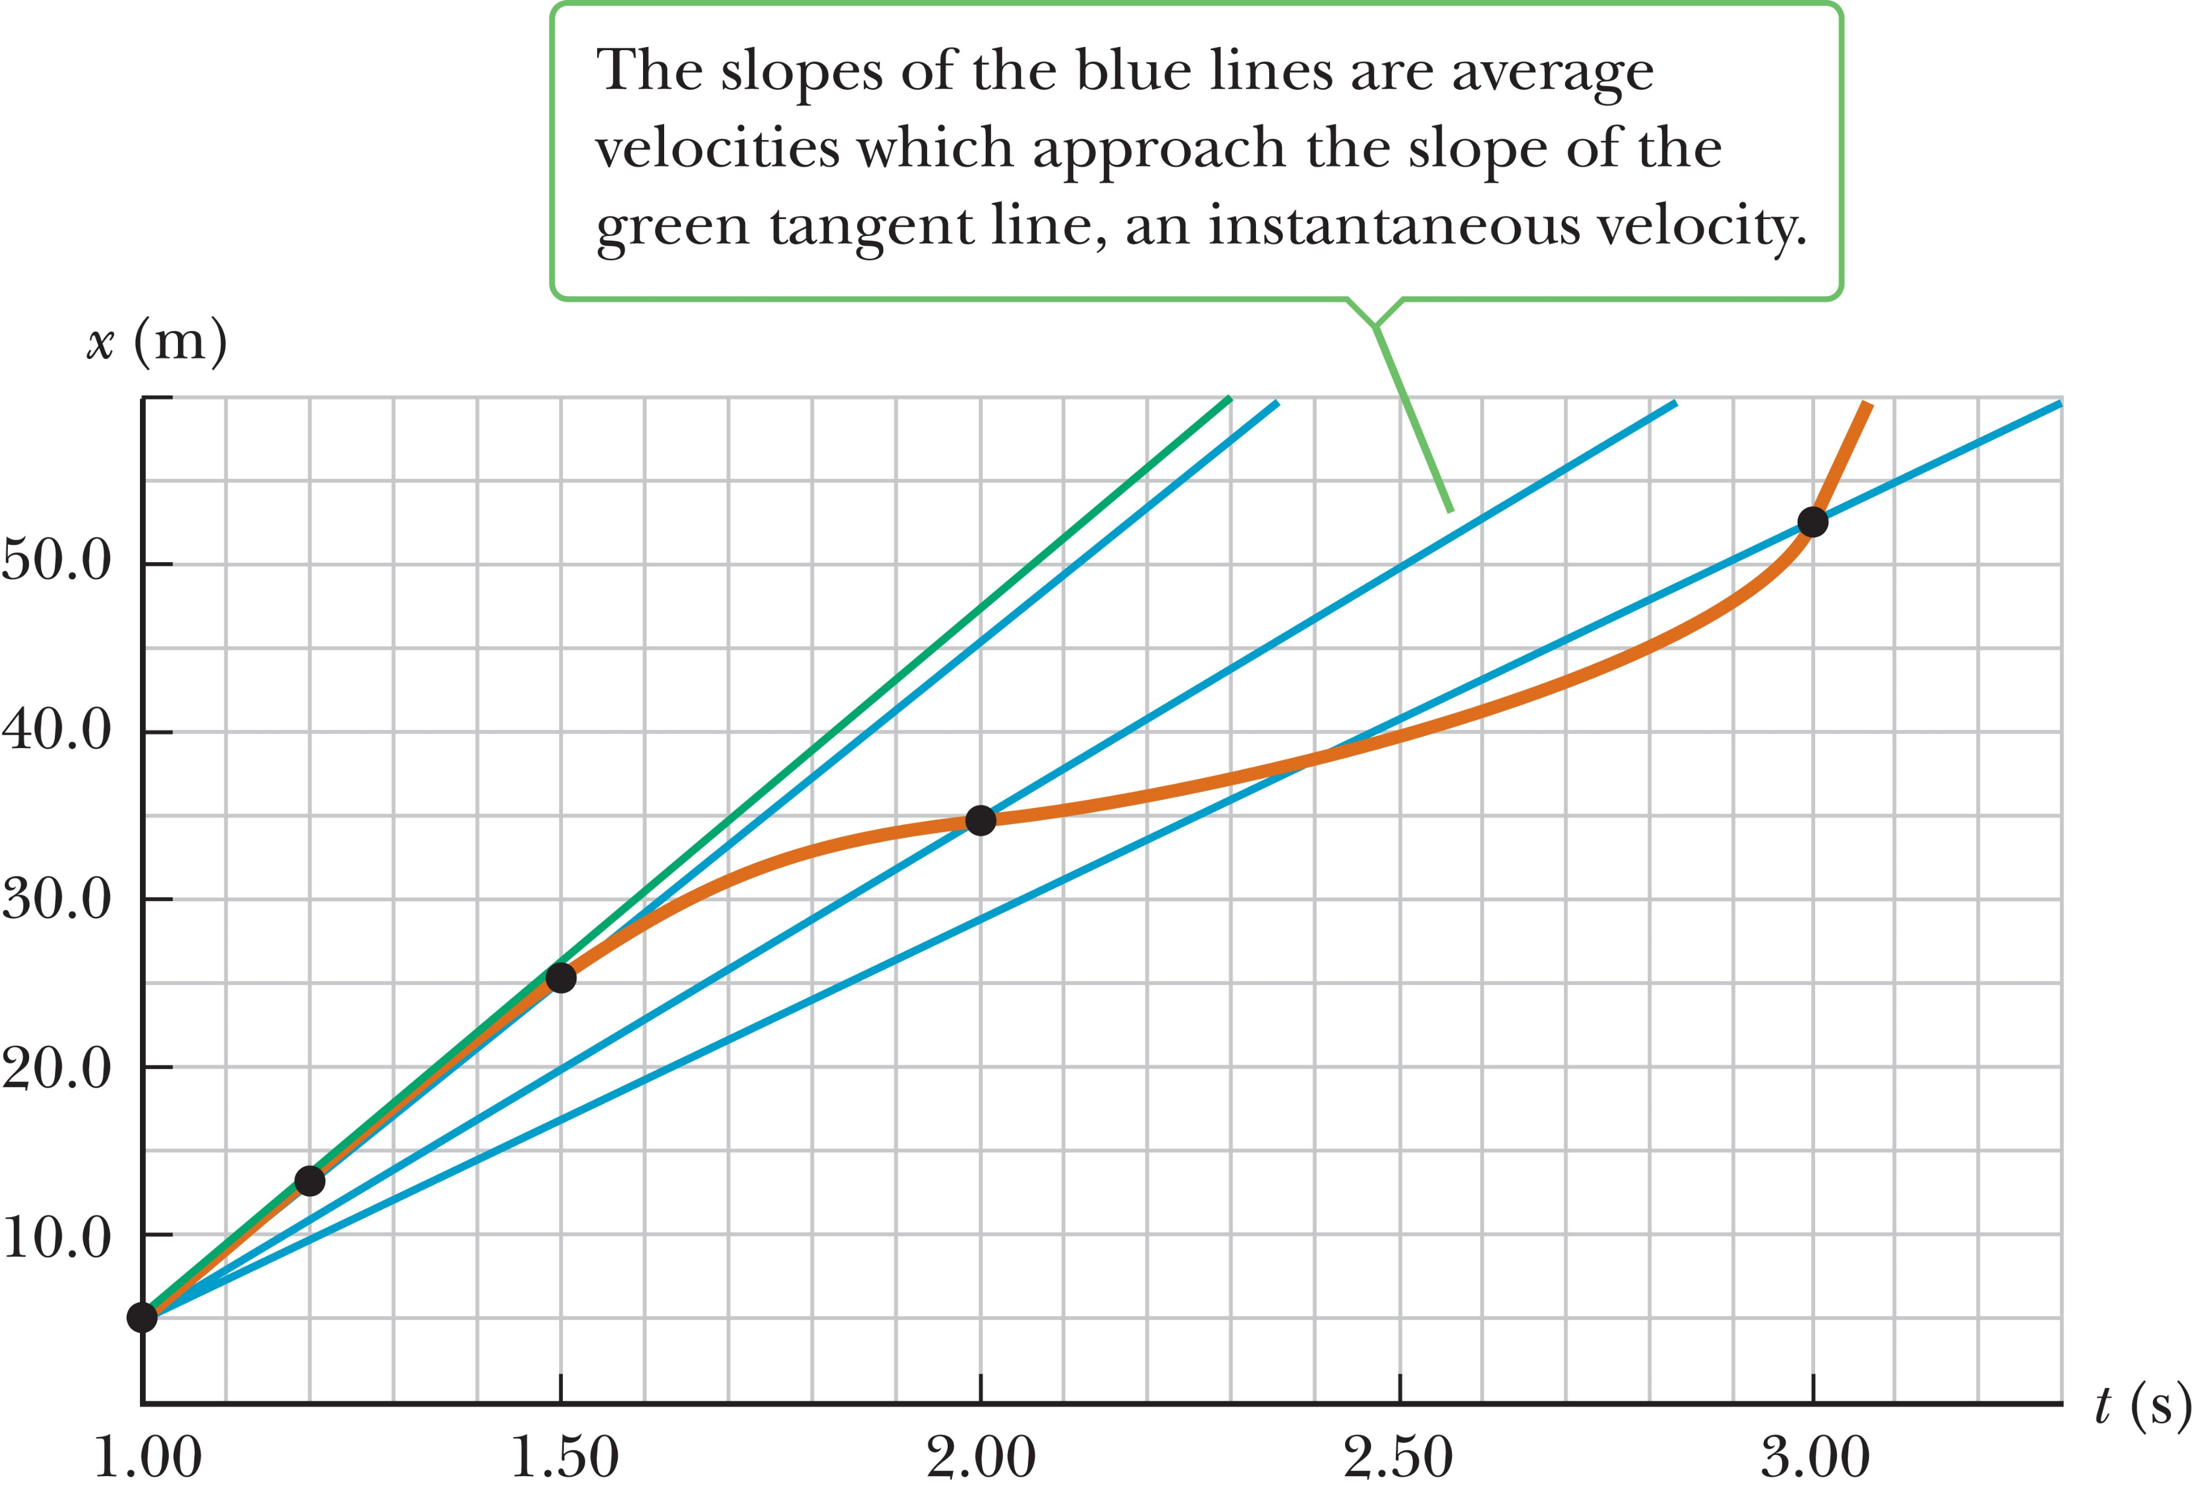
Instantaneous Velocity
The slope of the line tangent to the position-versus-time curve at “a given time” is defined to be the instantaneous velocity at that time.
Notes:
Figure 2.6 Graph representing the motion of the car from the data in Table 2.2.
In the figure, the chords formed by the blue lines gradually approach a tangent line as the time interval becomes smaller.
[click to show text] The slope of the line tangent to the position-versus-time curve at “a given time” is defined to be the instantaneous velocity at that time.
The instantaneous speed of an object, which is a scalar quantity, is defined as the magnitude of the instantaneous velocity.
Like average speed, instantaneous speed, which we will usually just call “speed”, has no direction associated with it so doesn’t have an algebraic sign.
For example, [click to show equations] if one object has an instantaneous velocity of +15 m/s along a given line and another object has an instantaneous velocity of –15 m/s along the same line, both have an instantaneous speed of 15 m/s

Slide 34
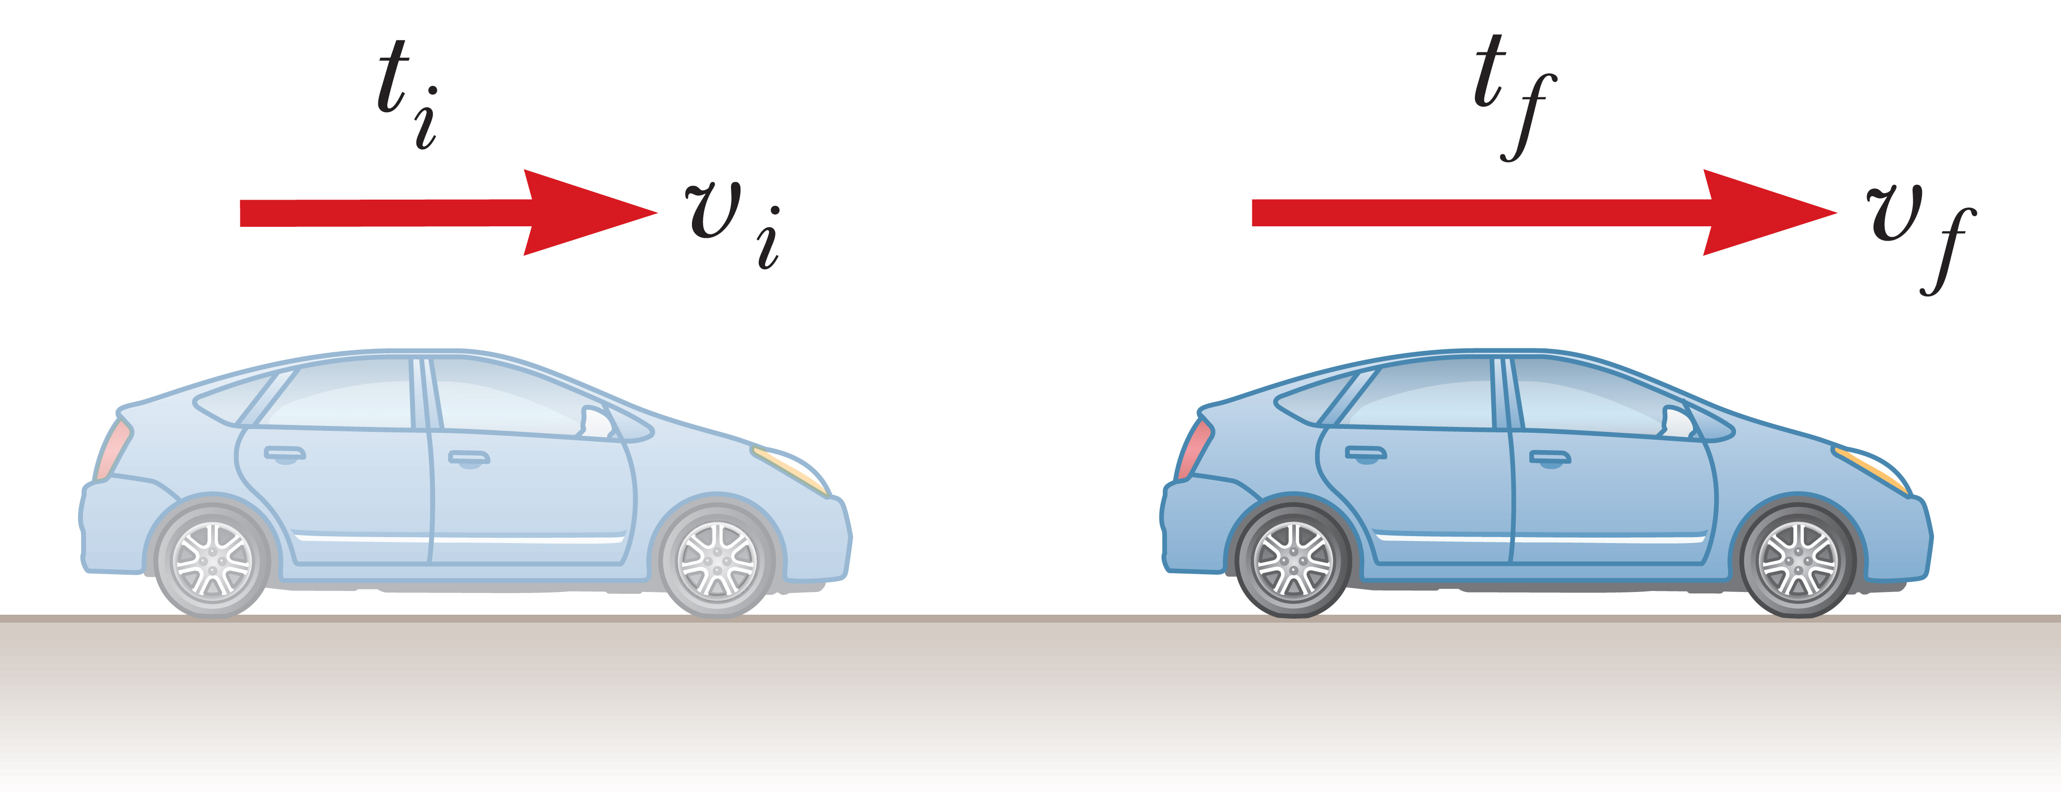
Average Acceleration
Notes:
Figure 2.8 A car moving to the right accelerates from a velocity of v_{i} to a velocity of v_{f} in the time interval Δt = t_{f} – t_{i}.
When you are driving your car, it’s rare you travel for long distances at constant velocity. The velocity of the car increases when you step harder on the gas pedal and decreases when you apply the brakes. The velocity also changes when you round a curve, altering your direction of motion. The changing of an object’s velocity with time is called acceleration.
In the figure, the car moves along a straight highway. At time t_{i} it has a velocity of v_{i} , and at time t_{f} its velocity is v_{f} .
The average acceleration [click to show equation] during the time interval Δt is the change in velocity divided by the change in time.

Slide 35
Average Acceleration
Notes:
Let’s imagine the car in the figure accelerates from an initial velocity of v_{i} = 110 m/s to a final velocity of v_{f} = 120 m/s in a time interval of 2 s, and both velocities are toward the right, selected as the positive direction.
Let’s use our definition to calculate the average acceleration for this time interval, [click to show equation] which is +5 m/s².
Acceleration is a vector quantity having dimensions of length divided by the time squared. An average acceleration of +5 m/s² means that, on average, the car increases its velocity by 5 m/s every second in the positive x-direction.

Slide 36
Average Acceleration
velocity and acceleration in same direction → speed increases with time
velocity and acceleration are in opposite directions → speed decreases with time.
Notes:
For the case of motion in a straight line, the direction of the velocity of an object and the direction of its acceleration are related.
When the object’s velocity and acceleration are in the same direction, the speed of the object increases with time. When the object’s velocity and acceleration are in opposite directions, the speed of the object decreases with time.
Suppose the velocity of a car changes from –10 m/s to –20 m/s [click to show equations] in a time interval of 2 s. The minus signs indicate that the velocities of the car are in the negative x-direction; they do not mean that the car is slowing down! Let’s calculate the average acceleration. [click to show equation]. Our result is –5 m/s. The minus sign indicates that the acceleration vector is also in the negative x-direction. Because the velocity and acceleration vectors are in the same direction, the speed of the car must increase as the car moves to the left.
Positive and negative accelerations specify directions relative to chosen axes, not “speeding up” or “slowing down.” The terms speeding up refers to an increase in speed, and slowing down refers to a decrease in speed.

Slide 37
Think – Pair – Share
True or False? A car must always have an acceleration in the same direction as its velocity.
Notes:
Justify your answer to a neighbor, and listen to their ideas. Be ready to contribute to a group discussion in a couple of minutes.
Answer: False
Reasoning: The car may be slowing down, so that the direction of its acceleration is opposite the direction of its velocity.

Slide 38
Think – Pair – Share
True or False? It’s possible for a slowing car to have a positive acceleration.
Notes:
Develop your explanation, run it by a neighbor to see if it makes sense, and then we’ll hear from you in about two minutes.
Answer: True
Reasoning: If the velocity is in the direction chosen as negative, a positive acceleration causes a decrease in speed.

Slide 39
Think – Pair – Share
True or False? An object with constant nonzero acceleration can never stop and remain at rest.
Notes:
Think about it, share your thoughts with another classmate, and in two minutes we’ll all talk it through together.
Answer: True
Reasoning: For an accelerating particle to stop at all, the velocity and acceleration must have opposite signs, so that the speed is decreasing. If this is the case, the particle will eventually come to rest. If the acceleration remains constant, however, the particle must begin to move again, opposite to the direction of its original velocity. If the particle comes to rest and then stays at rest, the acceleration has become zero at the moment the motion stops. This is the case for a braking car—the acceleration is negative and goes to zero as the car comes to rest.

Slide 41
Instantaneous Acceleration
Notes:
As you can imagine, the value of the average acceleration is often different for different time intervals, so it’s useful to define the instantaneous acceleration, which is analogous to the instantaneous velocity.
The instantaneous acceleration a is the limit of the average acceleration as the time interval Δt goes to zero. Again, the notation means that the ratio Δv over Δt is evaluated for smaller and smaller values of Δt. The closer Δt gets to zero, the closer the ratio gets to a fixed number, which is the instantaneous acceleration.

Slide 42
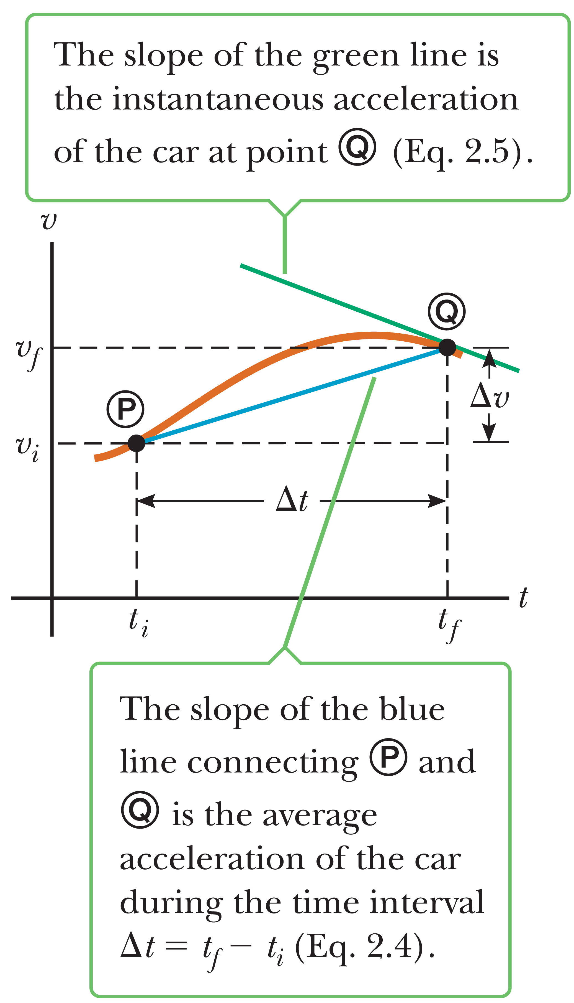
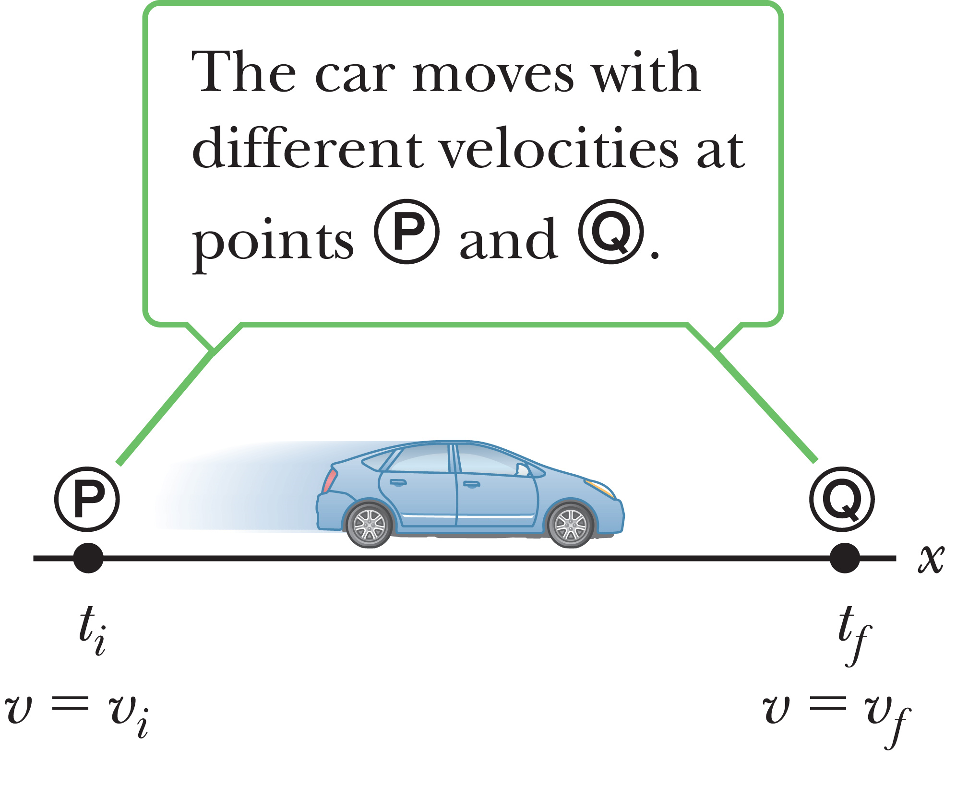
Instantaneous Acceleration
The instantaneous acceleration of an object at a given time equals the slope of the tangent to the velocity versus time graph at that time.
Notes:
Figure 2.9 (a) (left) A car, modeled as a particle, moving along the x-axis from P to Q, has velocity v_{xi} at t = t_{i} and velocity v_{xf} at t = t_{f} . (b) (right) Velocity vs. time graph for an object moving in a straight line.
The graph on the left is a velocity versus time graph, which plots the velocity of the car shown in the figure on the right against time. The graph, for example, could represent the motion of a car along a busy street.
The average acceleration of the car between times t_{i} and t_{f} can be found by determining the slope of the line joining points P and Q. If we imagine that point Q is brought closer and closer to point P, the line comes closer and closer to becoming tangent at P. [click to show text] The instantaneous acceleration of an object at a given time equals the slope of the tangent to the velocity versus time graph at that time.
From now on, we will use the term acceleration to mean “instantaneous acceleration.”
In the special case where the velocity-versus-time graph of an object’s motion is a straight line, the instantaneous acceleration of the object at any point is equal to its average acceleration. That also means the tangent line to the graph overlaps the graph itself. In that case, the object’s acceleration is said to be uniform, which means that it has a constant value.

Slide 43
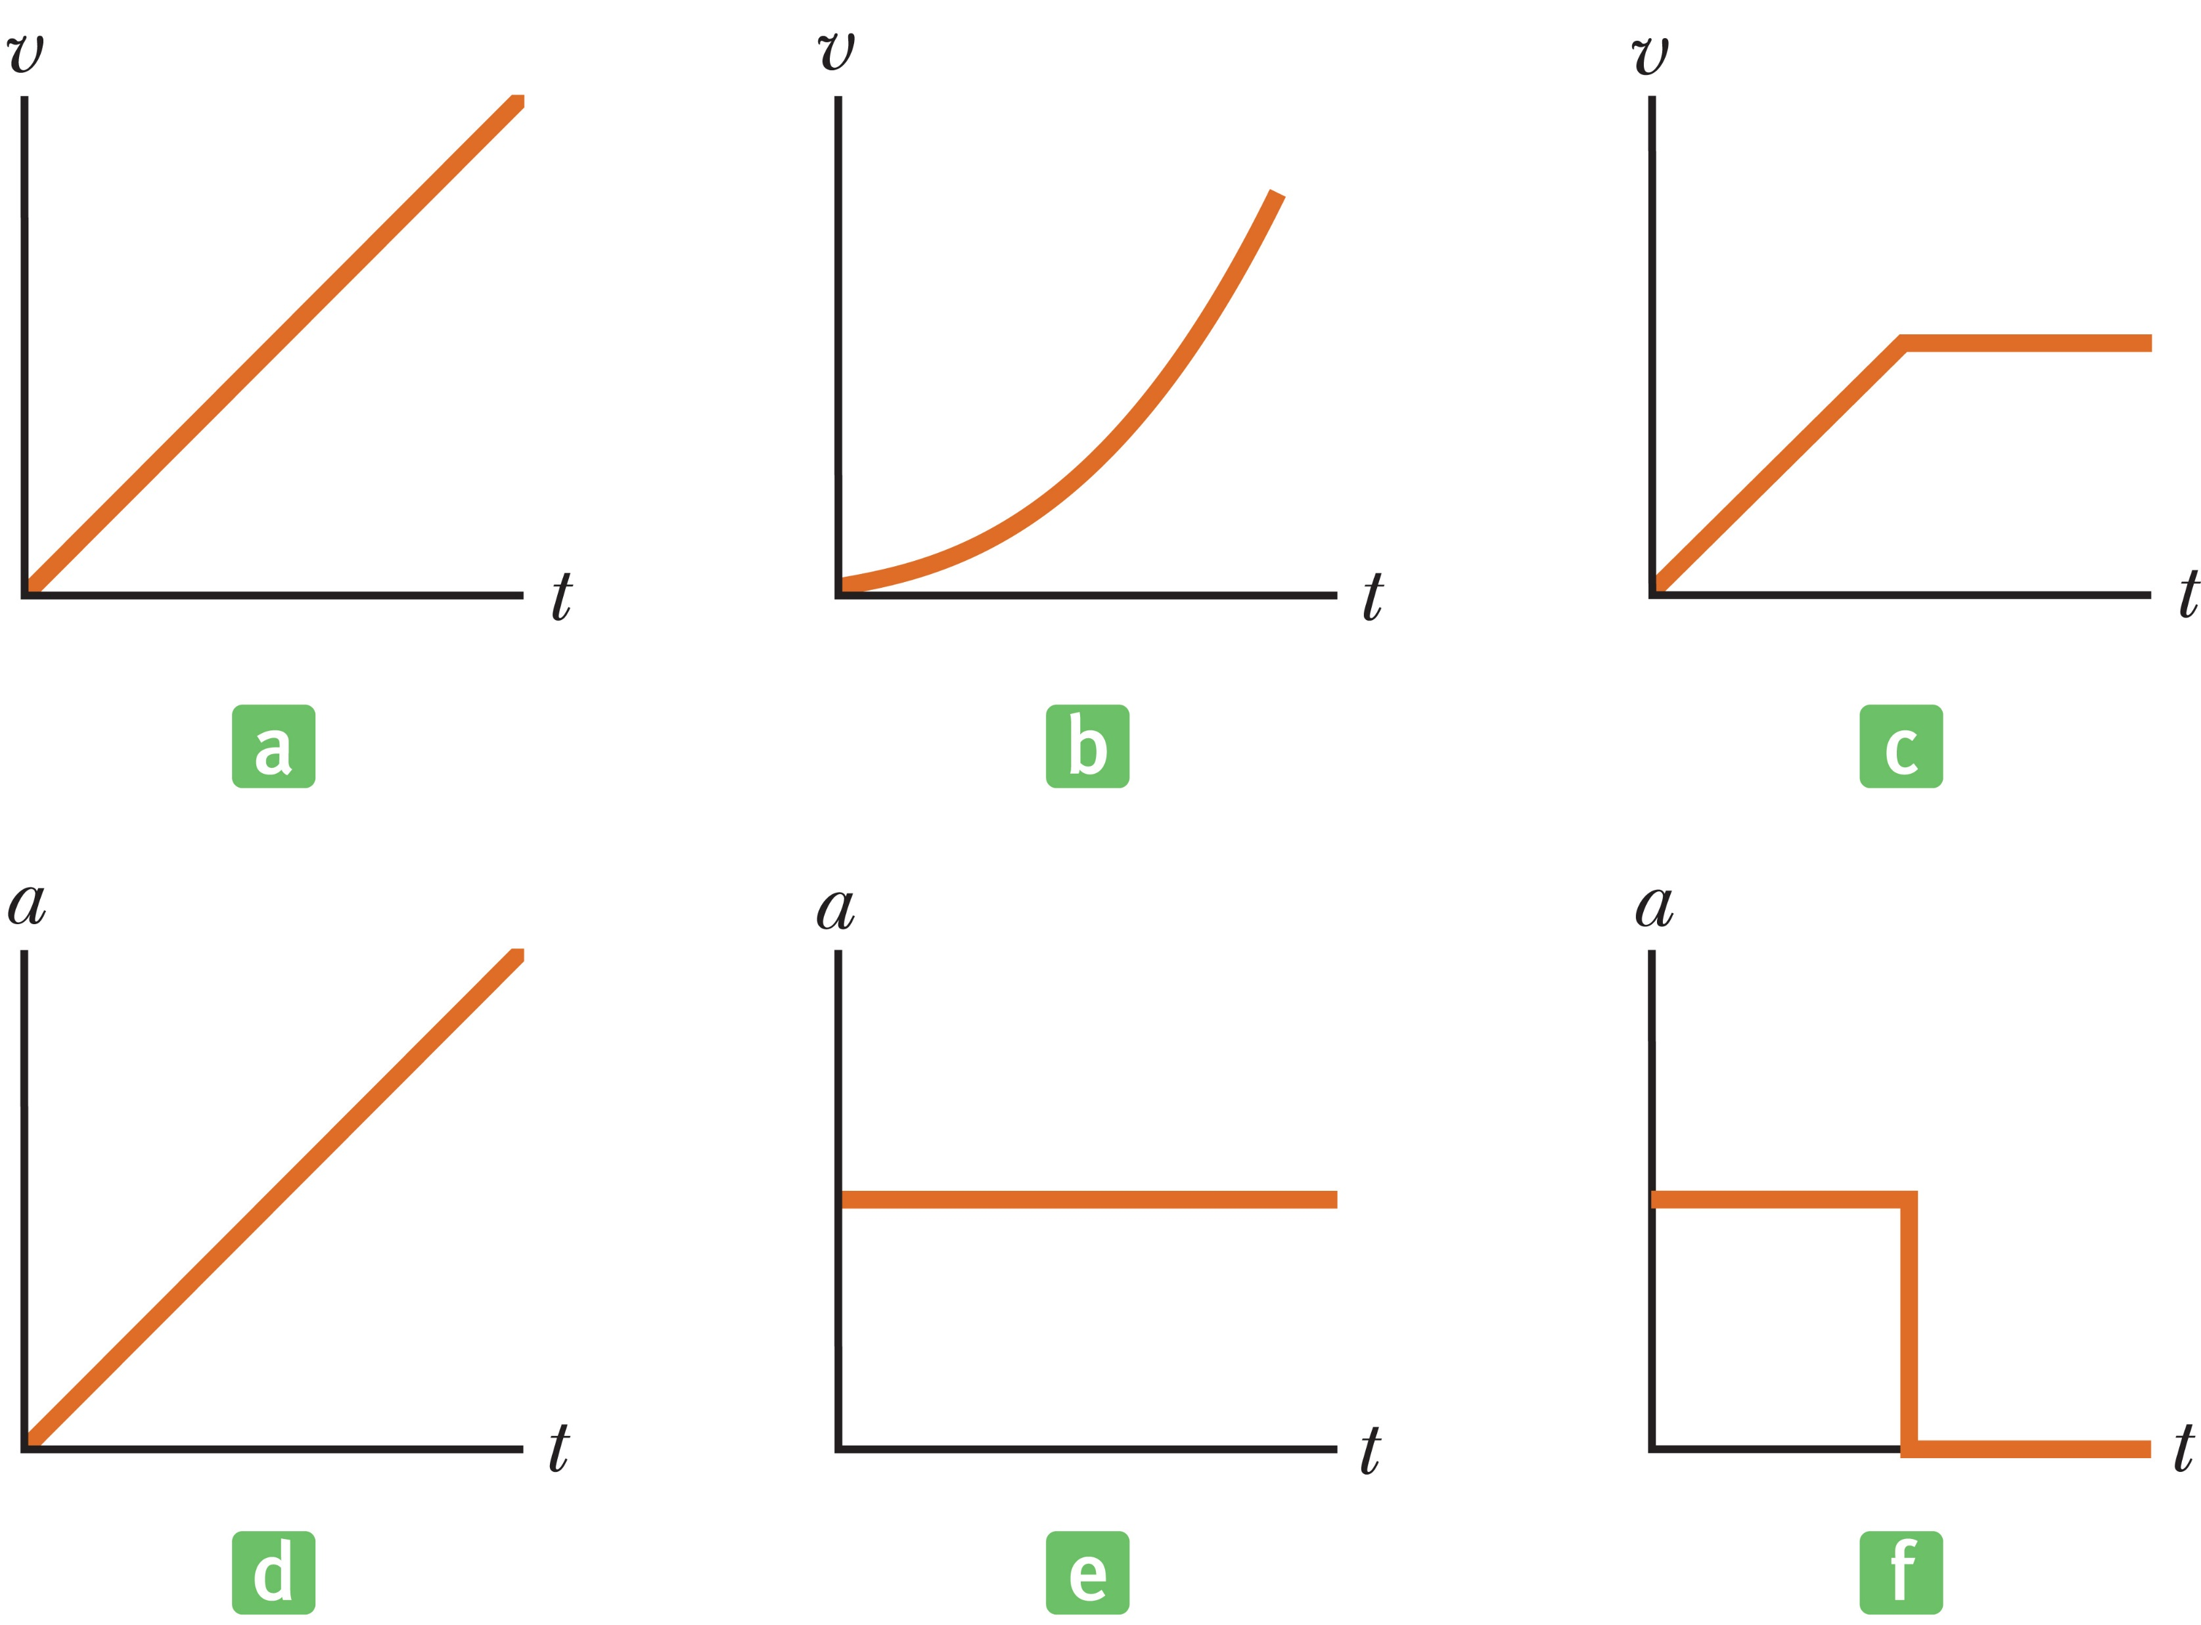
Think – Pair – Share
Parts (a), (b), and (c) of the figure below represent three graphs of the velocities of different objects moving in straight-line paths as functions of time. The possible accelerations of each object as functions of time are shown in parts (d), (e), and (f). Match each velocity vs. time graph with the acceleration vs. time graph that best describes the motion.
a and e, b and f, c and d
a and d, b and f, c and e
a and e, b and d, c and f
Notes:
Think about it, check in with a classmate, and we’ll discuss it as a group in a few minutes.
Answer: a and e, b and d, c and f
Reasoning: The velocity-vs.-time graph (a) has a constant slope, indicating a constant acceleration, which is represented by the acceleration-vs.-time graph (e).
Graph (b) represents an object whose speed always increases, and does so at an ever increasing rate. Thus, the acceleration must be increasing, and the acceleration-vs.-time graph that best indicates this behavior is (d).
Graph (c) depicts an object which first has a velocity that increases at a constant rate, which means that the object’s acceleration is constant. The motion then changes to one at constant speed, indicating that the acceleration of the object becomes zero. Thus, the best match to this situation is graph (f).

Slide 44
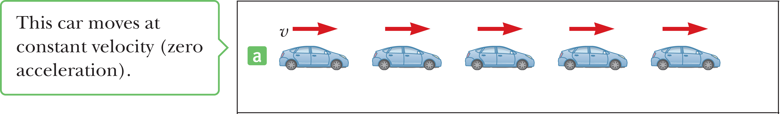
Motion Diagrams
Notes:
Figure 2.12 (a) Motion diagram of a car moving along a straight roadway in a single direction. The velocity at each instant is indicated by a red arrow.
Sometimes people confuse velocity and acceleration, but they’re very different concepts. Let’s take a look at this motion diagram, which is a representation of a moving object at successive time intervals, with velocity and acceleration vectors sketched at each position, red for velocity vectors and violet for acceleration vectors. We can assume that the time intervals between adjacent positions in the motion diagram are equal.
You can think of a motion diagram as the images resulting from a stroboscopic photograph of a moving object. Each image is made as the strobe light flashes. This figure represents three sets of strobe photographs of cars moving along a straight roadway from left to right. The time intervals between flashes of the stroboscope are equal in each diagram.
In the figure, the images of the car are equally spaced. That means the car moves the same distance in each time interval, so the car moves with constant positive velocity and has zero acceleration. The red arrows are all the same length, representing constant velocity, and there are no violet arrows, which means zero acceleration.

Slide 45
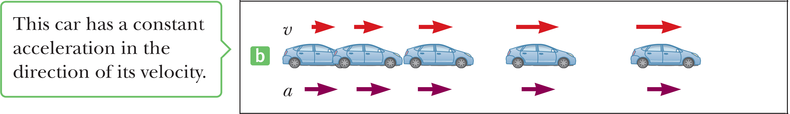
Motion Diagrams
Notes:
Figure 2.12 (b) The constant acceleration is indicated by a purple arrow.
In this figure, the images of the car become farther apart as time progresses and the velocity vector increases with time, because the car’s displacement between adjacent positions increases as time progresses. The car is moving with a positive velocity and a constant positive acceleration. The red arrows are successively longer in each image, and the violet arrows point to the right.

Slide 46
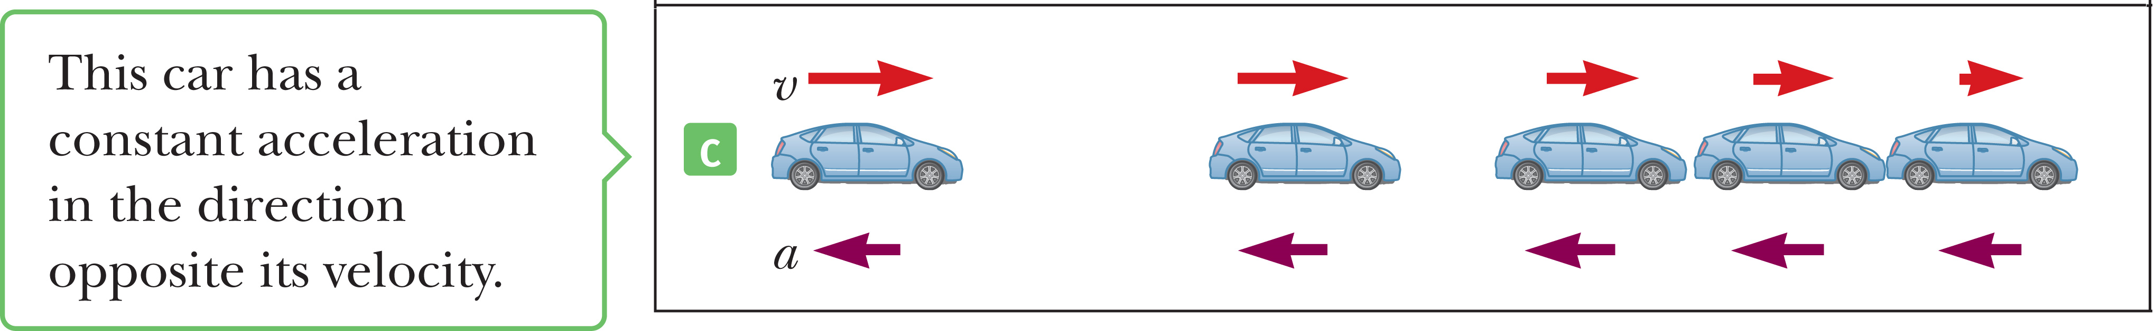
Motion Diagrams
Notes:
Figure 2.12 (c)
In this figure, the car slows as it moves to the right because its displacement between adjacent positions decreases with time. In this case, the car moves initially to the right with a constant negative acceleration. The velocity vector decreases in time, as you can see by the red arrows getting shorter, and eventually reaches zero, as would happen when the brakes are applied. Notice that the acceleration and velocity vectors are not in the same direction. The car is moving with a positive velocity, but with a negative acceleration.

Slide 47
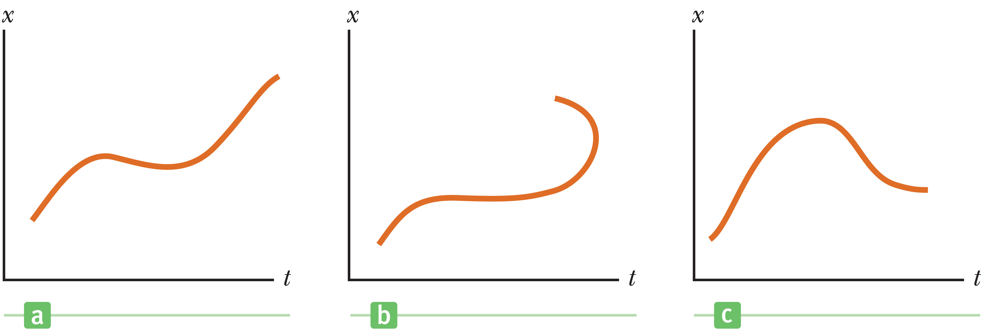
Think – Pair – Share
The three graphs in the figures below represent the position vs. time for objects moving along the x-axis. Which, if any, of these graphs is not physically possible?
Graph a is impossible.
Graph b is impossible.
Graph c is impossible.
All three are possible.
Notes:
Develop your explanation, run it by a neighbor to see if it makes sense, and then we’ll hear from you in about two minutes.
Answer: Graph b is impossible.
Reasoning: According to graph b, there are some instants in time when the object is simultaneously at two different x-coordinates. This is physically impossible.

Slide 48

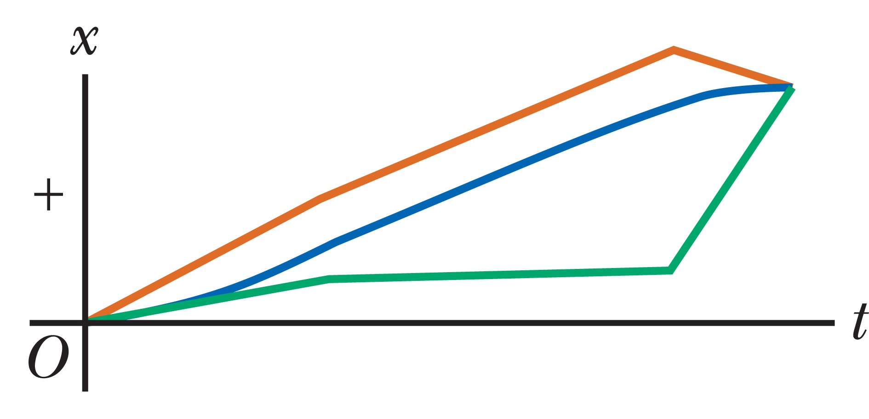
Think – Pair – Share
This figure is a diagram of a multiflash image of an air puck moving to the right on a horizontal surface. The images sketched are separated by equal time intervals, and the first and last images show the puck at rest. In the graph, which color graph best shows the puck’s position as a function of time?
red
green
blue
Notes:
In the next couple of minutes, think about your choice, and talk it over with a neighbor. We’ll all talk in around two minutes.
Answer: blue
Reasoning: The blue graph best shows the puck’s position as a function of time. As seen in the multiflash diagram, the distance the puck has traveled grows at an increasing rate for approximately three time intervals, grows at a steady rate for about four time intervals, and then grows at a diminishing rate for the last two intervals.

Slide 49
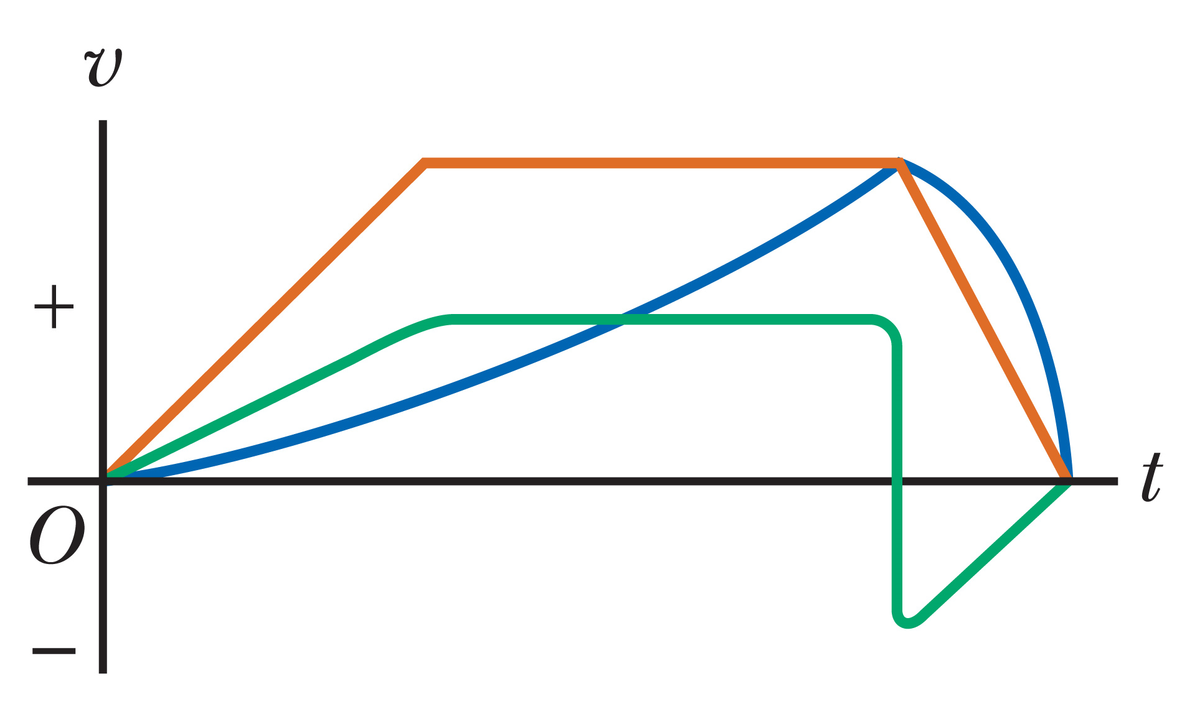
Think – Pair – Share
In the figure, which color graph best shows the puck’s velocity as a function of time?
red
green
blue
Notes:
In the next few minutes, think about your choice, and talk it over with a neighbor, then we’ll compare answers.
Answer: red
Reasoning: The red graph best illustrates the speed (distance traveled per time interval) of the puck as a function of time. It shows the puck gaining speed for approximately three time intervals, moving at constant speed for about four time intervals, then slowing to rest during the last two intervals.

Slide 50
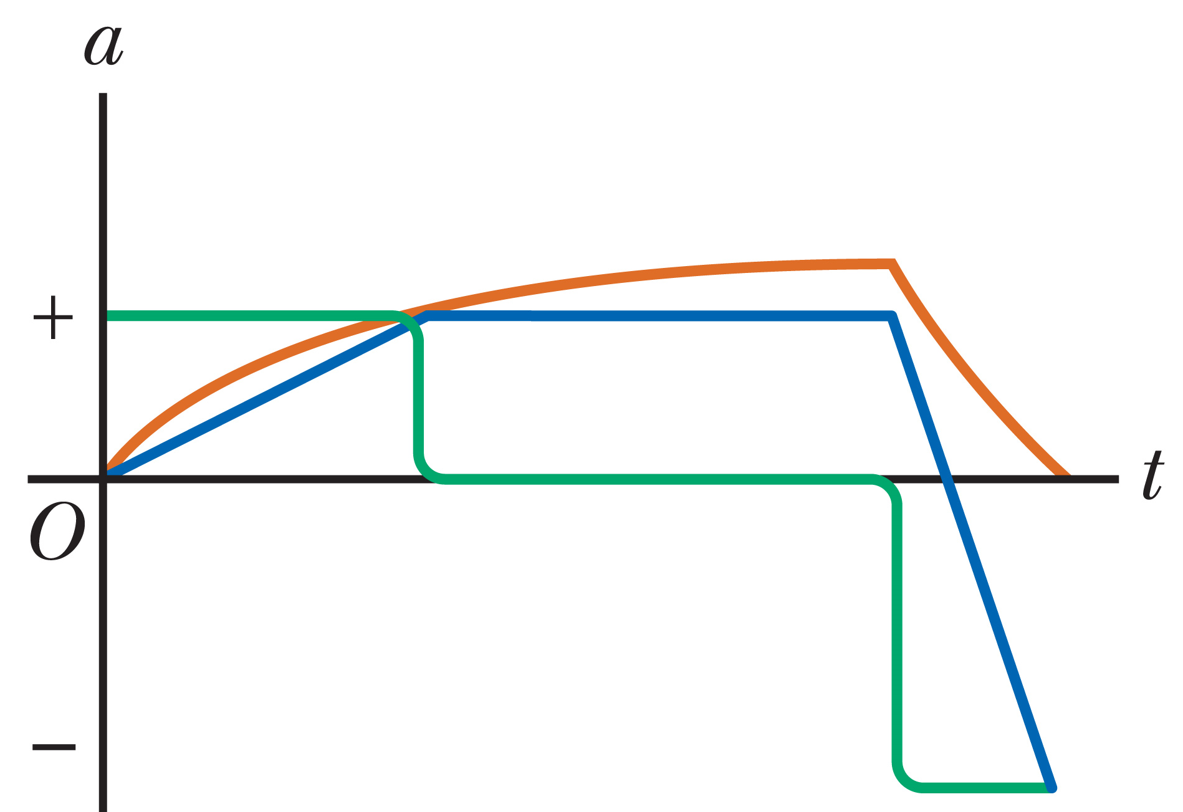
Think – Pair – Share
In the figure, which color graph best shows the puck’s acceleration as a function of time?
red
green
blue
Notes:
Think about it, get your own answer, and check to see if your neighbor has a similar answer. We’ll talk about it in a minute.
Answer: green
Reasoning: The green graph best shows the puck’s acceleration as a function of time. The puck gains velocity (positive acceleration) for approximately three time intervals, moves at constant velocity (zero acceleration) for about four time intervals, and then loses velocity (negative acceleration) for roughly the last two time intervals.

Slide 51
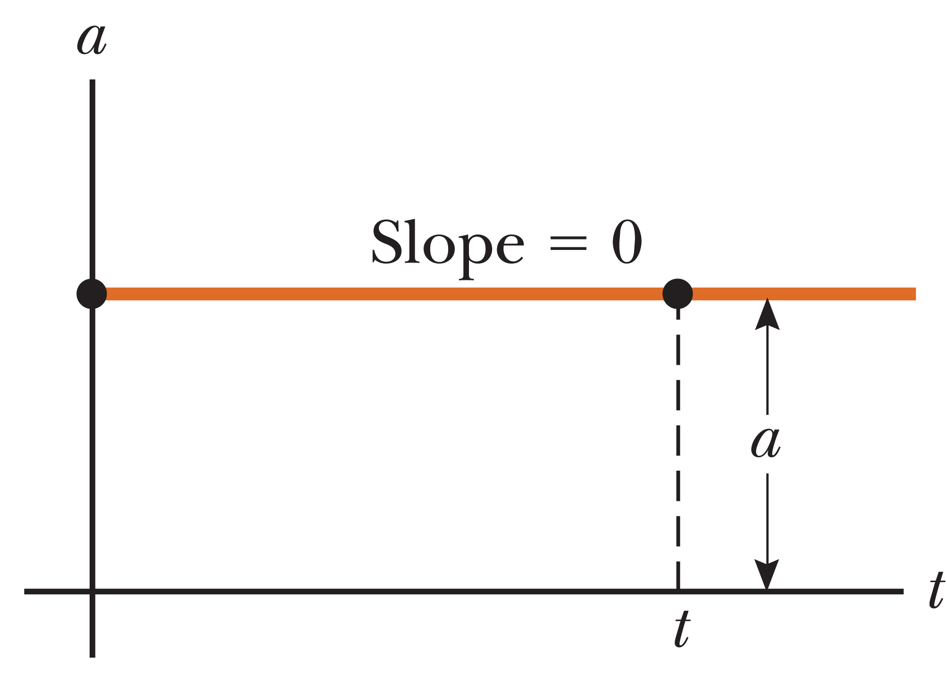
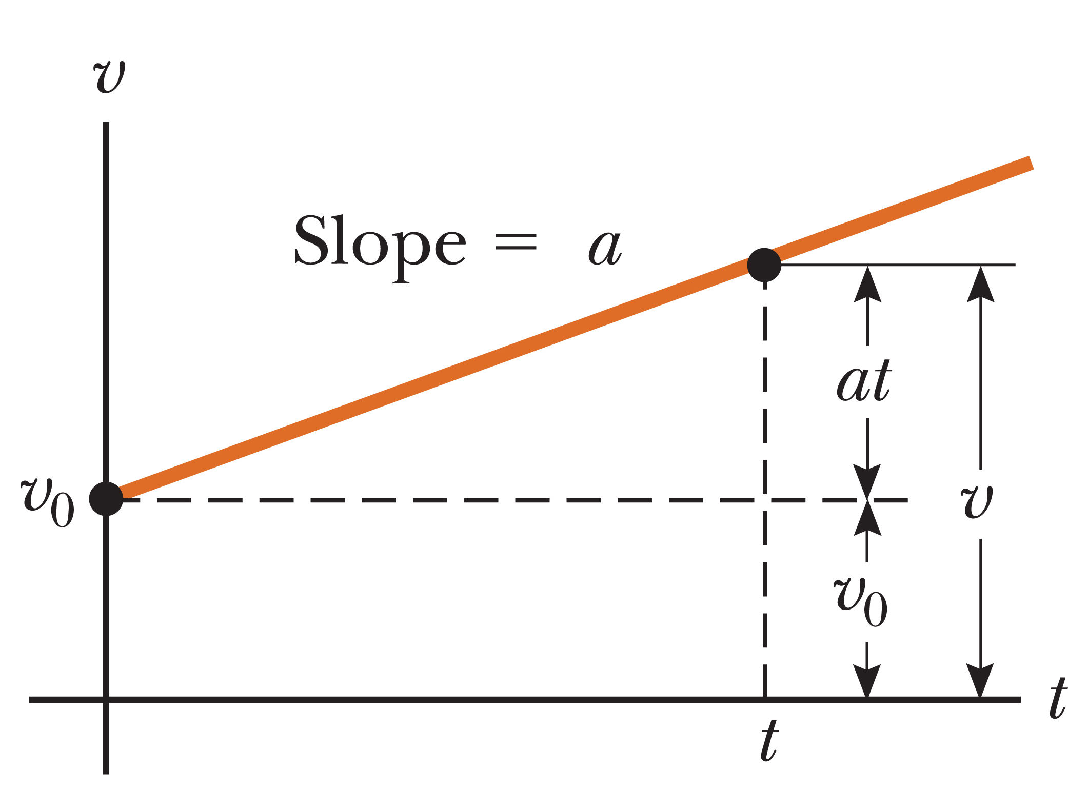
One-Dimensional Motion with Constant Acceleration
For constant acceleration, the instantaneous acceleration at any point in a time interval is equal to the value of the average acceleration over the entire time interval.
Notes:
Figure 2.15 A particle moving along the x-axis with constant acceleration a. (a) (top) the acceleration vs. time graph, (b) (bottom) the velocity vs. time graph.
In our study of mechanics, we will often be dealing with the situation of constant acceleration. This type of motion is very important, because it applies to many situations, including an object in free fall near Earth’s surface, when air resistance can be neglected.
The top figure shows motion with constant acceleration.
[click to show text] When an object moves with constant acceleration, the instantaneous acceleration at any point in a time interval is equal to the value of the average acceleration over the entire time interval.
That means the velocity increases or decreases at the same rate throughout the motion, and a plot of v versus t, shown in the bottom figure, gives a straight line with either positive, zero, or negative slope.
Since the average acceleration equals the instantaneous acceleration when a is constant, we can eliminate the bar used to denote average values from our defining equation for acceleration, so we have the equation shown. [click to show equation]
Let’s choose t_{i} to be zero, and t_{f} to be some arbitrary time t. Let v_{i} be v₀, which represents the initial velocity at t = 0, and v_{f} to be v, the velocity at any arbitrary time t. [click to show equation]
Rearranging, we get our first kinematic equation. [click to show equation] This equation states that the acceleration steadily changes the initial velocity by an amount at.

Slide 52
One-Dimensional Motion with Constant Acceleration
Notes:
Let’s look at an example. Let's say a car starts with a velocity of +2.0 m/s to the right and accelerates to the right with a = +6.0 m/s².
[click to show equation] Putting in the numbers and calculating, we find the car will have a velocity of +14 m/s after 2.0 s have elapsed.
The graphical interpretation of v is shown in the figure from before. The velocity varies linearly with time according to our equation, as it should for constant acceleration.

Slide 53
One-Dimensional Motion with Constant Acceleration
Notes:
Since the velocity is increasing or decreasing uniformly with time, we can express the average velocity in any time interval as the arithmetic average of the initial velocity v₀ and the final velocity v. Keep in mind that this expression is valid only when the acceleration is constant, in which case the velocity increases uniformly.
[click for next line] Let’s combine this result with our definition of average velocity, and set t_{i} = 0 and t_{f} = t, and x_{f} – x_{i} equal to Δx.
[click for next line] Our result is an expression for Δx, which can be rearranged to give us the equation shown.

Slide 54
One-Dimensional Motion with Constant Acceleration
Notes:
We can make a substitution in our result for Δx, using our equation for v. [click to show equation] We get our second kinematic equation.

Slide 55
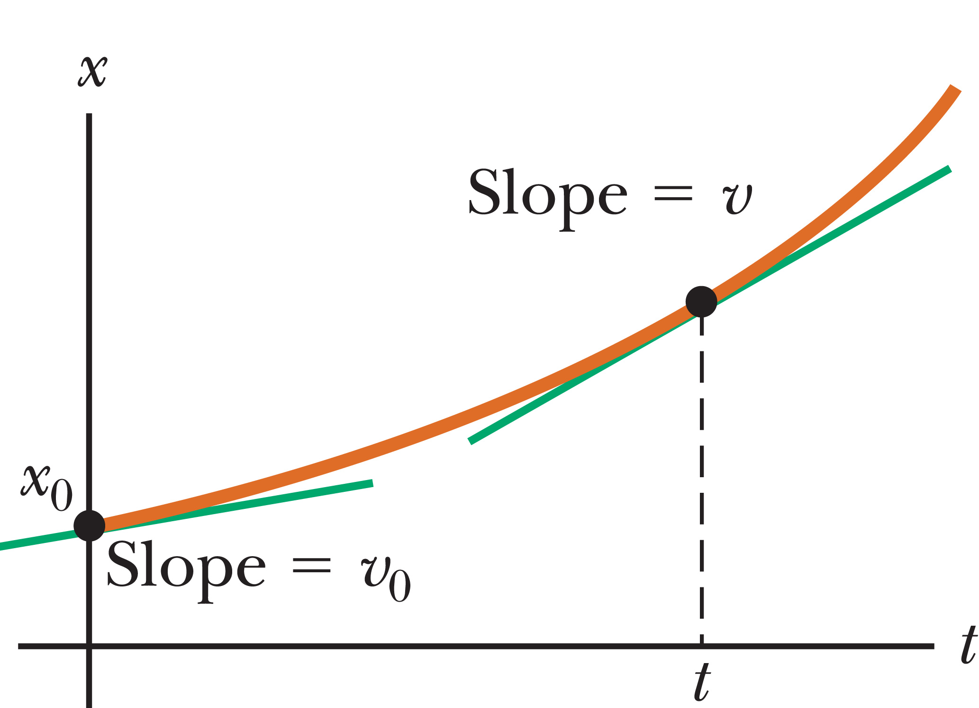
One-Dimensional Motion with Constant Acceleration
The area under the graph of v versus t for any object is equal to the displacement Δx of the object.
Notes:
Figure 2.15 (c) (left) The position vs. time graph.
Figure (right) The velocity vs. time graph.
The figure on the left shows a plot of x versus t for our equation, which is related to the graph of velocity versus time, shown on the right. The area under the curve in the right-hand figure is equal to the displacement Δx. [click to show areas] This is a very important result. In fact, [click to show text] the area under the graph of v versus t for any object is equal to the displacement Δx of the object.

Slide 56
One-Dimensional Motion with Constant Acceleration
Notes:
Finally, we can obtain an expression that doesn’t contain time, by solving our velocity equation for t, then substituting into the displacement equation, [click to show equation] and simplifying. [click to show equation] We get our third kinematic equation.

Slide 57
One-Dimensional Motion with Constant Acceleration
Notes:
The table shows our three equations. Remember, these are for constant acceleration only.

Slide 58

One-Dimensional Motion with Constant Acceleration: Problem-Solving Strategy
  Read the problem
2. Draw a diagram
3. Label all quantities
4. Choose your equations:
5. Solve
6. Check
Notes:
Here is our problem-solving strategy for motion in one dimension at constant acceleration:
Read the problem.
Draw a diagram, choosing a coordinate system, labeling initial and final points, and indicating directions of velocities and accelerations with arrows.
Label all quantities, circling the unknowns. Convert units as needed.
Choose your equations from the table. All kinematics problems in this topic can be solved with the first two equations, and the third is often more convenient.
Solve for the unknowns. Doing so often involves solving two equations for two unknowns.
Check your answer, using common sense and estimates. Most of these problems reduce to writing the kinematic equations from the table and then substituting the correct values into the constants a, v₀, and x₀ from the given information. Doing this produces two equations—one linear and one quadratic— for two unknown quantities

Slide 59
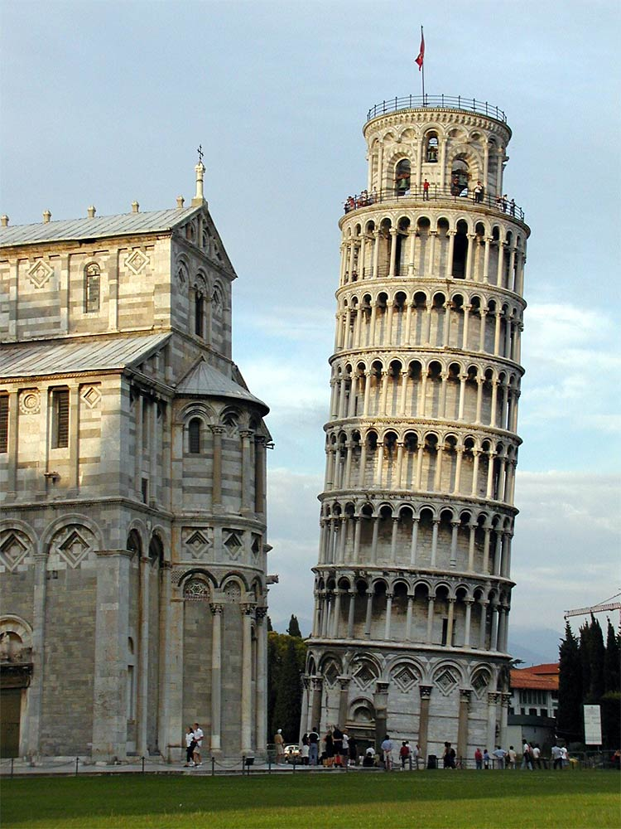
Freely Falling Objects
Notes:
Figure Leaning Tower of Pisa
When air resistance is negligible, all objects dropped under the influence of gravity near Earth’s surface fall toward Earth with the same constant acceleration.
Before around 1600, it was generally thought that heavier objects fell faster than lighter ones. This is due to the teachings of the great philosopher Aristotle, who lived from 384 to 322 BCE. Galileo Galilei wasn’t satisfied with this, and tested Aristotle’s assumptions. Legend has it that he dropped two unequal weights simultaneously from the Leaning Tower of Pisa, shown here in the photo, and found that they hit the ground at approximately the same time.
We do know that Galileo rolled balls down inclined planes and measured the distances they covered in successive time intervals. He used an incline so that the acceleration was reduced, that enabled Galileo to make accurate measurements of the intervals. Some people refer to this experiment as “diluting gravity.” From these experiments, Galileo drew conclusions about freely falling objects, because a falling ball is equivalent to a ball going down a vertical incline.
Galileo’s achievements in the science of mechanics paved the way for Newton in his development of the laws of motion, which we will study in Topic 4.
Image credit:
https://commons.wikimedia.org/wiki/File%3ALeaning_Tower_of_Pisa.jpg
By Softeis (Own work) [GFDL (http://www.gnu.org/copyleft/fdl.html) or CC-BY-SA-3.0 (http://creativecommons.org/licenses/by-sa/3.0/)], via Wikimedia Commons [Public Domain]

Slide 60
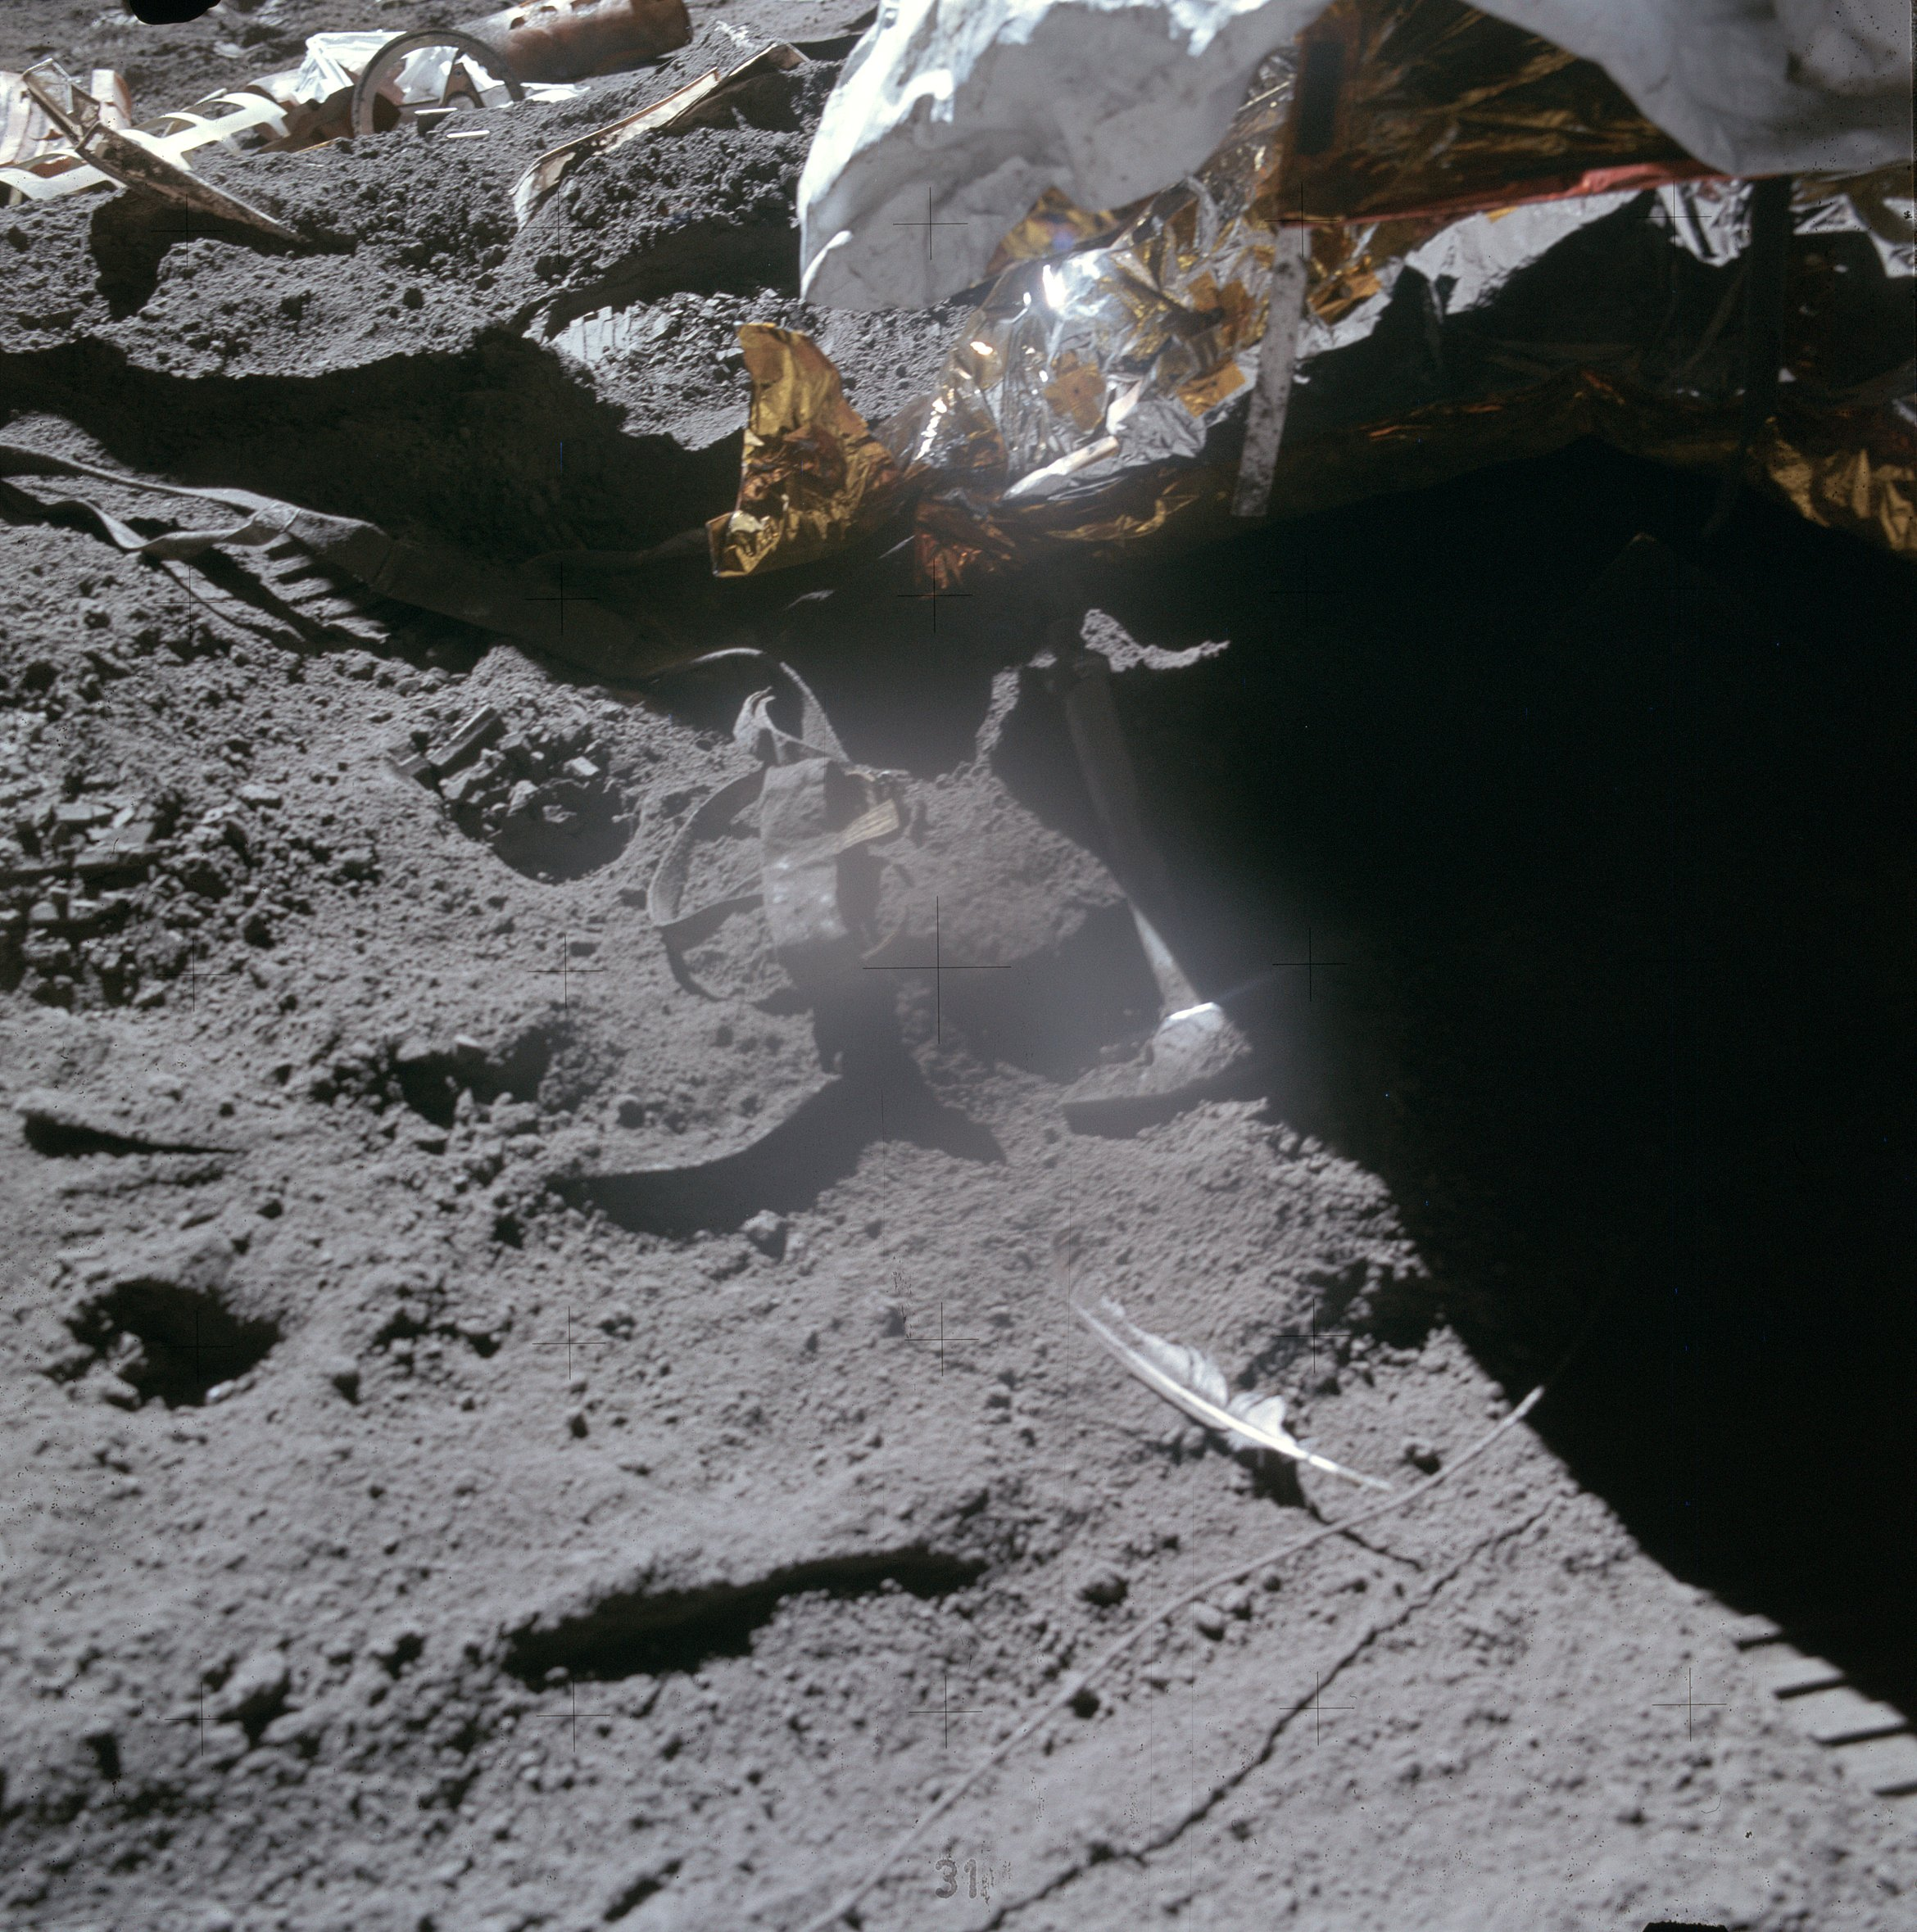
Freely Falling Objects
A freely falling object is any object moving freely under the influence of gravity alone.
Notes:
Figure Dropping feather and hammer at same instant on the Moon
Imagine dropping a hammer and a feather from the same height. The hammer will hit the ground first, right? Well, this experiment was tested on the Moon by astronaut Davit Scott on August 2, 1971, and the hammer and feather fell with exactly the same acceleration, and hit the surface at the same time. There is no atmosphere on the Moon, and so there is no air drag, like we have here on Earth. Often, though, we will find that air resistance is negligible. The ideal case, where we can ignore air resistance, is called free fall.
[click to show text] A freely falling object is any object moving freely under the influence of gravity alone, regardless of its initial motion. Objects thrown upward or downward and those released from rest are all considered freely falling.
We represent the magnitude of the free-fall acceleration by the symbol g. The value of g decreases with increasing altitude, and varies slightly with latitude as well. At Earth’s surface, the value of g is approximately 9.8 m/s². [click to show equation] If we neglect air resistance and assume that the free-fall acceleration doesn’t vary with altitude over short vertical distances, then the motion of a freely falling object is the same as motion in one dimension under constant acceleration. This means that we can use our kinematics equations. [click to show equations] It’s conventional to define “up” as the + y-direction and to use y as the position variable. That means a equals –g, so our equations are as shown.
Image credit:
https://commons.wikimedia.org/wiki/File%3AApollo_15_F%26H.jpg
By NASA [Public domain], via Wikimedia Commons

Slide 61
Think – Pair – Share
A tennis player on serve tosses a ball straight up. While the ball is in free fall, its acceleration
increases.
decreases.
increases and then decreases.
decreases and then increases.
remains constant.
Notes:
Think about it for yourself, then check with a classmate, and we’ll check your answer in about 1 minute.
Answer: remains constant
Reasoning: The acceleration of the ball remains constant while it is in the air. The magnitude of its acceleration is the free-fall acceleration, g = 9.80 m/s².

Slide 62
Think – Pair – Share
As the tennis ball travels through the air, its speed
increases.
decreases.
increases and then decreases.
decreases and then increases.
remains the same.
Notes:
Run your explanation by a classmate or two, and listen to theirs. In a couple of minutes, let’s hear your answers.
Answer: increases and then decreases
Reasoning: As it travels upward, its speed decreases by 9.80 m/s during each second of its motion. When it reaches the peak of its motion, its speed becomes zero. As the ball moves downward, its speed increases by 9.80 m/s each second.

Slide 63
Think – Pair – Share
A skydiver jumps out of a hovering helicopter. A few seconds later, another skydiver jumps out, so they both fall along the same vertical line relative to the helicopter. Both skydivers fall with the same acceleration. (Assume g is constant.) The vertical distance between them
increases.
decreases.
stays the same.
Notes:
Come up with an answer, consult with a neighbor or two, and then we’ll get together to talk about it in a few minutes.
Answer: increases
Reasoning: The first jumper will always be moving with a higher velocity than the second. Thus, in a given time interval, the first jumper covers more distance than the second, and the separation distance between them increases.

Slide 64
Think – Pair – Share
For the two skydivers, The difference in their velocities
increases.
decreases.
stays the same.
Notes:
Consult with each other, come up an answer, and we’ll hear your ideas in 2 minutes.
Answer: stays the same
Reasoning: At any given instant of time, the velocities of the jumpers are definitely different, because one had a head start. In a time interval after this instant, however, each jumper increases his or her velocity by the same amount, because they have the same acceleration. Thus, the difference in velocities stays the same.

Slide 65

Assessing to Learn
Michael is going to the store 6 miles away. He rides his bike at 12 mph for the first half of the trip, then walks at 4 mph for the remainder.
Michael's average speed for the trip to the store is closest to:
1. 2 mph 2. 4 mph 3. 6 mph
4. 8 mph 5. 10 mph 6. 12 mph
7. 14 mph
8. exactly halfway between two of the values above
9. impossible to determine
Notes:
Decide on an answer, and check with your neighbor. We’ll go over it together in about 5 minutes.
Answer: Possible: (3), (4), (9)
Question A2.01
Commentary
Purpose: To introduce or hone the concept of average speed.
Discussion:
The average speed is the total distance traveled divided by the total time needed to travel that distance. In this case, we know the total distance is 6 miles, but we do not know the total time.
If you assume that "first half of the trip" means after 3 miles, then it takes Michael 1/4 hour to go the first 3 miles (at 12 mph) and 3/4 hour to go the second 3 miles (at 4 mph), for a total of 1 hour and an average speed of 6 mph.
If you assume that "first half of the trip" means that he spent the same amount of time at each speed, then the average speed is the average of 12 mph and 4 mph, or 8 mph. Let's get this another way: let t be the time needed to complete each half of the trip (in hours). The total distance is therefore (12t + 4t), which must be equal to 6 miles, or 16t = 6. But the average speed is simply the total distance divided by the total time, or 6/(2t) = 3/t = 8 (mph).
Since the meaning of "the first half of the trip" is ambiguous here — does it refer to distance or time? — answers (3), (4), and (9) are all defensible.
Key Points:
The average speed for a journey is equal to the total distance traveled divided by the total time required.
Sometimes everyday language like "the first half of the trip" is not precise enough for physics use.
For Instructors Only
Most students will simply average 12 mph and 4 mph to get 8 mph, so even though there is a valid assumption that will lead to this answer, most students will not have thought much about it. You will need to find out why students picked each choice.
Note that the "average speed" is properly interpreted as a "time-weighted" average, though most students will not appreciate what this means. On a graph of speed vs. time, the average is the area below the graph (total distance) divided by the length of the base (total time).
Some students might have learned a technique for correctly computing average speed without having any clue why it works. They break the trip into well chosen equal time intervals, then average the (constant) speeds during the intervals. In the case of equal distances, if we break the trip into four 15-minute intervals, the speeds are 12, 4, 4, and 4 mph, for an average of (12+4+4+4)/4 = 6 (mph).
Source: UMass Assessing to Learn

Slide 66
Assessing to Learn
Wendy walks 10 m in one direction at 2 m/s, then runs 6 m in the same direction at 6 m/s. Next, she stops for 4 seconds, and finally walks in the opposite direction at 4 m/s for 6 seconds.
Wendy's average speed is closest to:
1. ½ m/s 2. 1 m/s 3. 1½ m/s
4. 2 m/s 5. 2½ m/s 6. 3 m/s
3½ m/s 8. 4 m/s
9. the negative of one of the choices above
10. impossible to determine
Notes:
Think about it yourself for a few minutes or so, then check in with a neighbor and talk it over. We’ll see what you come up with in about five minutes.
Answer: 3 m/s
Question A2.02
Commentary
Purpose: To hone the concept of "average speed".
Discussion:
The "average speed" of someone is the total distance traveled divided by the total time needed to travel that distance. In this case, Wendy walks 10 m, then runs 6 m, stops briefly, and finally walks 24 m, for a total distance traveled of 40 m. Direction does not matter. It takes Wendy a total of 16 seconds to travel that distance, for an average speed of 2.5 m/s.
Note that you cannot ignore the 4 seconds during which Wendy is not moving. That is still part of her motion.
Key Points:
The average speed of an object is the total distance it travels (the total length of the path along which it moves, regardless of direction) divided by the total time of travel.
Average speed is never negative.
Average speed is not the magnitude of "average velocity".
For Instructors Only
Answer (1) is the magnitude of the average velocity.
Answer (2) is the average of the four velocities mentioned (2, 6, 0, and –4).
Answer (3) is closest to the average of the three non-zero velocities (2, 6, and –4).
Answer (6) is the average of the four individual speeds (2, 6, 0, and 4).
Answer (7) is closest to the average speed if the four seconds spent at rest are ignored. (Some people ignore "rest stops" on long car trips when computing average speed.)
Answer (8) is the average of the three non-zero speeds (2, 6, and 4).
Answer (9) would fit the average velocity, –½ m/s.
Answer (10), "impossible to determine", might be chosen because directions are not given (which is irrelevant), or because the travel segments are described inconsistently (which makes the question more difficult but not impossible).
Of course, students may make choices based on algebra mistakes as well.
Some alternate approaches to answering the question:
Sketch speed vs. time, or otherwise break the process into 16 1-second intervals. Average these 16 speeds to get 2½ m/s.
Break the 16 seconds into two 8-second intervals. Wendy travels 16 m for an average speed of 2 m/s during the first and 24 m for an average speed of 3 m/s during the second. The average of these is 2½ m/s.
Break the process into any number of equal time intervals and determine the average speed during each. Since average speed is a "time average", you can average these averages.
A sketch of speed vs. time (or even velocity vs. time, suitably analyzed) should help students organize information and compute the correct value.
Some students may question whether someone can go immediately from one speed or velocity to another. The quick answer is that we are ignoring these short periods of acceleration. A longer answer is that the given speeds are averages for the distances or times given. So, for example, during the second leg of the process, Wendy would actually reach a speed larger than 6 m/s during the 6 m she runs. The bottom line is that she completes the distance in 1 second.
Additional Discussion Questions
1. What is Wendy's average velocity?
Sketch Wendy's velocity vs. time.
Source: UMass Assessing to Learning

Slide 67

Assessing to Learn
A ball is thrown straight up into the air. Its position at 7 instants of time are shown in the figure; the maximum height is reached at position 4. At which of the labeled points is the speed of the ball smallest?
1. point 1 2. point 2 3. point 3
4. point 4 5. point 5 6. point 6
7. point 7
8. exactly 2 of the points shown
9. more than 2 of the points shown
10. impossible to determine
Notes:
Take a stab at it yourself, then compare your thoughts with a neighbor, and see what you can come up with together, and after about three minutes we’ll talk about it as a class.
Answer: Point 4
Question A2.03a
Commentary
Purpose: To probe your understanding of the difference between speed and velocity, and establish the idea that the velocity (and speed) of a vertically launched projectile at the top of its trajectory is zero for one instantaneous point in time.
Discussion:
An object's velocity is the rate of change of rate of change of its position, and describes both how fast the object is moving ("speed") and in which direction (positive or negative sign for one dimension, vector direction for two or three). Speed is the magnitude of velocity (absolute value in one dimension), and is never negative.
As the ball moves upward, it slows down under the influence of gravity; that means the velocity (which is positive) gets smaller and smaller. When it reaches zero, the ball is at rest for one instant in time, and immediately starts moving downward with a negative velocity. As the ball falls faster and faster downward, the velocity gets more negative (larger speed in the negative direction). Thus, the speed is positive everywhere except for point (4) at the very top, where it is zero instantaneously.
If the question had asked where the velocity is least, the correct answer would be (7): the most negative number is the least.
Key Points:
Velocity is the rate at which position is changing, and has a magnitude and a direction.
Speed is the magnitude of the velocity, and is never negative.
An object launched vertically upward has a positive velocity while moving upward (assuming we define our coordinate system so up is the positive direction), negative velocity while falling back down, and zero velocity for just an instant as the velocity changes from positive to negative.
For Instructors Only
This question exists largely to set up the next two questions in this three-question set.
Use this question to ascertain whether your students understand the difference between velocity vs. speed, and that both are momentarily zero at the top of the trajectory. Then move on to the next to questions, which are likely to be much more contentious and productive.
One issue that may need discussion is what "smaller/larger" and "less/greater" mean in the context of a number line with positive and negative numbers. Students may not be aware that "smaller" means "closer to zero" or "smaller in magnitude", while "less" means "closer to the negative end of the number line".
Source: UMass Assessing to Learning

Slide 68
Assessing to Learn
A ball is thrown straight up into the air. Its position at 7 instants of time are shown in the figure; the maximum height is reached at position 4. At which of the labeled points is the acceleration of the ball smallest?
1. point 1 2. point 2 3. point 3
4. point 4 5. point 5 6. point 6
7. point 7
8. exactly 2 of the points shown
9. more than 2 of the points shown
10. impossible to determine
Notes:
Compare your answers with a classmate’s, and we’ll all compare notes in about two minutes.
Answer: Possible: (7) or (9)
Question A2.03b
Commentary
Purpose: To explore your understanding of the concept of acceleration, probe for the common misconception that an object's acceleration is zero whenever its velocity is momentarily zero, and develop your understanding of "free fall".
Discussion:
While traveling up and back down, the only significant force affecting the ball is gravity. We call this situation "free fall" (even for the upward part of the motion). The gravitational force is a constant, depending only on the mass of the ball and not on the ball's position or motion. According to Newton's second law (F_{net} = ma), the acceleration of a body is proportional to the net force acting upon it. Since the force on a body in free-fall is constant, so is the acceleration. Thus, answer (9) is best.
(You'll be learning more about Newton's second law soon; for now, all you need is the basic ideas that acceleration is proportional to total force, the only force acting is gravity, and gravity is constant.)
You might be tempted to think that the acceleration is zero at the very top of the trajectory, just like the velocity. However, if the acceleration were zero, that would mean the velocity is not changing; so if the velocity were zero, it would remain zero, and the ball would just hover there. For a ball resting on a table, the acceleration and velocity are both zero, which is why the ball doesn't move.
You might argue that the acceleration is not constant, but is larger at point 1 than point 7. This may be correct, if your argument is based on aerodynamic drag (air resistance): on the way up, drag opposes the motion and thus exerts a downward force that augments gravity; on the way down, drag opposes the motion and thus exerts an upward force that opposes gravity. Furthermore, that force is stronger when the ball is moving faster, at the start and end of the trajectory. So, answer (7) is defensible.
If you don't make the approximation of "local gravity" but instead take into account the fact that the gravitational force on the ball gets weaker as the ball gets farther away from the Earth, then you could argue that the acceleration is smallest at point (4), the top of the trajectory. However, this effect is incredibly small, far smaller than air resistance. If you're going to be this exacting, the effect of air resistance will dominate, and (7) is a better answer than (4).
Key Points:
An object in "free fall" (i.e., traveling under the influence of gravity alone) has a constant downward acceleration.
If an object has zero velocity and zero acceleration at the same time, it is remaining stationary.
The best answer to this question (and many others) depends on what approximations you make. Learning what approximations physicists typically make, and when they make them, is an important part of learning physics.
For Instructors Only
Worried about a problem that requires referring to Newton's second law before actually presenting it? Remember, these questions are to stimulate and organize learning, not to "test" students on material already covered. "Fair" is irrelevant; "productive" is the goal.
Don't be dismayed if students don't neglect air resistance. Part of learning physics is learning to make the standard assumptions and approximations that practicing physicists do. Explicitly discussing such assumptions and considering how making or not making them affects answers helps them to do so. If we assert that the acceleration is the same everywhere and we don't explicitly point out that we're ignoring air resistance and that what we said is only true in that approximation, we can confuse students rather than helping them.
Of course, including air resistance isn't the only reason why a student might choose answer (7). As always, our first task is to elicit as complete as possible a spectrum of students' arguments for their answers.
Source: UMass Assessing to Learning

Slide 69
Assessing to Learn
A ball is thrown straight up into the air. Its position at 7 instants of time are shown in the figure; the maximum height is reached at position 4. At which of the labeled points is the speed of the ball largest?
1. point 1 2. point 2 3. point 3
4. point 4 5. point 5 6. point 6
7. point 7
8. exactly 2 of the points shown
9. more than 2 of the points shown
10. impossible to determine
Notes:
Take a couple of minutes to figure out the answer yourself—talk with each other if you get stuck—and then we’ll talk about it together.
Answer: Possible (1) and (8)
Question A2.03c
Commentary
Purpose: To enrich your understanding of the relationship between acceleration, velocity, displacement, and position; develop your qualitative reasoning skills; and demonstrate the power of reasoning with graphs.
Discussion:
The ball slows down as it rises, comes momentarily to rest, and then falls back down with increasing speed. The ball's speed must therefore be largest at either point 1, point 7, or both. Neglecting air resistance, it's easy to show that the speed of the ball is the same at points 1 and 7 using the principle of Conservation of Energy. However, we won't be seeing that until later in the course. How can we convince ourselves that the speed is the same at these two points using the physics we already know?
In the previous problem, we established that the ball's acceleration is constant since the only force acting on it is gravity, which is constant. Acceleration is the rate of change of velocity, which means that acceleration is the slope of a velocity-vs.-time graph. If acceleration is constant, the velocity-vs.-time graph must be a straight line. [see graph on next slide]
Velocity is the rate of change of position, which means that the area under the velocity-vs.-time graph indicates the displacement of the object: the change in its position (x_{f} – x_{i}). The area above the t-axis indicates positive displacement (increase of position), area below indicates negative displacement (decrease of position). If the ball is to return to the point at which it started, its total displacement must be zero. This means that the top-left triangle must have the same area as the bottom-right triangle. The only way for this to happen is if the triangles are the same size, which means that the velocity at the end has the same magnitude as the velocity at the beginning. Thus, the speed at points 1 and 7 must be the same.
If we do not neglect air resistance, acceleration isn't quite constant, so the velocity vs. time graph is slightly curved, and the final speed won't be quite the same as the initial speed to make the total displacement be zero.
Key Points:
In the absence of air resistance, a vertical projectile lands with the same speed at which it was launched.
Acceleration is the slope of a velocity vs. time graph, and displacement (change in position) is the area under it.
Graphs are helpful tools for reasoning about situations and answering questions. Understanding how to interpret the slope of and area under a graph is powerful.
For Instructors Only
Though we might be tempted to simply assert that the ball's speed must be the same at start and finish — perhaps considering it almost self-evident — it's not necessarily so obvious to students, especially with the tools they currently have to work with.
If we want students to use graphs, free-body diagrams, and other non-algebraic representations, we must give them problems where these approaches are clearly superior, and also model their use.
Source: UMass Assessing to Learning

Slide 70
Assessing to Learn

Slide 71
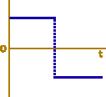
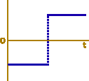
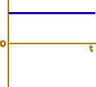
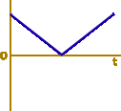
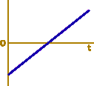
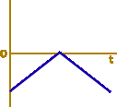
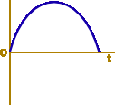
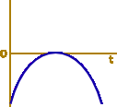
Assessing to Learn
A ball is rolled up an incline so that it goes part-way up and then rolls back down. Which of the graphs below could represent its acceleration vs. time from the instant it is released until it returns to where it started?
1. 2. 3. 4.
5. 6. 7. 8.
None of the graphs 10. Two or more of the graphs
Notes:
Come up with your own answer, then compare notes with your neighbor to see if you agree. We’ll discuss it in three minutes.
Answer: (3)
Question A2.04a
Commentary
Purpose: To hone the concept of acceleration, focusing on its vector nature, and how to represent it graphically. In particular, this question targets the common misconception that positive acceleration means "speeding up" and negative acceleration means "slowing down".
Discussion:
A ball rolled up an incline slows down, stops at the top, then speeds up again as it rolls back down. It is common but incorrect to think that the acceleration is negative while the ball slows down and positive while the ball speeds up.
Acceleration is defined as the change in velocity. As the ball rolls up the incline, its velocity points in its direction of motion, parallel to the plane and uphill. As the ball slows down, the velocity vector gets shorter. The change in the velocity vector between two subsequent times is therefore a vector pointing parallel to the plane and downhill. So the acceleration points downhill.
As the ball rolls down the hill, its velocity again points in the direction of motion, which is now downhill. It is speeding up, so the velocity vector is getting longer. The change in the velocity vector between two subsequent times is therefore a vector pointing parallel to the plane and downhill. So the acceleration again points downhill.
Even at the very top of its motion, when the ball stops rolling up and starts rolling back down, its velocity is changing from a vector pointing up the plane to one pointing down the plane. Here too the acceleration points downhill. Throughout its entire motion, the ball's acceleration is nonzero and points down the plane. Therefore, answers (1), (2), (4), (5), (6), (7), and (8) cannot be valid.
Answer (9) can be valid, if we choose a coordinate system so that the positive direction is down the plane. This may be an unusual choice, but it is valid. Keep in mind that coordinate systems are arbitrary mathematical constructs we define to help us solve problems; we can orient them however we wish. Since the question asks which of the graphs could represent the ball's acceleration vs. time, answer (9) is the best choice.
Key Points:
Acceleration is the rate of change of velocity.
If an object is traveling in a straight line and slowing down, acceleration points in the opposite direction of its motion. If it is speeding up, acceleration points in the direction of motion.
"Positive" and "negative" accelerations refer to the direction relative to a coordinate system, not to speeding up or slowing down.
Coordinate systems are arbitrary and may be oriented however we wish, though some choices are more common and convenient than others.
For Instructors Only
This is first of two similar questions exploring graphs of velocity and acceleration. We recommend presenting both questions back-to-back, collecting answers for each, before discussing or revealing anything about either. Most students generally choose answer (2), since they associate "slowing down" with "negative acceleration" and "speeding up" with "positive acceleration". The instructor must lead students to explicitly articulate this idea, and then convince them that it is inconsistent with the definition of acceleration.
Some students, especially those who are trying to deal with coordinate frames and just slightly missing the mark, will pick (1), or perhaps both (1) and (2). These students may be more sensitive than most to the fact that the "positive" direction is positive. For them, choosing down to be positive makes (1) valid.
Answer (9) is a likely choice for students who understand that the acceleration will not change magnitude or direction, but assume that the positive direction must be up the plane. Others, less confident in their thinking, will assume that they are wrong and pick one of the other answers.
Graph (4) is a valid graph of speed vs. time, and (5) is a valid graph of velocity vs. time. If you are discussing the two questions in the set together, this is a good connection to make.
Graph (6) is the negative of the speed. (7) is position vs. time with the initial height chosen as the origin, and (8) is position vs. time with the topmost point chosen as the origin.
Source: UMass Assessing to Learning

Slide 72
Assessing to Learn
A ball is rolled up an incline so that it goes part-way up and then rolls back down. Which of the graphs below could represent its velocity vs. time from the instant it is released until it returns to where it started?
1. 2. 3. 4.
5. 6. 7. 8.
None of the graphs 10. Two or more of the graphs
Notes:
Think it over, be ready to justify your choice, and consider your neighbor’s explanation. We’ll talk as a class in three minutes.
Answer: (6)
Question A2.04b
Commentary
Purpose: To hone the concept of velocity, focusing on its vector nature and how to represent it graphically.
Discussion:
We expect the ball to slow down, change direction, then speed up in the opposite direction, all with constant acceleration. There are two valid ways of representing this motion, though only one of them is shown.
Graph (5) shows an object moving in the negative direction but slowing down, then stopping (where the line crosses the t-axis) and speeding up in the positive direction. If we choose a coordinate system such that downhill is positive, and uphill is negative, this is a possible graph for the motion of the ball. So (5) is a defensible answer.
If uphill were chosen as the positive direction, the velocity-vs.-time graph would be a straight line with a negative slope, starting above the t-axis and ending below it. This choice is not included among the answers.
Graph (1) depicts a ball that travels up the incline with constant velocity, and then suddenly and instantaneously reverses. This graph would be more appropriate for a ball that rolls along a horizontal floor and then rebounds off of a wall. (2) is the same, but with positive and negative directions reversed, as if downhill were chosen as the positive direction.
Graph (4) is a valid representation of speed vs. time, but not of velocity vs. time. Since the function depicted is always positive except for the inflection point, the object would always be moving in the same direction. This graph might represent a car that slows down, stops momentarily at an intersection, and then speeds up again in the same direction as before.
Graph (6) cannot be speed vs. time for any coordinate system: speed is never negative. As with (4), it could represent a car slowing and stopping momentarily at an intersection and the proceeding in the same direction, if the car were traveling in the negative direction of our coordinate system for the entire time.
Note that acceleration vs. time is the slope of velocity vs. time. For graph (5), the slope is constant and positive at all times, so the corresponding graph of acceleration vs. time must be a constant, positive value, such as graph (3).
Key Points:
The sign of an object's velocity indicates whether it is moving in the "positive" or "negative" direction as defined by a chosen coordinate system. The magnitude indicates the object's speed.
If an object experiences constant acceleration, its velocity-vs.-time graph must be a straight line whose slope equals the value of acceleration.
There is no one "right" coordinate system for a situation or problem. For convenience and out of habit, we generally choose the positive direction to be upward or to the right, but that is not necessary.
For Instructors Only
This is second of two similar questions exploring graphs of velocity and acceleration. We recommend presenting both questions back-to-back, collecting answers for each, before discussing or revealing anything about either.
Most likely, the majority of your students will select answer (9): "None of the graphs". They are most likely looking for a graph that begins with a positive value of velocity sloping down to a negative value at the end, because they are using the convention that "up" is positive. A primary objective of this question is to help them appreciate that this is merely a choice, not a necessity. If "down" is chosen to be positive, then (5) is a valid choice, and the question asks which of the graphs could represent the ball's velocity vs. time.
Students should not be expected to know that the ball will slow down going up and speed up rolling back down, rather than instantaneously reversing direction. Changes in speed are difficult to detect in real-life observation, and students who have never taken physics before may not realize the ball is in fact slowing down as it rolls up the incline. If any students choose answers (1) or (2) for this reason, it is important to confirm that they are correctly representing their physical model of the situation graphically, though their physical intuition needs refinement. Simply saying those answers are wrong risks confusing such students — they might think they were wrong for the wrong reason.
Source: UMass Assessing to Learning

Slide 73
Assessing to Learn
Ralph walks 3 m to the left in 2 seconds, then 4 m to the right in 3 seconds. Next, he stops for 3 seconds, and finally walks 5 m to the left in 4 seconds.
Ralph's final position is closest to:
1. 0 m 2. 2 m 3. 4 m 4. 6 m
5. 8 m 6. 10 m 7. 12 m 8. 14 m
9. The negative of one of the choices above
10. Impossible to determine
Notes:
Think about it, talk with each other, and we’ll all talk about it together in a couple of minutes.
Answer: Impossible to determine
Question A2.05a
Purpose: To hone your understanding of "position".
Discussion:
An object's "position" is its location relative to a coordinate system. We know a lot about the motion of Ralph, but we do not know his position, because we do not know where to place the origin of the coordinate system. In other words, we do not know Ralph's initial position. It is tempting, but unjustified, to assume that he begins at the origin.
Also, the question does not define which direction is "positive". Even if the question told us that Ralph began at the origin, we would not know whether he ended up at 4 m or –4 m. "Positive to the right" is a convention we use when drawing graphs on paper, but does not necessarily describe the coordinate system of Ralph's world.
Key Points:
An object's "position" is its location relative to an origin.
The origin of a coordinate system is not necessarily an object's starting point.
Knowing changes in position is not enough to determine final position unless we know the initial position as well.
For Instructors Only
This is the first of three related questions that help students distinguish and relate position, distance traveled, and displacement.
Students choosing answer (3) are most likely assuming Ralph begins at the origin. Students choosing answer (9) may be doing the same, and assuming that "left" means "in the negative direction".
To help students understand why an object's starting position might not always be at the origin, ask how they would describe a situation with two individuals beginning in different places.
Source: UMass Assessing to Learning

Slide 74
Assessing to Learn
Ralph walks 3 m to the left in 2 seconds, then 4 m to the right in 3 seconds. Next, he stops for 3 seconds, and finally walks 5 m to the left in 4 seconds.
The distance Ralph travels is closest to:
1. 0 m 2. 2 m 3. 4 m 4. 6 m
5. 8 m 6. 10 m 7. 12 m 8. 14 m
9. The negative of one of the choices above
10. Impossible to determine
Notes:
Think about it yourself, then share ideas with a neighbor, and then share with the big group in three minutes.
Answer: 12 m
Question A2.05b
Commentary
Purpose: To hone your understanding of "distance traveled".
Discussion:
The "distance traveled" by someone is not how far the person ends up from his original location, but the total amount of distance covered during the process of moving. If you walk from home to the store and then back again, your "distance traveled" is twice the distance to the store, even though you end up where you started. When driving a car, the distance traveled is the change in odometer reading.
We often call this the "total" distance traveled, just to be clear.
In this case, Ralph walks 3 m, then 4 m, and finally 5 m, for a total of 12 m. Direction does not matter, nor does his starting position.
Key Points:
The "distance traveled" is the total distance moved during a specified process. It is the sum of the distances traveled during each leg of a trip.
The distance traveled is always positive. Direction does not matter.
The distance traveled depends on the path taken between two points, but it does not depend on how long it takes to complete.
For Instructors Only
This is the second of three related questions that help students distinguish and relate position, distance traveled, and displacement.
Students who choose answer (3) are likely determining the displacement, or its magnitude, rather than the distance traveled. They may think of this as the "net" distance traveled.
Students choosing answer (9) may be determining the displacement and assuming positive is to the right, or applying some kind of sign convention to the distance, or perhaps a different error.
Source: UMass Assessing to Learning

Slide 75
Assessing to Learn
Ralph walks 3 m to the left in 2 seconds, then 4 m to the right in 3 seconds. Next, he stops for 3 seconds, and finally walks 5 m to the left in 4 seconds.
Ralph’s displacement is closest to:
1. 0 m 2. 2 m 3. 4 m 4. 6 m
5. 8 m 6. 10 m 7. 12 m 8. 14 m
9. The negative of one of the choices above
10. Impossible to determine
Notes:
Work it out yourself, check with a neighbor and compare, and we’ll share around the room in a few minutes.
Answer: Possible (3) and (9)
Question A2.05c
Commentary
Purpose: To hone your understanding of "displacement".
Discussion:
An object's displacement is the change in its position: final position minus initial position. It has direction associated with it, and does not depend on the path taken between the initial and final points or on the time interval. Mathematically, if x describes an object's position, we represent its displacement as Δx.
Ralph ends up 4 m to the left of his original position, so his displacement is "4 m, left". If the positive direction is chosen to be to the left, then "4 m" (answer 3) is acceptable; if positive is chosen to be to the right, then "–4 m" (answer 9) is acceptable.
Key Points:
An object's "displacement" is the change in its position.
Displacement has a direction associated with it, represented by the sign of the displacement (positive or negative) in one dimension and by a vector direction in two or more dimensions.
Displacement does not depend on how the object gets from the initial to the final point.
For Instructors Only
This is the third of three related questions that help students distinguish and relate position, distance traveled, and displacement.
Students might not like that there are two acceptable answers, and that the correctness depends on the assumption made about the positive direction.
Source: UMass Assessing to Learning

Slide 76
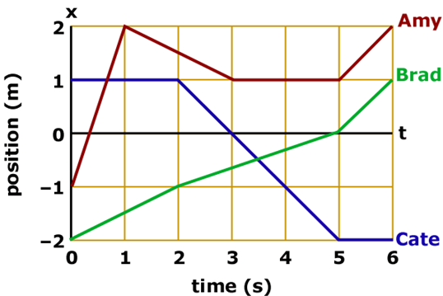
Assessing to Learn
Amy, Brad, and Cate are walking (or running) along a straight line as represented below.
Which people have the same displacement?
none; they all have different displacements
Amy and Brad
Amy and Cate
Brad and Cate
all three are the same
Notes:
Decide on the answer, convince your neighbor, and in a few minutes, be ready to convince the rest of us!
Answer: Amy and Brad
Question A2.06a
Commentary
Purpose: To hone your understanding of displacement.
Discussion:
Displacement is the change in position. The intermediate path does not matter, but the overall direction does.
Amy starts at x = –1 m and ends at x = +2 m, for a displacement of +3 m. Brad starts at x = –2 m and ends at x = +1 m, for a displacement of +3 m. Cate starts at x = +1 m and ends at x = –2 m, for a displacement of –3 m.
So, even though Amy and Brad have completely different paths, and also start and end at different points, each person's position changes by 3 m in the "positive" direction, so they have the same displacement.
Key Points:
Displacement Δx is the change in position, Δx = x_{final} – x_{initial}.
Displacement has a magnitude and a direction. In one dimension, a positive or negative sign indicates direction. In two or more dimensions, we use a vector.
Displacement does not depend upon the details of the motion between two points, or where they are relative to the origin.
For Instructors Only
This one of six questions about this graph. You do not need to use them all, or in any particular order.
Students who choose answer (5) are probably considering only the magnitude of the displacement.
Students who choose answer (1) might be confusing displacement with distance traveled or with final position, or otherwise taking the path traveled into account.
(Brad and Cate both have the same distance traveled — 3 m — though in opposite directions. Amy travels a longer total distance for the same magnitude of displacement.)
Depending on how much experience students have working with graphical representations, students may have difficulty interpreting these position-vs.-time graphs. (The more trouble they have, the more they need to wrestle with this!) They might think they depict actual two-dimensional paths (y vs. x) as seen from above. Students who think this might still choose Amy and Brad as having the same displacement. A question specifically asking students to compute the displacement or the distance traveled will help tease this apart.
Source: UMass Assessing to Learning

Slide 77
Assessing to Learn
Amy, Brad, and Cate are walking (or running) along a straight line as represented below.
Which people have the largest displacement?
only Amy
only Brad
only Cate
Amy and Brad
Amy and Cate
Brad and Cate
all are the same
impossible to determine
Notes:
Choose your answer, check with a neighbor, and we’ll talk about it as a class in a few minutes.
Answer: all are the same
Question A2.06b
Commentary
Purpose: To hone your understanding of displacement.
Discussion:
Displacement is the change in position. The intermediate path does not matter, but the overall direction does.
Amy starts at x = –1 m and ends at x = +2 m, for a displacement of +3 m. Brad starts at x = –2 m and ends at x = +1 m, for a displacement of +3 m. Cate starts at x = +1 m and ends at x = –2 m, for a displacement of –3 m.
Thus, assuming that "largest" refers to the magnitude of the displacement, all three have the same magnitude of 3 m.
Key Points:
Displacement Δx is the change in position, Δx = x_{final} – x_{initial}.
Displacement does not depend upon the details of the motion between two points, or where they are relative to the origin.
The "largest" of a set of numbers usually refers to the one with the greatest magnitude, while the "greatest" usually refers to the most positive or least negative (i.e., the one farthest towards the positive end of the number line). People are not always consistent about this, however.
For Instructors Only
This one of six questions about this graph. You do not need to use them all, or in any particular order.
Amy and Cate end up farthest from the origin, each 2 m away, with Amy at a positive position and Cate at a negative position. Students who choose answers (1) or (5) could be confusing displacement with position or magnitude of position.
Amy and Brad have the same positive displacement. Students who choose answer (4) are perhaps thinking that "+3" is larger than "–3". (We typically interpret "largest", "smallest", "larger than", and "smaller than" as referring to magnitude and "greatest", "least", "greater than", and "less than" as referring to relative position along a number line. So, for example, –3 is "less than" but also "larger than" +1.)
Amy walks the farthest distance. Students who choose answer (1) might think that they are being asked for the distance traveled.
Students unaccustomed to position–time graphs may interpret the graph lines as two-dimensional paths or y vs. x trajectories. With this interpretation, all three people still have the same magnitudes of displacement. You can determine whether this mistake is occurring by asking students during post-question discussion what numerical value of the displacement they found. If they say that the displacements are all about 7 m long, then they are probably interpreting these graphs as y vs. x instead of x vs. t.
Source: UMass Assessing to Learning

Slide 78
Assessing to Learn
Amy, Brad, and Cate are walking (or running) along a straight line as represented below.
Amy's distance traveled is closest to:
1 m
3 m
5 m
7 m
9 m
11 m
13 m
15 m
17 m
exactly halfway between two of the values above
Notes:
Come up with your answer, then check to see what your neighbor came up with. We’ll look at this as a big group in a few minutes.
Answer: 5 m
Question A2.06c
Commentary
Purpose: To hone your understanding of "distance traveled".
Discussion:
The distance traveled by an object is the total length of the path followed. It is a non-negative number, with no direction associated with it. The distance a car travels is the increase in its odometer reading.
Amy starts at x = –1 m and first walks to x = +2 m, a distance of 3 m. Then she walks to x = +1 m, a distance of 1 m. Next she stands still at x = +1 m for 2 seconds. Finally she walks back to x = +2 m, a distance of 1 m. Thus, the total distance traveled is 3 + 1 + 0 + 1 = 5 m.
Note that these graphs are not y vs. x, but position x vs. time t. These people are walking along a single straight line, and the coordinate along this straight line is x. This representation is useful and common, so you should make sure you understand it.
Brad and Cate travel each travel a total distance of 3 m.
Key Points:
"Distance traveled" refers to the total length of the path followed by an object. It is a magnitude with no sign or direction.
For Instructors Only
This one of six questions about this graph. You do not need to use them all, or in any particular order.
Students who choose answer (5) or perhaps (6) may be interpreting the graphs as y vs. x (top views). If the graph did show y vs. x, Amy's distance traveled would be about 9.8 m (and her displacement is about 6.7 m).
Source: UMass Assessing to Learning

Slide 79
Assessing to Learn
Amy, Brad, and Cate are walking (or running) along a straight line as represented below.
Which people have the same average speed during the time period shown?
none; they all have different average speeds
Amy and Brad
Amy and Cate
Brad and Cate
all three are the same
Notes:
Think about it, check with a neighbor, and we’ll discuss the answer in about three minutes.
Answer: Brad and Cate
Question A2.06d
Commentary
Purpose: To hone your understanding of average speed.
Discussion:
The average speed is the total distance traveled divided by the total time needed to travel that distance. Direction does not matter.
The time period is the same for all three people, so we can focus on total distance traveled. If two people travel the same distance, they must have the same average speed.
Amy travels 5 m in 6 seconds. Brad and Cate travel 3 m in 6 seconds, even though it is in opposite directions and with completely different pattern of speeds. Thus, Brad and Cate have the same average speed.
Key Points:
An object's average speed is the total distance it travels divided by the total time it is traveling.
Average speed is not the magnitude of average velocity!
For Instructors Only
This one of six questions about this graph. You do not need to use them all, or in any particular order.
Students who answer (1) may be interpreting these graphs as y vs. x, since with that interpretation all three have different path lengths.
Students who answer (5) may be finding the magnitude of the average velocity, since that is the same for all three people (0.5 m/s).
Students are likely to compute numerical values for the average speeds, not realizing that since the times are the same they can focus only on distance traveled. We recommend asking about this during discussion, so they may realize they could have saved themselves some work by thinking more.
If students are having difficulty with this, sketching speed-vs.-time plots may help.
An alternative technique students may have learned for computing average speed is to break the time period into six one-second intervals, and find the speed during each. Then, they can average those six values. (We don't recommend this approach, as it obscures the concepts underlying average speed and doesn't generalize easily to situations with non-constant velocity.)
Source: UMass Assessing to Learning

Slide 80
Assessing to Learn
Amy, Brad, and Cate are walking (or running) along a straight line as represented below.
Which people are moving toward the origin at t = 2½ s?
None
Amy only
Brad only
Cate only
Amy and Brad
Amy and Cate
Brad and Cate
All three
Notes:
Think about it, talk about it, and we’ll touch base in a couple of minutes.
Answer: all three
Question A2.06e
Commentary
Purpose: To hone the your understanding of instantaneous velocity, in particular of its direction.
Discussion:
We often use "positive" or "negative" to describe the direction of the velocity, but "positive" does not always mean "away from the origin" and "negative" does not always mean "toward the origin". These are true only when the position is positive. In this case, Amy and Cate have positive positions and negative velocities at t = 2½ s, so they are moving toward the origin, i.e., moving toward x = 0. Cate reaches the origin at t = 3 s.
But Brad is also moving toward x = 0. His position is negative and his velocity is positive. He reaches the origin at t = 5 s.
Note that Amy does not return to the origin after being there earlier, but this does not mean she is not moving toward the origin at t = 2½ s. If she had continued to walk at ½ m/s, she would have reached the origin at t = 5 s, but instead, she stops at t = 3 s and then starts to move away from the origin at t = 5 s.
Key Points:
For motion in one dimension, a "positive" velocity is away from the origin if the position is positive and towards the origin if the position is negative. (Vice-versa for a "negative" velocity.)
For Instructors Only
This one of six questions about this graph. You do not need to use them all, or in any particular order.
Answer (6) can be surprisingly common: students often assume that people are on the positive side of an origin, even if it might seem obvious to you that some are and some aren't.
Students who choose answer (7) or (4) may be thinking that Amy isn't moving towards the origin because she doesn't actually reach it; they are using a different interpretation of "moving towards.“
Students choosing answer (2) may be confusing "origin" with "original position".
For follow-up discussion, you can ask additional questions such as "Which people have a positive velocity at t = 4 s?“
Source: UMass Assessing to Learning

Slide 81
Assessing to Learn
Amy, Brad, and Cate are walking (or running) along a straight line as represented below.
During which 1-second time period(s) are there
at least two people with the same speed?
0–1 s
1–2 s
2–3 s
3–4 s
4–5 s
5–6 s
None of the time intervals
Two of the time intervals
Three of the time intervals
Four or more of the time intervals
Notes:
Take a moment to come up with an answer, share with a classmate, and I’ll interrupt the discussions to hear what you decided in about four minutes. Be ready to share.
Answer: Three of the time intervals
Question A2.06f
Commentary
Purpose: To hone your understanding of (instantaneous) speed.
Discussion:
The speed is the magnitude of velocity, and does not have a direction associated with it. An object's speed is the rate at which its position is changing at a particular instant of time — "how fast" it is moving at that instant.
On a graph of position vs. time, velocity is the slope, and a straight line means that the velocity is constant. So, for instance, during the first second, Amy runs from x = –1 m to x = +2 m, a displacement of +3 m in one second, for a velocity of +3 m/s. Then, during the next two seconds, Amy walks from x = +2 m to x = +1 m, a displacement of –1 m, for a velocity of –½ m/s during that 2-second time interval. Meanwhile, Brad has a velocity of +½ m/s during the first 2 seconds, so he and Amy have the same speed from t = 1 s until t = 2 s.
During each 1-second time interval, each person's speed is constant, so we can compare these speeds to answer the question.
During three of the time intervals, two people have the same speed: (1) from t = 1 s to t = 2 s, both Amy and Brad are moving at the same speed of ½ m/s, though in opposite directions; (2) from t = 4 s to t = 5 s, Amy and Cate are moving at the same speed, i.e., they are both not moving, so their speed is zero; and (3) from t = 5 s to t = 6 s, Amy and Brad are again moving at the same speed, though this time it is 1 m/s.
Key Points:
Speed is the magnitude of velocity.
Two objects can have the same speed but different velocities, if they are moving in different directions.
For Instructors Only
This one of six questions about this graph. You do not need to use them all, or in any particular order.
Students who answer (8), two time intervals, and claim that the two intervals are 0-1 s and 2-3 s, may be confusing position with speed, or interpreting the graph as velocity vs time. During these intervals, two people cross paths. Students who interpret the plot as velocity vs. time may also have trouble identifying intervals, since if this were such a graph Amy and Cate have the same "speed" at the instants t = 3 s and t = 6 s.
Students choosing answer (8) for intervals 4–5 s and 5–6 s may be considering the direction of the velocity as well as its magnitude, or may simply have overlooked that interval. Discussion should reveal this.
Students omitting interval 4–5 s may be thinking, explicitly or implicitly, that zero is not a speed.
Asking students to construct a sketch of speed vs. time may help them sort out the ideas here.
Source: UMass Assessing to Learning

Slide 82
TOPIC summary
Topic 2: Motion in One Dimension

Slide 83
Topic Summary
  Displacement
  Velocity
  Acceleration
Notes:
Displacement
The displacement of an object moving along the x-axis is defined as the change in position of the object, Δx = x_{f} – x_{i} , where x_{i} is the initial position of the object and x_{f} is its final position.
A vector quantity is characterized by both a magnitude and a direction. A scalar quantity has a magnitude only.
Velocity
The average speed of an object is given by the equation shown. The average velocity v during a time interval Δt is the displacement Δx divided by Δt.
The average velocity is equal to the slope of the straight line joining the initial and final points on a graph of the position of the object versus time. The slope of the line tangent to the position-versus-time curve at some point is equal to the instantaneous velocity at that time. The instantaneous speed of an object is defined as the magnitude of the instantaneous velocity.
Acceleration
The average acceleration a of an object undergoing a change in velocity Δv during a time interval Δt is shown here. The instantaneous acceleration of an object at a certain time equals the slope of a velocity versus time graph at that instant.

Slide 84
Topic Summary
One-Dimensional Motion with Constant Acceleration
Freely Falling Objects
Notes:
One-Dimensional Motion with Constant Acceleration
The most useful equations that describe the motion of an object moving with constant acceleration along the x-axis are as shown. All problems can be solved with the first two equations alone, the last being convenient when time doesn’t explicitly enter the problem. After the constants are properly identified, most problems reduce to one or two equations in as many unknowns.
Freely Falling Objects
An object falling in the presence of Earth’s gravity exhibits a free-fall acceleration directed toward Earth’s center. If air friction is neglected and if the altitude of the falling object is small compared with Earth’s radius, then we can assume that the free-fall acceleration g = 9.8 m/s² is constant over the range of motion. Our kinematics equations apply, with a = –g.

Slide 85
