Slide 1
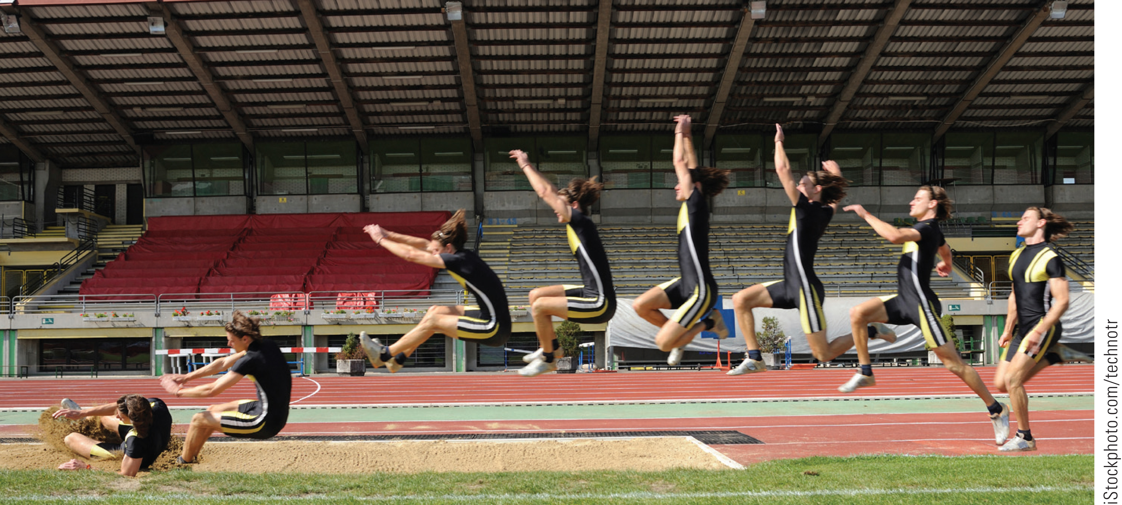
Topic 3: Motion in Two Dimensions
College Physics, 11e
Raymond A. Serway;
Chris Vuille

Slide 2
Reading Question 3-1
A book is moved once around the perimeter of a tabletop with the dimensions 1.0 m × 2.0 m. If the book ends up at its original position, what is its displacement and what is the distance it traveled?
displacement of 0 m, distance traveled 0 m
displacement of 0 m, distance traveled 6 m
displacement of 6 m, distance traveled 6 m
displacement of 6 m, distance traveled 0 m

Slide 3
Reading Question 3-1
A book is moved once around the perimeter of a tabletop with the dimensions 1.0 m × 2.0 m. If the book ends up at its original position, what is its displacement and what is the distance it traveled?
displacement of 0 m, distance traveled 0 m
displacement of 0 m, distance traveled 6 m
displacement of 6 m, distance traveled 6 m
displacement of 6 m, distance traveled 0 m

Slide 4
Reading Question 3-2
A vector lies in the x-y plane. For what orientations will both components be negative?
The vector lies between 180° and 270° from the x-axis.
The vector lies between 0° and 90° from the x-axis.
The vector lies between 90° and 180° from the x-axis.
None. Just like for vector magnitudes, components are always positive.

Slide 5
Reading Question 3-2
A vector lies in the x-y plane. For what orientations will both components be negative?
The vector lies between 180° and 270° from the x-axis.
The vector lies between 0° and 90° from the x-axis.
The vector lies between 90° and 180° from the x-axis.
None. Just like for vector magnitudes, components are always positive.

Slide 6
Reading Question 3-3
Which of the following quantities, if any, remain constant as a projectile moves through its parabolic trajectory?
(i) speed (ii) acceleration (iii) the horizontal component of velocity (iv) the vertical component of velocity
(i) only
(ii) and (iii)
(ii) and (iv)
all of them

Slide 7
Reading Question 3-3
Which of the following quantities, if any, remain constant as a projectile moves through its parabolic trajectory?
(i) speed (ii) acceleration (iii) the horizontal component of velocity (iv) the vertical component of velocity
(i) only
(ii) and (iii)
(ii) and (iv)
all of them

Slide 8
Reading Question 3-4
A sailor drops a wrench from the top of a sailboat's mast while the boat is moving steadily and rapidly in a straight line. Where will the wrench hit the deck?
at the base of the mast
behind the mast, along the direction opposite to the motion of the boat
in front of the mast, along the direction of the motion of the boat
impossible to tell

Slide 9
Reading Question 3-4
A sailor drops a wrench from the top of a sailboat's mast while the boat is moving steadily and rapidly in a straight line. Where will the wrench hit the deck?
at the base of the mast
behind the mast, along the direction opposite to the motion of the boat
in front of the mast, along the direction of the motion of the boat
impossible to tell

Slide 10
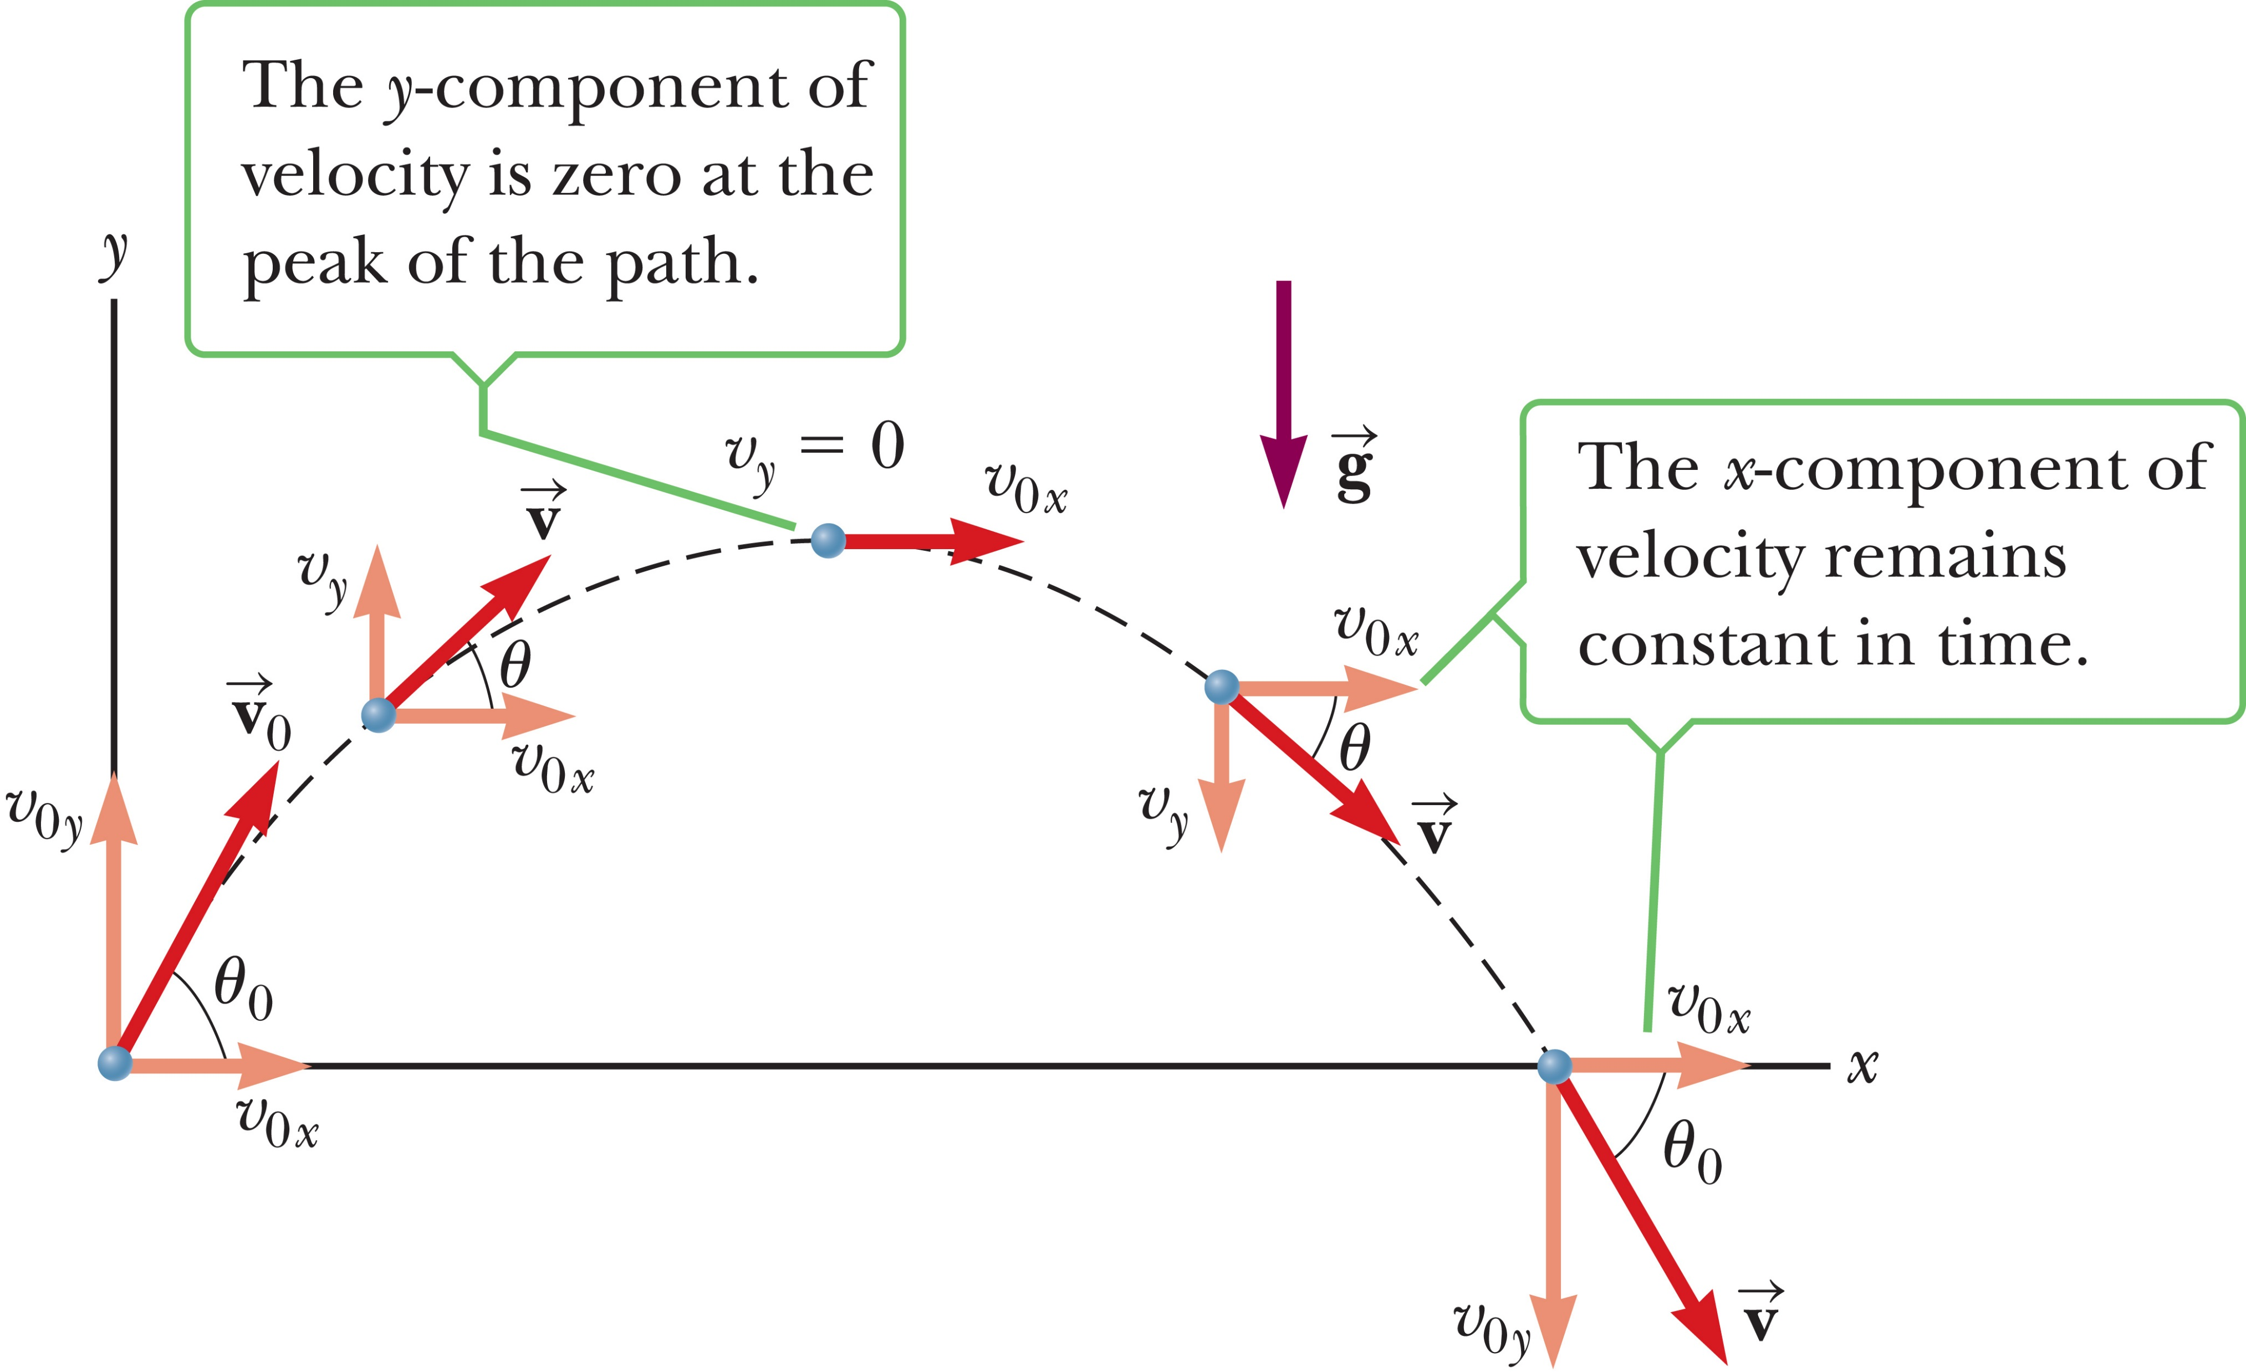
Reading Question 3-5
As a projectile thrown upward at a non-vertical angle moves in a parabolic path, at what point along its path are the velocity and acceleration vectors for the projectile parallel to each other?
at the point just before the projectile lands
at the highest point
at the launch point
nowhere

Slide 11
Reading Question 3-5
As a projectile thrown upward at a non-vertical angle moves in a parabolic path, at what point along its path are the velocity and acceleration vectors for the projectile parallel to each other?
at the point just before the projectile lands
at the highest point
at the launch point
nowhere

Slide 12
TOPIC Discussion
Topic 3: Motion in Two Dimensions
Notes:
Our study of motion so far has involved the concepts of displacement, velocity, and acceleration in one dimension. In this new topic, we will extend those concepts by applying vector techniques to study two-dimensional motion, including projectiles and relative motion.

Slide 13
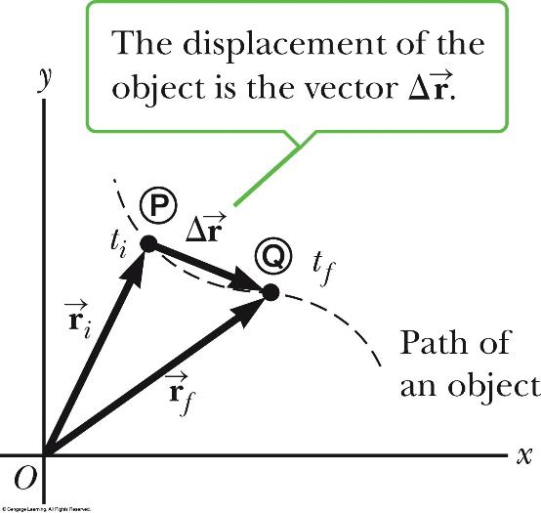
Displacement in Two Dimensions
Notes:
Figure 3.1 An object moving along some curved path between points P and Q. The displacement vector Δr is the difference in the position vectors: Δr = r_{f} – r_{i}.
In one-dimensional motion, the direction of a vector quantity such as a velocity or acceleration can be taken into account by a plus or minus sign. For example, the velocity of a rocket is positive if the rocket is going up and negative if it’s going down. When working in two or three dimensions, we need the concept of vectors.
Look at the figure, which shows an object is moving through space. When the object is at some point Ⓟ at time t_{i} , its position is described by the position vector r_{i} , drawn from the origin to P. When the object has moved to some other point Q at time t_{f}, its position vector is r. From the vector diagram, you can see that the final position vector is the sum of the initial position vector and the displacement. From this we can conclude that an object’s displacement is defined as the change in its position vector.

Slide 14
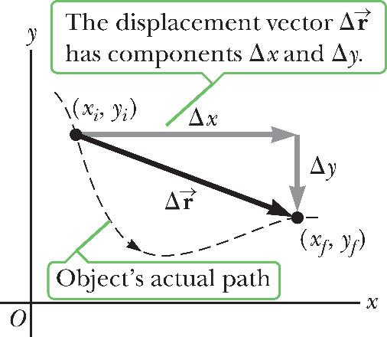
Displacement in Two Dimensions
Notes:
Figure 3.2 The displacement vector has components Δx = x_{f} – x_{i} and Δy = y_{f} – y_{i}.
The displacement vector has components Δx and Δy as shown in the figure, for an object that moves from location (x_{i}, y_{i}) to (x_{f}, y_{f}) in a time interval Δt. The x-component of the object’s displacement is Δx = x_{f} – x_{i} and the y-component is Δy = y_{f} – y_{i}.

Slide 15
Velocity in Two Dimensions
Notes:
Let’s generalize the definitions of velocity and acceleration we covered in Topic 2. An object’s average velocity during a time interval Δt is its displacement divided by Δt. Because the displacement is a vector quantity and the time interval is a scalar quantity, we conclude that the average velocity is a vector quantity directed along Δr.
The x- and y-components of the average velocity are given by the equations shown, and express the rate at which an object’s position is changing along the x- and y-axes, respectively. Note that the magnitude of the average velocity is just the distance between the endpoints divided by the elapsed time.
An object’s instantaneous velocity v [click to show equation] is the limit of its average velocity as Δt goes to zero.

Slide 16
Velocity in Two Dimensions
Notes:
An object’s average acceleration during a time interval Δt is the change in its velocity Δv divided by Δt. Average acceleration has components given by the equations shown, where v_{x} and v_{y} are the x- and y-components of the velocity vector. An object’s instantaneous acceleration vector a [click to show equation] is the limit of its average acceleration vector as Δt → 0.
You should be aware that an object can accelerate in several ways:
(1) The magnitude of the velocity vector, which is the speed, may change with time.
(2) The direction of the velocity vector may change with time, even though the speed is constant. This can happen along a curved path.
(3) Both the magnitude and the direction of the velocity vector may change at the same time.

Slide 17
Think – Pair – Share
Which of the following objects can’t be accelerating?
an object moving with a constant speed
an object moving with a constant velocity
an object moving with along a curve
Notes:
Think about it, share your thoughts with another classmate, and in two minutes we’ll all talk it through together.
Answer: an object moving with a constant velocity
Reasoning: If velocity is constant, the acceleration (rate of change in velocity) is zero. An object may have constant speed (magnitude of velocity) but still be accelerating due to a change in direction of the velocity. If an object is following a curved path, it is accelerating because the velocity is changing in direction.

Slide 18
Think – Pair – Share
Consider the following controls in an automobile: gas pedal, brake, steering wheel. The controls in this list that cause an acceleration of the car are
all three controls.
the gas pedal and the brake.
only the brake.
only the gas pedal.
Notes:
Come up with your answer, and an explanation or justification of that answer, and see if you can convince a classmate. We’ll review your responses in 2 minutes. Be sure you can explain your answer.
Answer: all three controls
Reasoning: If velocity is constant, the acceleration (rate of change in velocity) is zero. An object may have constant speed (magnitude of velocity) but still be accelerating due to a change in direction of the velocity. If an object is following a curved path, it is accelerating because the velocity is changing in direction.

Slide 19
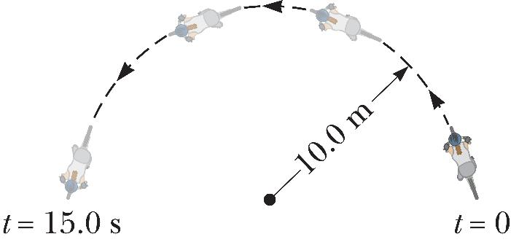
Think – Pair – Share
A girl on a bicycle takes 15.0 s to ride half way around a circular track of radius 10.0 m. What is the girl’s average speed?
Notes:
Take a stab at it yourself first, but if you want to compare your answers with a neighbor, you can. We’ll go over it in 2 minutes.
Answer: 2.09 m/s
Reasoning: Average speed is the path length travelled divided by the time interval. In this case, the path length equals πR, half the circumference of the circular path, with R = 10.0 m. Her average speed is (Average speed) = πR/Δt = π(10.0 m)/15.0 s = 2.09 m/s.

Slide 20
Think – Pair – Share
A girl on a bicycle takes 15.0 s to ride half way around a circular track of radius 10.0 m. What is the magnitude of her average velocity?
Notes:
Do a quick calculation and compare it to a classmate. Let’s talk in a few minutes.
Answer: 1.33 m/s
Reasoning: Her average velocity has magnitude $\left|{\vec{v}}_{av}\right|$ = $\left|\frac{Δ\vec{r}}{Δt}\right|$ = $\frac{2R}{Δt}$ = $\frac{2(10.0 m)}{15.0 s}$ = 1.33 m/s.

Slide 21
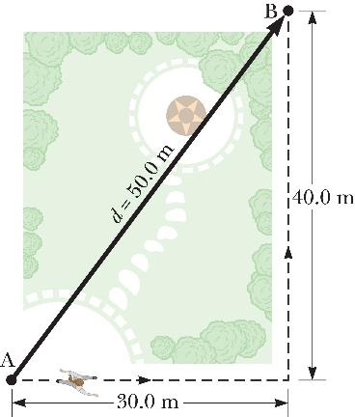
Velocity in Two Dimensions
Notes:
Figure 3.3 A woman jogs along the dashed path from A to B in 20.0 s, traveling a path length of 30.0 m + 40.0 m = 70.0 m and a distance d of 50.0 m.
Average velocity is a vector equal to the displacement divided by the time interval and depends only on the motion’s endpoints but not on the actual path traveled between them.
Average speed is a scalar equal to the actual path length traveled, including any retracing of steps or deviations from a straight line, divided by the elapsed time.
The figure shows a woman jogging along the rectangular periphery of a small green space, going from point A to point B in 20.0 s. The path length is 30 m + 40 m = 70 m, so her average speed, equal to her path length divided by the elapsed time, is 70 m divided by 20 s = 3.5 m/s. The magnitude of her average velocity depends only on the distance between the endpoints, which is 50 m, so that v_{av} = d over r = 50 m divided by 20 s = 2.5 m/s.

Slide 22
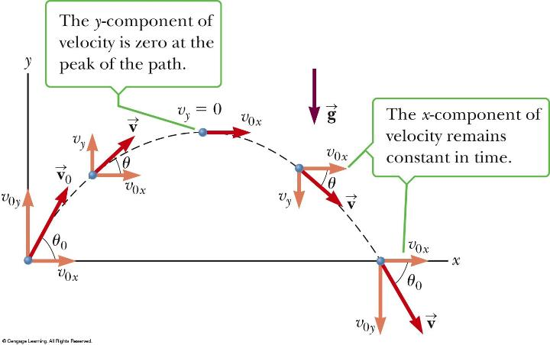
Two-Dimensional Motion
Projectile motion: horizontal and vertical motions are independent
Notes:
Figure 3.5 The parabolic trajectory of a particle that leaves the origin with a velocity of v₀. Note that v changes with time. However, the x-component of the velocity, v_{x}, remains constant in time, equal to its initial velocity, v_{0x}. Also, v_{y} = 0 at the peak of the trajectory, but the acceleration is always equal to the free-fall acceleration and acts vertically downward.
In this topic, we look at objects that move in both the x- and y-directions simultaneously under constant acceleration. An important special case of this two-dimensional motion is called projectile motion. Anyone who has tossed any kind of object into the air has observed projectile motion. If the effects of air resistance and the rotation of Earth are neglected, the path of a projectile in Earth’s gravity field is curved in the shape of a parabola, as shown in the figure. The positive x-direction is horizontal and to the right, and the y-direction is vertical and positive upward. The most important experimental fact about projectile motion in two dimensions is that the horizontal and vertical motions are completely independent of each other. This means that motion in one direction has no effect on motion in the other direction.
Imagine tossing a baseball along the path shown in the figure. The motion in the y-direction will look just like a ball tossed straight up under the influence of gravity.

Slide 23
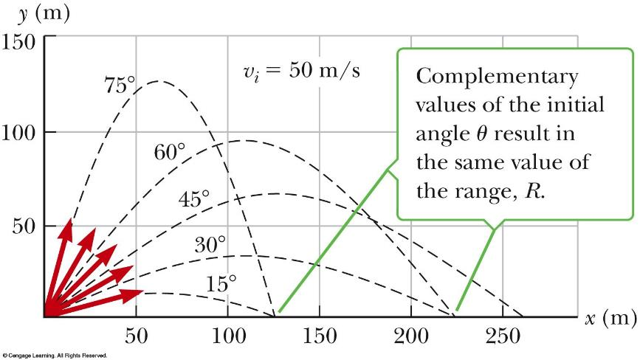
Two-Dimensional Motion
Notes:
Figure 3.6 A projectile launched from the origin with an initial speed of 50 m/s at various angles of projection.
This figure shows the effect of various initial angles. Notice that complementary angles give the same horizontal range.

Slide 24
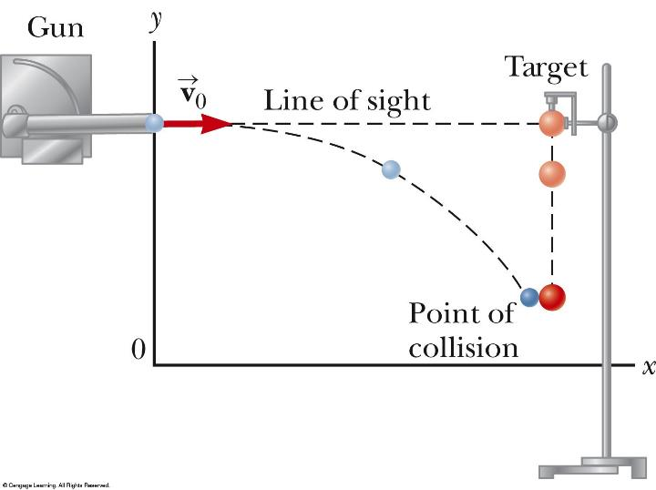
Two-Dimensional Motion
Notes:
Figure 3.7 A ball is fired at a target at the same instant the target is released. Both fall vertically at the same rate and collide.
This figure shows an experiment illustrating the independence of horizontal and vertical motion. The gun is aimed directly at the target ball and fired at the instant the target is released. In the absence of gravity, the projectile would hit the target because the target wouldn’t move. However, the projectile still hits the target in the presence of gravity. That means the projectile is falling through the same vertical displacement as the target despite its horizontal motion.

Slide 25
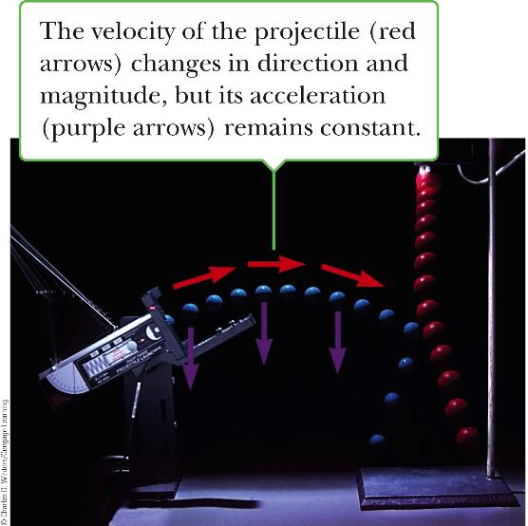
Two-Dimensional Motion
Notes:
Figure 3.8 Multiflash photograph of the projectile–target demonstration. If the gun is aimed directly at the target and is fired at the same instant the target begins to fall, the projectile will hit the target.
The experiment also works when set up as in the image shown, when the initial velocity has a vertical component.

Slide 26
Two-Dimensional Motion
Notes:
In general, our equations of constant acceleration follow separately for both the x-direction and the y-direction. Notice that the initial velocity has two components.
Let’s assume that at t = 0 the projectile leaves the origin with an initial velocity v₀. If the velocity vector makes an angle θ₀ with the horizontal, where θ₀ is called the projection angle, then from the definitions of the cosine and sine functions and the figure shown we can write these equations, [click to show equations] where v_{0x} is the initial velocity (at t = 0) in the x-direction and v_{0y} is the initial velocity in the y-direction.

Slide 27
Two-Dimensional Motion
Notes:
Our equations for motion with constant acceleration in one dimension carry over to the two-dimensional case; there is one set of three equations for each direction, as you can see here.
The object’s speed v can be calculated from the components of the velocity using the Pythagorean theorem: The angle that the velocity vector makes with the x-axis is given by the inverse tangent. This formula for θ, as you recall, must be used with care, because the inverse tangent function returns values only between –90° and +90°. Adding 180° is necessary for vectors lying in the second or third quadrant.

Slide 28
Two-Dimensional Motion
Notes:
Let’s write the kinematic equations for the case of projectiles close to Earth’s surface, when friction is negligible. Notice that the acceleration in the x-direction is 0, because air resistance is neglected. This means that a_{x} = 0, and the projectile’s velocity component along the x-direction remains constant. If the initial value of the velocity component in the x-direction is v_{0x} = v₀ cos θ₀, then this is also the value of v_{x} at any later time. The horizontal displacement can be written as shown.
For the motion in the y-direction, [click to show equations] we make the substitution a_{y} = –g and v_{0y} = v₀ sin θ₀ .

Slide 29
Two-Dimensional Motion
v_{x} is constant
a_{y} = –g.
v_{y} and y: identical to free-fall
Projectile motion: superposition of motions in the x- and y-directions.
Notes:
Let’s summarize the important facts about projectile motion.
1. Provided air resistance is negligible, the horizontal component of the velocity v_{x} remains constant because there is no horizontal component of acceleration.
2. The vertical component of the acceleration is equal to the free-fall acceleration –g.
3. The vertical component of the velocity and the displacement in the y-direction are identical to those of a freely falling body.
4. Projectile motion can be described as a superposition of two independent motions in the x- and y-directions.

Slide 30
Think – Pair – Share
Suppose you are carrying a ball and running at constant speed, and wish to throw the ball and catch it as it comes back down. You should
throw the ball at an angle of about 45° above the horizontal and maintain the same speed.
throw the ball straight up in the air and slow down to catch it.
throw the ball straight up in the air and maintain the same speed.
Notes:
Come with something on your own, talk it over with a classmate, and be ready to share it with the class in a couple of minutes.
Answer: throw the ball straight up in the air and maintain the same speed
Reasoning: A projectile has constant horizontal velocity. Thus, if the runner throws the ball straight up into the air, the ball maintains the horizontal velocity it had before it was thrown (that is, the velocity of the runner). In the runner’s frame of reference, the ball appears to go straight upward and come straight downward. To a stationary observer, the ball follows a parabolic trajectory, moving with the same horizontal velocity as the runner and staying above the runner’s hand.

Slide 31
Think – Pair – Share
As a projectile moves in its parabolic path, the velocity and acceleration vectors are perpendicular to each other
everywhere along the projectile’s path.
at the peak of its path.
nowhere along its path.
not enough information is given.
Notes:
Think for a minute, check with a classmate, and be ready to share your answer and justify it in about 2 minutes.
Answer: at the peak of its path
Reasoning: The velocity is always tangential to the path while the acceleration is always directed vertically downward. Thus, the velocity and acceleration are perpendicular only where the path is horizontal. This only occurs at the peak of the path.

Slide 32
Problem-Solving Strategy: Projectile Motion
Sketch projectile path
Resolve v₀ into components
Treat horizontal and vertical motion separately
Horizontal motion: constant velocity
Vertical motion: constant acceleration
Notes:
To solve projectile motion problems, follow this strategy.
Select a coordinate system and sketch the path of the projectile, including initial and final positions, velocities, and accelerations.
Resolve the initial velocity vector into x- and y-components.
Treat the horizontal motion and the vertical motion independently.
Follow the techniques for solving problems with constant velocity to analyze the horizontal motion of the projectile.
Follow the techniques for solving problems with constant acceleration to analyze the vertical motion of the projectile.

Slide 33
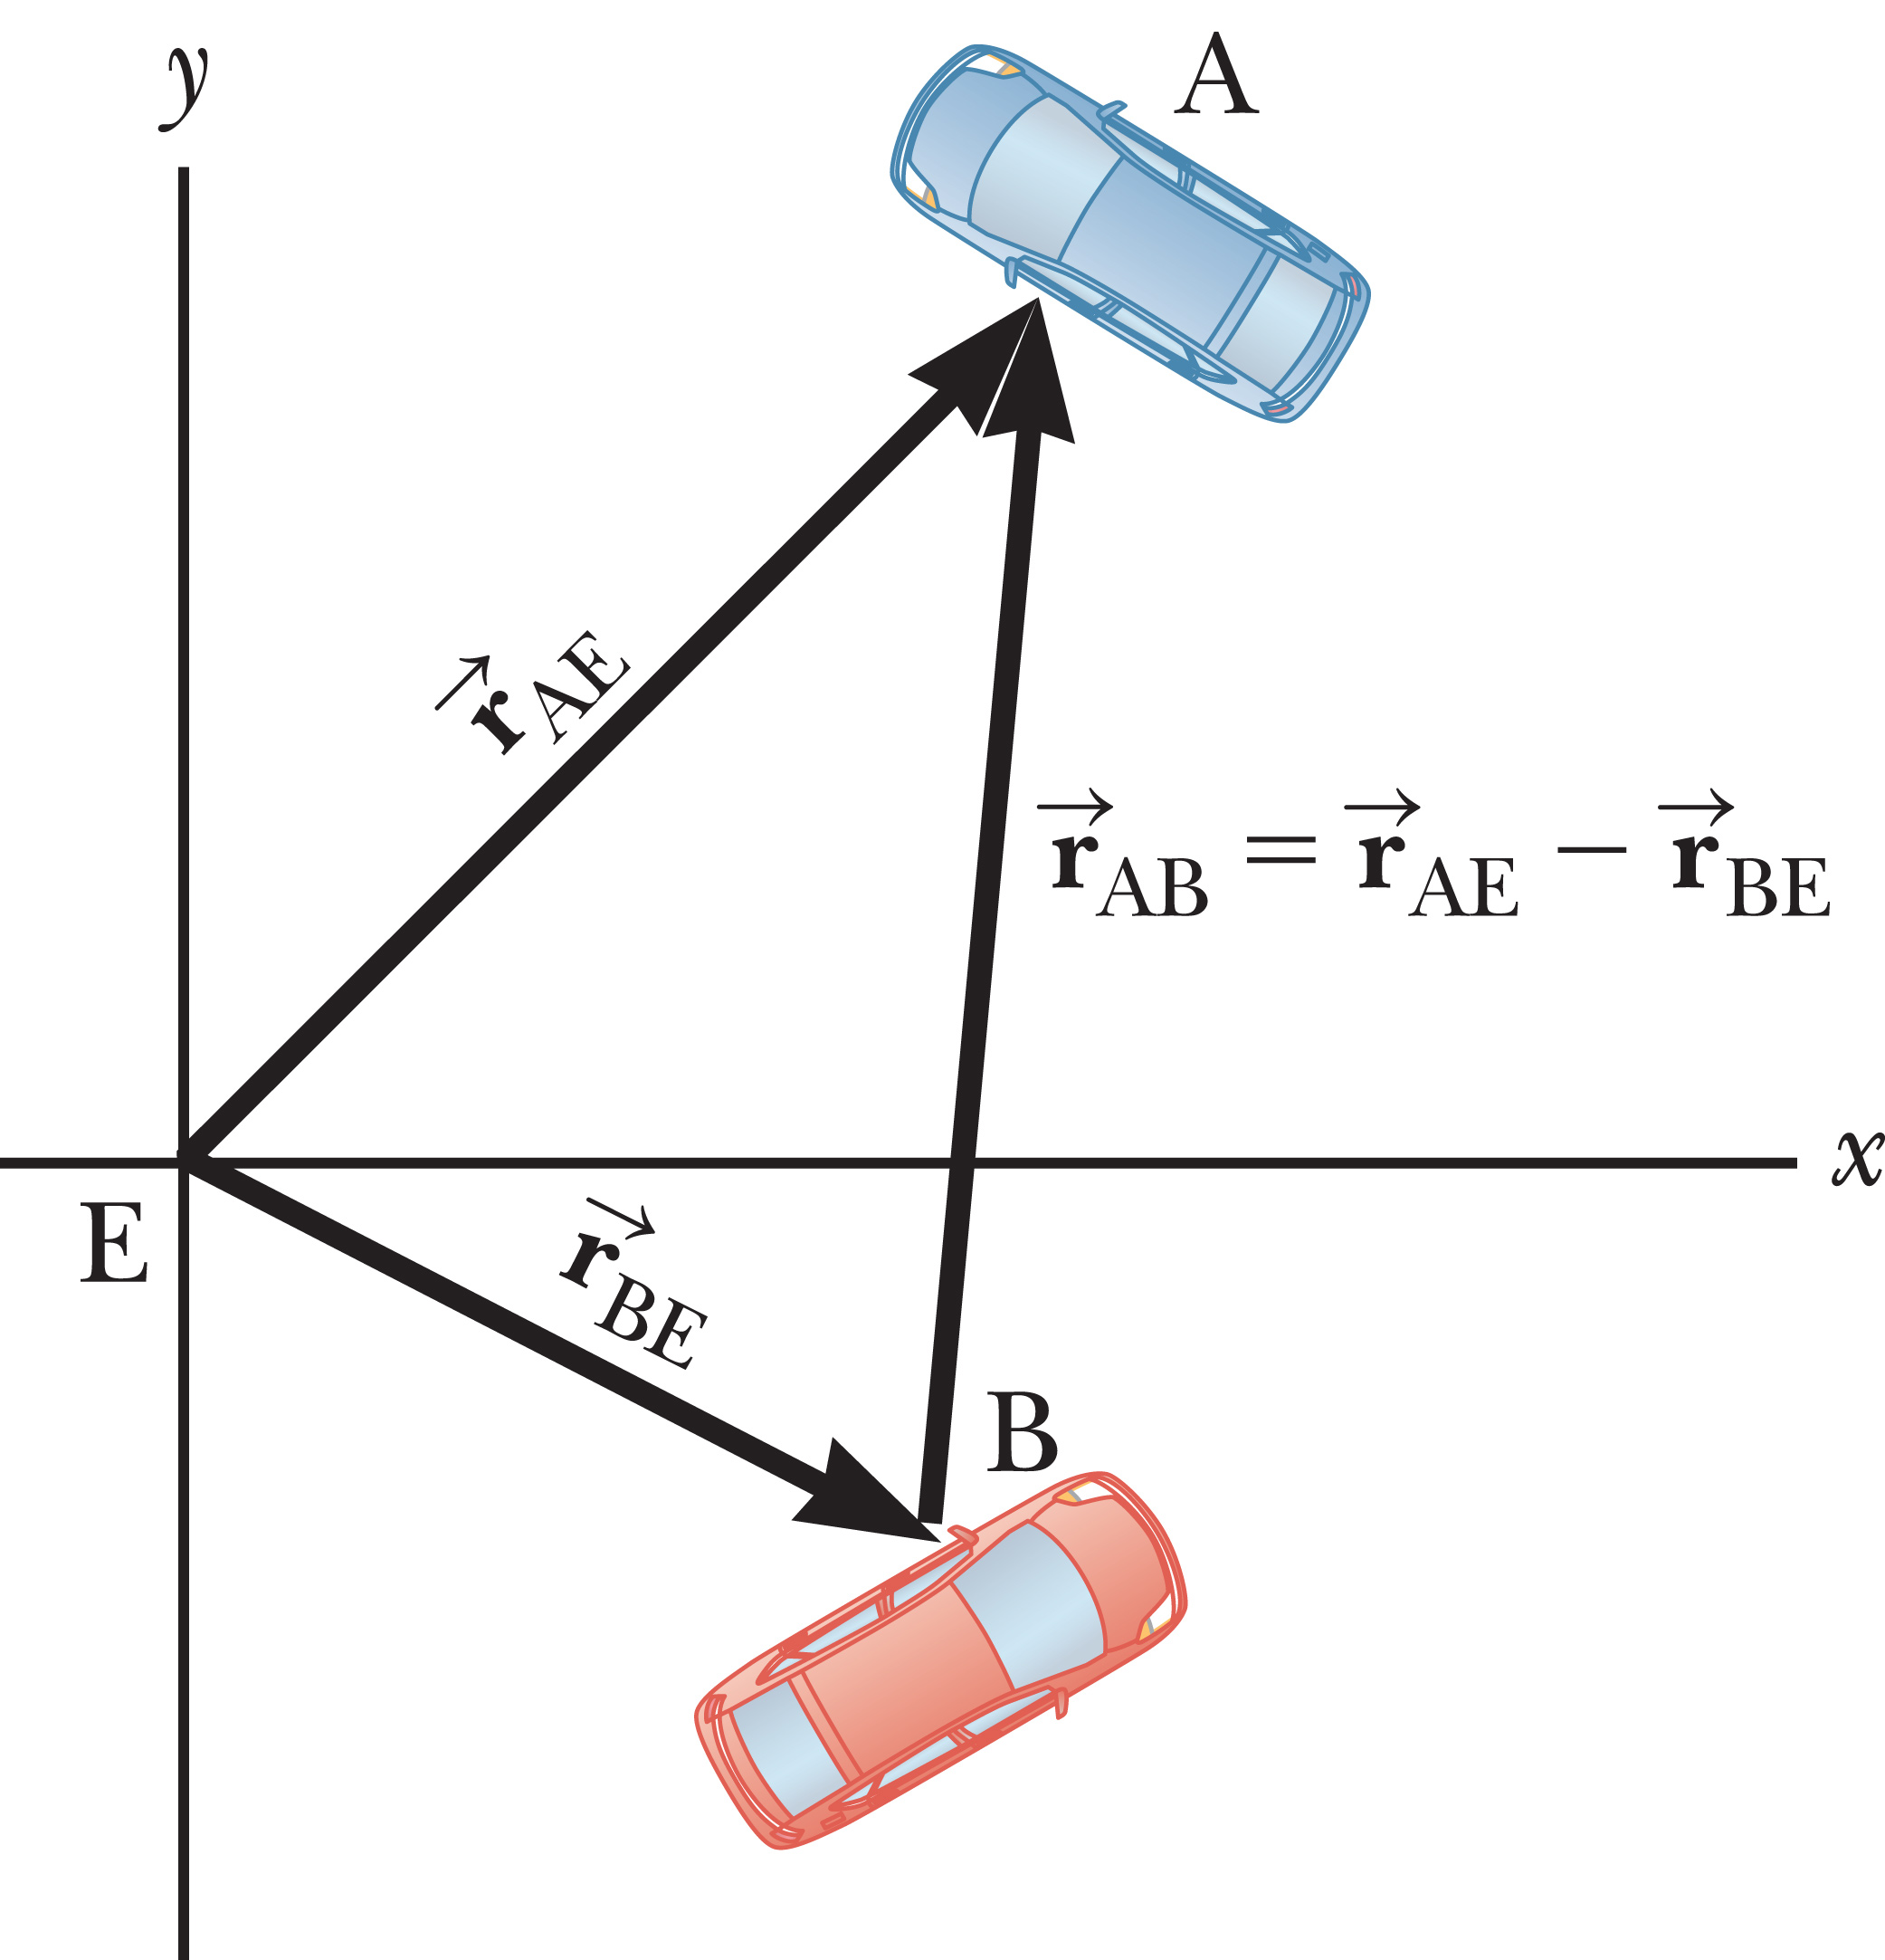
Relative Velocity
Notes:
Figure 3.14 The position of Car A relative to Car B can be found by vector subtraction. The rate of change of the resultant vector with respect to time is the relative velocity equation.
Relative velocity is all about relating the measurements of two different observers, one moving with respect to the other. The measured velocity of an object depends on the velocity of the observer with respect to the object.
Think about driving on a highway, for example. Cars moving in the same direction are often moving at high speed relative to Earth, but relative to each other they hardly move at all. To an observer at rest at the side of the road, a car might be traveling at 60 mi/h, but to an observer in a truck traveling in the same direction at 50 mi/h, the car would appear to be traveling only 10 mi/h.
So measurements of velocity depend on the reference frame of the observer. Reference frames are just coordinate systems. Most of the time, we use a stationary frame of reference relative to Earth, but occasionally we use a moving frame of reference associated with a bus, car, or plane moving with constant velocity relative to Earth.
In two dimensions relative velocity calculations can be confusing, so we will use a systematic approach. Look at the figure. E is an observer, assumed stationary with respect to Earth. The two cars are labeled A and B, and r_{AE} is the position of Car A as measured by E, in a coordinate system fixed with respect to Earth, r_{BE} is the position of Car B as measured by E, and r_{AB} is the position of Car A as measured by an observer in Car B. For this notation, the first letter tells us what the vector is pointing at and the second letter tells us where the position vector starts.
The position vectors of Car A and Car B relative to E, r_{AE} and r_{BE}, are given in the figure, so how do we find r_{AB}, the position of Car A as measured by an observer in Car B? We simply draw an arrow pointing from Car B to Car A, which can be obtained by subtracting r_{BE} from r_{AE}. [click to show equation]
Now, the rate of change of these quantities with time gives us the relationship between the associated velocities. [click to show equation]
The coordinate system of observer E doesn’t have to be fixed to Earth, although it often is.
Take careful note of the pattern of subscripts. Also, be aware that the equation doesn’t work for observers traveling a sizable fraction of the speed of light, when Einstein’s theory of special relativity comes into play.

Slide 34
Problem-Solving Strategy: Relative Velocity
Label objects
Write relative velocities
Write an equation similar to:.
Solve for the two unknown components
Notes:
Here is the strategy you can use when solving relative-velocity problems.
Label each object involved (usually three) with a letter that reminds you of what it is, for example E for Earth).
Look through the problem for phrases such as “The velocity of A relative to B” and write the velocities as v_{AB}. When a velocity is mentioned but it isn’t explicitly stated as relative to something, it’s almost always relative to Earth.
Take the three velocities you’ve found and assemble them into an equation similar to this one shown, with subscripts in an analogous order.
There will be two unknown components. Solve for them with the x- and y-components of the equation developed in step 3.

Slide 35
Assessing to Learn
Consider the following situations: · a car slowing down at a stop sign · a ball being swung in a circle at constant speed · a vibrating string · the Moon orbiting the Earth · a skydiver falling at terminal speed · an astronaut in an orbiting space station · a ball rolling down a hill · a person driving down a straight section of highway at constant speed with her foot on the accelerator · a molecule in the floor of this room In how many of the situations is the object accelerating?
Notes:
Try out your explanation on a classmate, and see if you buy theirs. We’ll get back together in about four minutes.
Answer: 7
Question A3.01
Commentary
Purpose: To introduce the concept of acceleration, explore your pre-existing definitions of the term, and contrast "everyday" usage of the word with the way physicists use it.
Discussion:
In physics, "acceleration" means the rate of change of velocity with respect to time. The more the velocity changes during a certain interval (say, 1 second), the larger the acceleration is.
There are three ways in which the velocity can change: (1) the speed increases; (2) the speed decreases; or (3) the direction of motion changes. If any one of these occurs, then the object is said to be "accelerating". In other words, unlike everyday usage, "accelerating" does not necessarily mean "speeding up".
When a car is slowing down, we say it is accelerating. We generally avoid the phrases "deceleration" and "negative acceleration" as unnecessary and unhelpful. We avoid "negative acceleration" because an object can have a negative value for acceleration and still be speeding up — for example, if it is moving in the negative direction.
When a ball is moving in a circle, its direction of motion is constantly changing, so it is accelerating even if its speed is constant.
A vibrating string (except for its endpoints) is accelerating at most instants in time, though it happens so quickly that we cannot perceive the changes in velocity. The only time it is not accelerating is when its speed is maximum. When the string stops and reverses direction at the extremes of its motion, its acceleration is largest.
The Moon orbiting the Earth is moving in a circle, so it is accelerating.
A skydiver moving at terminal speed has a constant velocity and thus zero acceleration.
An astronaut in an orbiting space station may not be moving relative to the space station, but the station is not a proper frame of reference since it is accelerating as it orbits the Earth. (In this course, a proper frame of reference has no acceleration.) The Earth is a better frame of reference, and the astronaut is moving in a circle around it, so she is accelerating.
A ball rolling down a hill generally speeds up.
A person (or car, or any object) moving at constant speed along a straight line has constant velocity, and thus zero acceleration. This is true even though we must press the "accelerator" pedal to maintain constant velocity.
A molecule in a solid that is not at absolute zero temperature is vibrating, so like the vibrating string it is accelerating most of the time. The solid as a whole may still be at rest.
Key Points:
An object's acceleration is the rate at which its velocity is changing.
If an object's speed or direction of motion changes, we say it is "accelerating".
We avoid using the phrases "deceleration" and "negative acceleration" to mean "slowing down".
For Instructors Only
A nice feature of this style of question ("how many of the following...") is that even if a student answers the "correct" number of objects (7), there are 36 different combinations to arrive at this answer, so there is really no need to focus any attention at all on the correctness of the students’ numerical answers. Rather, class discussion should proceed immediately to considering each situation independently and applying the definition of acceleration.
We encourage students to wrestle with their own definitions at this stage. This question may be used prior to any formal presentation of acceleration, since everyone already "knows" the term; the disagreements that typically arise prepare students to appreciate and better understand the formal definition.
It is not too early to mention forces, at least informally. Many students already have some ideas about force that can help them sort out what you are trying to explain regarding acceleration. For example, in the cases that have nonzero acceleration, identify the force(s) causing it; in cases with zero acceleration, discuss how any forces present balance out.
Source: UMass Assessing to Learn

Slide 36
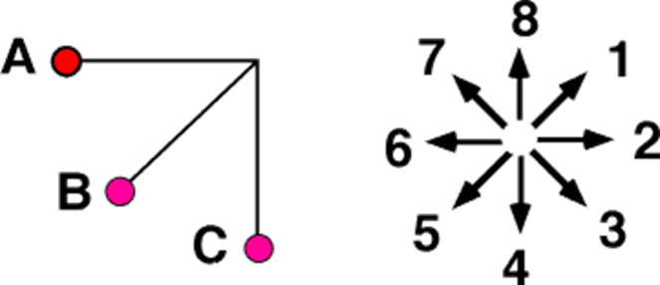
Assessing to Learn
A pendulum is released from rest at position A and swings toward the vertical under the influence of gravity as depicted below. When at position B, which direction most nearly corresponds to the direction of the acceleration?
Notes:
Figure out your answer, check it with a classmate, and be ready to share in about two minutes.
Answer: 2
Question A3.02
Commentary
Purpose: Develop your understanding of the vector nature of acceleration in curvilinear motion.
Description:
Acceleration is the rate of change of velocity. If an object's speed is changing, that means the length of its velocity vector is changing, so the acceleration must have a nonzero component parallel to the velocity vector. If an object's direction of motion is changing, that means the direction of the velocity vector is changing, so the acceleration must have a nonzero component perpendicular to the velocity vector.
At point B, the pendulum bob is both speeding up and changing direction. At that moment its velocity points in a direction tangential to the circular path it follows: direction (3). Since it is speeding up, the acceleration must have a component that points in direction (3). Since it is traveling in a curved path, it must have an acceleration component that points towards the center of the curve (the so-called "centripetal acceleration"), direction (1). Thus, the acceleration vector must point somewhere between directions (1) and (3), so (2) is probably the best choice. (To find the exact direction, we would have to calculate the relative sizes of these two components of the acceleration.)
Key Points:
Acceleration is a vector that describes the rate of change of the velocity vector's magnitude and its direction.
It is often useful to divide the acceleration into components that are parallel (tangential) and perpendicular to the object's direction of motion.
A nonzero tangential component of acceleration indicates that the object is changing speed.
A nonzero perpendicular component of acceleration indicates that the object is changing direction.
For Instructors Only
Students often neglect one component or the other in this question. Common answers include (1) (fixated on the centripetal acceleration or the string), (3) (fixated on tangential acceleration and the increase in speed), and (4) (fixated on gravity).
Students choosing answer (5) might be revealing a misunderstanding of the fictitious "centrifugal force".
Answer (9), impossible to determine, is defensible if chosen because students don't know enough to determine the relative sizes of the two acceleration components, and therefore can't choose among directions (1), (2), and (3).
Source: UMass Assessing to Learn

Slide 37
TOPIC summary
Topic 3: Motion in Two Dimensions

Slide 39
Topic Summary
Displacement, Velocity, and Acceleration in Two Dimensions
Notes:
Displacement, Velocity, and Acceleration in Two Dimensions
The displacement of an object in two dimensions is defined as the change in the object’s position vector.
The average velocity of an object during the time interval Δt is shown here. Taking the limit of this expression as Δt gets arbitrarily small gives the instantaneous velocity v.
The direction of the instantaneous velocity vector is along a line that is tangent to the path of the object and in the direction of its motion.
The average acceleration of an object with a velocity changing by Δv in the time interval Δt is shown. Taking the limit of this expression as Δt gets arbitrarily small gives the instantaneous acceleration a.

Slide 40
Topic Summary
Two-Dimensional Motion
Notes:
Two-Dimensional Motion
The general kinematic equations in two dimensions for objects with constant acceleration are, for the x- and y- directions, are given here.
The speed v of the object at any instant can be calculated from the components of velocity at that instant using the Pythagorean theorem, and the angle that the velocity vector makes with the x-axis can be found by taking the inverse tangent.

Slide 41
Topic Summary
Two-Dimensional Motion
Notes:
Two-Dimensional Motion
The horizontal and vertical motions of a projectile are completely independent of each other.

Slide 42
Topic Summary
Two-Dimensional Motion
Notes:
Two-Dimensional Motion
The kinematic equations are easily adapted and simplified for projectiles close to the surface of the Earth. The equations for the motion in the horizontal, or x-direction, and the vertical, or y-direction, are shown here.
Problems are solved by algebraically manipulating one or more of these equations, which often reduces the system to two equations and two unknowns.

Slide 43
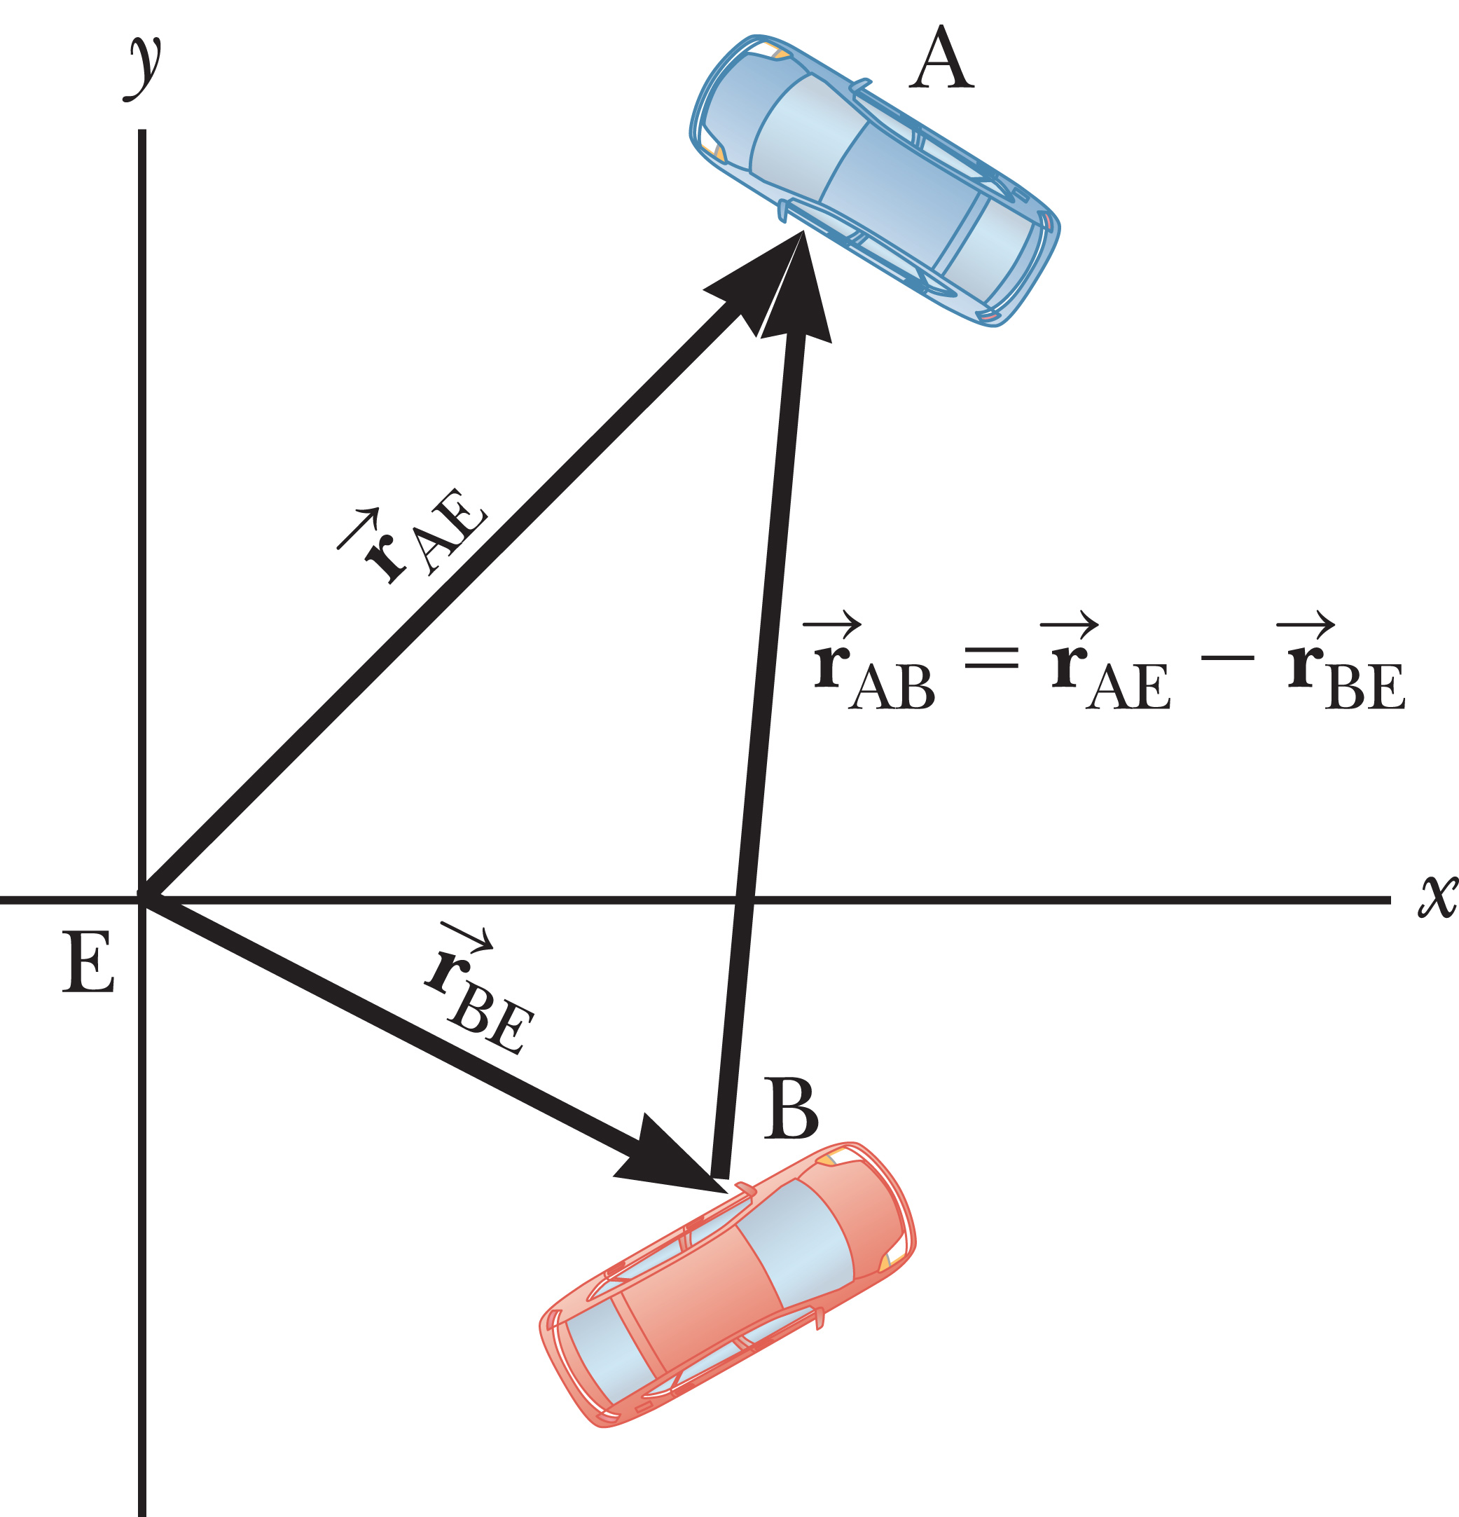
Topic Summary
Relative Velocity
Notes:
Two-Dimensional Motion
Let E be an observer, and B a second observer traveling with velocity v_{BE} as measured by E, as shown in the figure. If E measures the velocity of an object A as v_{AE}, then B will measure A’s velocity as v_{AB} = v_{AE} – v_{BE}. The relative velocity equation can be derived from the figure by dividing the relative position equation by the Δt and taking the limit as Δt goes to zero.
Solving relative velocity problems involves identifying the velocities properly and labeling them correctly, substituting into the equation, and then solving for unknown quantities.

