Slide 1
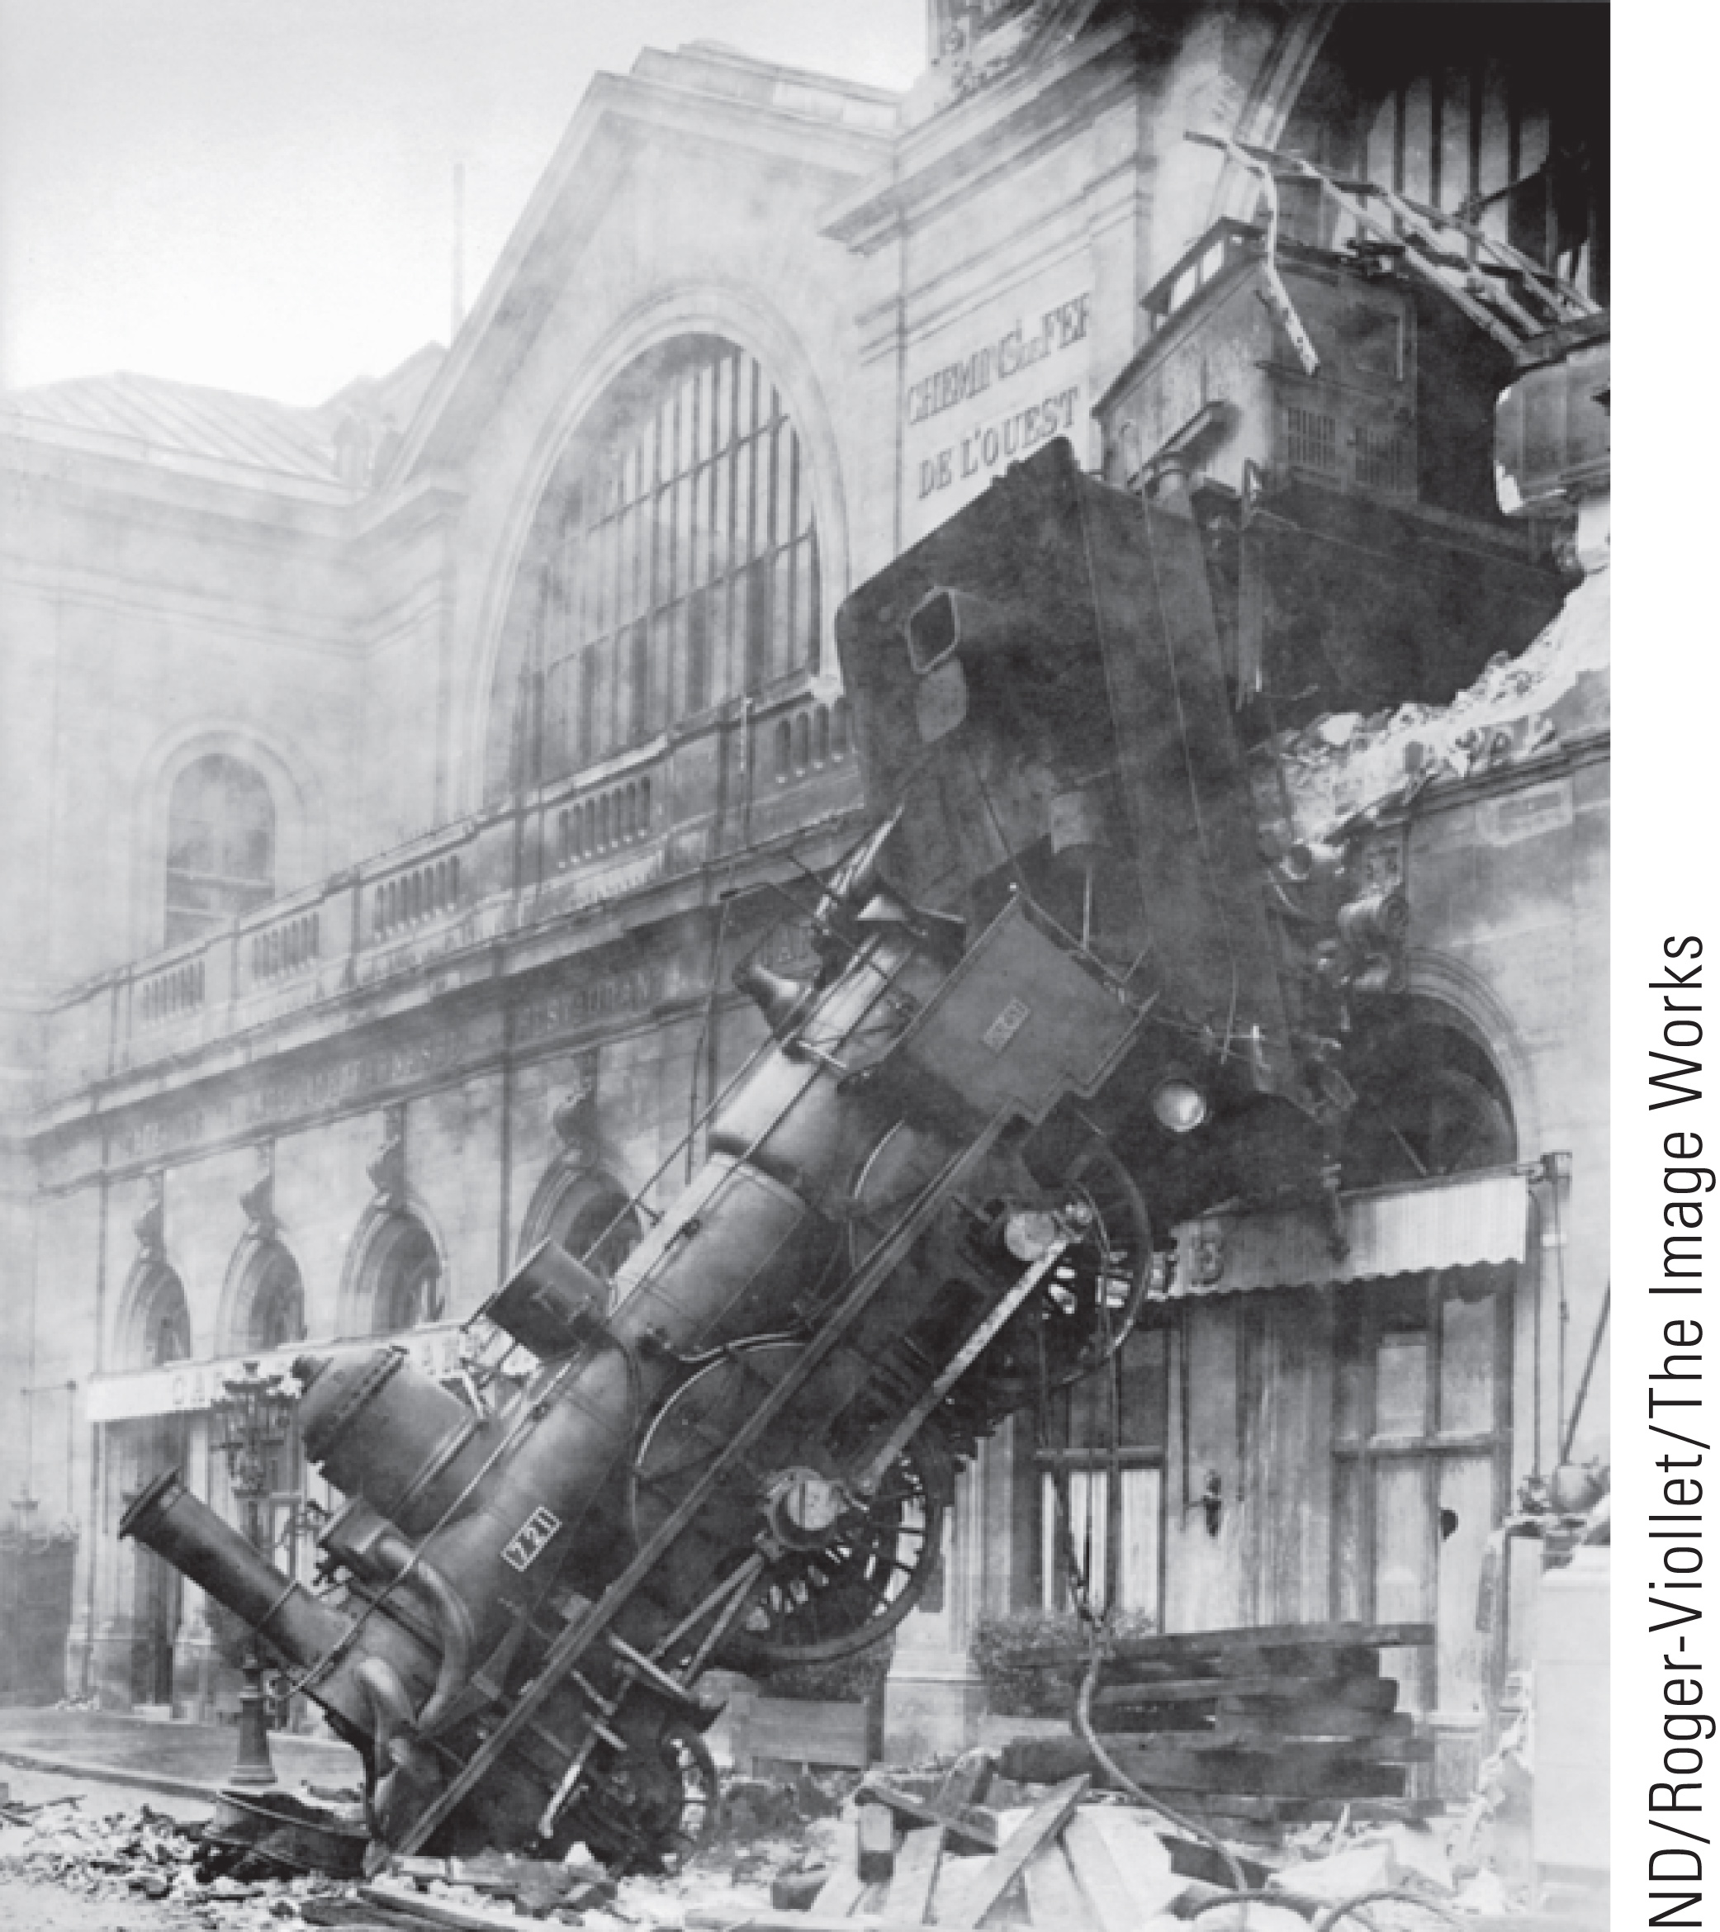
Topic 4: Newton’s Laws of Motion
College Physics, 11e
Raymond A. Serway; Chris Vuille

Slide 3
Reading Question 4.1
An object moves with a constant velocity. Which of the following cannot be true for the object?
No forces act on the object.
A single force acts on the object.
Two forces act on the object.
Three forces act on the object.
©Cengage

Slide 4
Reading Question 4.1
An object moves with a constant velocity. Which of the following cannot be true for the object?
No forces act on the object.
A single force acts on the object.
Two forces act on the object.
Three forces act on the object.
©Cengage

Slide 5
Reading Question 4.2
An object accelerates when it experiences a nonzero net force. Which of the following statements is always true?
The object moves in the direction of the net force.
The object’s velocity increases.
The object’s velocity is in the same direction as its acceleration.
The object’s acceleration is in the same direction as the net force that acts on it.
©Cengage

Slide 6
Reading Question 4.2
An object accelerates when it experiences a nonzero net force. Which of the following statements is always true?
The object moves in the direction of the net force.
The object’s velocity increases.
The object’s velocity is in the same direction as its acceleration.
The object’s acceleration is in the same direction as the net force that acts on it.
©Cengage

Slide 7
Reading Question 4.3
A model rocket of mass, m, is fired upward from a launch pad with some initial speed, v. A gravitational force is exerted on the rocket
at all points in its motion except at it highest point.
at all points in its motion.
at no points in its motion.
at none of these choices.
©Cengage

Slide 8
Reading Question 4.3
A model rocket of mass, m, is fired upward from a launch pad with some initial speed, v. A gravitational force is exerted on the rocket
at all points in its motion except at it highest point.
at all points in its motion.
at no points in its motion.
at none of these choices.
©Cengage

Slide 9
Reading Question 4.4
A race car, moving quickly around a track, collides with a mosquito, which splatters on the car’s windshield. Which object experiences a greater magnitude impact force?
Both experience the same force.
One cannot tell; you need to know the speeds of the mosquito and the race car.
The mosquito
The race car
©Cengage

Slide 10
Reading Question 4.4
A race car, moving quickly around a track, collides with a mosquito, which splatters on the car’s windshield. Which object experiences a greater magnitude impact force?
Both experience the same force.
One cannot tell; you need to know the speeds of the mosquito and the race car.
The mosquito
The race car
©Cengage

Slide 11
Reading Question 4.5
A race car, moving quickly around a track, collides with a mosquito, which splatters on the car’s windshield. Which object experiences a greater magnitude acceleration?
Both experience the same acceleration.
The race car
The mosquito
One cannot tell; you need to know the speeds of the mosquito and the race car.
©Cengage

Slide 12
Reading Question 4.5
A race car moving quickly around a track collides with a mosquito, which splatters on the car’s windshield. Which object experiences a greater magnitude acceleration?
Both experience the same acceleration.
The race car
The mosquito
One cannot tell; you need to know the speeds of the mosquito and the race car.
©Cengage

Slide 13
Reading Question 4.6
When you sit in a chair, there is necessarily a reaction force to the gravitational force acting on your body. Which of the following best describes this reaction force?
The force of gravity you exert on the Earth
The force you exert downward on the seat of the chair
The normal force exerted by the chair onto you
None of these forces
©Cengage

Slide 14
Reading Question 4.6
When you sit in a chair, there is necessarily a reaction force to the gravitational force acting on your body. Which of the following best describes this reaction force?
The force of gravity you exert on the Earth
The force you exert downward on the seat of the chair
The normal force exerted by the chair onto you
None of these forces
©Cengage

Slide 15
TOPIC Discussion
Topic 4: Newton’s Laws of Motion
©Cengage
Notes:
Now we turn our attention to classical mechanics, which describes the relationship between the motion of objects and the forces acting on them. If we aren’t looking at objects comparable to the size of atoms or traveling close to the speed of light, classical mechanics is an excellent description of nature. In this topic, we will look at Newton’s three laws of motion and his law of gravity. These are considered to be among the greatest achievements of the human mind.

Slide 16
Forces
©Cengage
Notes:
You can imagine a force as a push or a pull on some object, for example, when a tennis ball is hit with a racket. The player can hit the ball at different speeds and direct it into different parts of the opponent’s court. The applied force has magnitude and direction, so force is a vector quantity, just like velocity and acceleration.

Slide 17
Forces
©Cengage
Notes:
Imagine pulling on a spring. The spring stretches. If you pull hard enough on a wagon, the wagon moves. When you kick a football, it deforms briefly and is set in motion.
These are all examples of contact forces, which result from physical contact between two objects. Other examples of contact forces are the ground that supports us and walls that block our progress. Friction forces both enable and impede motion. These properties are primarily electromagnetic forces, which are very strong and have a long range.
Remember that atoms are composed of tightly bound nuclei of neutrons and protons surrounded by swarms of electrons. If we imagine the proton in a hydrogen atom to be the size of a ping-pong ball, the electron would be the size of a bacterium, at most, and would orbit the nucleus at a distance of a kilometer. The electrons in atoms are responsible for the forces that form chemical bonds and more extended structures, such as crystals or membranes and tissues, which results in the macroscopic world of everyday life.
The normal force, which we will look at in detail shortly, prevents us from falling toward the center of the Earth and is due to an enormous number of electromagnetic interactions between the ground and the soles of our feet. We can’t walk on water because the hydrogen bonds between water molecules are too weak and random. If the water freezes to ice, the stronger crystalline structure supports our weight.
Other contact forces have similar origins. The tension force of a string depends on fibers, which in turn depend on microscopic and molecular structures ultimately created by electromagnetic forces. Friction forces result from microscopic irregularities of the areas in contact.

Slide 19
Forces
©Cengage
Notes:
Another class of forces doesn’t involve any direct physical contact. Early scientists, including Newton, were uneasy with the concept of forces that act between two disconnected objects. Even so, Newton used this “action-at-a-distance” concept in his law of gravity, which says a mass at one location, such as the Sun, affects the motion of a distant object, such as Earth even though the two are not in evident physical contact.
Michael Faraday, who lived from 1791 to 1867, introduced the concept of a field to help conceptualize these action-at-a-distance phenomena. The corresponding forces are called field forces. According to this approach, an object of mass M, such as the Sun, creates an invisible influence that stretches throughout space. A second object of mass m, such as Earth, interacts with the field of the Sun, not directly with the Sun itself. So the force of gravitational attraction between two objects, illustrated in the left-hand figure, is an example of a field force. The force of gravity keeps objects bound to Earth and also gives rise to what we call the weight of those objects.
Another common example of a field force is the electric force that one electric charge exerts on another, as depicted in the middle figure. A third example is the force exerted by a bar magnet on a piece of iron, as shown on the right.

Slide 20
Forces
The strong nuclear force
The electromagnetic force
The weak nuclear force
The gravitational force
©Cengage
Notes:
The known fundamental forces in nature are all field forces. These are, in order of decreasing strength,
the strong nuclear force between subatomic particles;
the electromagnetic forces between electric charges;
the weak nuclear force, which arises in certain radioactive decay processes; and
the gravitational force between objects.
The strong force keeps the nucleus of an atom from flying apart due to the repulsive electric force of the protons. The weak force is involved in most radioactive processes and is important in the nuclear reactions that generate the Sun’s energy output. The strong and weak forces operate only on the nuclear scale, with a very short range on the order of 1^{0–15} m. Outside this range they have no influence. Classical physics deals only with gravitational and electromagnetic forces, which have infinite range.

Slide 21
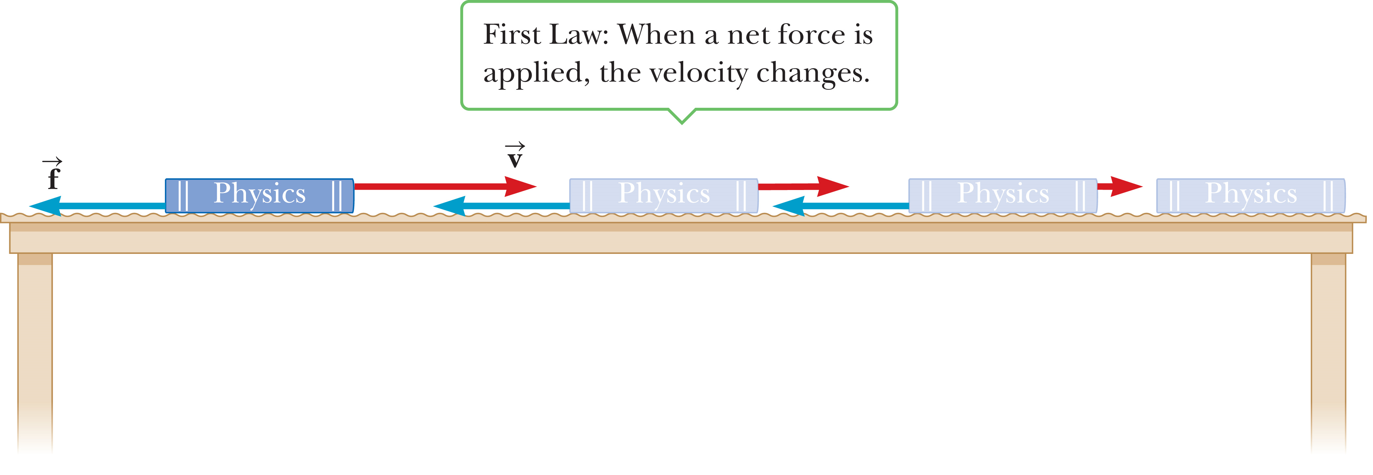
Newton’s First Law
©Cengage
Notes:
Think about a book lying on a table. If we leave the book alone, it remains at rest. Now imagine pushing the book with a horizontal force great enough to overcome the force of friction between the book and the table, setting the book in motion. Because the magnitude of the applied force exceeds the magnitude of the friction force, the book accelerates, as illustrated in the figure. When the applied force is withdrawn, friction slows the book to a stop.

Slide 22
Newton’s First Law
©Cengage
Notes:
Now imagine pushing the book across a smooth, waxed floor. The book again comes to rest once the force is no longer applied, but not as quickly as before. Finally, if the book is moving on a horizontal frictionless surface, as shown in this figure, it continues to move in a straight line with constant velocity until it hits a wall or some other obstruction.

Slide 23
Newton’s First Law
Newton’s first law of motion: An object moves with a velocity that is constant in magnitude and direction unless a nonzero net force acts on it.
©Cengage
Notes:
Before about 1600, it was generally assumed that the natural state of matter was the state of rest. Galileo Galilei devised thought experiments—such as an object moving on a frictionless surface, as in the previous slide—and concluded that it’s not the nature of an object to stop once set in motion, but rather to continue in its original state of motion. This idea was later formalized as Newton’s first law of motion: An object moves with a velocity that is constant in magnitude and direction unless a nonzero net force acts on it.
The net force on an object is defined as the vector sum of all external forces exerted on the object. External forces come from the object’s environment. If an object’s velocity isn’t changing in either magnitude or direction, then its acceleration and the net force acting on it must both be zero. Internal forces, on the other hand, originate within the object itself and can’t change the object’s velocity, although we will see in a later topic that they can change an object’s rate of rotation. Because they don’t influence an object’s velocity, internal forces aren’t included in Newton’s first law. It’s not really possible to “pull yourself up by your own bootstraps.”

Slide 24
Mass and Inertia
Inertia: The tendency of an object to continue in its original state of motion.
Mass: A measure of the object’s resistance to changes in its motion due to a force.
©Cengage
Notes:
Imagine hitting a golf ball off a tee with a driver. If you’re a good golfer, the ball will sail a couple of hundred yards down the fairway. Now imagine teeing up a bowling ball and striking it with the same club, not really something I would recommend! Your club would probably break, you might sprain your wrist, and the bowling ball, at best, would fall off the tee, take half a roll, and come to rest. From this, we can conclude that although both balls resist changes in their state of motion, the bowling ball offers much more effective resistance.
The tendency of an object to continue in its original state of motion is called inertia.
A measure of the object’s resistance to changes in its motion due to a force is called mass.
This kind of mass is often called inertial mass because it’s associated with inertia.
The greater the mass of a body, the less it accelerates under the action of an applied force. The SI unit of mass is the kilogram. Mass is a scalar quantity, so it obeys the rules of ordinary arithmetic.

Slide 25
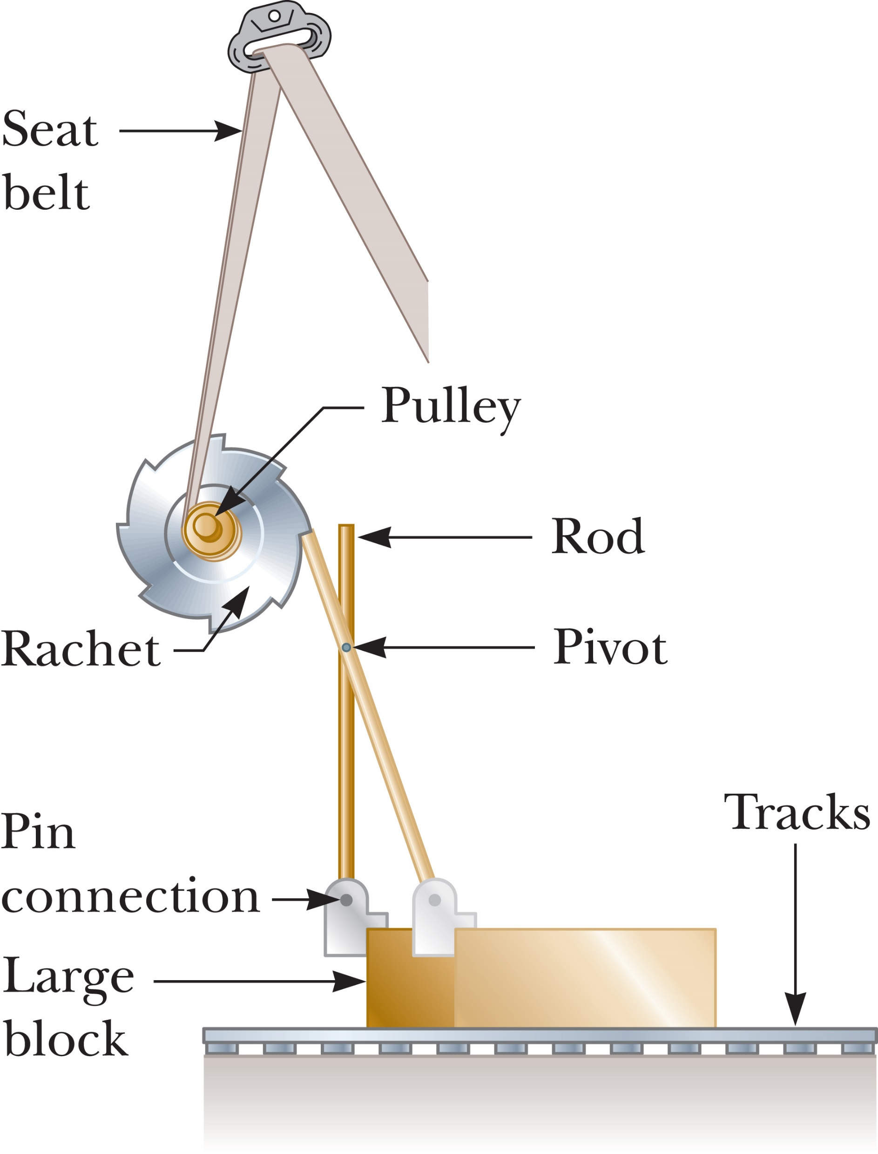
Newton’s First Law
©Cengage
Notes:
We can use the concept of inertia to explain the operation of a type of seat belt mechanism. As you know, the purpose of the seat belt is to hold the passenger firmly in place relative to the car, to prevent serious injury in the event of an accident. Take a look at the figure. Under normal conditions, the ratchet turns freely to allow the harness to wind on or unwind from the pulley as the passenger moves. In an accident, the car undergoes a large acceleration and rapidly comes to rest. Because of its inertia, the large block under the seat continues to slide forward along the tracks. The pin connection between the block and the rod causes the rod to pivot about its center and engage the ratchet wheel. At this point, the ratchet wheel locks in place, and the harness no longer unwinds.

Slide 26
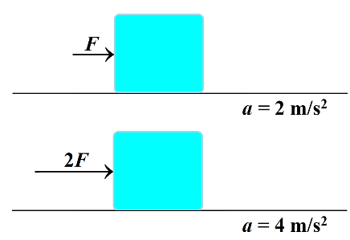
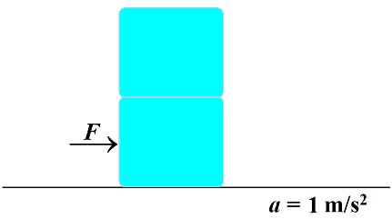
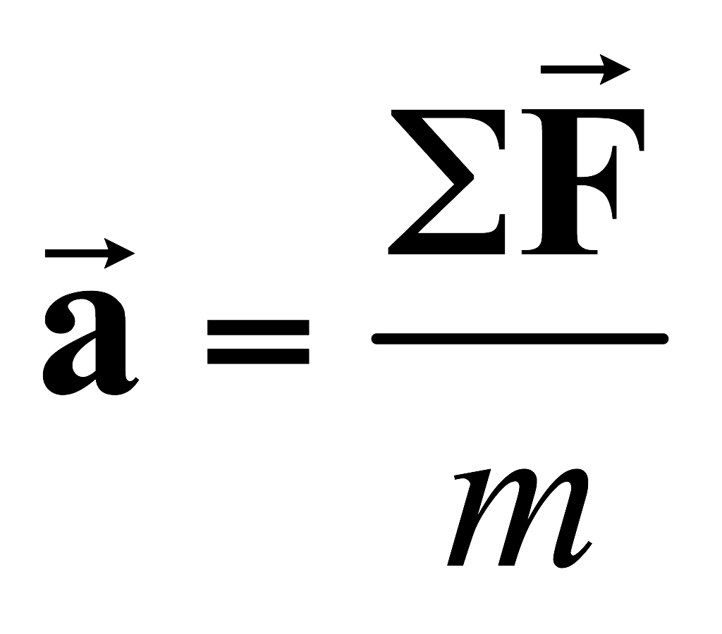
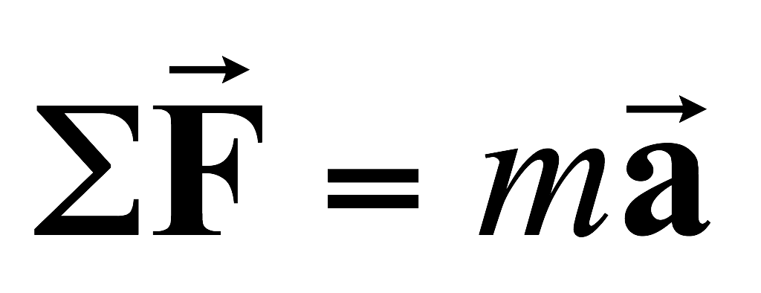
Newton’s Second Law
Acceleration directly proportional to net force
Acceleration inversely proportional to mass
©Cengage
Notes:
Newton’s first law explains what happens to an object that has no net force acting on it: the object either remains at rest or continues moving in a straight line with constant speed. Newton’s second law answers the question of what happens to an object that does have a net force acting on it.
Imagine pushing a block of ice across a frictionless horizontal surface. When you exert some horizontal force on the block, it moves with an acceleration of, say, 2 m/s². If you apply a force twice as large, the acceleration doubles to 4 m/s². Pushing three times as hard triples the acceleration, and so on. From observations like these, we conclude that [click to show text] the acceleration of an object is directly proportional to the net force acting on it.
Mass also affects acceleration. Suppose you stack identical blocks of ice on top of one another while pushing the stack with constant force. If the force applied to one block produces an acceleration of 2 m/s², then the acceleration drops to half that value, 1 m/s², when two blocks are pushed; to one-third the initial value when three blocks are pushed; and so on. We can conclude that [click to show text] the acceleration of an object is inversely proportional to its mass.
These observations are summarized in Newton’s second law: [click to show equation] The acceleration a of an object is directly proportional to the net force acting on it and inversely proportional to its mass, where a is the acceleration of the object, m is its mass, and ΣF is the vector sum of all forces acting on it.
Multiplying through by m, [click to show equation] we have the result shown. Physicists commonly refer to this equation as “F = ma.”

Slide 27
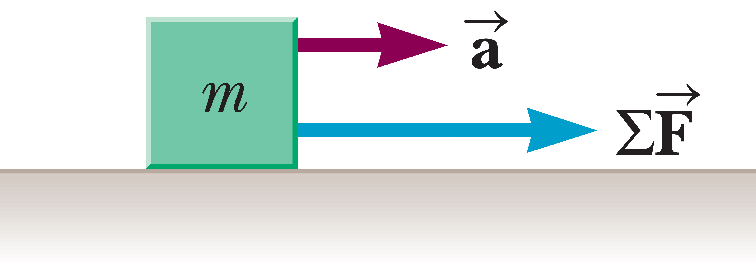
Newton’s Second Law
©Cengage
Notes:
The figure illustrates the relationship between the mass, acceleration, and the net force. The second law is a vector equation, so has three the components shown. When there is no net force on an object, its acceleration is zero, which means the velocity is constant.

Slide 28
Units of Force and Mass
©Cengage
Notes:
The SI unit of force is the newton. When 1 newton of force acts on an object that has a mass of 1 kg, it produces an acceleration of 1 m/s² in the object. From this definition and Newton’s second law, we see that the newton can be expressed in terms of the fundamental units of mass, length, and time. In the U.S. customary system, the unit of force is the pound.
The table summarizes the units of mass, acceleration, and force in the SI and U.S. customary systems.

Slide 29
Think – Pair – Share
True or false? An object can move even when no force acts on it.
©Cengage
Notes:
Think about it, share your thoughts with another classmate, and in 2 minutes we’ll all talk it through together.
Answer: True
Reasoning: If the resultant force on an object is zero (either because no forces are present or the vector sum of the forces present is zero), the object can still move with constant velocity.

Slide 30
Think – Pair – Share
True or false? If an object isn’t moving, no external forces act on it.
©Cengage
Notes:
Think about it, talk to your neighbor, and let’s talk in a minute.
Answer: False
Reasoning: An object that remains at rest has zero acceleration. However, any number of external forces could be acting on it, provided that the vector sum of these forces is zero.

Slide 31
Think – Pair – Share
True or false? If a single force acts on an object, the object accelerates.
©Cengage
Notes:
Consider your answer, share with your classmate, and be ready to share with all of us in a minute or two.
Answer: True
Reasoning: When a single force acts, the resultant force cannot be zero, and the object must accelerate.

Slide 32
Think – Pair – Share
True or false? If an object accelerates, at least one force is acting on it.
©Cengage
Notes:
Come up with your response, check with your neighbor, and share with the class in a minute.
Answer: True
Reasoning: When an object accelerates, a set containing one or more forces with a nonzero resultant must be acting on it.

Slide 33
Think – Pair – Share
True or false? If an object isn’t accelerating, no external force is acting on it.
©Cengage
Notes:
Come up with an answer, talk about it with your neighbor, and let’s see what you come up with in about a minute.
Answer: False
Reasoning: If the resultant force on an object is zero (either because no forces are present or the vector sum of the forces present is zero), the object can still move with constant velocity.

Slide 34
Think – Pair – Share
True or false? If the net force acting on an object is in the positive x-direction, the object moves only in the positive x-direction.
©Cengage
Notes:
Figure out the answer, check to see if your neighbor agrees, and in a minute or so we’ll talk about it as a group.
Answer: False
Reasoning: If the net force is in the positive x-direction, the acceleration will be in the positive x-direction. However, the velocity of an object does not have to be in the same direction as its acceleration (consider the motion of a projectile).

Slide 35
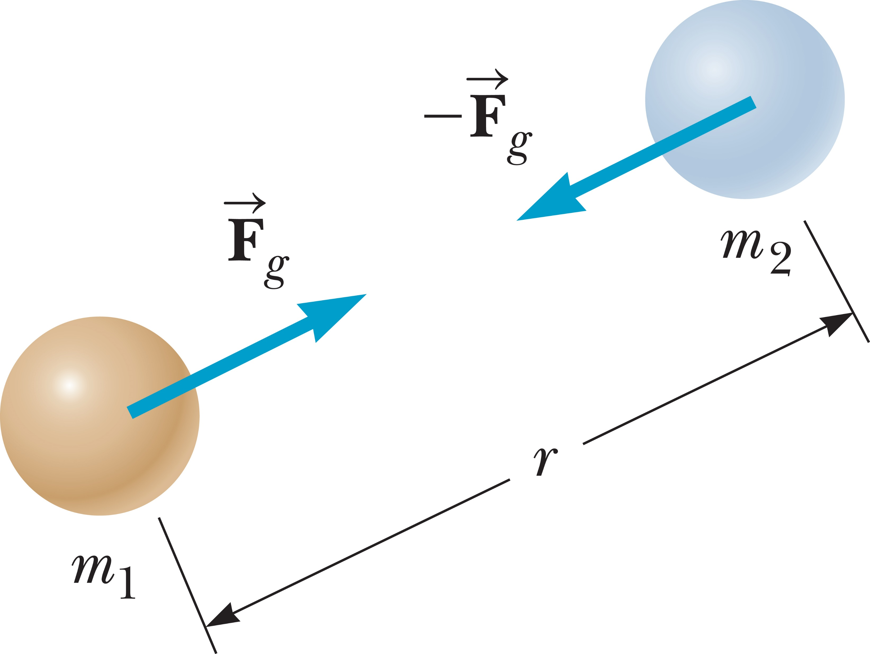
The Gravitational Force
©Cengage
Notes:
The gravitational force is the mutual force of attraction between any two objects in the Universe. Even though the gravitational force can be very strong between very large objects, it’s the weakest of the fundamental forces.
Let’s see just how weak gravity is. Imagine rubbing a balloon in your hair, which gives the balloon a tiny electric charge. Because of electric forces, the balloon will stick to a wall, and resist the gravitational pull of the entire Earth!
Newton’s law of universal gravitation states that every particle in the Universe attracts every other particle with a force that is directly proportional to the product of the masses of the particles and inversely proportional to the square of the distance between them. If the particles have masses m₁ and m₂ and are separated by a distance r, as in the figure, the magnitude of the gravitational force F_{g} is [click to show equation] given here, where G is the universal gravitation constant. We will take a closer look at the gravitational force in a later topic.

Slide 36
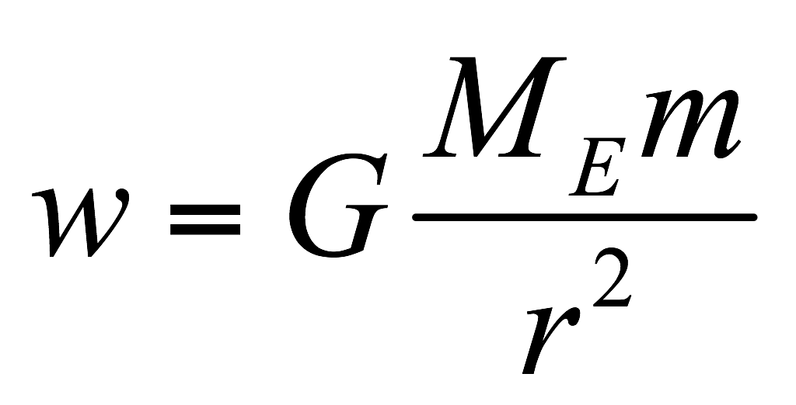
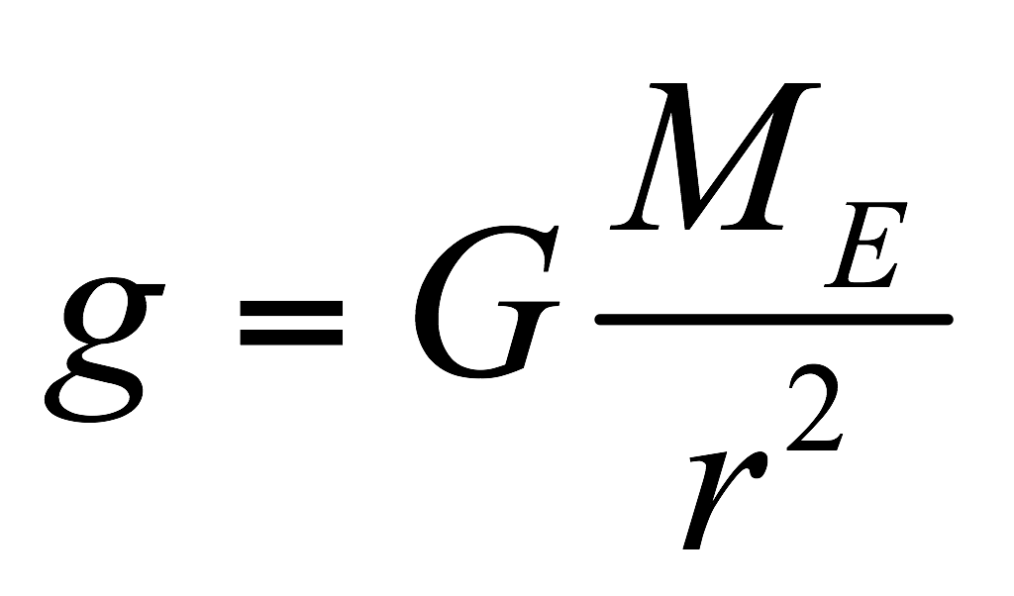
Weight
©Cengage
Notes:
The magnitude of the gravitational force acting on an object of mass m is called the weight w of the object, given by the equation shown, where g is the acceleration of gravity.
We can write an alternate definition of the weight of an object with mass m using Newton’s law of gravitation, [click to show equation] where M_{E} is the mass of Earth and r is the distance from the object to Earth’s center. If the object is at rest on Earth’s surface, then r is equal to Earth’s radius R_{E}. Because r² is in the denominator, we can see that the weight decreases with increasing r. So the weight of an object on a mountaintop is less than the weight of the same object at sea level.
Comparing these two equations, we can write g, [click to show equation] the gravitational acceleration, as shown.

Slide 37
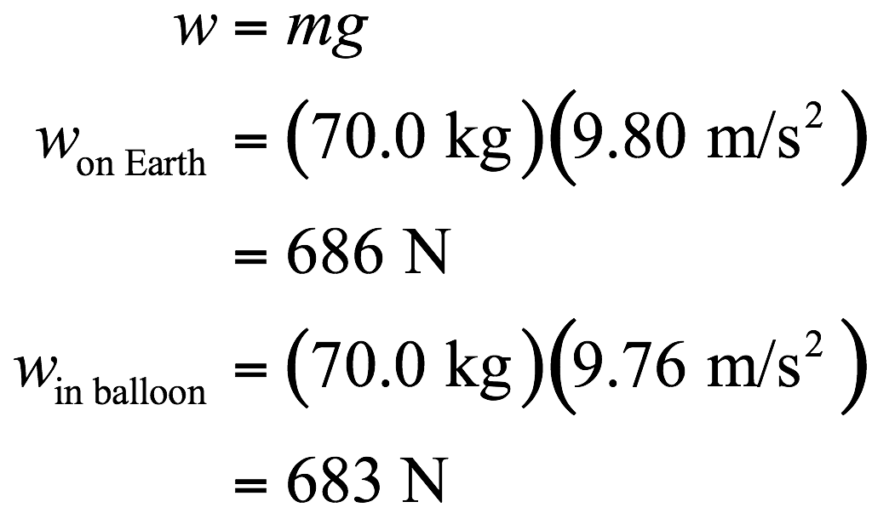
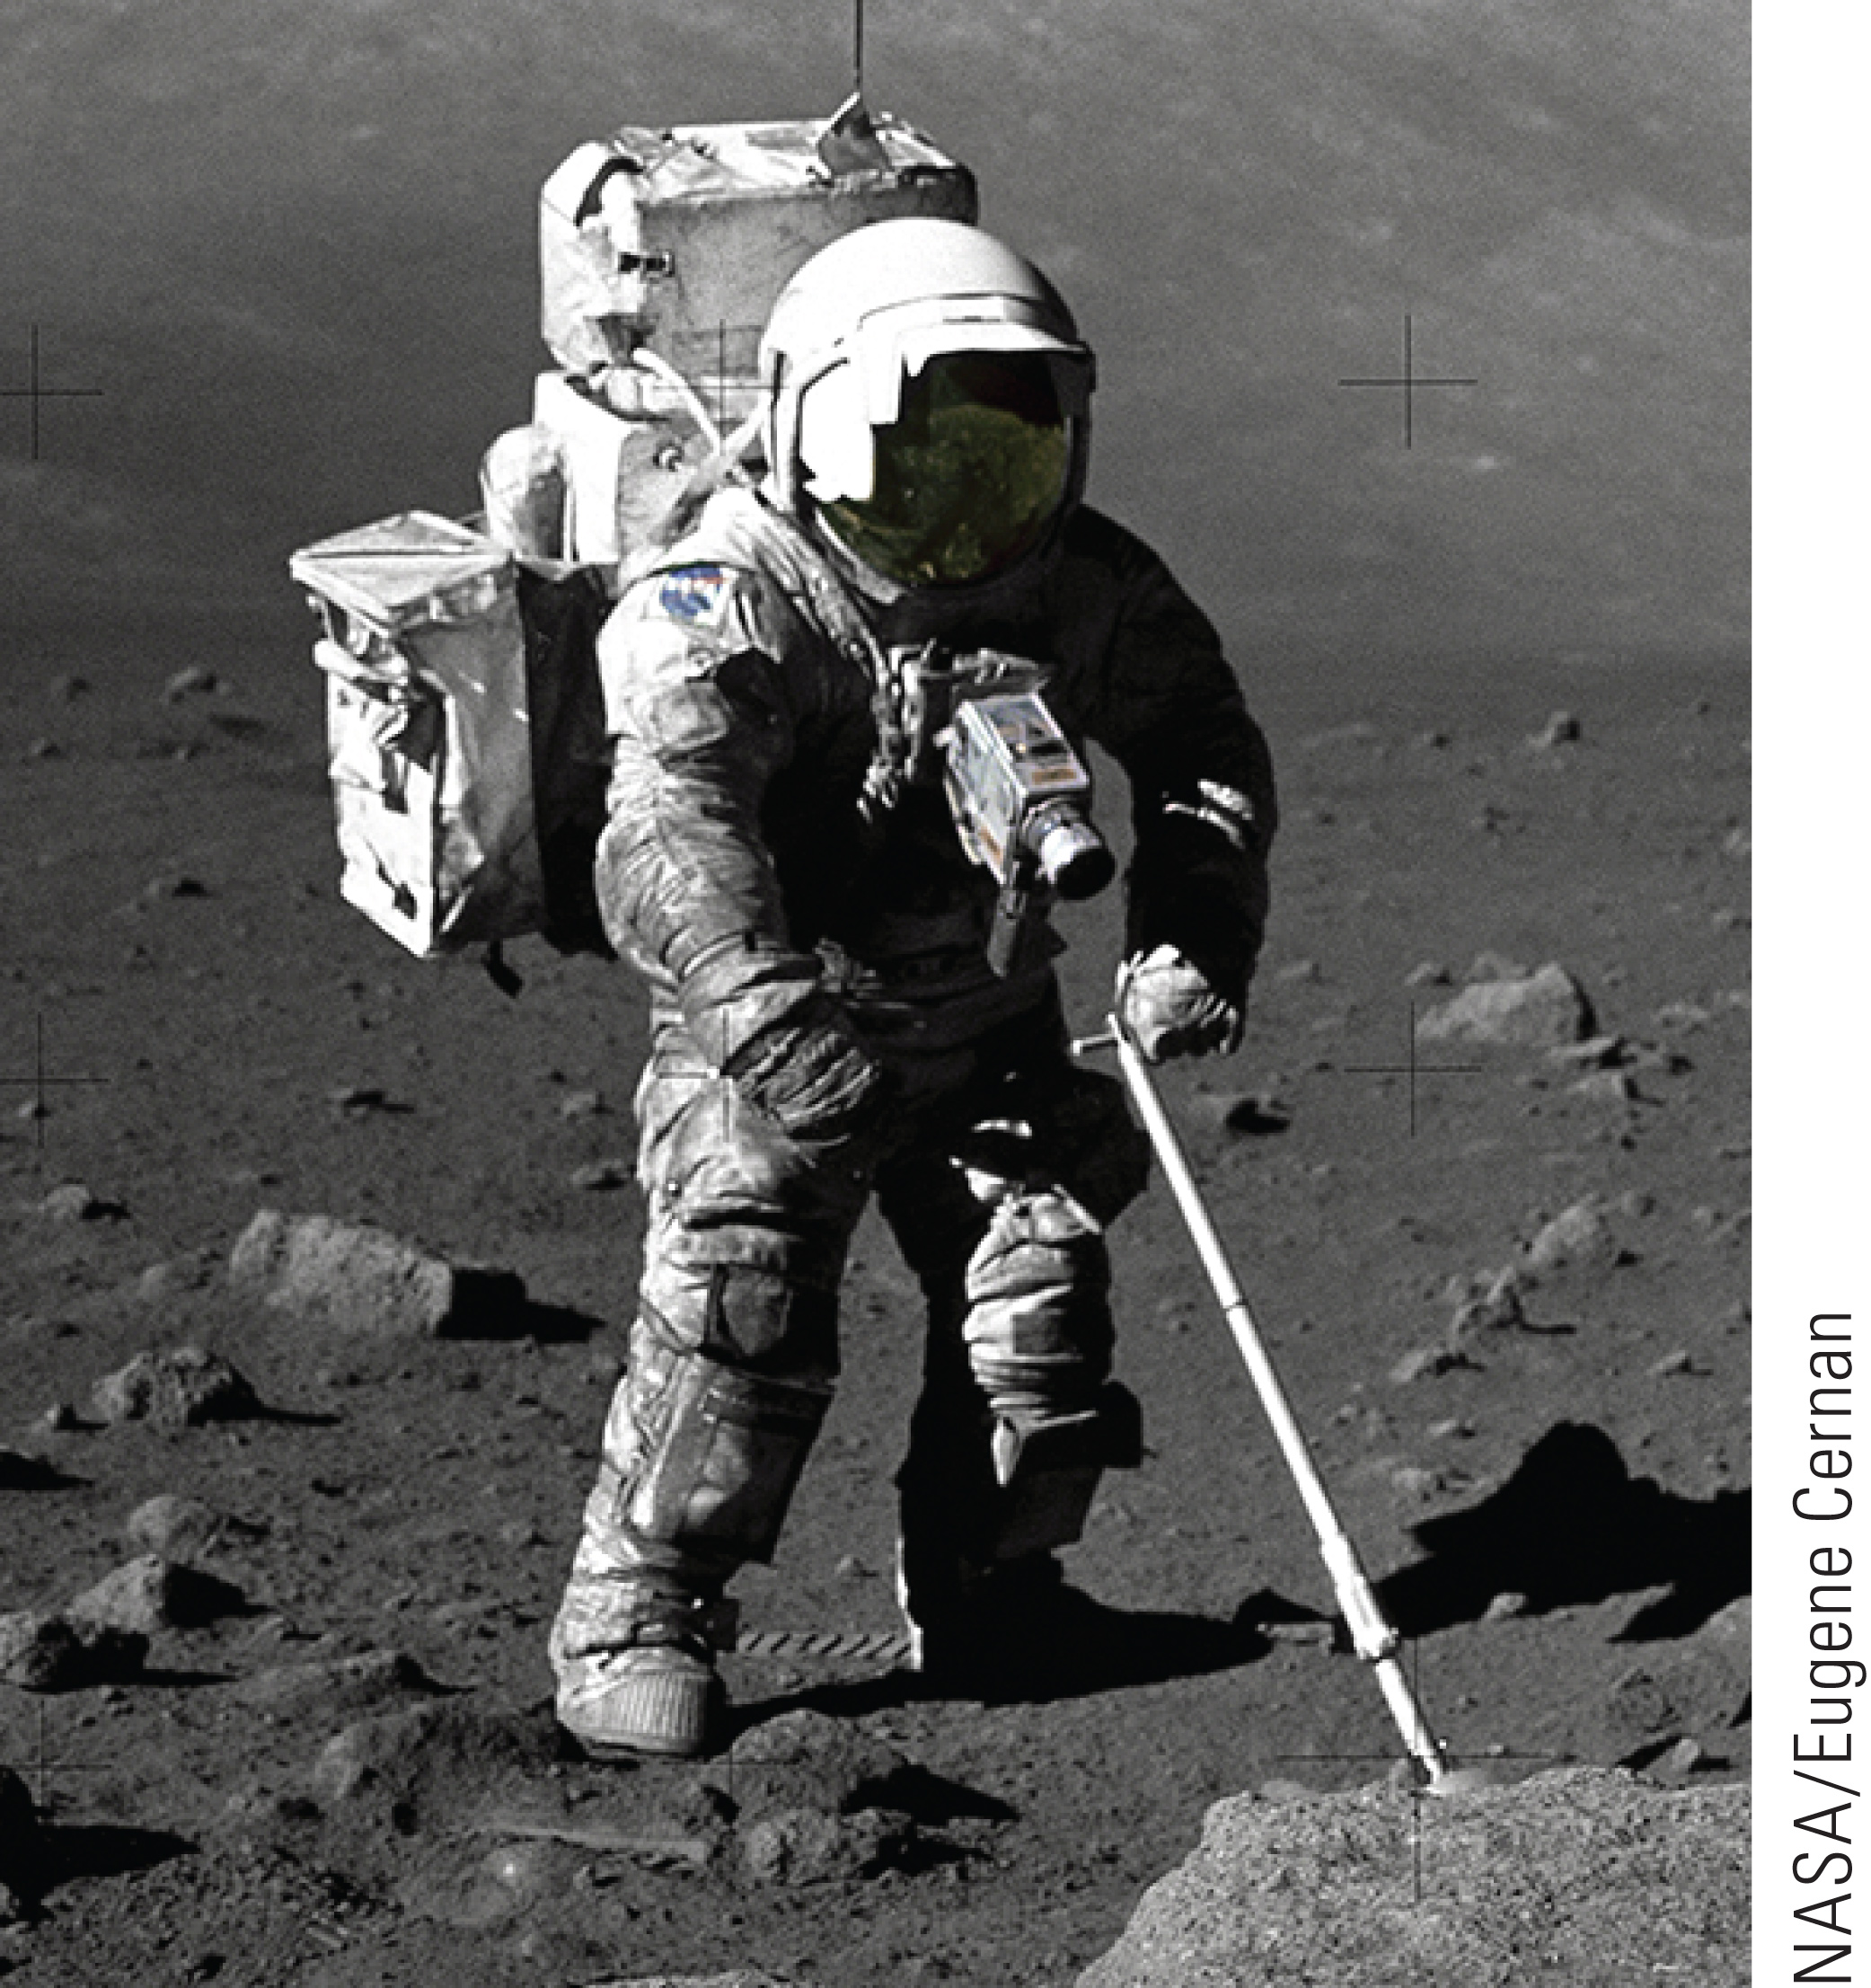
Weight
©Cengage
Notes:
Unlike mass, weight is not an inherent property of an object, because it can take different values depending on the value of g in a given location. If an object has a mass of 70 kg, for example, then its weight at a location where g = 9.80 m/s² is mg = 686 N. In a high-altitude balloon, where g might be 9.76 m/s², the object’s weight would be 683 N.
The value of g also varies slightly due to the density of matter in a given locality. In this course and in our textbook, unless stated otherwise, the value of g will be understood to be 9.80 m/s², its value near the surface of the Earth.

Slide 38
Think – Pair – Share
Which has a greater value, a newton of gold won on Earth or a newton of gold won on the Moon?
The newton of gold on the Earth
The newton of gold on the Moon
The value is the same, regardless.
©Cengage
Notes:
Take a couple of minutes to think about this, discuss it with a neighbor, and then we’ll all talk about it.
Answer: The newton of gold on the Moon
Reasoning: The newton is a unit of weight, and the quantity (or mass) of gold that weighs 1 newton is XXXX. Because the value of g is smaller on the Moon than on the Earth, someone possessing 1 newton of gold on the Moon has more gold than does a person having 1 newton of gold on Earth.

Slide 39
Think – Pair – Share
True or false? No force of gravity acts on an astronaut in an orbiting space station.
©Cengage
Notes:
We’ll talk in 2 minutes—share your thoughts with your neighbor during that time.
Answer: False
Reasoning: When on an orbiting space station, the astronaut is farther from the center of Earth than when on the surface of the Earth. Thus, the astronaut experiences a reduced gravitational force, but that force is not zero.

Slide 40
Think – Pair – Share
True or false? At 3 Earth radii from the center of Earth, the acceleration of gravity is 1/9 its surface value.
©Cengage
Notes:
Figure out the answer, and see if your neighbor got the same result. We’ll talk about it in a couple of minutes.
Answer: True
Reasoning: On or above the surface of Earth, the acceleration of gravity is inversely proportional to the square of the distance from the center of Earth. Therefore, when this distance is increased by a factor of 3, the acceleration of gravity decreases by a factor of 9.

Slide 41
Think – Pair – Share
True or false? If two identical planets, each with surface gravity g and volume V, coalesce into one planet with volume 2V, the surface gravity of the new planet is 2g.
©Cengage
Notes:
Figure out the answer, and see if your neighbor got the same result. We’ll talk about it in a couple of minutes.
Answer: False
Reasoning: The acceleration of gravity on the surface of a planet of mass M and volume V is g = F_{g} /m = GM/R², where R = (3V/4π)^{1/3}. If the mass and volume are doubled (as when two identical planets coalesce), the radius becomes R’ = (3(2V)/4π)^{1/3} = 2^{1/3}R, and the surface gravity becomes g’ = GM’/R’² = G(2M)/(2^{1/3}R)² = 2^{2/3}g.

Slide 42
Think – Pair – Share
True or false? One kilogram of gold would have greater value on Earth than on the Moon.
©Cengage
Notes:
Think for yourself for a moment, pair up to compare your thoughts with a neighbor, and then we’ll hear from you in 2 minutes.
Answer: False
Reasoning: Unlike the weight of an object, its mass is independent of the local acceleration of gravity. Thus, 1 kilogram of gold contains the same amount of gold on the Moon as it does on Earth.

Slide 43
Newton’s Third Law
©Cengage
Notes:
Imagine driving a nail into a block of wood, as shown in the figure. To accelerate the nail and drive it into the block, the hammer must exert a net force on the nail. Part of Newton’s genius was that he recognized that a single isolated force couldn’t exist, but that forces in nature always exist in pairs. According to Newton, as the nail is driven into the block by the force exerted by the hammer, the hammer is slowed down and stopped by the force exerted by the nail.

Slide 44
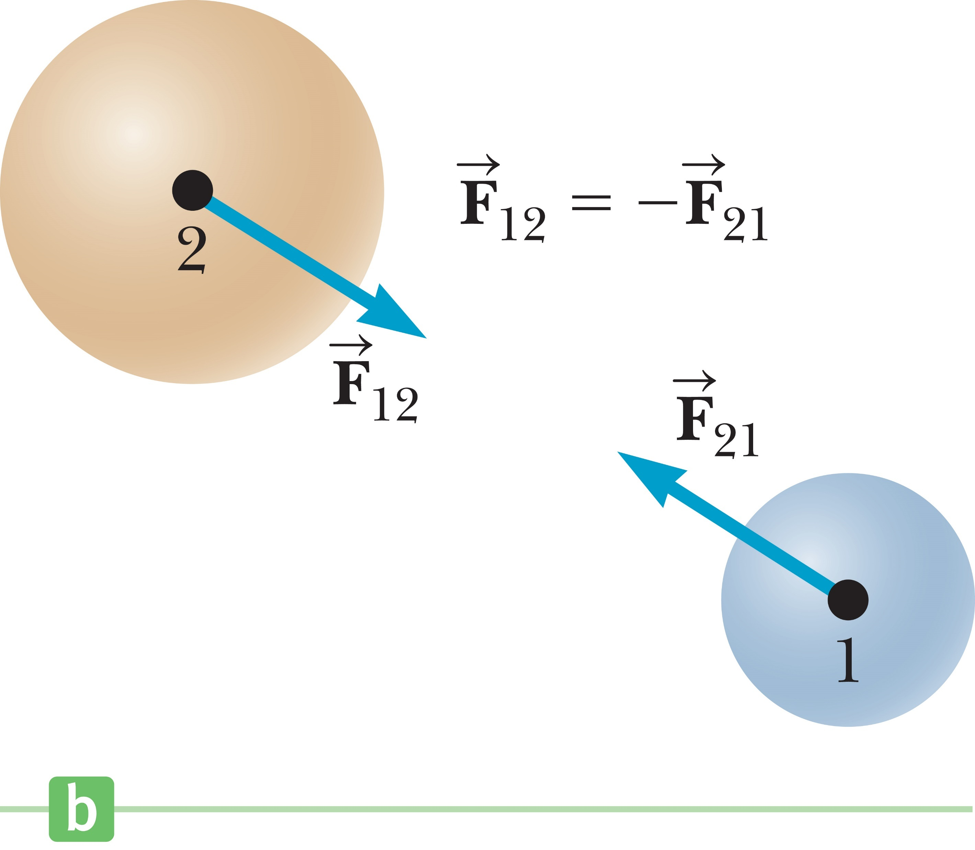
Newton’s Third Law
The action force is equal in magnitude to the reaction force and opposite in direction. In all cases, the action and reaction forces act on different objects.
Notes:
Newton described such paired forces with his third law: If object 1 and object 2 interact, the force F₁₂ exerted by object 1 on object 2 is equal in magnitude but opposite in direction to the force F₂₁ exerted by object 2 on object 1.
This law is illustrated in the figure, and states that a single isolated force can’t exist. The force F₁₂ exerted by object 1 on object 2 is sometimes called the action force, and the force F₂₁ exerted by object 2 on object 1 is called the reaction force. In reality, either force can be labeled the action or reaction force.
[click to show text] The action force is equal in magnitude to the reaction force and opposite in direction. In all cases, the action and reaction forces act on different objects.
Think of a freely falling projectile. The force acting on it is the force of gravity exerted by Earth on the projectile, F_{g} and the magnitude of this force is its weight mg. The reaction to force F_{g} is the gravitational force exerted by the projectile on Earth. The reaction force accelerates the Earth toward the projectile, the same way the action force accelerates the projectile toward Earth. But remember the Earth is huge—its acceleration due to this reaction force is negligibly small.
When walking, for example, we exert a frictional force against the ground. The reaction force of the ground against our foot propels us forward. In the same way, the tires on a bicycle exert a frictional force against the ground, and the reaction of the ground pushes the bicycle forward.

Slide 45
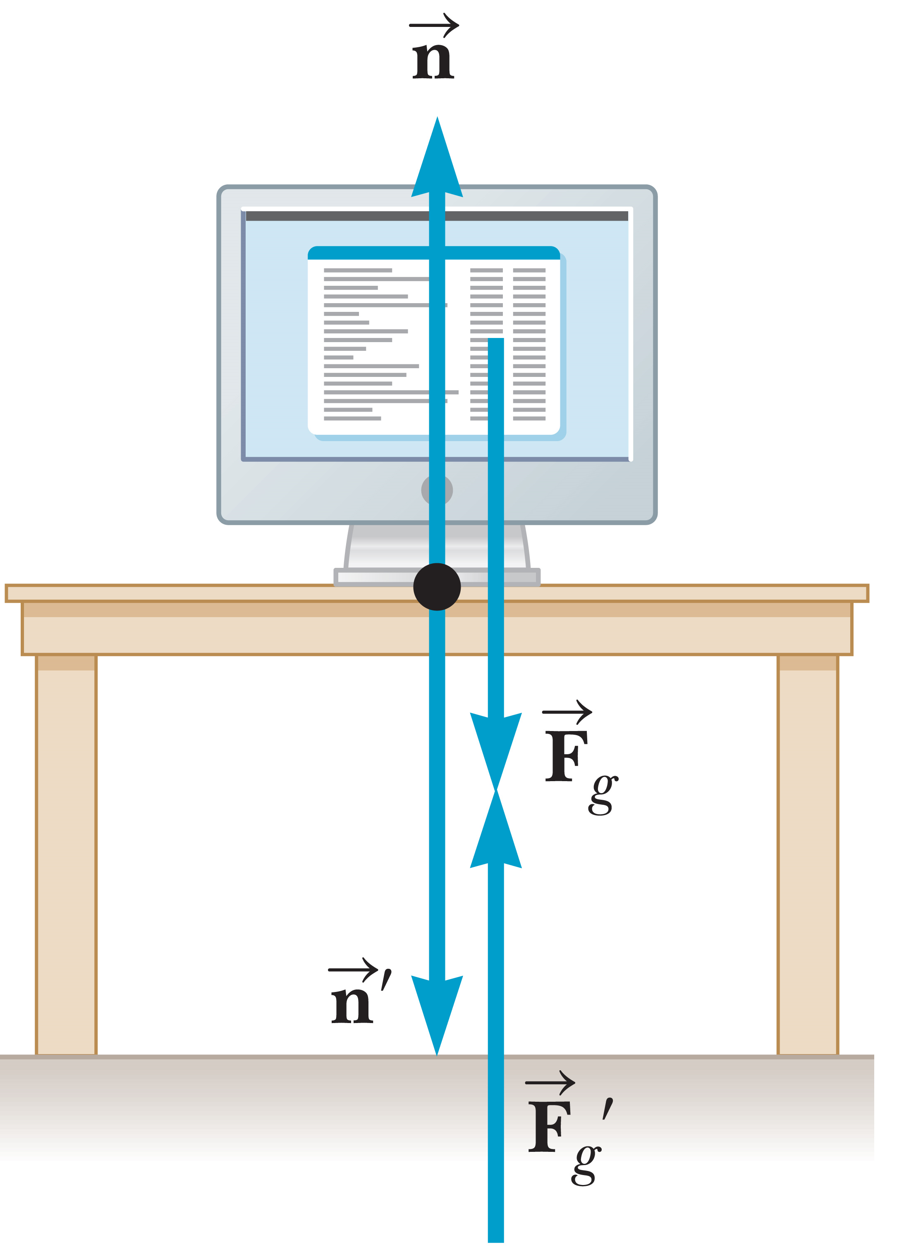
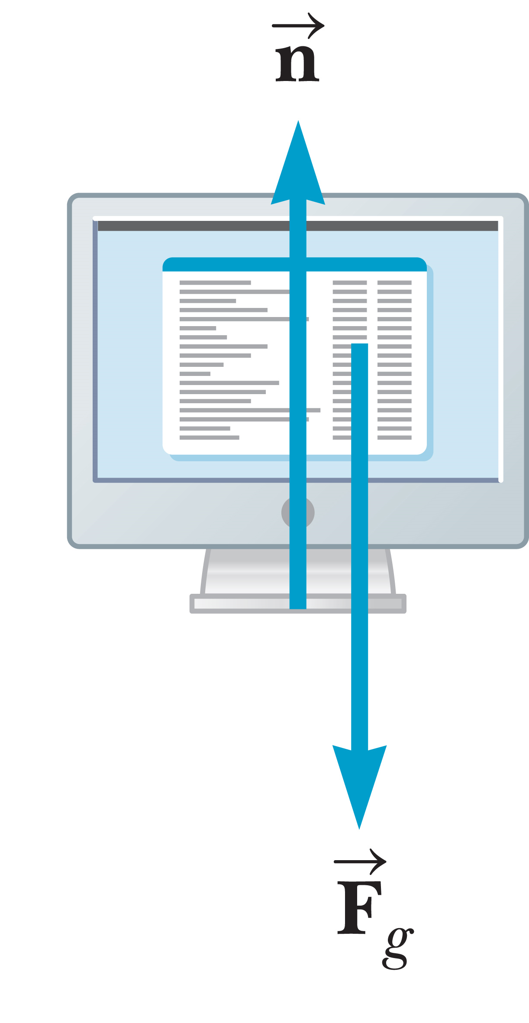
Newton’s Third Law
©Cengage
Notes:
As you now know, Earth exerts a gravitational force on any object. If the object is a monitor at rest on a table, as in the figure, the reaction force is the gravitational force the monitor exerts on the Earth. The monitor doesn’t accelerate downward because it’s held up by the table. That means the table exerts an upward force n, called the normal force, on the monitor. Normal is a technical term from mathematics and means “perpendicular” in this context. The normal force is an elastic force that comes from the cohesion of matter and is electromagnetic in origin. It balances the gravitational force acting on the monitor, preventing the monitor from falling through the table, and can have any value needed, up to the point of breaking the table. The reaction to n is the force exerted by the monitor on the table, n’.
So, as you can see, in this case the forces n and n’ both have the same magnitude as F_{g}. Note that the forces acting on the monitor are F_{g} and n, as shown in the figure on the right. The two reaction forces, F_{g}’ and n’, are exerted by the monitor on objects other than the monitor. Remember that the two forces in an action–reaction pair always act on two different objects. Because the monitor is not accelerating in any direction, Newton’s second law gives us the relationships shown. [click to show equations]

Slide 46
Think – Pair – Share
A small sports car collides head-on with a massive truck. Which vehicle experiences the greater impact force (in magnitude)?
The car
The truck
Neither; the force is the same on both.
©Cengage
Notes:
Think for yourself for a moment, compare your thoughts with a neighbor, and then we’ll hear from you in 2 minutes.
Answer: Neither, the force is the same on both.
Reasoning: Newton’s third law states that the car and truck will experience equal magnitude (but oppositely directed) forces.

Slide 47
Think – Pair – Share
A small sports car collides head-on with a massive truck. Which vehicle experiences the greater acceleration?
The car
The truck
The accelerations are the same.
©Cengage
Notes:
Decide on an answer, and check with your neighbor. We’ll go over it together in a minute or two.
Answer: The car
Reasoning: Newton’s second law states that acceleration is inversely proportional to mass when the force is constant. Thus, the lower mass vehicle (the car) will experience the greater acceleration.

Slide 48
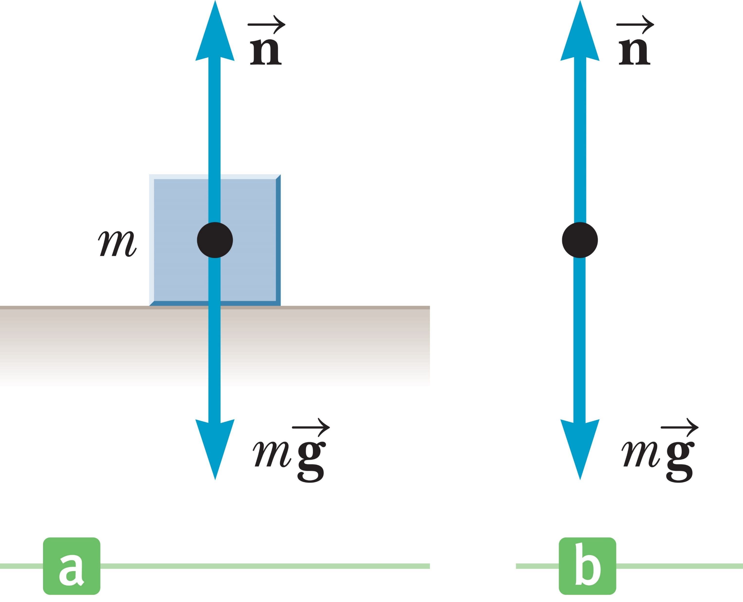
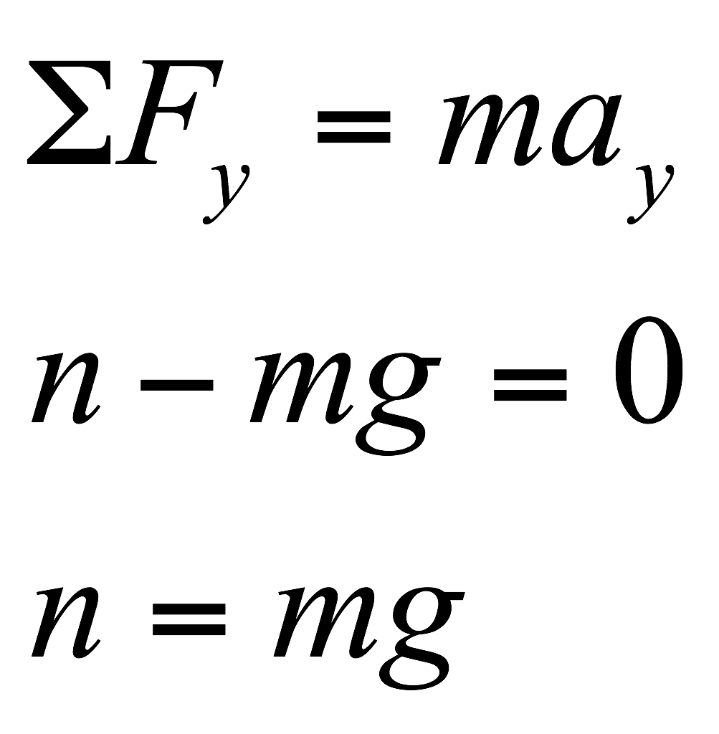
Case 1: The Normal Force on a Level Surface
©Cengage
Notes:
This figure on the left shows a block at rest on a flat surface. The two forces acting on the block are the normal force, acting upward, and the gravity force, directed downward.
The figure on the right is called the free-body diagram for the block, where only the forces acting on the block are shown. Free-body diagrams include only the forces acting directly on the object in question. Forces or reaction forces acting on different bodies aren’t shown. For example, the reaction force to the gravity force acting on the block is the gravity force exerted by the block on the Earth, which doesn’t appear in the block’s free-body diagram.
The y-component of the second law of motion, with a_{y} = 0, yields these equations. [click to show equations] The normal force in this case is equal to the weight of the object.

Slide 49
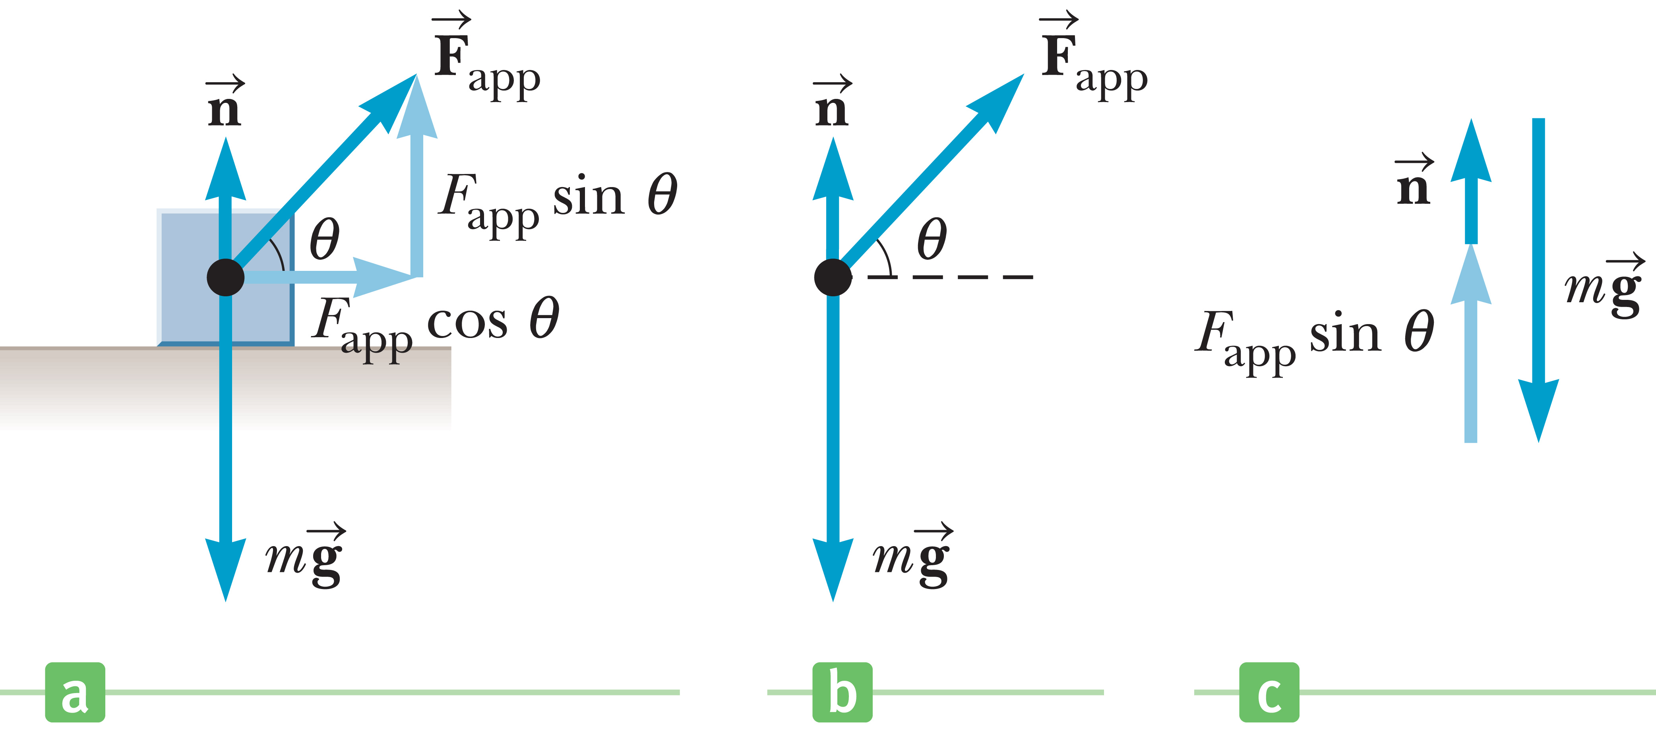
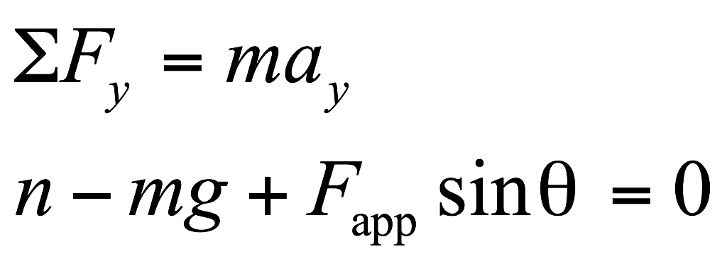
Case 2: The Normal Force on a Level Surface with an Applied Force
©Cengage
Notes:
The figure on the left shows a block at rest on a flat surface. The three forces acting on the block are the normal force, directed upward; the gravity force, directed downward; and an applied force, directed at a positive angle θ.
Let’s apply the second law of motion to the y-direction. [click to show equations] This second equation can easily be solved for the normal force n. [click to show equation] Notice that if the angle is positive, then the sine of the angle is positive, and the y-component of the applied force supports some of the weight, reducing the normal force. This is clearer when we separate out the y-components, as in the figure on the far right. The sum of the normal force and the y-component of the applied force equals the magnitude of the weight.

Slide 50
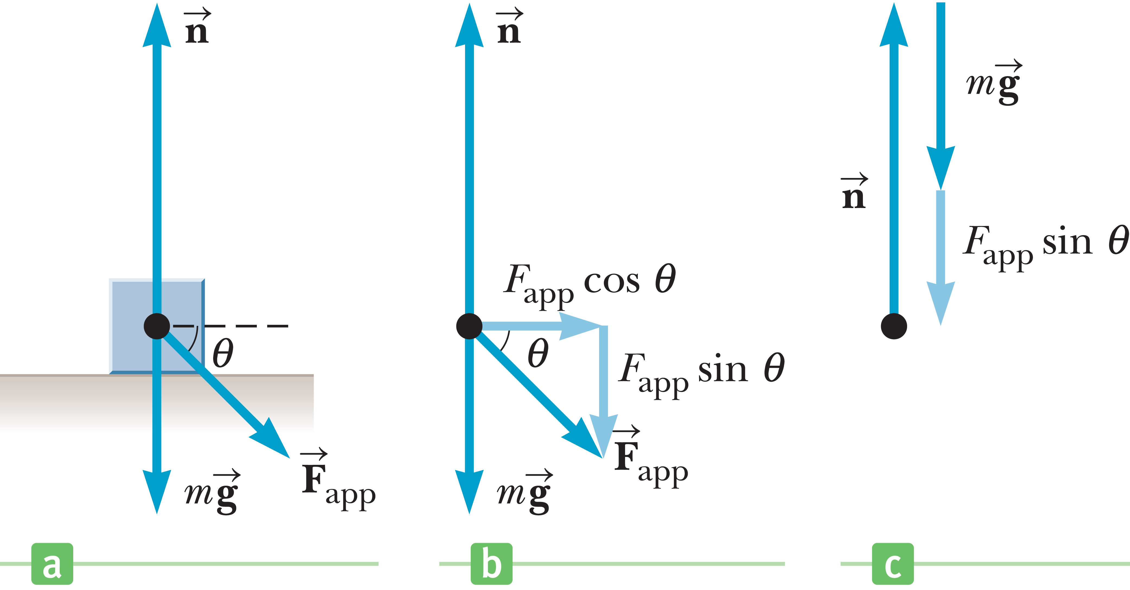
Case 2: The Normal Force on a Level Surface with an Applied Force
©Cengage
Notes:
If the angle is negative, then the sine of the angle is also negative, making a positive contribution to the normal force, as illustrated in this figure. The normal force must be larger, and in this case its magnitude is equal to the sum of the weight and the y-component of the applied force.

Slide 51
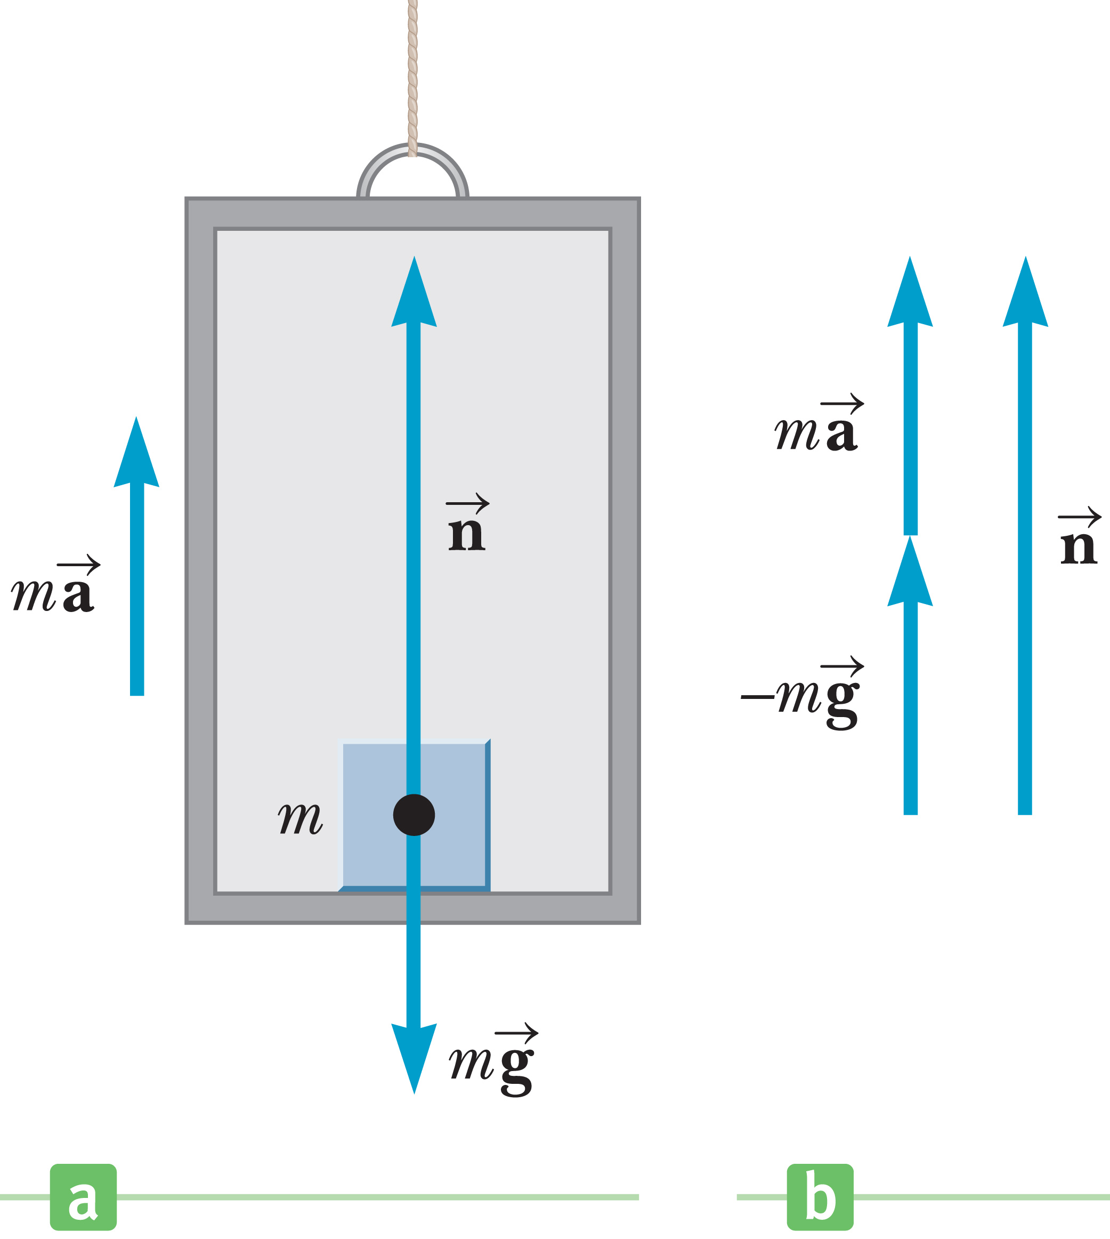
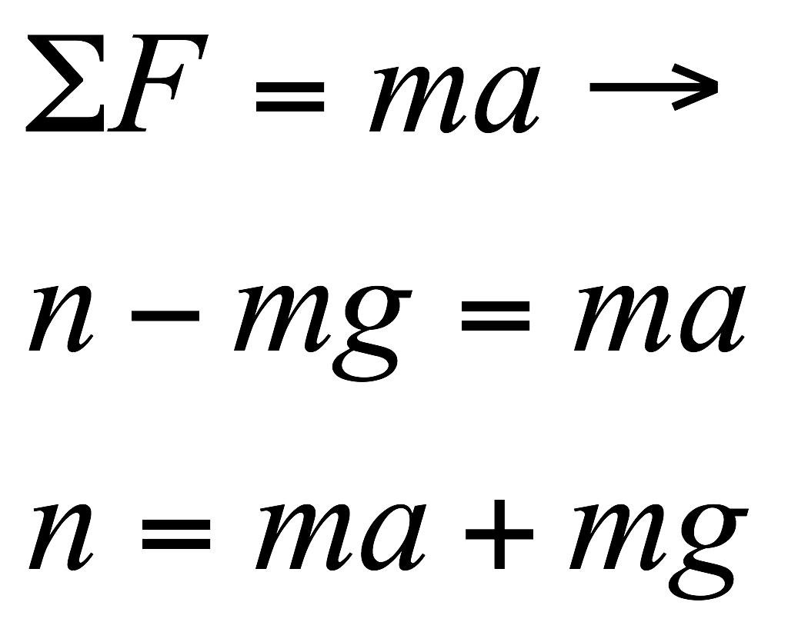
Case 3: The Normal Force on a Level Surface Under Acceleration
Notes:
This figure shows a block on a flat surface that is under acceleration, for example, in an elevator. The two forces acting on the block are the normal force, directed upward, and the gravity force, directed downward. An acceleration upward increases the magnitude of the normal force, because the normal force must not only compensate for gravity, but also provide the acceleration. The y-component of the second law of motion yields the equations shown.

Slide 52
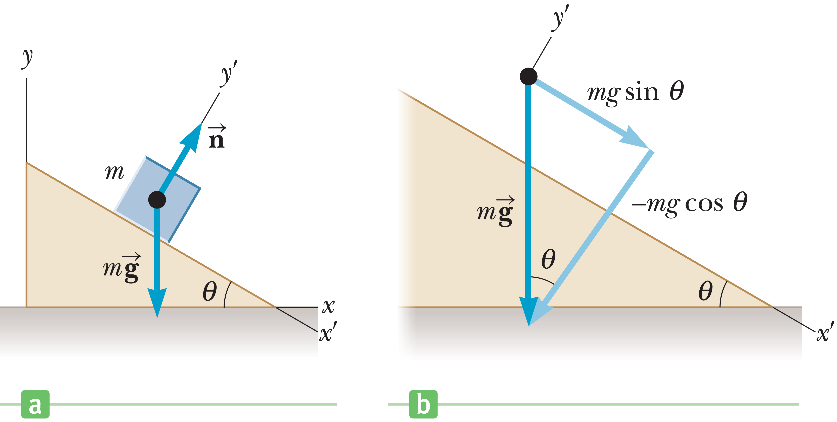
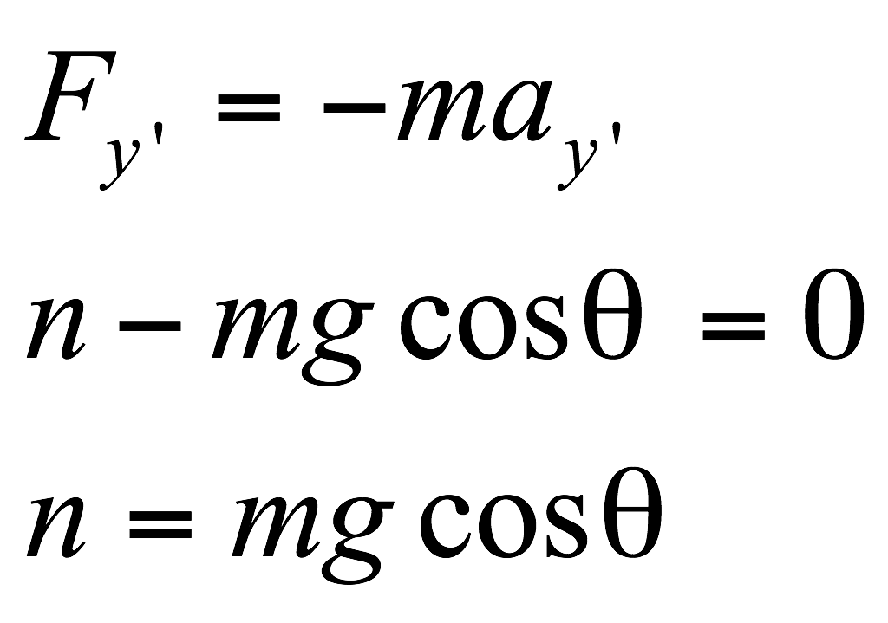
Case 4: The Normal Force on a Slope
©Cengage
Notes:
A problem you will see often involves an object resting on a surface tilted at some constant angle. If you rotate your coordinate system so that it is tilted in the same way, this really simplifies the mathematics of these types of problems. Of course any orientation of coordinate system will give you the same answer, because changing our coordinates doesn’t alter the physics of the situation. But simplifying the math is a nice idea. In the case shown in the figure on the left, we have x’-axis running parallel to the slope and y’-axis perpendicular to the slope.
Now look at the figure on the right. The force due to gravity can then be broken into two components. [click to show equations]
The second law for the y’-direction can be solved for the normal force. [click to show equations] The normal force on a slope is equal in magnitude to the component of the gravity force perpendicular to the slope.
Also, notice that the force on the block directed down the slope due to gravity is given by the equation shown. Keep in mind that when approaching these problems, it’s often possible to immediately treat them as one-dimensional, because all that is needed from the y-direction is the normal force.

Slide 53
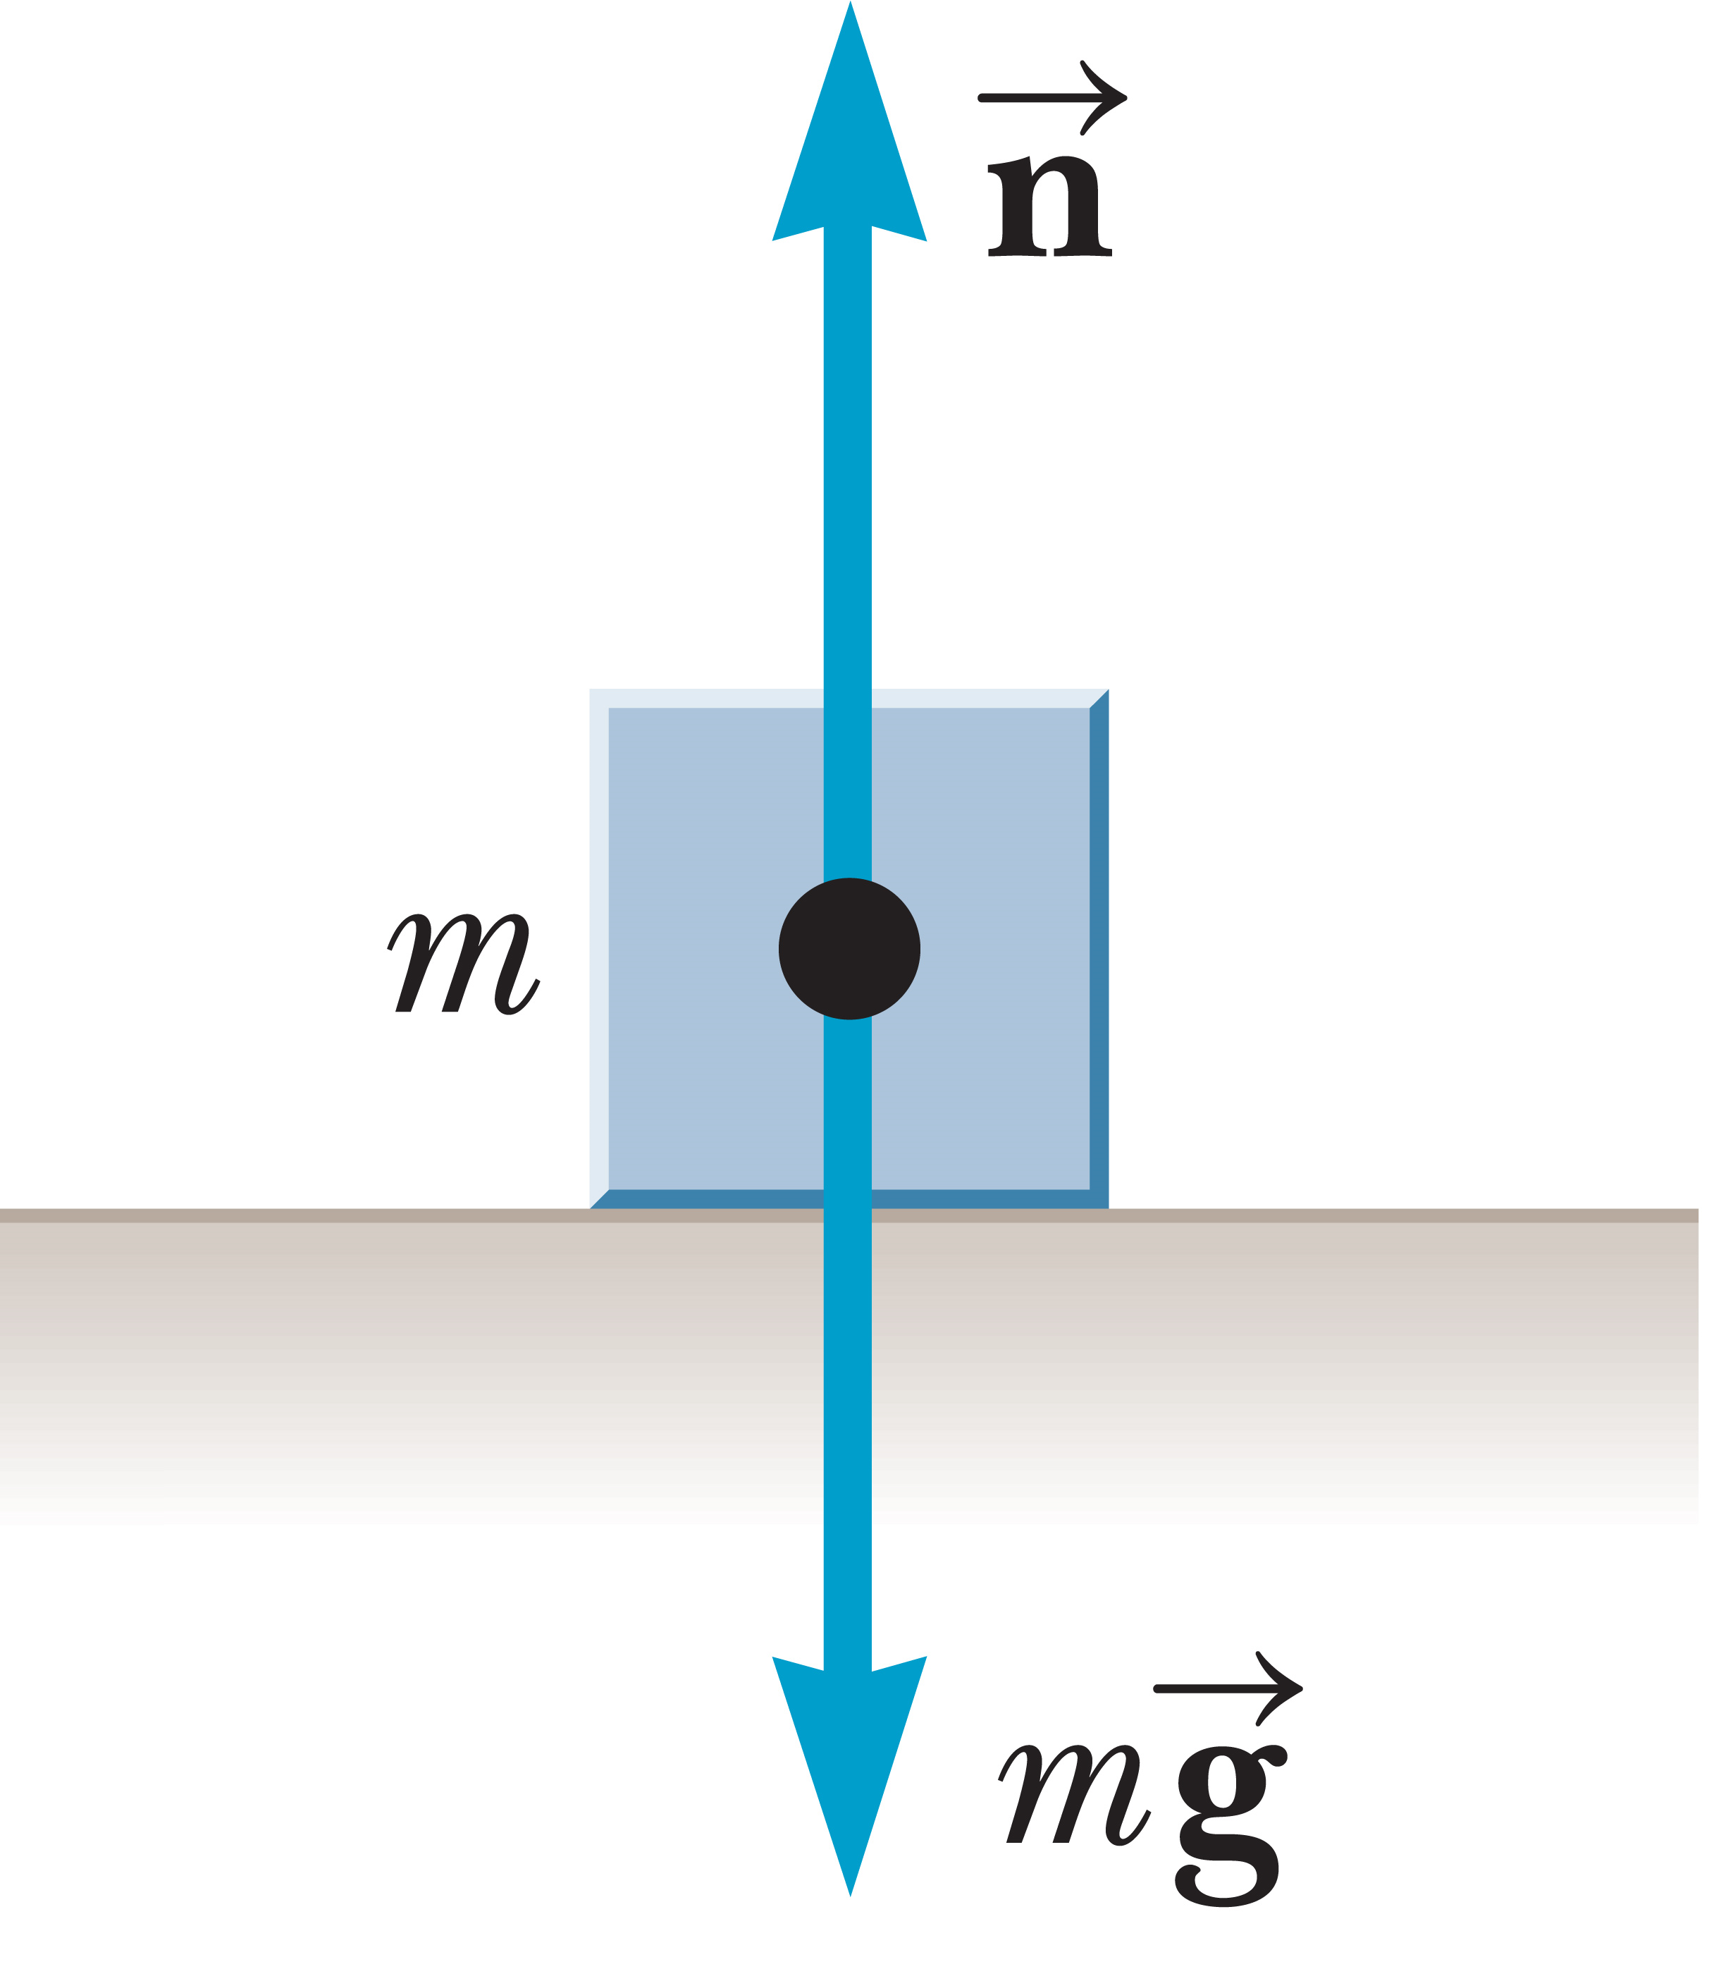
The Normal Force and Atmospheric Pressure
©Cengage
Notes:
As we have seen, the normal force acting on an object, for example, a block on a level surface, opposes the gravity force that pulls the block toward the center of the Earth. Technically, the normal force also opposes the downward pressure of atmosphere on the top of the block. Because of microscopic imperfections, air infiltrates beneath even a very smooth object resting on a relatively smooth surface, effectively canceling out the downward pressure with an equal upward pressure. When air can be excluded from beneath an object, then atmospheric pressure acts only downward, and the object is held very firmly in place. This is the “suction-cup effect” that allows suction cup darts to stick to windows. It works better when the cups are slightly damp and when the surface is extremely smooth, because under those conditions the air can be more effectively excluded from beneath the cup. In general, unless stated otherwise, it will always be assumed that pressure forces on objects cancel.

Slide 54
The Force of Kinetic Friction
©Cengage
Notes:
Friction is a contact force from the microscopic interactions between a body and its environment. Air friction affects vehicles from cars to rockets. Fluid friction affects the motion of ships or the passage of fluid in pipes. But don’t get the wrong idea. Friction is not always something that impedes motion. Without friction, we wouldn’t be able to walk or pick up and hold objects. Friction is also caused when an object is in contact with a surface.
Microscopically, tiny protrusions on the interacting surfaces interlock, soften, and break or bend when force is applied. Kinetic friction is friction that arises during motion. It depends on the materials the surfaces are made of, how smooth they are, and how firmly they are in contact. The normal force is the measure of that firmness of contact, and so it makes sense that the greater the normal force, the larger the kinetic friction force.
Generally, we will model the interactions between two surfaces as being proportional to the normal force. The magnitude of the kinetic friction force f_{k} acting on an object moving on a surface is given by the equation shown, where n is the normal force acting on the object and μ_{k} is called the coefficient of kinetic friction between the object and the surface.
The force f_{k} acts in the direction opposite that of the motion.
Calculating the kinetic friction force is easy. First, find the normal force, and then multiply it by the coefficient, μ_{k}.

Slide 55
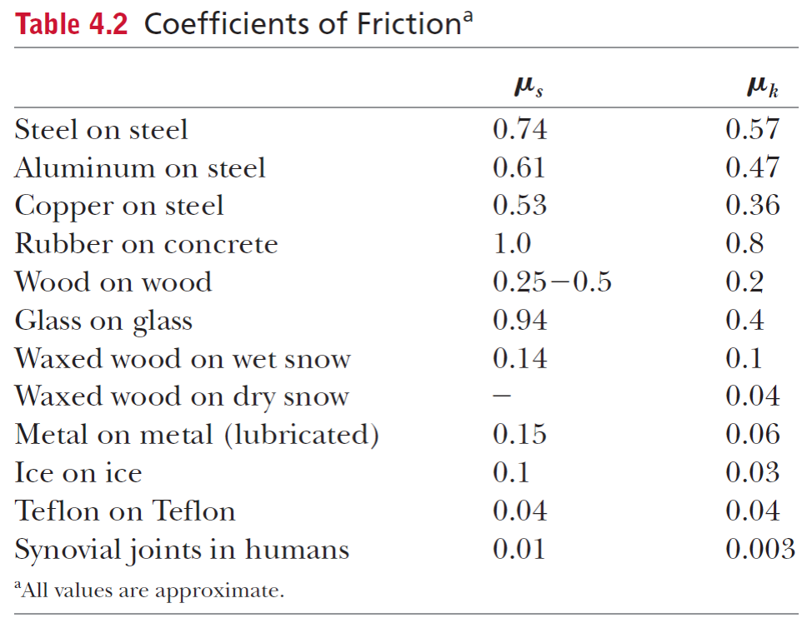
Newton’s Third Law
Notes:
That coefficient depends on the object and the surface and is determined experimentally. In reality, surface variations we can’t see can affect the value of the coefficient, as can the velocity of the object. In any case, these coefficients are useful, but we should think of them as averages over time and approximations. For our purposes, we’ll assume a coefficient of friction is always constant for a given surface and object.
The table shows some representative values of the coefficients of kinetic and static friction. We’ll look at static friction in a little while.

Slide 56
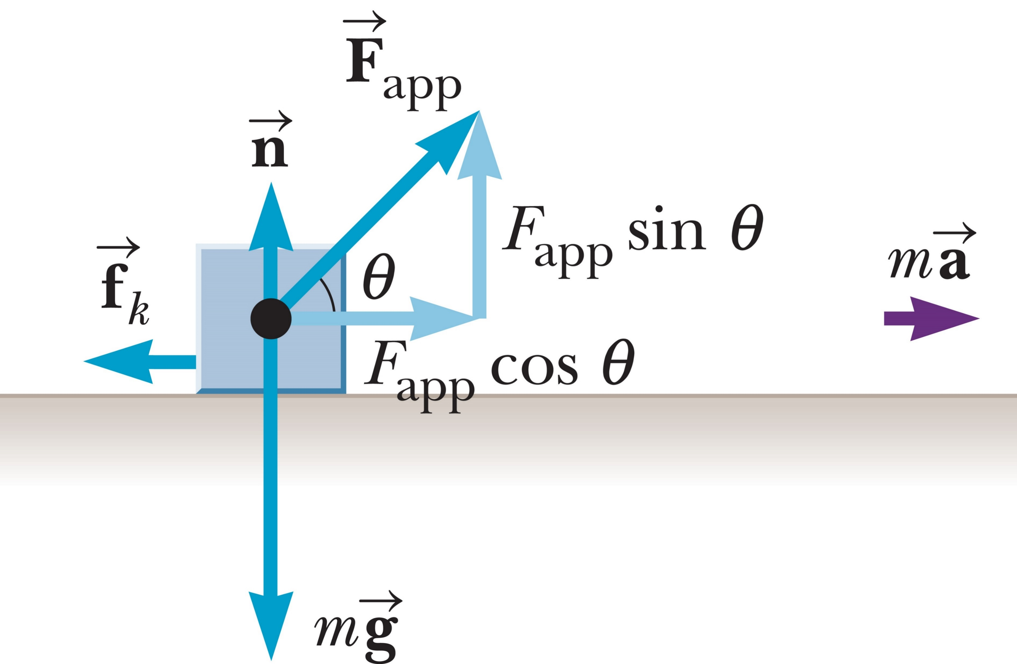
Newton’s Third Law
©Cengage
Notes:
This diagram illustrates the effect of a kinetic friction force on a block. Let’s first calculate the normal force. [click to show equation]
Then we can write the x-component of the second law of motion. [click to show equations]
The angle of the applied force is critical for us to determine the resultant acceleration of the block. As the angle increases from zero, the part of the applied force acting in the x-direction decreases, as do the normal and kinetic friction forces.

Slide 57
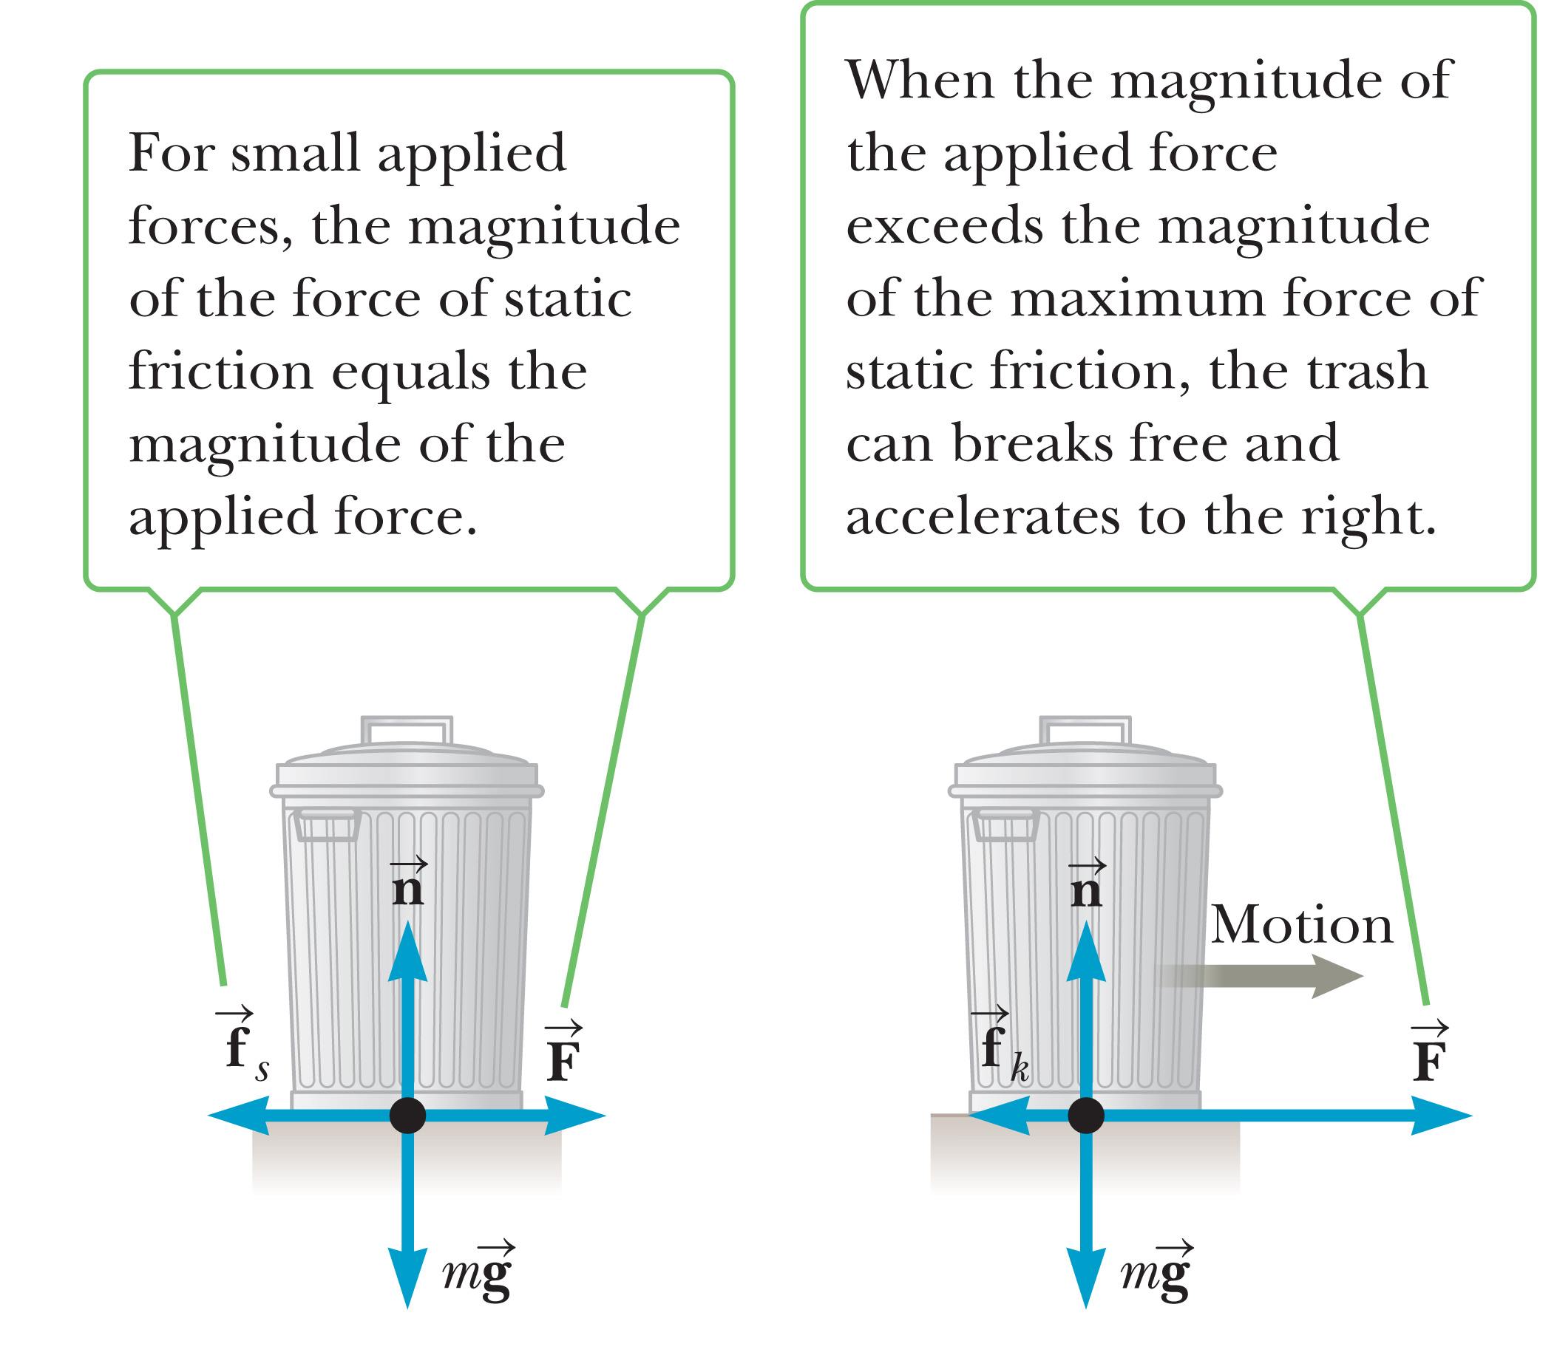
Static Friction Forces
Notes:
Look at the figure on the left. When a horizontal force F is exerted against the trash can, it typically doesn’t move unless the force exceeds some critical value, as depicted in the figure on the right. That critical value is the maximum static friction force. The actual static friction force is always less than or equal to that maximum. As with the kinetic friction force, the static friction force arises from microscopic interactions between the object and the surface it rests on.

Slide 58
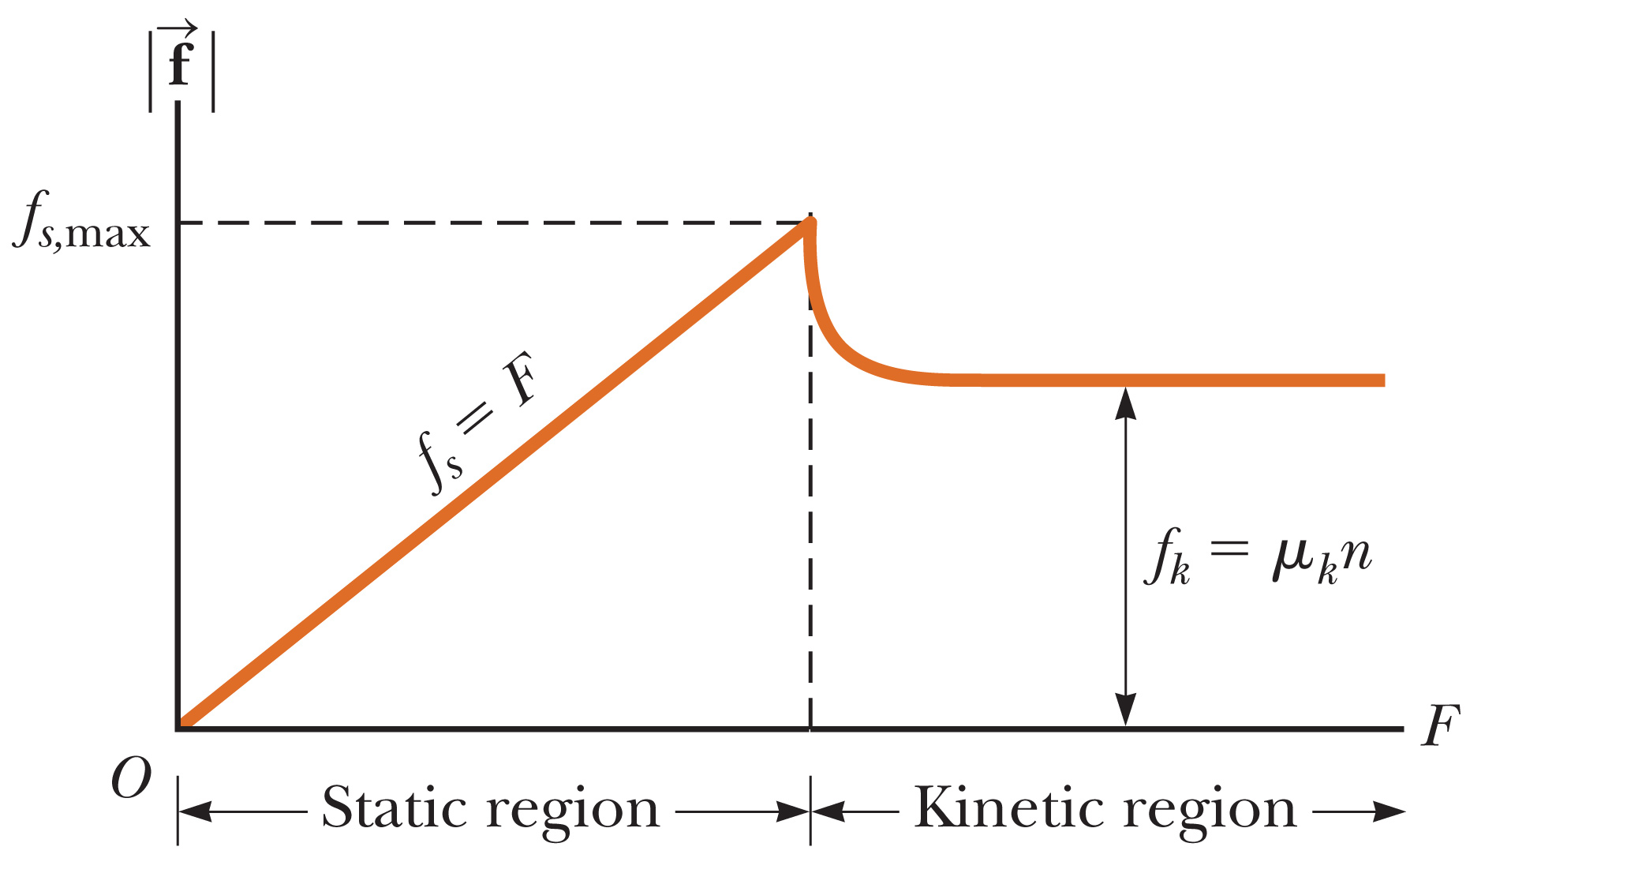
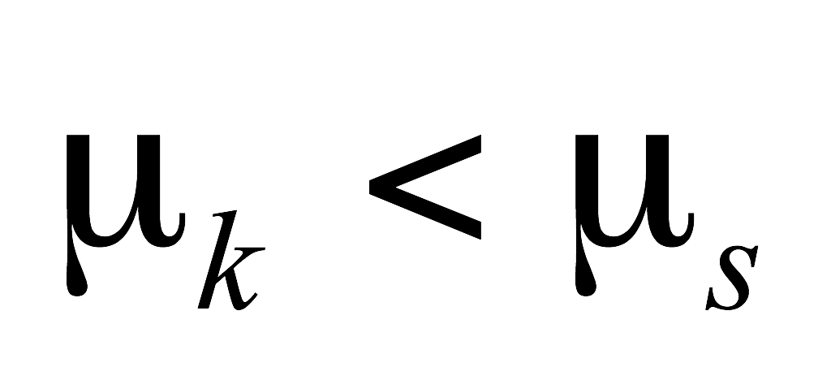
Newton’s Third Law
©Cengage
Notes:
This graph illustrates how static friction works. As the applied force gradually increases, so does the static friction force, acting in the opposite direction. When the applied force exceeds the maximum static friction force, the object begins to move, and kinetic friction takes over. In general, the kinetic friction coefficient is less than the static friction coefficient.
The magnitude of the static friction force acting on an object at rest satisfies the inequality shown, [click to show equation] where n is the normal force and μ_{s} is the coefficient of the maximum static friction force between the object and the surface. The force f_{s} acts in the direction opposite that of the impending motion, which you can think of as the motion that results if static friction were not sufficient to prevent it.

Slide 59
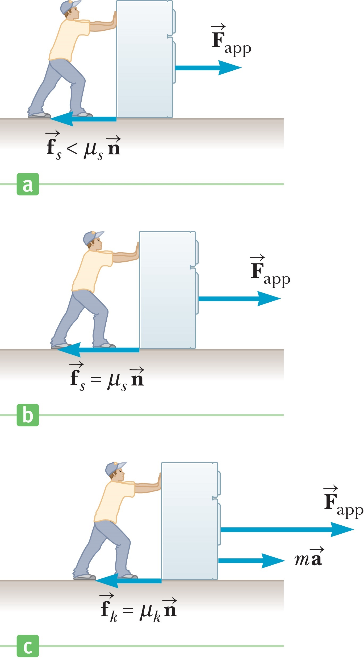
Newton’s Third Law
©Cengage
Notes:
Unlike the kinetic friction force, the static friction force takes on any value between zero and its maximum value of μ_{s}n, depending on the magnitude of the applied force. The static friction force self-adjusts, depending on the net force acting on an object, as you can see in the figures here.

Slide 60
Think – Pair – Share
If you press a book flat against a vertical wall with your hand, in what direction is the friction force exerted by the wall on the book?
Downward
Upward
Out from the wall
Into the wall
©Cengage
Notes:
Come up with your answer, then check to see what your neighbor came up with. We’ll look at this as a big group in 2 minutes.
Answer: Out from the wall
Reasoning: Friction forces are always parallel to the surfaces in contact, which, in this case, are the wall and the cover of the book. This tells us that the friction force is either upward or downward. Because the tendency of the book is to fall downward due to gravity, the friction force must be in the upward direction.

Slide 61
Think – Pair – Share
A crate is sitting in the center of a flatbed truck. As the truck accelerates to the east, the crate moves with it, not sliding on the bed of the truck. In what direction is the friction force exerted by the bed of the truck on the crate?
To the west
To the east
There is no friction force, because the crate is not sliding.
©Cengage
Notes:
Think about it, check with a neighbor, and we’ll discuss the answer in about 2 minutes.
Answer: To the east
Reasoning: The static friction force between the bottom surface of the crate and the surface of the truck bed is the net horizontal force on the crate that causes it to accelerate. It is in the same direction as the acceleration, toward the east.

Slide 62
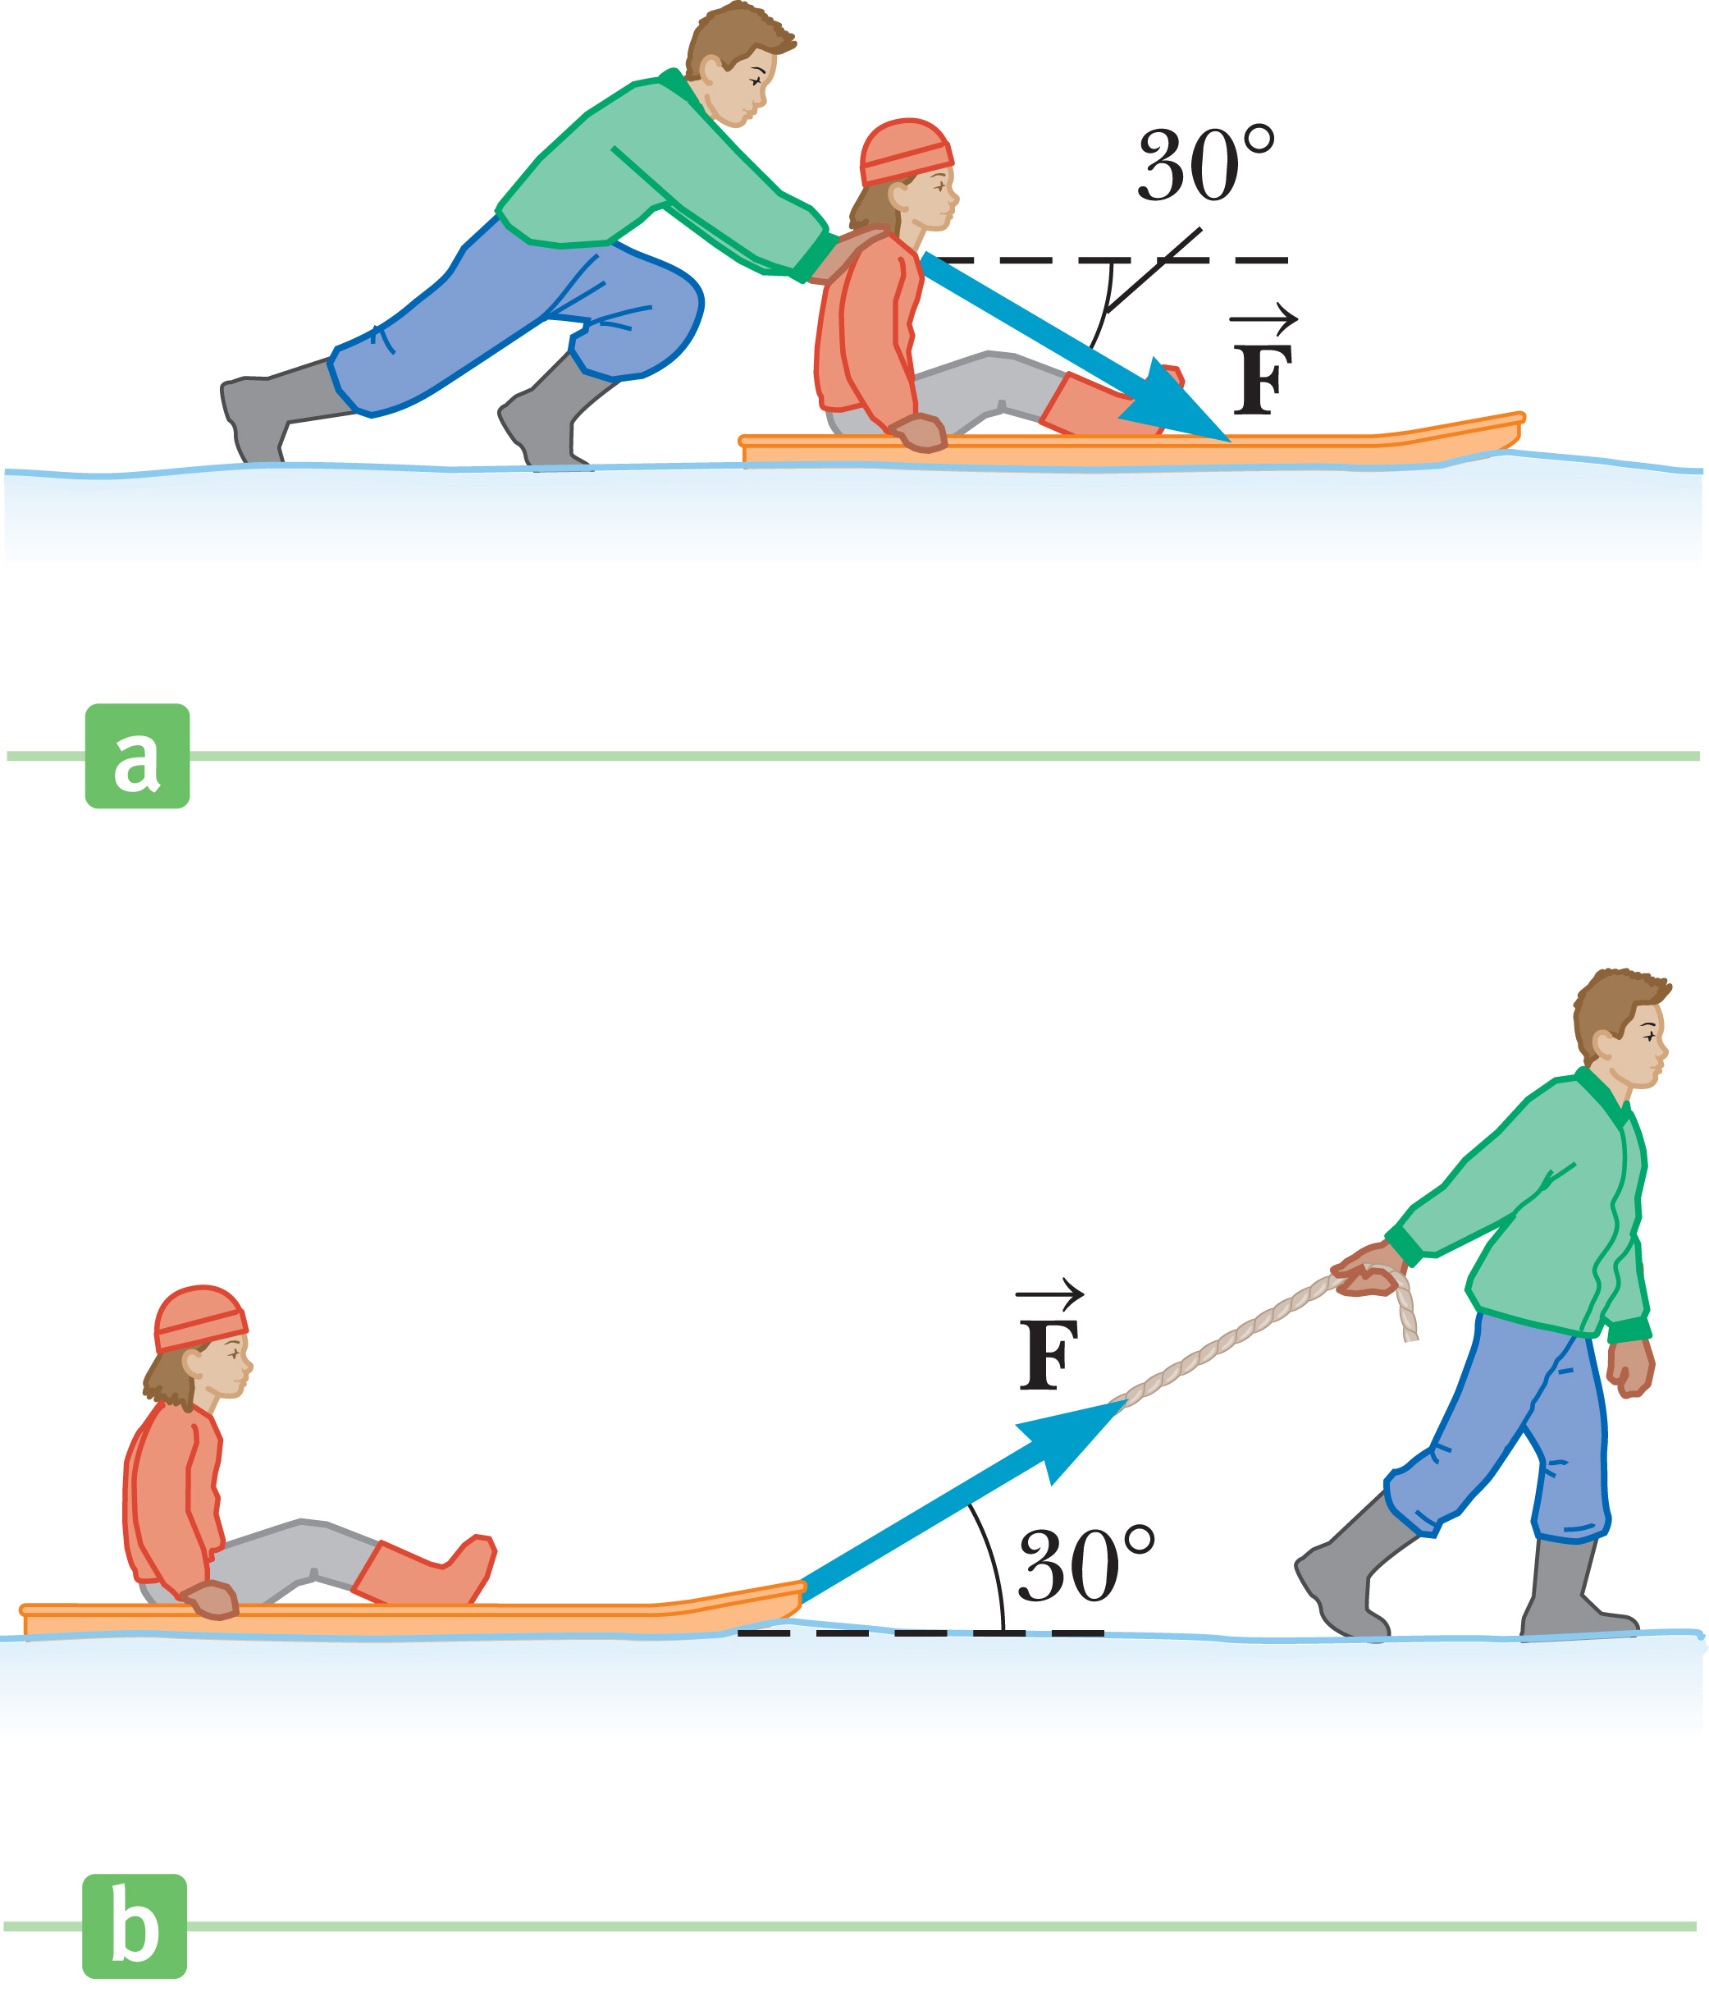
Think – Pair – Share
Suppose your friend is sitting on a sled and asks you to move her across a flat, horizontal field. You have a choice of (a) pushing her form behind by applying a force downward on her shoulders at 30° below the horizontal (figure a), or (b) attaching
a rope to the front of the sled and
pulling with a force at 30° above
the horizontal (figure b). Which
option would be easier?
Situation (a)
Situation (b)
Notes:
Think about it, talk about it, and we’ll touch base in a couple of minutes.
Answer: Situation (b)
Reasoning: It is easier to attach the rope and pull. In this case, there is a component of your applied force that is upward. This reduces the normal force between the sled and the snow. In turn, this reduces the friction force between the sled and the snow, making it easier to move. If you push from behind, with a force having a downward component, the normal force is larger, the friction force is larger, and the sled is harder to move.

Slide 63
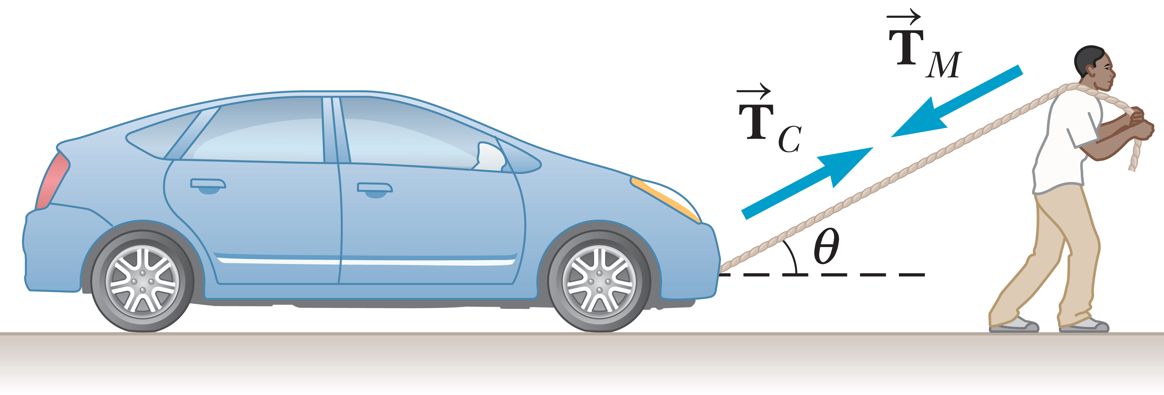
Tension Forces
©Cengage
Notes:
Take a look at the figure of a man pulling a car. There is a tension force in the rope, which acts along the direction of the rope and exerts a force on the car and the man. If we neglect the mass of the rope, the tension is the same all along it. The tension force on the car, T_{C}, has the same magnitude as the tension force on the man, T_{M}. You can think of the tension force as the force that would be read on a spring scale, if it were spliced into the cable.
Tension forces are due to microscopic electromagnetic interactions that resist the separating of a long, thin string of matter when a force is applied to it. The string becomes taut, and through it the force can then be transmitted to the object the cable is attached to.

Slide 64
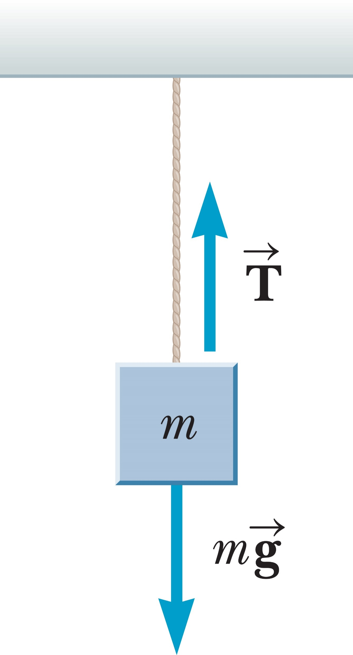
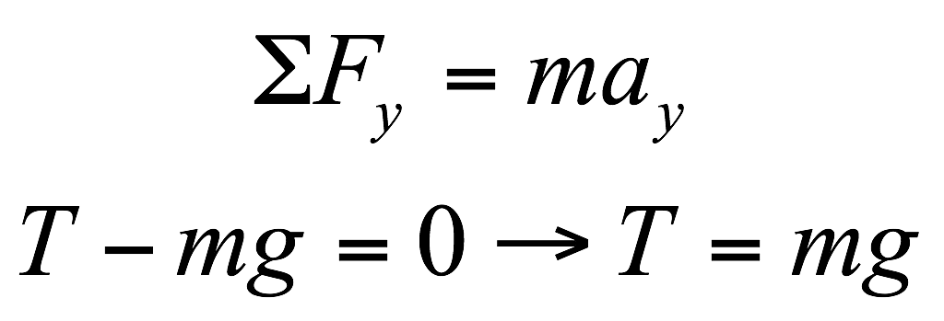
Case 1: Vertical Tension Forces on a Static Object
©Cengage
Notes:
The figure shows an object is dangling at the end of a vertical string. The object is in equilibrium so the acceleration is zero. The y-component of the second law gives an expression for the tension in the string. As you can see, the tension force is equal to the supported weight.

Slide 65
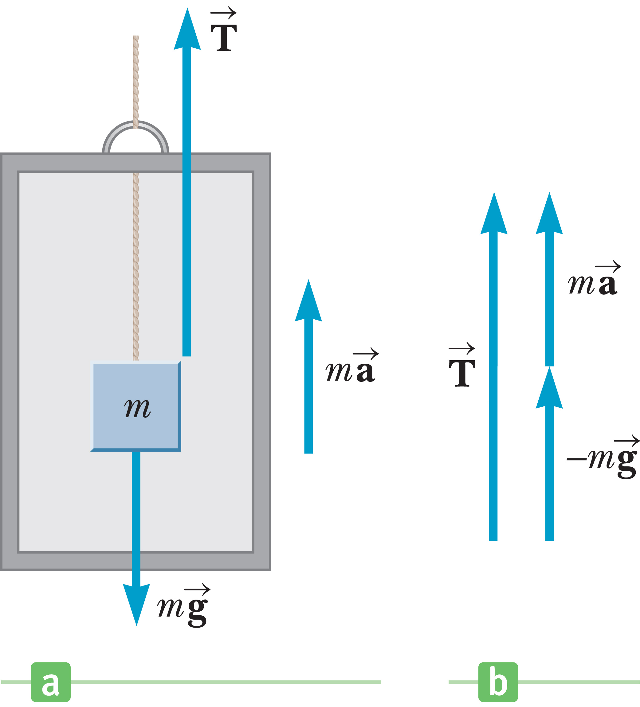
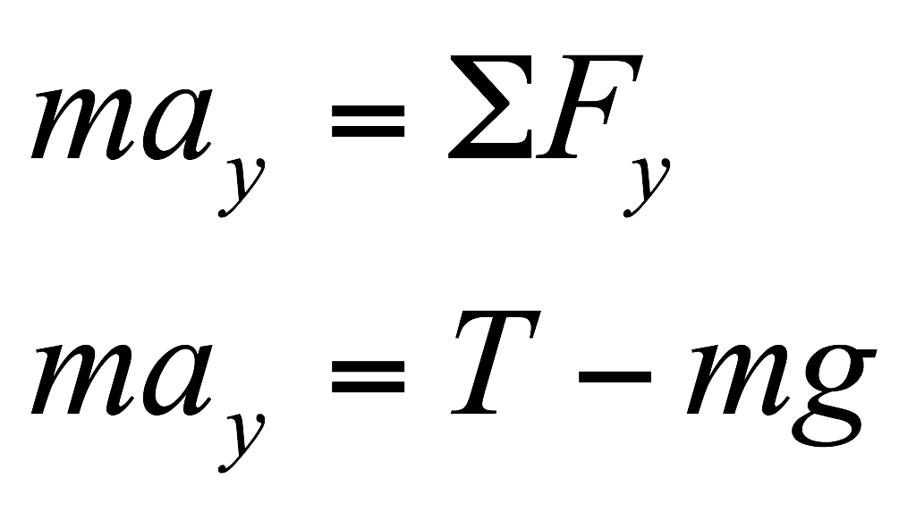
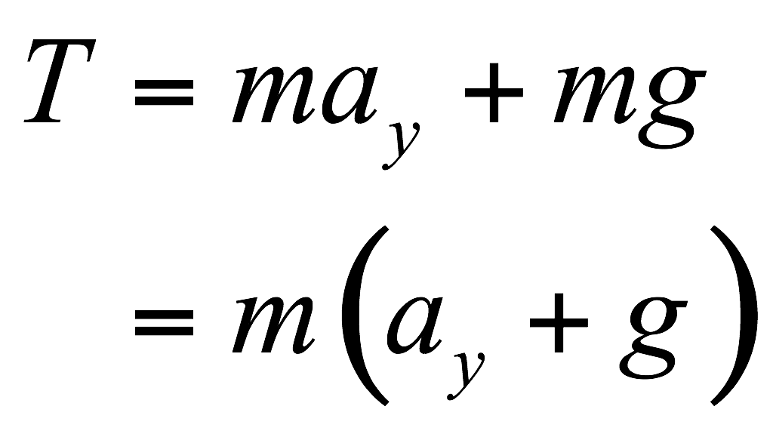
Case 2: Vertical Tension Forces on an Accelerating Object
©Cengage
Notes:
In this figure, a string is attached to an object and put under tension so that it accelerates the object upward. The tension force must support the weight and also provide the acceleration. The correct expression can be derived from the y-component of the second law given in the equations shown. This can be rearranged algebraically [click to see equation] to get the result shown. Accelerating upward increases the tension, whereas accelerating downward decreases the tension.

Slide 66
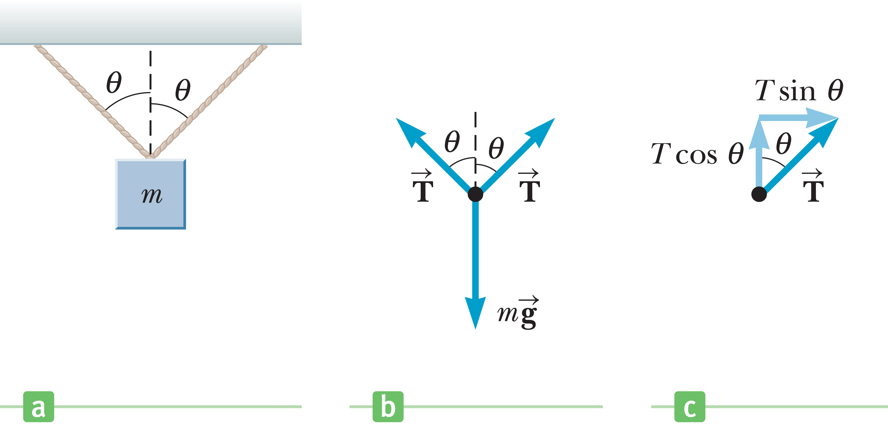
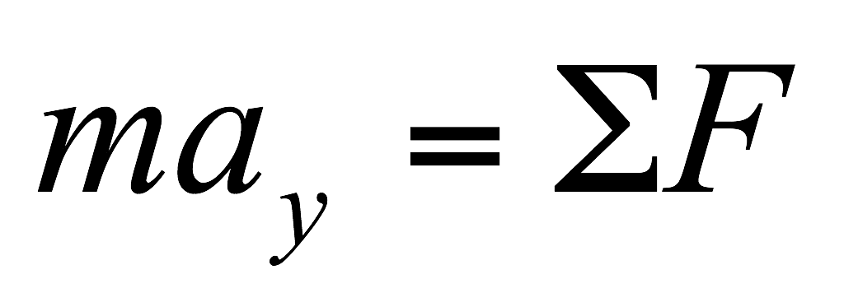
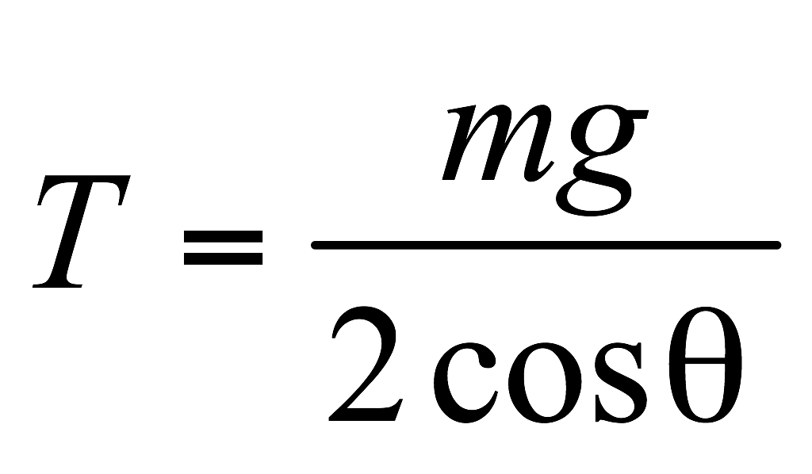
Case 3: Two Tension Forces at Symmetric Angles
Notes:
In the case shown in the figure, two tensions act on one object symmetrically. For this to work, the points of attachment must be chosen carefully, in which case the tensions will be equal.
Let’s apply Newton’s second law in the y-direction. [click to show equation] The y-component of each tension is given by T cos θ, [click to show equations] and the weight acts downward. Because the object is not moving, the acceleration is zero. [click to show equation] We can solve for the tension T. [click to show equation]
Whether the expression involves a sine or a cosine depends on what angles are given in the problem.

Slide 67
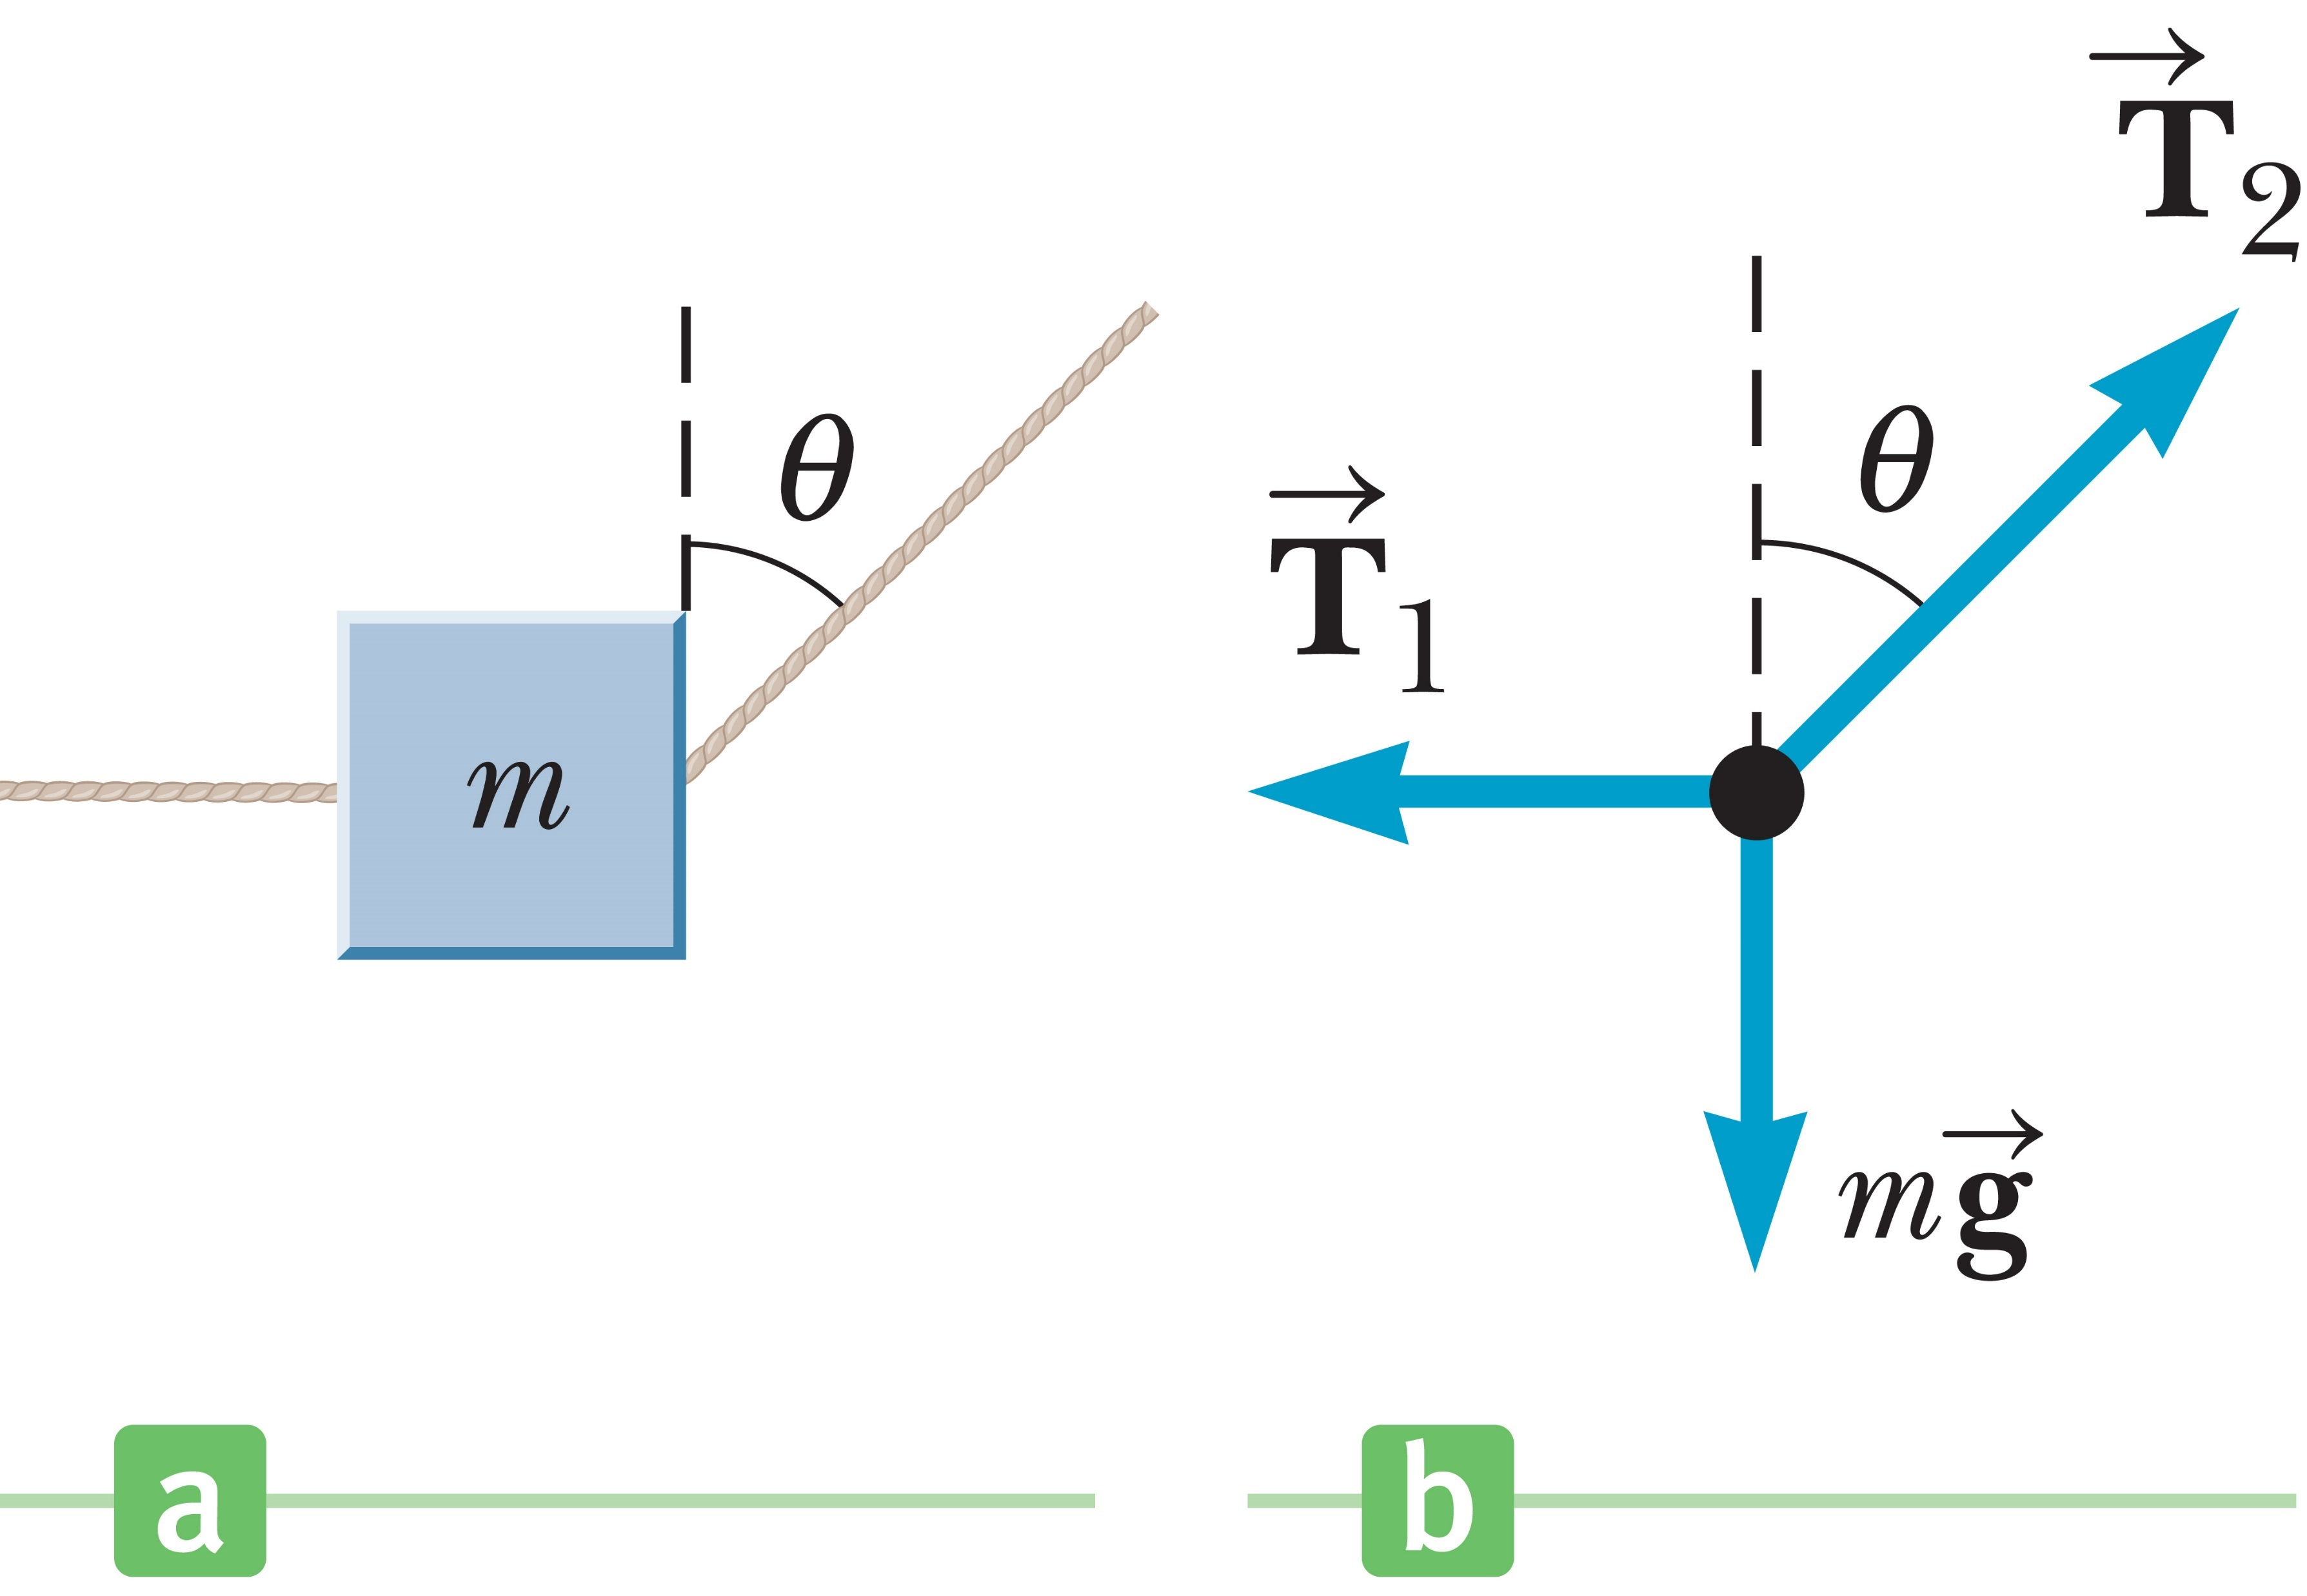
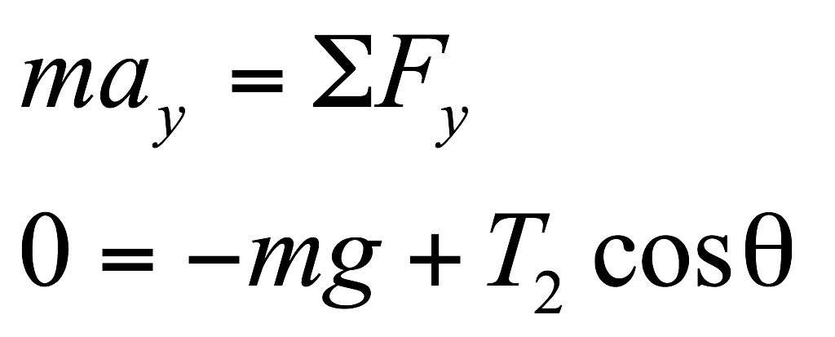
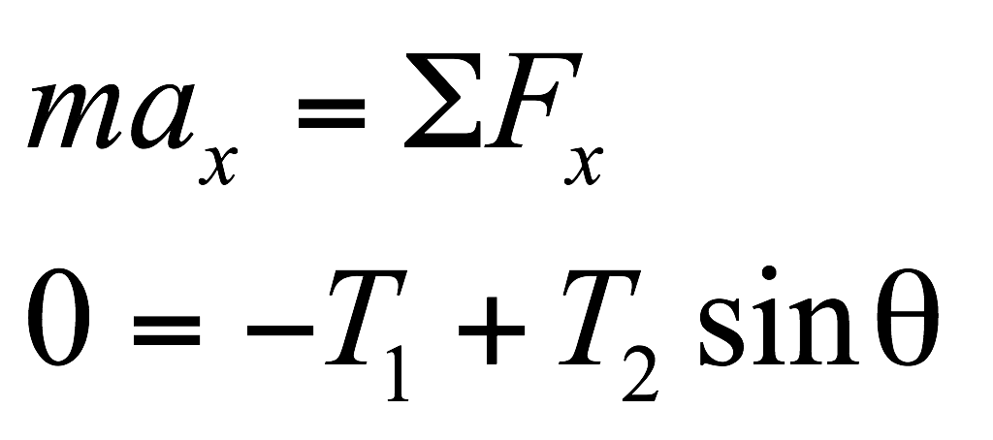
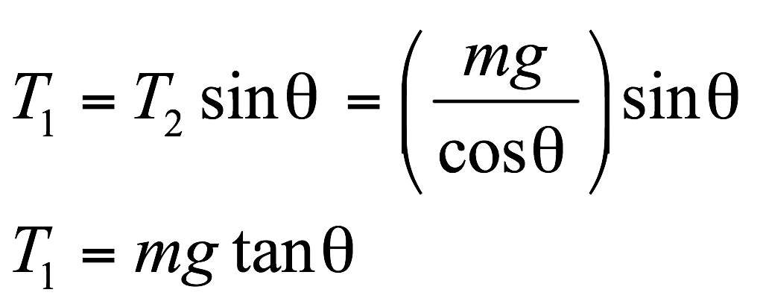
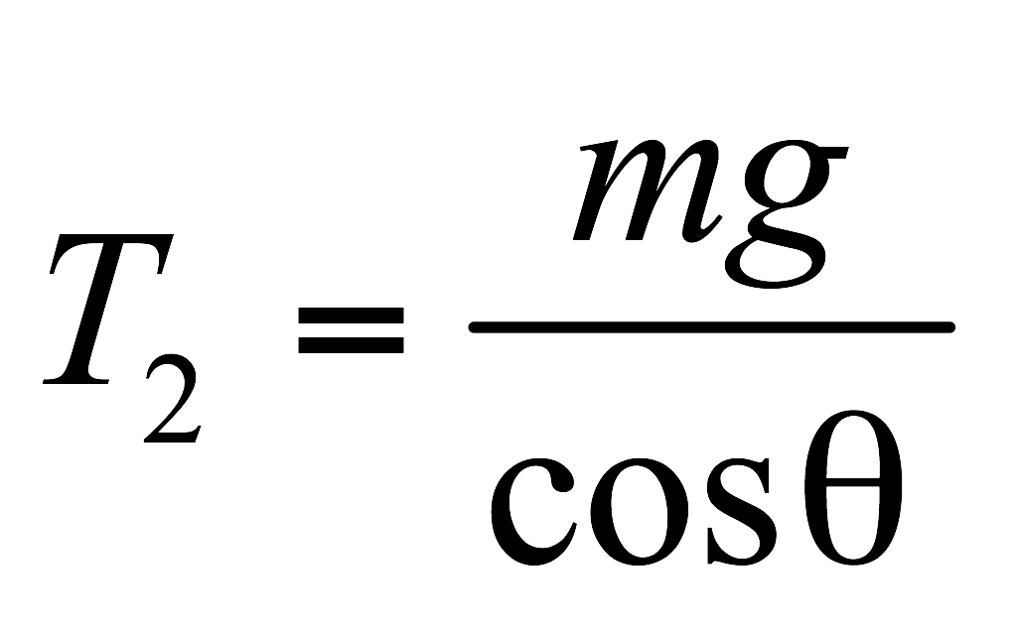
Case 4: Two Tensions at Nonequal Angles
Notes:
Sometimes you will see situations where the tensions form non-equal angles, as in the example shown in the figure. In these cases, you will need to write two equations with two unknowns for the two tensions, T₁ and T₂. Notice that in this case the given angle of 30.0° is with respect to the vertical, so the adjacent side of the triangle formed by the vector T₂ corresponds to the y-direction, which requires a cosine function.
With a_{y} = 0, the y-component of the second law yields the equation here [click to show equation], which can easily be solved for the tension, T₂. [click to show equation]
Again, the given angle 30.0° is with respect to the vertical, so the opposite side of the triangle formed by the vector T₂ corresponds to the x-direction, requiring a sine function. [click to show equations] With a_{x} = 0, the x-component of the second law can be solved for the tension T₁. [click to show equation]
The basic procedure is as follows: Using the two components of the second law, write two equations and solve for the two unknowns.

Slide 68
Applications of Newton’s Laws
©Cengage
Notes:
Now we are ready to apply Newton’s laws to objects under the influence of constant external forces. We will assume that objects behave as particles, so we don’t need to consider the possibility of rotational motion. We also neglect any friction effects and the masses of any ropes or strings involved. [click to show equation] With these approximations, the magnitude of the tension exerted along a rope is the same at all points in the rope.

Slide 69
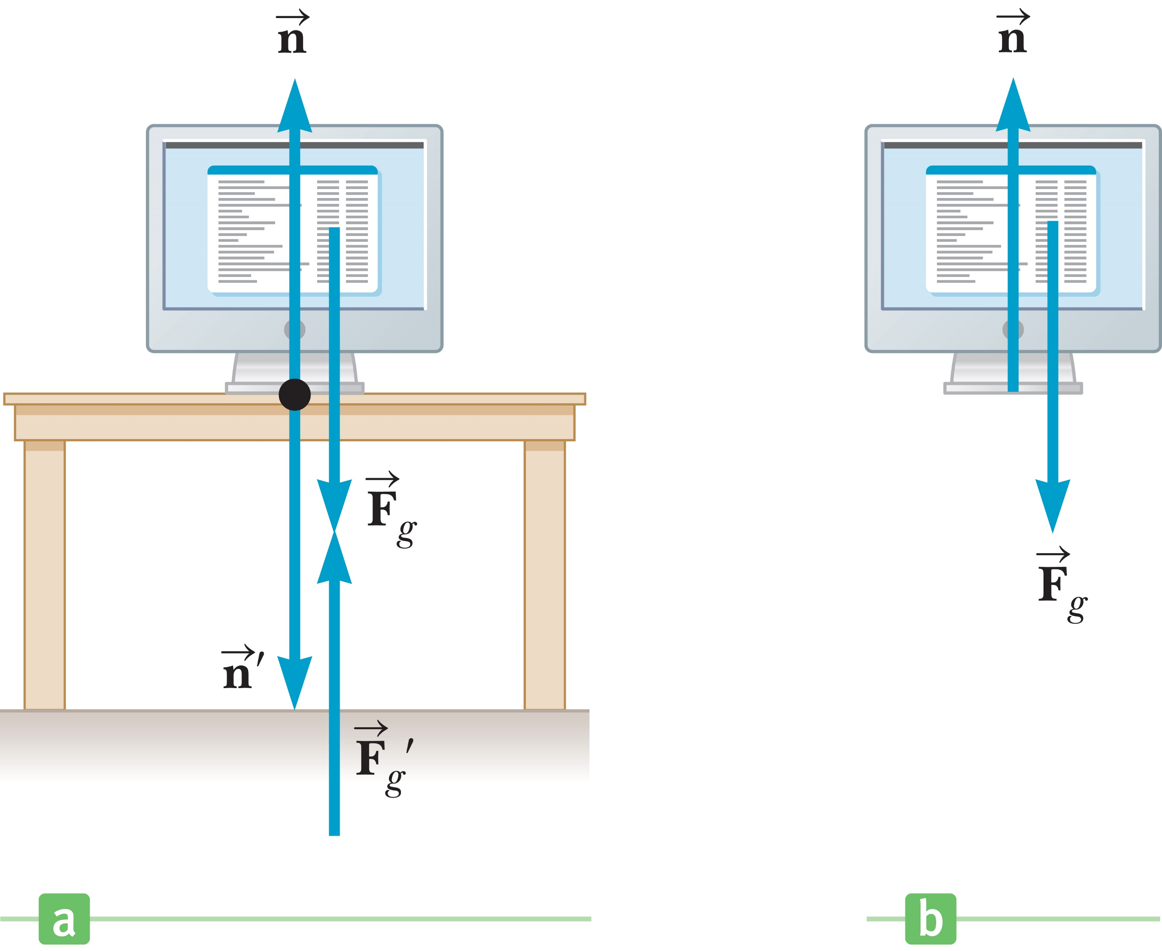
Newton’s Third Law
©Cengage
Notes:
When we apply Newton’s law to an object, we are interested only in those forces that act on the object. Look again at the figure of the monitor. The only external forces acting on the monitor are n and F_{g}. The reactions to these forces, n’ and F_{g}’, act on the table and on Earth, respectively, and don’t appear in Newton’s second law applied to the monitor.

Slide 70
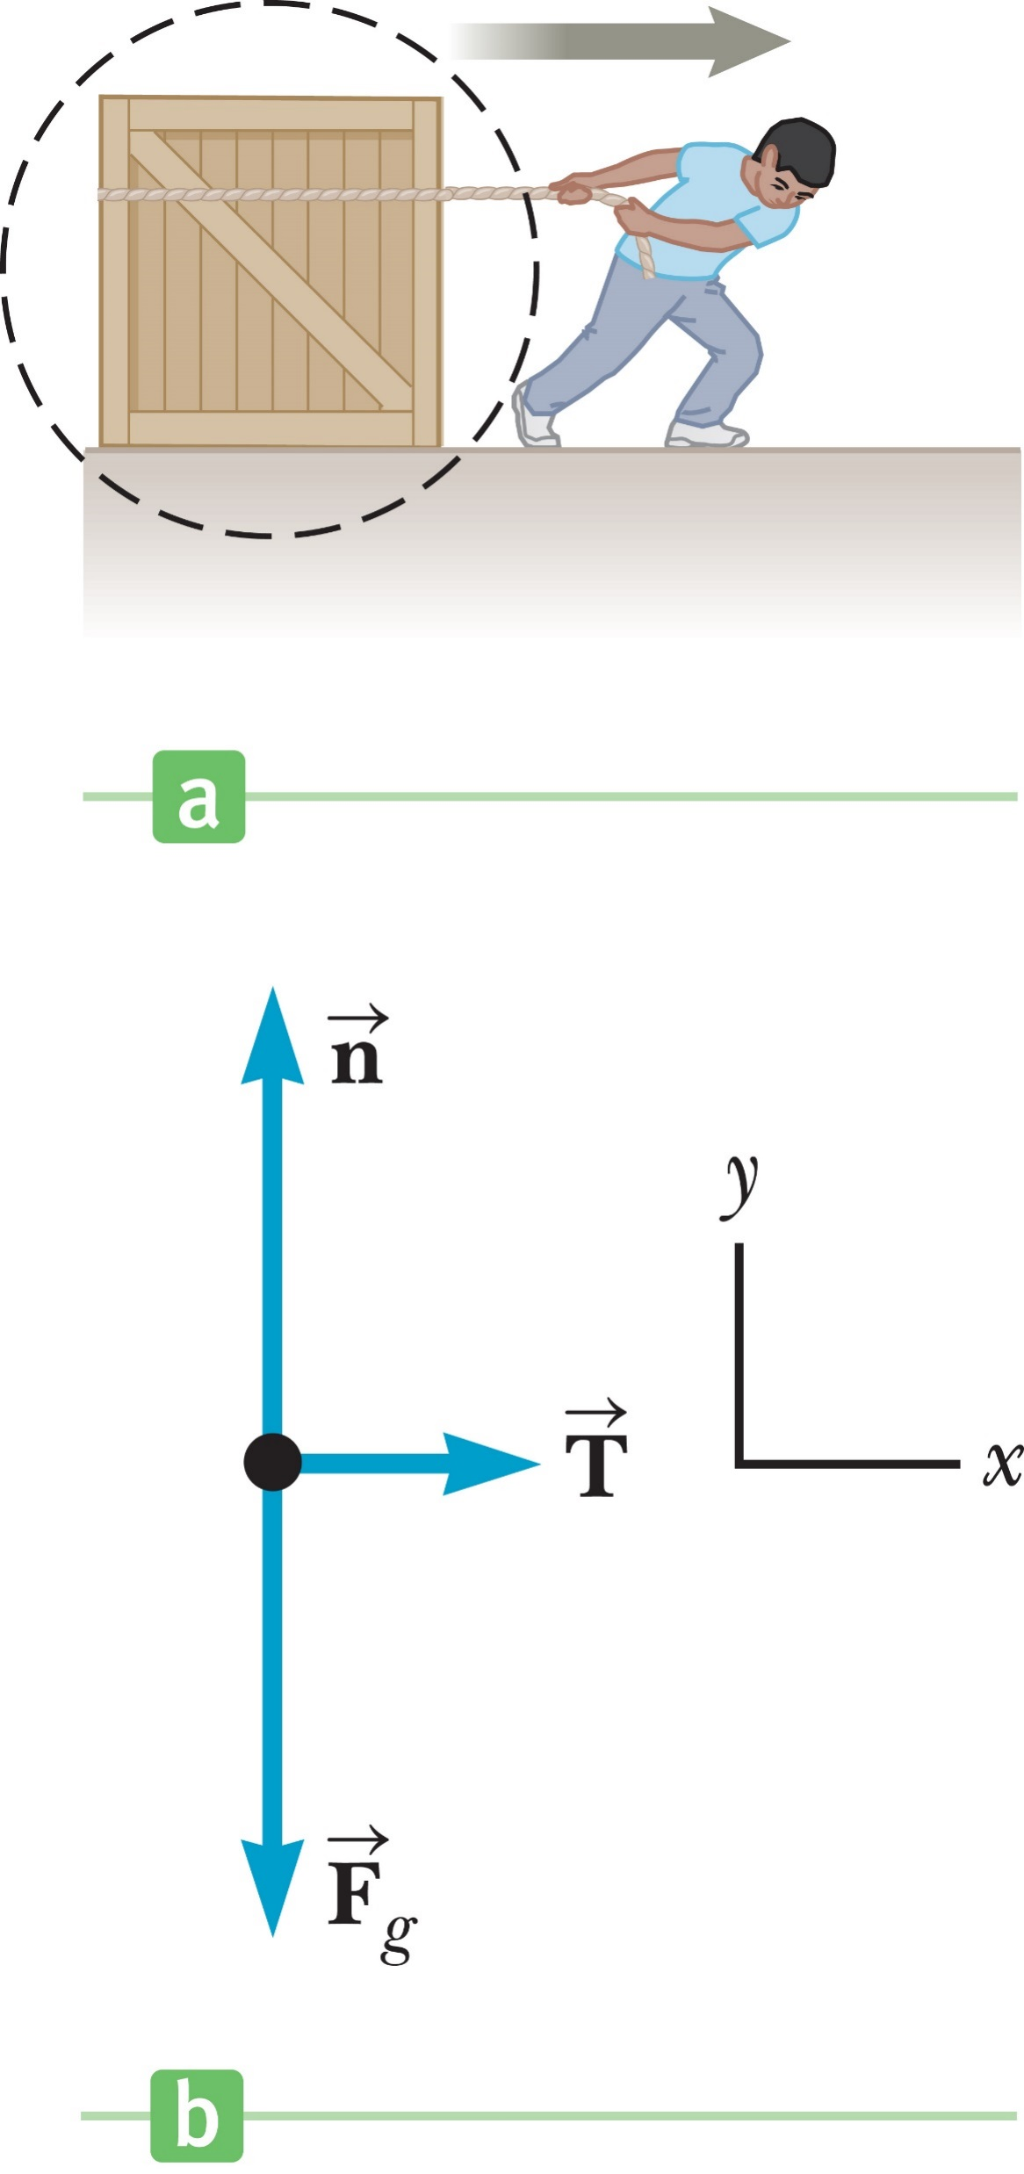
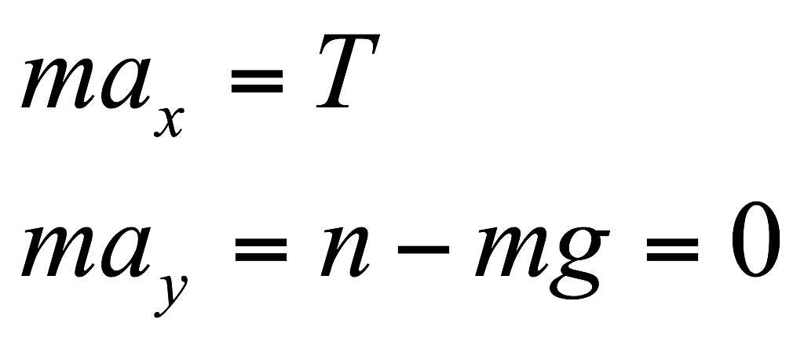
Newton’s Third Law
Notes:
Let’s consider a crate being pulled to the right on a frictionless, horizontal surface, as in the figure. Suppose you wish to find the acceleration of the crate and the force the surface exerts on it. The horizontal force exerted on the crate acts through the rope. The force that the rope exerts on the crate is denoted by T because it’s a tension force. The magnitude of T is equal to the tension in the rope. A dashed circle is drawn around the crate to emphasize the importance of isolating the crate from its surroundings. Because we are interested only in the motion of the crate, we must be able to identify all forces acting on it.
The free-body diagram illustrates these forces. The free-body diagram for the crate also includes the force of gravity F_{g} exerted by Earth and the normal force n exerted by the floor. The construction of a correct free-body diagram is an essential step in applying Newton’s laws. An incorrect diagram will most likely lead to incorrect answers!
The reactions to these forces—the force exerted by the rope on the hand doing the pulling, the force exerted by the crate on Earth, and the force exerted by the crate on the floor—aren’t included in the free-body diagram because they act on other objects and not on the crate. This means they don’t directly influence the crate’s motion. Only forces acting directly on the crate are included.
Now let’s apply Newton’s second law to the crate. First we choose an appropriate coordinate system. In this case it’s convenient to use the one shown in the figure, with the x-axis horizontal and the y-axis vertical. We can apply Newton’s second law in the x-direction, y-direction, or both, depending on what we’re asked to find in a problem. The results are shown here. [click to show equations] From these equations, we find [click to show equations] that the acceleration in the x-direction is constant, T over m, and that the normal force is given by n = mg. Because the acceleration is constant, we can use the equations of kinematics as needed.

Slide 71
Problem-Solving Strategy: Newton’s Second Law
Read the problem.
Draw a picture of the system.
Label your picture.
Draw a free-body diagram.
Apply Newton’s second law
Solve.
©Cengage
Notes:
Problems involving Newton’s second law can be very complex. This is a systematic approach to solving these types of problems, by breaking the solution process down into smaller, intermediate goals.
Read the problem carefully at least once.
Draw a picture of the system, identify the object of primary interest, and indicate forces with arrows.
Label each force in the picture in a way that will bring to mind what physical quantity the label stands for (e.g., T for tension).
Draw a free-body diagram of the object of interest, based on the labeled picture. If additional objects are involved, draw separate free-body diagrams for them. Choose convenient coordinates for each object.
Apply Newton’s second law. The x- and y-components of Newton’s second law should be taken from the vector equation and written individually. This usually results in two equations and two unknowns.
Solve for the desired unknown quantity, and substitute the numbers. In the special case of equilibrium, the foregoing process is simplified because the acceleration is zero.

Slide 72
Objects in Equilibrium
©Cengage
Notes:
Objects that are either at rest or moving with constant velocity are said to be in equilibrium. Because a = 0, this equation shows that the vector sum of all the forces, the net force, acting on an object in equilibrium is zero. We can write Newton’s second law for the x- and y-components. [click to show equations]
We won’t consider three-dimensional problems in this course, but we can extend our components to a three-dimensional problem by adding a third equation for the z-component. [click to show equation]

Slide 73
Think – Pair – Share
Consider the two situations shown in the figures, in which there is no acceleration. In both cases, the men pull with a force of magnitude F. How does the reading on the scale in figure (i) relate to the reading on the scale in figure (ii)?
The scale in situation (i) gives the greater reading.
The scale in situation (ii) gives the greater reading.
The scales in both situations give identical readings.
Notes:
Think about it, talk it over with a classmate, and we’ll hear from you in a minute or two.
Answer: The scales in both situations give identical readings.
Reasoning: In case (i), the scale records the tension in the rope attached to its right end. The section of rope in the man’s hands has zero acceleration, and hence zero net force acting on it. This means that the tension in the rope pulling to the left on this section must equal the force F the man exerts toward the right on it. The scale reading in this case will then be F. In case (ii), the person on the left can be modeled as simply holding the rope tightly while the person on the right pulls. Thus, the person on the left is doing the same thing that the wall does in case (i). The resulting scale reading is the same whether there is a wall or a person holding the left side of the scale.

Slide 74
Think – Pair – Share
For the woman being pulled forward on the toboggan in the figure below, the magnitude of the normal force exerted by the ground on the toboggan is
equal to the total weight of the woman plus the toboggan.
greater than the total weight.
less than the total weight.
possibly greater than or less than the total weight, depending on the size of the weight relative to the tension in the rope.
©Cengage
Notes:
Think it over, be ready to justify your choice, and consider your neighbor’s explanation. We’ll talk as a class in 2 minutes.
Answer: less than the total weight
Reasoning: The tension in the rope has a vertical component that supports part of the total weight of the woman and sled. Thus, the upward normal force exerted by the ground is less than the total weight.

Slide 75
Two-Body Problems: The System Approach
©Cengage
Notes:
We can also apply Newton’s second law of motion to systems of objects. If two bodies are connected by an inextensible string so that the bodies have a common acceleration, it’s possible to use the system approach, which treats the bodies as a single object. The second law of motion for the system approach is shown here, where F_{ext} are forces external to the system. Internal forces, for example, a tension force holding the system together, do not appear. Internal forces must be found by applying the second law to individual bodies in the system. The system approach, naturally, can be extended to three or more bodies.

Slide 76
Assessing to Learn
A baseball is struck by a bat. While the ball is in the air, what objects exert forces on the ball?
Earth 2. Bat 3. Air
4. Bat, air 5. Earth, bat 6. Earth, air
7. Earth, bat, air
8. There are no forces on the ball.
9. The answer depends on whether the ball is going up, going down, or at its highest point.
©Cengage
Notes:
Try out your explanation on a classmate, and see if you buy his or hers. We’ll get back together in about 4 minutes.
Answer: Earth, air
Question B1.01
Commentary
Purpose: To develop the concept of force and draw out the common misconception that a force can persist after the interaction causing it has ceased.
Discussion:
Except for gravitation, all the forces you will encounter for now require direct contact with an object or substance that causes them. (Later, you will encounter a few others such as the electric and magnetic forces that act over a distance.)
When the ball is in the air, the only object or substance touching the ball is the air, so the only forces on the ball are due to the Earth (gravitation) and the air (buoyancy and air resistance/drag).
The bat exerts a force on the ball while the bat and ball are touching, and this causes the ball’s initial motion. However, once the ball leaves the bat, this force disappears; thereafter, all changes in motion are due to the Earth and the air. Once the bat loses contact with the ball, it cannot affect its motion, and we say that the force is no longer exerted.
No forces are needed to keep something moving. An object in motion will remain in motion until forces act to change its motion. In this case, the bat gives the ball an initial velocity, and then the Earth and the air combine to give the ball an acceleration, thus changing its velocity (making it slow down and travel a curved path).
Key Points:
All forces are caused by interactions between two objects or substances.
For now, the only force you need to deal with that acts over a distance is gravity. All others require physical contact between the causing object/substance and the body being acted on.
When contact between to objects ceases, the contact forces between them also disappear.
For Instructors Only
It is common for students to think that a force is needed to sustain motion; in some cases, this conception is more specific, namely, that motion requires a force in the direction of motion. For this question, the conception manifests itself in the belief that there is a “force of the bat” that propels the ball during flight. Some students believe that the force of the bat goes away when the ball reaches its highest point and the Earth takes over, causing the ball to fall.
It is often useful to discuss the forces on the ball at three separate instants: (1) as it is rising, (2) when it is at its highest point, and (3) as it is falling. Students’ answers and explanations might change.
Discussion Questions:
What forces are being exerted on the ball, and what object exerts each force?
How do you know when a force is being exerted by one object on another?
Do the sizes of the forces on the ball change? Do the directions of the forces change? Describe how.
Do you have any control over the force of the bat on the ball? Can you make it larger or smaller or change its direction once the ball is flying through the air?
Suggestions:
Ask students if they have a way of exerting a force on an object without touching it. Invite them to move an object in the front of the room without leaving their seats and touching the item.
If Newton’s Second Law has been introduced, attempt to relate the forces exerted on the ball to the ball’s acceleration. See if students agree that, if air resistance and buoyancy can be neglected, the ball has a constant acceleration of 9.8 m/s² toward the Earth during its entire trajectory. If they agree, ask what they can conclude about the net force on the ball while airborne.
Source: UMass Assessing to Learn.

Slide 77
Assessing to Learn
Three blocks are stacked as shown below. How many forces are acting on the bottom block (m₃)?
1. One force 2. Two forces
3. Three forces 4. Four forces
5. Five forces 6. Six forces
7. More than six forces
8. No forces acting on the block
9. Cannot be determined
©Cengage
Notes:
Think about it, check in with a neighbor, and we’ll discuss it in 3 minutes.
Answer: Possible: (3) and (4)
Question B1.02
Commentary
Purpose: To hone and clarify the concept of force, and consider strategies for identifying the forces on an object.
Discussion:
Except for gravitation, all of the common forces you will see in mechanics require “direct” contact, though sometimes the agent is the air and you might not see the contact. So, in many situations, if you can identify all of the agents touching something, you can also determine the forces being exerted.
Air exerts a buoyant force on the block, but its magnitude is small, and we generally ignore this force. The only other agents touching the bottom block are the floor and the middle block. Thus, there are three forces on the bottom block: (1) gravitation, down, exerted by the Earth; (2) normal force, up, exerted by the floor; and (3) normal force, down, exerted by the middle block. Thus, answer (3) is preferred. Answer (4) is also defensible if you include buoyancy due to the air.
The upper block is not touching the bottom block, so it cannot exert a force on it.
Note that the force of the middle block acting on the lower block is a normal force, not a gravitational force. It turns out that this force pushing has the same strength as the total weight of the upper two blocks, but this does not mean that the force is “the weight of the two blocks.” In a free-body diagram, for instance, the force pushing down should be labeled as a normal force.
Key Points:
To identify the forces on a body, identify all the objects (or substances) in physical contact with the body; each can exert a contact force. Then, include any action-at-a-distance forces, such as gravity.
Air exerts a buoyant force, but in most circumstances it is negligibly small and we ignore it.
For Instructors Only
This problem has multiple defensible answers (3 and 4), and students who pick one may do so for the wrong reasons. Thus, it is crucial to have students volunteer explanations for their answers during whole-class discussion and to interact with the reasoning rather than with the answers themselves.
A common mistake is for students to claim there are four forces: gravitation due to the Earth, normal force due to the floor (or table), and the two gravitational forces on the upper two blocks (somehow “transmitted” to the lower one).
Some students will say that there are three forces, but one will be the “weight of the upper two blocks” or the “weight of m₁ and m₂.” This seems like a correct answer, but should not be treated as valid. The third force should be a normal force, whose value in this situation happens to be equal to the weight of the upper two blocks. If, for example, the system were accelerating, the normal force pushing down on m₃ would not be equal to the weight of the upper two blocks.
It can help tremendously to have students analyze the wording of their own statements. Many will admit that the force pushing down on the top of the bottom block is the “gravitational force exerted on the upper two blocks.” They should be able to see that the force “on the bottom block” cannot be a force exerted “on the upper two blocks.”
This question provides a good opportunity to discuss the nature of the normal force and of “constraint forces,” forces whose value is determined procedurally, with no empirical law. Students may have prior experience that allows them to solve certain problems correctly, but they might not have seen situations in which they must actually understand the normal force.
It would be technically correct but undesirable for students to include gravitational forces between the blocks, or other infinitesimal forces, in their count. Deciding what to include and what to neglect in problem solving is a learned skill, and discussing how these decisions are made can be worthwhile.
Question B1.03 makes an effective follow-up to this. It is a similar question, but the situation includes the additional subtlety of whether a contact force should be considered as one force or split into normal and friction forces.
Discussion Questions:
Does m₃ exert a force on m₁? If not, why not? How can m₁ exert a force on m₃ without m₃ exerting a force on m₁?
What part of m₂ interacts with m₃? What part of m₁ interacts with m₃?
Is weight a force? If so, what agent exerts the force?
Can an object interact with another object without touching it? If so, when? If not, why not?
Is the normal force exerted by m₂ on m₃ less than, equal to, or greater than the weight of m₂?
Source: UMass Assessing to Learn.

Slide 78
Assessing to Learn
A block of mass m is on a rough surface, with a spring attached and extended. As the block moves up the incline a small distance, how many forces are exerted on the mass?
1. One force 2. Two forces 3. Three forces
4. Four forces 5. Five forces 6. Six forces
7. Seven forces 8. More than 7 forces
9. None of the above
9. Impossible to determine
©Cengage
Notes:
Come up with your own answer, then check with a neighbor. Let’s talk in 3 minutes.
Answer: Possible: (4), (5), (6), (7), (8)
Question B1.03
Commentary
Purpose: To develop the skill of identifying all the (relevant) forces acting on an object and appreciate some of the ambiguities that involves.
Discussion:
The question has many defensible answers. What matters is not which answer you pick, but the validity of your reasoning. The most extreme answer is “an uncountable number of forces, one for each atom outside the mass interacting with each atom inside the mass.” So (8) is not wrong, but this way of thinking is not useful: it does not help us to analyze or understand the situation.
To identify the forces on an object, we identify all the objects interacting with it. In this case, the object is touched by the plane, string, spring, and air, and the Earth pulls on it gravitationally. The plane, string, and spring each exert a contact force on the object, and the air exerts both buoyancy and drag (air resistance), so we can say there are six forces acting: answer (6). (Warning: when you study electricity and magnetism, you will encounter other forces that act “at a distance” the way that gravity does.)
However, we often separate the contact force of a surface into its two components and treat them as distinct forces (normal and friction), so we can identify seven forces on the object: normal (due to the plane), kinetic friction (also due to the plane), tension (due to the string), elastic (due to the spring), buoyancy (due to the air), air drag (also due to the air), and gravitation (due to the Earth): answer (7).
But buoyancy and air drag are generally negligible, so to solve a physics problem, we would usually ignore them and identify the other five as the ones we must consider. That means answer (5) is defensible, and this would probably be the “expected” answer on a physics exam, as these are the five we need to use to solve a typical problem. (If we treated the force of the plane as one contact force rather than as distinct friction and normal forces, we would have an argument for answer (4).)
So, one can make a plausible argument for answers (4), (5), (6), (7), or (8). What matters is not which answer you choose, but whether your reasoning is cogent and defensible.
You should not count the “net force” along with the others: the net force is the vector sum of all of the individual forces, and is not a separate force that needs to be considered or accounted for.
Key Points:
To identify the forces acting on an object, identify all the objects that contact it; each one will exert a force. If the object has mass and the problem is not in “outer space,” the Earth will also exert a gravitational force.
Some contact forces are split into “pushing” and “sliding” components and treated as two separate forces: a normal one and a frictional one.
For Instructors Only
Part of learning to do physics is learning to make the “right” assumptions—the assumptions that experts do. This is a process of acculturation as well as of understanding physical laws, and we can help students along by explicitly discussing the assumptions we make and the ways we interpret questions. This question demonstrates a powerful tactic that involves presenting students with a question with multiple defensible answers, and then discussing the various answers and demonstrating the reasoning an expert might use and the standard assumptions she might make. We strongly recommend downplaying the notion of “right” and “wrong” here in favor of cogency.
When introducing forces to your students, we suggest identifying all valid forces, even if you will routinely neglect some of them in the future.
Most experienced teachers and students consider the normal and friction forces separate and independent even though they are simply components of one contact force exerted by the incline. Students need to understand this if the advice to “count forces by identifying all objects interacting with the body” is to be useful.
Some students will include other, “ridiculous” forces such as the gravitational attraction of the Moon, the Sun, the planets, etc. This is a good opportunity to make a distinction between “wrong,” “right,” and “right but not useful.”
Source: UMass Assessing to Learn.

Slide 79
Assessing to Learn
A monkey hangs on a rope. What forces act on the monkey? (Ignore forces due to the air.)
Friction, gravitation
Tension, gravitation
3. Friction, tension, gravitation
4. Normal, friction, gravitation
5. More than one true answer
6. None of the above
7. Cannot be determined
©Cengage
Notes:
Come up with an answer, consult with a neighbor or two, and then we’ll get together to talk about it in a few minutes.
Answer: Possible: (1), (2)
Question B1.04
Commentary
Purpose: To explore the notion of a “free body” when identifying the forces on something.
Discussion:
When identifying the forces on an object, we generally start with gravitation. If the object has mass and is in a gravitational field (such as that produced by the Earth), then the object has weight, and therefore it has a gravitational force on it.
Gravitation is the only common force that does not require direct contact between the object and the agent exerting it. All others—tension, friction (static and kinetic), normal, spring, air resistance/drag, and buoyancy—arise from contact.
The monkey is touching only a rope, and we are told to ignore any effects due to the air, so only the rope can exert any relevant forces on the monkey.
There are many valid ways to analyze this situation. The most precise answer would be to say that the rope exerts a friction force upward on the monkey. In other words, treating the monkey as the free body, it is friction that balances gravitation and keeps the monkey at rest. Friction requires a normal force, which in this situation would be horizontal. But there is no net normal force, so we cannot show a normal force vector on a free-body diagram for the monkey.
Another way to approach this situation is to treat that small bit of rope in the monkey’s hand as being part of the free body we are identifying forces on, in which case the force exerted by the rope is a tension force upward. Although this is less precise than the previous answer, it is the more common.
(If forces due to the air were included, we would also identify buoyancy, and perhaps a drag force if a wind were blowing.)
Key Points:
To identify the forces acting on a body, start with gravity if the body is in a gravitational field. Then, include forces for all objects and substances that contact the body.
There may be more than one way to describe and analyze a situation.
The set of forces acting on a body may depend crucially on exactly how one defines and delineates the “body.”
For Instructors Only
This simple question can spark a lively debate among students as they try to sort out the roles of friction, normal force(s), and tension. Impassioned advocates may defend all sides of the issue, and we encourage you to let the argument unfold on its own.
It is common practice to say that the upward force on the monkey is tension, but this is not precise and therefore can confuse some students, especially if it is simply asserted without a full explanation.
Most of the issues are resolved by definitions, and there are many valid answers, as outlined above. If we take the system or “body” to be the monkey and only the monkey, then the tension force is not exerted. Friction and a set of normal forces are the ones making direct contact with the monkey. If we consider only the “net” normal force, or sum of all normal forces, then the resultant is zero, so it may be neglected. If we consider a certain small bit of rope to be part of the system as well, then tension is the only contact force on the system.
Having students understand the “right” or “best” answer to this question is not as important as exploring definitions for “system,” “direct contact,” “free body,” and related ideas, as well as identifying common assumptions and practice.
There are many other similar situations that arise when trying to draw free-body diagrams. For instance, have the monkey hang from a loop in the rope. It is again common practice to say that the upward force is tension, though looking at the situation more closely, we can see that the loop of rope is pushing up on the monkey’s hand, so the force is actually a normal force.
Here are some more examples.
Replace the rope with a spring. Even if we include a small bit of the spring as part of the system, it is defensible to call the force exerted by the spring “tension” even though it is common practice to call it a spring force.
The monkey floating in water experiences a buoyant force, which is a type of normal force.
The monkey sitting on a compressed spring experiences either a spring force or a normal force, depending on your point of view.
Source: UMass Assessing to Learn.

Slide 80
Assessing to Learn
A thin wire is stretched horizontally between two walls. If a weight W is hung on the wire, what is true about the tension T in the wire?
T < W
T = W
T > W
The relationship between T and W cannot be determined.
©Cengage
Notes:
Consult with each other, come up an answer, and we’ll hear your ideas in 2 minutes.
Answer: T > W
Question B1.05
Commentary
Purpose: To develop your understanding of the vector nature of force.
Discussion:
The weight W is at rest, so the net force on it is zero, and the wire must support its weight. The wire will sag at least a little, forming a “V” shape with the weight at the lowest point. We can analyze this as two tension forces acting on the weight, one pulling up and to the left and the other pulling up and to the right. If the situation is symmetric (the weight is in the middle of the wire), each tension force has a vertical component equal to half the weight of W. The wire will also have a nonzero horizontal component. If the wire is tight enough that it stretches very little, the wire will be close to horizontal and the horizontal component will be larger than the vertical component, so T > W. (The closer to horizontal the wire is, the larger the horizontal component and thus the tension will be.)
Force is a vector, so direction and components matter. The vertical components of the tensions in the two wires combine to balance the gravitational force on the weight, and the horizontal components balance each other. To visualize this, it can help to draw a free-body diagram for the weight, and make it as accurate as possible.
You can also get a better understanding of this situation with a simple experiment. Hold one end of a rope or string and have a friend hold the other. Pull hard enough to keep the rope straight. Now, have someone else hang a heavy object from the middle of the rope. Can you pull hard enough to straighten the rope? As you change the tension in the rope by how hard you pull, what happens to the angle of the rope? When you and your friend hold both ends of the rope together so that it hangs straight down, what fraction of the weight does each of you support?
Key Points:
Force is a vector. When forces balance, their components balance in each direction.
When two forces balance a third by acting from two different directions, the sum of their magnitudes will be greater than the force they are balancing.
For Instructors Only
We are assuming that the thin wire does not stretch very much. If it stretches enough, it can become far enough from the horizontal that T < W. We must admit that the wire stretches and sags at least infinitesimally, however, or there would be no vertical component of the tension to balance the weight.
Students commonly say that the tension is half the weight of the hanging object. They are truly amazed when the tension is not only larger, but much larger, than the weight. They are thinking of forces as scalars, not vectors.
Some students may use experience of everyday situations to answer, for example, from hanging wet clothes on a clothesline to dry.
A demonstration can be very useful. Use spring scales to measure the tension in the rope at its two ends. Otherwise, you might have students who simply disregard what you are saying because they do not believe you.
An alternative is to do the following: Have two people hold a rope horizontally between them and tell the class that you are going to hang a gallon of water (or something equivalently heavy) from the middle of it. Ask the class how hard these people must pull to keep the rope horizontal. Many students will say that each must pull with half the weight of the hanging object. The demonstrators will find it impossible, and the class will enjoy watching them try to do it anyway.
Source: UMass Assessing to Learn.

Slide 81
Assessing to Learn
Consider the following three items. A. 100 g of steam on the Moon B. 10 g of water on the Earth C. 20 g of ice floating in water on the Earth Put these items in order of increasing weight:
1. A < B < C 2. A < C < B 3. B < A < C
4. B < C < A 5. C < A < B 6. C < B < A
7. None of the above
8. Impossible to determine
©Cengage
Notes:
Decide on the correct answer, and then find out if your neighbor has the same idea. In 2 minutes, be ready to share your answer and your reasoning.
Answer: B < A < C
Question B2.01a
Commentary
Purpose: To sensitize you to the similarities and differences between weight, mass, and density.
Discussion:
Weight is the total gravitational force on something; it is not the same thing as mass. If the object is far from any objects that can exert a gravitational force, we say it is “weightless”; otherwise, it has weight. The empirical law for gravitation is F_{g} = mg, where m is the mass (e.g., in kg) and g is the gravitational constant at that point in space (in units of force per kilogram). g is about 10 N/kg on the Earth (9.81 if you want to be picky) and about 1.7 N/kg on the Moon. In other words, near the surface of the Earth, for every kg of mass something has, its weight is 10 N. On the Moon, the same object would weigh 1.7 N—about 1/6 as large.
It is easy to be confused about the weight of steam, as it is a gas and its weight cannot be measured. However, because it has mass, it must also have weight if it is in a gravitational field. Likewise, ice floating has weight because it has mass and is near the surface of the Earth.
"Weight” is often explained as “a scale reading.” This can be a source of confusion, as this commonsense “definition” only works in limited circumstances and fails for gases, floating solids, or accelerating bodies.
Given that g on the Moon is about 1/6 as strong as g on the Earth, 10 g of water on the Earth has the smallest weight, then 100 g of steam on the Moon, then 20 g of ice on Earth (whether floating or not).
Key Points:
All matter in a gravitational field has weight, and the weight depends only on the mass and the strength of the gravitational field at that location.
Be careful not to confuse mass and weight, especially because the words are used interchangeably in everyday language.
Thinking of g as a force constant in N/kg, rather than as an acceleration in m/s², is less likely to lead to confusion.
For Instructors Only
This is the first of three questions exploring weight, mass, and density. They are interrelated, and we recommend discussing them jointly after presenting and collecting answers for all three.
Many students have some chemistry background. That can be useful to tap into, as they know that all atoms have an intrinsic mass. Unfortunately, the molar mass is often referred to as “atomic weight” even though it is given in grams; this can further confuse the issue.
Some students think that there is no gravity on the Moon because there is no atmosphere.
Unlike most textbooks, we find it pedagogically advantageous to define g as the “gravitational constant” or “gravitational field strength” rather than the “acceleration due to gravity,” and give its units in N/kg (in analogy with, say, Hooke’s Law for springs). Otherwise, students can become confused about the “acceleration due to gravity,” sometimes looking for or expecting there to be accelerations due to other forces. A more precise phrase would be “acceleration due to gravity in the absence of all other forces” or “acceleration in free fall,” but these phrases also have limitations. “Gravitational field strength” or simply “gravitational constant” do not have these limitations.
Source: UMass Assessing to Learn.

Slide 82
Assessing to Learn
Consider the following three items. A. 100 g of steam on the Moon B. 10 g of water on the Earth C. 20 g of ice floating in water on the Earth Put these items in order of increasing mass:
1. A < B < C 2. A < C < B 3. B < A < C
4. B < C < A 5. C < A < B 6. C < B < A
7. None of the above
8. Impossible to determine
©Cengage
Notes:
Discuss your ideas with your classmate, and let’s talk as a group in a couple of minutes.
Answer: B < C < A
Question B2.01b
Commentary
Purpose: To sensitize you to the similarities and differences between weight, mass, and density.
Discussion:
Every atom has mass. For instance, the atomic mass (mass of 1 mole) of carbon is 12 grams. Mass represents how hard or easy something is to accelerate, and is not affected by the local gravitational constant g.
Consider an astronaut repairing a broken satellite. On the Earth, the satellite weighs many tons, and also has a large mass. In space though, the weight is very small and the astronaut can support its weight very easily. But the satellite remains very difficult to move, because it is so hard to accelerate—and once moving, it is very hard to stop again!
The quantities given are all masses, so 10 g of water (on the Earth) has the smallest mass, then 20 g of ice, then 100 g of steam.
For Instructors Only
This is the second of three questions exploring weight, mass, and density.
The primary point of confusion for students is likely to be the mass of the steam, as it is a gas. Some students just do not understand how a gas can have mass. One way to approach this is by appealing to the microscopic view of a gas consisting of atoms, which have mass. Another is to discuss the consequences of air (or gas) having no mass: When I blow air on my hand, I would not be able to feel it; when I pump up a basketball, I would not be able to hear it; there would be no air resistance or drag, which would be great for car fuel efficiency, but there also could be no airplanes, because there would be no lift; hurricanes would not have any devastating effects, because there would be no energy in its winds. There are many other examples as well. The manifestations of air having mass are everywhere.
Source: UMass Assessing to Learn.

Slide 83
Assessing to Learn
Consider the following three items. A. 100 g of steam on the Moon B. 10 g of water on the Earth C. 20 g of ice floating in water on the Earth Put these items in order of increasing density:
1. A < B < C 2. A < C < B 3. B < A < C
4. B < C < A 5. C < A < B 6. C < B < A
7. None of the above
8. Impossible to determine
©Cengage
Notes:
Think about your answer, share it with your neighbor, and be ready to share with the whole class in about 2 minutes.
Answer: A < C < B
Question B2.01c
Commentary
Purpose: To sensitize students to the similarities and differences between weight, mass, and density.
Discussion:
The density is the ratio of mass to volume (not of weight to volume).
Some people think that solids are always more dense than fluids. Although this is often true, ice is an exception because it floats in water. Its density is about 90% as large as that of water. In other words, 100 milliliters of water has a mass of 100 grams, but the same volume of ice has a mass of only about 90 grams.
People often confuse density with mass and/or weight. A battleship has a very large mass (and therefore a very large weight), but because it floats, its average density must be smaller than that of water. A coin is very light, having a mass of only a few grams (a nickel is 5 grams), but a coin sinks in water, which means its density is larger.
Because density is defined in terms of the mass, not weight, gravitational field strength is irrelevant; an object or substance has the same density on the Moon and on the Earth (unless, of course, the Moon’s vacuum causes changes in the volume of the substance).
Steam (in any amount, anywhere) has the smallest density, then ice, then water. The masses and locations are not meaningful for answering this question.
Key Points:
The density of an object or substance is its mass divided by its volume, and does not depend on gravitational field strength.
Big objects are not necessarily denser than small ones.
Everyday language is very sloppy about distinguishing between mass, weight, and density, but physics depends on precise usage.
If one substance floats on another, the floating one is less dense.
For Instructors Only
This is the last of three questions exploring mass, weight, and density.
In everyday usage, we often use the same terms to refer to mass, weight, and density. We might say that something is “heavy” or “light,” and usually context alone tells us whether we are referring to mass, weight, or density. Therefore, it is useful for students to think about “light” objects that sink (such as coins) and “heavy” objects that float (such as battleships).
As a follow-up, you can ask students if ice floats in water on the Moon, and if so, whether the water line would change. This will induce students to think about their ideas of mass, weight, and density.
Source: UMass Assessing to Learn.

Slide 84
Assessing to Learn
An astronaut floats inside an orbiting space station. Which of the following are true? A. No forces act on the astronaut. B. The astronaut has no mass. C. The astronaut has no weight.
1. A only 2. B only 3. C only
3. A and B 5. A and C 6. B and C
7. All are true.
8. None are true.
©Cengage
Notes:
Think about it, and be prepared to justify your response. We’ll talk as a group in 4 minutes, but feel free to bounce your thoughts off a classmate in the meanwhile and see what makes sense.
Answer: None are true.
Question B2.02
Commentary
Purpose: To distinguish the concepts of force, mass, and weight.
Discussion:
Does a force act on the astronaut? Yes! The astronaut is traveling in a circle or ellipse about the Earth. Because her velocity is changing (velocity is direction and speed), the astronaut must be accelerating, which means a force must be acting on her. The Earth is exerting a gravitational force on the astronaut that keeps her in orbit, rather than sailing off into space.
Does the astronaut have mass? Yes! All matter has mass, always. Mass determines an object’s inertia: how hard or easy it is to accelerate. A floating object can still be difficult to accelerate. A floating coin is much easier to accelerate than a floating astronaut.
Does the astronaut have weight? Yes! In physics, we define “weight” to be the total gravitational force on something. Because the Earth exerts a gravitational force on her, the astronaut has weight. To someone within the space station the astronaut appears to be “weightless” because the observer and the space station—the entire frame of reference—has exactly the same acceleration that she does. To be precise, we can say that an object floating inside an orbiting space station has an “apparent weight” of zero.
The orbiting space station is not a “proper” frame of reference, because it is accelerating. To judge whether the astronaut is accelerating, we must observe the motion from a nonaccelerating frame.
(The International Space Station orbits the Earth once every 90 minutes, and it is always within 450 km of Earth’s surface. Thus, its acceleration is about 9.5 m/s², and a 200-lb astronaut would weigh about 190 lb. At 6 Earth radii, a 200-lb astronaut would weigh about 6 lbs. This may seem small, but it is still the largest force acting on the astronaut, and therefore it cannot be neglected.)
Key Points:
All matter has mass, always.
An object’s weight is the total gravitational force acting on it. Any mass in a gravitational field has weight.
According to Newton’s first law, any object that is accelerating must be experiencing a nonzero net force. An object whose direction is changing is accelerating, even if the speed is not changing.
Objects in free-fall or orbit have only apparent, not real, weightlessness.
Newton’s laws are not valid in an accelerating frame of reference, so such a frame is not generally useful for analyzing motion.
For Instructors Only
This is a good question for drawing out misconceptions about force, mass, weight, free-fall, and “weightlessness.” Everyday language rarely distinguishes between free-fall and true weightlessness, so students may experience considerable confusion here.
Invoking scale readings as an operational definition of weight is not a good solution; a scale merely measures the normal force exerted by the scale, which only equals an object’s weight in a proper reference frame and when no other forces impact the normal force.
Source: UMass Assessing to Learn.

Slide 85
Assessing to Learn
Consider the three situations shown below. In each case two small carts are connected by a spring. A constant force F is applied to the leftmost cart in each case. In each situation the springs are compressed so that the distance between the two carts never changes. Which of the following statements must be true regarding the compression of the spring in each case? Assume the springs are identical.
1. Compression A = Compression B = Compression C
B = C < A 3. A < B = C
4. A < B < C 5. B < A < C
6. C < A < B 7. A < C < B
None of the above
Cannot be determined
Notes:
Think about it, check your answers with a neighbor, and get ready to share your ideas in 5 minutes.
Answer: B < A < C
Question B2.03
Commentary
Purpose: To explore Newton’s second law and model the normal force between two objects.
Discussion:
The total mass of each system is 4M and the net force on each system is F, so the acceleration of each system—and each object in each system—is the same.
Isolating the right cart in each system, the net force on it is the spring force. Note that the applied force is exerted only on the left cart, and the left cart experiences two horizontal forces, F to the right and the spring force to the left. But the right cart experiences only one horizontal force, so it is the net force. In any one system, the spring force is the same on both carts.
Because the accelerations of the rightmost carts in all three situations are equal, the least massive cart must have the smallest net force on it, and the most massive one must have the largest net force on it. Therefore, the spring pushing the M cart to the right must be compressed the least, followed by the spring pushing the 2M cart, and finally, the spring pushing the 3M cart to the right.
This arrangement of two carts connected by a spring is a useful model for the normal force, because you can “see” the forces more easily. Imagine that the carts were not connected by springs, but were only touching each other. We would replace the spring force with a normal force, but everything else about the situation would be the same. The normal force pushing the 3M cart to the right would be largest, and the normal force pushing the M cart to the right would be smallest. Also, the normal force pushing to the right in each system would be as strong as the normal force pushing to the left.
Key Points:
Newton’s second law can be applied to a “system” of objects moving together. It can also be applied individually to each object within the system.
Only external forces contribute to the net force on a system. In this case, the spring force does not affect the acceleration of any of the 2-cart systems.
The more a spring is compressed (or stretched), the larger the force it exerts on either end.
A compressed spring placed between two objects is a useful model of the normal force.
For Instructors Only
Students may not be comfortable applying Newton’s second law to a multi-object system. They may not realize that they do this all the time: when we apply Newton’s laws to an extended object, we are already treating it as a collection of atoms, all of which are moving at the same velocity, and therefore, each of which has the same acceleration (ignoring microscopic motion, of course).
Students should be discouraged from calculating the accelerations, and instead be encouraged to apply qualitative reasoning. Students should be encouraged also to draw free-body diagrams for each cart and for one of the two-cart systems. Which forces are included? Only external forces should be on a free-body diagram. Which forces balance? Vertical forces balance. What is the net force in each case? The sum of the horizontal forces.
Note that we are assuming that there is no oscillatory motion, which is difficult to eliminate in real life. This may be a point of confusion for students.
Additional Questions:
1. How would your answer change if the force F was applied to the left on the right cart of each system?
2. Using the same three systems, assume now that each spring is compressed by the same amount d. Compare the applied forces exerted on the left cart.
Blocks of 3 kg and 2 kg are side-by-side on a smooth, horizontal surface. A horizontal 12‑N force is applied to the 3-kg block. (a) What are the accelerations of the blocks? (b) What are the net forces on the two blocks? (c) Show that the normal forces that the two blocks exert on each other must have the same strength in order for your answers to (a) and (b) to be correct. In other words, demonstrate that Newton’s third law is satisfied in this situation even though you have not used it or assumed it to be true.
Source: UMass Assessing to Learn.

Slide 86
Assessing to Learn
Consider the three situations below, labeled A, B, and C. Ignore friction. After each system is released from rest, how do the tensions in the strings compare?
1. A = B = C 2. B = C < A 3. A = C < B
4. A < B < C 5. A < C < B 6. B < A < C
7. B < C < A 8. C < A < B 9. C < B < A
10. Impossible to determine
Notes:
Think about it, talk it over with a classmate, and we’ll hear from you in a couple of minutes.
Answer: B < C < A
Question B2.04
Commentary
Purpose: To reason qualitatively about forces and accelerations, and to recognize that tension is a “constraint force” with a situation-dependent magnitude.
Discussion:
It is common for students to think that the tension is equal to 20 N in all three cases. However, this is impossible, otherwise the net force on each hanging mass would be zero, and it would not accelerate.
In A, the 2-kg block does not move or accelerate, so the tension in the string balances gravitation, which is 20 N.
In B, both blocks speed up. This means that the tension is the string must be smaller than the weight of the hanging block, so that there is a net force acting downward on the 2-kg (hanging) block.
Likewise, in C, both blocks speed up, so the tension in the string must be smaller than the weight of the hanging block.
So we need to ask “In which case, B or C, is the acceleration larger?” because the case with the larger acceleration will have the larger net force and thus the smaller tension. Intuitively, the acceleration of the blocks in B must be largest, B would have the smallest tension. Thus, B < C < A = 20 N.
We can also use extreme case reasoning to distinguish B and C without solving any equations. Imagine the 1-kg block in B is only 1 gram (smaller than the mass of a dime), and imagine that the upper 2-kg block in C is 2000 kg (as large a mass as a car). In this case, the hanging block in B would fall at nearly 10 m/s/s and the tension would be almost zero. And the hanging block in C would barely accelerate at all and the tension would be just slightly less than 20 N.
Key Points:
Tension is a “constraint” force, which means there is no formula or empirical law to determine its value. Instead, the tension adjusts to the given situation, taking on whatever (positive) value is required to keep the string a fixed length.
You do not have to solve these situations in order to compare the tensions. Qualitative reasoning is all you need to do the comparison. Actually solving for the tensions is much more work, and you might not even believe the result when you get it. Reasoning through to an answer can increase your understanding.
"Extreme case reasoning"—imagining the situation with exaggerated quantities—is a useful technique for making qualitative comparisons and developing intuition for a situation.
For Instructors Only
This style of problem—comparing the value of a quantity across similar situations—is powerful for drawing attention to particular features and for demonstrating the utility of qualitative reasoning. The instructor should strongly resist students’ desire for quantitative calculations! Extreme case reasoning may be new and uncomfortable to students, but this is a good situation to engage them in it.
Making connections to other constraint forces, such as the normal and static friction forces, can be helpful.
Source: UMass Assessing to Learn.

Slide 87
Assessing to Learn
Two blocks are arranged as shown and kept at rest by holding the 1 kg block in place. The tension in the string is closest to:
1. 9 N 2. 10 N 3. 11 N 4. 12 N 5. 13 N
6. 10 N at the left end; 12 N at the right
7. 10 N in the left segment; 11 N in the middle segment; 12 N in the right segment
8. Smoothly varying from 10 N by the
left block to 12 N by the right block
9. None of the above
10. Impossible to determine
Notes:
Think it over, run your ideas by a classmate, and be ready to share with the class in about 3 or 4 minutes.
Answer: 12 N
Question B2.05a
Commentary
Purpose: To clarify the concept of tension, how it can be determined, and the assumptions we often make when working with it.
Discussion:
Let’s assume as little as possible, and see where it leads us. The block on the right weighs about 12 N, so we know that the tension at that end of the string is 12 N also, because the block is not accelerating. Traveling up the string, we expect the tension to become slightly larger, as we take into account the weight of the string: a point in the string must support the weight of the block and all the string hanging below it. If we neglect the string’s weight, the tension must be 12 N everywhere in the rightmost segment of the string.
The pulley on the right has no rotational acceleration, so the tension pulling down on it must be equal to the tension pulling left on it. This is true whether or not the pulley has mass.
Moving along the string to the left, a real string (i.e., with mass) would sag in the middle. This one doesn’t sag, so the tension is 12 N everywhere in the middle segment of the string.
The pulley on the left also has no rotational acceleration, so the tension at the top of the leftmost segment is 12 N.
Traveling down the left string, the tension would get slightly smaller if the string had mass, as lower parts support less weight. If the string’s weight is negligible, then the tension is 12 N everywhere along the leftmost segment.
Thus, assuming the string is massless, the tension everywhere in it is 12 N.
Note that the weight of the 1-kg block is about 10 N, so a downward force of 2 N is needed to keep it at rest. If the 1.2-kg block were supported at rest instead of the 1-kg block, the tension in the string would be 10 N everywhere.
Key Points:
There is no straightforward law or equation for calculating the tension in a string. The tension will take on whatever value is required to keep the objects it is attached to from pulling farther apart.
If we don’t approximate strings as massless, the tension in them is not the same everywhere, and this makes calculations much more difficult.
If a string passes over a pulley, the tension in each part of the string must be the same or the pulley will have a rotational acceleration.
For Instructors Only
This is the first of two related questions using the same situation.
Instructors often assert or assume that the tension is the same everywhere in a string without letting students see the implications of a non-massless string or non-massless pulleys. As a rule, students have difficulty separating the consequences of the approximation from more general principles. This can be particularly hard to overcome later when we address massive pulleys and strings.
Students might not recognize or register the critical feature that the 1-kg block is held in place, but think that the system is moving or accelerating.
As a follow-up, try asking the question again with the other block held in place. To check for understanding, you can also ask students to explain how the 1-kg block can remain at rest with a tension force of 12 N pulling up on it.
Source: UMass Assessing to Learn.

Slide 88
Assessing to Learn
Two blocks are arranged as shown and released from rest. The tension in the string is closest to
1. 9 N 2. 10 N 3. 11 N 4. 12 N 5. 13 N
6. 10 N at the left end; 12 N at the right
7. 10 N in the left segment; 11 N in the middle segment; 12 N in the right segment
8. Smoothly varying from 10 N by the
left block to 12 N by the right block
9. None of the above
10. Impossible to determine
Notes:
Think about it for yourself, then check with a classmate, and we’ll check your answer in about 4 minutes.
Answer: 11 N
Question B2.05b
Commentary
Purpose: To help you to understand tension, especially in a dynamic situation.
Discussion:
If the string is massless, the tension must be the same everywhere in a segment (between a block and pulley, or between two pulleys). Otherwise, some massless sub-portion of the segment would have a nonzero net force on it (more tension on one end than the other), and its acceleration would be infinite.
When a string passes over a pulley, the pulley will have a rotational acceleration if the tensions are different on the two sides. If the pulley is massless, the rotational acceleration would be infinite, so with a massless pulley the tension is always the same on either side. We won’t have the tools to handle pulleys with mass until we discuss rotational dynamics, so for now we’ll generally assume all pulleys are massless. So, in this question we can say the tension in the string will be the same everywhere, from one block all the way to the other.
The 1.2-kg block accelerates downward, so the net force on it must also point downward, which means the tension in the string is less than 12 N. The 1-kg block accelerates upward, so the net force on it must point upward as well, which means the tension in the string must be larger than 10 N. So, we know that 10 N < T < 12 N.
Without solving for the exact values of the accelerations and the tension, it is impossible to give a precise value for the tension, but 11 N is certainly a reasonable approximation. 11 N cannot be exactly correct, because then the accelerations of the two blocks would be different, which is impossible if the string remains taut and does not stretch. A tension of 11 N on the 1-kg block yields an acceleration of 1 m/s² upward, while the same tension on the 1.2-kg block yields an acceleration of about 0.8 m/s² downward. Therefore, the tension must be slightly smaller than 11 N, and the acceleration must be something near 0.9 m/s².
Note that tension is a “constraint” force, which means its value adjusts to take on whatever value is required to enforce a physical constraint of the system—in this case, that the string maintains a constant length and the blocks stay the same distance apart (along the string). This means the two blocks also have the same speed at all times, as well as the same magnitudes of acceleration. (In this situation, the directions of their velocities are opposite each other, as are the directions of their accelerations.)
Key Points:
Tension is a constraint force and will have whatever value is required to keep the objects at either end of the string from moving farther apart than the length of the string. There is no one equation for calculating the tension.
The tension is the same everywhere in a section of massless string.
The tension is the same in the string on either side of a massless pulley, even if the pulley is experiencing rotational acceleration.
In many problems, you can estimate a numerical value fairly well without a detailed calculation to determine its precise value.
For Instructors Only
This is the second of two questions using the same situation.
This question may engender—or rather, reveal—much confusion, as students often believe that T = mg is a formula or empirical law for the tension. They do not appreciate that tension adjusts to the physical situation. Thus, most students’ answers will arise out of an attempt to reconcile conflicting ideas, and the resulting distribution of answers can appear random.
Some students will attempt to solve the problem and compute a numerical value for the tension. We recommend discouraging this, for example, by giving students very little time to determine and submit an answer. Students should be encouraged to reason toward and estimate an answer, as that better develops conceptual understanding and physical intuition.
A nice follow-up or exam question is to put identical blocks on either end of the string and indicate that the system is in motion. Students who are still confused may not be able to see that because the blocks are not accelerating, the tension in the string is equal to the (common) weight of each block.
Source: UMass Assessing to Learn.

Slide 89
Assessing to Learn
A car accelerates down a straight highway. Which of the free-body diagrams shown below best represents the forces on the car?
2.
3. 4.
5. None of these 6. Cannot be determined
Notes:
Share your ideas with a neighbor, and get ready to share with the class in about 4 minutes.
Answer: (4)
Question B1.06
Commentary
Purpose: To hone your understanding of forces by exploring the motion of a self-propelled vehicle.
Discussion:
Many people when asked “What makes a car accelerate?” will answer, “The motor.” The motor is certainly an essential feature of this situation, but having a motor is not the whole story.
Imagine that the car is on ice. The motor can spin just as much as it does on a dry road, but the car does not move. Why? Because friction is needed for motion. On the road, the friction force of the roadway on the wheels prevents the wheels from spinning, so it acts in the direction the car moves: the direction of the net force.
Think about your own movement. You are a self-propelled vehicle, just like a car. You convert energy and push on the ground in order to go. If the ground is slippery, you don’t move. The direction you are pushing on the ground is “backwards” (assuming you want to move forward), so the ground is pushing in the opposite direction, or “forward.” Thus, friction provides the external force to make you go forward.
Therefore, the horizontal forces are friction in the direction of motion and air resistance opposite the direction of motion. Note that the friction is “static,” because the tires generally do not slip during normal operation. If the tires slip because the accelerator pedal is pushed too hard, the friction force will be kinetic but will still act in the direction of the car’s motion.
It’s not clear exactly what the “force of the motor” might be—presumably something to do with the drive shaft. Any such force is an internal force and therefore cannot affect the motion of the car and should not be included in a free-body diagram. Only external forces are included in a free-body diagram.
Key Points:
Only external forces belong on free-body diagrams.
For self-propelled objects, an internal mechanism may provide the energy but the friction force of a surface acting on the object provides the force to make the object accelerate.
Even though the object as a whole is moving, the friction force is static if the part of the object contacting the ground is stationary at the moment of contact.
For Instructors Only
Self-propelled motion is very common. We literally do it every day, whether we drive a car or not, but it is poorly understood. Many students have trouble understanding how the friction force can be exerted in the direction of motion, because all of their experience is with kinetic friction opposing the motion of objects.
Students will need patient help sorting through these ideas, but the time and effort is usually worth it, as it will deepen students’ appreciation of many critical concepts: internal vs. external forces, static friction, Newton’s second and third Laws, etc.
To help students see that the force they exert while walking is “backward,” stand on a large board resting on marbles, or a similar frictionless surface. When you start walking, the board will fly backward (and you will not move much!). This can be done as a thought experiment as well; most students will intuitively understand that the board must move backward.
Source: UMass Assessing to Learn.

Slide 90
Assessing to Learn
A mass of 5 kg sits at rest on an incline, making an angle of 30° to the horizontal. If μ_{s} = 0.7, what is the friction force on the block?
43.3 N, down the incline
25 N, up the incline
10 N, down the incline
30.3 N, up the incline
None of the above
©Cengage
Notes:
Think for yourself for a few minutes, pair up to compare your thoughts with a neighbor’s, and then we’ll hear from you in about 5 minutes.
Answer: 25 N, up the incline
Question B2.06
Commentary
Purpose: To understand constraint forces and how to determine the value of the static friction force.
Discussion:
Static friction is a constraint force: a force that isn’t defined by a formula, but rather takes on whatever value is necessary (within limits) to satisfy Newton’s second law. The normal force and tension force are other constraint forces. We sometimes call them procedural forces because one must resort to a procedure, rather than a specific equation, to determine their value.
A common mistake is to think that the magnitude of the friction force is the coefficient of friction μ times the normal force N (which must itself be determined procedurally, though that is straightforward here). That would be correct for kinetic friction, where f_{k} = μ_{k}N; however, here we are dealing with static friction, where f_{s} ≤ μ_{s}N. Because of the inequality, it only gives us an upper limit on the magnitude; the actual value will be whatever is required to keep the block stationary on the plane, that is, to satisfy Newton’s second law with zero acceleration.
If you work out the numbers, (2) turns out to be the best answer: the component of the block’s weight parallel to the plane is 25 N (downhill), and no other forces have a parallel component, so the static friction force must be 25 N up the plane. You don’t even need to determine the normal force, unless you want to check whether friction is strong enough here to hold the block in place. (If the angle were larger than about 35°, it would not be.)
Key Points:
Constraint forces like normal, tension, and static friction forces have no force law and cannot generally be calculated from a formula. Rather, they take on whatever value is required to satisfy a physical constraint on the object (such as “the block doesn’t slide” or “the block doesn’t fall through the plane").
The “equation” for static friction, f_{s} ≤ μ_{s}N, only gives the maximum possible value of the force, not the actual value.
For Instructors Only
Choice (1) is the magnitude of the normal force, but pointing down the incline rather than up. (2) is correct. (3) is a random distracter. (4) will be popular: it is the maximum static friction force (μ_{s}N), which students will choose if they interpret it as a force law rather than a maximum limit.
This problem can strengthen the common misconception that N = mg cos(θ) is a general formula for determining the normal force. In order to combat that and enhance students’ appreciation of constraint forces, we suggest following this question with one in which the normal force must be determined procedurally and is not equal to mg cos(θ). During discussion, you might ask students what the normal force on the block in this problem is, and then ask them what it would be if a second, smaller block were perched on top of it or if a string were pulling vertically upward on it.
Source: UMass Assessing to Learn.

Slide 91
Assessing to Learn
Two blocks, having the same mass but different sizes, slide with the same constant speed on a smooth surface, then move onto a surface having friction coefficient μ_{k}. Which stops in the shorter time?
M₁
M₂
Both stop in the same time
Cannot be determined
Notes:
Come up with your answer, and an explanation or justification of that answer, and see if you can convince a classmate. We’ll review your responses in 3 minutes. Be sure you can explain your answer.
Answer: Both stop at the same time
Question B2.07a
Commentary
Purpose: To develop your understanding of friction (as we normally model it).
Discussion:
We are told that even though the two blocks have different sizes, they have the same mass. Because the normal force balances the gravitational force in this situation, this means that the normal forces exerted by the floor are the same on both blocks.
In this course, we use a model of friction in which the force does not depend on the size of objects or on the contact area between them. It depends only on the normal force and the coefficient of kinetic friction: F_{kf} = μ_{k}F_{N}. Therefore, both blocks experience the same force of friction, which is equal to the net force. Because they also have the same mass, they must have the same acceleration. And because they start at the same speed, they must take the same amount of time to stop.
We are ignoring air resistance, which would affect the two blocks differently due to their different sizes. However, as you are told that the blocks are moving with the same constant speed before moving into the rough region, you know that air resistance is negligibly small.
Other models of friction are possible and might take into account other factors and features. For most situations, though, our simple model works quite well.
Key Points:
The friction force, as we model it, depends only on the coefficient of friction and the normal force.
We generally ignore air resistance (drag). In this case, we can reason that air resistance must be negligible in order to fit the given description.
An object’s size (volume) does not affect its acceleration; only its mass and the net force on it matter.
For Instructors Only
This is the first of two similar questions. This one is intended merely to clarify the common model of kinetic friction. Students might have intuitive models that contradict the (oversimplified but standard) model generally taught. Dealing with this issue should not take too much time.
Introductory physics is often taught as “revealed truth.” We prefer to make it explicit that everything in physics is a model of reality, with some sphere of utility and some degree of incompleteness or inaccuracy.
Students who include air resistance can validly choose the larger mass (M₂) as stopping first. However, you should note that including air resistance is not consistent with the description, as then the two blocks could not be moving at constant speed, even on a frictionless surface. The term smooth is used synonymously with frictionless. Some students might not be aware of this usage.
Source: UMass Assessing to Learn.

Slide 92
Assessing to Learn
Two blocks, M₁ > M₂, having the same speed, move from a frictionless surface onto a surface having friction coefficient μ_{k}. Which stops in the shorter time?
M₁
M₂
Both stop in the same time
Cannot be determined
Notes:
Take a stab at it yourself first, but if you want to compare your answers with a neighbor’s, you can. We’ll go over it in 2 minutes.
Answer: Both stop at the same time
Question B2.07b
Commentary
Purpose: To explore the effect an object’s mass has on acceleration due to friction.
Discussion:
Note that the block that appears smaller in the figure has the larger mass.
As discussed in the previous question, the friction force on an object is proportional to its mass and the coefficient of friction. The net force on each block is due to friction alone. Thus, the net force on each is proportional to the block’s mass. According to Newton’s second law, each block’s acceleration is equal to the net force on it divided by its mass. Thus, the acceleration of each block must be the same: the mass “cancels out” because it appears in both the numerator (from the empirical law for friction) and the denominator (from Newton’s second law).
If the blocks have the same acceleration and same initial speed, they stop in the same amount of time.
Key Points:
In many situations, the force on an object is proportional to its mass, so mass cancels out, and the resulting acceleration does not depend on mass.
For Instructors Only
This is the second of two similar questions. In this one, the masses differ. This question gets at the common phenomenon, often confusing to students, in which mass cancels out of the calculation for an object’s dynamical behavior. Students should learn to understand this and be able to see it qualitatively, rather than finding that sometimes the variable m mysteriously disappears from their algebra and sometimes it doesn’t.
Some students may carelessly assume that the block drawn larger in the figure is the more massive. Attention to detail is important in physics!
It is common for students to apply incomplete reasoning, either arguing that the heavier mass experiences a larger friction force and thus slows more rapidly, or that the heavier mass has more inertia and thus slows more gradually. Some students may guess the correct answer without being able to justify it; they should be encouraged to formulate an argument.
A good follow-up discussion question is “Can you think of any other situations for which an object’s acceleration is independent of its mass?“
Source: UMass Assessing to Learn.

Slide 93
TOPIC summary
Topic 4: Newton’s Laws of Motion
©Cengage

Slide 94
Topic Summary
Forces
Strong nuclear force
Electromagnetic force
Weak nuclear force
Gravitational force
©Cengage
Notes:
Forces
There are four known fundamental forces of nature:
The strong nuclear force between subatomic particles
The electromagnetic forces between electric charges
The weak nuclear forces, which arise in certain radioactive decay processes
The gravitational force between objects
These are collectively called field forces. Classical physics deals only with the gravitational and electromagnetic forces. Forces such as friction or the force of a bat hitting a ball are called contact forces. On a more fundamental level, contact forces have an electromagnetic nature.

Slide 95
Topic Summary
The Laws of Motion
Newton’s first law
Newton’s second law
Newton’s law of universal gravitation
©Cengage
Notes:
The Laws of Motion
Newton’s first law states that an object moves at constant velocity unless acted on by a force. The tendency for an object to maintain its original state of motion is called inertia. Mass is the physical quantity that measures the resistance of an object to changes in its velocity.
Newton’s second law states that the acceleration of an object is directly proportional to the net force acting on it and inversely proportional to its mass. The net force acting on an object equals the product of its mass and acceleration.
Newton’s universal law of gravitation relates the gravitational forces between two objects, which is illustrated in the figure.

Slide 96
Topic Summary
The Laws of Motion
Weight
Newton’s third law
©Cengage
Notes:
The Laws of Motion
The weight w of an object is the magnitude of the force of gravity exerted on that object and is given by w = mg, where g is the acceleration of gravity.
Solving problems with Newton’s second law involves finding all the forces acting on a system and writing f = ma for the x-component and y-component separately. These two equations are then solved algebraically for the unknown quantities.
Newton’s Third Law
Newton’s third law states that if two objects interact, as shown in the figure, the force F₁₂ exerted by object 1 on object 2 is equal in magnitude and opposite in direction to the force F₂₁ exerted by object 2 on object 1. For example, the force of a hammer on a nail is equal in magnitude and opposite in direction to the force of the nail on the hammer. An isolated force can never occur in nature.

Slide 97
Topic Summary
The Normal and Kinetic Friction Forces
Case 1
Case 2
©Cengage
Notes:
The Normal and Kinetic Friction Forces
The normal force is the response of a surface to contact with a given object. There are four common physical contexts and the normal force n for those cases are:
Case 1: At rest on a level surface.
Case 2: Applied force at an angle.

Slide 98
Topic Summary
Case 3
Case 4
Kinetic friction force
©Cengage
Notes:
The Normal and Kinetic Friction Forces
Case 3: Level surface, under acceleration.
Case 4: Sloped surface. In Case 4, it’s also useful to know that the component of the gravitational force acting down the slope.
Kinetic friction force
The magnitude of the kinetic friction force f_{k} acting on an object moving on a surface is given by the equation here.

Slide 99
Topic Summary
Static Friction Forces
Tension Forces
Case 1
©Cengage
Notes:
Static Friction Forces
The magnitude of the static friction force acting on an object at rest satisfies the inequality shown, where n is the normal force and μ_{s} is the coefficient of the maximum static friction force between the object and the surface. Notice that only the maximum static friction force, f_{s,max}, involves the use the static friction coefficient, μ_{s}. In general, the static friction force is found by solving for it in the second law of motion for equilibrium.
Tension Forces
Tension forces are conveyed by the use of strings, cords, or cables. Finding their values involves using the second law for equilibrium and solving for the tensions. An applied force can also create a tension force. Unlike problems involving the normal force, there are numerous contexts. Some examples follow, the object considered a point particle:
Case 1: Vertical tension on a static object.

Slide 100
Topic Summary
Tension Forces
Case 2
Case 3
©Cengage
Notes:
Tension Forces
Case 2: Vertical tension forces in an accelerating object.
Case 3: Two tension forces at symmetric angles.
When the angles are not equal, it’s necessary to develop two equations and two unknowns using Newton’s second law of motion for equilibrium.

Slide 101
Topic Summary
Applications of Newton’s Laws
Two-Body Problems
©Cengage
Notes:
Applications of Newton’s Laws
An object in equilibrium has no net external force acting on it, and the second law, in component form, gives the first line of equations. These two equations are useful for solving problems in statics, in which the object is at rest or moving at constant velocity.
An object under acceleration requires the same two equations, but with the acceleration terms included. When the acceleration is constant, the equations of kinematics can supplement Newton’s second law.
Two-Body Problems
If two bodies are interacting with each other, the second law of motion must be developed for each individual body while simultaneously solving the resulting equations. If that interaction involves two objects connected by an inextensible string, so that the bodies have a common acceleration, it’s possible to use the system approach. The system approach involves only forces external to the system, not internal forces between the bodies constituting the system. Internal forces must be found by applying the second law to individual bodies in the system.

Slide 104
Used ealier in presentation

