Slide 1
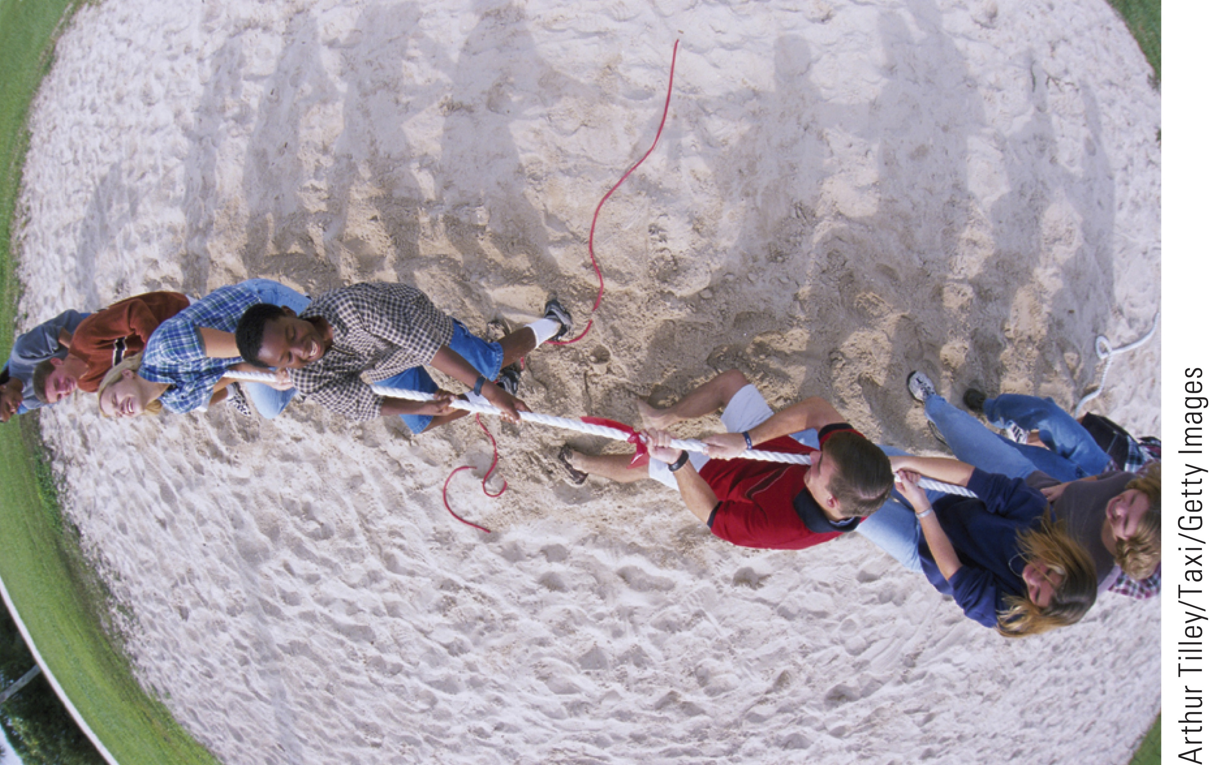
Topic 5: Energy
College Physics, 11e
Raymond A. Serway; Chris Vuille

Slide 2
Reading Question 5.1
The gravitational force exerted by the Earth on the Moon holds the moon in an orbit around the Earth. Let us assume that the orbit is perfectly circular. The work done by this gravitational force during a one-week interval in which the Moon moves through a displacement in its orbital path is
negative.
zero.
positive.
impossible to determine with the information given.
©Cengage

Slide 3
Reading Question 5.1
The gravitational force exerted by the Earth on the Moon holds the moon in an orbit around the Earth. Let us assume that the orbit is perfectly circular. The work done by this gravitational force during a one-week interval in which the Moon moves through a displacement in its orbital path is
negative.
zero.
positive.
impossible to determine with the information given.
©Cengage

Slide 4
Reading Question 5.2
The gravitational potential energy of a system
depends on the reference configuration for zero potential energy.
is always positive.
is always negative.
is none of these.
©Cengage

Slide 5
Reading Question 5.2
The gravitational potential energy of a system
depends on the reference configuration for zero potential energy.
is always positive.
is always negative.
is none of these.
©Cengage

Slide 6
Reading Question 5.3
Which of the following is (are) conserved in an isolated system?
The kinetic energy alone
The potential energy alone
Both the potential energy and the kinetic energy
The sum of the kinetic energy and the potential energy
©Cengage

Slide 7
Reading Question 5.3
Which of the following is (are) conserved in an isolated system?
The kinetic energy alone
The potential energy alone
Both the potential energy and the kinetic energy
The sum of the kinetic energy and the potential energy
©Cengage

Slide 8
Reading Question 5.4
Consider two slides, both of the same height. One is long and the other is short. From which slide will a child have a greater final speed when sliding off? Assume that there is no friction acting.
The child on the longer slide will have a greater final speed.
The child on the shorter slide will have a greater final speed.
The final speed will be the same for the child on the longer slide as it is for the children on the shorter slide.
We cannot tell from the information given.
©Cengage

Slide 9
Reading Question 5.4
Consider two slides, both of the same height. One is long and the other is short. From which slide will a child have a greater final speed when sliding off? Assume that there is no friction acting.
The child on the longer slide will have a greater final speed.
The child on the shorter slide will have a greater final speed.
The final speed will be the same for the child on the longer slide as it is for the children on the shorter slide.
We cannot tell from the information given.
©Cengage

Slide 10
Reading Question 5.5
A ball is thrown straight up in the air. At what position is its kinetic energy a maximum? At what position is the gravitational potential energy of the ball–Earth system a maximum? Consider only the trip up.
The maximum kinetic energy occurs at the top of the ball’s trajectory, and the maximum gravitational potential energy occurs at the top of the ball’s trajectory.
The maximum kinetic energy occurs at the point of release, and the maximum gravitational potential energy occurs at the point of release.
The maximum kinetic energy occurs at the point of release, and the maximum gravitational potential energy occurs at the top of the ball’s trajectory.
The maximum kinetic energy occurs at the top of the ball’s trajectory, and the maximum gravitational potential energy occurs at the point of release.
©Cengage

Slide 11
Reading Question 5.5
A ball is thrown straight up in the air. At what position is its kinetic energy a maximum? At what position is the gravitational potential energy of the ball–Earth system a maximum? Consider only the trip up.
The maximum kinetic energy occurs at the top of the ball’s trajectory and the maximum gravitational potential energy occurs at the top of the ball’s trajectory.
The maximum kinetic energy occurs at the point of release and the maximum gravitational potential energy occurs at the point of release.
The maximum kinetic energy occurs at the point of release and the maximum gravitational potential energy occurs at the top of the ball’s trajectory.
The maximum kinetic energy occurs at the top of the ball’s trajectory and the maximum gravitational potential energy occurs at the point of release.
©Cengage

Slide 12
Reading Question 5.6
In the case of a force varying with position, what feature of the force vs. position graph represents the work done during a displacement?
The maximum force times the maximum position
The beginning force times the total displacement
The area under the curve
Nothing
©Cengage

Slide 13
Reading Question 5.6
In the case of a force varying with position, what feature of the force vs. position graph represents the work done during a displacement?
The maximum force times the maximum position
The beginning force times the total displacement
The area under the curve
Nothing
©Cengage

Slide 14
TOPIC Discussion
Topic 5: Energy
©Cengage
Notes:
Our goal in this topic is to develop a better understanding of energy and how to quantify it. Energy is present in the Universe in many different forms, including mechanical, chemical, electromagnetic, and nuclear energy. Even the inert mass of everyday matter contains a very large amount of energy. Although energy can be transformed from one kind to another, all observations and experiments to date suggest that the total amount of energy in the Universe never changes. That’s also true for an isolated system, which is a collection of objects that can exchange energy with one another, but not with the rest of the Universe. If one form of energy in an isolated system decreases, then another form of energy in the system must increase. Understanding how energy changes from one form to another is essential in all the sciences. In this topic, the focus is mainly on mechanical energy, which is the sum of kinetic energy—the energy associated with motion, and potential energy—the energy associated with relative position.

Slide 15
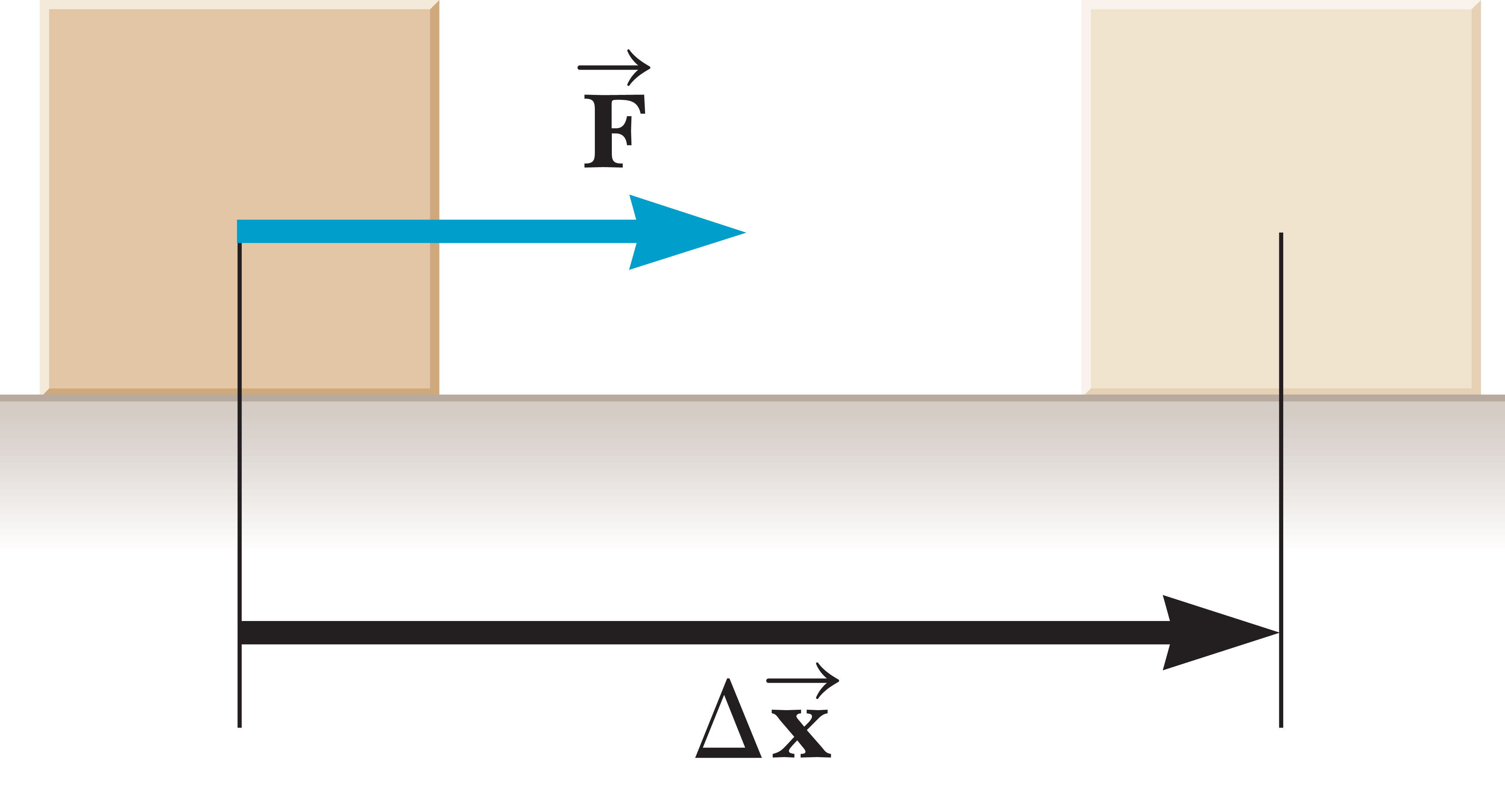
Work
Notes:
Work has a different meaning in physics than it does in everyday usage. In physics, work is done only if an object is moved through some displacement while a force is applied to it. Doing work involves applying a force to an object while moving it a given distance. You might be tempted to think of work as F times d, where F is the magnitude of the force acting on the object and d is the magnitude of the object’s displacement. But this only gives the magnitude of work done on an object when the force is constant and parallel to the displacement, which must be along a line. This works for certain cases, but in general a more sophisticated definition is required.
The figure shows a block undergoing a displacement Δx along a straight line while acted on by a constant force F in the same direction. The work done on an object by a constant force during a linear displacement along the x-axis is given in the equation here, [click to show equation] where F_{x} is the x-component of the force and Δx = x_{f} – x_{i} is the object’s displacement. Notice that in one dimension, Δx is a vector quantity. That means Δx can be either positive or negative. Work, though, is a scalar quantity.
Work is a positive number if F_{x} and Δx are both positive or both negative, in which case, the work increases the mechanical energy of the object. If F_{x} is positive and Δx is negative, or vice versa, then the work is negative, and the object loses mechanical energy. Our equation for work is valid even when the constant force is not parallel to the x-axis. Work is only done by the part of the force acting parallel to the object’s direction of motion.

Slide 16
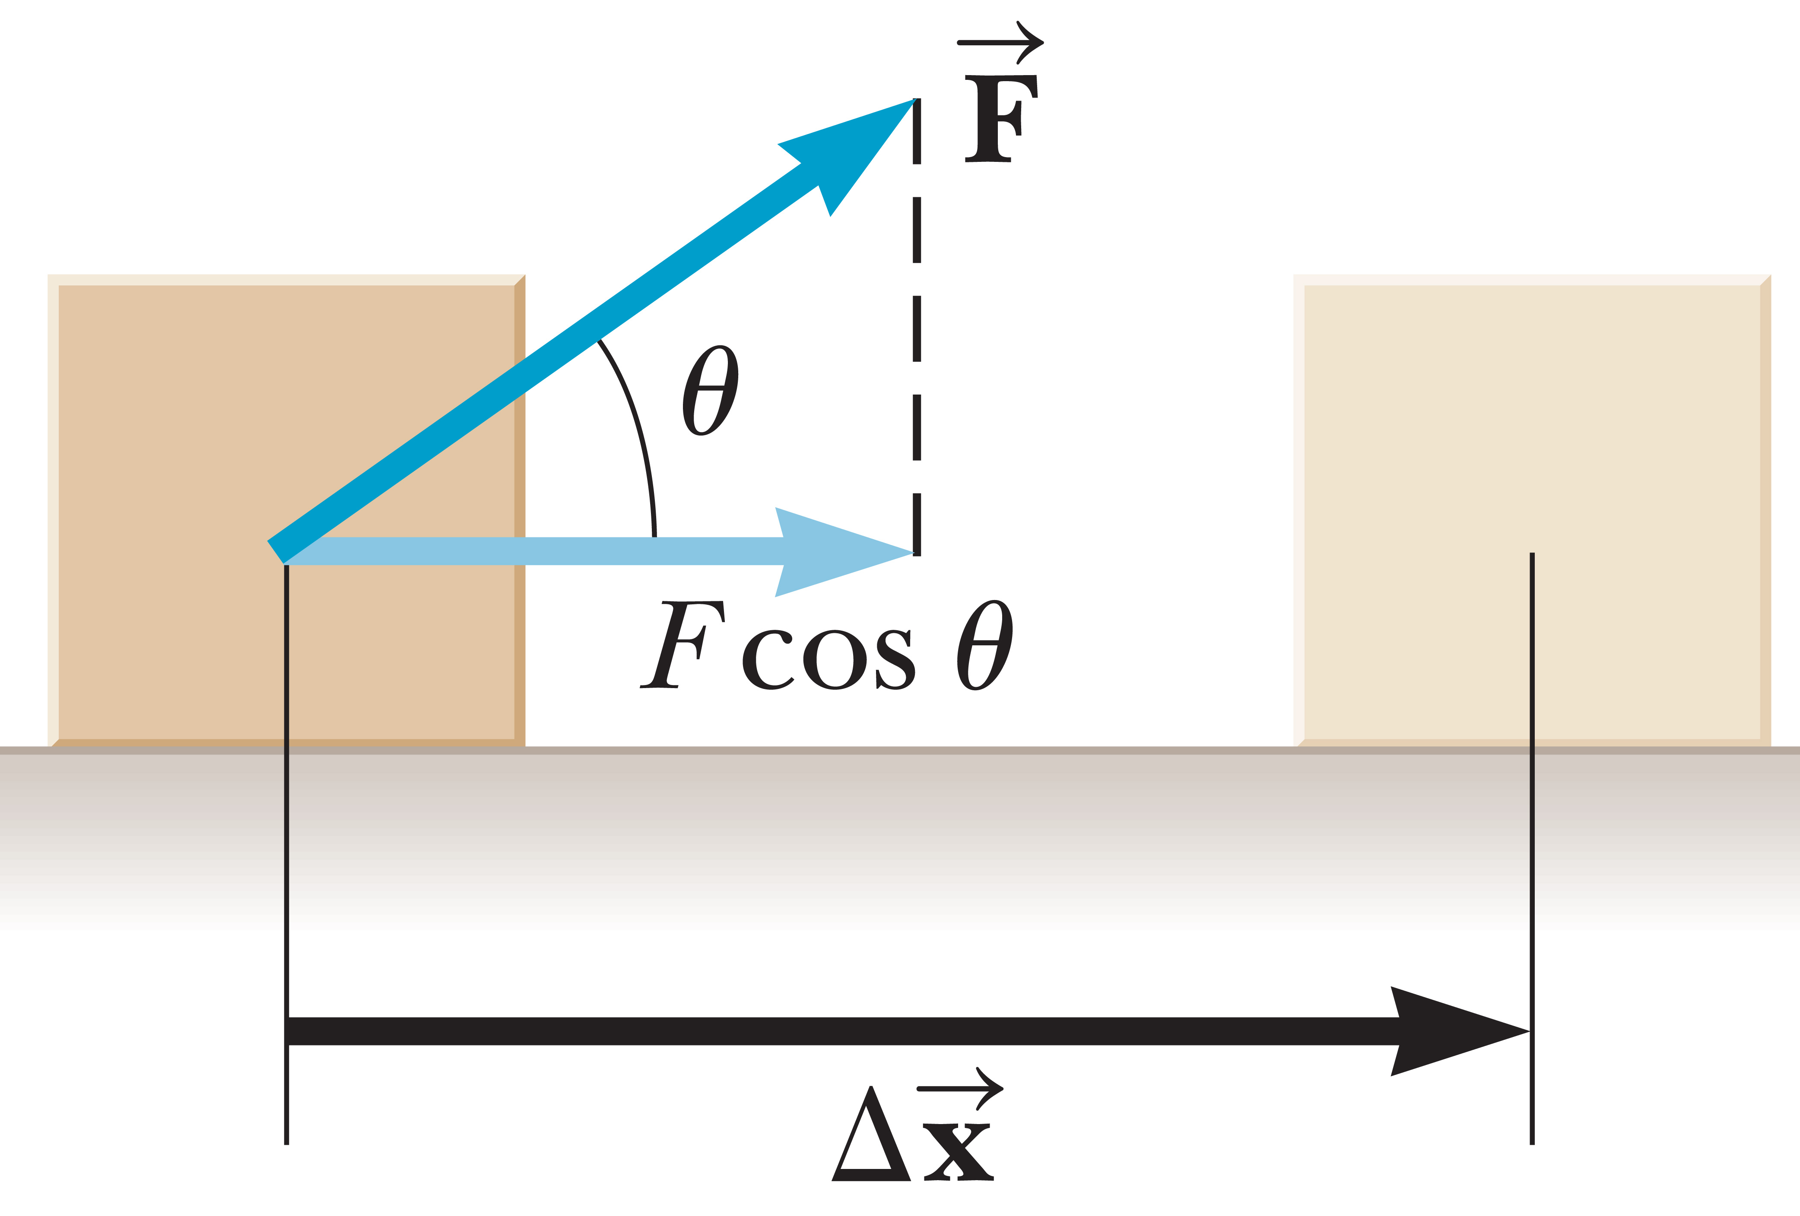
Work
©Cengage
Notes:
Another definition of work is to relate the work done on an object to the angle the displacement makes with respect to the force. Take a look at the triangle in the figure. The components of the vector F can be written as shown.
Notice that only the x-component, which is parallel to the direction of motion, makes a nonzero contribution to the work done on the object.
The work done on an object by a constant force during a linear displacement is shown in this equation, [click to show equation] where d is the magnitude of the displacement and θ is the angle between the vectors F and Δx.

Slide 17
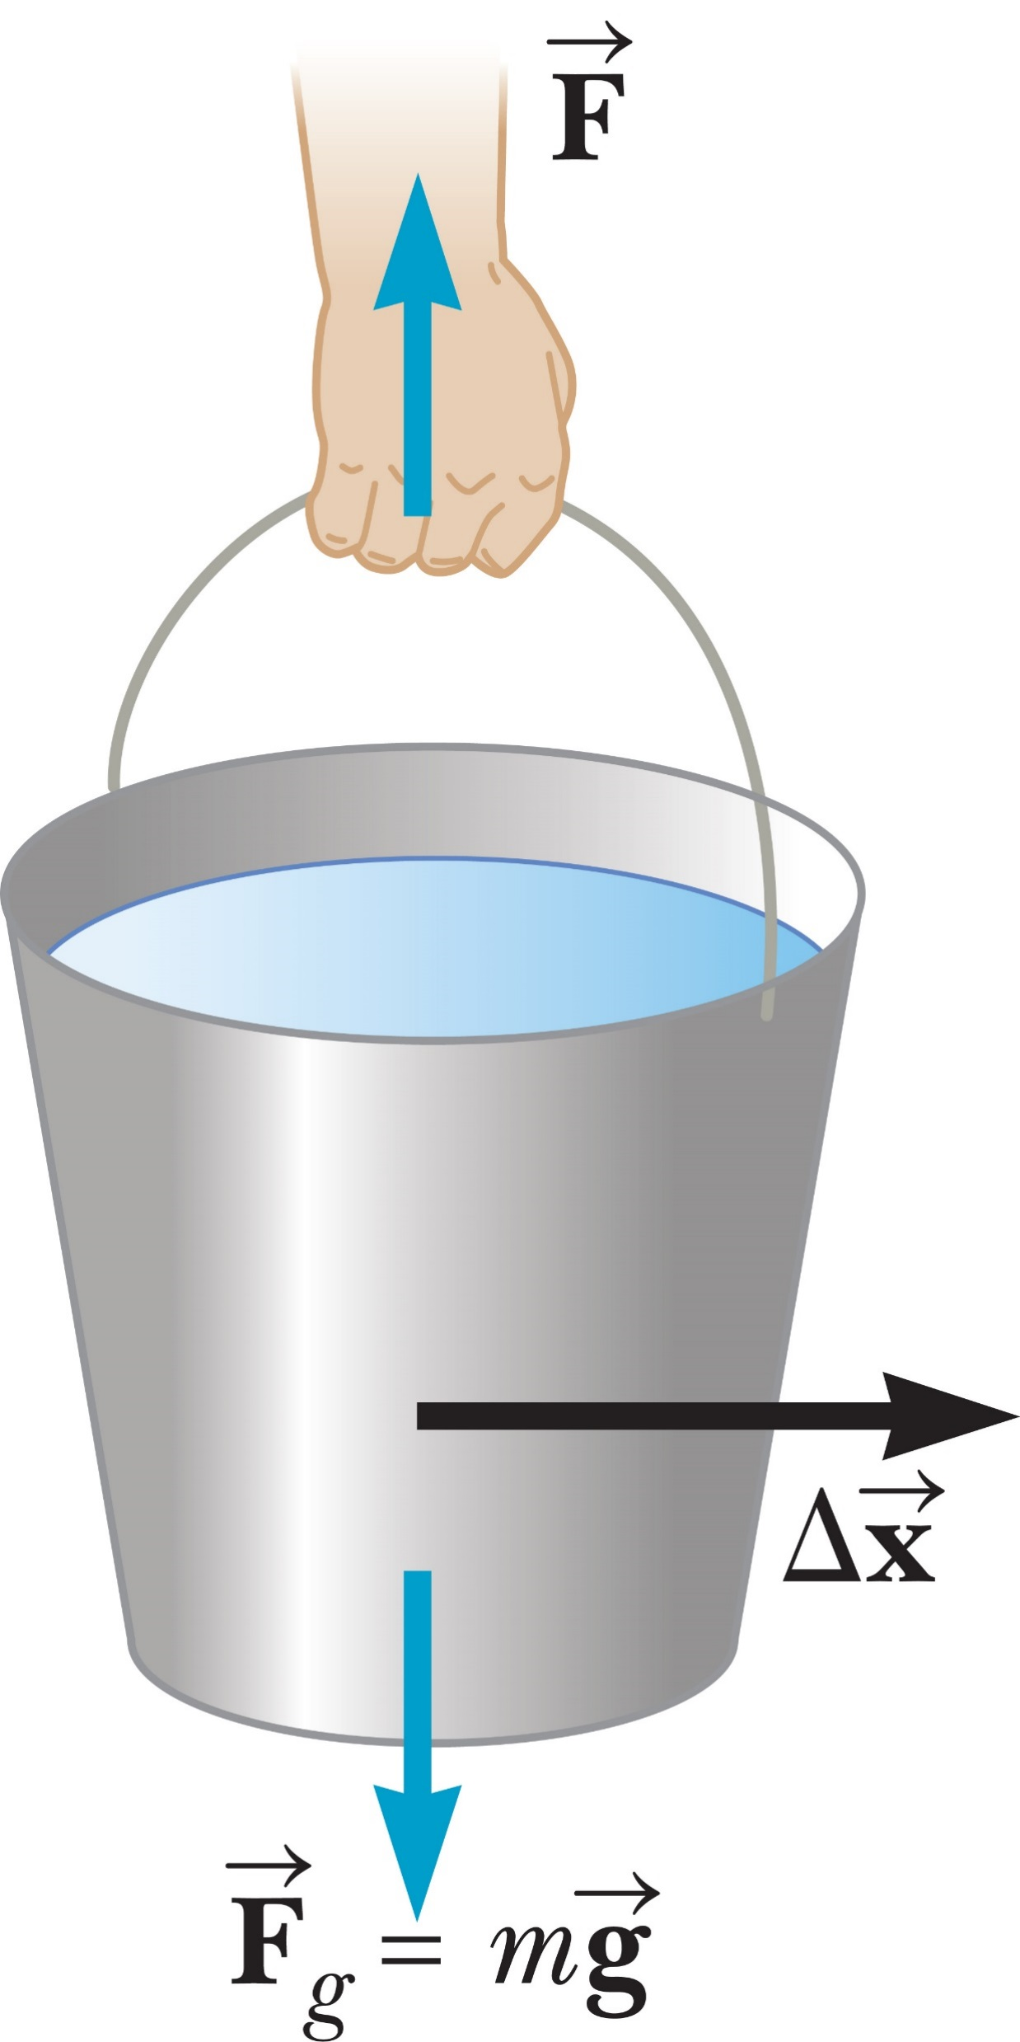
Work
©Cengage
Notes:
We can use our definition for work when the displacement is not specifically along the x-axis or any other axis. In the figure, a man carries a bucket of water horizontally at constant velocity. The upward force exerted by the man’s hand on the bucket is perpendicular to the direction of motion, so it does no work on the bucket. This can also be seen from our equation because the angle between the force exerted by the hand and the direction of motion is 90°, giving cos 90° = 0 and W = 0. In the same way, the force of gravity does no work on the bucket.
Work always requires a system of more than just one object. A nail, for example, can’t do work on itself, but a hammer can do work on the nail by driving it into a board. In general, an object may be moving under the influence of several external forces. In that case, the net work done on the object as it undergoes some displacement is just the sum of the amount of work done by each force.

Slide 18
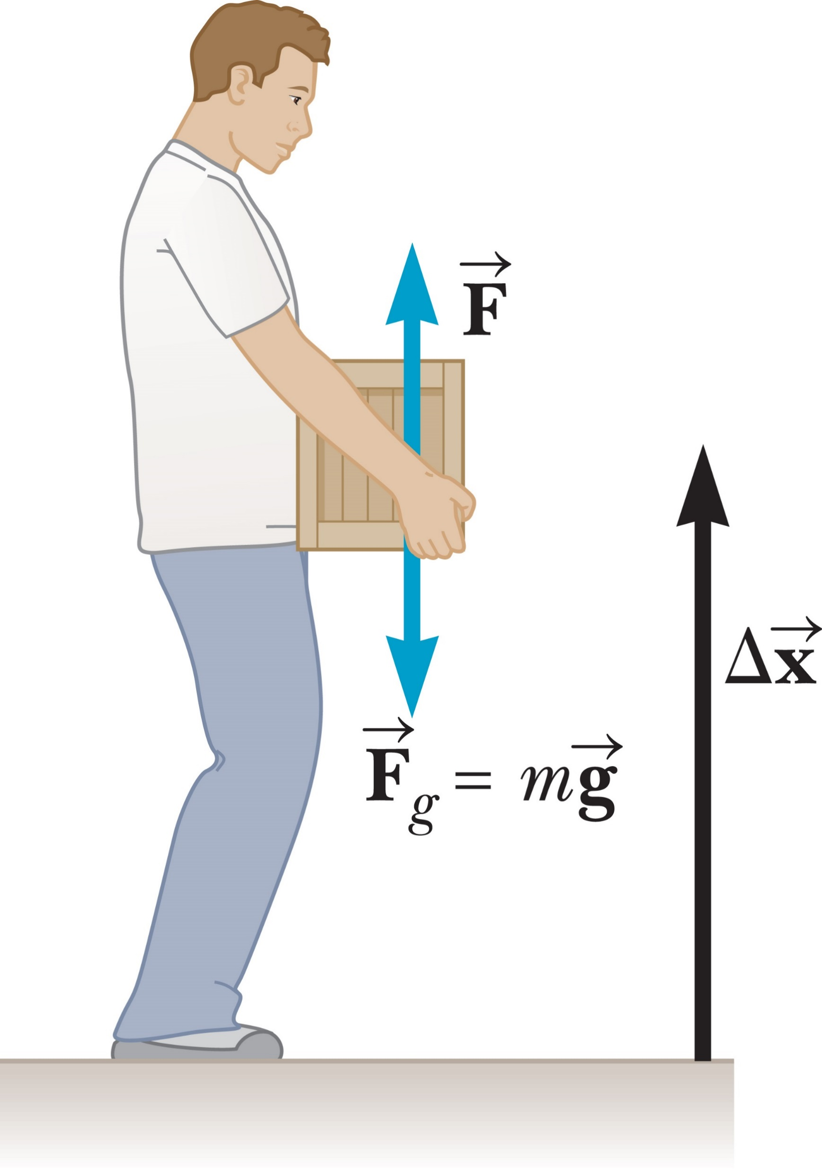
Work
©Cengage
Notes:
Work can be either positive or negative. In our definition of work, F and d are magnitudes, which are never negative. That means work is positive or negative, depending on whether cos θ is positive or negative. This depends on the direction of the force relative to the direction of the displacement. When these vectors are pointing in the same direction, the angle between them is 0°, so cos 0° = +1 and the work is positive.
For example, when a student lifts a box, as shown in the figure, the work he does on the box is positive because the force he exerts on the box is upward, in the same direction as the displacement. In lowering the box slowly back down, the student still exerts an upward force on the box, but the motion of the box is downward. Because the vectors F and Δx are now in opposite directions, the angle between them is 180°, and cos 180° = –1 and the work done by the student is negative.
In general, when the part of F parallel to Δx points in the same direction as Δx , the work is positive; otherwise, it’s negative.

Slide 19
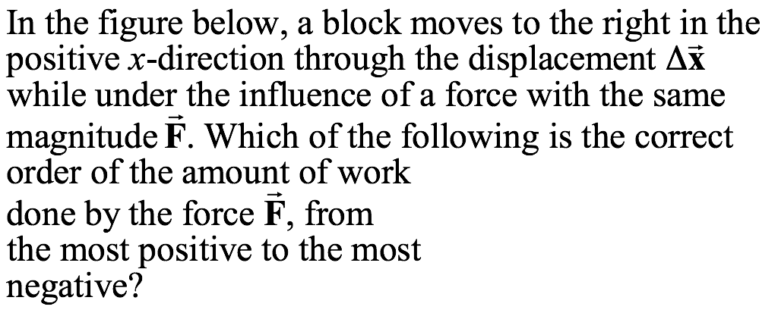
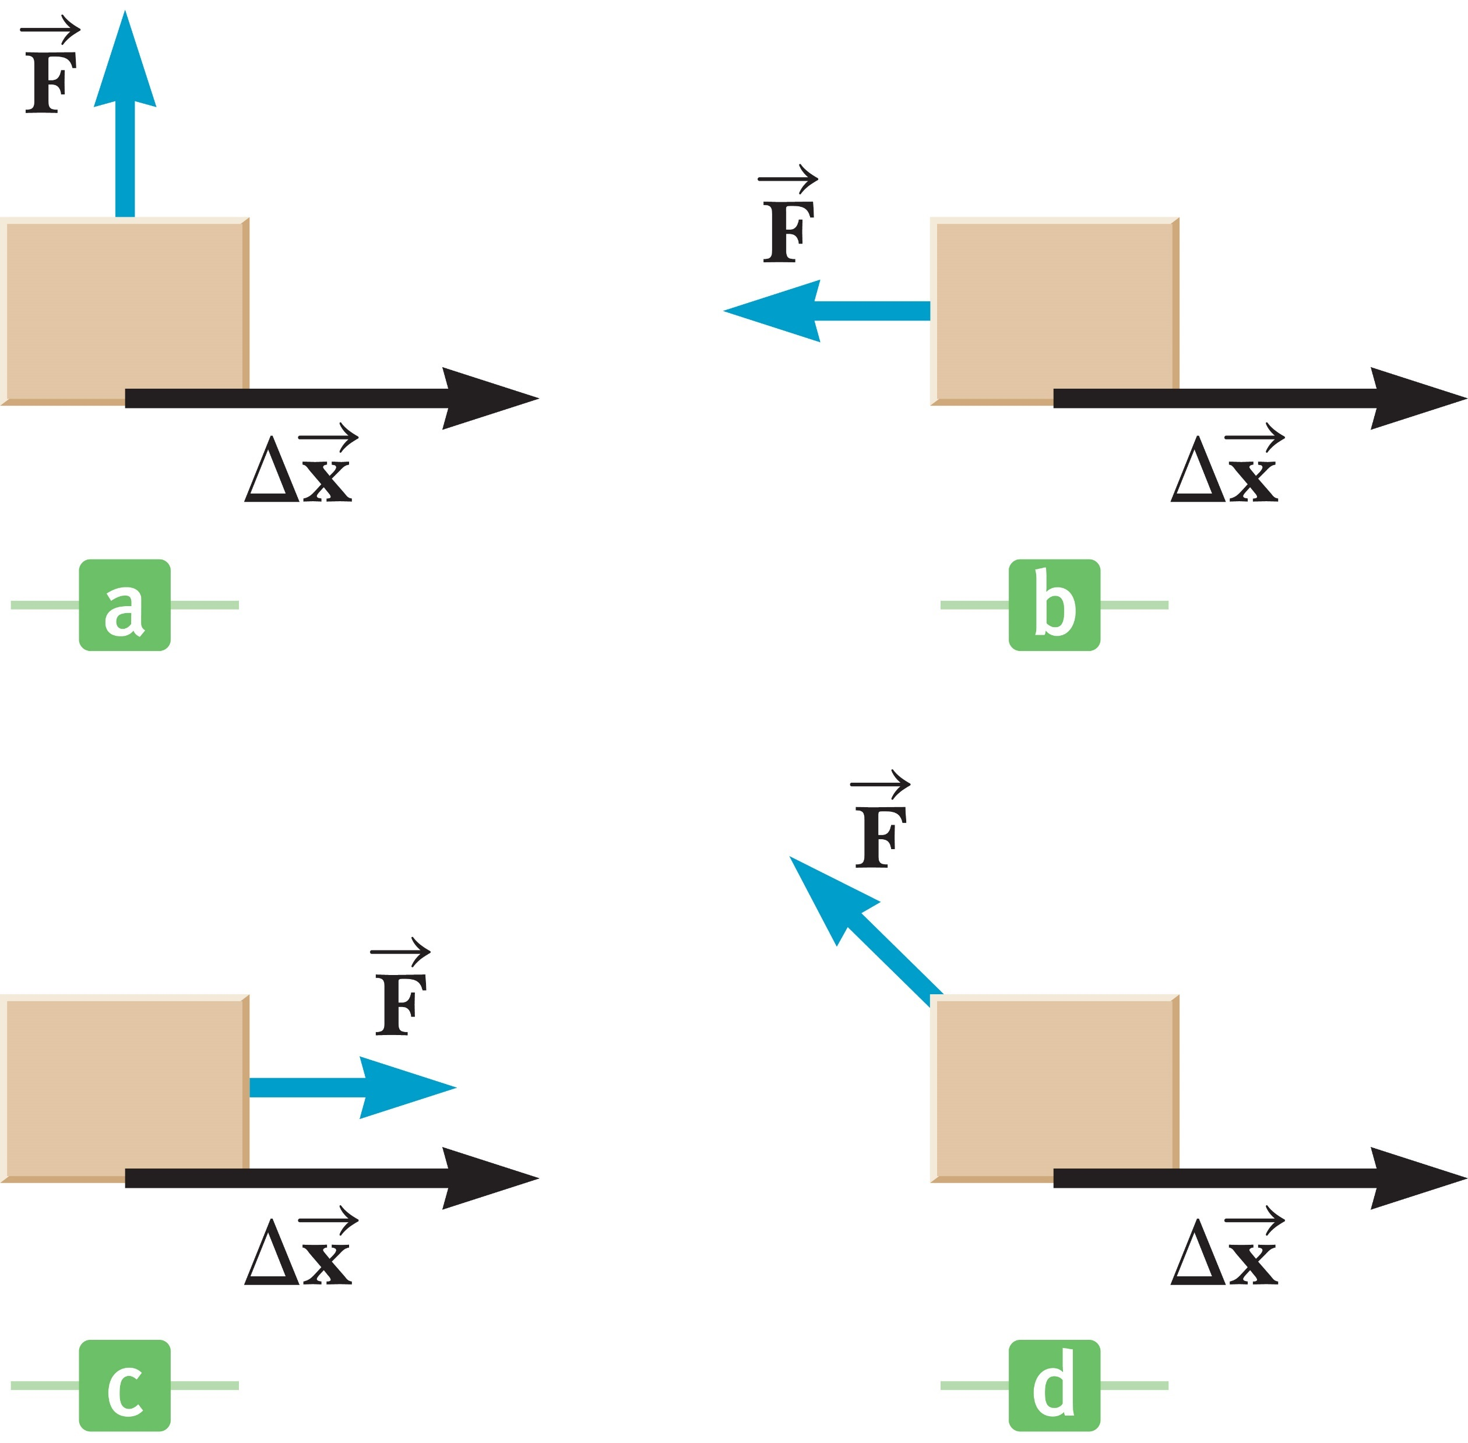
Think – Pair – Share
d, c, a, b
c, a, b, d
c, a, d, b
©Cengage
Notes:
Think about it, talk to your neighbor, and let’s talk in a minute.
Answer: c, a, d, b
Reasoning: An object that remains at rest has zero acceleration. However, any number of external forces could be acting on it, provided that the vector sum of these forces is zero.

Slide 20
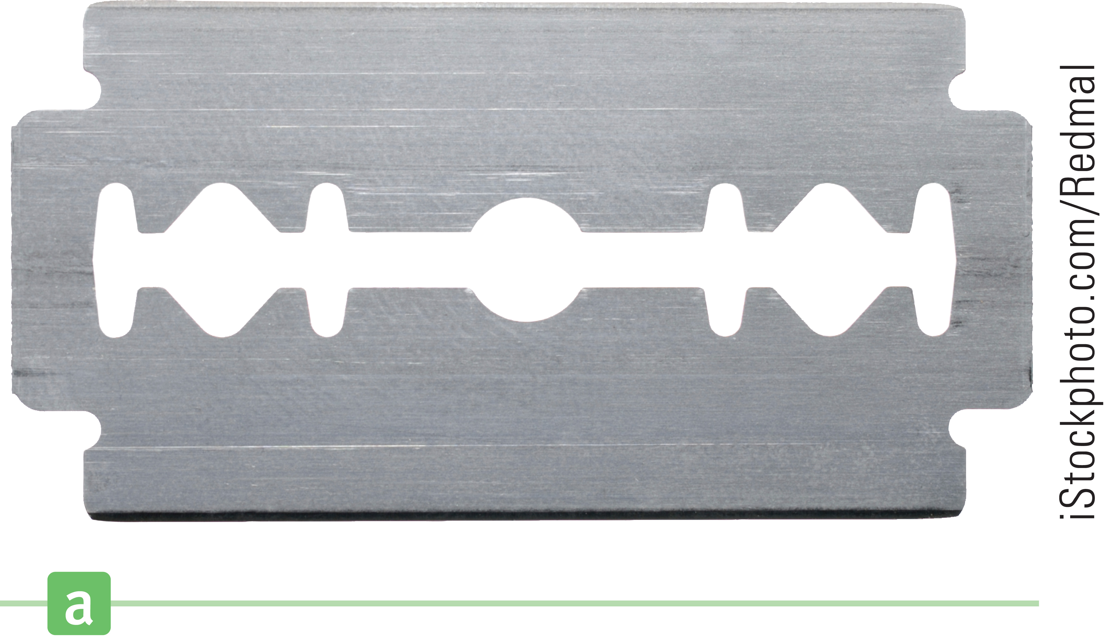
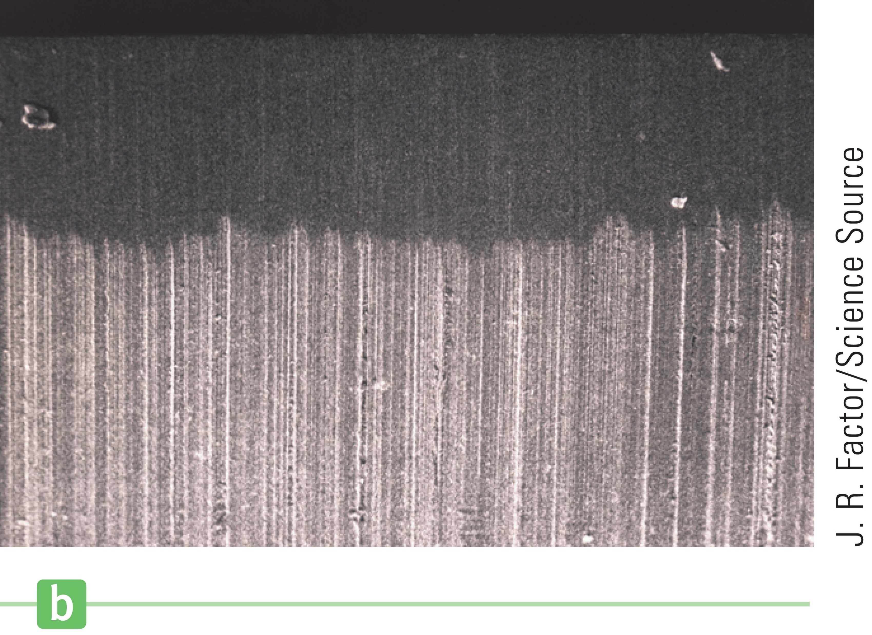
Work and Dissipative Forces
©Cengage
Notes:
Frictional work is extremely important in everyday life because doing almost any other kind of work is impossible without it. Cars wouldn’t work without friction, or conveyor belts, or even our muscle tissue.
Friction is a complex process, and it is caused by numerous microscopic interactions over the entire area of the surfaces in contact. Imagine a metal block sliding over a metal surface. Microscopic “teeth” in the block encounter equally microscopic irregularities in the underlying surface.
Look at the figure. You might think the edge of a razor blade is smooth, but the figure on the right is a microscopic view which shows it has many irregularities.
So you can imagine that when the metal block slides over the surface, these irregularities pressing against one another deform, get hot, and weld to the opposite surface. Work must be done breaking these temporary bonds, and that comes at the expense of the energy of motion of the block, which we will discuss in a few minutes. The energy lost by the block goes into heating both the block and its environment, with some energy converted to sound. The friction force of two objects in contact and in relative motion to each other always dissipates energy in these relatively complex ways. For our purposes, the phrase “work done by friction” will denote the effect of these processes on mechanical energy alone.

Slide 21
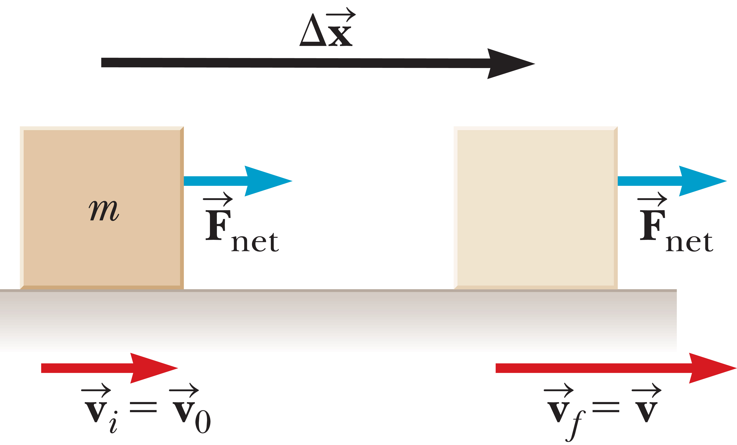
Kinetic Energy and the Work–Energy Theorem
©Cengage
Notes:
As you have found, solving problems using Newton’s second law can be complicated. An alternative approach is to relate the speed of an object to the net work done on it by external forces. If the net work can be calculated for a given displacement, the change in the object’s speed is easy to evaluate.
The figure shows an object of mass m moving to the right under the action of a constant net force, also directed to the right. Because the force is constant, we know from Newton’s second law that the object moves with constant acceleration. If the object is displaced by Δx, the work done by the net force on the object is given by this equation. [click to show equation]
Recall the relationships for an object undergoing constant acceleration. [click to show equations] We can solve this for aΔx, then substitute into the equation for work, [click to show equation] to get the result shown.

Slide 22
Kinetic Energy and the Work–Energy Theorem
©Cengage
Notes:
So the net work done on an object equals a change in a quantity of the form ½ mv². This term carries units of energy and involves the object’s speed, so it can be interpreted as energy associated with the object’s motion.
The kinetic energy KE of an object of mass m moving with a speed v is defined by the equation shown.
Like work, kinetic energy is a scalar quantity.
An important result of this is known as the work–energy theorem. [click to show equation] The net work done on an object is equal to the change in the object’s kinetic energy, where the change in the kinetic energy is due entirely to the object’s change in speed. The proviso on the speed is necessary because work that deforms or causes the object to warm up invalidates this equation, although under most circumstances it remains approximately correct. From our equation, a positive net work means that the final kinetic energy is greater than the initial kinetic energy. This means that the object’s final speed is greater than its initial speed. So positive net work increases an object’s speed, and negative net work decreases its speed.

Slide 23
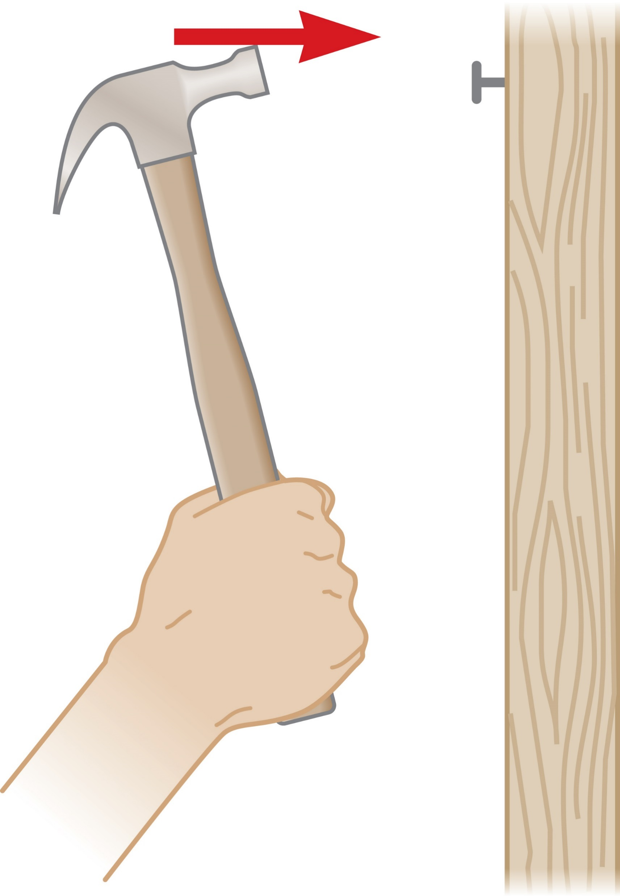
Kinetic Energy and the Work–Energy Theorem
©Cengage
Notes:
We can also think of kinetic energy as the work a moving object can do in coming to rest. For example, suppose a hammer is on the verge of striking a nail, as in the figure. The moving hammer has kinetic energy and so can do work on the nail. The work done on the nail is F Δx, where F is the average net force exerted on the nail and Δx is the distance the nail is driven into the wall. That work, plus small amounts of energy carried away by heat and sound, is equal to the change in kinetic energy of the hammer.
We derived the work–energy theorem assuming that the net force acting on the object was constant. A more general derivation, using calculus, would show that the result is valid under all circumstances, including the application of a variable force.

Slide 24
Think – Pair – Share
True or false? A block slides at constant speed down a ramp while acted on by three forces: its weight, the normal force, and kinetic friction. The combined net work done by all three forces on the block equals zero.
©Cengage
Notes:
Come up with your own answer, then compare notes with your neighbor to see if you agree. We’ll discuss it in 2 minutes.
Answer: True
Reasoning: The net work equals the change in kinetic energy, which in this
case equals zero because the block slides at constant speed.

Slide 25
Think – Pair – Share
True or false? A block slides at constant speed down a ramp while acted on by three forces: its weight, the normal force, and kinetic friction. Each force does zero work on the block as it slides.
©Cengage
Notes:
Think about it, check with a classmate, and let’s talk in a minute.
Answer: False
Reasoning: The gravitational force of weight on the block does positive work as the block slides down the ramp. The normal force does zero work and the kinetic friction force does negative work.

Slide 26
Think – Pair – Share
True or false? A block slides at constant speed down a ramp while acted on by three forces: its weight, the normal force, and kinetic friction. Each force does negative work on the block as it slides.
©Cengage
Notes:
Decide on your answer, run it by your partner, and we’ll talk about it in a minute or two.
Answer: False
Reasoning: The gravitational force of weight on the block does positive work as the block slides down the ramp.

Slide 27
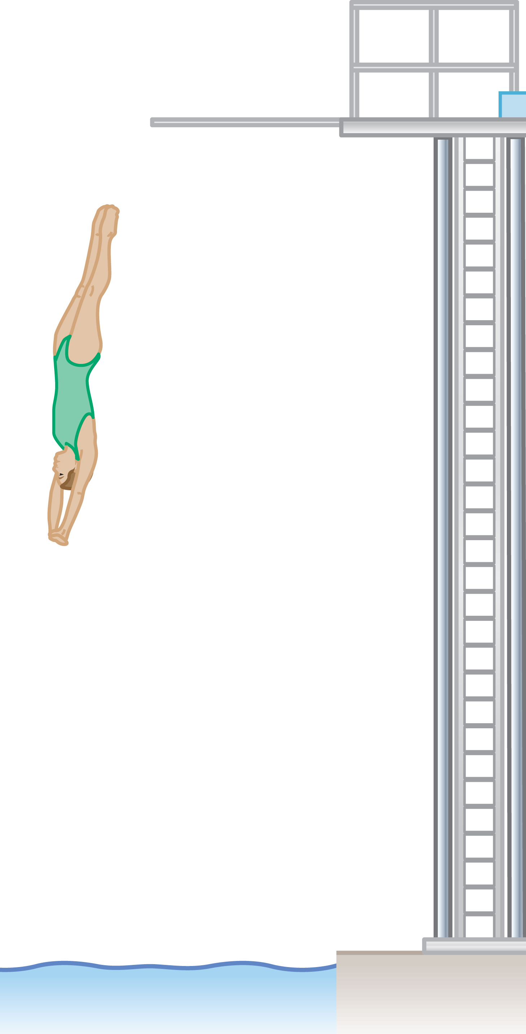
Conservative and Nonconservative Forces
©Cengage
Notes:
There are two general kinds of forces. The first is called a conservative force. Gravity is probably the best example of a conservative force. To understand the origin of the name, think of a diver climbing to the top of a 10-meter platform. The diver has to do work against gravity in making the climb. Once at the top, she can recover the work as kinetic energy by taking a dive. Her speed just before hitting the water will give her a kinetic energy equal to the work she did against gravity in climbing to the top of the platform, minus the effect of some nonconservative forces, such as air drag and internal muscular friction.

Slide 28
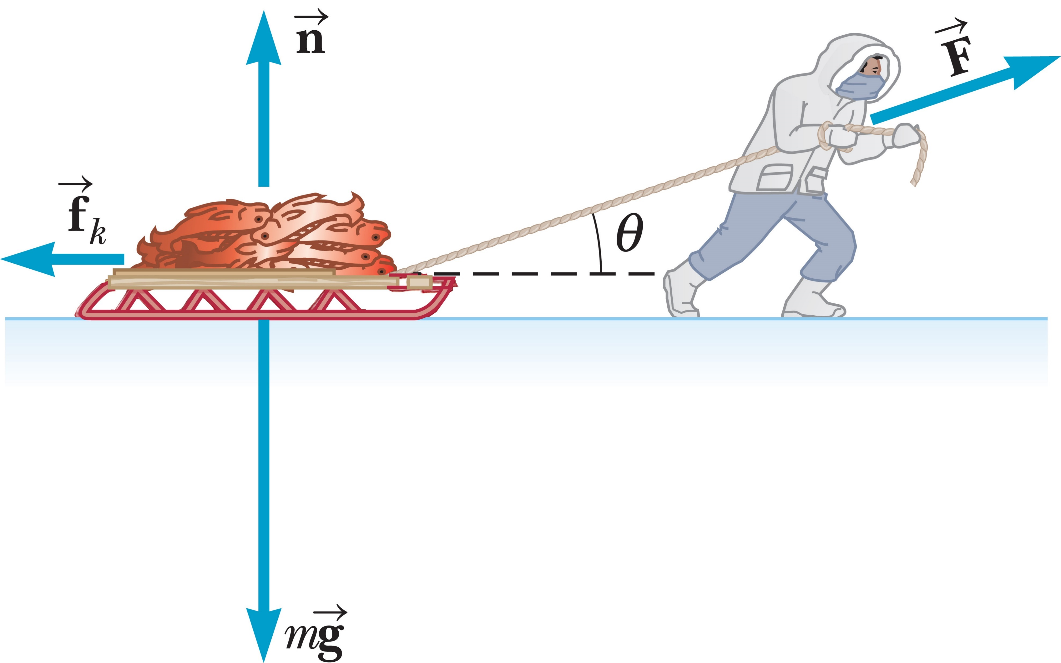
Conservative and Nonconservative Forces
©Cengage
Notes:
A nonconservative force is generally dissipative, which means that it tends to randomly disperse the energy of bodies on which it acts. This dispersal of energy often takes the form of heat or sound. Kinetic friction and air drag are good examples. Propulsive forces, like the force exerted by a jet engine on a plane or by a propeller on a submarine, are also nonconservative. Work done against a nonconservative force can’t be easily recovered.
Dragging objects over a rough surface requires work. When the Eskimo shown in the figure dragged his sled across terrain having a nonzero coefficient of friction, the net work is smaller than it would be in the case of no friction. The missing energy goes into warming the sled and its environment. Losses such as these can’t be avoided, and all the energy can’t be recovered, so these forces are called nonconservative.

Slide 29
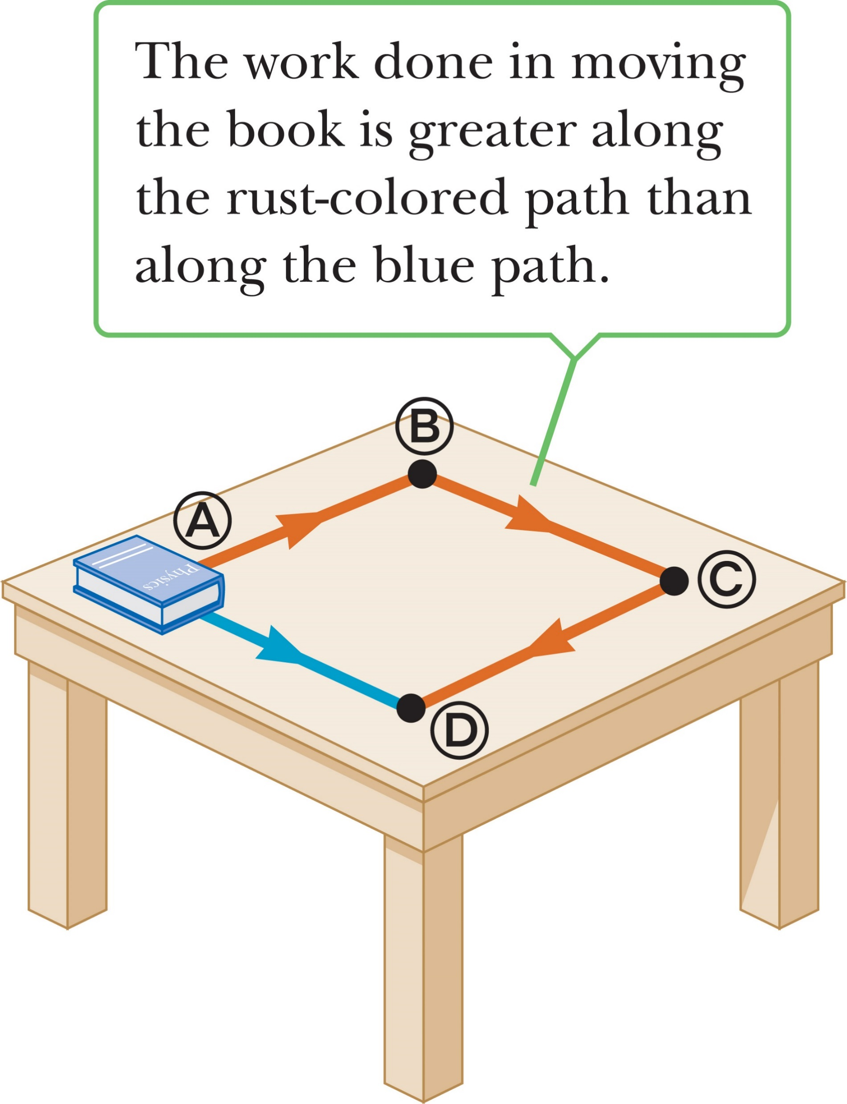
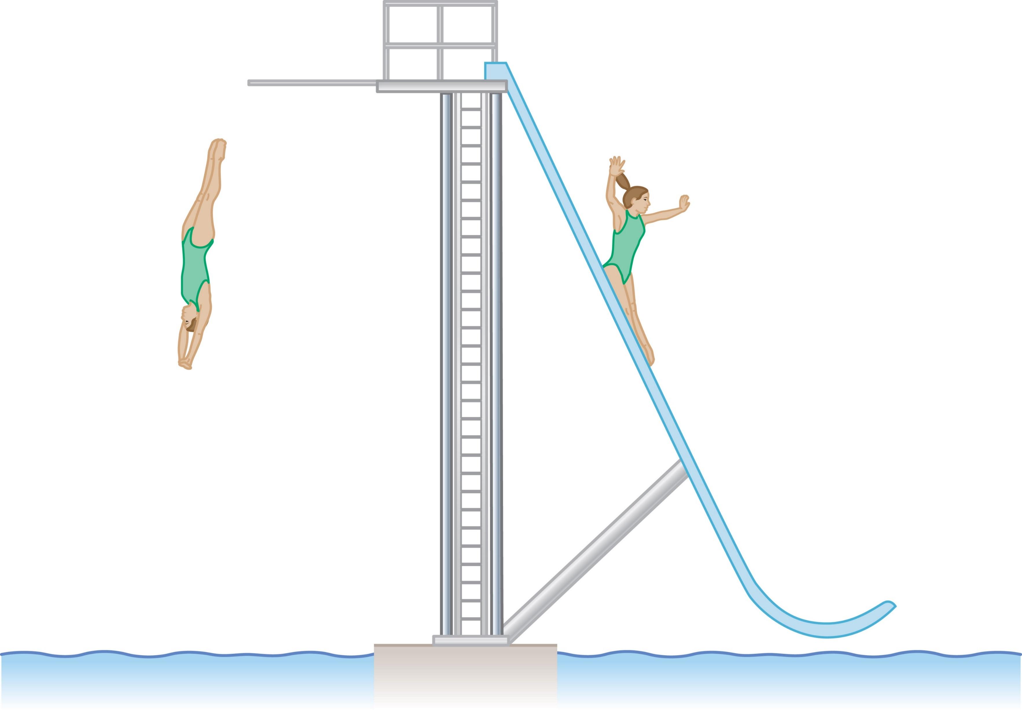
Conservative and Nonconservative Forces
Conservative force → work force does moving an object between two points is path-independent
Notes:
Here’s another way to characterize conservative and nonconservative forces. Let’s measure the work done by a force on an object traveling between two points along different paths.
The work done by gravity on someone going down a frictionless slide, as in the figure on the left, is the same as that done on someone diving into the water from the same height.
This equality doesn’t hold for nonconservative forces. For example, look at the figure on the right. Sliding a book directly from point Ⓐ to point Ⓓ requires a certain amount of work against friction, but sliding the book along the three other legs of the square, from Ⓐ to Ⓑ, Ⓑ to Ⓒ, and finally Ⓒ to Ⓓ, requires three times as much work.
We can now state a definition of a conservative force: [click to show text] A force is conservative if the work it does moving an object between two points is the same no matter what path is taken. Nonconservative forces, as we’ve seen, don’t have this property.

Slide 30
Conservative and Nonconservative Forces
©Cengage
Notes:
We can rewrite the work–energy theorem in terms of the work done by nonconservative forces and the work done by conservative forces because the net work is just the sum of these two.

Slide 31
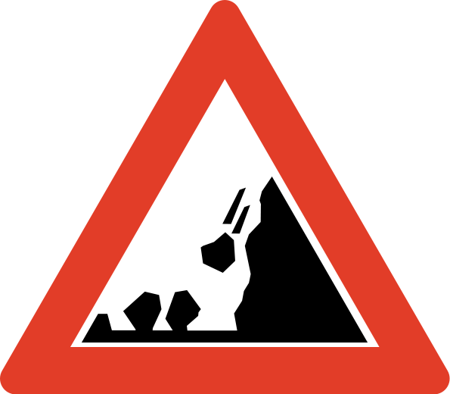
Gravitational Potential Energy
©Cengage
Notes:
An object with kinetic energy, which is energy of motion, can do work on another object, just like a moving hammer can drive a nail into a wall. A brick on a high shelf can also do work: it can fall off the shelf, accelerate downward, and hit a nail squarely, driving it into the floorboards. The brick is said to have potential energy associated with it, because from its location on the shelf it can potentially do work. Potential energy is a property of a system, rather than of a single object, because it’s due to the relative positions of interacting objects in the system.
Image credit:
https://commons.wikimedia.org/wiki/File%3A0bnsc-114_1.svg
By NRA/Vegvesenet (vegvesen.no) [Public domain], via Wikimedia Commons

Slide 32
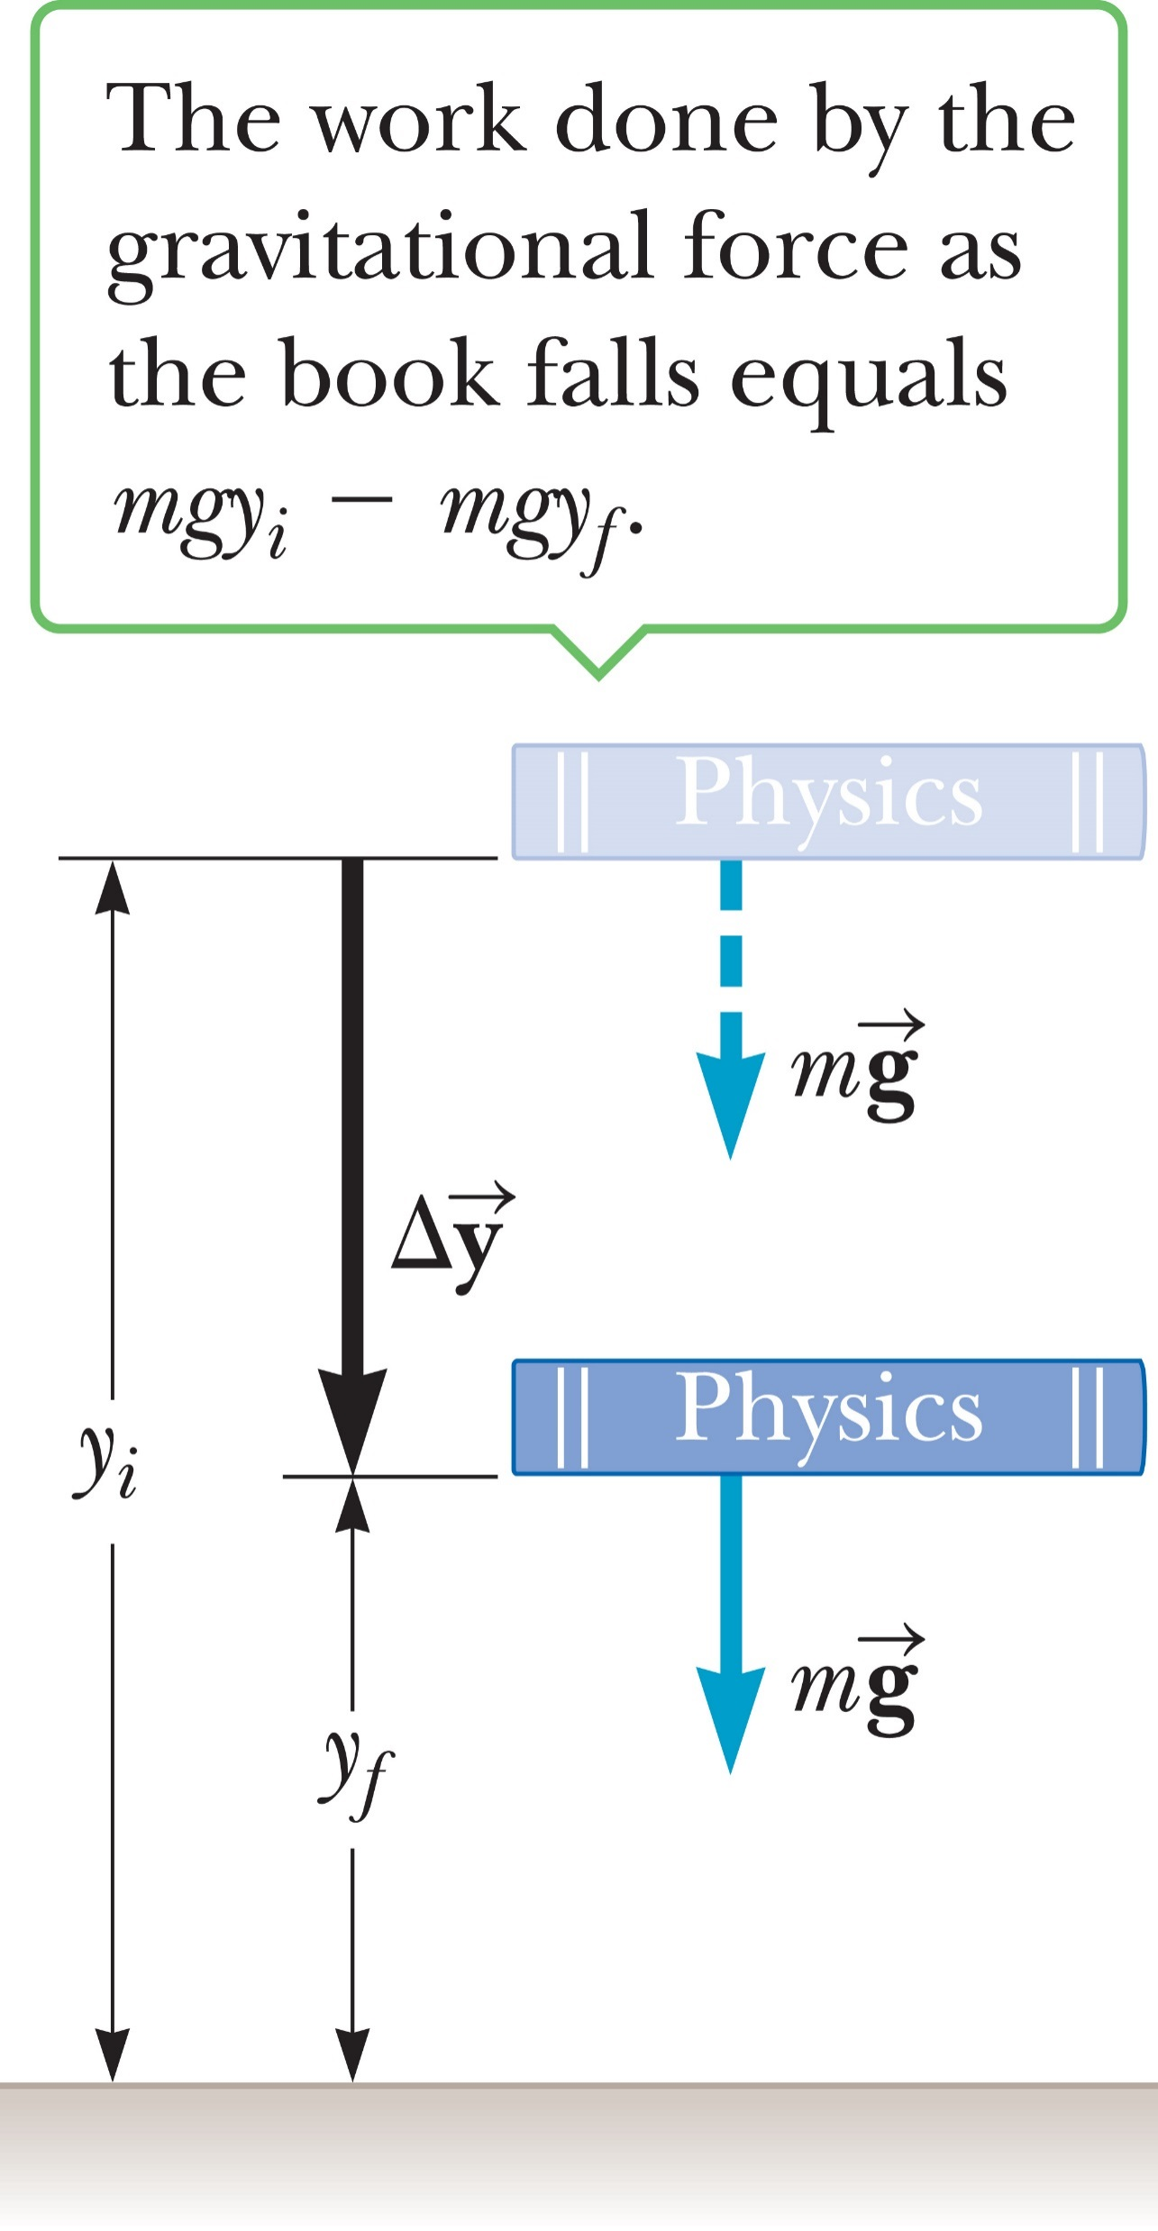
Gravitational Work and Potential Energy
Notes:
Gravity is a conservative force, and for every conservative force we can find a special expression called a potential energy function. When we evaluate this function at any two points in an object’s path of motion and find the difference, we get the negative of the work done by that force between those two points. Potential energy, like work and kinetic energy, is a scalar quantity.
Take a look at the book in the figure. Let’s find the work done by gravity on the book when it moves from one position to another. The negative of that work is the change in the gravitational potential energy of the system, and from that expression, we’ll be able to identify the potential energy function. In the figure, the book of mass m falls from a height y_{i} to a height y_{f}, where the positive y-coordinate represents position above the ground. We neglect the force of air friction, so the only force acting on the book is gravitation. How much work is done? The magnitude of the force is mg and that of the displacement is Δy = y_{i} – y_{f}, a positive number, while both F and Δy are pointing downward, so the angle between them is zero.
Let’s apply our definition of work to this system, where d = y_{i} – y_{f}. [click to show equations] Factoring out the minus sign was deliberate, by the way. This result for gravitational work holds for any object because the gravitational force is conservative. We can include W_{g} as the work done by gravity in the work–energy theorem, [click to show equation] where W_{nc} is the work done by the nonconservative forces. Now let’s substitute the expression for W_{g}. [click to show equation] Next, let’s isolate W_{nc}. [click to show equation]
We can connect the gravitational work and gravitational potential energy.
The gravitational potential energy of a system consisting of Earth and an object of mass m near Earth’s surface is given by the equation shown, [click to show equation] where g is the acceleration of gravity and y is the vertical position of the mass relative to the surface of Earth or some other reference point.
In this definition, y = 0 is usually taken to correspond to Earth’s surface, but that is not strictly necessary. It turns out that only differences in potential energy really matter.
So the gravitational potential energy associated with an object located near the surface of Earth is the object’s weight mg times its vertical position y above Earth. From this definition, we have the relationship between gravitational work and gravitational potential energy. The work done by gravity is the same as the negative of the change in gravitational potential energy.

Slide 33
Gravitational Work and Potential Energy
©Cengage
Notes:
Finally, using the relationships shown, we can write an extension of the work–energy theorem. [click to show equation]
This equation says that the work done by nonconservative forces, W_{nc}, is equal to the change in the kinetic energy plus the change in the gravitational potential energy.
This equation is true in general, even when other conservative forces besides gravity are present. The work done by these additional conservative forces will again be recast as changes in potential energy and will appear on the right-hand side along with the expression for gravitational potential energy.

Slide 34
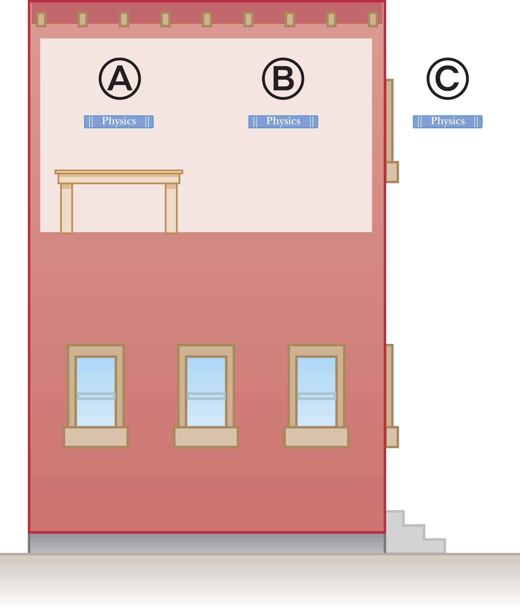
Reference Levels for Gravitational Potential Energy
©Cengage
Notes:
In solving problems involving gravitational potential energy, it’s important to choose a location at which to set that energy equal to zero. This is the same as choosing the place where y = 0. The choice is completely arbitrary because the important quantity is the difference in potential energy, and this difference will be the same regardless of the choice of zero level. Be aware, though, once you decided on this position, it must remain fixed for a given problem.
Although it’s always possible to choose the surface of Earth as the reference position for zero potential energy, the problem statement of a problem will usually suggest a convenient position to use.
For example, consider a book at several possible locations, as in the figure. When the book is at A, a natural zero level for potential energy is the surface of the desk. When the book is at B, the floor might be a more convenient reference level. Finally, for a location such as C, where the book is held out a window, the surface of Earth is a logical choice for the zero level of potential energy. The choice, however, makes no difference: Any of the three reference levels could be used as the zero level, regardless of whether the book is at A, B, or C.

Slide 35
Gravity and the Conservation of Mechanical Energy
When a physical quantity is conserved, the numeric value of the quantity remains the same throughout the physical process.
The sum of the kinetic energy and the gravitational potential energy remains constant at all times → it is a conserved quantity.
Notes:
Conservation principles play a very important role in physics. When a physical quantity is conserved, the numeric value of the quantity remains the same throughout the physical process. Even though the form of the quantity may change in some way, its final value is the same as its initial value.
The kinetic energy of an object falling only under the influence of gravity is constantly changing, as is the gravitational potential energy. Obviously, then, these quantities aren’t conserved. Because we assume that all nonconservative forces are absent, we can set W_{nc} = 0 in our equation. [click to show equation] Let’s rearrange this equation. [click to show equation] We get a very interesting result. According to this equation, [click to show text] the sum of the kinetic energy and the gravitational potential energy remains constant at all times and hence is a conserved quantity. We denote the total mechanical energy by E = KE + PE, and say that the total mechanical energy is conserved.

Slide 36
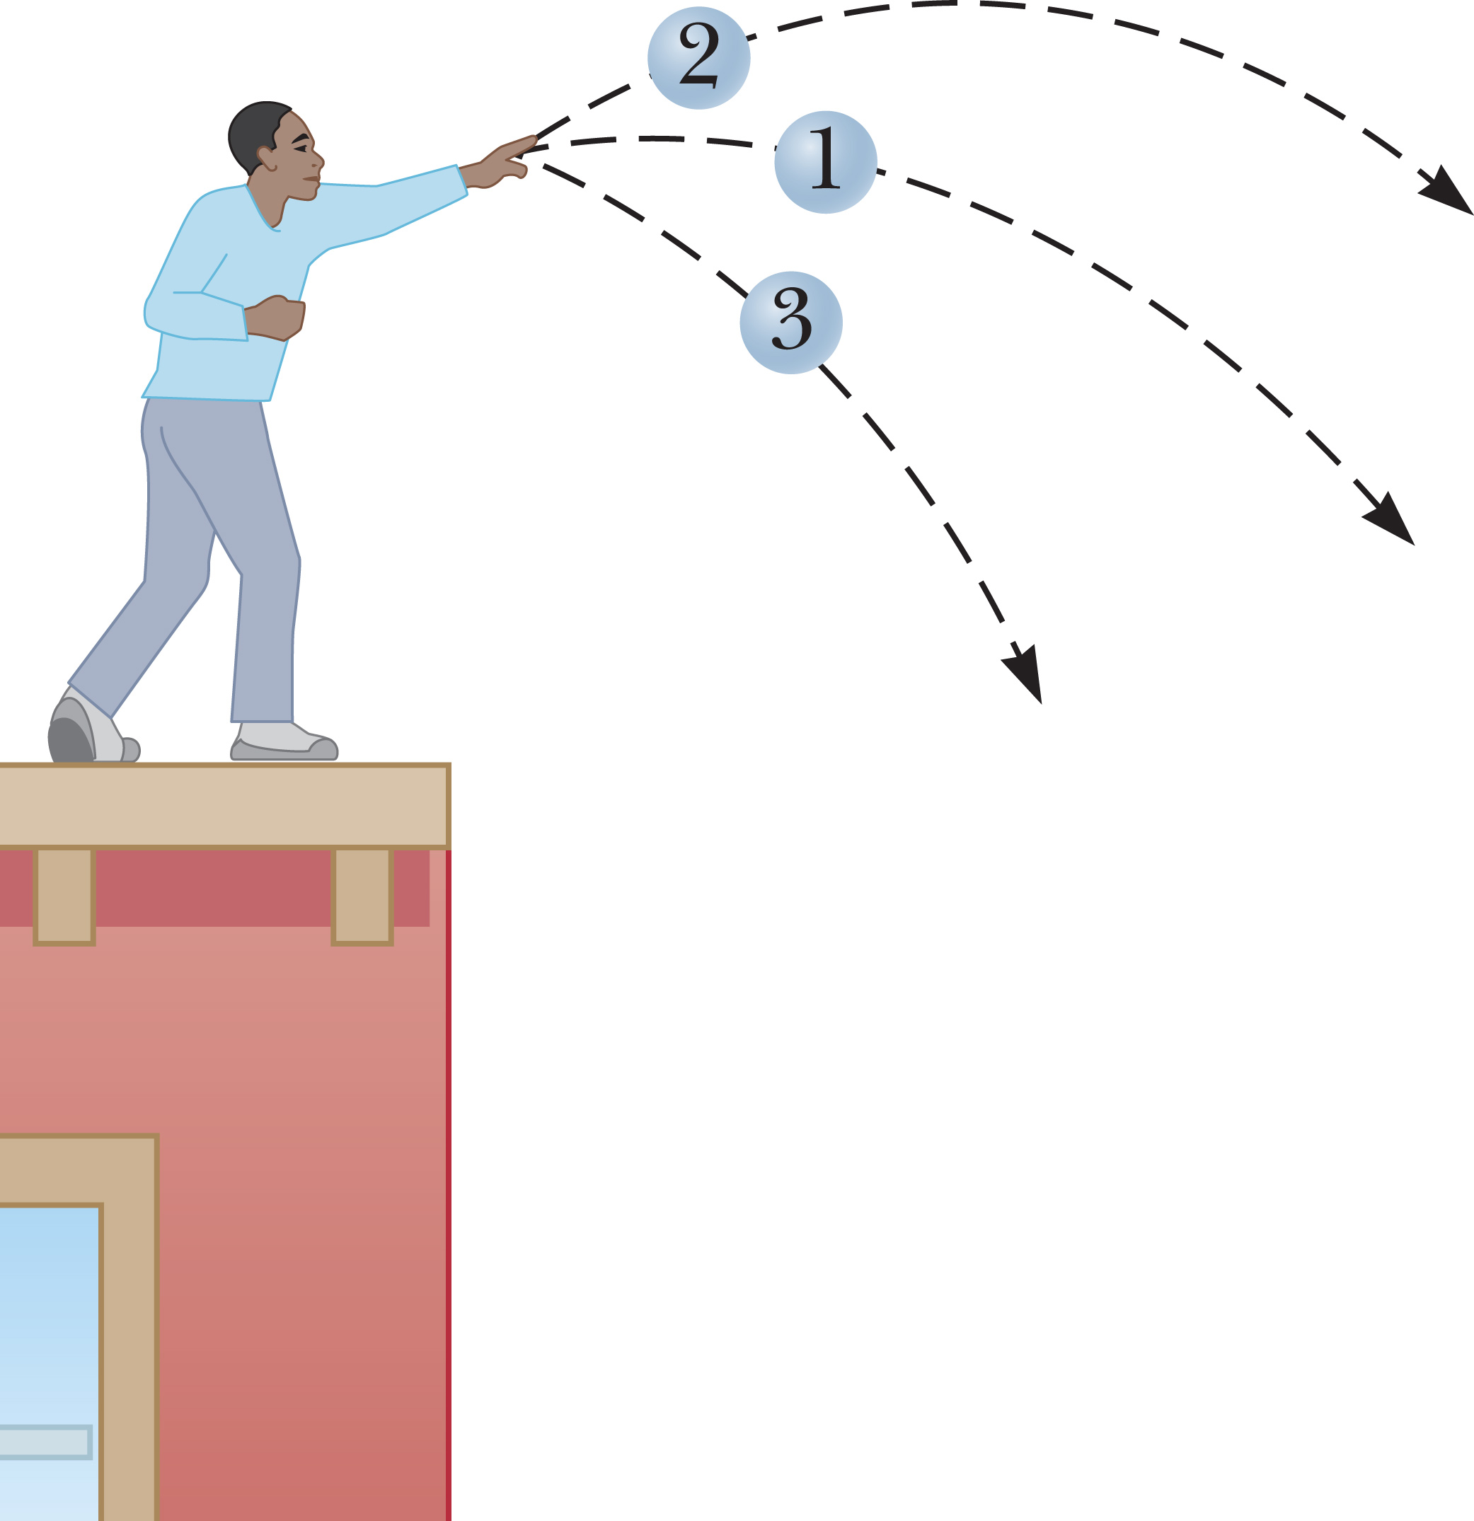
Gravity and the Conservation of Mechanical Energy
©Cengage
Notes:
Imagine tossing a rock off the side of a building. Let’s ignore any drag forces. As the rock falls, its speed increases, so its kinetic energy increases. As the rock approaches the ground, the potential energy of the rock–Earth system decreases. Whatever potential energy is lost as the rock moves downward appears as kinetic energy, and our equation says that in the absence of nonconservative forces like air drag, the trading of energy is exactly even. This is true for all conservative forces, not just gravity. In any isolated system of objects interacting only through conservative forces, the total mechanical energy of the system remains the same at all times.
If the force of gravity is the only force doing work within a system, then the principle of conservation of mechanical energy takes the form shown. [click to show equation]
This form of the equation is particularly useful for solving problems explicitly involving only one mass and gravity. In that special case, which you will see fairly often, notice that the mass cancels out of the equation. [click to show equation]
Keep in mind, though, that is possible only because any change in kinetic energy of the Earth in response to the gravity field of the object of mass m has been neglected, and rightfully so! In general, there must be kinetic energy terms for each object in the system, and gravitational potential energy terms for every pair of objects. Other terms have to be added when other conservative forces are present, as we’ll soon see.

Slide 37
Think – Pair – Share
Three identical balls are thrown from the top of a building, all with the same initial speed. The first ball is thrown horizontally; the second, at some angle above the horizontal; and the third, at some angle below the horizontal, as in the figure below. Disregarding air resistance, rank the speeds of the balls as they reach the ground, from fastest to slowest.
1, 2, 3
2, 1, 3
3, 1, 2
All three balls strike the ground at the same speed.
©Cengage
Notes:
Explain your thinking to a neighbor, and listen to his or her ideas. In a few minutes, we’ll discuss it and find out what you decided.
Answer: All three balls strike the ground at the same speed.
Reasoning: All three balls have the same speed the moment they hit the ground because all start with the same kinetic energy and undergo the same total change in gravitational potential energy.

Slide 38
Think – Pair – Share
Bob, of mass m, drops from a tree limb at the same time that Esther, also of mass m, begins her descent down a frictionless slide. If they both start at the same height above the ground, which of the following is true about their kinetic energies as they reach the ground?
Bob’s kinetic energy is greater than Esther’s.
Esther’s kinetic energy is greater than Bob’s.
They have the same kinetic energy.
The answer depends on the shape of the slide.
©Cengage
Notes:
Think about it, talk it over with a neighbor, and then we’ll discuss it in 2 minutes.
Answer: They have the same kinetic energy.
Reasoning: They both start from rest, so the initial kinetic energy is zero for each of them. They have the same mass and start from the same height, so they have the same initial potential energy. Because neither spends energy overcoming friction, all of their original potential energy will be converted into kinetic energy as they move downward. Thus, they will have equal kinetic energies when they reach the ground.

Slide 39
Problem-Solving Strategy: Applying Conservation of Mechanical Energy
Define the system.
Choose a location for y = 0.
Select the body of interest, and identify two points.
Write down the conservation of energy equation, and identify the unknown quantity.
Solve for the unknown quantity.
©Cengage
Notes:
Here are the steps to use when solving problems involving conservation of mechanical energy and gravity.
Define the system, including all interacting bodies. Verify the absence of nonconservative forces.
Choose a location for y = 0, the zero point for gravitational potential energy.
Select the body of interest and identify two points—one point where you have given information and the other point where you want to find out something about the body of interest.
Write down the conservation of energy equation for the system. Identify the unknown quantity of interest.
Solve for the unknown quantity, which is usually either a speed or a position, and substitute known values.
It’s usually best to do the algebra with symbols rather than substituting known numbers first, because it’s easier to check the symbols for possible errors. The exception is when a quantity is clearly zero, in which case you can immediately substitute zero, which will greatly simplify your algebra.

Slide 40
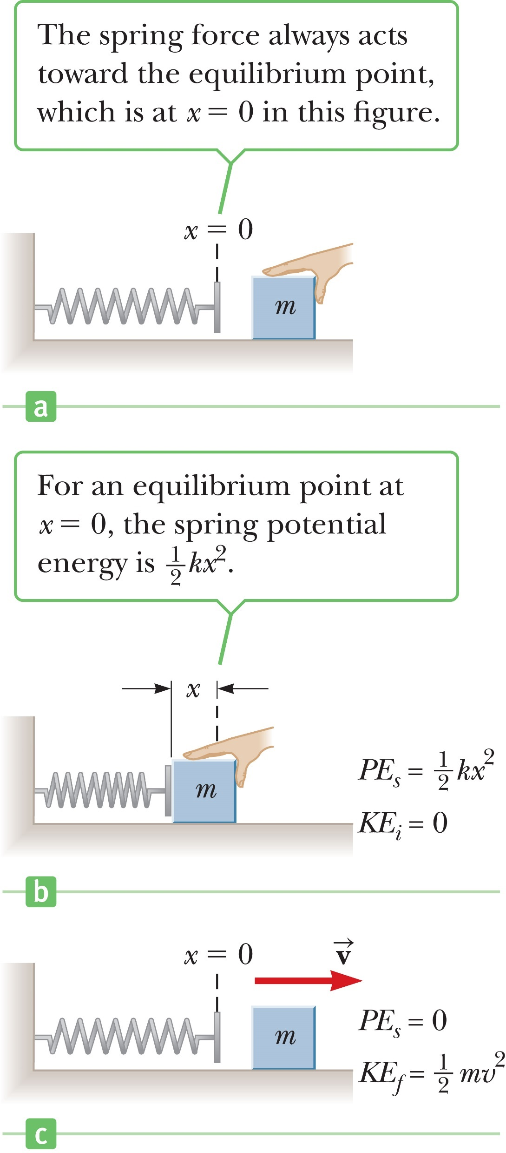
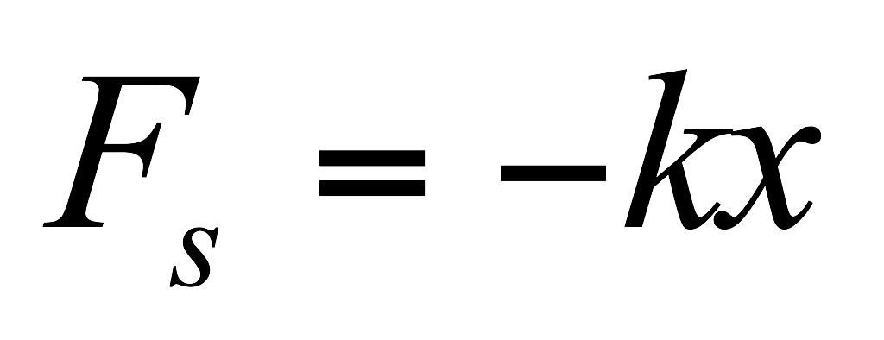
Spring Potential Energy
©Cengage
Notes:
Let’s take a look at springs. Springs are found in machines of all kinds, in watches, toys, cars, and trains. Work done by an applied force in stretching or compressing a spring can be recovered by removing the applied force, so like gravity, the spring force is conservative, as long as losses through internal friction of the spring can be neglected. That means a potential energy function can be found and used in the work–energy theorem.
The top figure shows a spring in its equilibrium position, where the spring is neither compressed nor stretched. The bottom figure shows someone pushing a block against the spring, which compresses it a distance x. Here x represents a displacement from the equilibrium position, which for our purposes will always be taken to be at x = 0. Experimentally, it turns out that doubling a given displacement requires twice the force, and tripling it takes three times the force. This means the force exerted by the spring must be proportional to the displacement, [click to show equation] as shown in the equation, where k is a constant of proportionality, the spring constant, carrying units of newtons per meter.
This equation is called Hooke’s law, after Sir Robert Hooke, who discovered the relationship. The force F_{s} is often called a restoring force because the spring always exerts a force in a direction opposite the displacement of its end, tending to restore whatever is attached to the spring to its original position. For positive values of x, the force is negative, pointing back toward equilibrium at x = 0, and for negative x, the force is positive, again pointing toward x = 0.
For a flexible spring, k is a small number, maybe about 100 N/m, but for a stiff spring k is large, about 10 000 N/m. The value of the spring constant k is determined by how the spring was formed, its material composition, and the thickness of the wire. The minus sign ensures that the spring force is always directed back toward the equilibrium point.

Slide 41
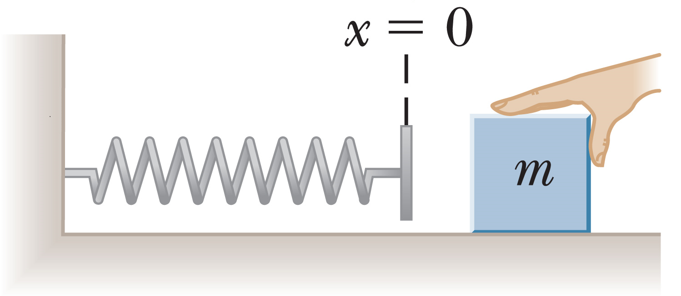
Spring Potential Energy
©Cengage
Notes:
The elastic potential energy is associated with the spring force. Elastic potential energy is another way of looking at the work done by a spring during motion because it is equal to the negative of the work done by the spring. It can also be considered stored energy from the work done to compress or stretch the spring.
Take a look at the spring in the figure. Let’s find the work done by the spring when compressed by an applied force from equilibrium to a displacement x. The spring force points in the direction opposite the motion, so we expect the work to be negative. In this case, because this is a varying force, we can use the average force to find the work done by the spring force. [click to show equations] The work done by the spring force is given in the equation shown.
In general, when the spring is stretched or compressed from x_{i} to x_{f} , the work done by the spring is given by the equation for W_{s}. [click to show equations]
The work done by a spring can be included in the work–energy theorem, as shown [click to show equation], where PE_{g} is the gravitational potential energy.

Slide 42
Spring Potential Energy
©Cengage
Notes:
The elastic potential energy associated with the spring force is PE_{s}, where k is the spring constant and x is the distance the spring is stretched or compressed from equilibrium. The quantity PE_{s} is often called the spring potential energy, to differentiate it from other forms of elastic potential energy, such as that of rubber bands or piano strings, which have different mathematical forms.
We can use this expression to write a new form of the work–energy theorem, including both gravitational and elastic potential energy, [click to show equation] where W_{nc} is the work done by nonconservative forces, KE is kinetic energy, PE_{g} is gravitational potential energy, and PE_{s} is the elastic potential energy. PE, which we used before to denote gravitational potential energy alone, will from now on denote the total potential energy of a system, including potential energies due to all conservative forces acting on the system.

Slide 43
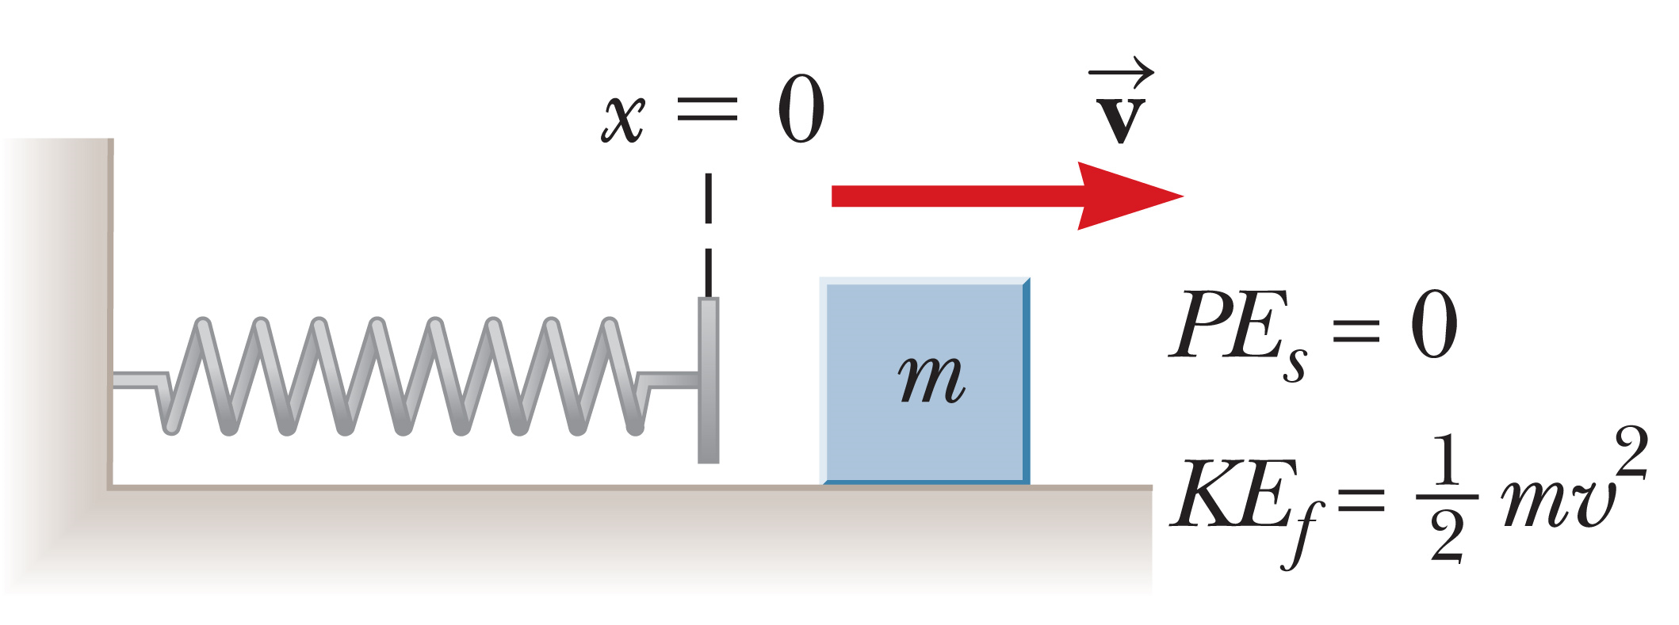
Spring Potential Energy
©Cengage
Notes:
The figure shows how the stored elastic potential energy can be recovered. When the block is released, the spring snaps back to its original length, and the stored elastic potential energy is converted to kinetic energy of the block. The elastic potential energy stored in the spring is zero when the spring is in the equilibrium position (x = 0). Potential energy is stored in the spring when it’s stretched. The elastic potential energy is a maximum when the spring has reached its maximum compression or extension. Finally, the potential energy is always positive when the spring is not in the equilibrium position.
In the absence of nonconservative forces, so we can write an extended form for conservation of mechanical energy. [click to show equation]

Slide 44
Think – Pair – Share
Calculate the elastic potential energy of a spring with spring constant k = 225 N/m that is compressed by 1.00 × 10²² m.
©Cengage
Notes:
Calculate the answer, and compare it to your neighbor’s; then, in a few minutes, we’ll see what you’ve come up with.
Answer: 1.13 × 10⁻² J
Reasoning: The elastic potential energy is PE_{s} = ½ kx² where x is the displacement
from equilibrium. When the spring is compressed, x_{compressed} = −1.00 × 10⁻² m. Therefore, x² = 1.00 × 10⁻⁴ m², and PE_{s} = ½ kx² = ½(225 N/m)(1.00 × 10⁻⁴ m²) = 1.13 × 10⁻² J

Slide 45
Think – Pair – Share
Calculate the elastic potential energy of a spring with spring constant k = 225 N/m that is stretched by 1.00 × 10²² m.
©Cengage
Notes:
Perform the calculation, see if your classmate got the same result, and let’s compare in a few minutes.
Answer: 1.13 × 10⁻² J
Reasoning: The elastic potential energy is PE_{s} = ½ kx² where x is the displacement
from equilibrium. When the spring is stretched, x_{stretched} = 1.00 × 10⁻² m. As in the previous slide, x² = 1.00 × 10⁻⁴ m². Therefore, x² = 1.00 × 10⁻⁴ m², and PE_{s} = ½ kx² = ½(225 N/m)(1.00 × 10⁻⁴ m²) = 1.13 × 10⁻² J

Slide 46
Think – Pair – Share
True or false? The elastic potential energy of a stretched or compressed spring is always positive.
©Cengage
Notes:
Share your thoughts with a neighbor, and we’ll go over it in class in a minute or so.
Answer: True
Reasoning: PE_{s} = ½ kx², where the spring constant, k, and x² are both positive.

Slide 47
Think – Pair – Share
Elastic potential energy depends on the spring constant and the distance the spring is stretched or compressed. By what factor does the elastic potential energy change if the spring’s stretch is doubled?
©Cengage
Notes:
Do some quick calculations, compare your results with a classmate’s, and be ready to share with the class in about 2 or 3 minutes.
Answer: 4
Reasoning: The elastic potential energy scales with x². As the stretch is doubled, the potential energy increases by 2² = 4.

Slide 48
Think – Pair – Share
Elastic potential energy depends on the spring constant and the distance the spring is stretched or compressed. By what factor does the elastic potential energy change if the spring’s stretch is tripled?
©Cengage
Notes:
Figure out your answer, check with your neighbor, and let’s talk in a few minutes.
Answer: 9
Reasoning: As the stretch is tripled, the potential energy increases by 3² = 9.

Slide 49
Systems and Energy Conservation
©Cengage
Notes:
You remember that the work–energy theorem can be written as shown. As we have seen, any work done by conservative forces, such as gravity and springs, can be accounted for by changes in potential energy. The work–energy theorem [click to show equation] can then be written as shown, where now PE includes all potential energies.
Let’s rearrange this equation. [click to show equation]
The total mechanical energy is given by E = KE + PE, [click to show equation] so let’s make this substitution into our equation. [click to show equation] The results are that the work done on a system by all nonconservative forces is equal to the change in mechanical energy of that system. If the mechanical energy is changing, it has to be going somewhere. The energy either leaves the system and goes into the surrounding environment, or it stays in the system and is converted into a nonmechanical form such as thermal energy.
As an example, think of a block sliding along a rough surface. Friction creates thermal energy, absorbed partly by the block and partly by the surrounding environment. When the block warms up, something called internal energy increases. The internal energy of a system is related to its temperature, which in turn is a consequence of the activity of its parts, such as the motion of atoms in a gas or the vibration of atoms in a solid.
Energy can be transferred between a nonisolated system and its environment. If positive work is done on the system, energy is transferred from the environment to the system. If negative work is done on the system, energy is transferred from the system to the environment.

Slide 50
Systems and Energy Conservation
Work
Heat
Mechanical
Electrical transmission
Electromagnetic radiation
©Cengage
Notes:
So far, we have encountered three methods of storing energy in a system: kinetic energy, potential energy, and internal energy. However, we’ve seen only one way of transferring energy into or out of a system: through work. Other methods will be studied in later topics, but let’s go ahead and summarize them here.
Work, in the mechanical sense of this topic, transfers energy to a system by displacing it with an applied force.
Heat is the process of transferring energy through microscopic collisions between atoms or molecules. For example, a metal spoon resting in a cup of coffee becomes hot because some of the kinetic energy of the molecules in the liquid coffee is transferred to the spoon as internal energy.
Mechanical waves transfer energy by creating a disturbance that propagates through air or another medium. For example, energy in the form of sound leaves your stereo system through the loudspeakers and enters your ears to stimulate the hearing process. Other examples of mechanical waves are seismic waves and ocean waves.
Electrical transmission transfers energy through electric currents. This is how energy enters your stereo system or any other electrical device.
Electromagnetic radiation transfers energy in the form of electromagnetic waves such as light, microwaves, and radio waves. Examples of this method of transfer include cooking a potato in a microwave oven and light energy traveling from the Sun to Earth through space.

Slide 51
Conservation of Energy in General
©Cengage
Notes:
The principle of conservation of energy says that energy can’t be created or destroyed, only transferred from one form into another. This principle is not confined to physics. In biology, energy transformations take place in myriad ways inside all living organisms.
One example is the transformation of chemical energy to mechanical energy that causes flagella to move and propel an organism.
Some bacteria use chemical energy to produce light, as you can see in the photo. Although the mechanisms that produce these light emissions are not well understood, living creatures often rely on this light for their existence. For example, certain fish have sacs beneath their eyes filled with light-emitting bacteria. The emitted light attracts creatures that become food for the fish.

Slide 52
Think – Pair – Share
A book of mass m is projected with a speed v across a horizontal surface. The book slides until it stops due to the friction force between the book and the surface. The surface is now tilted 30°, and the book is projected up the surface with the same initial speed v. When the book has come to rest, how does the decrease in mechanical energy of the book–Earth system compare to that when the book slid over the horizontal surface?
It’s the same.
It’s larger on the tilted surface.
It’s smaller on the tilted surface.
More information is needed.
Notes:
Think about it, share with your neighbor, and be ready to talk about your answer in a few minutes.
Answer: It’s smaller on the tilted surface.
Reasoning: The decrease in mechanical energy of the system is f_{k}(Δx). This has a smaller value on the tilted surface for two reasons: (1) The force of kinetic friction f_{k} is smaller because the normal force is smaller, and (2) the displacement Δx is smaller because a component of the gravitational force is pulling on the book in the direction opposite to its velocity.

Slide 53
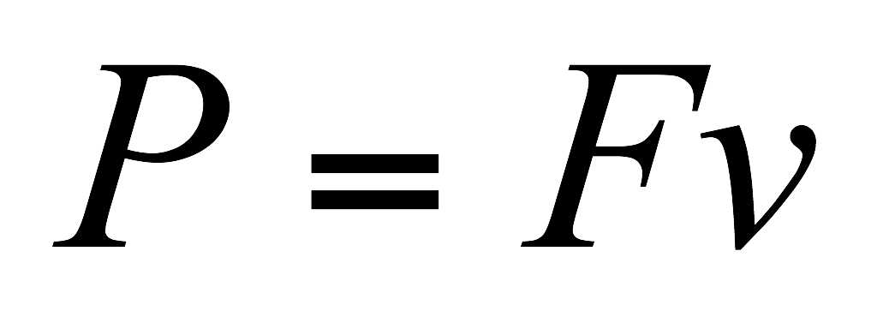
Power
©Cengage
Notes:
Power is the rate at which energy is transferred. It is important in the design and use of practical devices, such as electrical appliances and engines of all kinds, and in the understanding of living creatures, because the maximum work per second, or power output, of an animal varies greatly with output duration.
Power is defined as the rate of energy transfer with time: If an external force does work W on an object in the time interval Δt, then the average power delivered to the object is the work done divided by the time interval.
Let’s rewrite our equation for average power by making a substitution. [click to show equations] Notice that Δx over Δt is the average velocity of the object during the time Δt. According to this result, average power is a constant force times the average velocity. The force F is the component of force in the direction of the average velocity.
A more general definition, called the instantaneous power, [click to show equation] can be written down with a little calculus and has the same form. In this equation, both the force F and the velocity v must be parallel, but can change with time.

Slide 54
Power
©Cengage
Notes:
The SI unit of power is the joule per second (J/s), also called the watt, named after James Watt. The unit of power in the U.S. customary system is the horsepower (hp). The horsepower was first defined by Watt, who needed a large power unit to rate the power output of his new invention, the steam engine. The watt is commonly used in electrical applications, but it can be used in other scientific areas as well. For example, European sports car engines are rated in kilowatts.
In electric power generation, it’s customary to use the kilowatt-hour as a measure of energy. One kilowatt-hour (kWh) is the energy transferred in 1 h at the constant rate of 1 kW = 1 000 J/s. It’s important to realize that a kilowatt-hour is a unit of energy, not power. [click to show equation]
When you pay your electric bill, you’re buying energy, and that’s why your bill lists a charge for electricity of about 10 cents/kWh. The amount of electricity used by an appliance can be calculated by multiplying its power rating, usually expressed in watts and valid only for normal household electrical circuits, by the length of time the appliance is operated.

Slide 55
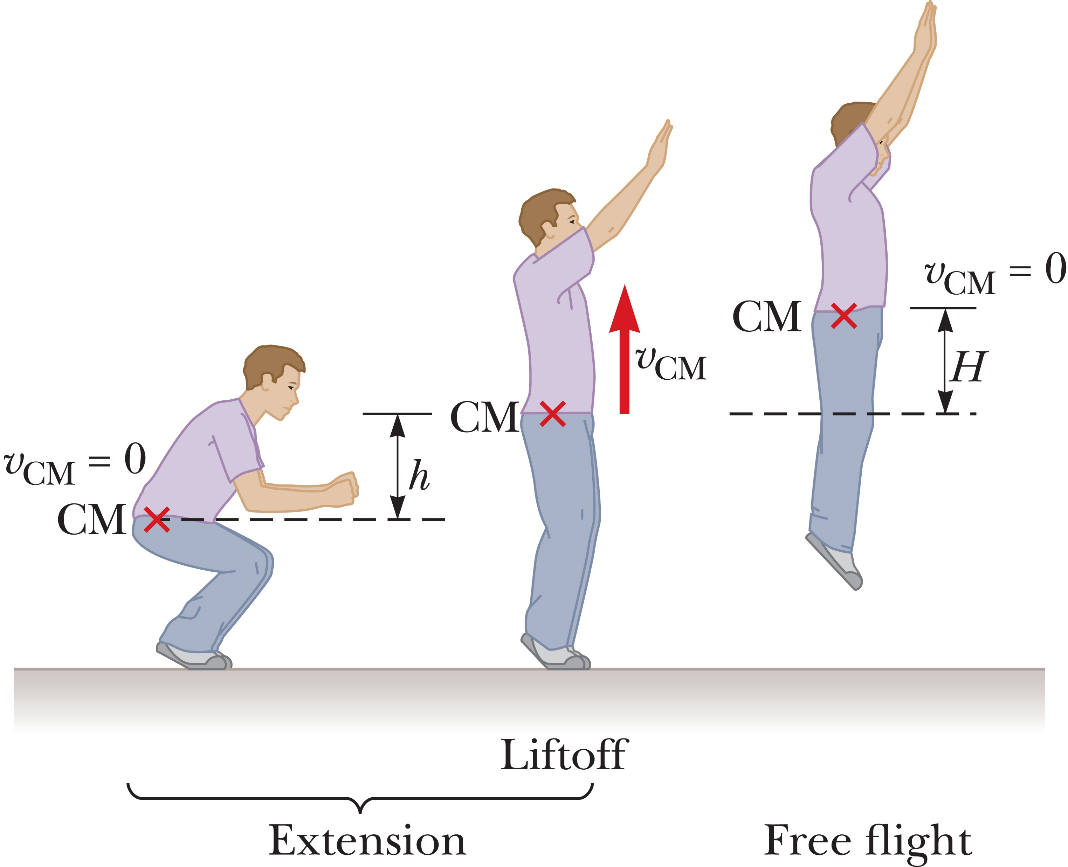
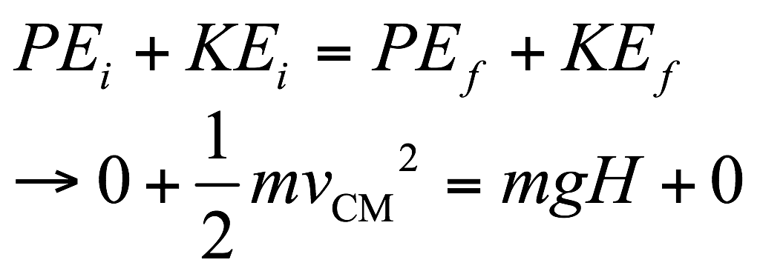
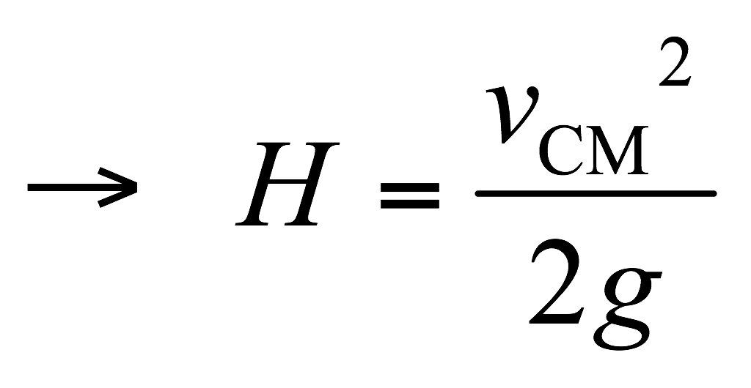
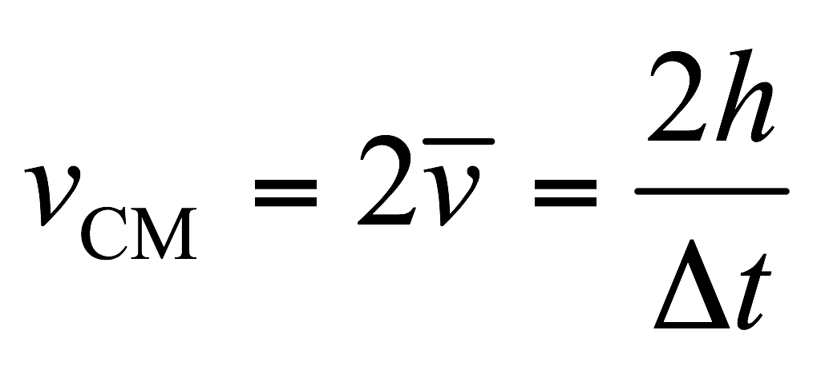
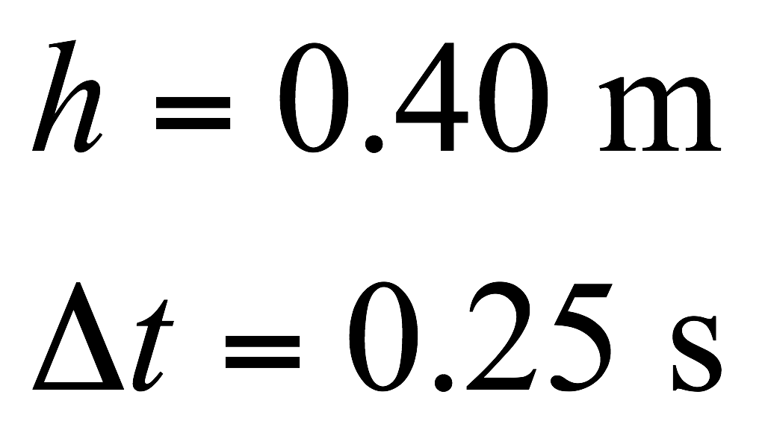
Energy and Power in a Vertical Jump
©Cengage
Notes:
Think about jumping straight up as shown in the figure. The stationary jump consists of two parts: extension and free flight. In the extension phase, the person jumps up from a crouch, straightening the legs and throwing up the arms; the free-flight phase occurs when the jumper leaves the ground. Because the body is an extended object and different parts move with different speeds, we describe the motion of the jumper in terms of the position and velocity of the center of mass, which is the point in the body at which all the mass may be considered to be concentrated. The figure shows the position and velocity of the center of mass at different stages of the jump.
Using the principle of the conservation of mechanical energy; and taking PE_{i}, the gravitational potential energy of the jumper–Earth system just as the jumper lifts off from the ground to be zero; and noting that the kinetic energy KE_{f} of the jumper at the peak is zero, [click to show equation] we can find H, [click to show equations] the maximum increase in height of the center of mass.
We can estimate v_{CM} by assuming that the acceleration of the center of mass is constant during the extension phase. If the depth of the crouch is h and the time for extension is Δt, [click to show equation] we find the result shown.
Measurements on a group of male college students show typical values of h = 0.40 m and Δt = 0.25 s. [click to show equations] The time is set by the fixed speed with which muscle can contract. Let’s plug in our values and see what we get. [click to show equations]

Slide 56
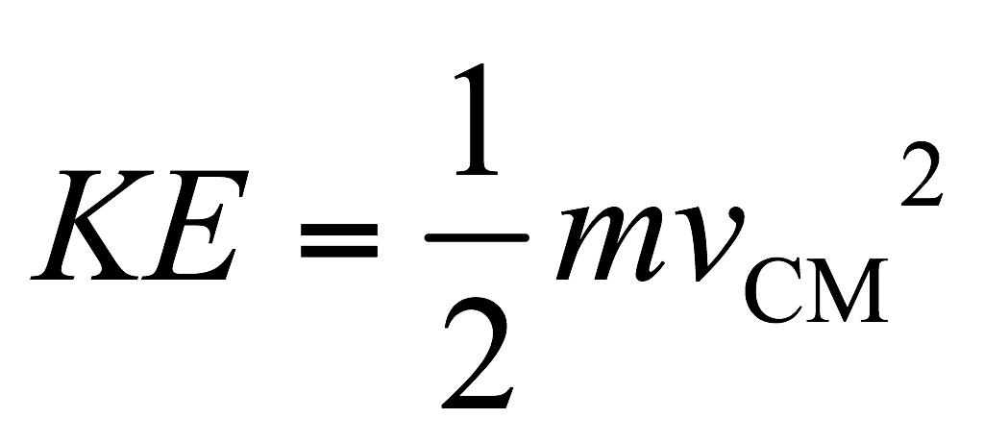
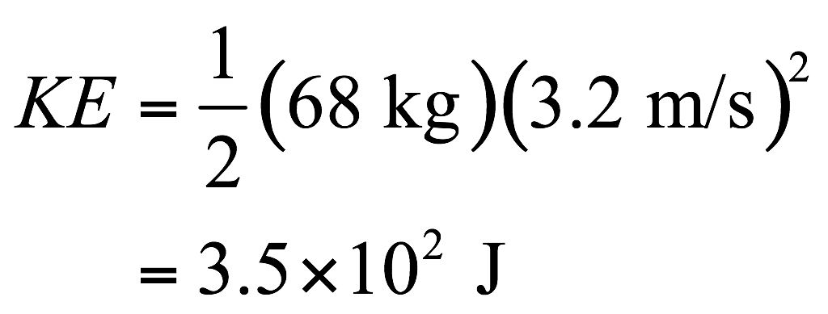
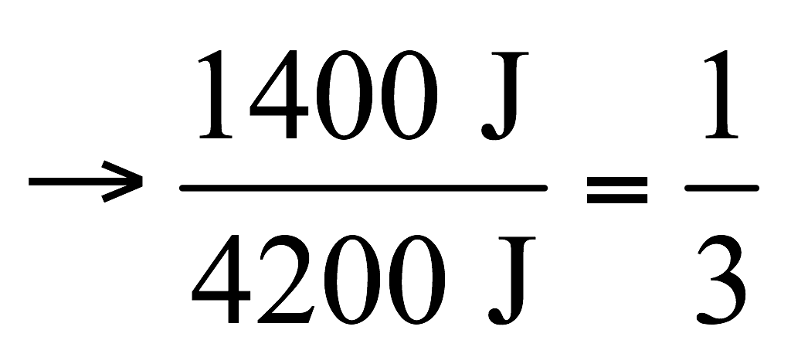
Energy and Power in a Vertical Jump
©Cengage
Notes:
Now let’s calculate the kinetic energy for this jumper, assuming a mass of 68 kg. [click to show equation]
It might seem like this is a large expenditure of energy, But let’s make a simple calculation to show that jumping and exercise in general are not good ways to lose weight in spite of their many health benefits. Because the muscles are at most 25% efficient at producing kinetic energy from chemical energy (muscles always produce a lot of internal energy and kinetic energy as well as work—that’s why you perspire when you work out), they use up four times the 350 J, [click to show equation] which is about 1400 J of chemical energy in one jump.
This chemical energy ultimately comes from the food we eat, with energy content given in units of food calories and 1 food calorie equal to 4200 J. [click to show equations] So the total energy supplied by the body as internal energy and kinetic energy in a vertical jump is only about one-third of a food calorie!

Slide 57
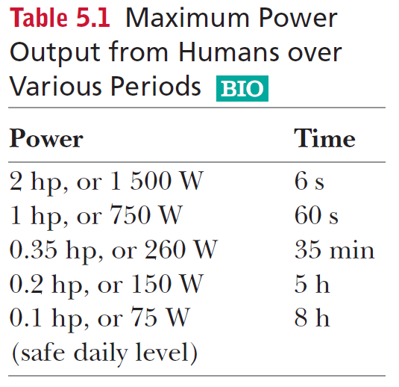
Energy and Power in a Vertical Jump
©Cengage
Notes:
Finally, it’s interesting to calculate the average mechanical power that can be generated by the body in strenuous activity for brief periods. Here we find that humans can produce about 2 hp of mechanical power for periods on the order of seconds.
The table shows the maximum power outputs from humans for various periods while bicycling and rowing, which are activities in which it is possible to measure power output accurately.

Slide 58
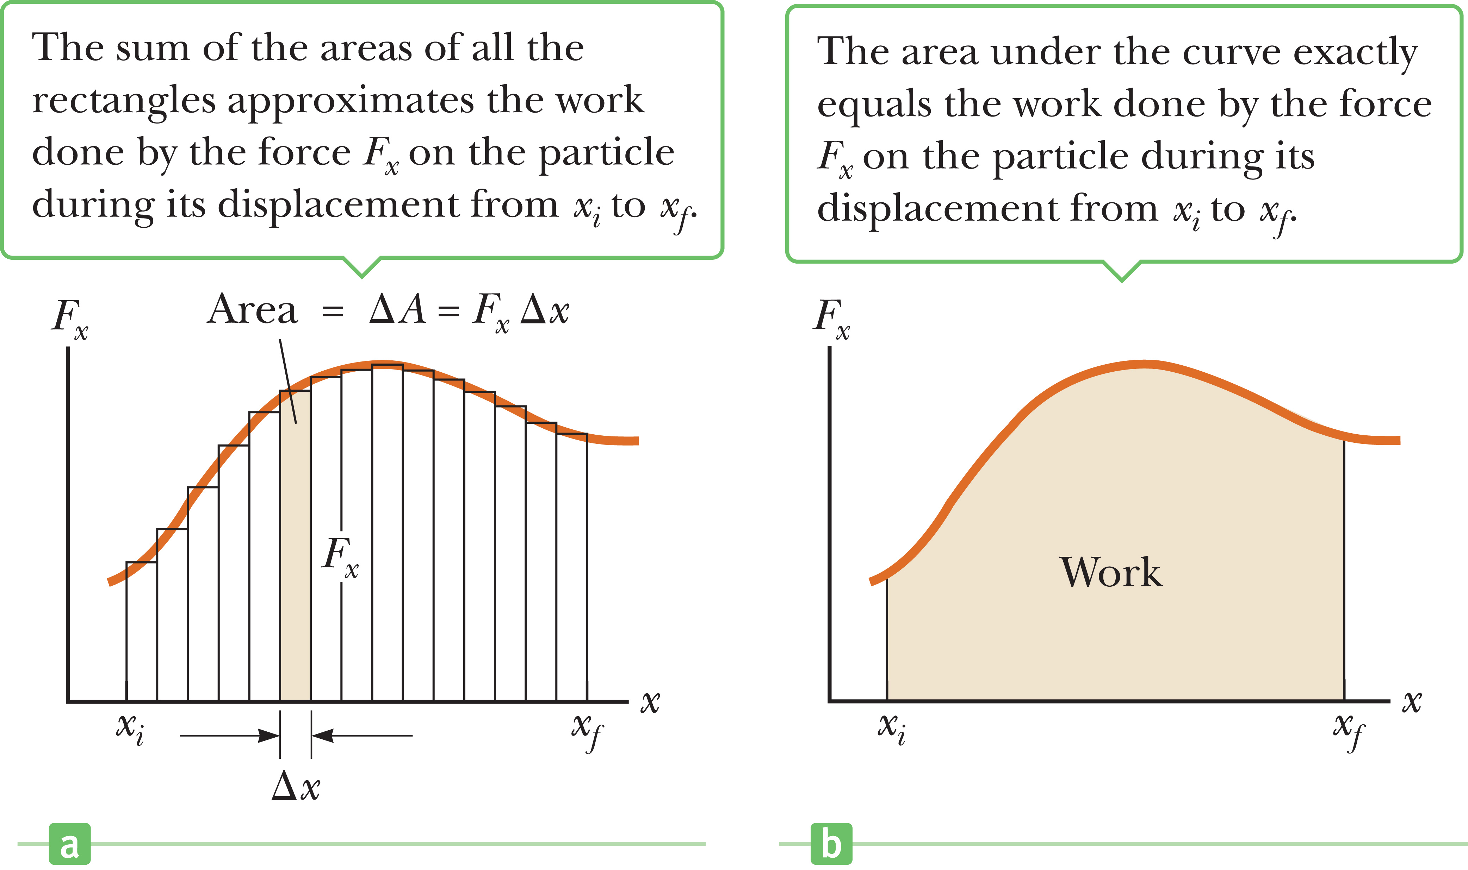
Work Done by a Varying Force
Work done by a variable force on an object that undergoes a displacement equals the area under the graph of F_{x} vs. x.
Notes:
Imagine an object is displaced along the x-axis under the action of a force that acts in the x-direction and varies with position. The object is displaced in the direction of increasing x from x_{i} to x_{f} . In such a situation, we can’t use W = Fd to calculate the work done by the force because this relationship applies only when F is constant in magnitude and direction.
But let’s imagine that the object undergoes the small displacement Δx shown the graph on the left; then the x-component of the force is nearly constant over this interval, and we can approximate the work done by the force for this small displacement [click to show equation] as shown. This quantity is just the area of the shaded rectangle in the figure.
If we imagine that the curve of F vs. x is divided into a large number of such intervals, then the total work done for the displacement from x_{i} to x_{f} is approximately equal to the sum of the areas of a large number of small rectangles. [click to show equation]
Now imagine going through the same process with twice as many intervals, each half the size of the original Δx. The rectangles then have smaller widths and will better approximate the area under the curve. Continuing the process of increasing the number of intervals while allowing their size to approach zero, the number of terms in the sum increases without limit, but the value of the sum approaches a definite value equal to the area under the curve bounded by F_{x}, and the x-axis in the figure on the right. In other words, [click to show text] the work done by a variable force acting on an object that undergoes a displacement is equal to the area under the graph of F_{x} vs. x.

Slide 59
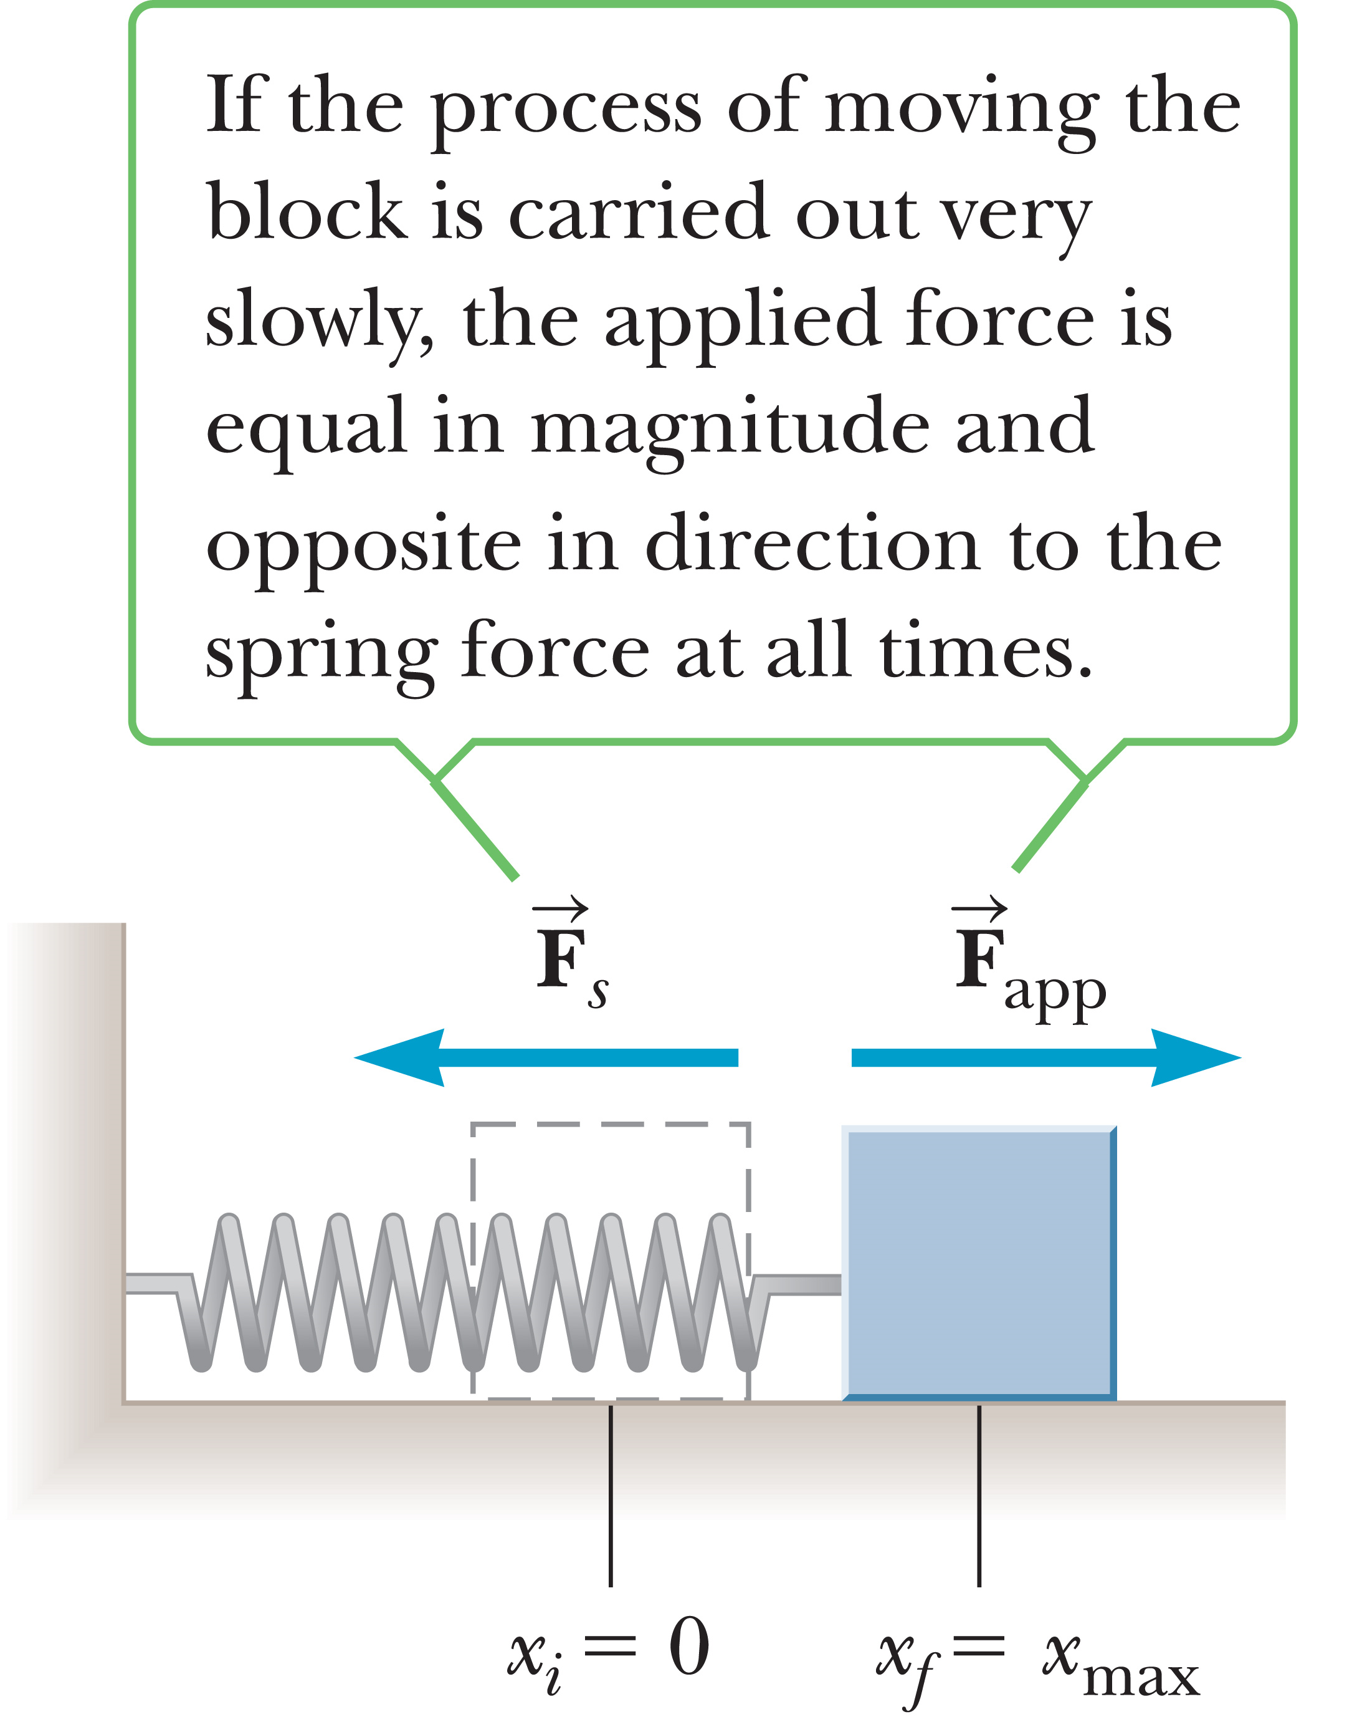
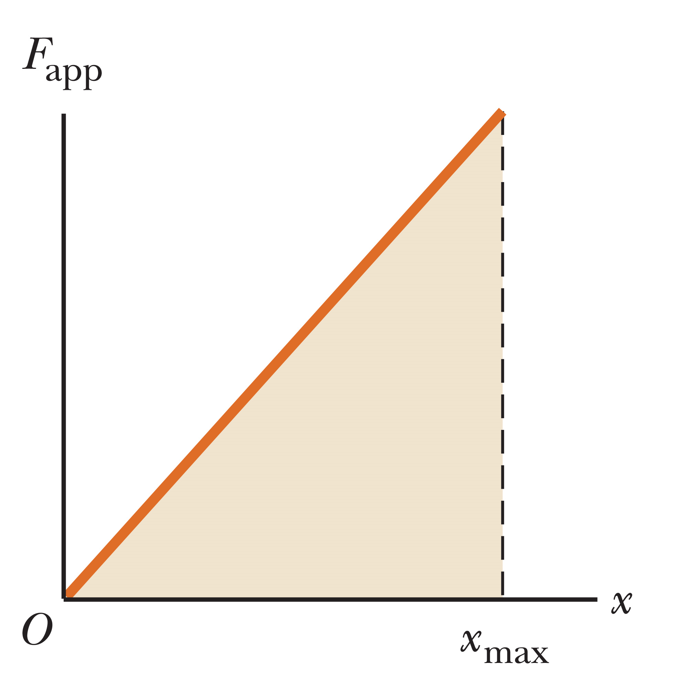
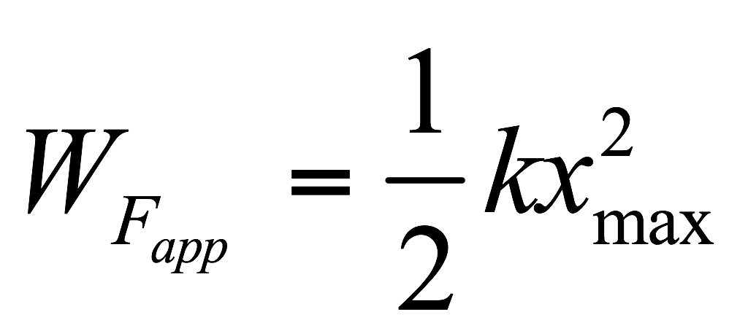
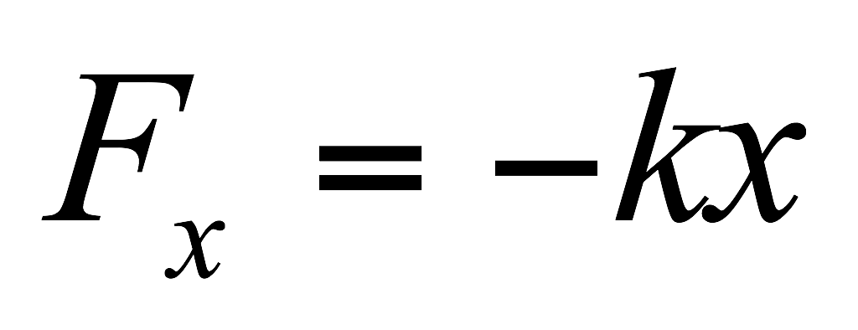
Work Done by a Varying Force
Notes:
The block on a horizontal, frictionless surface connected to a spring, shown in the figure, is a common physical system where force varies with position. When the spring is stretched or compressed a small distance x from its equilibrium position x = 0, it exerts a force on the block given by [click to show equation] F_{x} = – kx, where k is the force constant of the spring.
Now let’s determine the work done by an external agent on the block as the spring is stretched very slowly from x_{i} = 0 to x_{f} = x_{max}. This work can be easily calculated by noting that at any value of the displacement, Newton’s third law tells us that the applied force is equal in magnitude to the spring force and acts in the opposite direction. [click to show equation]
A plot of F_{app} vs. x is a straight line, as shown in the figure on the right. That means the work done by this applied force in stretching the spring from x = 0 to x = x_{max} is the area under the straight line in this figure, which in this case is the area of the shaded triangle. [click to show equation] During this same time the spring has done exactly the same amount of work, but that work is negative, because the spring force points in the direction opposite the motion. The potential energy of the system is exactly equal to the work done by the applied force and is the same sign, which is why potential energy is thought of as stored work.

Slide 60
Assessing to Learn
In which of the following cases would you do the least amount of work?
You push a box a distance d across a floor.
You pick up the box, walk a distance d, and gently put the box down on the floor.
You pick up the box, walk a distance d, and drop the box.
Both 1 and 2 are the least.
Both 1 and 3 are the least.
Both 2 and 3 are the least.
The amount of work done is the same in all three cases.
The amount of work cannot be determined from information given.
Notes:
Decide on an answer, and check with your neighbor. We’ll go over it together in a few minutes.
Answer: You pick up the box, walk a distance d, and gently put the box down on the floor.
Question C1.01
Commentary
Purpose: To introduce the formal definition of work.
Discussion:
In physics, we have a mathematical definition for work based on the forces exerted on an object and the object’s motion. The work done by a constant force F is W_{F} = Fd||, where F is the magnitude of the force F, and d|| is the component of the object’s displacement parallel to F. (There are other forms of the definition of work, but this is the most useful here.)
Picking up the box requires a certain amount of positive work to be done. The force is mg (up) and the displacement is h (up), so the work is mgh. Carrying the box requires zero work to be done, because the displacement is horizontal and therefore the component parallel to the force is zero. (To be precise, some positive work is done when you start moving and some negative work is done when you stop, for zero total work.) And lowering the box requires a certain amount of negative work to be done. The force is still mg (up), but now the displacement is h (down), so the component parallel to the force is negative, and the work done is –mgh. Thus, the total work done in case (2) is zero.
In case (3), the total work is positive because you do positive work to lift the box, zero work while walking, and zero work while the box falls, as you aren’t exerting any force on it at all.
In case (1), you will do some work as you apply a force in the direction you push the box; how much work depends on how much friction there is between the box and floor. Because even a “negligible” amount of friction is nonzero, answer (2) is best using a physics definition of work.
Other definitions of work are valid as well. If you apply one of several possible everyday definitions, other answers are defensible.
Key Points:
The physics definition of work does not always agree with everyday usage of the term. Sometimes you can get very tired doing no “work” at all!
For a force exerted on an object, positive work is done if the force has a positive component in the direction of motion, and negative work is done if the force has a negative component in that direction (i.e., points opposite the direction of motion).
A force acting perpendicularly to the direction of motion does zero work.
For Instructors Only
This problem is intended for use when first introducing the concept of work and is intended to elicit a vigorous discussion of the term’s meaning. We suggest using it before any formal definition has been presented, and then, after a discussion that draws out students’ preconceptions and colloquial definitions, introducing the physics usage of the word. This will help students better appreciate the definition when it comes, and be more defensive about confusing the technical and commonplace meanings.
When using this question before formally defining of work, “right” or “wrong” is not a useful distinction. Each one of the answers is defensible depending on one’s perspective. Rather, strive to have students become conscious of and articulate their various interpretations of “work."
Actually analyzing the exertion of a human in terms of the physics definition of work is possible, but quite difficult as humans are not conservative systems; the details of muscle fiber operation, with their continual contraction and relaxation and energy dissipation even when holding something stationary, are relevant.
Source: UMass Assessing to Learn.

Slide 61
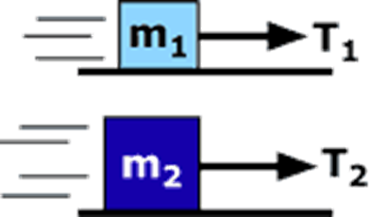
Assessing to Learn
Two blocks with mass m₂ > m₁ are pulled as shown along horizontal surfaces, each at a constant speed v. Which tension force does more work moving the block a distance D along the surface?
1. T₁ 2. T₂ 3. Neither; both do zero work.
4. Neither; both do the same amount of negative work.
5. Neither; both do the same amount of positive work.
6. Impossible to determine without knowing the masses
7. Impossible to determine without knowing the coefficients of friction
8. Impossible to determine without
knowing the speed v
9. Impossible to determine for
some other reason
Notes:
Think about it yourself for a couple of minutes or so, then check in with a neighbor and talk it over. We’ll see what you come up with in about 4 minutes.
Answer: Possible: (2), (7)
Question C1.02a
Commentary
Purpose: To integrate force ideas and work ideas.
Discussion:
In each case, the block is not accelerating, so the net force is zero. Thus, the tension force must be equal in magnitude to the kinetic friction force, and the normal force must be equal in magnitude to the weight of the block. The kinetic friction force is proportional to the normal force (f_{k} = μ_{k}N). The normal force is larger in case 2, as the mass (and hence the weight) is larger.
The work done is the tension multiplied by the distance D. The distances are the same, so the question becomes “Which tension force is larger?” Because the accelerations are zero, this is equivalent to asking, “Which friction force is larger?” If we assume that the surfaces are the same and the blocks are made of similar material, then the coefficients of friction will be the same. With this assumption, case 2 will have a larger friction force, which means T₂ is larger and therefore does more work. So, answer (2) is defensible.
On the other hand, because we are not told anything about the coefficients of friction, answer (7) is defensible.
Students might think that no work is being done on the blocks, as the kinetic energy is not changing. However, the question asks about the work done by a particular force, not the net work.
Students might ignore friction. Because the blocks are moving at constant velocity, friction must be present to oppose the tension force.
(Note that if the tension were being applied at an upward angle, the problem would become considerably more complicated.)
Key Points:
The work done by a particular force is different from the total work done on an object.
The work done by a particular force depends on the displacement of the object and the component of the force along the direction of motion.
Even though we are not given numerical values for the masses, speed, and so on, we can still reason through to an answer under certain assumptions.
There is more than one defensible answer to this question. Make sure your answer is consistent with your chosen assumptions and that you are aware of the assumptions you are making.
For Instructors Only
This is the first of three related questions designed to explore student reasoning about work, the normal force, and the kinetic friction force. Here we highlight the reasoning needed to understand work. Even though we are talking about work and energy ideas, we still need to be able to analyze situations using forces; we cannot forget all that useful stuff!
Note that it is common to say that an object moving at constant speed has “no acceleration.” It is more proper to say “zero acceleration,” as the object still has an acceleration; its value is zero.
Yes, this question is ambiguous: should students assume that the coefficients of friction are the same? Rather than a liability, this ambiguity is a strength of the question: it focuses students’ attention on the significance of that quantity and the implications of assuming one way or another. We suggest not mentioning anything about the coefficients of friction before or while students answer the question; instead, let disagreement among students raise the topic naturally. Then, stress that neither assumption (and corresponding answer) is “right"; rather, the point is the implications of the choice and the cogency of subsequent reasoning.
Source: UMass Assessing to Learning.

Slide 62
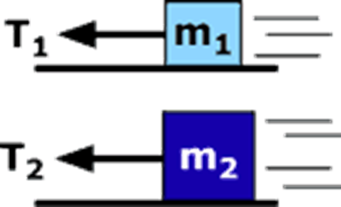
Assessing to Learn
Two blocks with mass m₂ > m₁ are pulled as shown along rough horizontal surfaces with the same coefficient of friction. Both are pulled at constant speed, but v₂ < v₁. Which tension force does more work moving the block a distance D along the surface?
1. T₁ 2. T₂ 3. Neither; both do zero work.
4. Neither; both do the same amount of negative work.
5. Neither; both do the same amount of positive work.
6. Impossible to determine without knowing the masses
7. Impossible to determine without knowing the speeds
8. Impossible to determine for
some other reason
Notes:
Take a stab at it yourself, and then compare your thoughts with a neighbor to see what you can come up with together, and after about 4 minutes we’ll talk about it as a class.
Answer: T₂
Question C1.02b
Commentary
Purpose: To integrate force ideas with work ideas, exploring the definition of work and the quantities it does and does not depend on.
Discussion:
There are four forces on each block: (1) gravitation, down; (2) normal, up; (3) tension, left; and (4) kinetic friction, right. Because the vertical component of acceleration is zero, the normal force balances gravitation and is therefore larger for the heavier block (case 2). As the coefficients of friction are the same, and f_{k} = μ_{k}N, the friction force is larger in case 2 as well. Because neither block is accelerating, the tension force must balance the kinetic friction force, so the tension force is larger in case 2. Both blocks move through the same distance, so according to the definition of work, T₂ does more work.
How about the sign? Both forces do positive work even though they are pointed to the left. The displacement is also to the left, so the component of tension along the direction of motion is positive.
Also, think about what would happen without any friction: both blocks would speed up, which means tension (the only force doing work) is doing positive work.
The result does not depend on the speed of the block, as work depends on force and displacement (not velocity or time). Block 2 takes more time to move a distance D, but that does not affect the work.
Key Points:
Work is positive when the component of force along the direction of motion is positive, and negative when the component is negative. Negative work does not mean work in the negative (leftward) direction; it means work due to a force that opposes the object’s motion.
Work depends on force and displacement, not velocity or time. Because forces are related to acceleration, work is also related to acceleration.
Two objects moving at constant velocity have the same acceleration (zero), even when they have different speeds.
For Instructors Only
This is the second of three related questions using similar situations. In the first, we considered the impact of different masses (and left the coefficients of friction ambiguous). In this, we have equal masses but vary the block speeds.
Students commonly think work is a vector, whose sign is used to indicate direction; such a misconception should be elicited, made explicit, and dispelled.
A forward reference to the concept of power may be of benefit here.
Source: UMass Assessing to Learning.

Slide 63
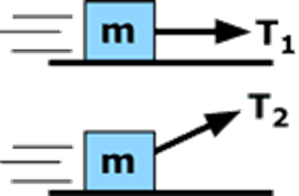
Assessing to Learn
Two identical blocks are pulled as shown along rough horizontal surfaces with the same coefficient of friction. Both are pulled at constant speed v. Which tension force does more work moving the block a distance D along the surface?
1. T₁ 2. T₂ 3. Neither; both do zero work.
4. Neither; both do the same amount of negative work.
5. Neither; both do the same amount of positive work.
6. Impossible to determine without knowing the mass m
7. Impossible to determine without knowing the speed v
8. Impossible to determine without knowing the angle of T₂
9. Impossible to determine for 2 of the reasons above
10. Impossible to determine for some other reason
Notes:
Compare your answers with a classmate’s, and we’ll all compare notes in about 4 minutes.
Answer: T₁
Question C1.02c
Commentary
Purpose: To integrate force ideas with work ideas, highlighting the role of a force’s components in determining the work it does.
Discussion:
There are four forces on each block: (1) gravitation, down; (2) normal, up; (3) tension, right/up; and (4) kinetic friction, left. The normal force and the vertical component of tension balance gravitation, so the normal force is larger in case 1. Since the coefficients of friction are the same, and f_{k} = μ_{k}N, the friction force is larger in case 1 as well. Since neither block is accelerating, the horizontal component of the tension force must balance the kinetic friction force, so this component is larger in case 1. The displacement is horizontal, so the work done depends only on the horizontal component of tension. Therefore, T₁ does more work.
T₂ might be larger than T₁, depending on the angle of the rope, but this is not relevant to the question asked. It is not the larger force that does the larger amount of work, but the force with the larger component along the direction of motion.
Key Points:
The work done by a force depends on the component of that force along the direction of motion. A large force does a small amount of work when the component along the direction of motion is small. And when the component is zero, the work is zero.
The normal force is not always equal to the weight of the object. The normal force is a “constraint” force, which means it will balance all forces with components perpendicular to the surface.
For Instructors Only
This is the last of three related questions using similar situations. In the first, we considered the impact of different masses (and left the coefficients of friction ambiguous); in the second we had equal masses but varied the block speeds. In this, masses and speeds are equal, and we instead vary the angle and perhaps magnitude of the tension force.
This question highlights the fact that the normal force is a constraint force (rather than as a force with an empirical law). It also highlights the fact that only the component of a force along the direction of motion contributes to the work done.
Some students may not notice that the masses of the blocks are the same. (In the two previous cases, the lower block was more massive than the upper one.) Rather than heading this off, let it happen and then come to light during the discussion. This is of greater long-term benefit, helping students learn to be more careful in the future.
Source: UMass Assessing to Learning.

Slide 64
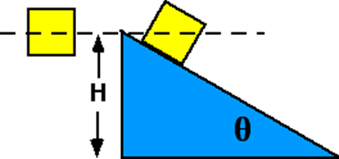
Assessing to Learn
Two identical blocks fall a distance H. One falls directly down; the other slides down a frictionless incline. Which has the larger speed at the bottom?
The one falling vertically
The one sliding down the incline
Both have the same speed.
Cannot be determined
©Cengage
Notes:
Take a couple of minutes to figure out the answer yourself—talk with each other if you get stuck—and then we’ll talk about it together.
Answer: Both have the same speed.
Question C1.03a
Commentary
Purpose: To hone the concept of work.
Discussion:
We will ignore the effects of air resistance.
The gravitational force acts vertically downward. The work done by a constant force is the magnitude of the force times the displacement in the direction of the force. In both cases, the block’s vertical displacement is the same. Because the force is the same and the displacement in the direction of the force is the same, the work done by gravitation is the same.
For the block falling vertically, no other forces act, so this is the total work done on it.
For the block on the incline, a normal force also acts. The normal force is perpendicular to the displacement, however, so it does zero work. And we are told that the incline is frictionless, which means the force of friction is small enough to ignore and also does zero work. So, the total work done on this block is the same as for the vertical block.
According to the work-kinetic energy theorem, if both blocks have the same amount of work done on them, they must have the same kinetic energy at the bottom, and thus the same speed.
Note that the block on the incline takes longer to reach the bottom. Why? Because although it has the same speed as the falling block at any given height, that speed is not directed entirely downward. In other words, its acceleration is smaller, so to reach the same final speed, it must take longer to reach the bottom.
Key Points:
The total work done on an object by all forces (internal and external) is equal to the change in the object’s kinetic energy (work-kinetic energy theorem). In this case, zero work is done by internal forces.
The work done on an object by a force depends on the component of the object’s displacement along the direction the force is applied, not on the object’s total displacement.
Work and energy ideas are powerful for relating forces, distances, and speeds. They are not so useful for determining times.
For Instructors Only
This question is good for exploring the concept of work, and leading up to the definition of potential energy and the principle of conservation of energy.
Students commonly believe that because the falling block lands first, it must be moving faster than the block on the incline.
Another common error is for students to run a “mental simulation” and decide that the falling block has the higher speed, not realizing that their intuition includes the effects of friction.
Because both blocks have the same speed regardless of their mass, an informative and valuable follow-up is to ask the same question again, but with different masses for the two blocks.
Note that internal forces can do work on a system, though none do in this case. Thus, it is important to describe the work-kinetic energy theorem in terms that will generalize properly later and to avoid using phrases such as “net work,” “work done by the net force,” and “work done by external forces.” In other words, we generally use a “particle” model in which there is necessarily no deformation, no internal degrees of freedom, no moving parts, and no effects of rotation. However, students generally do not appreciate the subtleties of the particle model, especially when we use it with obvious non-particles. We also do not usually explain the transition from a particle model to a non-particle model, so it is recommended to avoid certain oversimplifications and overgeneralizations. The proper statement of the work-kinetic energy theorem is that the total work done by all forces on a system, internal and external, is equal to the change in total kinetic energy of the constituents of that system. That is, internal forces can do work on a system, and now we can properly apply the work-kinetic energy theorem to lots of more interesting situations, such as accelerating cars, bouncing balls, masses being “exploded” by a spring, and spinning disks.
Source: UMass Assessing to Learning.

Slide 65
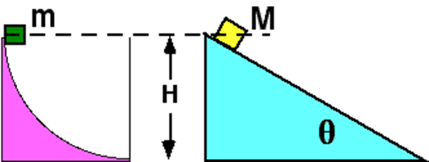
Assessing to Learn
Two masses, M > m, travel down the surfaces shown. Both surfaces are frictionless. Which mass has the larger speed at the bottom?
m
M
Both have the same speed.
Cannot be determined
Notes:
Come up with your own answer, then compare notes with your neighbor to see if you agree. We’ll discuss it in 3 minutes.
Answer: Both have the same speed.
Question C1.03b
Commentary
Purpose: To hone the concept of work.
Discussion:
The surfaces are frictionless, and we will ignore air resistance, so two forces act on each block: gravitation, down; and normal, perpendicular to the surface.
We cannot use Newton’s laws to answer the question because our mathematics is not sophisticated enough to find the speed as a function of time when the force is not constant or not known as a function of time. However, because the normal force always acts perpendicularly to the motion of the block, it does zero work in each situation. This means energy ideas are useful.
Because there is no friction, we can use the work-kinetic energy theorem. The only force that does nonzero work is gravitation, and that acts downward, so only the vertical component of each block’s displacement is relevant. Thus, the blocks will have kinetic energies of mgH and MgH at the bottom. Because kinetic energy is ½mv² and ½Mv², v² = gH and both blocks have the same speed at the bottom.
In other words, the weight is proportional to mass, but the kinetic energy is also proportional to mass, so the mass cancels out. Without friction, the speed of each block at the bottom depends only on the vertical distance it falls and not on the angle or shape of the incline or the mass of the block. (With friction, the final speeds would be different.)
This does not mean that both blocks reach the bottom at the same time. One block will take longer, but when it does reach the bottom, it will have the same final speed as the first.
Key Points:
The work-kinetic energy theorem is useful for problems where we want to relate forces, distances, and speeds, and have a complicated path or nonconstant acceleration and no friction.
The work done on an object by a force depends on the component of the object’s displacement along the direction the force is applied, not on the object’s total displacement.
Often, the mass of an object does not affect its motion because it cancels out of calculations. This generally happens for forces that are proportional to the mass of the object acted on.
For Instructors Only
Students who choose answer (2) may be thinking that the larger mass has the larger potential energy change, and therefore the larger speed at the bottom.
Students who choose answer (1) may be applying the intuitive idea that because m reaches the bottom first, it must have the larger final speed.
Students may have other reasons for choosing an incorrect answer, making it worth your while to spend time soliciting all the different lines of thinking for each choice.
Note that when there is friction, we cannot properly apply the work-kinetic energy theorem.
Source: UMass Assessing to Learning.

Slide 66
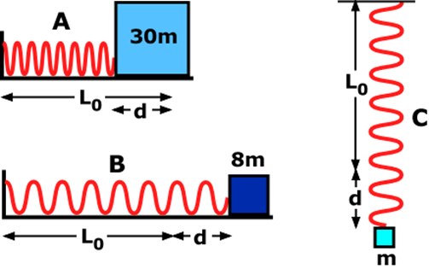
Assessing to Learn
Three identical springs are arranged as shown below. Put these in order from largest to smallest spring force:
A > B > C
A > B = C
A = B > C
B > A > C
B = A > C
B > A = C
None of the above
Impossible to determine
Notes:
Think it over, be ready to justify your choice, and consider your neighbor’s explanation. We’ll talk as a class in 4 minutes.
Answer: None of the above
Question B2.08
Commentary
Purpose: To introduce the spring force and stress the point that it depends only on the compression or extension of the spring from its resting length.
Discussion:
The magnitude of the spring force is given by F_{s} = kd, where k is the spring constant (or elastic constant) measured in N/m, and d is how far the spring is compressed or stretched from its relaxed state. A spring that obeys this relationship is called “ideal.”
We sometimes write this relationship as F_{s} = –kx, where x is the displacement of the end of the spring from its relaxed position. This is a vector equation, and the minus sign indicates that the direction of the force is opposite the displacement of the end of the spring. Another form of the same relationship is F_{s} = k|L–L₀|, where L is the length of the spring, L₀ is its relaxed length, and |x| is the absolute value of x. In other words, d = |L–L₀|.
An ideal spring has the same spring constant for both compression and extension. Also, the orientation of the spring does not matter.
The spring force does not depend on any factors other than its elastic constant k and how far it is compressed or stretched. In situation A, the spring is compressed a distance d, so the force is to the right with a magnitude of kd. In situation B, the spring is stretched an amount d, so the force is to the left with the same magnitude kd. In situation C, the spring is stretched an amount d, so the force is up with the same magnitude kd. Thus, the best answer is (7), “None of the above,” as “A = B = C” is the correct ordering.
It is easy to become distracted by the physical arrangement. In C, the spring force is certainly equal to the weight mg of the hanging block, but this is not relevant. In A and B, there is likely to be a maximum static friction force that is larger than the weight of the hanging block, but again, this is irrelevant. The actual static friction force must be kd in both cases.
Key Points:
The force exerted by an “ideal” spring has a magnitude of kd, where k is a constant describing the strength of the spring and d is the distance the spring has been extended or compressed from its resting length. This is called Hooke’s Law.
The spring force does not depend on the orientation of the spring, whether the spring is stretched or compressed, or what the spring is attached to.
The spring force is restoring, in that if the spring is stretched, the force pulls its ends together; if it is compressed, the force pushes its ends apart.
For Instructors Only
Students are likely to be distracted by irrelevant features, such as the masses of the blocks or the static friction forces in situations A and B.
Confusion about the static friction force can lead to difficulties here. That is, if students think the static friction force is always equal to μ_{s}N, they might reason that the friction force on block A is larger than that on block B, so the spring force on A must also be larger to keep it stationary. To help resolve the confusion, you can point out that one could push block A to the left and have it stay in equilibrium even though the spring force becomes larger. Likewise, block B could be pulled to the right and it would stay in equilibrium.
Answer (1) will be common if students approach this question via F_{net} = 0, as the maximum static friction force is likely to be larger in A than in B, and both are likely to be larger than the weight of block C.
Students sometimes don’t realize that k for compression is the same as k for extension.
Note that we really do use “None of the above” as the best or only correct answer sometimes. If we don’t, students quickly stop considering it as a serious option, and then will assume they are incorrect whenever they don’t find their preferred answer in the list. When any students choose “None of the above” for a question (whether appropriately or not), we advocate asking them what answer they would like to see on the list; this provides more information for the instructor and the rest of the class.
Source: UMass Assessing to Learning.

Slide 67
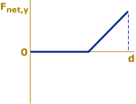
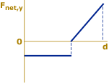
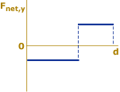
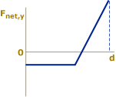
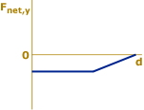
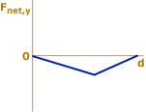
Assessing to Learn
A block is dropped onto a vertical spring. Which net force vs. distance graph best represents the net force on the block as a function of its distance traveled? Consider only the motion of the block from the time it is dropped until it first comes to rest.
1. 2. 3. 4. 5.
6. 7. 8. 9. 10. None of these
©Cengage
Notes:
Think about it, talk with each other, and we’ll all talk about it in a couple of minutes.
Answer: (4)
Question B2.09
Commentary
Purpose: To develop your understanding of forces and ability to reason with them, especially with the spring force.
Discussion:
Before the block hits the spring, the only force exerted on it is gravitation, acting downward. Taking “up” to be positive, the net force in the vertical direction is –mg.
When the block hits the spring, there are two forces exerted on the block: gravitation, down; and the spring force, acting upward. The gravitational force is the same as before, –mg. According to Hooke’s law, the spring force is proportional to the compression x of the spring, kx. It is positive, because it is pointed up.
Drawing the two forces separately and then adding them up to find the net force can be helpful. (see figure on next slide) The gravitational force is constant and negative, as shown by the orange horizontal line. The spring force is zero initially, and then increases linearly with compression once the block reaches the spring, as shown in green. The sum of these two forces gives answer (4) above.
Note that the block does not stop when the net force is equal to zero, that is, at the equilibrium point where kx = mg. This is when it starts to slow down. When the block stops, the net force is large and positive, causing the block to reverse direction and eventually rebound to its initial height above the spring.
Key Points:
The gravitational force is exerted at all times; do not ignore it once another force is exerted.
An object does not stop when the net force on it is zero. This is when the acceleration, not the velocity, is zero.
The minus sign in Hooke’s law indicates the spring force is in the opposite direction of the spring’s compression or extension, which may or may not be the negative direction in your coordinate system.
For Instructors Only
Students often don’t realize that the block continues to speed up after first touching the spring, only slowing down once it has passed the equilibrium point. In other words, students often think that an object starts to slow down the instant it first touches the spring. (And for a very stiff spring, this is not far from what really happens.)
Students might object to graph 4 because the maximum net force (when the block stops) is so much larger than the weight of the block. However, this is a general result for ideal springs: If the block is dropped from any height above the spring, even a very small height, the maximum spring force will be more than twice as large as the weight. The maximum net force will therefore be larger than the weight.
Students who choose a graph having a negative slope for the spring force might not understand what is meant by the minus sign in Hooke’s law. They should be encouraged to apply common sense, perhaps drawing a free-body diagram to help.
Graph 6 is the qualitative shape of a valid velocity vs. distance graph for the situation, and students who choose it might be confusing velocity with acceleration and/or force.
Note that the area under F_{net,y} vs. d is the total work done on the block. Since the block begins and ends at v = 0, its change in kinetic energy is zero, so the total area “under” the graph should be zero, that is, the total area below the d axis should be exactly equal to the total area above the d axis.
Source: UMass Assessing to Learning.

Slide 68
Assessing to Learn
©Cengage

Slide 69
Assessing to Learn
Two identical steel balls are released from rest from the same height and travel along tracks as shown and labeled below. Which ball reaches the end of its track first?
The ball on track A
The ball on track B
Neither; it’s a tie.
Not enough information
©Cengage
Notes:
Think about it yourself, then share ideas with a neighbor, and then share with the big group in 4 minutes.
Answer: The ball on track B
Question C2.01a
Commentary
Purpose: To develop strategic problem-solving skills and learn to choose the best principle for answering a question.
Discussion:
If the balls roll without slipping, energy losses due to friction are negligible, and both balls end up at the same speed at the end of the tracks. But this does not mean they get there at the same time.
It turns out that ball B, on the lower track, wins the race every time. Discussion of why this is the case is included with the commentary for the second question in this set.
For Instructors Only
This is the first of two related questions. The discussion has been kept minimal so that students will consider the next arrangement before being shown the detailed solution.
Many students expect the two balls to tie, intuitively reasoning that ball B travels farther but faster and these two aspects should “about cancel out.” Careless reasoning with conservation of energy may support this way of thinking. In other words, they recognize that the initial speeds are the same and that the final speeds are the same, and they incorrectly reason that the times must be the same too.
Most students ignore what is going on while ball B is going down into the “flat valley” and again while it is going back up again. They often reason, even after seeing a demonstration, that the flat part of the track is long enough so that the effect of the sloped regions is overcome. In other words, students expect ball B to fall behind on both slopes. The long straight section is key, in their minds, to the outcome.
Some people choose ball A because they think that ball B will get stuck in the valley due to frictional losses. If the balls roll without slipping, then both balls reach the end of the tracks. If desired with your own demo, you can roll ball B along its track (but not ball A!) to demonstrate that it does reach the end without getting stuck.
A popular answer is “Not enough information.” Students often think that if the horizontal section is very small, ball A wins; if the horizontal section is very long, ball B wins; and if the horizontal section is just right, the balls tie. Therefore, since students are not sure which category it is, the best answer must be “Not enough information."
Other students choose “Not enough information” simply because ball A travels the shorter distance but ball B travels faster.
Note that this is really a kinematics demo even though it is best done after conservation of energy has been covered. This is to help students sort through valid approaches and pick the one that fits the situation best.
If you can arrange it, this is an excellent question to do in conjunction with a demonstration. First pose the question, collect answers, and allow students to discuss and justify their responses while you maintain a “poker face” and don’t divulge the real result. Then, do the demonstration, and follow with more discussion and explanation from students. Do not offer any explanations of your own, and do not correct students’ explanations, even if many seem invalid or inadequate; note them for after the next question, when there will be a much stronger motivation to understand what is going on. In other words, use the next question to fully explore the reasoning needed to show that ball B wins the race every time, even if the horizontal section is taken away.
Source: UMass Assessing to Learning.

Slide 70
Assessing to Learn
Two identical steel balls are released from rest from the same height and travel along tracks as shown and labeled below. Which ball reaches the end of its track first?
The ball on track A wins by a large margin.
The ball on track A wins by a small margin.
It’s a tie.
The ball on track B wins by a small margin.
The ball on track B wins by a large margin.
Not enough information
©Cengage
Notes:
Work it out yourself, check with a neighbor and compare, and we’ll share around the room in about 4 minutes.
Answer: The ball on track B wins by a large margin.
Question C2.01b
Commentary
Purpose: To check your understanding of the physics underlying the previous question.
Discussion:
The only difference between this situation and the previous one is that here track B has no flat section between the two slopes. This does not matter: Even though the flat section has been removed, the result is the same, with ball B winning the race.
It turns out that this is a kinematics demonstration. Force and energy ideas are not as useful as motion ideas for understanding the outcome. In particular, by focusing on the horizontal motion of the balls, we can prove that ball B wins the race every time.
Imagine a graph of each ball’s horizontal velocity component v_{x} vs. time. Just before ball B starts down into the “V,” the two balls are moving with the same v_{x} and are side by side. As ball B rolls down into the valley, it is speeding up, which means its acceleration vector points down the slope. This vector has an x component to the right (i.e., positive) and a y component down (negative). Meanwhile a_{x} for ball A is zero.
Because a_{x} is positive for ball B, its v_{x} is increasing above that of ball A, reaching a maximum value at the bottom of the V. Then ball B immediately starts to go up the other side of the V. Even though it is slowing down, it is still traveling faster horizontally than ball A, because at the top of the V, ball B has the same v_{x} as ball A.
Thus, v_{x} for ball B is equal to or larger than that for ball A during its entire motion. Because the horizontal displacements are the same and v_{x} is on average larger for ball B, ball B must win the race. In fact, ball B will win by a large margin.
Note that many of these arguments are false if ball B slips while rolling or if it loses contact with the track. In other words, we are assuming that ball B rolls without slipping during its entire motion.
Key Points:
To analyze this situation, x-velocity and x-acceleration, not speed and energy, are the useful quantities to consider.
Don’t confuse speed, velocity, and the individual components of velocity.
Try to recognize the difference between “kind of” understanding the answer to a question and “really getting it.”
For Instructors Only
This is the second of two related questions. These questions can be answered using only kinematics and an intuitive understanding that ball B will speed up while rolling downhill. We have placed them later in the course, however, so they can serve to help students learn strategic problem-solving skills about selecting from among the various principles available to them. The questions are more meaningful when students can consider what they might (and might not) learn through energy arguments.
After discussing the previous question, students often believe that ball B somehow makes up for the fact that it travels a longer distance by going faster on the straightaway between the two slopes. In essence, they either ignore the sloped parts of the previous tracks, or they decide that the effect is negligible. This question forces students to confront what is happening on the slopes.
Some students try to second-guess the instructor here, perhaps reasoning that the outcome must be different than the previous demo, otherwise, why would the instructor show it to them.
You might need to point out that the ball rolls without slipping during its entire motion. It turns out that this is a fairly restrictive constraint on the shape of track B.
Students often disregard any outcome with ball B winning, because they are using invalid reasoning. They take the extreme case of an infinitely deep V, recognizing that ball B loses, and conclude that ball B loses in every case. The mistake is that because the ball rolls without slipping, it is inappropriate to compare a deep V with this situation. Ball B would literally fly off the track and hit the other side of the V, completely nullifying any comparison.
Even those students who accept the idea that v_{x} is increasing along the downhill sometimes have trouble with the idea that ball B continues to pull ahead of ball A along the uphill part of the V. They simply cannot understand how something can be “slowing down” yet still “pull ahead.” Instead, they think that ball B pulls ahead of ball A during the downhill, and then, perhaps because the “motion is reversed,” ball A catches up as ball B travels on the uphill, with the balls ending up in a tie.
Some students might choose that ball B wins by a small margin. For most, it is a very small margin.
It is likely that no students will select choice (5). They simply cannot believe that ball B can win by a large margin.
As with the previous item, a demonstration is recommended. The outcome is truly sensational, with ball B winning by a large margin.
Source: UMass Assessing to Learning.

Slide 71
TOPIC summary
Topic 5: Energy
©Cengage

Slide 72
Topic Summary
Work
Kinetic Energy
The Work–Energy Theorem
©Cengage
Notes:
Work
The work done on an object by a constant force is given in the equation shown, where F is the magnitude of the force, d is the magnitude of the object’s displacement, and θ is the angle between the direction of the force F and the displacement Δx, as you can see in the figure. Solving simple problems requires substituting values into this equation. More complex problems, such as those involving friction, often require using Newton’s second law to determine forces.
Kinetic Energy and the Work–Energy Theorem
The kinetic energy of a body with mass m and speed v is given by the equation shown.
The work–energy theorem states that the net work done on an object of mass m is equal to the change in its kinetic energy. Work and energy of any kind carry units of joules.
Solving problems involves finding the work done by each force acting on the object and summing them up, which is W_{net}, followed by substituting known quantities into the work-energy theorem, solving for the unknown quantity.
Conservative forces are special: work done against them can be recovered—it’s conserved. An example is gravity: the work done in lifting an object through a height is effectively stored in the gravity field and can be recovered in the kinetic energy of the object simply by letting it fall.
Nonconservative forces, such as surface friction and drag, dissipate energy in a form that can’t be readily recovered. To account for such forces, the work–energy theorem can be rewritten as shown, where W_{nc} is the work done by nonconservative forces and W_{c} is the work done by conservative forces.

Slide 73
Topic Summary
Gravitational Potential Energy, Gravity, and Nonconservative Forces
©Cengage
Notes:
Gravitational Potential Energy, Gravity, and Nonconservative Forces
The gravitational force is a conservative field. Gravitational potential energy is another way of accounting for gravitational work W_{g}.
To find the change in gravitational potential energy as an object of mass m moves between two points in a gravitational field, substitute the values of the object’s y-coordinates.
The work–energy theorem can be generalized to include gravitational potential energy. Gravitational work and gravitational potential energy should not both appear in the work–energy theorem at the same time, only one or the other, because they’re equivalent.
Setting the work due to nonconservative forces to zero and substituting the expressions for KE and PE, a form of the conservation of mechanical energy with gravitation can be obtained, as shown. To solve problems with this equation, identify two points in the system—one where information is known and the other where information is desired. Substitute and solve for the unknown quantity.

Slide 74
Topic Summary
Spring Potential Energy
©Cengage
Notes:
Spring Potential Energy
The spring force is conservative, and its potential energy is given by the equation shown here.
Spring potential energy can be put into the work–energy theorem. When nonconservative forces are absent, W_{nc} = 0 and mechanical energy is conserved.

Slide 75
Topic Summary
Systems and Energy Conservation
Power
©Cengage
Notes:
Systems and Energy Conservation
The principle of the conservation of energy states that energy can’t be created or destroyed. It can be transformed, but the total energy content of any isolated system is always constant. The same is true for the universe at large. The work done by all nonconservative forces acting on a system equals the change in the total mechanical energy of the system, where PE represents all potential energies present.
Power
Average power is the amount of energy transferred divided by the time taken for the transfer.
This expression can also be written as shown, where v with a bar over it is the object’s average velocity and F is constant and parallel to v.
The instantaneous power is given by the last equation, where F must be parallel to the velocity v, and both quantities can change with time.
The unit of power is the watt (W = J/s).
To solve simple problems, substitute given quantities into one of these equations. More difficult problems usually require finding the work done on the object using the work–energy theorem or the definition of work.

