Slide 1
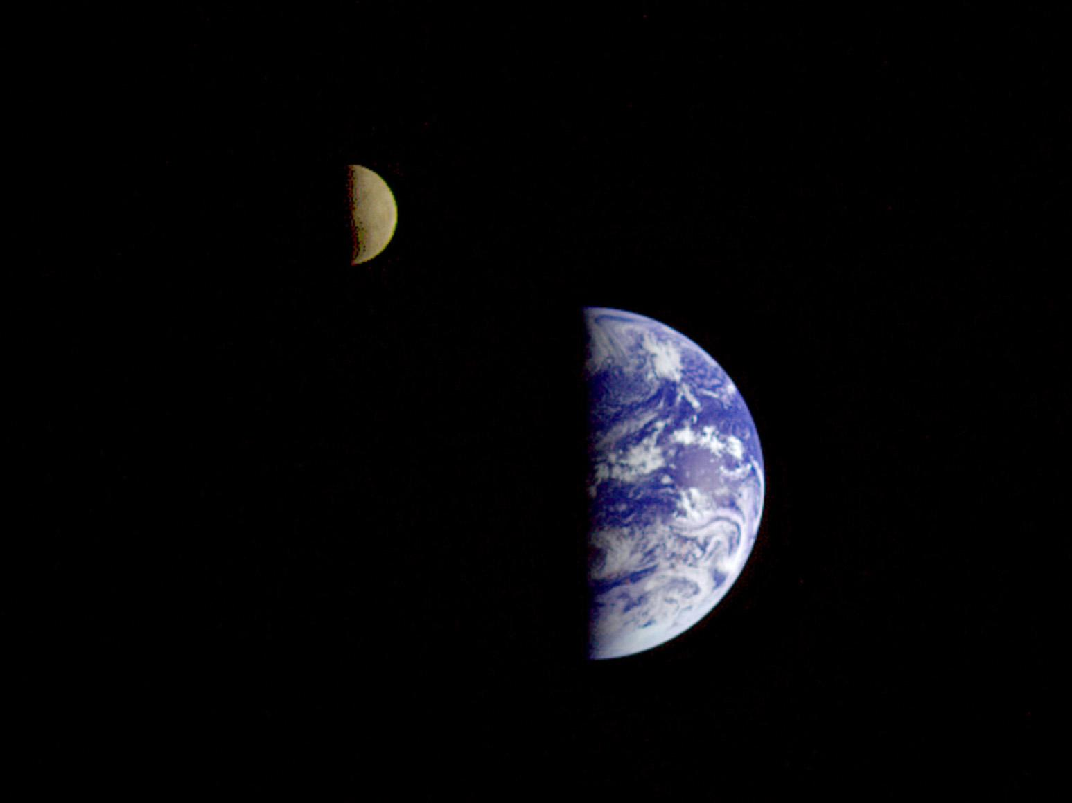

Topic 7: Rotational Motion and Gravitation
College Physics, 11e
Raymond A. Serway; Chris Vuille
Notes:
Image credit:
https://commons.wikimedia.org/wiki/File%3AEarth_and_Moon_.jpg
By Nasa.gov http://www.nasa.gov/topics/earth/earthday/earthday_gallery.html [Public domain], via Wikimedia Commons

Slide 2
Reading Question 1-1
A rigid object is rotating with an angular speed ω > 0. The angular velocity vector w and the angular acceleration vector a are anti-parallel. The angular speed of the rigid object is
clockwise and increasing.
clockwise and decreasing.
counterclockwise and increasing.
counterclockwise and decreasing.

Slide 3
Reading Question 1-1
A rigid object is rotating with an angular speed ω > 0. The angular velocity vector w and the angular acceleration vector a are anti-parallel. The angular speed of the rigid object is
clockwise and increasing.
clockwise and decreasing.
counterclockwise and increasing.
counterclockwise and decreasing.

Slide 4
Reading Question 1-2
The Earth remains in orbit about the Sun, rather than falling in to the Sun, because
it is outside of the gravitational influence of the Sun.
the net force on the Earth is zero.
although the Earth is constantly being pulled toward the Sun, it is always moving with a velocity component perpendicular to the direction that it is being pulled.
none of these apply.

Slide 5
Reading Question 1-2
The Earth remains in orbit about the Sun, rather than falling in to the Sun, because
it is outside of the gravitational influence of the Sun.
the net force on the Earth is zero.
although the Earth is constantly being pulled toward the Sun, it is always moving with a velocity component perpendicular to the direction that it is being pulled.
none of these apply.

Slide 6
Reading Question 1-3
A space station orbits the Earth with constant speed. What can be said about the space station's acceleration?
It is zero because the space station moves with constant speed.
It is greater than 9.8 m/s² because the space station is moving so quickly.
It is less than 9.8 m/s² because the space station is so high above the Earth’s surface.
It is equal to 9.8 m/s².

Slide 7
Reading Question 1-3
A space station orbits the Earth with constant speed. What can be said about the space station's acceleration?
It is zero because the space station moves with constant speed.
It is greater than 9.8 m/s² because the space station is moving so quickly.
It is less than 9.8 m/s² because the space station is so high above the Earth’s surface.
It is equal to 9.8 m/s².

Slide 8
Reading Question 1-4
Select the best phrase to complete the following statement: "The gravitational force of the Earth
affects all objects equally."
on an object is a function of an object's mass."
has no effect on the rate at which objects accelerate as they fall."
is exactly the same size for a given object everywhere on the Earth."

Slide 9
Reading Question 1-4
Select the best phrase to complete the following statement: "The gravitational force of the Earth
affects all objects equally."
on an object is a function of an object's mass."
has no effect on the rate at which objects accelerate as they fall."
is exactly the same size for a given object everywhere on the Earth."

Slide 10
Reading Question 1-5
Which of the following forms of energy is the greatest for a system of a comet in orbit about the Sun during perihelion (the comet's closest approach to the Sun).
the total mechanical energy
the potential energy
the kinetic energy
none of these

Slide 11
Reading Question 1-5
Which of the following forms of energy is the greatest for a system of a comet in orbit about the Sun during perihelion (the comet's closest approach to the Sun).
the total mechanical energy
the potential energy
the kinetic energy
none of these

Slide 12
Reading Question 1-6
Which of the following trips would consume more fuel for a given spacecraft?
a trip from the Earth to the Moon
a trip from the Moon to the Earth
They both require the same amount of fuel.
It is impossible to determine.

Slide 13
Reading Question 1-6
Which of the following trips would consume more fuel for a given spacecraft?
a trip from the Earth to the Moon
a trip from the Moon to the Earth
They both require the same amount of fuel.
It is impossible to determine.

Slide 14
TOPIC Discussion
Topic 7: Rotational Motion and Gravitation
Notes:
We experience rotational motion every day—the Earth’s rotation creates the cycles of day and night, rotating wheels make it easier to get around, gears in a Swiss watch rotate. The concepts of angular velocity, angular acceleration, and centripetal acceleration are important to our understanding the motions of a car moving around a circular racetrack or clusters of galaxies orbiting a common center. In this topic we will explore rotational motion for objects, from bicycle wheels to orbiting planets.

Slide 15
Angular Velocity and
Angular Acceleration
Notes:
When we studied linear motion, we needed to understand the concepts of displacement Δx, velocity v, and acceleration a. Each of these has its analog in rotational motion: angular displacement Δθ, angular velocity ω, and angular acceleration α.
First, let’s look at some fundamental ideas. [click to show equation] You know that the distance s around a circle is given by 2πr, where r is the radius of the circle. Dividing both sides by r results in the expression shown. Notice that this is a dimensionless quantity, since s and r have dimensions of length.
[click to show equations] 2π corresponds to 360°, π to 180°, and π/2 to 90°. Let’s introduce a new unit of angle measurement, the radian, [click to show equation] where 180° = π rad.

Slide 16
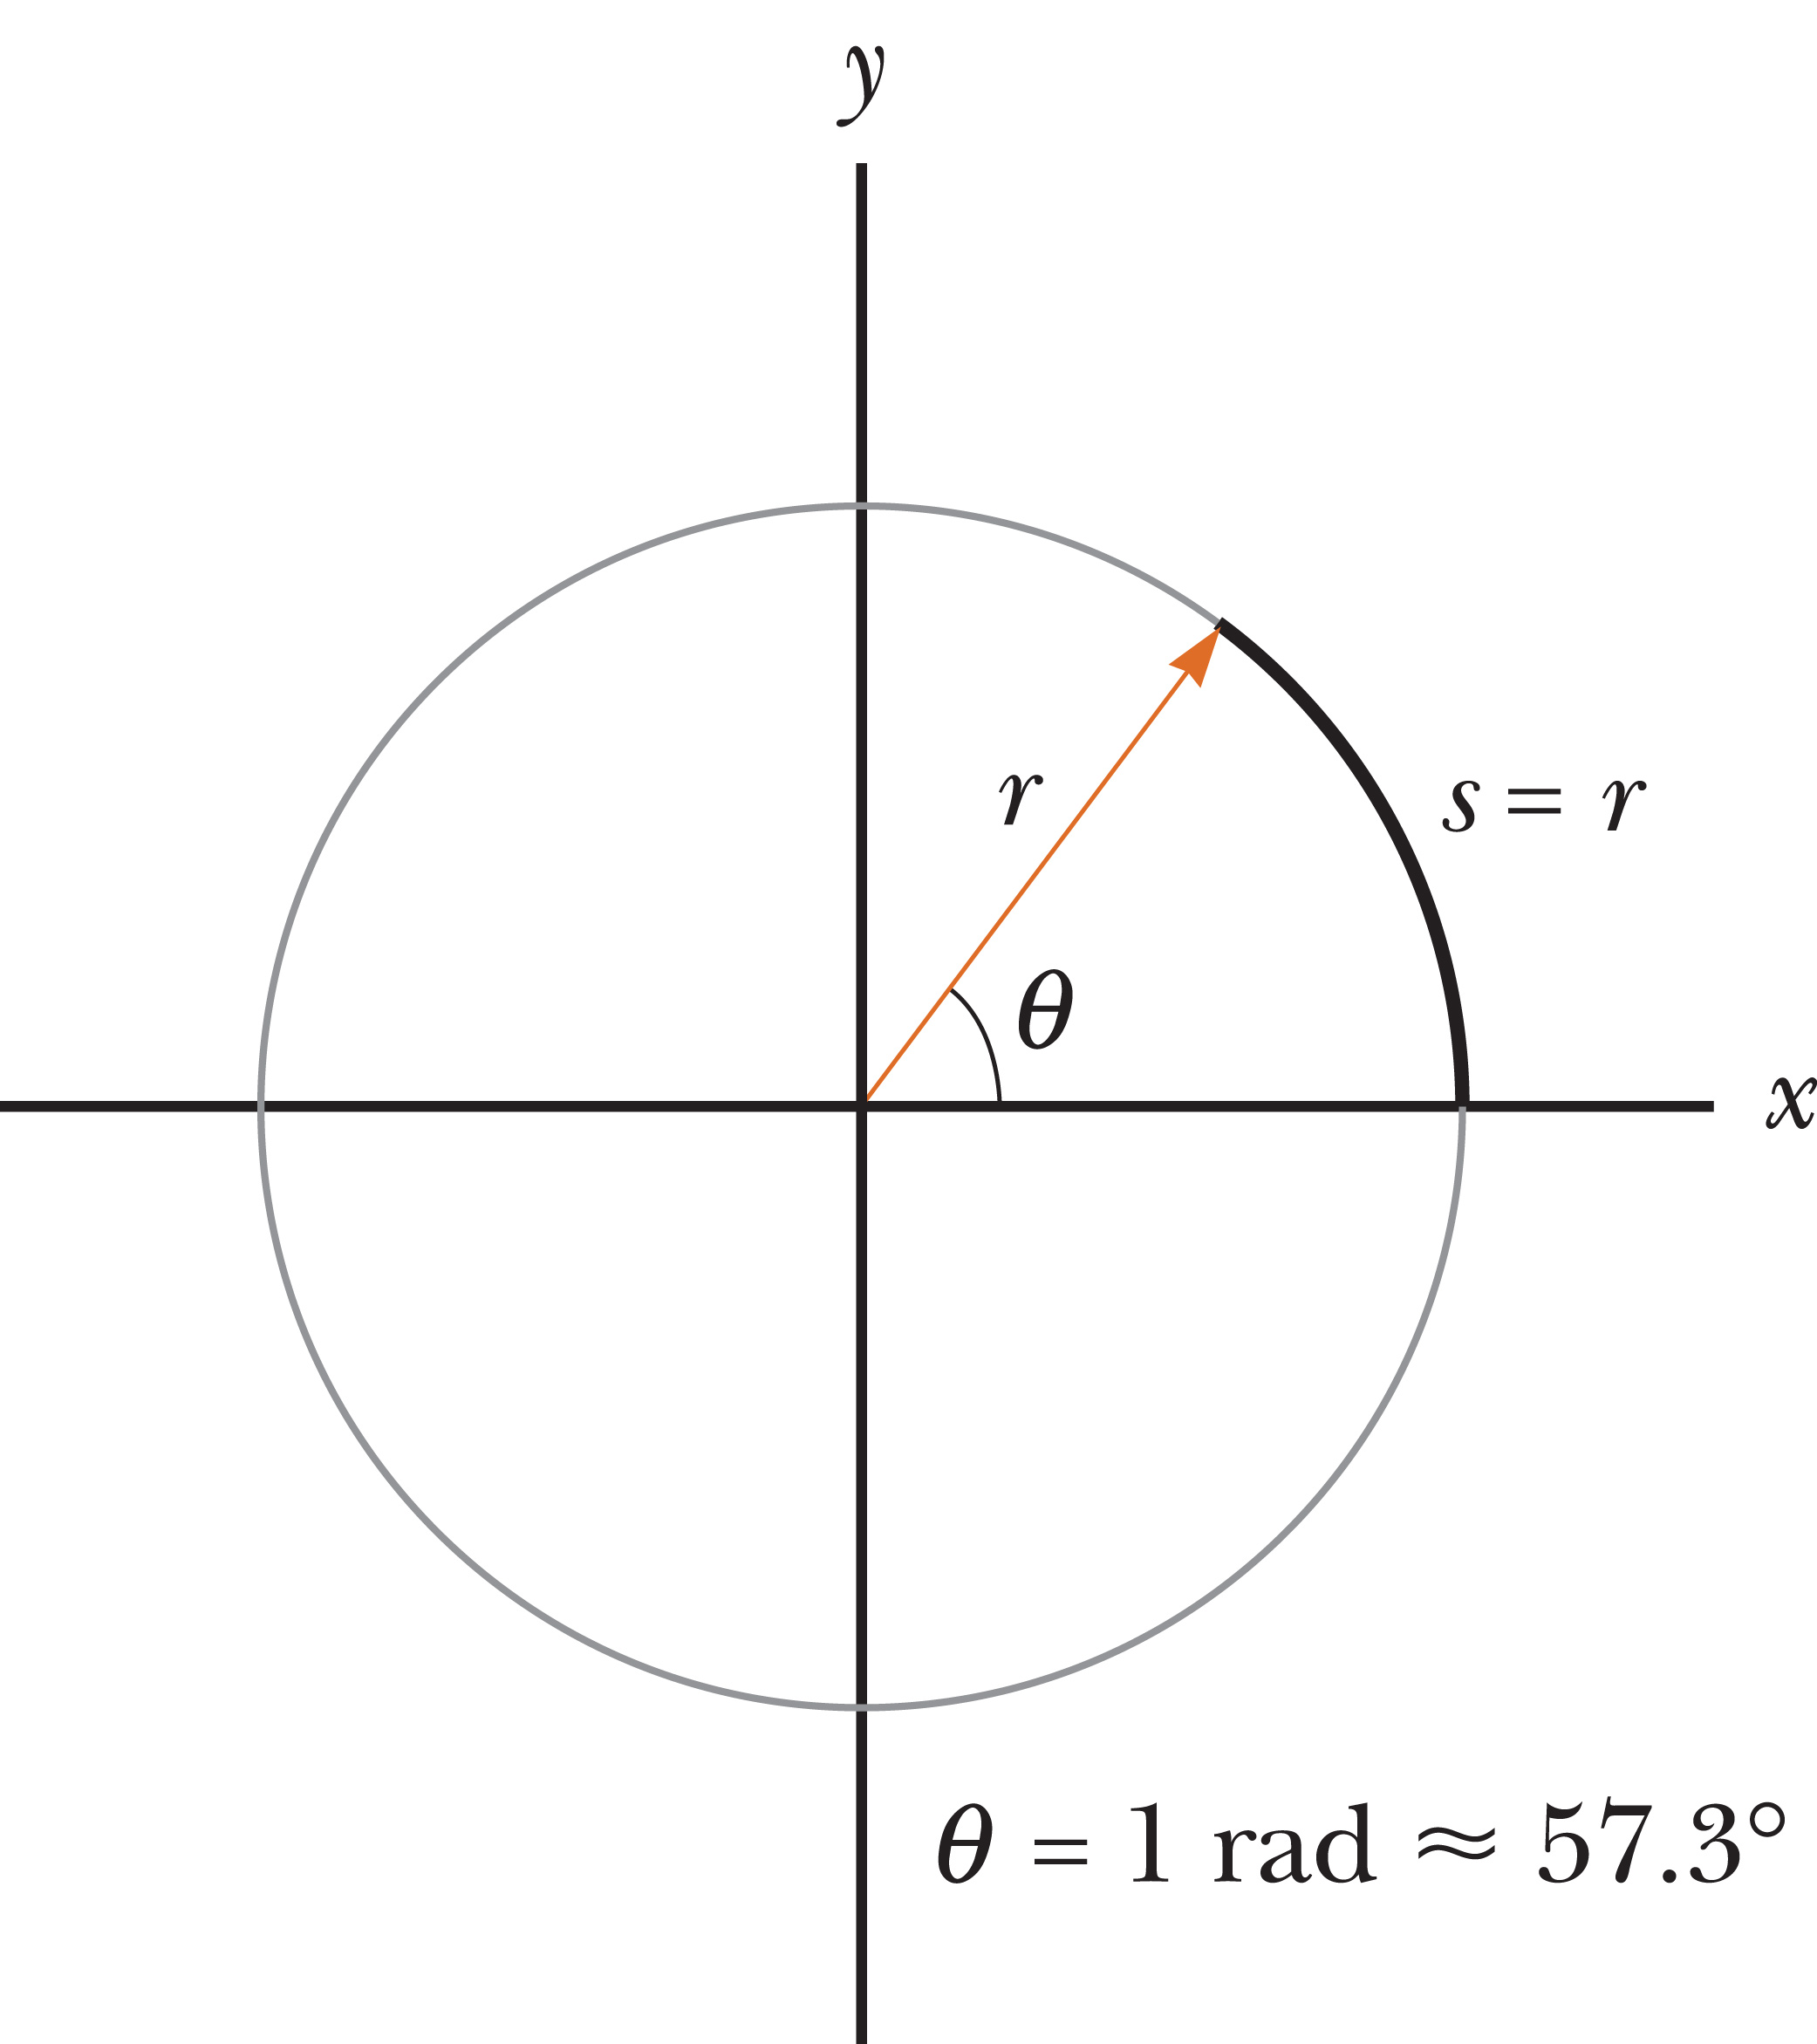
Angular Velocity and
Angular Acceleration
Notes:
Take a look at the circle. The angle θ subtended by an arc length s along a circle of radius r, measured in radians counterclockwise from the positive x-axis, is shown. The angle θ is an angular displacement from the positive x-axis, and s the corresponding displacement along the circular arc, also measured from the positive x-axis. The angle shown in the figure illustrates the size of 1 radian, which is approximately 57°.
Converting from degrees to radians requires multiplying by the ratio π rad over 180°. Take a look at the example. [click to show equation] 45° is π over 4 radians.
Generally, angular quantities in physics must be expressed in radians. Be sure to set your calculator to radian mode!

Slide 17
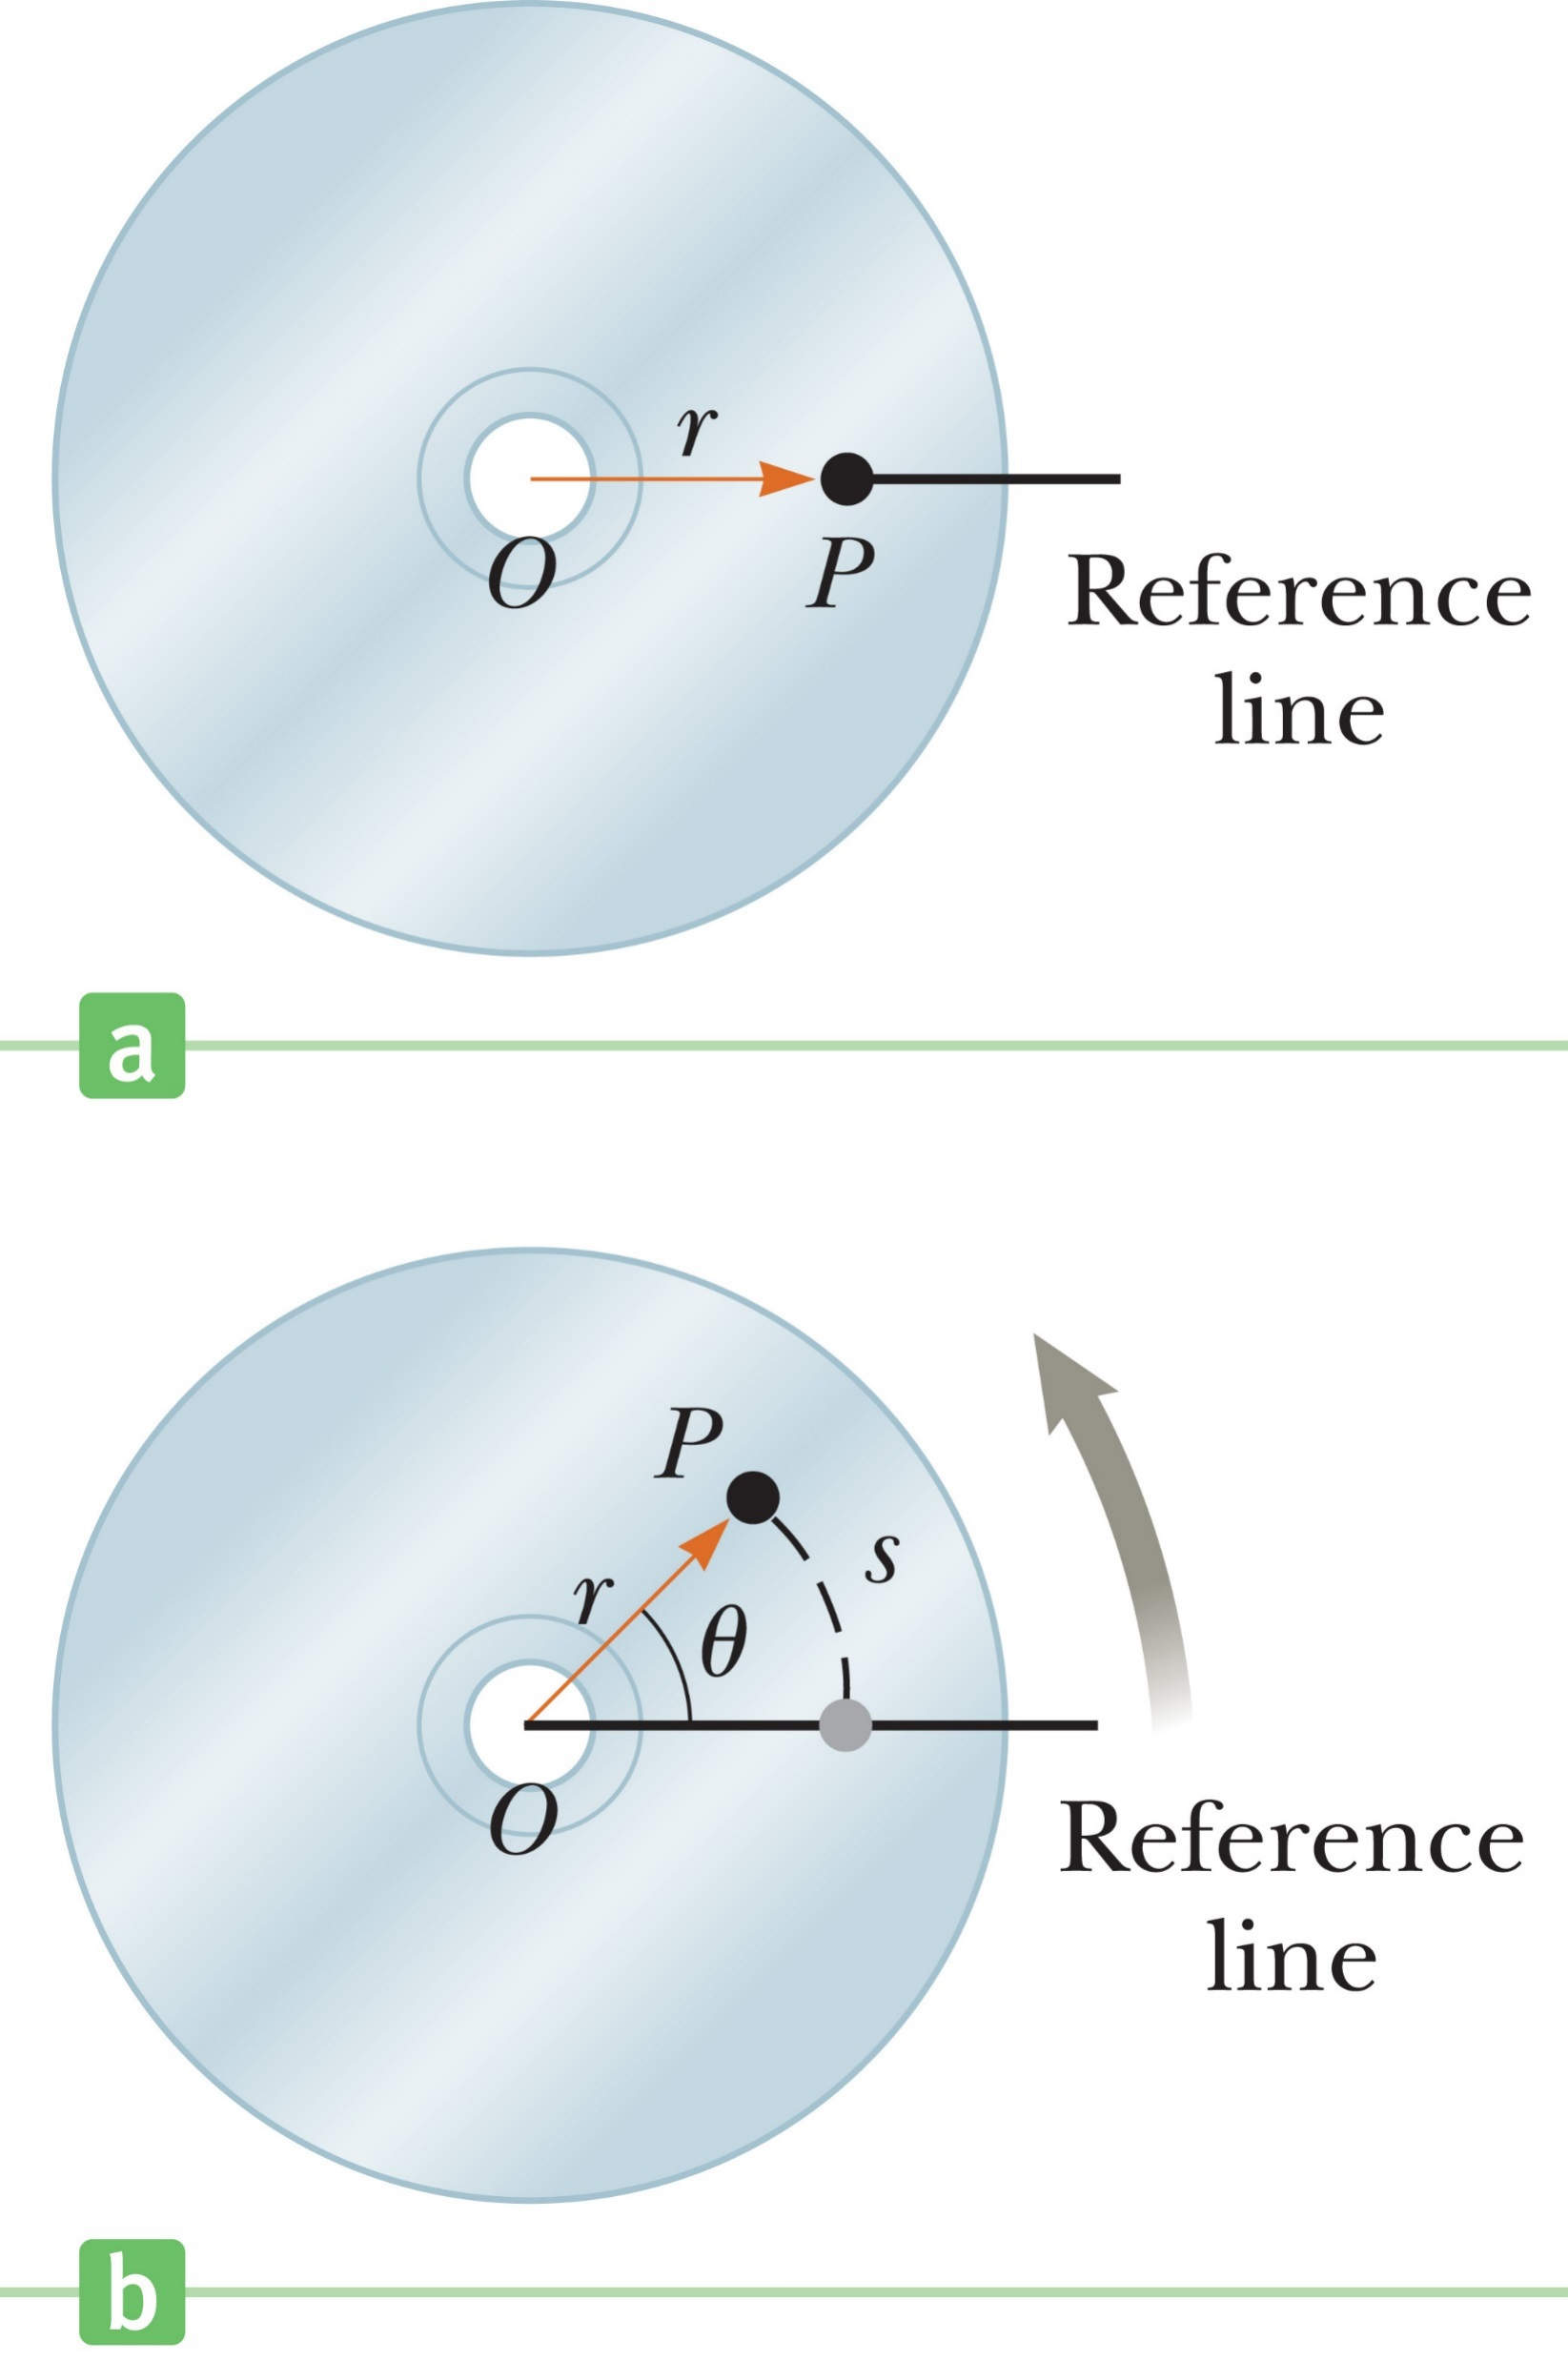
Angular Velocity and
Angular Acceleration
Notes:
The figures show a top view of a rotating compact disc. This is an example of a “rigid body,” where each part of the body is fixed in position relative to all other parts of the body. When a rigid body rotates through a given angle, all parts of the body rotate through the same angle at the same time.
Look at the figure on the left. For the compact disc, the axis of rotation is at the center of the disc, O. A point P on the disc is at a distance r from the origin and moves about O in a circle of radius r. Now, we set up a fixed reference line, and assume that at time t = 0 the point P is on that reference line.
After a time interval Δt, the point P has advanced to a new position, as shown in the figure on the right. In this time interval, the line OP has moved through the angle θ with respect to the reference line. The angle θ is measured in radians, and is called the angular position. It is analogous to the linear position variable x.
Notice also that point P has moved an arc length s measured along the circumference of the circle.

Slide 18
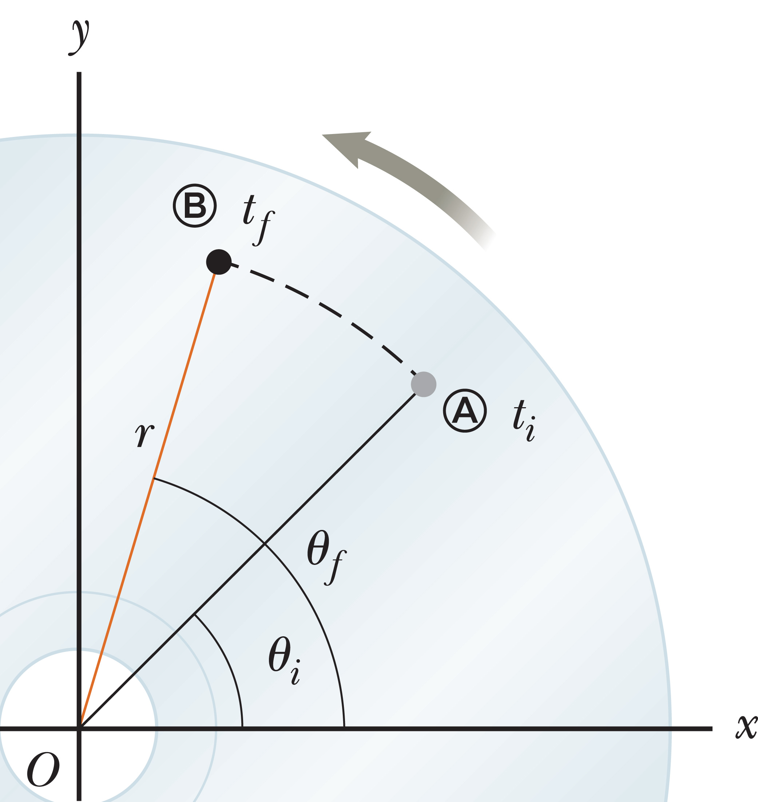
Angular Velocity and
Angular Acceleration
Notes:
In this figure, as a point on the rotating disc moves from Ⓐ to Ⓑ in a time Δt, it starts at an angle θ_{i} and ends at an angle θ_{f}. The difference θ_{f} – θ_{i} is called the angular displacement. An object’s angular displacement, Δθ, is the difference in its final and initial angles.
Let’s work a quick example. [click to show equations] If a point on a disc is at θ_{i} = 4 rad and rotates to angular position θ_{f} = 7 rad, the angular displacement is Δθ = 3 rad.
We use angular variables to describe the rotating disc because each point on the disc undergoes the same angular displacement in any given time interval.

Slide 19
Angular Velocity and
Angular Acceleration
Notes:
So we can rewrite our equation for θ like this, where Δs is a displacement along the circular arc subtended by the angular displacement.
Now we are ready to define an angular velocity. [click to show equation]
For very short time intervals, the average angular velocity approaches the instantaneous angular velocity, just as in the linear case. The instantaneous angular velocity [click to show equation] of a rotating rigid object is the limit of the average velocity as the time interval Δt approaches zero.
We take ω to be positive when θ is increasing (counterclockwise motion) and negative when θ is decreasing (clockwise motion). When the angular velocity is constant, the instantaneous angular velocity is equal to the average angular velocity.
The instantaneous angular speed of an object is defined as the magnitude of the instantaneous angular velocity. Instantaneous angular speed, or “angular speed” has no direction associated with it and carries no algebraic sign.
For example, if one object is rotating counterclockwise with an angular velocity of +5.0 rad/s and another object is rotating clockwise with an angular velocity of –5.0 rad/s, both have an angular speed of 5.0 rad/s.

Slide 20

Think – Pair – Share
A rigid body is rotating counterclockwise about a fixed axis. Each of the following pairs of quantities represents an initial angular position and a final angular position of the rigid body. Which of the sets can only occur if the rigid body rotates through more than 180°?
3 rad, 6 rad
–1 rad, 1 rad
1 rad, 5 rad
Notes:
Do some quick calculations, then check with a neighbor. Let’s talk in two minutes.
Answer: 1 rad, 5 rad
Reasoning: For a rotation of more than 180°, the angular displacement must be larger than π = 3.14 rad. The angular displacements in the three choices are (a) 6 rad –3 rad = 3 rad, (b) 1 rad – (–1 rad) = 2 rad, and (c) 5 rad –1 rad = 4 rad.

Slide 21
Think – Pair – Share
A rigid body rotates counterclockwise about a fixed axis for exactly one second. Each of the following pairs of quantities represents an initial angular position and a final angular position of the rigid body. Which choice represents the lowest angular speed?
3 rad, 6 rad
–1 rad, 1 rad
1 rad, 5 rad
Notes:
Get your answer, and compare with a classmate, then let’s see what you’ve come up with in a few minutes.
Answer: –1 rad, 1 rad
Reasoning: Because all angular displacements occurred in the same time interval, the displacement with the lowest value will be associated with the lowest average angular speed.

Slide 22
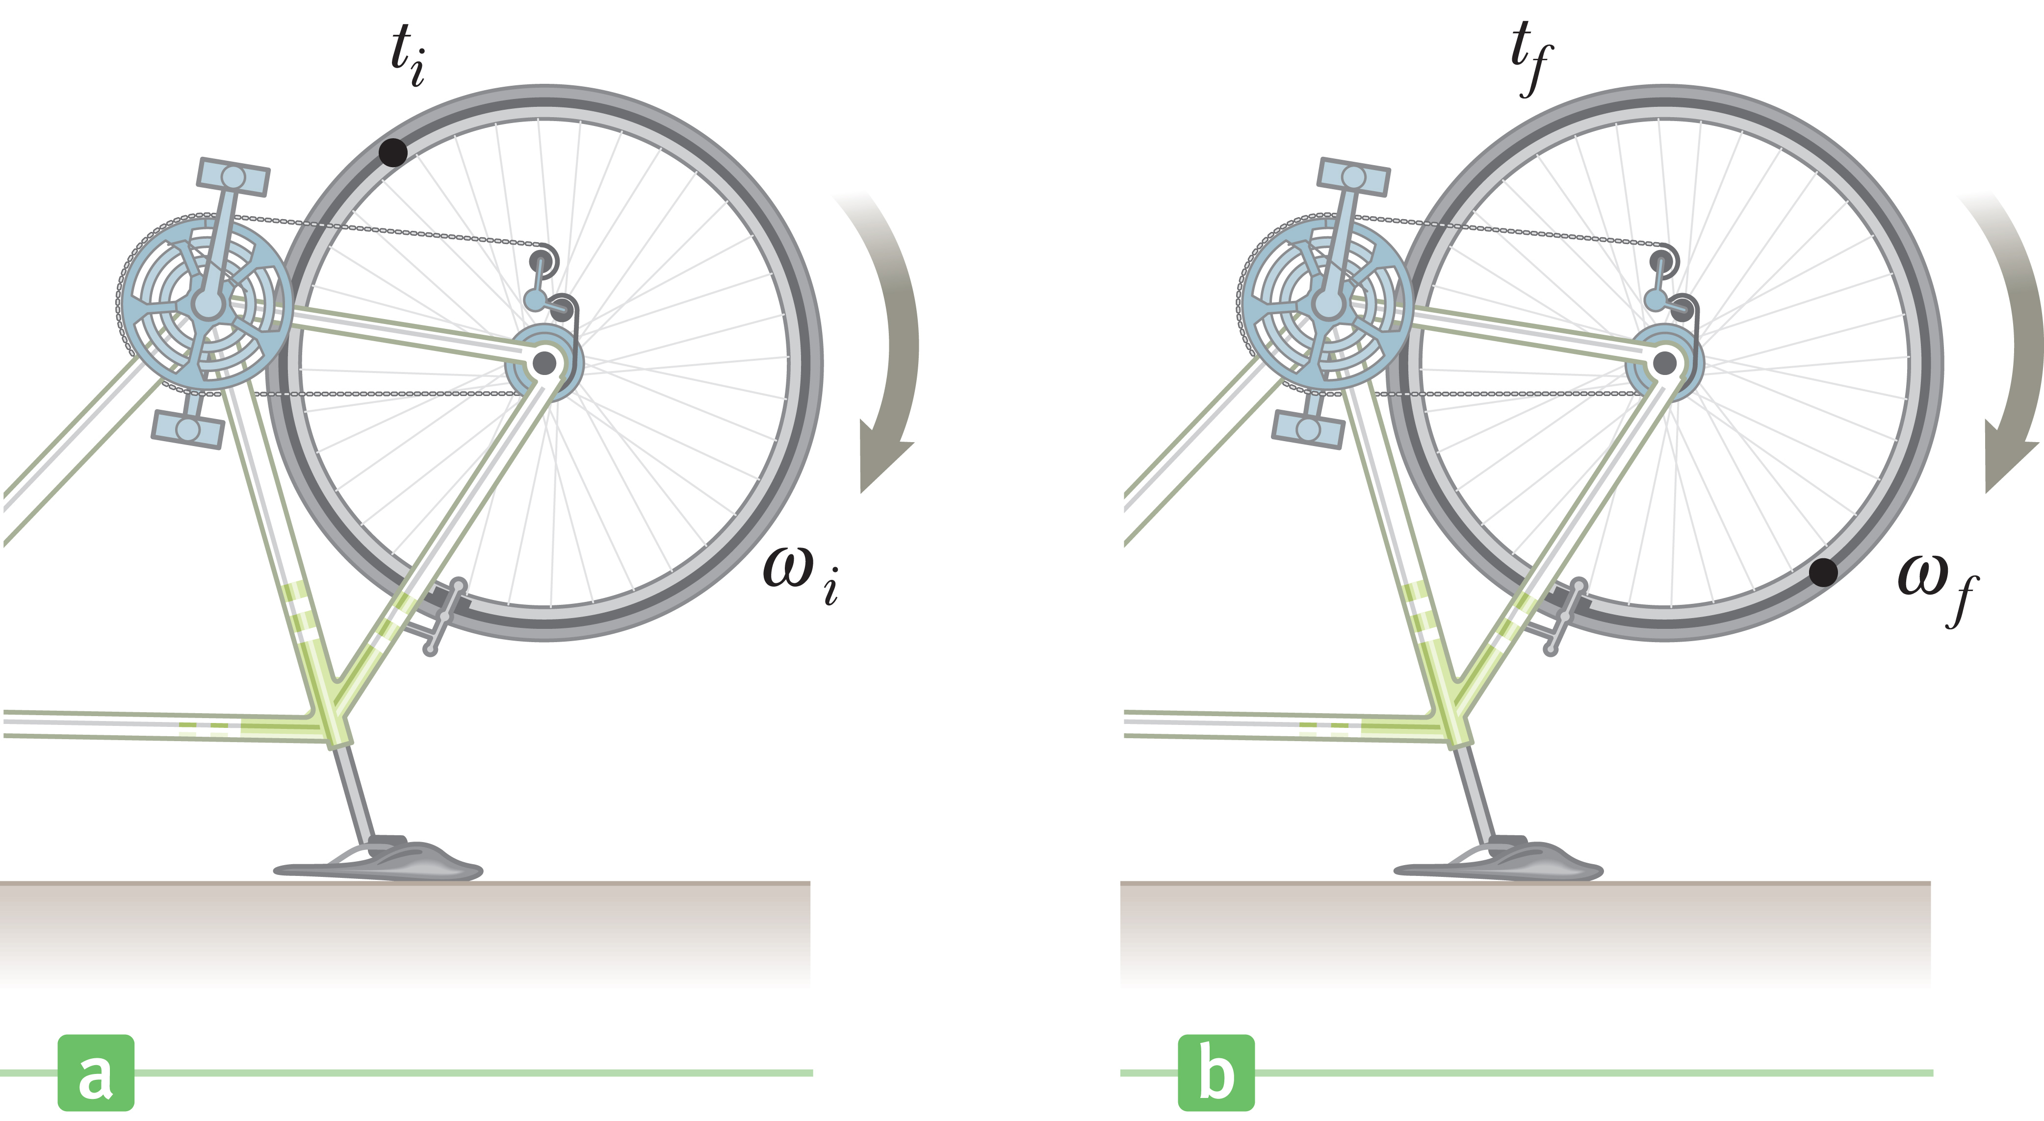
Angular Velocity and
Angular Acceleration
Notes:
The figure shows a bicycle turned upside down so that a repair technician can work on the rear wheel. The bicycle pedals are turned so that at time t_{i} the wheel has angular velocity ω_{i} , the figure on the left, and at a later time t_{f} it has angular velocity ω_{f} , the figure on the right.
A changing angular velocity leads to the concept of an angular acceleration. [click to show equation] An object’s average angular acceleration during the time interval Δt is the change in its angular velocity divided by Δt.
Positive angular accelerations are in the counterclockwise direction, and negative angular accelerations in the clockwise direction.

Slide 23
Angular Velocity and
Angular Acceleration
Notes:
Let’s use our definition to solve a problem. If the angular velocity goes from 15 rad/s to 9.0 rad/s in 3.0 s, the average angular acceleration during that time interval is –2.0 rad/s².
The negative sign indicates that the angular acceleration is clockwise, although notice that the angular velocity is still positive but slowing down, and is in the counterclockwise direction.

Slide 24
Angular Velocity and
Angular Acceleration
When a rigid object rotates about a fixed axis, every portion of the object has the same angular velocity and the same angular acceleration.
Notes:
There is also an instantaneous version of angular acceleration: The instantaneous angular acceleration is the limit of the average angular acceleration over Δt as the time interval approaches zero.
When a rigid object rotates about a fixed axis, every portion of the object has the same angular velocity and the same angular acceleration.

Slide 25
Rotational Motion under
Constant Acceleration
Notes:
Let’s compare the defining equation for the average angular velocity with that of the average linear velocity. In these equations, ω takes the place of v and θ takes the place of x, so the equations differ only in the names of the variables. Every linear quantity we have encountered so far has a corresponding “twin” in rotational motion, so we can write equations of rotational kinematics.
The table shows both the linear and angular versions.

Slide 26
Think – Pair – Share
A rigid body is rotating counterclockwise about a fixed axis. Each of the following pairs of quantities represents an initial angular position and a final angular position of the rigid body. If the object starts from rest at the initial angular position, moves counterclockwise with constant angular acceleration, and arrives at the final angular position with the same angular speed in all three cases, for which choice is the angular acceleration the highest?
3 rad, 6 rad
–1 rad, 1 rad
1 rad, 5 rad
Notes:
Figure out the answer, check with a classmate, and let's talk in a minute or two.
Answer: –1 rad, 1 rad
Reasoning: From α = ω²/2Δα it is seen that the case with the smallest angular displacement involves the highest angular acceleration.

Slide 27
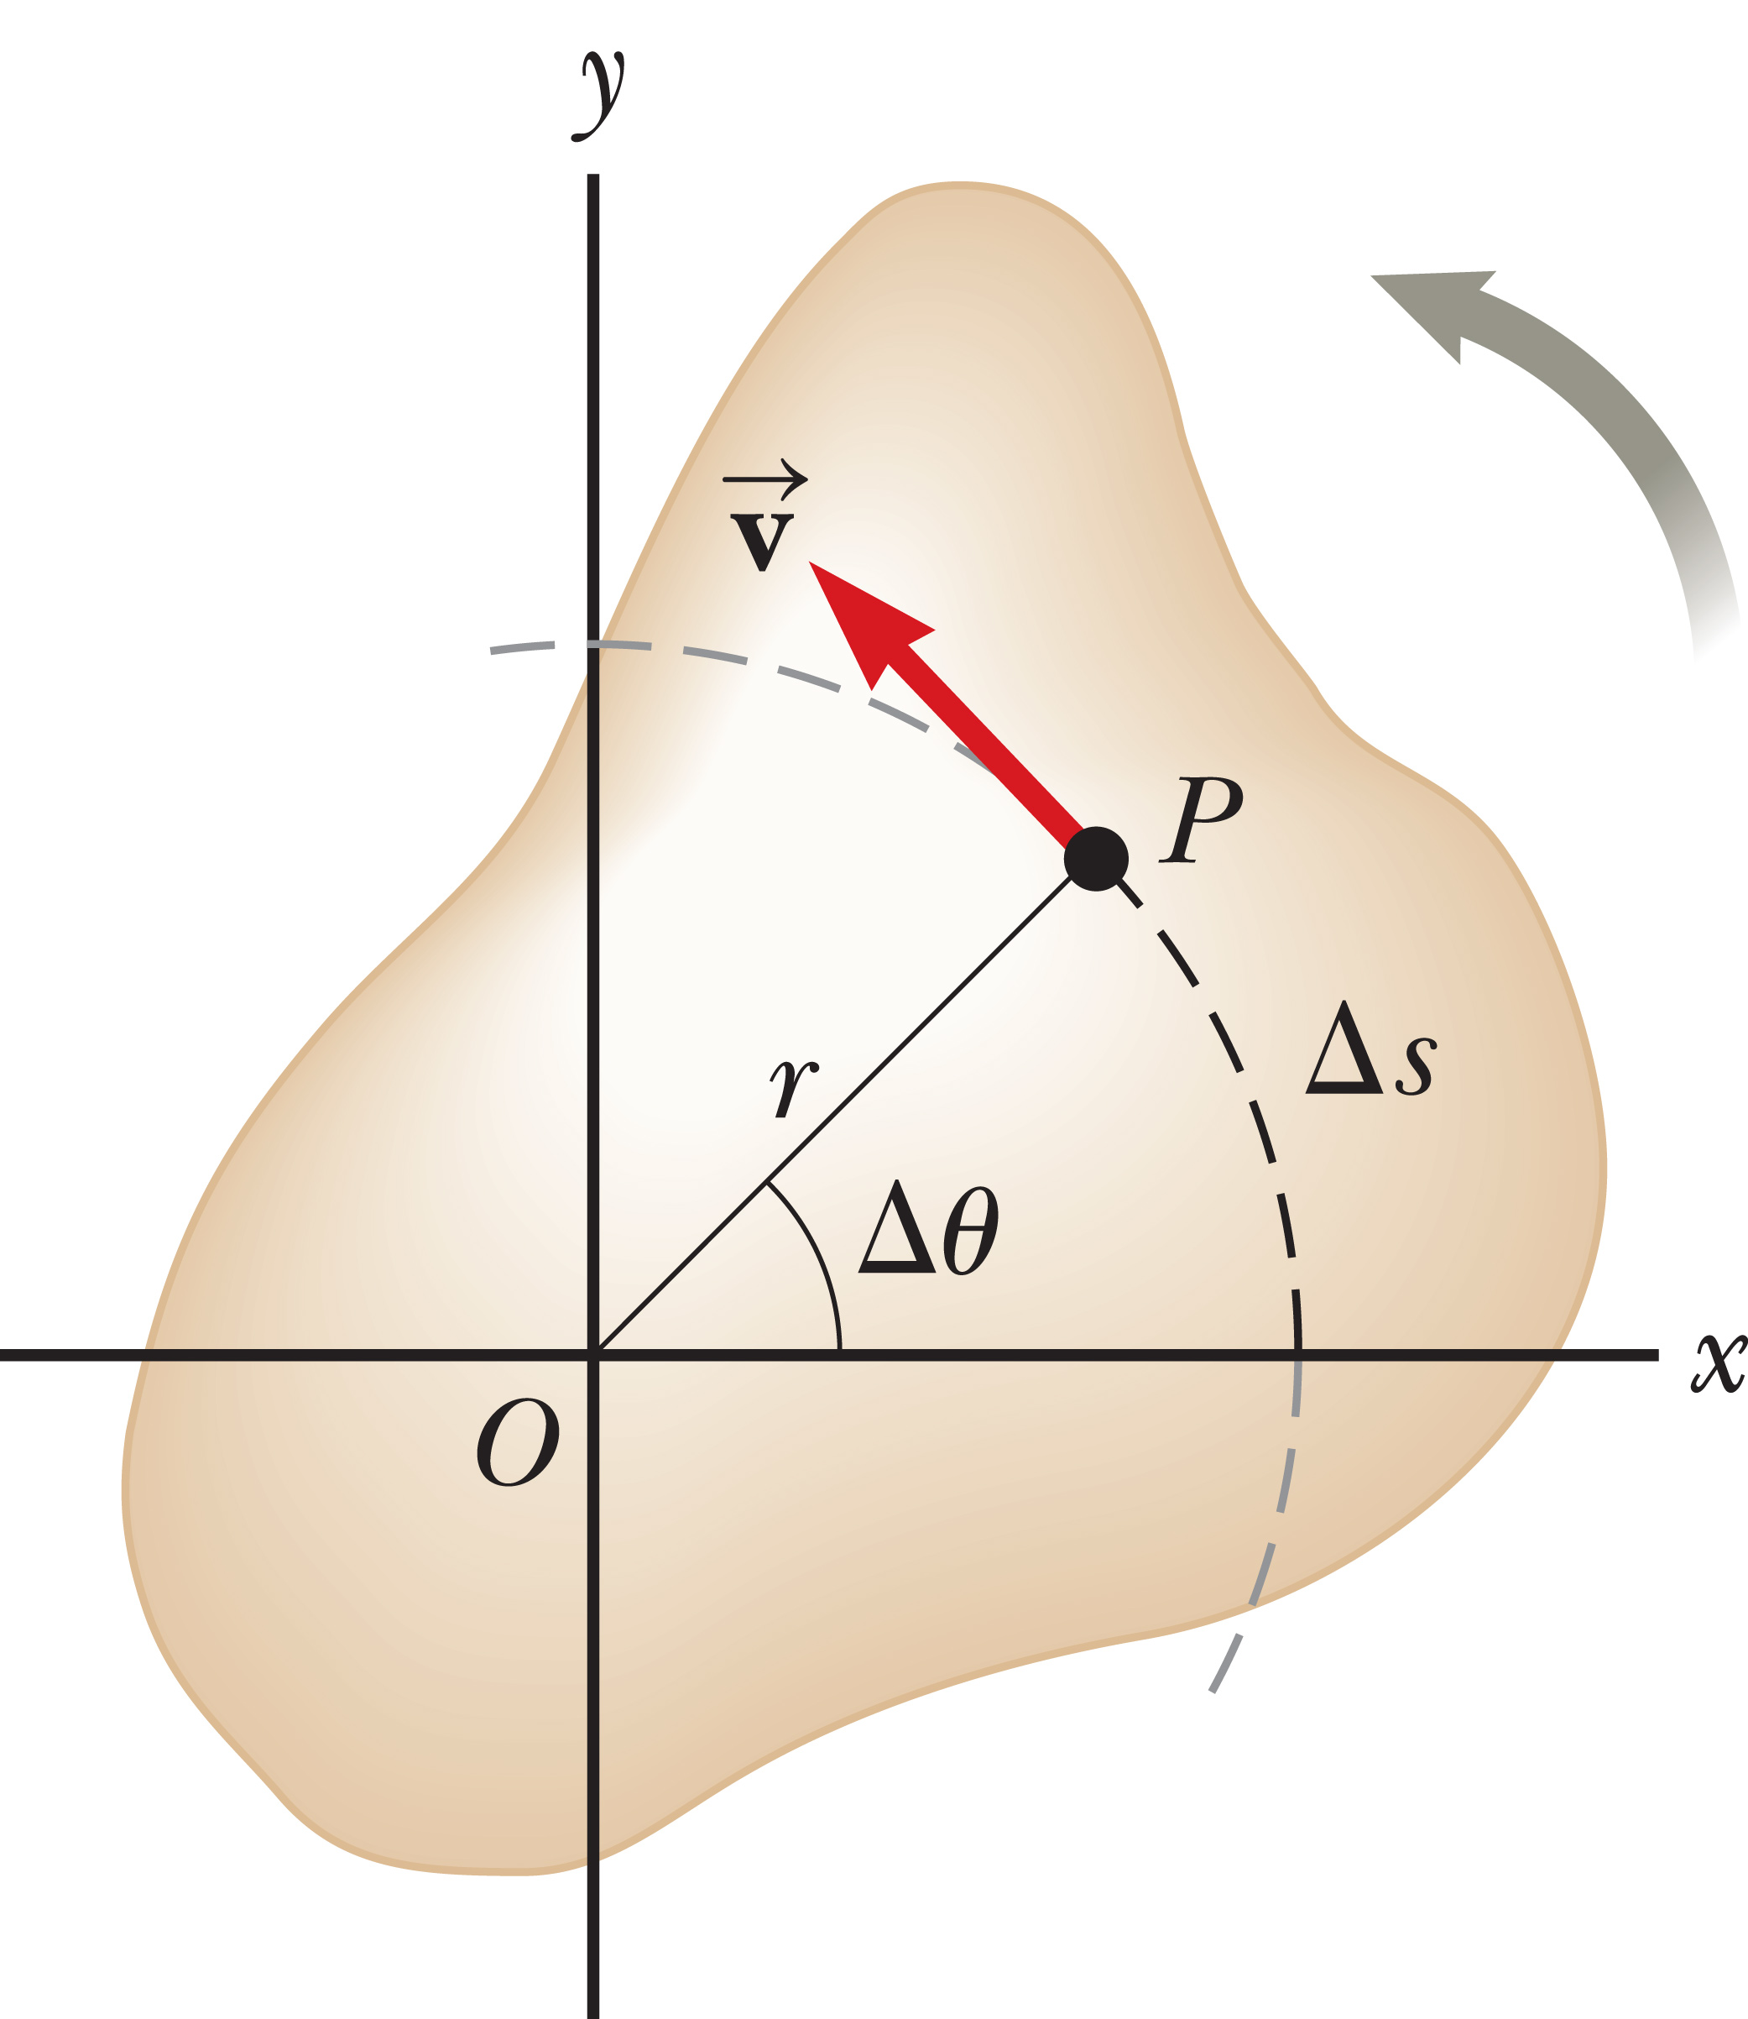
Tangential Velocity and Acceleration
Notes:
Take a look at the arbitrarily shaped object rotating about the z-axis through the point O. The z-axis is pointing out of the slide. Let’s assume the object rotates through the angle Δθ, and so point P moves through the arc length Δs, in the interval Δt. We can write the relationship shown.
Let’s divide both sides of this equation by Δt, [click to show equation] the time interval during which the rotation occurs.
When Δt is very small, the angle Δθ is also small and the ratio Δθ over Δt is close to the instantaneous angular velocity ω. On the other side of the equation, the ratio Δs over Δt approaches the instantaneous linear speed v for small values of Δt. This means that when Δt gets arbitrarily small, we get [click to show equation] this relationship.

Slide 28
Tangential Velocity and Acceleration
Tangential velocity equals distance from the axis of rotation times the angular velocity.
Notes:
As we just discussed, in the figure, the point P traverses a distance Δs along a circular arc during the time interval Δt at a linear speed of v. The direction of P’s velocity vector v is tangent to the circular path. The angular component of v is ω = vt, which is called the tangential velocity of a particle moving in a circular path, written as shown.
The tangential velocity of a point on a rotating object equals the distance of that point from the axis of rotation multiplied by the angular velocity.
This equation shows that the tangential velocity of a point on a rotating object increases as that point is moved outward from the center of rotation toward the rim, as expected; however, notice that every point on the rotating object has the same angular velocity.
Tangential speed is the magnitude of the tangential velocity, and is also called the linear speed. Keep in mind that this equation is valid only when ω is measured in radians per unit time. You might come across other measures of angular velocity, such as degrees per second and revolutions per second, but these angle measurements need to be converted to radians.

Slide 29
Tangential Velocity and Acceleration
Tangential acceleration equals distance from the axis of rotation times angular acceleration.
Notes:
Let’s now imagine the rotating object changes its angular speed by Δω in the time interval Δt. At the end of this interval, the speed of a point on the object, such as P, has changed by the amount Δv_{t}, as we see in the equation. Let’s divide both sides by Δt. On the left-hand side of the equation, note that the ratio Δv_{t} over Δt tends to the tangential acceleration of that point. [click to show equation] As the time interval Δt is taken to be arbitrarily small, Δω over Δt approaches the instantaneous angular acceleration. [click to show equation]
[click to show text] The tangential acceleration of a point on a rotating object equals the distance of that point from the axis of rotation multiplied by the angular acceleration. Again, radian measure must be used for the angular acceleration term in this equation.

Slide 30
Think – Pair – Share
Andrea and Chuck are riding on a merry-go-round. Andrea rides on a horse at the outer rim of the circular platform, twice as far from the center of the circular platform as Chuck, who rides on an inner horse. When the merry-go-round is rotating at a constant angular speed, Andrea's angular speed is
twice Chuck's.
the same as Chuck's.
half of Chuck's.
impossible to determine.
Notes:
Explain your answer to a neighbor, and listen to their ideas. Be ready to contribute to a group discussion in a few minutes.
Answer: the same as Chuck’s
Reasoning: All points in a rotating rigid body have the same angular speed.

Slide 31
Think – Pair – Share
Andrea and Chuck are riding on the same merry-go-round, in the same positions. When the merry-go-round is rotating at a constant angular speed, Andrea's angular speed is
twice Chuck's.
the same as Chuck's.
half of Chuck's.
impossible to determine.
Notes:
Explain your answer to a neighbor, and listen to their ideas. Be ready to contribute to a group discussion in a few minutes.
Answer: twice Chuck’s
Reasoning: Andrea and Chuck have the same angular speed but Andrea moves in a circle with twice the radius of the circle followed by Chuck. Thus, from v_{t} = rω it is seen that Andrea’s tangential speed is twice Chuck’s.

Slide 32

CDs and Phonograph Records
Notes:
Before MP3s and streaming became the mediums of choice for recorded music, compact discs and phonographs were popular. There are similarities and differences between the rotational motion of phonograph records and that of compact discs.
A phonograph record rotates at a constant angular speed. Popular angular speeds were 33 1/3 rev/min for long-playing , which were nicknamed “LPs”, 45 rev/min for “singles,” and 78 rev/min used in very early recordings. At the outer edge of the record, the pickup needle, called the stylus, moves over the vinyl material at a faster tangential speed than when the needle is close to the center of the record. This means the sound information is compressed into a smaller length of track near the center of the record than near the outer edge.
CDs, on the other hand, are designed so that the disc moves under the laser pickup at a constant tangential speed. Because the pickup moves radially as it follows the tracks of information, the angular speed of the compact disc must vary according to the radial position of the laser. Because the tangential speed is fixed, the information density per length of track anywhere on the disc is the same.
Image credit: https://commons.wikimedia.org/wiki/File%3ALinn_Sondek_LP12_with_Linn_Ekos_arm_and_Linn_Klyde_cartridge_-_spinning_LP12.jpg
Ohconfucius at English Wikipedia [CC BY-SA 3.0 (http://creativecommons.org/licenses/by-sa/3.0), GFDL (http://www.gnu.org/copyleft/fdl.html), GFDL (http://www.gnu.org/copyleft/fdl.html) or CC BY-SA 3.0 (http://creativecommons.org/licenses/by-sa/3.0)], via Wikimedia Commons [Public Domain]

Slide 33
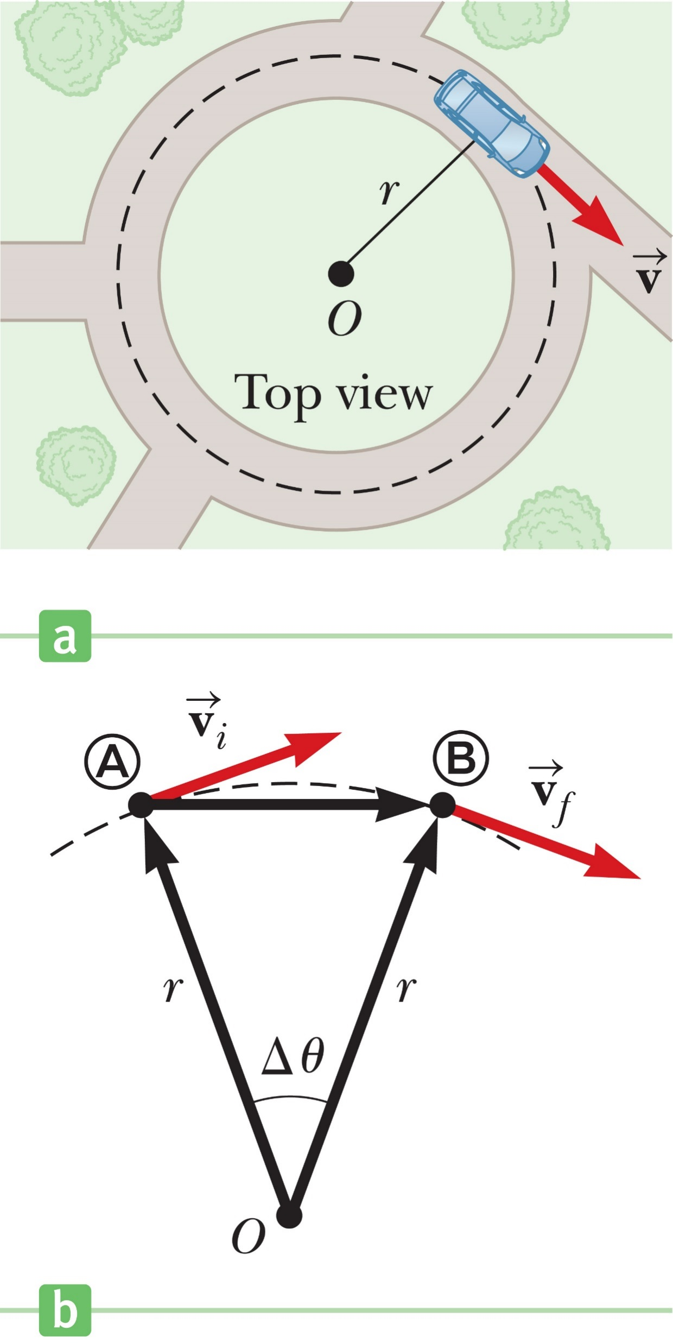
Centripetal Acceleration
Notes:
The top figure shows a car moving in a circular path with constant linear speed v. Even though the car moves at a constant speed, it still has an acceleration. To understand this, let’s consider the defining equation for average acceleration. [click to show equation] The numerator represents the difference between the velocity vectors v_{f} and v_{i}. These vectors may have the same magnitude, corresponding to the same speed, but if they have different directions, their difference can’t equal zero.
The direction of the car’s velocity as it moves in the circular path is continually changing, as you can see in the bottom figure. For circular motion at constant speed, the acceleration vector always points toward the center of the circle. This type of acceleration is called a centripetal, or center-seeking, acceleration. Its magnitude is given by the this equation. [click to show equation;]

Slide 34
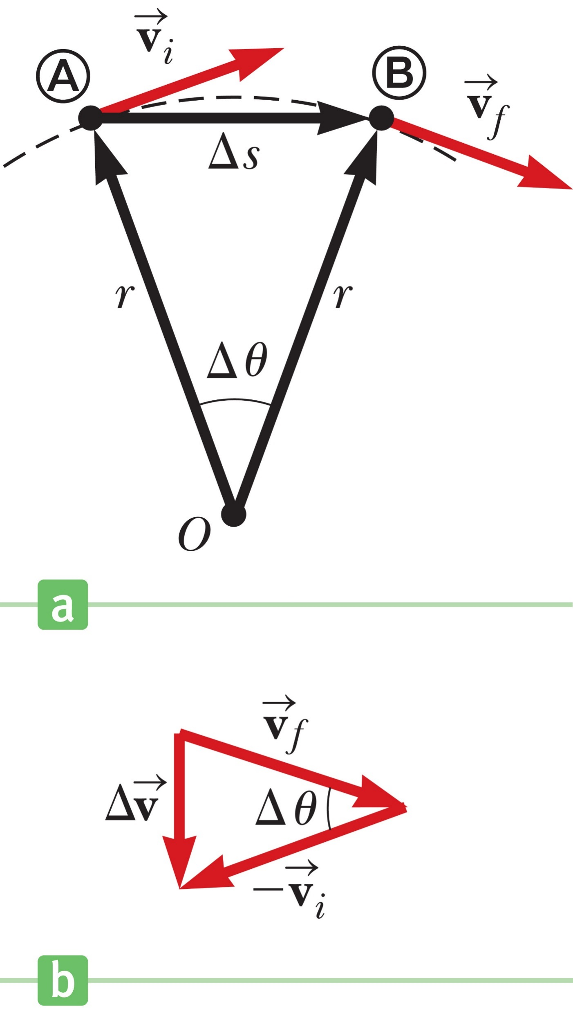
Centripetal Acceleration
Notes:
Let’s derive this equation. Consider the figure on the left. An object is first at point Ⓐ with velocity v_{i} at time t_{i} and then at point Ⓑ with velocity v_{f} at a later time t_{f} . We assume v_{i} and v_{f} differ only in direction; their magnitudes are the same. [click to show equation] To calculate the acceleration, let’s begin with the average acceleration equation. [click to show equation] When Δt is very small, Δs and Δθ are also very small.
In the figure on the right, v_{f} is almost parallel to v_{i}, and the vector Δv is approximately perpendicular to them, pointing toward the center of the circle. In the limiting case when Δt becomes vanishingly small, Δv points exactly toward the center of the circle, and the average acceleration becomes the instantaneous acceleration.
Notice that from the equation for average accelration, a and Δv point in the same direction in this limit, so the instantaneous acceleration points to the center of the circle.
The triangle in the left-hand figure, which has sides Δs and r, is similar to the one formed by the vectors in the figure on the right, so the ratios of their sides are equal. [click to show equation] Substituting, we get the expression shown. [click to show equation]
But Δs is the distance traveled along the arc of the circle in time Δt, and in the limiting case when Δt becomes very small, Δs over Δt approaches the instantaneous value of the tangential speed, v. At the same time, the average acceleration approaches the instantaneous centripetal acceleration, [click to show equation] our expression reduces to the centripetal acceleration.

Slide 35
Centripetal Acceleration
Notes:
Because the tangential velocity is related to the angular velocity through the relation v_{t} = rω, an alternate form of centripetal acceleration is shown here.
Let’s look at dimensions. [click to show equation]
Understand that physically an acceleration can occur only if some force is present. For example, if a car travels in a circle on flat ground, the force of static friction between the tires and the ground provides the necessary centripetal force. Note that the centripetal acceleration is always directed toward the center of rotation.

Slide 36
Centripetal Acceleration
Notes:
We have been looking at circular motion at constant speed. When an object moves in a circle but is speeding up or slowing down, a tangential component of acceleration is also present. Because the tangential and centripetal components of acceleration are perpendicular to each other, we can find the magnitude of the total acceleration with the Pythagorean theorem.

Slide 37
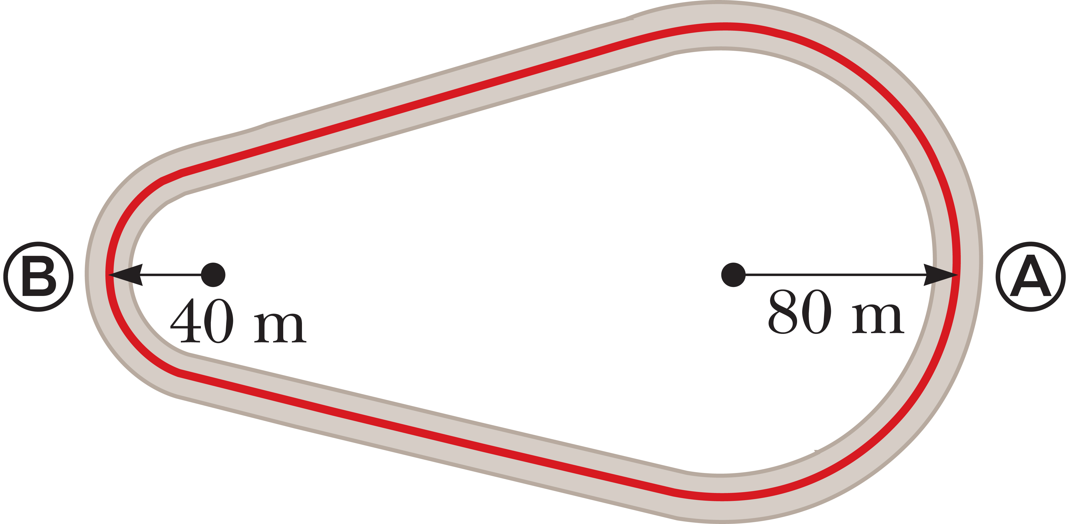
Think – Pair – Share
A race track is constructed such that two arcs of radius 80 m at A and 40 m at B are joined by two stretches of straight tracks as in the figure. In a particular trial run, a driver traveled at a constant speed of 50 m/s for one complete lap. In this case, the ratio of the tangential acceleration at A to that at B is
½
¼
2
4
The tangential acceleration is zero at both points.
Notes:
Develop your explanation, run it by a neighbor to see if it makes sense, and then we’ll hear from you in about two minutes.
Answer: The tangential acceleration is zero at both points.
Reasoning: Since the tangential speed is constant, the tangential acceleration is zero.

Slide 38
Think – Pair – Share
In a particular trial run, a driver traveled at a constant speed of 50 m/s for one complete lap. In this case, the ratio of the centripetal acceleration at A to that at B is
½
¼
2
4
The tangential acceleration is zero at both points.
Notes:
Think about it, share your thoughts with another classmate, and in two minutes we’ll all talk it through together.
Answer: ½
Reasoning: The centripetal acceleration, a_{c} = v²/r, is inversely proportional to the radius when the tangential speed is constant.

Slide 39
Think – Pair – Share
In a particular trial run, a driver traveled at a constant speed of 50 m/s for one complete lap. In this case, the angular speed is greatest at
A
B
It is equal at both A and B.
Notes:
Consider your answer, discuss it with a neighbor, and be ready to share in a couple of minutes.
Answer: B
Reasoning: The angular speed, ω = v_{t}/r, is inversely proportional to the radius when the tangential speed is constant.

Slide 40
Think – Pair – Share
An object moves in a circular path with constant speed v. Which of the following statements is true concerning the object?
Its velocity is constant, but its acceleration is changing.
Its acceleration is constant, but its velocity is changing.
Both its velocity and acceleration are changing.
Its velocity and acceleration remain constant.
Notes:
Figure out your answer, share it with your neighbor, and see what they say. We’ll talk it through as a big group in around two minutes.
Answer: Both its velocity and acceleration are changing.
Reasoning: Both the velocity and acceleration are changing in direction, so neither of these vector quantities is constant.

Slide 41
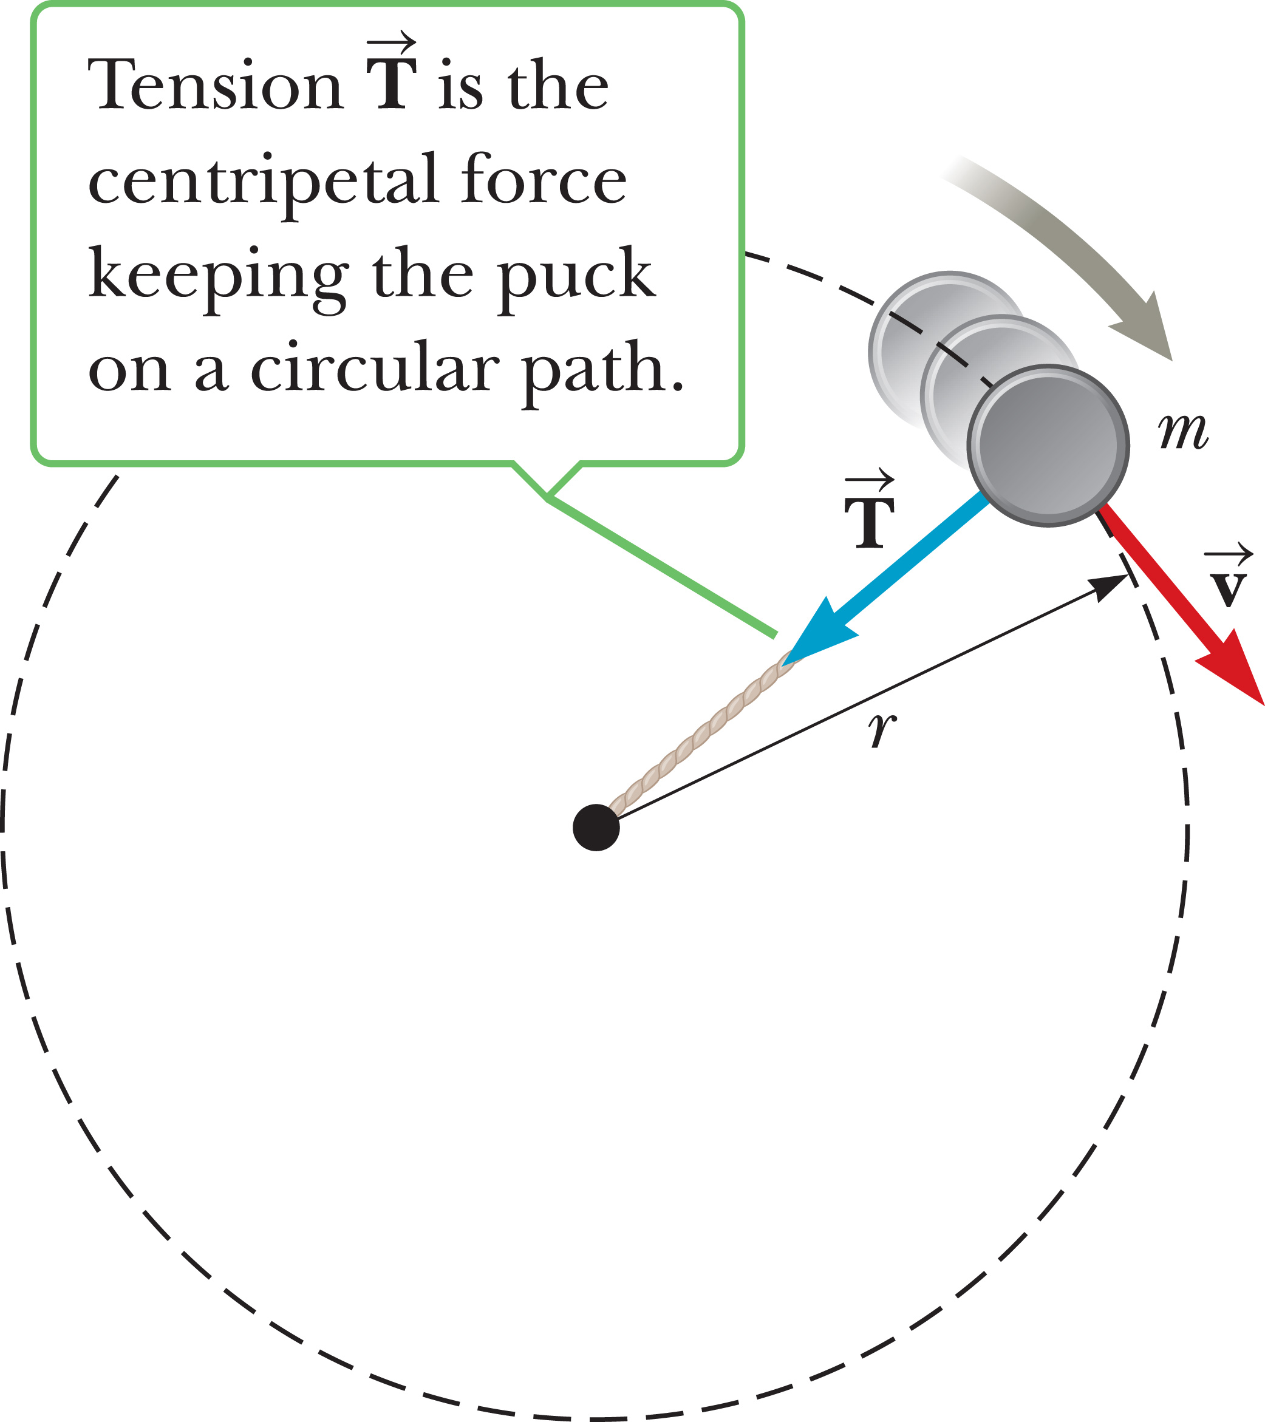
Forces Causing Centripetal Acceleration
Notes:
We can apply Newton’s second law of motion to problems involving circular motion. An object can have a centripetal acceleration only if some external force acts on it. For a ball whirling in a circle at the end of a string, that force is the tension in the string. For a car moving on a flat circular track, the force is friction between the car and track. A satellite in circular orbit around Earth has a centripetal acceleration due to the gravitational force between the satellite and Earth. Be aware that some books use the term “centripetal force,” which can give the mistaken impression that it is a new force of nature. This is not the case: The adjective “centripetal” in “centripetal force” simply means that the force in question acts toward a center.
Let’s consider a puck of mass m that is tied to a string of length r and is being whirled at constant speed in a horizontal circular path, as illustrated in the figure. Its weight is supported by a frictionless table.
Why does the puck move in a circle? Because of its inertia, the tendency of the puck is to move in a straight line; however, the string prevents motion along a straight line by exerting a radial force on the puck—a tension force—that makes it follow the circular path.
The tension T is directed along the string toward the center of the circle, as shown in the figure.

Slide 42
Forces Causing Centripetal Acceleration
Notes:
In general, when converting Newton’s second law to polar coordinates, we get an equation relating the net centripetal force, F_{c}, which is the sum of the radial components of all forces acting on a given object, to the centripetal acceleration. The magnitude of the net centripetal force equals the mass times the magnitude of the centripetal acceleration, as shown in the equation here.
A net force which causes a centripetal acceleration acts toward the center of the circular path, and effects a change in the direction of the velocity vector. Imagine if that force suddenly vanished. Then the object would immediately leave its circular path and move along a straight line tangent to the circle.
Centrifugal, or center-fleeing, forces also exist, such as the normal force that prevents an object from falling toward the center of the Earth.

Slide 43
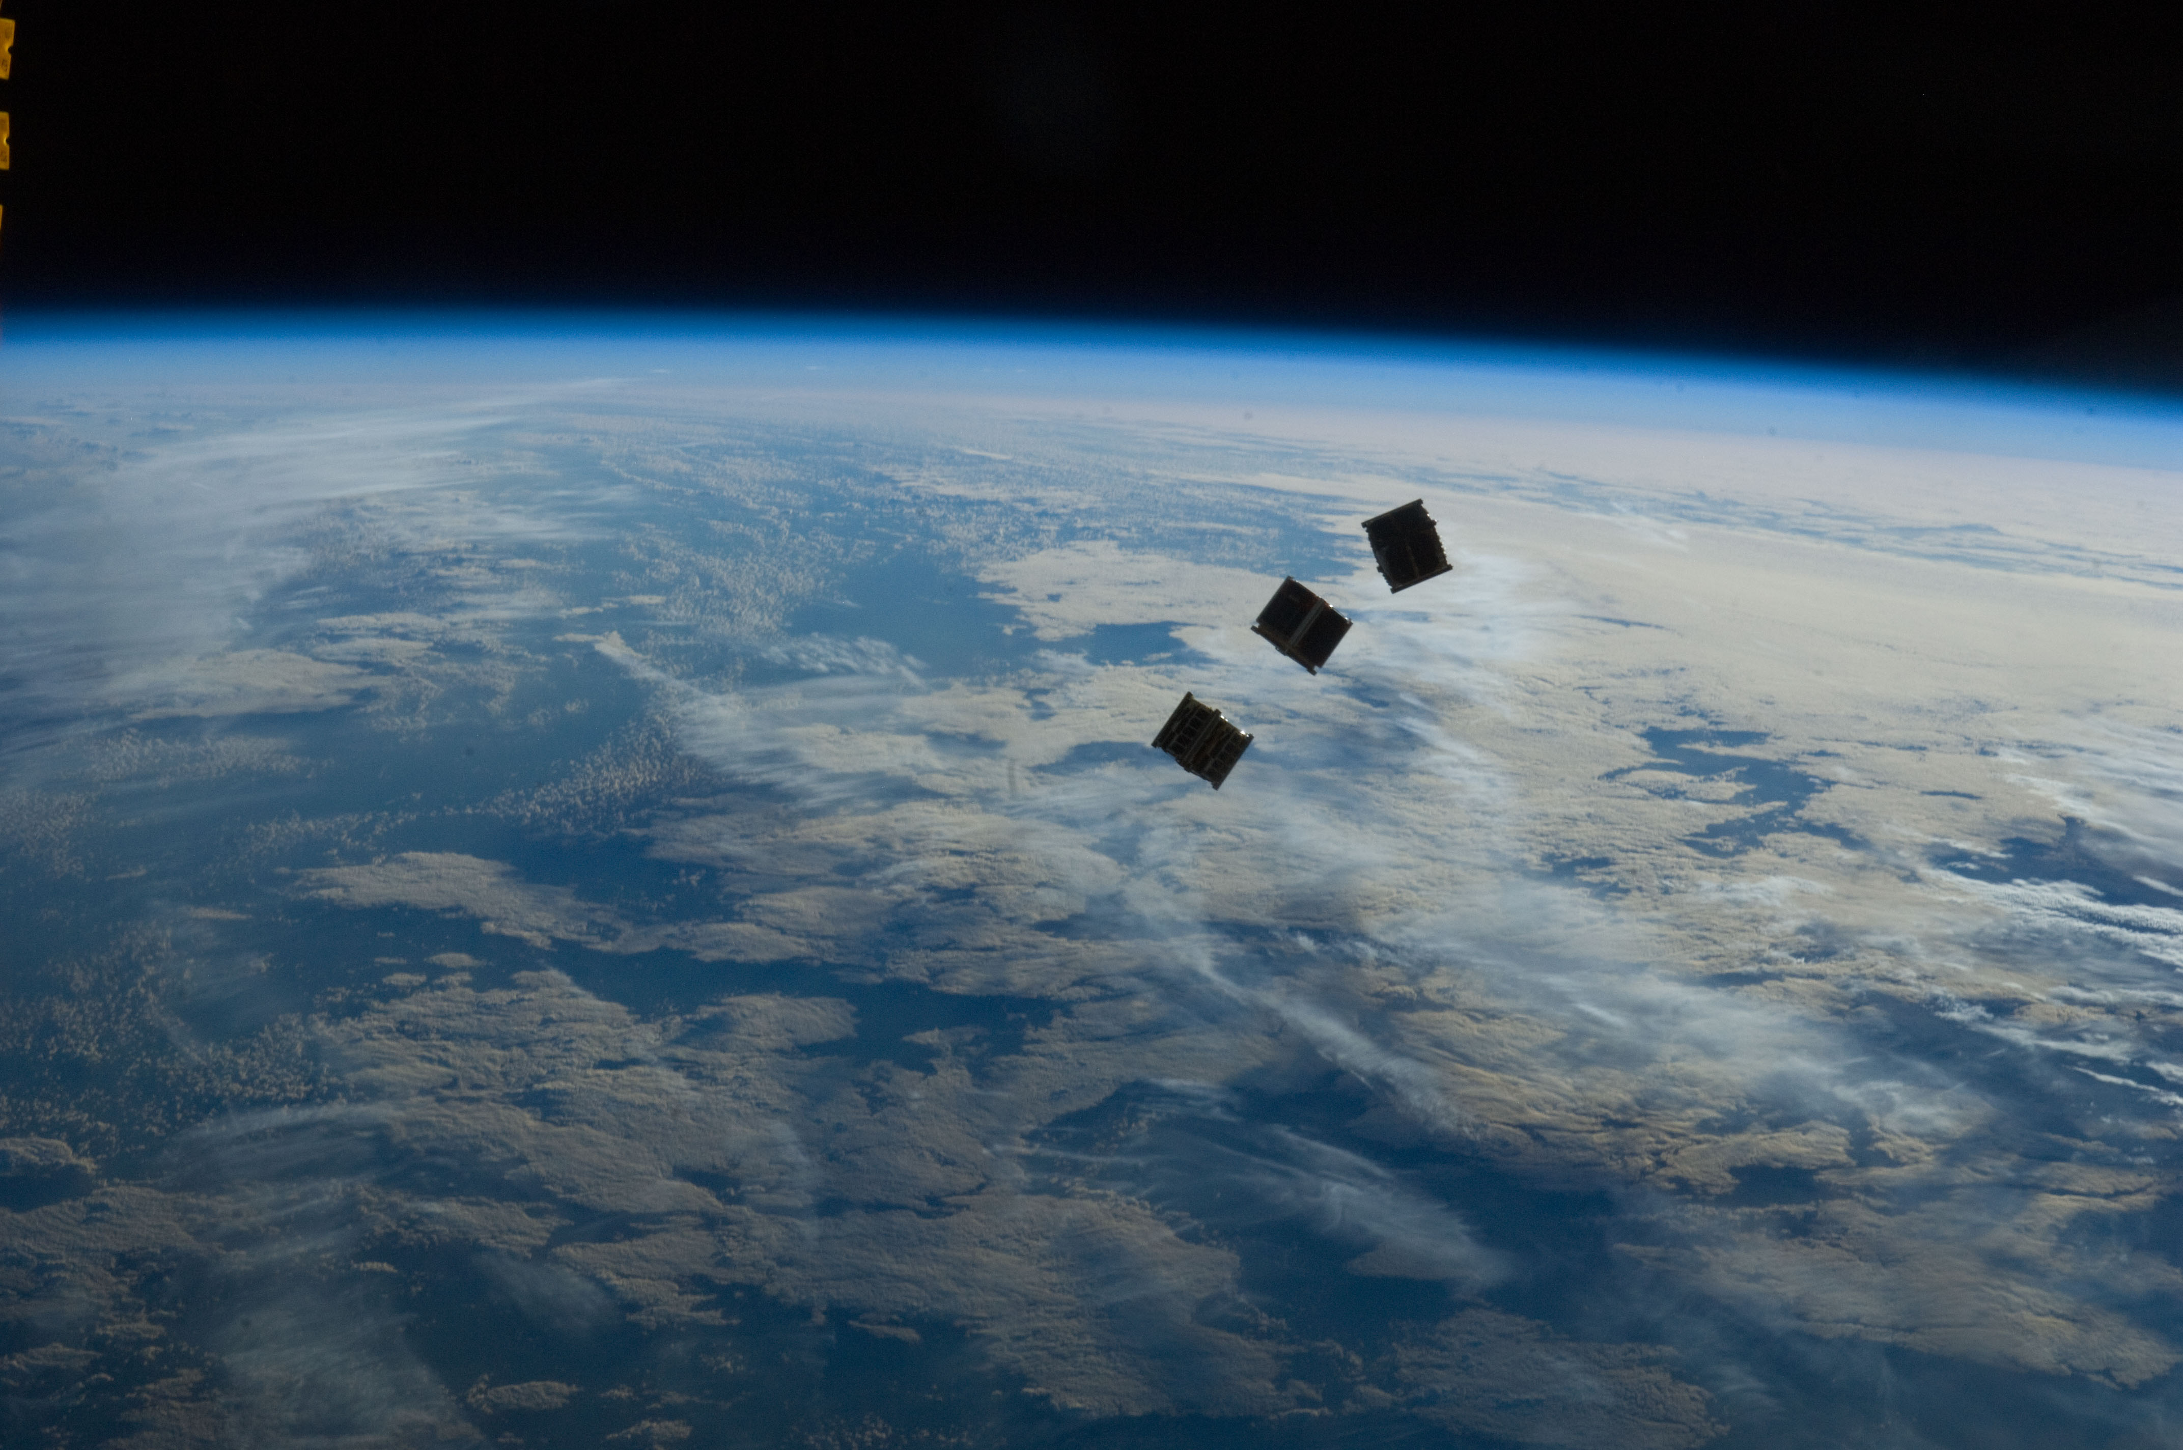
Forces Causing Centripetal Acceleration
Notes:
A radial force is a vector, and has a direction. Newton’s second law for uniform circular motion involves forces that are directed either towards the center of a circle or away from it. A force acting towards the center of the circle is by convention negative. Examples include the gravity force on a satellite or the string tension of a whirling yo-yo.
A force acting away from the center of the circle is positive. Examples of this include the normal force on a car traveling over the circular crest of a hill or the force of repulsion between like electric charges. In a similar way, the centripetal acceleration is negative because it acts towards the center of the circle.
Image credit:
https://commons.wikimedia.org/wiki/File%3AISS-33_Several_tiny_satellites_1.jpg
By NASA [Public domain], via Wikimedia Commons

Slide 44
Forces Causing Centripetal Acceleration
Notes:
Newton’s second law for uniform circular motion can be written as a vector, where the forces F_{r} are the radial forces acting on the mass m, positive if the force is away from the center of the circle, negative if the force is towards the center of the circle.
Centripetal, or center-seeking, forces have negative radial components, whereas centrifugal, or center-fleeing, forces have positive radial components.

Slide 45

Problem-Solving Strategy: Forces that Cause Centripetal Acceleration
Draw a free-body diagram
Choose a coordinate system
Find the net force F_{c} toward the center
Use Newton’s second law for the radial, tangential, and normal directions
Solve
Notes:
Draw a free-body diagram of the object under consideration, labeling all forces that act on it.
Choose a coordinate system that has one axis perpendicular to the circular path followed by the object, which is the radial direction, and one axis tangent to the circular path, which is the tangential, or angular, direction. The normal direction, perpendicular to the plane of motion, is also often needed.
Find the net force F_{c} toward the center of the circular path, where ΣF_{r} is the sum of the radial components of the forces. This net radial force causes the centripetal acceleration.
Use Newton’s second law for the radial, tangential, and normal directions, as required. Remember that the magnitude of the centripetal acceleration for uniform circular motion can always be written as shown.
Solve for the unknown quantities.

Slide 46
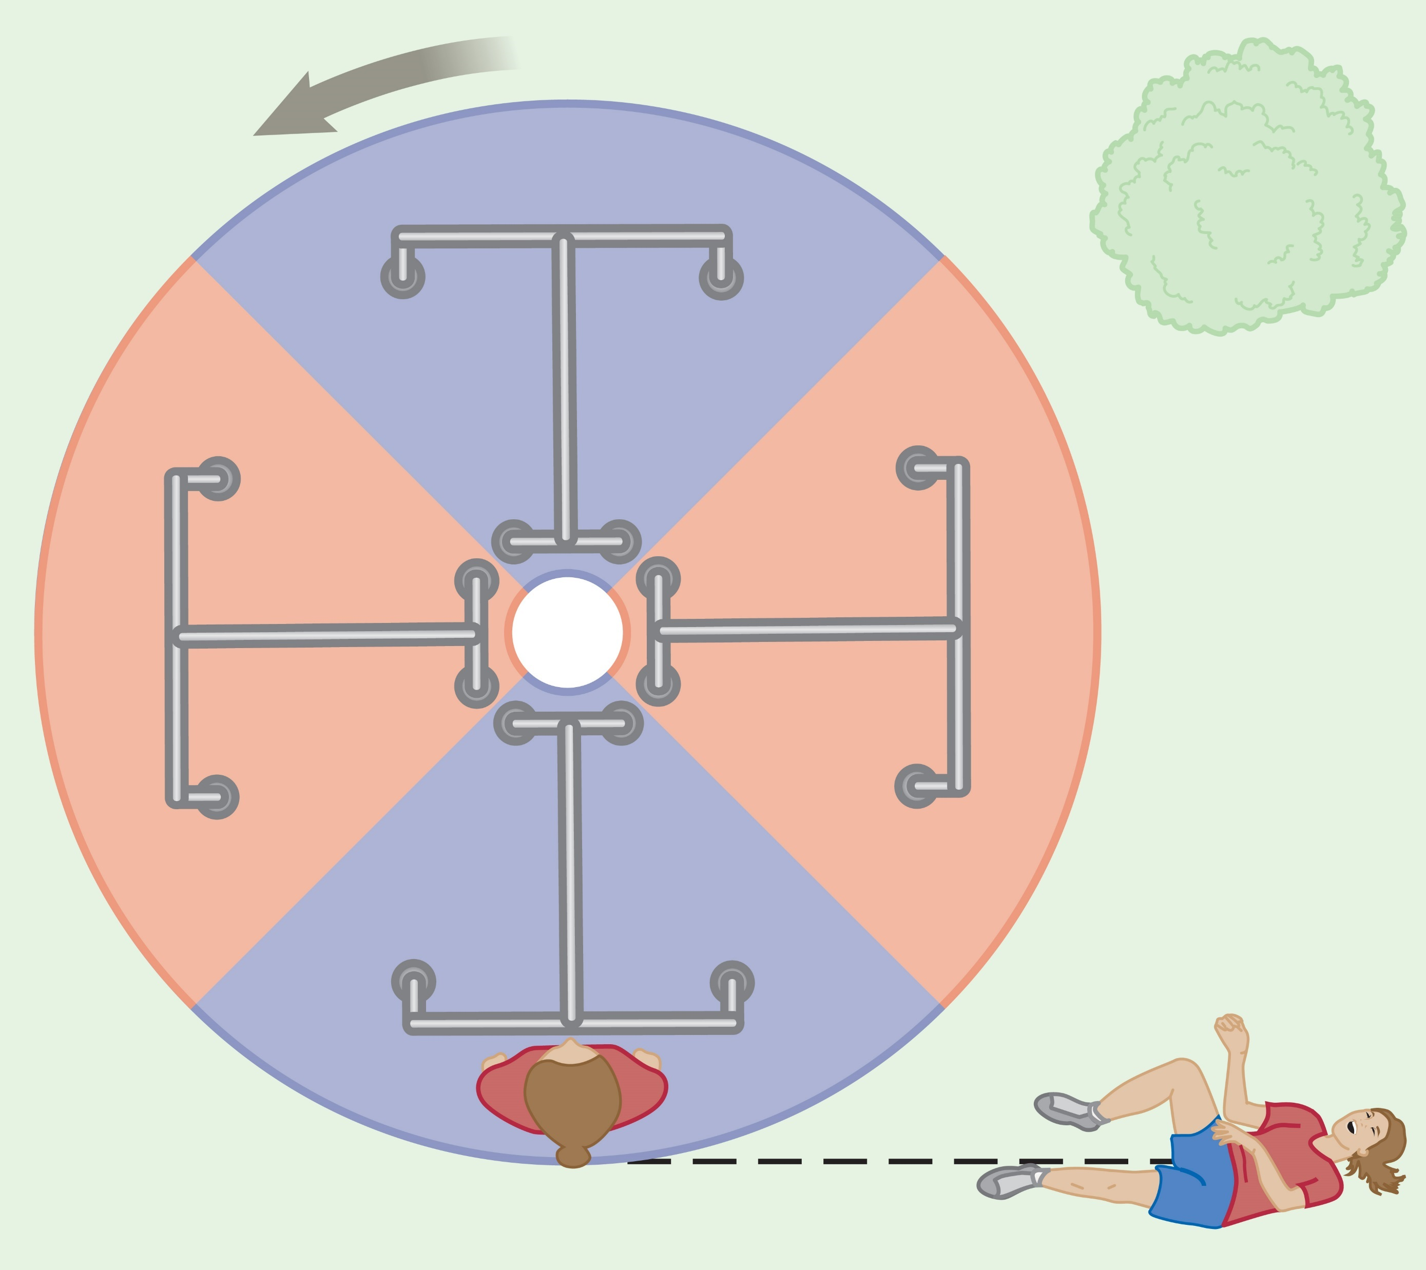
Fictitious Forces
Notes:
Anyone who has ridden a merry-go-round has experienced what feels like a “center-fleeing” force. Holding onto the railing and moving toward the center feels like a walk up a steep hill. Actually, this so-called centrifugal force is fictitious. In reality, if you are riding the merry-go-round, you are exerting a centripetal force on your body with your hand and arm muscles. Also, a smaller centripetal force is exerted by the static friction between your feet and the platform.
If your grip slipped, you wouldn’t be flung radially away; you would go off on a straight line, tangent to the point in space where you let go of the railing. You would land at a point that is farther away from the center, but not by “fleeing the center” along a radial line. Instead, you would travel perpendicular to a radial line, traversing an angular displacement while increasing your radial displacement, as you can see in the figure.

Slide 47
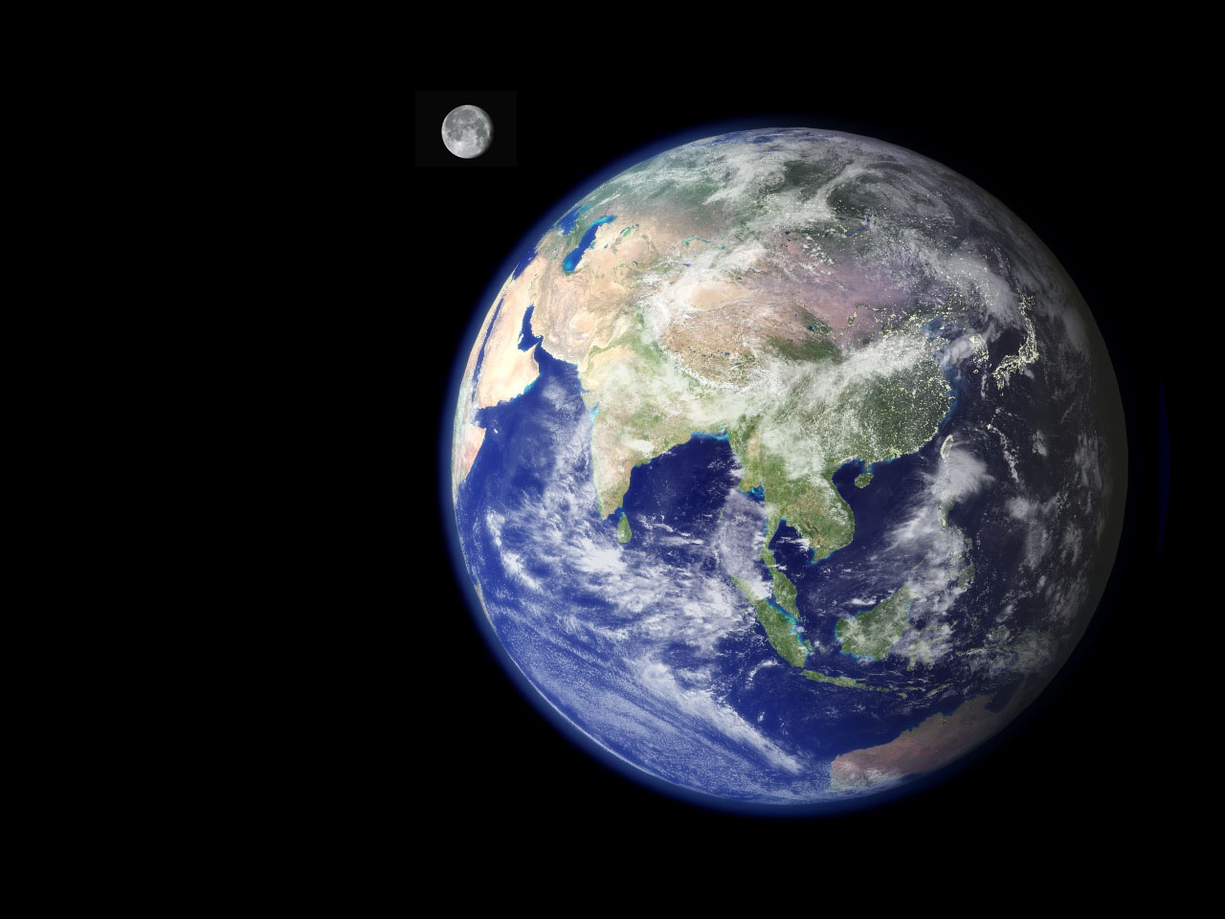
Newtonian Gravitation
Notes:
Before 1686, lots of data had been collected on the motions of the Moon and planets, but no one had a clear understanding of the forces affecting them. In that year, Isaac Newton provided the key that unlocked the secrets of the heavens. He knew that a net force had to be acting on the Moon. If it were not, the Moon would move in a straight-line path rather than in its almost circular orbit around Earth. Newton reasoned that it was the same kind of force that attracted objects—such as apples—close to the surface of the Earth. He called it the force of gravity.
In 1687 Newton published his work on the law of universal gravitation.
Image credit:
https://commons.wikimedia.org/wiki/File%3ANasa_earth.jpg
By NASA ESA (http://www.nasa.gov/) [Public domain], via Wikimedia Commons

Slide 48
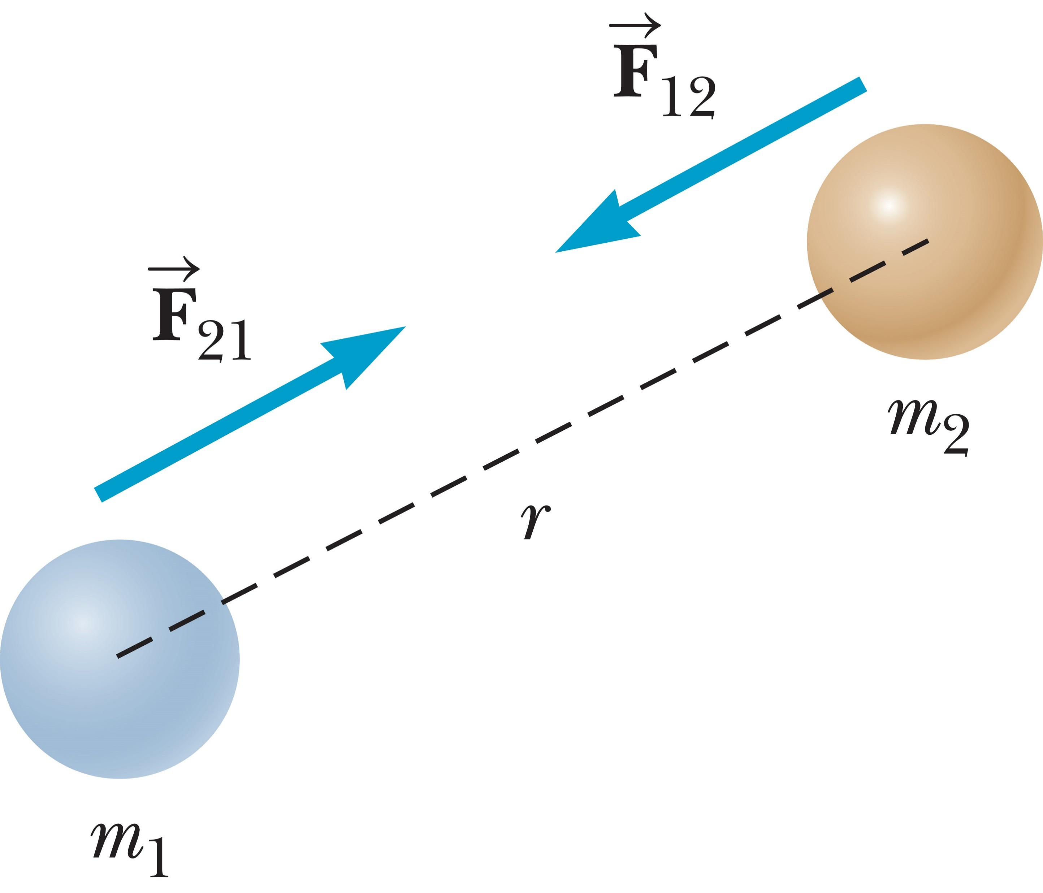
Newtonian Gravitation
The gravitational force exerted by a uniform sphere on a particle outside the sphere is the same as the force exerted if the entire mass of the sphere were concentrated at its center.
Notes:
If two particles with masses m₁ and m₂ are separated by a distance r, a gravitational force F acts along a line joining them, with magnitude given by the equation shown, where G is a constant of proportionality called the constant of universal gravitation. The gravitational force is always attractive.
This force law is an example of an inverse-square law, in that it varies as one over the square of the distance between particles.
From Newton’s third law, we know that the force exerted by m₁ on m₂, designated F₁₂ in the figure, is equal in magnitude but opposite in direction to the force F₂₁ exerted by m₂ on m₁, forming an action–reaction pair.
Another important fact is that [click to show text] the gravitational force exerted by a uniform sphere on a particle outside the sphere is the same as the force exerted if the entire mass of the sphere were concentrated at its center. This is called Gauss’s law, after the German mathematician and astronomer Karl Friedrich Gauss, and is also true of electric fields, which we will encounter in Topic 15. Gauss’s law is a mathematical result, true because the force falls off as an inverse square of the separation between the particles.

Slide 49
Newtonian Gravitation
Notes:
Near the surface of the Earth, the expression F = mg is valid. but you should be aware that the free-fall acceleration g varies considerably with altitude above the Earth, as you can see in the table.

Slide 50
Think – Pair – Share
A ball is falling toward the ground. Which of the following statements are false?
a) The force that the ball exerts on the Earth is equal in magnitude to the force that the Earth exerts on the ball.
b) The ball undergoes the same acceleration as Earth.
c) The magnitude of the force the Earth exerts on the ball is greater than the magnitude of the force the ball exerts on the Earth.
Statements a and b are false.
Statements a, b, and c are all false.
Statements a and c are false.
Statements b and c are false.
Notes:
Take a moment to come up with an answer, share with a classmate, and I’ll interrupt the discussions to hear what you decided in about 2 minutes. Be ready to share.
Answer: Statements b and c are false.
Reasoning: According to Newton’s law of universal gravitation, the force between the ball and the Earth depends on the product of their masses, so both forces, that of the ball on the Earth, and that of the Earth on the ball, are equal in magnitude. This follows also, of course, from Newton’s third law. The ball has large motion compared to the Earth because, according to Newton’s second law, the force gives a much greater acceleration to the small mass of the ball.

Slide 51
Think – Pair – Share
A planet has two identical moons with identical mass. Moon 1 is in a circular orbit of radius r. Moon 2 is in a circular orbit of radius 2r. The magnitude of the gravitational force exerted by the planet on Moon 2 is
four times as large as the gravitational force exerted by the planet on Moon 1.
twice as large as the gravitational force exerted by the planet on Moon 1.
the same as the gravitational force exerted by the planet on Moon 1.
half as large as the gravitational force exerted by the planet on Moon 1.
one-fourth as large as the gravitational force exerted by the planet on Moon 1.
Notes:
Think, check in with a classmate, and we’ll discuss it as a group in a few minutes.
Answer: one-fourth as large as the gravitational force exerted by the planet on Moon 1.
Reasoning: From F = GMm/r². the gravitational force is inversely proportional to the square of the radius of the orbit.

Slide 52
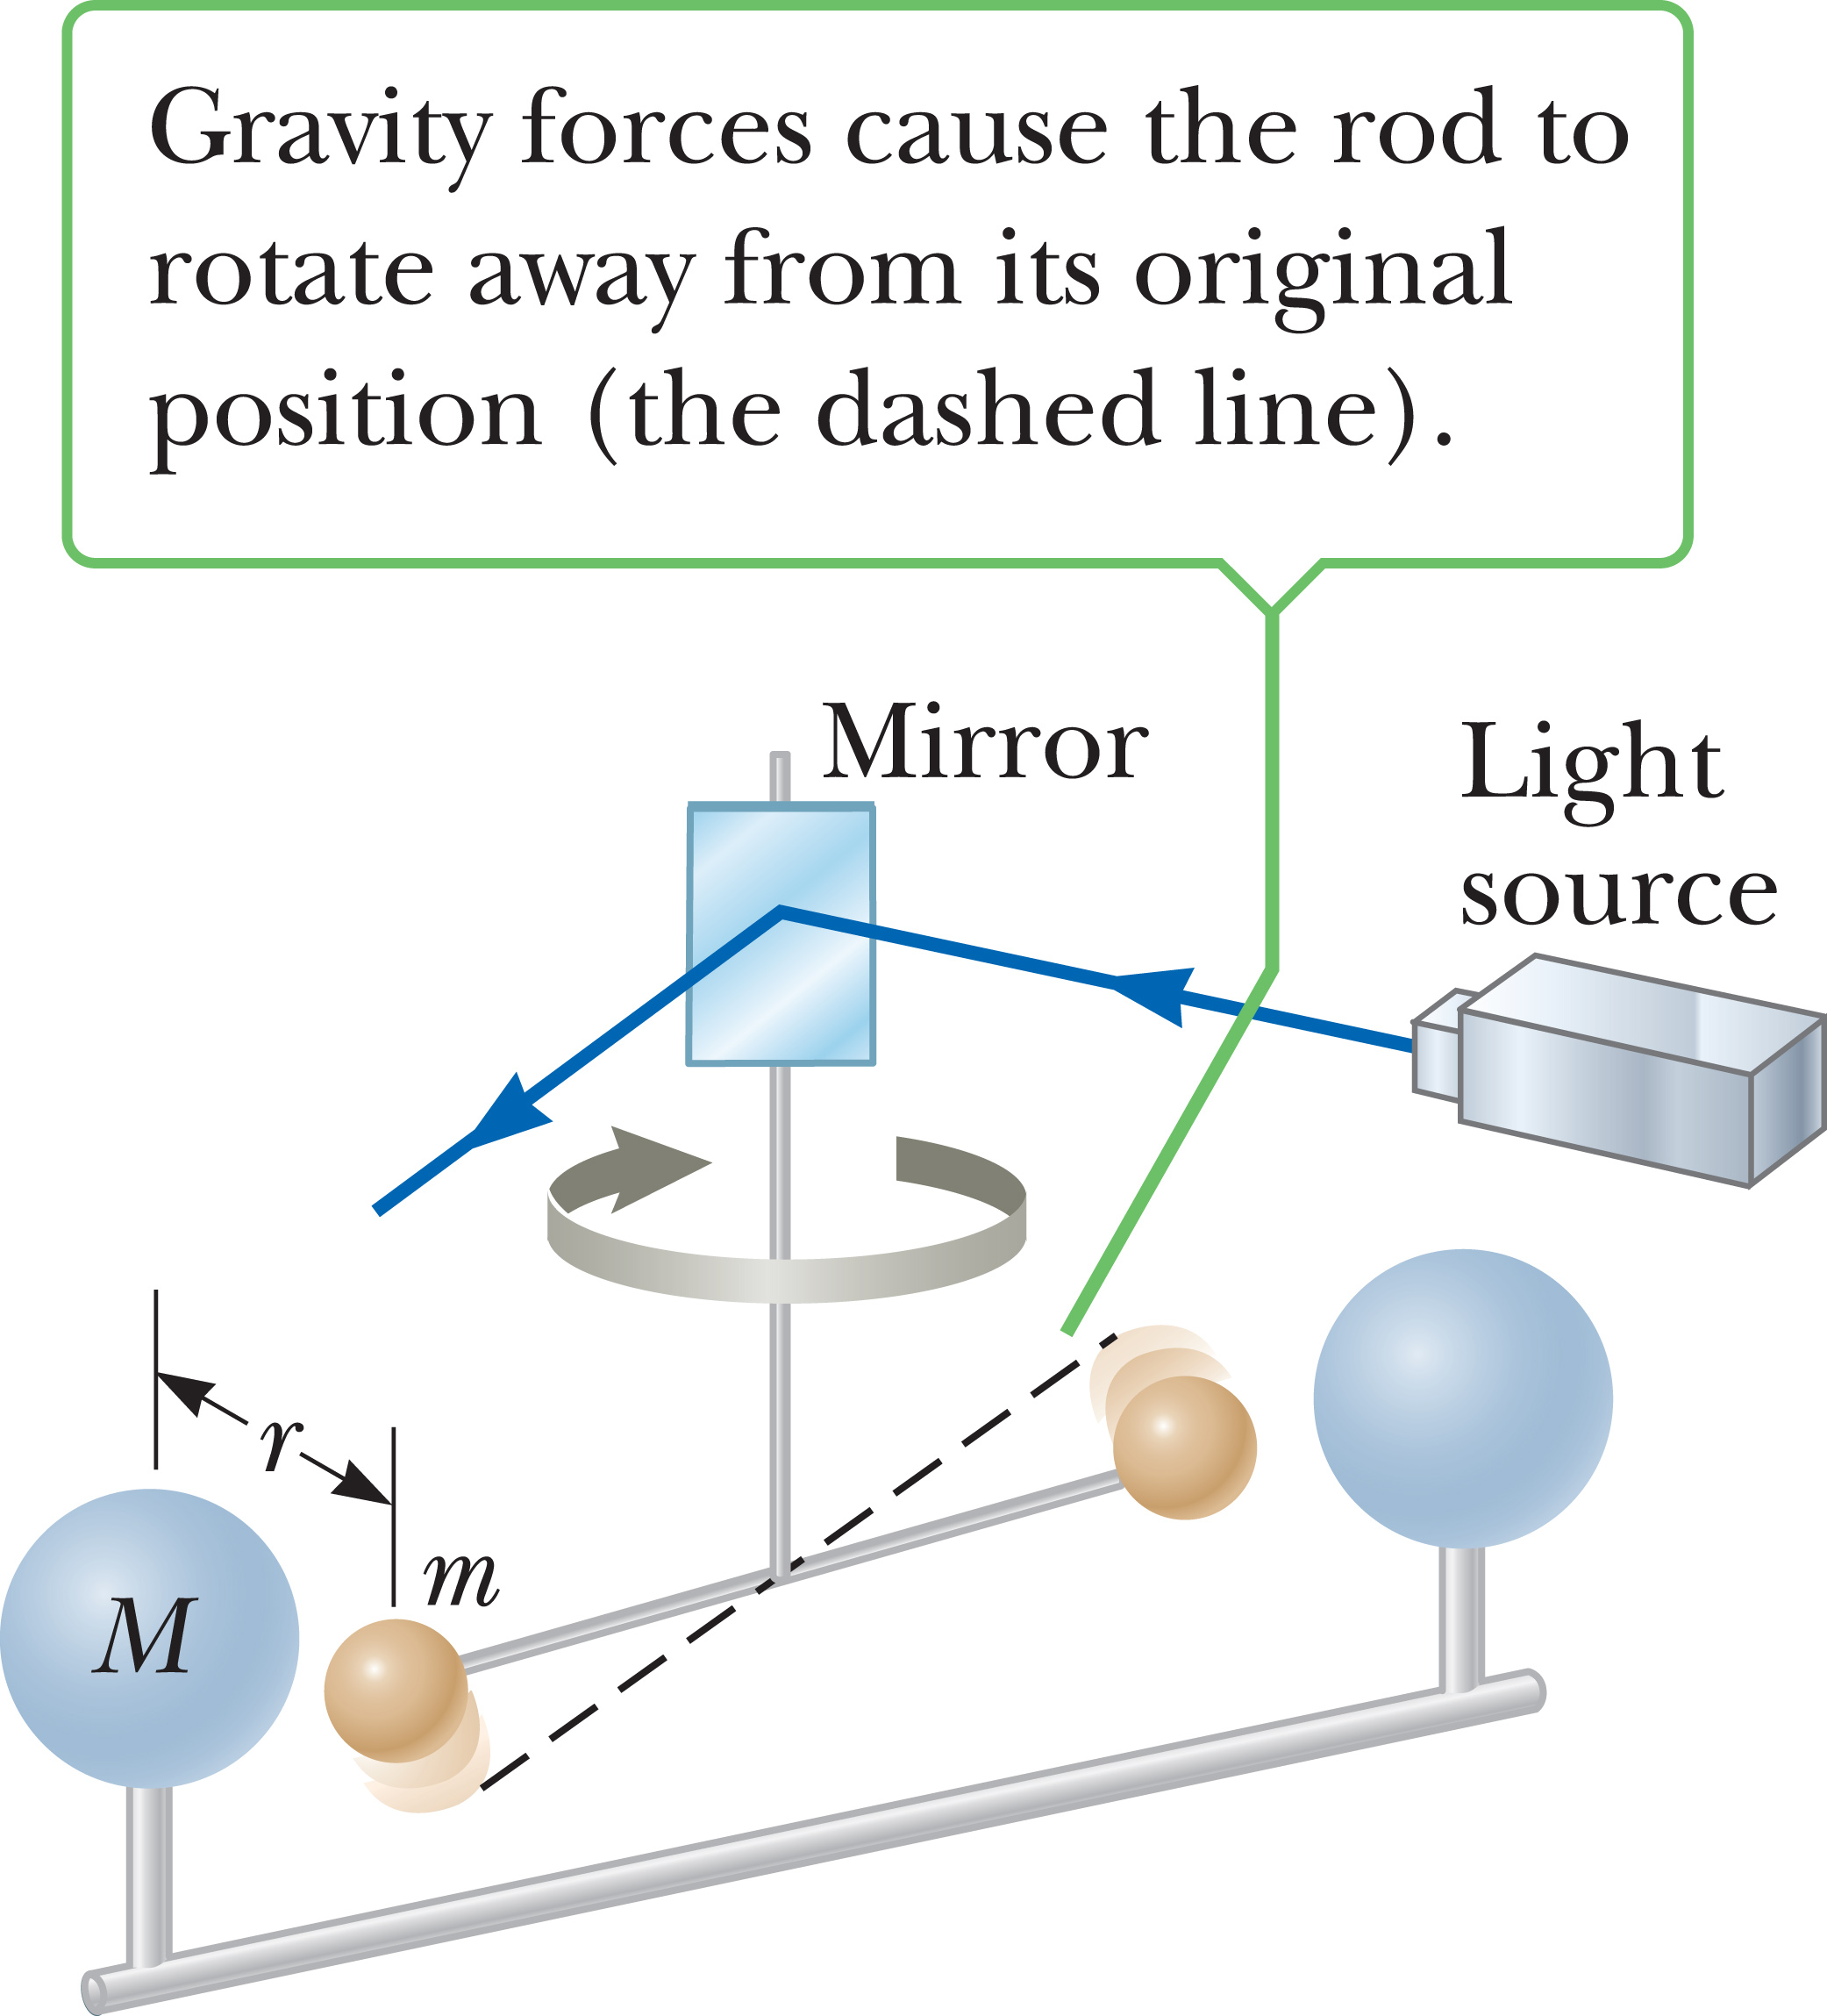
Measurement of the
Gravitational Constant
Notes:
You might be wondering where the gravitational constant G came from. It was first measured in an important experiment by Henry Cavendish in 1798. His apparatus is shown in the figure, and consists of two small spheres, each of mass m, fixed to the ends of a light horizontal rod suspended by a thin metal wire. Two large spheres, each of mass M, were placed near the smaller spheres. The attractive force between the smaller and larger spheres caused the rod to rotate in a horizontal plane and the wire to twist. The angle through which the suspended rod rotated was measured with a light beam reflected from a mirror attached to the vertical suspension.
The experiment was carefully repeated with different masses at various separations. In addition to providing a value for G, the results showed that the force is attractive, proportional to the product of the two masses, and inversely proportional to the square of the distance r.

Slide 53
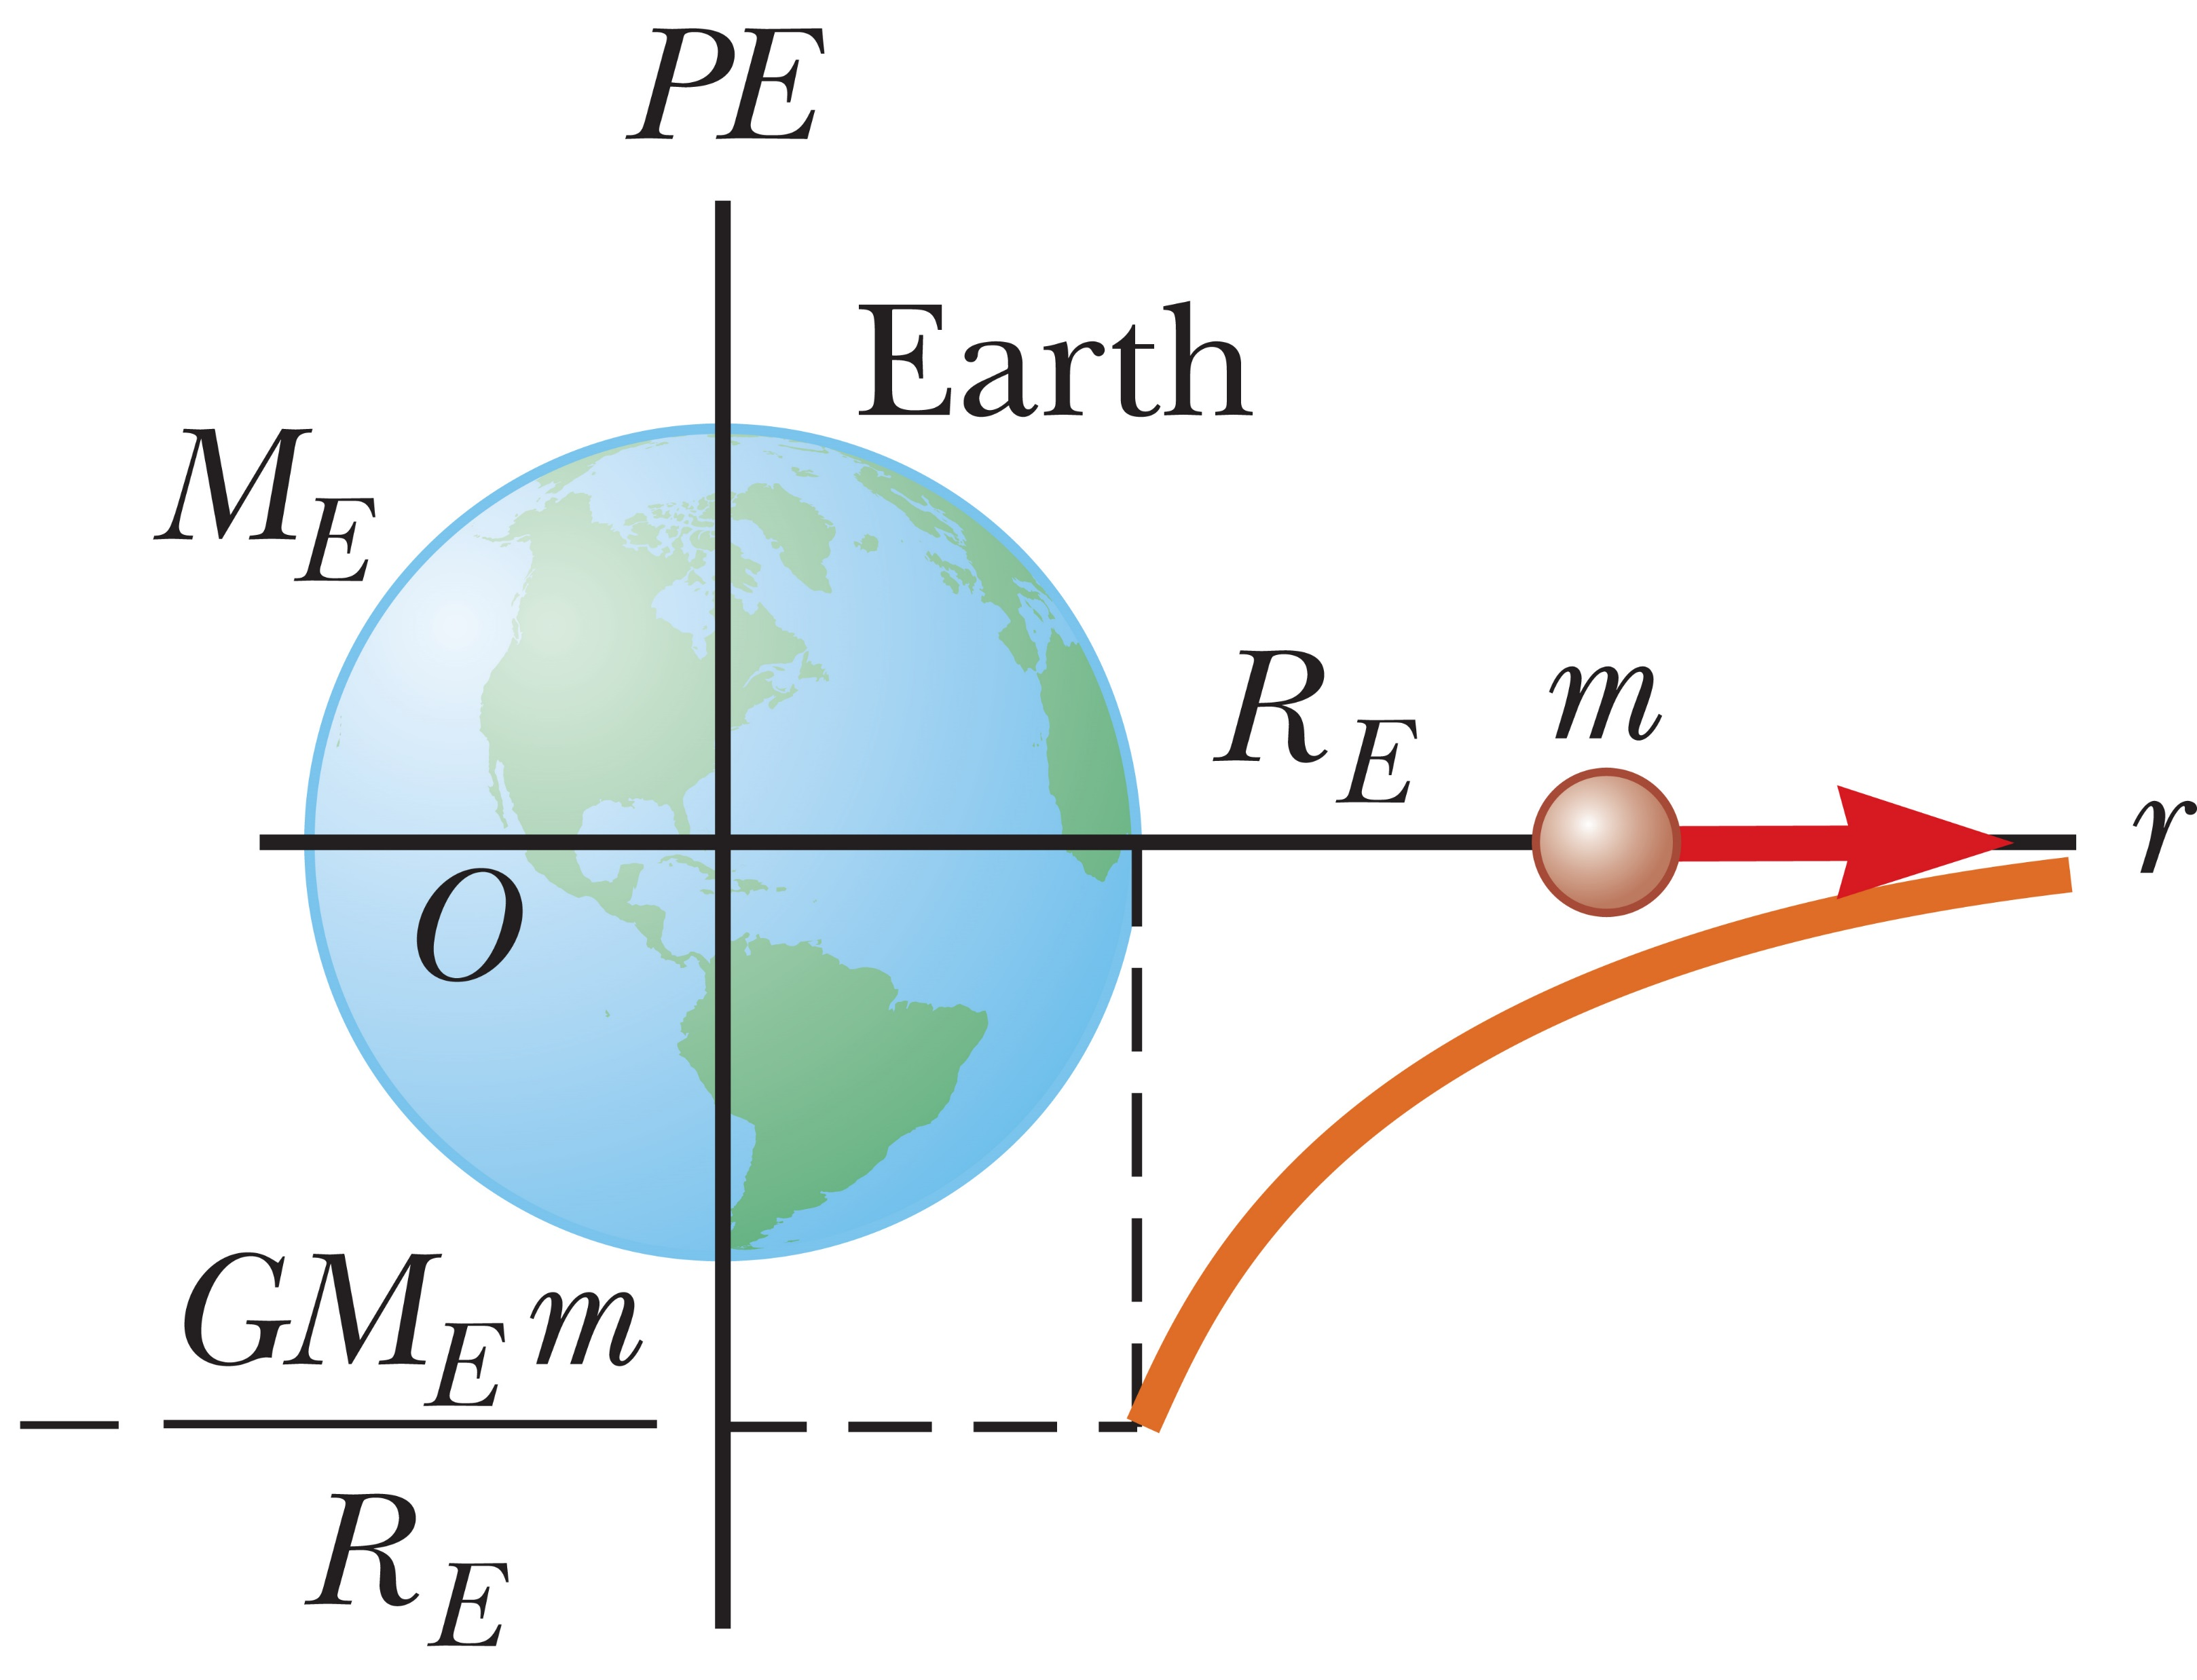
Gravitational Potential Energy Revisited
Notes:
You remember the potential energy associated with an object can be calculated from the equation PE = mgh, where h is the height of the object above or below some reference level. This equation is valid only when the object is near Earth’s surface. For objects high above Earth’s surface, such as a satellite, an alternative must be used because g varies with distance from the surface, as we saw in the table on a previous slide.
The gravitational potential energy associated with an object of mass m at a distance r from the center of Earth is given in the equation shown, where M_{E} is the mass of Earth and r is greater than or equal to R_{E} , the radius of Earth. As before, gravitational potential energy is a property of a system, in this case the object of mass m and the Earth. The figure illustrates this equation.
This equation is valid for the special case where the zero level for potential energy is at an infinite distance from the center of the Earth. Recall that the gravitational potential energy associated with an object is nothing more than the negative of the work done by the force of gravity in moving the object. If an object falls under the force of gravity from a great distance, which is effectively infinity, the change in gravitational potential energy is negative, which corresponds to a positive amount of gravitational work done on the system. This positive work is equal to the change in kinetic energy, which is also positive.

Slide 54
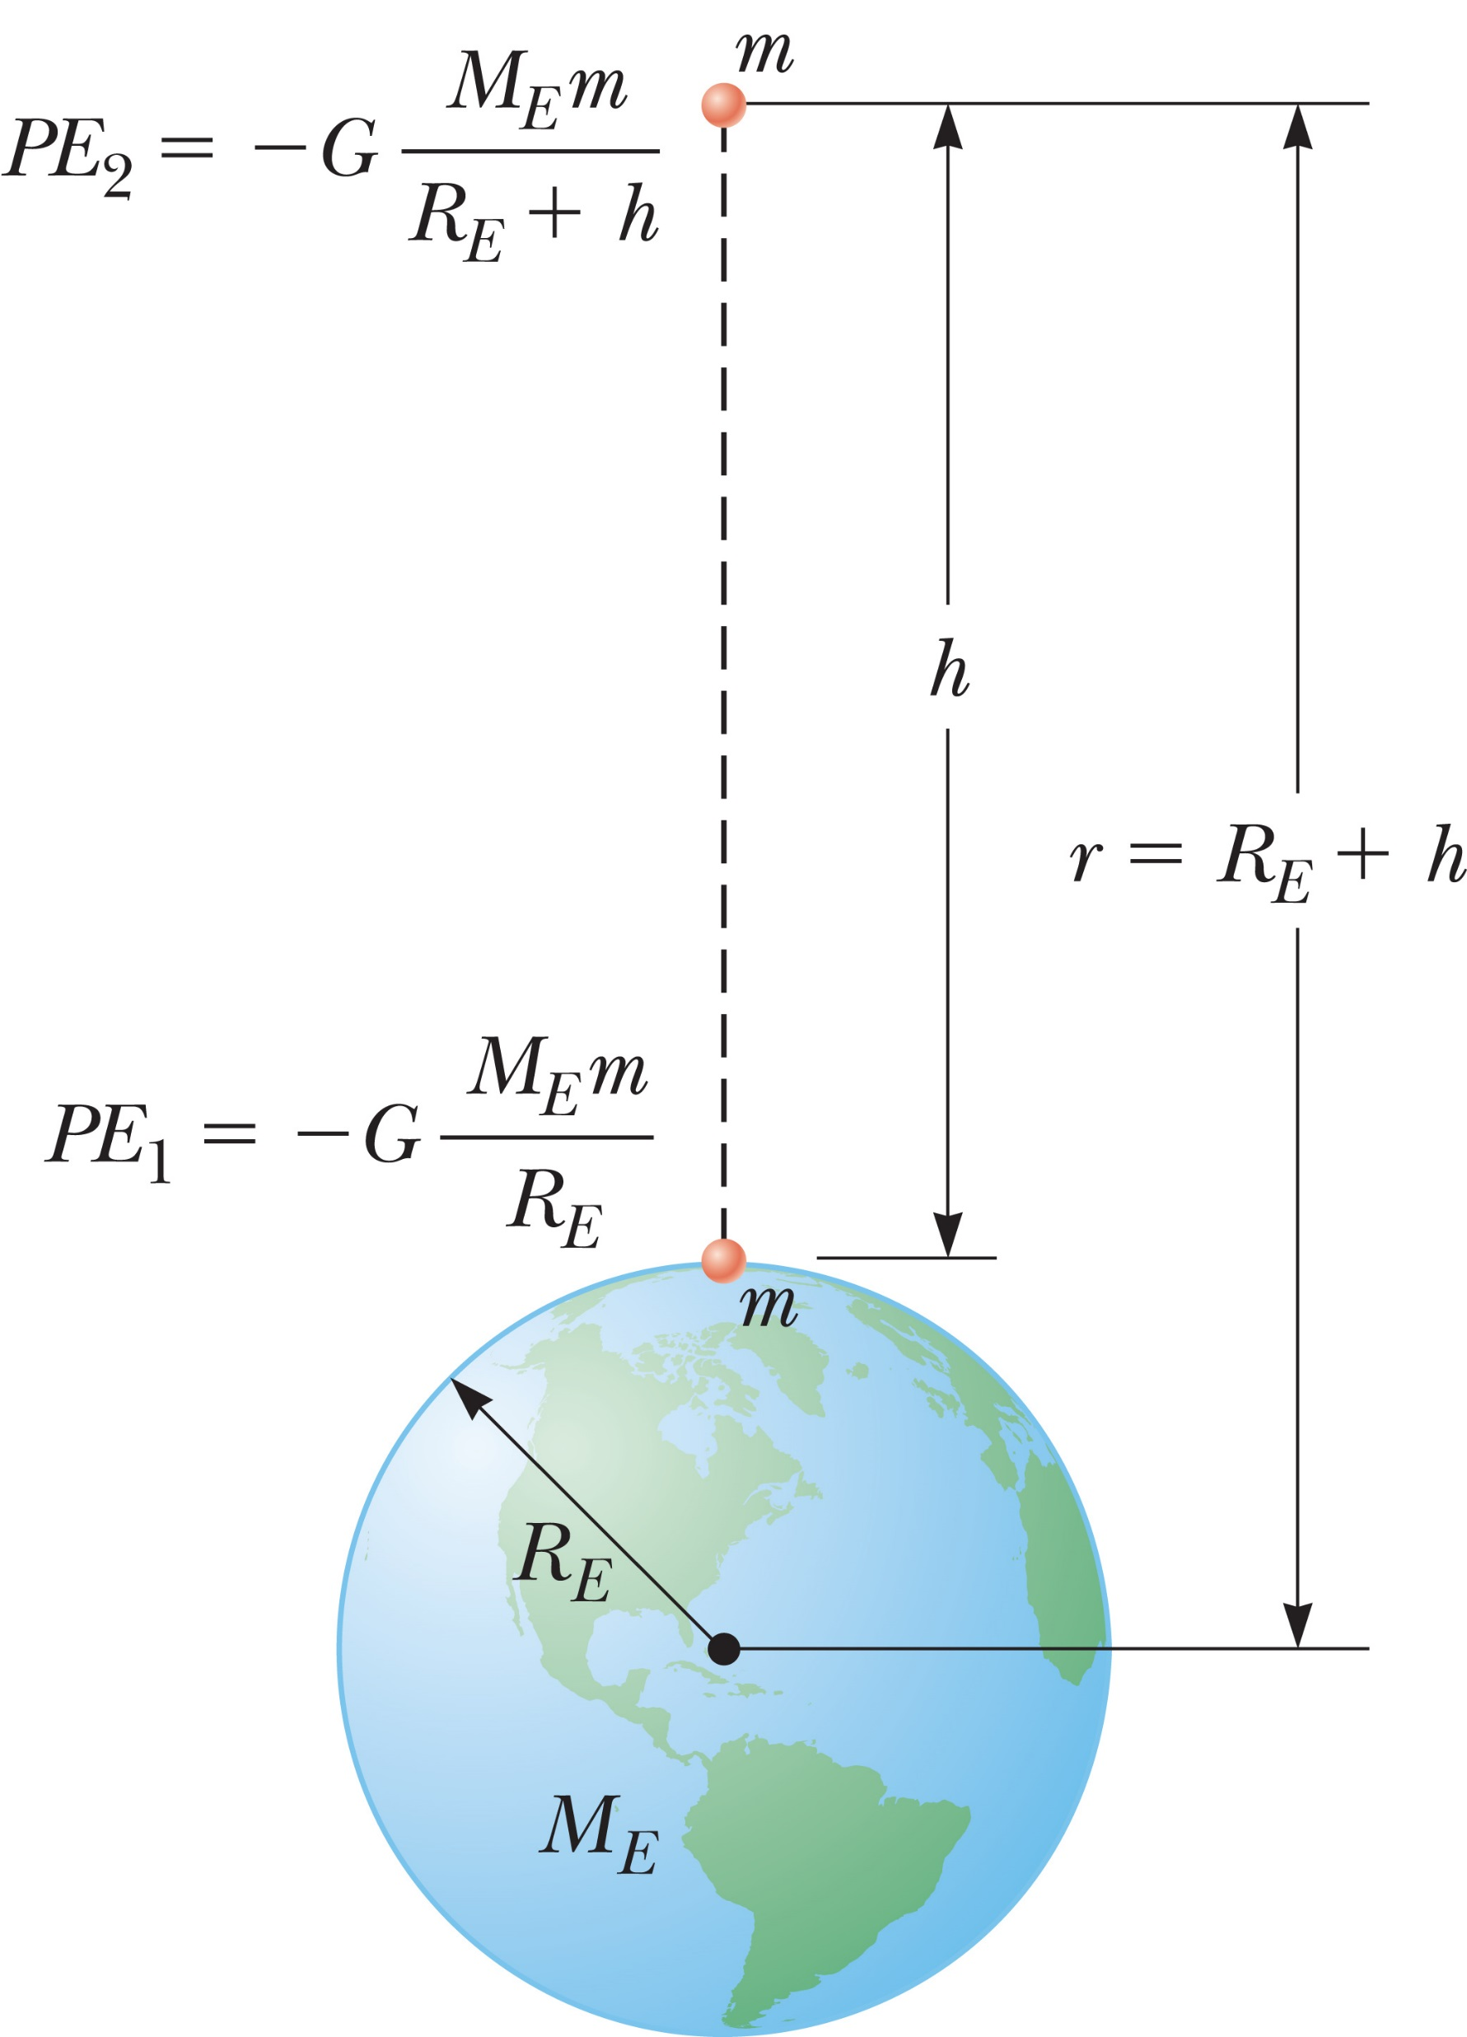
Gravitational Potential Energy Revisited
Notes:
When you look at the equation for gravitational potential energy, you may be wondering what happened to mgh. That expression is still valid when h is small compared with Earth’s radius.
To see this, let’s write the change in potential energy as an object is raised from the ground to height h, using the general form for gravitational potential energy, as illustrated in the figure. [click to show equation]
After finding a common denominator and applying some algebra, which you can do on your own, [click to show equation] we obtain this expression.

Slide 55
Gravitational Potential Energy Revisited
Notes:
When the height h is very small compared with R_{E}, h can be dropped from the second factor in the denominator. [click to show equation] Substituting this into the first expression, we get the result shown. [click to show equation]
As you recall, the free-fall acceleration at the surface of Earth is given by the equation here [click to show equation], so for r equal to R_{E}, we get [click to show equation] mgh.

Slide 56
Escape Speed
Notes:
If an object is projected upward from Earth’s surface with a large enough speed, it can soar off into space and never return. This speed is called Earth’s escape speed. It is also commonly called the escape velocity, but in fact is more properly a speed.
Earth’s escape speed can be found by applying conservation of energy. Suppose an object of mass m is projected vertically upward from Earth’s surface with an initial speed v_{i}. The initial mechanical energy, kinetic plus potential energy, of the object–Earth system is given by the equation shown. We neglect air resistance and assume the initial speed is just large enough to allow the object to reach infinity with a speed of zero.
This value of v_{i} is the escape speed v_{esc}. When the object is at an infinite distance from Earth, its kinetic energy is zero because v_{f} = 0, and the gravitational potential energy is also zero because 1/r goes to zero as r goes to infinity. That means the total mechanical energy is zero, and the law of conservation of energy gives this equation. [click to show equation] Solving, we get the escape speed. [click to show equation]
The escape speed for Earth is about 11.2 km/s, which corresponds to about 25,000 mi/h.
Note that the expression for v_{esc} doesn’t depend on the mass of the object projected from Earth, so a spacecraft has the same escape speed as a molecule.

Slide 57
Escape Speed
Notes:
Escape speeds for the planets, the Moon, and the Sun are listed in the table.
Escape speed and temperature determine to a large extent whether a world has an atmosphere and, if so, what the constituents of the atmosphere are. Planets with low escape speeds, such as Mercury, generally don’t have atmospheres because the average speed of gas molecules is close to the escape speed. Venus has a very thick atmosphere, but it’s almost entirely carbon dioxide, a heavy gas. The atmosphere of Earth has very little hydrogen or helium, but has retained the much heavier nitrogen and oxygen molecules.

Slide 58

Kepler’s Laws
Notes:
As we discussed back in Topic 2, in early history people generally regarded the Earth as the center of the Universe. This geocentric model was developed extensively by the Greek astronomer Claudius Ptolemy in the second century AD and was accepted for the next 1,400 years.
In 1543 Polish astronomer Nicolaus Copernicus showed that Earth and the other planets revolve in circular orbits around the Sun, called the heliocentric model. Danish astronomer Tycho Brahe made accurate astronomical measurements over a period of 20 years, providing the data for the currently accepted model of the solar system. Brahe’s precise observations of the planets and 777 stars were carried out with nothing more elaborate than a large sextant and compass, because the telescope hadn’t been invented yet!
German astronomer Johannes Kepler, who was Brahe’s assistant, acquired Brahe’s astronomical data and spent about 16 years trying to deduce a mathematical model for the motions of the planets. After many laborious calculations, he found that Brahe’s precise data on the motion of Mars about the Sun provided the answer. Kepler’s analysis first showed that the concept of circular orbits about the Sun had to be abandoned. He eventually discovered that the orbit of Mars could be accurately described by an ellipse with the Sun at one focus. He then generalized this analysis to include the motions of all planets.
Image credit:
https://commons.wikimedia.org/wiki/File:Heliocentric_solar_system.png
Heliocentric_solar_system.png ‎[Public Domain]

Slide 59
Kepler’s Laws
All planets move in elliptical orbits with the Sun at one of the focal points.
A line drawn from the Sun to any planet sweeps out equal areas in equal time intervals.
The square of the orbital period of any planet is proportional to the cube of the average distance from the planet to the Sun.
Notes:
His analysis is summarized in three statements known as Kepler’s laws:
1. All planets move in elliptical orbits with the Sun at one of the focal points.
2. A line drawn from the Sun to any planet sweeps out equal areas in equal time intervals.
3. The square of the orbital period of any planet is proportional to the cube of the average distance from the planet to the Sun.
Newton later demonstrated that these laws are consequences of the gravitational force that exists between any two objects. Newton’s law of universal gravitation, together with his laws of motion, provides the basis for a full mathematical description of the motions of planets and satellites.

Slide 60
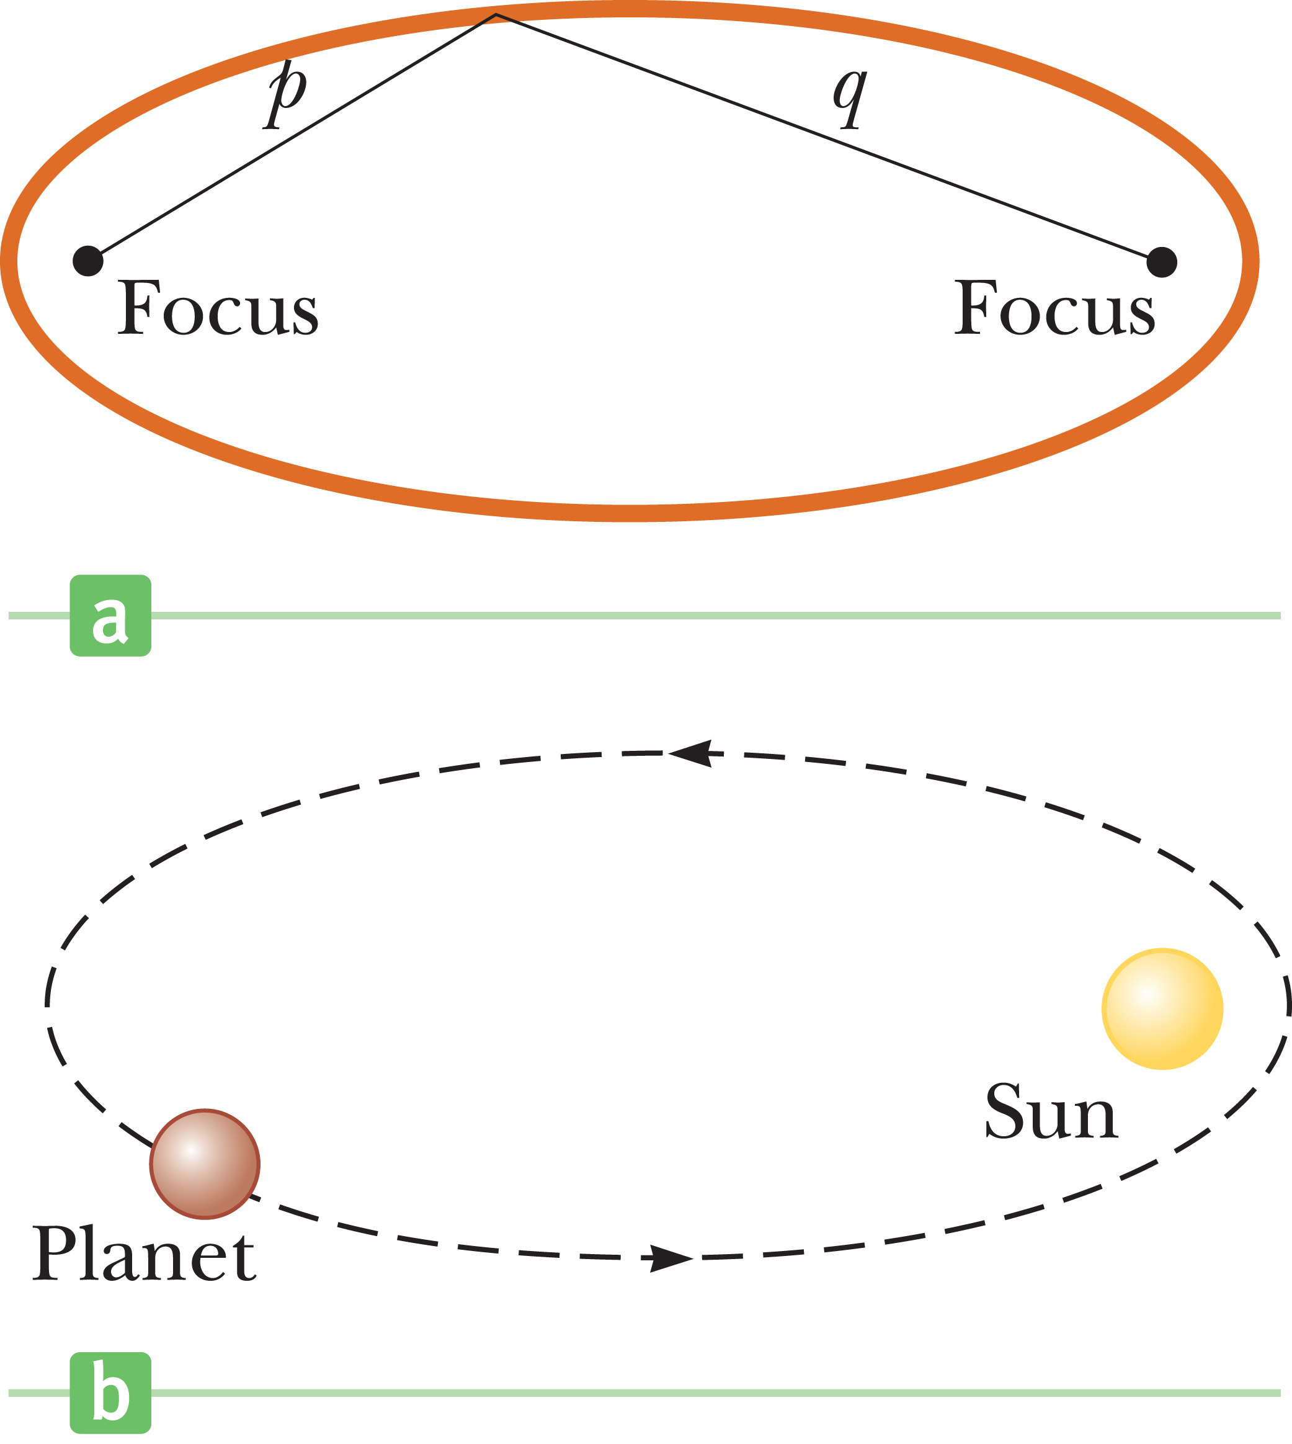
Kepler’s First Law
Notes:
The first law arises as a natural consequence of the inverse-square nature of Newton’s law of gravitation. Any object bound to another by a force that varies as 1/r² will move in an elliptical orbit.
As shown in the top figure, an ellipse is a curve drawn so that the sum of the distances from any point on the curve to two internal points called focal points or foci, singular, focus, is always the same. The semimajor axis a is half the length of the line that goes across the ellipse and contains both foci.
For the Sun–planet configuration shown in the bottom figure, the Sun is at one focus and the other focus is empty. Because the orbit is an ellipse, the distance from the Sun to the planet continuously changes.

Slide 61
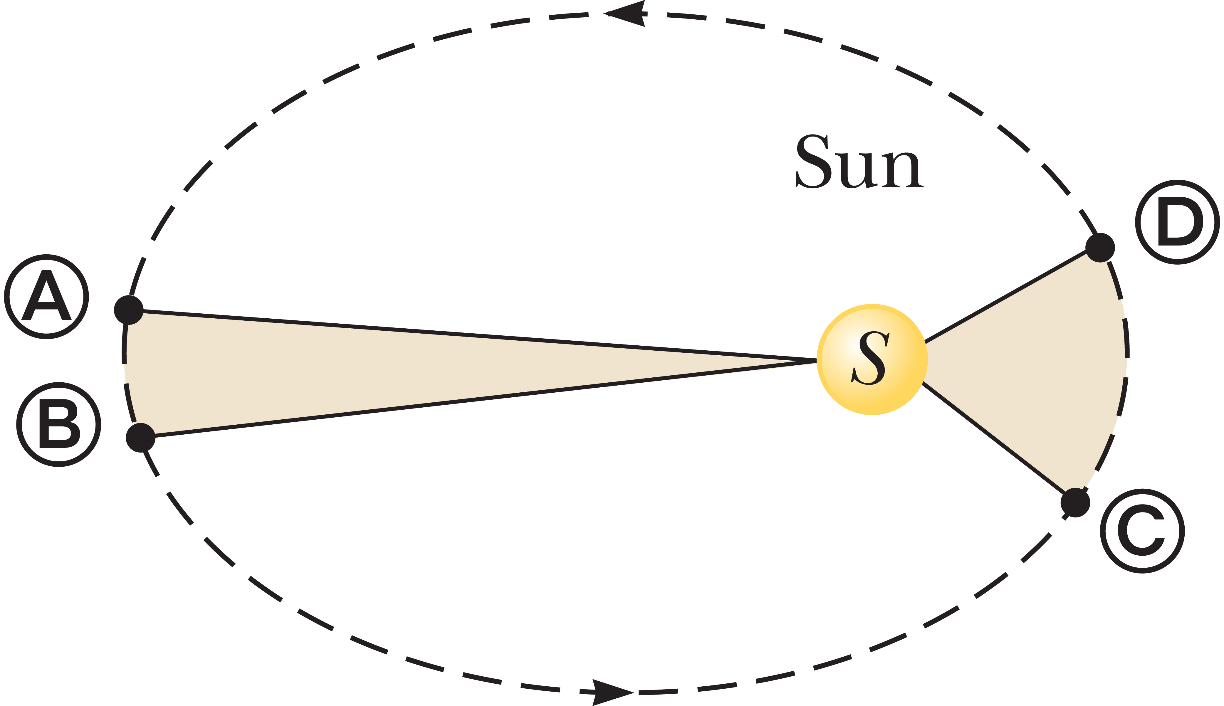
Kepler’s Second Law
Notes:
Kepler’s second law states that a line drawn from the Sun to any planet sweeps out equal areas in equal time intervals.
Consider a planet in an elliptical orbit about the Sun, as shown in the figure. In a given period Δt, the planet moves from point Ⓐ to point Ⓑ. The planet moves more slowly on that side of the orbit because it’s farther away from the Sun. On the opposite side of its orbit, the planet moves from point Ⓒ to point Ⓓ in the same amount of time, Δt, moving faster because it’s closer to the Sun. Kepler’s second law says that any two wedges formed as in the figure will always have the same area.
As we will see in Topic 8, Kepler’s second law is related to a physical principle known as conservation of angular momentum.

Slide 62
Kepler’s Third Law
Notes:
Let’s derive Kepler’s third law for the special case of a circular orbit.
Consider a planet of mass M_{p} moving around the Sun, which has a mass of M_{S}, in a circular orbit. Because the orbit is circular, the planet moves at a constant speed v. Newton’s second law, his law of gravitation, and centripetal acceleration then give the equations shown.
The speed v of the planet in its orbit is equal to the circumference of the orbit divided by the time required for one revolution, T, called the period of the planet. [click to show equation] Here we are substituting our expression and simplifying. Solving for T² [click to show equation], we get Kepler’s third law for circular orbits, where K_{S} is a constant.

Slide 63
Kepler’s Third Law
Notes:
This equation is Kepler’s third law for a circular orbit. The orbits of most of the planets are very nearly circular. Comets and asteroids, on the other hand, usually have elliptical orbits. For these orbits, the radius r must be replaced with a, the semimajor axis—half the longest distance across the elliptical orbit. This is also the average distance of the comet or asteroid from the Sun.
A more detailed calculation shows that K_{S} actually depends on the sum of both the mass of a given planet and the Sun’s mass. The masses of the planets, however, are negligible compared with the Sun’s mass; and so can be neglected, meaning this equation is valid for any planet in the Sun’s family.
If we consider the orbit of a satellite such as the Moon around Earth, then the constant has a different value, with the mass of the Sun replaced by the mass of Earth.

Slide 64
Kepler’s Third Law
Notes:
When time is measured in Earth years and the semimajor axis in astronomical units, where 1 AU = the distance from Earth to the Sun, Kepler’s law takes the simple form shown. This equation can be easily checked: Earth has a semimajor axis of one astronomical unit (by definition), and it takes one year to circle the Sun. This equation, of course, is valid only for the Sun and its planets, asteroids, and comets.
The table shows some useful planetary data. The last column shows that T² divided by r³ is very nearly constant.

Slide 65
Think – Pair – Share
Suppose an asteroid has a semimajor axis of 4 AU. How long does it take the asteroid to go around the Sun?
2 years
4 years
6 years
8 years
Notes:
Do a quick calculation, check with a classmate, and then we’ll hear from you in a couple of minutes.
Answer: 8 years
Reasoning: The semimajor axis of the asteroid’s orbit is 4 times the size of Earth’s orbit. Thus, Kepler’s third law, T³/R³ = constant, indicates that its orbital period is 8 times that of Earth.

Slide 66

Assessing to Learn
Estimate the speed of the Earth relative to the Sun in m/s.
1. less than 0.003 6. between 30 and 300
2. between 0.003 and 0.03 7. between 300 and 3,000
3. between 0.03 and 0.3 8. between 3,000 and 30,000
4. between 0.3 and 3 9. more than 30,000
5. between 3 and 30 10. Impossible to determine
Notes:
Think about it, do a quick calculation, and be prepared to justify your response. We’ll talk as a group in about 4 minutes, but feel free to check your answer with a classmate in the meanwhile and see if you both agree.
Answer: between 3,000 and 30,000
Question A3.03a
Commentary
Purpose: To develop your intuition about circular motion and gravitation.
Discussion:
Relative to the Sun, the Earth travels in a circular orbit whose radius is about 93 million miles (150 million km) and whose period is about 365 days. Therefore, the Earth travels at a constant speed of about 2π(150 × 10⁶ km)/(365 days), which is just under 30,000 m/s, or about 60,000 mph.
Key Points:
For an object moving with constant speed, the speed is equal to the distance traveled in some time period divided by the duration of that time period.
For uniform circular motion, speed can be found from circumference divided by period of rotation.
For Instructors Only
This is the first of two questions asking students to work out numerical values for the speed and acceleration of the Earth relative to the Sun. The context is to find the strength of the gravitational field of the Sun at the Earth.
If desired, only the second of these questions is needed.
If students don't know the relevant astronomical measurements, they should be encouraged to estimate them.
One possible point to discuss (after answers are collected and displayed) is the significance of the phrase "relative to the Sun" in the question.
(Technically, the period of the orbit of the Earth about the Sun is closer to 365.25 days. We are ignoring this effect.)
Source: UMass Assessing to Learn

Slide 67
Assessing to Learn
Estimate the acceleration of the Earth relative to the Sun in m/s².
1. less than 0.003 6. between 30 and 300
2. between 0.003 and 0.03 7. between 300 and 3,000
3. between 0.03 and 0.3 8. between 3,000 and 30,000
4. between 0.3 and 3 9. more than 30,000
5. between 3 and 30 10. Impossible to determine
Notes:
Do a quick calculation, check your answer with a neighbor, and get ready to share your results in 4 minutes.
Answer: between 0.003 and 0.03
Question A3.03b
Commentary
Purpose: To develop your intuition about circular motion and gravitation.
Discussion:
The Earth is traveling at a speed of about 30,000 m/s (60,000 mph) relative to the Sun, as discussed in the previous question.
The Earth is also moving in a circle, so its velocity vector is constantly changing direction. Thus, it is experiencing an acceleration. For an object traveling in a circle at constant speed ("uniform circular motion"), the acceleration vector points towards the center of the circle and has a magnitude of v²/R. Since the radius of the Earth's orbit is 150,000,000 km, its acceleration is toward the Sun has a magnitude of 0.006 m/s². This is a very, very small acceleration (1/1600 of the acceleration of an object dropped at the Earth's surface, relative to the Earth).
Because the gravitational force exerted by the Sun is the only force on the Earth, this value is also the gravitational field strength g of the Sun, i.e., 0.006 N/kg. (The Moon exerts a negligible force on the Earth.)
Key points:
The acceleration of the Earth relative to the Sun is quite small.
The acceleration of the Earth relative to the Sun is also the gravitational field strength of the Sun at the Earth, only about 0.006 N/kg.
For Instructors Only
This is the second of two questions asking students to use astronomical data to compute a motion quantity. This particular quantity, by Newton's 2nd law, is also the strength of the "local" gravitational field of the Sun at the Earth.
Students choosing one of the larger answers may be guessing, based on the magnitude of the previous question's answer (the speed of the Earth).
Another likely source of error is units confusion: answering in km/h or km/s or mph, for example.
This question pair also presents another opportunity to discuss the fact that we "feel" accelerations, not velocities. The fact that we cannot sense the Earth's motion implies that the Earth's acceleration, but not necessarily its velocity, must be small.
Source: UMass Assessing to Learn

Slide 68
Assessing to Learn
An object is at rest on the equator. Estimate its speed relative to the center of the Earth in m/s.
1. less than 0.001 6. between 10 and 100
2. between 0.001 and 0.01 7. between 100 and 1,000
3. between 0.01 and 0.1 8. between 1,000 and 10,000
4. between 0.1 and 1 9. more than 10,000
5. between 1 and 10 10. Impossible to determine
Notes:
Think about it, do a calculation, talk it over with a classmate, and we’ll hear from you in a minute or two.
Answer: between 100 and 1,000
Question A3.04a
Commentary
Purpose: To explore your current perceptions of circular motion, and set up the subsequent question.
Discussion:
A point on the equator is about 4,000 miles, or about 6,400 km, from the center of the Earth. Due to the rotation of the Earth once every 24 hours, this point is moving and thus has a nonzero speed. The point travels one circumference of the Earth in 24 hours, so the speed is constant and equal to the distance traveled divided by the time taken:
2π(6,400 km)/(24 h) = 465 m/s, or about 1,000 mph: answer (7).
Note that as we move toward the poles, the speed becomes smaller, because the circumference of the circle traveled every day is smaller. At the poles, this speed is zero.
Answering this question requires you to estimate the radius of the Earth. This is a valuable "benchmark" number to know. However, even if you don't know it, you should be able to estimate it with sufficient accuracy to answer the question correctly: any estimate between 1,375 and 13,750 km will produce the correct answer. By comparing to known geographical distances — for example, that the width of the lower 48 US states is about 3,000 miles or 4,800 km — you can figure that it should be somewhere between 5,000 and 10,000 km.
Key Points:
The speed of a point on the equator of the Earth is quite large, about 1,000 mph.
The speed of a point on the surface of the Earth becomes smaller away from the equator, because the circle traveled in one day becomes smaller.
The Earth's radius is approximately 4,000 miles or 6,400 km.
If you don't know a number such as the Earth's radius, you can often estimate it by comparing it to similar distances you do know.
Your body cannot feel that you are moving at a high speed; you can only feel accelerations, not speeds.
For Instructors Only
This is the first of two questions using this situation. The goals of this set are to help students distinguish velocity and acceleration better, if they have not done so yet, and to help students see that many experiments and demonstrations are still valid in spite of the acceleration of the classroom relative to the center of the Earth.
Students might be surprised to learn just how fast a point on the equator is moving due to the Earth's rotation, since they don't feel any motion.
One possible source of confusion is that students must realize a point on the Earth returns to almost the same position every 24 hours; this can be difficult for some to visualize. (Note that this is not absolutely true, since we are orbiting the Sun. There is a 1/365 correction: because we are orbiting the Sun, we rotate 366 times every 365 days. This is irrelevant for an estimate, but instructors should be aware of the fact nonetheless.)
An interesting and, for this problem, useful fact to know is that the meter is defined such that a (particular) quarter circle on the Earth has a length of 10,000 km. Thus, the circumference of the Earth at the equator is about 40,000 km.
Source: UMass Assessing to Learn

Slide 69
Assessing to Learn
An object is at rest on the equator. Estimate its acceleration relative to the center of the Earth in m/s².
1. less than 0.001 6. between 10 and 100
2. between 0.001 and 0.01 7. between 100 and 1,000
3. between 0.01 and 0.1 8. between 1,000 and 10,000
4. between 0.1 and 1 9. more than 10,000
5. between 1 and 10 10. Impossible to determine
Notes:
Make a calculation, run your result by a classmate, and be ready to share with the class in about two or three minutes.
Answer: between 0.01 and 0.1
Question A3.04b
Commentary
Purpose: To consider the validity of Newton's laws in a reference frame fixed to the Earth's surface.
Discussion:
An object "at rest" on the equator is moving at about 465 m/s (about 1,000 mph) relative to the center of the Earth, as discussed in the previous question.
The object is also moving at constant speed in a circle having a radius of 6,400 km, so its acceleration is toward the center of the Earth and has a magnitude of v²/R = 0.033 m/s². This is a very small acceleration. (An object starting from rest and accelerating with this value would take about 3 minutes to reach a normal walking speed of 3 mph.)
Even though objects "at rest" on the surface of the Earth are moving very quickly, we do not perceive any motion at all, because the acceleration is so small. This means that many experiments and demonstrations performed on the surface of the Earth are valid and do not violate Newton's laws. In other words, the surface of the Earth may be considered an inertial (Newtonian) frame of reference for all but the most sensitive experiments. This is good, since Newton's laws were discovered in this frame!
Note that as we move toward the poles, the acceleration becomes smaller, and the direction is no longer toward the center of the Earth, but toward the axis about which the Earth rotates. (Think about the circle being traveled and where its center is located.)
Key Points:
The acceleration of an object moving in a circle with constant speed is equal to v²/R.
We get no "sense of motion" from high speed, only from high acceleration.
Although a point on the Earth's surface is not a Newtonian (non-accelerating) reference frame, it is close enough to one that many experiments and demonstrations used to confirm Newton's laws are still valid.
A frame with large velocity does not invalidate Newton's laws; a frame with large acceleration does.
For Instructors Only
This is the second of two questions using this situation.
The main point of this question is not about the mechanics of circular motion (e.g., computing speeds and acceleration), but about valid Newtonian frames of reference.
Students in introductory physics should be warned against imagining themselves as part of a system undergoing accelerated motion. For instance, when discussing a car going around a curve in the road, many students will imagine being the driver or a passenger. This raises many issues that students are not prepared to deal with properly, such as fictitious forces like the centrifugal force. Thus, it is often best to simply remind students that Newton's laws are valid only in "inertial" frames, i.e., frames that are not accelerating, so they should always "view" the process from a proper frame.
Some students will naturally be curious about why we can validate Newton's laws within the classroom, since it is accelerating. Some of these students will still not have a firm grasp on the difference between velocity and acceleration, and when they discover just how quickly we are moving (either relative to the center of the Earth or relative to the Sun), they might have trouble accepting the whole Newtonian model. Thus, they might need to be reminded that Newton's laws are perfectly valid in a moving but inertial reference frame (e.g., a train) and that constant-velocity motion cannot be detected. It is acceleration that invalidates a moving frame, and the accelerations involved in a "laboratory" frame are very small.
Students might not appreciate the importance or value of the phrase "relative to the center of the Earth". The question is ambiguous without defining the frame of reference; the acceleration of the object is zero from a "laboratory" frame fixed to the Earth's surface.
If students do not know that the acceleration is v²/R or that the radius of the Earth is about 6,400 km, they should be encouraged to guess. They can still benefit from the question and subsequent discussion.
Students who choose a large value may be confusing velocity and acceleration, or assuming that a large velocity is likely to indicate a large acceleration.
Students who select the smallest answer may do so because they believe the acceleration is zero; this should be drawn out during discussion.
Source: UMass Assessing to Learn

Slide 70
Assessing to Learn
Estimate the speed of the Moon relative to the center of the Earth in m/s.
1. less than 0.003 6. between 30 and 300
2. between 0.003 and 0.03 7. between 300 and 3,000
3. between 0.03 and 0.3 8. between 3,000 and 30,000
4. between 0.3 and 3 9. more than 30,000
5. between 3 and 30 10. Impossible to determine
Notes:
Think about it for yourself, then check with a classmate, and we’ll check your answer in about 4 minutes.
Answer: between 300 and 3,000
Question A3.05a
Commentary
Purpose: To challenge your perceptions about circular motion, speed, velocity, and acceleration.
Discussion:
Relative to the Earth, the Moon travels in a circular orbit whose radius is about 250,000 mi (400,000 km) and whose period is about 28 days. Therefore, the Moon travels at a constant speed of about 2π(400,000 km)/(28 days), which is about 1,000 m/s or about 2,000 mph: answer (7).
If you don't know the radius of the Moon's orbit, you can estimate it. The Moon's radius is roughly one quarter of the Earth's, or about 1,600 km (actually, it's 1,738 km). If the Moon were only ten Earth radii from the Earth, it would look very large indeed when overhead! Something closer to 100 Earth radii is more reasonable. (The actual value is about 60.) If it were much farther than that, it would appear much smaller to the eye than it does; you can sketch a diagram and do some simple geometry to see that.
Key Points:
The Moon's orbital distance from the Earth is approximately 60 times the radius of the Earth.
The Moon travels at high speed in its orbit around the Earth.
For Instructors Only
This is the first of two questions asking students to work out numerical values for the speed and acceleration of the Moon relative to the Earth.
Students might just guess, perhaps because they are not sure how to estimate the speed, or because they do not know the relevant values for the radius or period of the Moon's orbit around the Earth. This is not bad; it helps students to adjust their physical intuition and sense of numbers, and opens up a discussion about ways to estimate physical quantities and place bounds on guesses.
Students might use 30 days as the period of the Moon's orbit, since that is the typical time between full moons. This is okay, since we are interested only in an estimate, but it should be noted that 30 days is not strictly correct. Since the Earth does not remain is the same place relative to the Sun, the Moon must travel a little farther than one complete period to reach a position where it is full as seen from the Earth.
Students who choose answer (4) may have computed the correct value in km/s and failed to convert to m/s.
A valuable follow-up question is to ask how the answer would change if the question asked about the Moon's speed relative to the Sun. (It would be very much larger.)
Source: UMass Assessing to Learn

Slide 71
Assessing to Learn
Estimate the acceleration of the Moon relative to the center of the Earth in m/s².
1. less than 0.003 6. between 30 and 300
2. between 0.003 and 0.03 7. between 300 and 3,000
3. between 0.03 and 0.3 8. between 3,000 and 30,000
4. between 0.3 and 3 9. more than 30,000
5. between 3 and 30 10. Impossible to determine
Notes:
Share your ideas with a neighbor, and get ready to share with the class in about four minutes.
Answer: less than 0.003
Question A3.05b
Commentary
Purpose: To challenge your perceptions about circular motion, speed, velocity, and acceleration.
Discussion:
The Moon is traveling at a speed of about 1,000 m/s (2,000 mph) relative to the Earth, as discussed in the previous question.
The Moon is also moving at constant speed in a circle having a radius of 400,000 km, so its acceleration is toward the Earth and has a magnitude of v²/R = 0.0027 m/s². This is a very, very small acceleration.
Key points:
For an object moving in a circle with uniform speed, its acceleration is v²/R towards the center of the circle.
The Moon is an example of something that has a speed much larger than we are accustomed to (2,000 mph) but an acceleration that is much smaller than we are accustomed to (about 0.003 m/s²).
Large speeds do not always indicate large accelerations. If the radius of the circular path is very large, the acceleration can be small even for large speed.
For Instructors Only
This is the second of two questions exploring students perceptions of speed and acceleration of objects in circular motion.
Students often think that a large speed is associated with a large acceleration; this is a familiar situation challenging that intuition.
Students might guess, and that is okay, since the question aims to develop students' physical intuition and sense of physical quantities. Many will guess a large value because they think that the acceleration is large when the speed is large. They do not always have an accurate sense of the effect of large circles.
Determining the answer in incorrect units, such as km/h, km/s, or mph, is a common error.
Technically, the radius of the circular orbit is very slightly smaller than the Earth-Moon distance, because the center of mass of the system is not at the center of the Earth. It is about 5,000 km from the Earth's center (or about 1,500 km below the surface of the Earth). We are ignoring this effect. Further, students are asked to find the acceleration "relative to the center of the Earth", which means this effect is not relevant.
Source: UMass Assessing to Learn

Slide 72
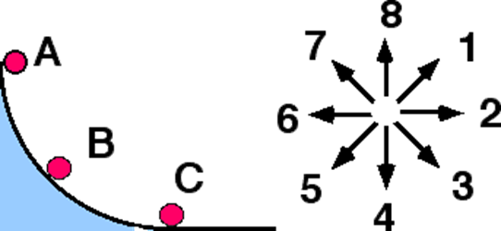
Assessing to Learn
A small ball is released from rest at position A and rolls down a vertical circular track under the influence of gravity. When the ball reaches position B, which of the indicated directions most nearly corresponds to the direction of the normal force on the ball?
9. Impossible to determine.
Notes:
Think for yourself for a moment, pair up to compare your thoughts with a neighbor, and then we’ll hear from you in 2 minutes.
Answer: (1)
Question B1.07a
Commentary
Purpose: To develop your understanding of the normal force by considering it for a moving object on a curved, non-horizontal surface.
Discussion:
The normal force is one component of the contact force exerted by one surface on another when the two surfaces are pushed together. The component perpendicular to the surface is called the normal force, and the component parallel to the surface is called the friction force.
In this case, since the surface is curved, we need to imagine a line tangent to the curve at point B. The directions perpendicular to this tangent line are (1) and (5), so the normal force must point in one of these directions. Since the normal force always pushes, the direction must be (1). In other words, the normal force always points away from the surface and toward the object acted upon.
Key Points:
The normal force is the component of the contact force between two surfaces that is perpendicular to the surfaces, pushing outward.
The normal force always points perpendicularly out from the surface.
For a curved surface, the normal force is perpendicular to a hypothetical plane tangent to the surface.
For Instructors Only
When the normal force is introduced to students, a flat horizontal surface is usually used to illustrate the concept. Flat surfaces are also used in the majority of problems that students solve. This question extends the context so that students consider the normal force exerted on an accelerated object moving on a curved, non-horizontal surface.
Those who answer (8) may be thinking that the normal force always opposes the gravitational force, as when an object is resting on a horizontal surface.
Students who answer (5) may be indicating the direction of the normal force exerted on the curved track by the ball.
The direction of the normal force is essentially a matter of definition. The track exerts a force on the ball. Dividing this force into a component perpendicular to the surface (called the normal force) and a component tangential to the surface (called the friction force) is a choice, made for convenience. There are no demonstrations one can do to show that the normal force points in a particular direction.
Discussion Questions:
If a ball were on a flat horizontal surface, what would be the direction of the normal force?
What would be the direction of the normal force if the ball were rolling across a flat horizontal surface?
What would be the direction of the normal force exerted on a block at rest on an incline?
What would be the direction of the normal force on a ball rolling down an incline?
What direction(s) are perpendicular to the track at point B?
Source: UMass Assessing to Learn

Slide 73
Assessing to Learn
A small ball is released from rest at position A and rolls down a vertical circular track under the influence of gravity. When the ball reaches position B, which of the indicated directions most nearly corresponds to the direction of the ball's acceleration?
9. Impossible to determine.
Notes:
Come up with your answer, and an explanation or justification of that answer, and see if you can convince a classmate. We’ll review your responses in 3 minutes. Be sure you can explain your answer.
Answer: (2)
Question B1.07b
Commentary
Purpose: Develop your understanding of the vector nature of acceleration in curvilinear motion.
Discussion:
When an object is traveling along a curve, it is useful to look at components of vectors parallel or tangent to the surface at a particular point, and also at the components perpendicular to the surface. Acceleration is one vector that can be analyzed more easily this way.
In this case, since the ball is moving in a circle, we know the direction of motion is changing, which means there is necessarily a component of acceleration perpendicular to the surface. The direction of this component is (1).
The ball is also speeding up, which means there is a component of acceleration along the direction of motion, (3).
The acceleration is the vector sum of these components. Even though we do not know how large these two components are, it is likely that the direction of the acceleration will be closest to direction (2).
Key Points:
Acceleration is a vector that describes the rate of change of the velocity vector's magnitude and its direction.
It is often useful to divide the acceleration into components that are parallel (tangential) and perpendicular to the object's direction of motion.
A nonzero tangential component of acceleration indicates that the object is changing speed.
A nonzero perpendicular component of acceleration indicates that the object is changing direction.
For Instructors Only
It is common for students to neglect one component or the other. Those who focus excessively on the ball's speeding up will choose direction (3), while those who focus excessively on the "radial" acceleration will choose direction (1).
Choosing (9), impossible to determine, is valid in this context, since we are assuming that students do not have sufficient experience to derive the relationships needed to be specific. These students should be pressed to find out the range of answers. They should recognize that if the "perpendicular" component is much larger than the "parallel" component, then the best answer is direction (1).
For a wide range of components, the best answer is direction (2). If the "parallel" component is much larger, then the best answer is direction (3).
Students might not realize just how large the ratio of components must be for direction (1) or (3) to be the best answer. The ratio must be more than 2.4.
Worked out carefully, the perpendicular component of acceleration is twice as large as its parallel component, so the direction of the acceleration is 18.43 degrees above direction (2).
Source: UMass Assessing to Learn

Slide 74
Assessing to Learn
A small ball is released from rest at position A and rolls down a vertical circular track under the influence of gravity as depicted below. When the ball reaches position B, which of the indicated directions most nearly corresponds to the direction of the net force on the ball?
9. Impossible to determine.
Notes:
Take a stab at it yourself first, but if you want to compare your answers with a neighbor, you can. We’ll go over it in 3 minutes.
Answer: (2)
Question B1.07c
Commentary
Purpose: Develop your understanding of the vector nature of force in curvilinear motion, and stress the relationship between force and acceleration.
Discussion:
There are three forces on the ball: (1) gravitation, down, due to the Earth; (2) normal force, up and to the right (direction 1), due to the surface; and (3) static friction, up and to the left (direction 7), also due to the surface. It is likely that the normal force is larger than the static friction force, but it is hard to predict how these will compare to gravitation. Thus, it would seem as though it is impossible to determine the direction of the net force.
However, there is another way to look at this situation. According to Newton's second law, the direction of the net force must be the same as the direction of the acceleration. In the previous question, we found that the ball's acceleration vector points approximately in direction (2). Thus, the net force must also point that way.
Key Points:
The net force on an object and the object's acceleration vector always have the same direction.
For Instructors Only
You may think this question is highly redundant with the previous one, but many students still get it wrong. They focus on the individual forces and try to figure out what the sum will be, and ignore newton's second law.
Students will choose (1) if they are focusing excessively on the normal force.
They will choose (3) if they are focusing on the component of gravitation parallel to the incline, and ignoring the normal force.
They will choose (4) if they think the net force is the gravitational force.
They will choose (5) if they think the net force is the centrifugal force.
Source: UMass Assessing to Learn

Slide 75
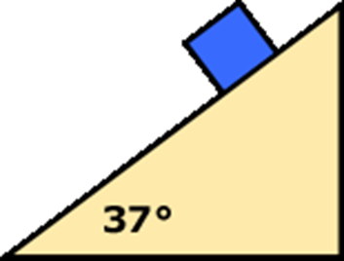
Assessing to Learn
A mass of 5 kg is released from rest on a smooth incline making an angle of 37° to the horizontal. The tangential component of acceleration is closest to:
10 m/s²
8 m/s²
6 m/s²
4 m/s²
2 m/s²
0 m/s²
Exactly halfway between 2 of the above answers
The negative of one of the answers above
It is impossible to determine the tangential component of the block's acceleration
I do not know what is meant by "tangential" in this situation
Notes:
Take a stab at it yourself first, but if you want to compare your answers with a neighbor, you can. We’ll go over it in a couple of minutes.
Answer: 6 m/s²
Question A3.06a
Commentary
Purpose: To hone the concept of the "tangential" component of acceleration by applying it to a familiar situation with linear motion.
Discussion:
Sometimes, it is easier to learn the meaning of a new term using a familiar situation. In this case, since there is no friction, it is relatively easy to determine the acceleration of the block as it slides down the incline. What is not so easy is to apply the definition of "tangential component".
The tangential component of acceleration is the rate at which the speed is changing. It is the component of acceleration along the direction of motion, even if that motion is in a straight line. In this case, the object is speeding up, so the tangential component of acceleration is positive.
For θ = 37°, the acceleration is 6 m/s² "down the incline", so the tangential component of acceleration is also 6 m/s²: answer (3).
Even though the block is sliding down the incline, the tangential component is not negative, because this would mean the block is slowing down. In a rotated coordinate frame in which the x-axis lies along the incline with the positive direction uphill, the x-component of the acceleration would be –6 m/s², but this is different from the tangential component.
Key Points:
The tangential component of acceleration is the component in the direction of the object's velocity vector. The object does not have to be moving along a curved path.
If an object is speeding up in any direction, the tangential component of acceleration is positive.
The sign of the tangential component of acceleration does not depend on the coordinate system you have chosen for the problem.
For Instructors Only
This is first of two questions designed to help students understand the tangential and radial components of acceleration by applying the new concepts to familiar, straight-line motion.
Some students will think that "tangential" has no meaning when the motion is in one dimension, or along a straight line. Even students who have much experience in physics might never have considered the concept in this context.
Some students will answer (3) correctly even though they do not totally understand what is being asked of them. They might simply be telling you that the magnitude of the acceleration is 6 m/s². Thus, drawing out the reasoning behind students' answers is vital.
Source: UMass Assessing to Learn

Slide 76
Assessing to Learn
A mass of 5 kg is released from rest on a smooth incline making an angle of 37° to the horizontal. The radial component of acceleration is closest to:
10 m/s²
8 m/s²
6 m/s²
4 m/s²
2 m/s²
0 m/s²
Exactly halfway between 2 of the above answers
The negative of one of the answers above
It is impossible to determine the tangential component of the block's acceleration
I do not know what is meant by "tangential" in this situation
Notes:
Come with something on your own, talk it over with a classmate, and be ready to share it with the class in a couple of minutes.
Answer: 0 m/s²
Question A3.06b
Commentary
Purpose: To hone the concept of the "radial component of acceleration" by applying it to a familiar situation with linear motion.
Discussion:
When an object is moving along a curved path, the radial direction is toward the center of the circle that best approximates the curve at the object's current location. This direction is always perpendicular to the direction of motion. When an object is moving along a straight line, the "radial" direction is still perpendicular to the direction of motion, and the "best" circle has an infinite radius.
The component of the acceleration perpendicular to the incline is zero, so the radial component of acceleration is also zero: answer (6).
For straight-line motion, there is an ambiguity here: the radial direction is perpendicular, but in which way? The center of the "circle" of infinite radius can be in any direction perpendicular to the line of motion: directly away from the plane, directly into the plane, directly out of the page, directly into the page, or somewhere in between. Fortunately, since this ambiguity only exists for straight-line motion, and the radial component of acceleration is always zero for straight-line motion, it doesn't matter.
Key Points:
The radial component of acceleration is the component of an object's acceleration vector along a direction perpendicular to the direction of the object's motion, pointing towards the center of the imaginary circle that best fits the curved trajectory of the object at its current location.
For straight-line motion, the radial component of the acceleration is always zero.
For Instructors Only
This is the second of 2 questions designed to introduce the concepts of "radial" and "tangential" components of acceleration, by applying the new terms to a familiar one-dimensional situation students should already know how to treat.
Most students will probably not know how to apply the term "radial" to this situation, since there does not appear to be any circle or curved path. Others might not know if the "best circle" should be above or below the incline (or parallel to it, perpendicular to the page).
Some students will likely answer 6 m/s², since that is the magnitude of the block's acceleration. Other students might think that the component is –6 m/s², perhaps because the block is accelerating down the incline.
It is useful to point out to students that even in straight-line motion, "tangential" and "radial" form a perpendicular pair of components, which means it is relatively easy to find the (total) acceleration vector.
Source: UMass Assessing to Learn

Slide 77
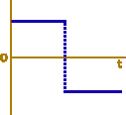
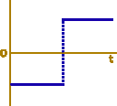
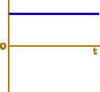
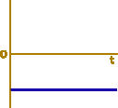
Assessing to Learn
A ball is rolled up an incline so that it goes part-way up and then rolls back down. Which of the graphs below could represent its tangential component of acceleration vs. time, from the instant it is released until it returns to its starting point?
1. 2. 3. 4.
5. Graphs 1 and 2 6. Graphs 3 and 4
7. None of the graphs
8. It’s not clear what is meant by “tangential” in this situation.
Notes:
Check with your partner to see if you got it right—if you disagree, or you’re both not sure, don’t worry. We’ll have a group discussion in 4 minutes.
Answer: (2)
Question A3.07
Commentary
Purpose: To hone the concept of tangential acceleration through graphical representation.
Discussion:
When learning about acceleration and its vector nature, you may have difficulty understanding why the acceleration of the ball in this situation is constant. Intuitively, it may seem that the acceleration should be negative when the object is slowing down and positive when it is speeding up. However, the acceleration of the ball in this situation is constant, pointing down the plane during the ball's entire motion. The component of acceleration along the plane will be always positive or always negative, depending on the coordinate system defined.
There is, however, a quantity that does describe the rate of change of the speed of an object: the tangential component of acceleration. When the object is slowing down, the tangential component of acceleration is negative, and when the object is speeding up, the tangential component of acceleration is positive. Therefore, graph (2) is a valid answer to this question.
(It is called the "tangential" component because when an object is moving along a curved path, it is the component of the acceleration vector along a direction tangential to the curve, in the direction the object is moving. You will see this quantity used most often when discussing circular motion, but it can be applied to straight-line motion as well.)
The tangential component does not depend on the coordinate frame chosen. Rather, it is defined relative to the direction of motion — the direction of the velocity.
Graph (1) is not a valid answer for any choice of coordinate system, since it means the object is speeding up and then slowing down.
Key Points:
The tangential component of acceleration is the component of the acceleration vector along an object's direction of motion, where the direction the object is moving is taken to be positive.
The tangential component of acceleration is the rate of change of an object's speed (not velocity). When the tangential component of acceleration is positive, the object is speeding up; when negative, it is slowing down.
The value of an object's tangential component of acceleration does not depend on the coordinate system chosen for the problem.
For Instructors Only
This question gives a name to the concept of "rate of change of speed" that many students intuitively attach to the word "acceleration".
Some students will not know how to interpret "tangential" when the motion is along a straight line. They might think "tangential" and "radial" only have meaning when an object is moving along a curved path. Although the tangential component of acceleration is mostly used in circular or at least curvilinear motion settings, applying it to linear motion as in this problem extends the context in which students encounter the concept. This helps them relate it to kinematics in general, rather than "pigeonholing" it with circular motion ideas only.
Students who select answers (3), (4), or (5) might be choosing a graph for the acceleration, not its tangential component.
Students may not see why (1) cannot be valid if (2) is. They do not realize that we cannot choose the direction that is positive for tangential acceleration, but that it is always the direction of motion. And this would not be surprising — we've tried hard to convince them that components can be positive or negative depending on coordinate system, and now we introduce a strange kind of component where it's not!
It may or may not be helpful to describe this component in terms of a coordinate system that is attached to the object and travels and turns along with it. (Formally, such a system is called the Frenet-Serret frame, and consists of a tangential unit vector in the direction of the derivative of the particle's position, a normal unit vector orthogonal to that and in the direction of the second derivative of the position, and a binormal unit vector orthogonal to the other two and forming a right-handed coordinate system.) Making this connection can be enriching, but it opens up a large can of worms, and should probably not be attempted unless you are willing to spend a good deal of time discussing inertial vs. non-inertial reference frames and similar issues.
Source: UMass Assessing to Learn

Slide 78
Assessing to Learn
An iceberg weighing 1,000 tons is floating in the North Atlantic. Consider the gravitational forces on the iceberg due to the Earth, the Moon, and the Sun. Put these gravitational forces in order of increasing magnitude.
You do not need to do any calculations. Use reasoning, or simply guess.
Earth < Moon < Sun
Earth < Sun < Moon
Moon < Sun < Earth
Moon < Earth < Sun
Sun < Moon < Earth
Sun < Earth < Moon
Notes:
You can check with a neighbor once you have worked it out for yourself, and we’ll talk through it in 3 minutes. Be ready to share your thoughts!
Answer: Moon < Sun < Earth
Question F1.0
Commentary
Purpose: To develop your ability to reason with universal gravitation.
Discussion:
The gravitational force on an object due to some source is equal to the mass of that object times the gravitational field strength due to the source. The gravitational field strength of a source depends on the mass of the source and how far away it is, as describe by Newton's law of universal gravitation. However, you can solve this problem purely through deduction, without any calculation at all.
In this situation, the weight and circumstances of the iceberg are irrelevant; the ordering of the gravitational forces depends only on the value of the gravitational field strength due to each of the three celestial objects.
If the water were removed, the iceberg would fall towards the Earth, not towards the Moon or Sun. Thus, the Earth must be exerting the strongest gravitational force. In fact, almost every time we solve a physics problem that takes place on the surface of the Earth, we consider the force of gravity due to the Earth but neglect the gravitational forces of the Moon and Sun because they are negligibly small.
Which of the other objects — the Moon or the Sun — exerts the next largest force? The Earth orbits the Sun, not the Moon. If the Moon were removed, the Earth's behavior would not change significantly; it would still orbit the Sun once a year. However, if the Sun were removed, the Earth's behavior would change dramatically; it would respond slightly as the Moon orbited it, but would no longer travel in its large circle about the Sun. Thus, the effect of the Sun's gravitational field on the Earth (and objects on it) is clearly larger than the effect of the Moon's gravitational field.
It might be tempting to think that the Moon exerts a larger force than the Sun because it is so much closer, but remember that it also has far less mass. You might also argue that the Moon has a larger influence than the Sun because the Moon's gravity causes significant tides on the Earth, while the Sun's causes only a small perturbation to those tides. However, tides are caused by the gradient of a gravitational field, not by the strength of that field. The Moon's gravitational field is weaker, but it is changing more rapidly with distance.
Key Points:
To figure out which force on a system is stronger, determine which has the larger effect (unless another force balances it and "cancels out" its effect).
The strength of the gravitational force on an object depends on both the mass of the source and the distance to that source.
For Instructors Only
Students who select answers (1) or (2) may think that the Earth exerts no gravitational force at all on the object, perhaps because the object is "floating". This indicates a fundamental misconception about weight.
Note that "impossible to determine" is not an available option. Students should be encouraged to select one of the answers, even if they are not sure if it is correct.
Students will likely want to compute the three forces using F_{g} = GMm/d², and may be frustrated if they are not given sufficient time to do this. They should be reminded that the question asks them only to compare the forces, not to compute them. They should be encouraged to find qualitative arguments.
We can confirm our qualitative argument via calculations, though this is not necessary and students should be discouraged from doing so. We include the following for the instructors' benefit.
The gravitational field strength at some location is g = GM/d², where G is the Universal gravitational constant, M is the mass of the agent exerting the gravitational force, and d is the separation of the agent and the object. (That is, the force is F_{g} = mg = GMm/d².) Since G is the same for all 3 forces, we can compare M/d² to find out which is largest and which is smallest.
For the Earth M = 6 × 10²⁴ kg and d = 6,400 km is the radius of the Earth. For the Moon, M = 7.4 × 10²² kg and d = 400,000 km is the orbital radius of the Moon about the Earth. For the Sun, M = 2 × 10³⁰ kg and d = 150,000,000 km is the orbital radius of the Earth about the Sun.
The results are tabulated below.
Agent Mass, M Separation, d Ratio, M/d²
(10²¹ kg) (10³ km) (10¹² kg/km²)
Earth 6,000 6.4 150,000
Moon 74 400 0.5
Sun 2×10⁹ 150,000 90
Thus, as reasoned above, the Earth exerts the strongest force, the Sun is next, and the Moon is smallest. Further, the Sun exerts a force almost 200 times as strong as that of the Moon.
We can also compute g due to each celestial body. Due to the Earth, it is about 10 N/kg. Due to the Sun, it is equal to the acceleration of the Earth relative to the Sun, or about 6 mN/kg (i.e., 0.006 N/kg). Due to the Moon, it is equal to about 30 µN/kg (3×10^{–5} N/kg), which can be deduced from its acceleration relative to the Earth multiplied by the ratio of the two masses (1:81). Of course, we can also use g = GM/d², but it is noteworthy to discover than we do not need G to determine these values of g.
Source: UMass Assessing to Learn

Slide 79
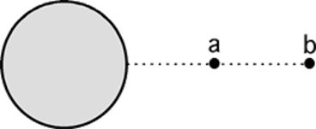
Assessing to Learn
Two identical objects are released from rest from heights R and 2R above the surface of the Earth. After traveling a distance R/2, which object has the larger speed?
Object a.
Object b.
Neither; they have the same speed.
Notes:
Think for a minute or two, check with a classmate, and be ready to share your answer and justify it in about 4 minutes.
Answer: Object a.
Question F1.02a
Commentary
Purpose: To extend work and energy ideas to a situation requiring universal gravitation, and to sensitize you to the danger of applying remembered results to new situations without resorting to general principles.
Discussion:
In a uniform gravitational field ("local gravity approximation"), two objects that fall the same distance from rest will have the same final speed, regardless of any difference in their starting heights. In this problem, however, the distances are comparable to the size of the Earth, so the gravitational field is far from uniform. (The question's wording does not explicitly state this, but the diagram implies it.)
You can try to argue for an answer based on Newton's law of universal gravitation (noting that the gravitational force is weaker for objects farther away), Newton's second law, and kinematics, but this tends to be confusing. Object b is farther away, so it experiences a weaker force; however, it falls for a longer time to cover the same distance, so it has more time to accelerate due to that force. Determining anything definitive about the final speed requires careful calculation.
As usual when talking about distances and speeds but not times, energy ideas are easiest to use. In this case, you must recognize that total mechanical energy is conserved since all acting forces are conservative; therefore, whichever object loses the most gravitational potential energy as it falls a distance of R/2 will gain the most kinetic energy and thus have the greatest final speed.
The trick is that for universal gravitation, an object's gravitational potential energy is zero at infinity and increasingly negative as the object gets closer to the Earth. Furthermore, the potential energy goes as one over the distance (from the center of the Earth), so that a given change in distance causes a greater change in potential energy closer to the source compared to far away. (This is clearer if you sketch a plot of 1/r.) Given this, object a will lose more potential energy falling a distance R/2 than will object b; both have a potential energy that starts negative and gets more negative, but a has the larger change. Thus, a will gain more kinetic energy and have the larger final speed, so (a) is the best answer.
Key Points:
Know what assumptions (like "local gravity") are involved in any physics principles, laws, rules, derived results, etc. that you learn, and be on the lookout for situations that violate those assumptions.
Be careful about using derived results like "objects that fall the same distance from rest end up with the same speed, regardless of how high they start" as if they were general truths. Trust general principles like the work-energy theorem, not specific rules that may depend on the details of a situation.
Energy ideas are usually more useful than forces and kinematics when reasoning about forces, distances, and speeds (but not times).
It is traditional to choose r = 0 as the reference point at which the gravitational potential is zero. With this convention, potential energy is always negative for universal gravitation.
For Instructors Only
This is a classic "extend the context" problem: it asks a familiar question in an unfamiliar context, requiring students to extend their understanding of conservation of energy outside the realm of local gravitation.
The problem may be considered ambiguous because its wording does not state that R is significant compared to the size of the Earth, and therefore that the local gravity approximation is inappropriate. However, the diagram shows a spherical Earth and clearly implies it. In addition, one might suspect that the choice of "R" as the distance variable is meant to signify the radius of the spherical Earth. This "ambiguity" is not a weakness of the question, but rather a strength: it provides the opportunity to sensitize students to the assumptions they may make. If some students fail to recognize the figure's implication, the instructor should engage students in a brief discussion about problem-solving strategy and exhort students to "use all the information available in a problem, including figures and variable names." Ambiguity in a question is often an asset rather than a liability.
This is a good problem for challenging students to reason qualitatively using tools like ratios and sketched graphs, rather than pulling out equations. One can go a long way here with a simple 1/r sketch for gravitational potential energy, indicating how the change in ordinate for a given change in abscissa varies at different points on the graph. One can build additional links by reasoning from the area under a force vs. position graph, and relating the work done to the change in kinetic energy.
Question F1.02b continues the exploration of negative potential and total energy in this situation, so the instructor need not fully resolve confusion about that here.
Source: UMass Assessing to Learn

Slide 80
Assessing to Learn
Two identical objects are released from rest from heights R and 2R above the surface of the Earth. After traveling a distance R/2, which object has the larger energy?
Object a.
Object b.
Neither; they have the same speed.
Notes:
Take a couple of minutes to think about this, discuss it with a neighbor, and then we’ll all talk about it.
Answer: Object b
Question F1.02b
Commentary
Purpose: To encounter and resolve the confusion that commonly surrounds negative potential energies in universal gravitation.
Discussion:
Because no dissipative forces act in this problem, total mechanical energy is conserved. Therefore, whichever object begins with the larger total energy will have the larger total energy at the end. (Note that the problem asks for the larger energy, not for the larger kinetic energy.)
Since both objects are initially at rest and thus have no kinetic energy, the one with the larger gravitational potential energy has the larger total energy. Note that gravitational potential energy is always negative, and gets more negative as an object gets closer to the Earth. Thus, object b has the greater (less negative) potential energy, and the answer must be (2).
Key Points:
A number can be greater than another number even if it is closer to zero: if both are negative, the "less negative" number is the larger one.
The total mechanical energy of a system can be negative.
When a question refers to "energy", be careful not to interpret that as the wrong kind of energy (kinetic, potential, or total mechanical).
When a system conserves mechanical energy, you can solve for it at the easiest point in time (e.g., the initial condition) even when the problem asks about it at a different time (e.g., the final condition).
For Instructors Only
This question builds upon Question F1.02a, and is intended to follow it. Question F1.02a should be presented and discussed to satisfaction before this one is presented.
Source: UMass Assessing to Learn

Slide 81
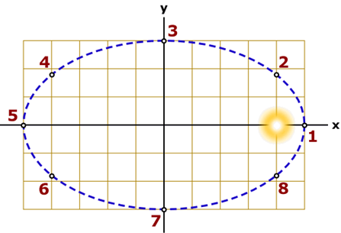
Assessing to Learn
A planet has the orbit shown below. Use the 8 labeled points to answer the question. Where is the planet when the total energy of the system is largest?
1. 1 only 2. 2 and 8 only 3. 3 and 7 only
4. 4 and 6 only 5. 5 only 6. 1 and 5 only
2, 4, 6, and 8
The total energy is the same everywhere.
9. None of the above
10. Impossible to determine
Notes:
We’ll talk in 2 minutes—share your thoughts with your neighbor during that time.
Answer: The total energy is the same everywhere.
Question F2.01a
Commentary
Purpose: To understand orbits, and to integrate various ideas in mechanics.
Discussion:
Taking the "system" to be the Sun and the planet, the total energy consists of gravitational potential energy and kinetic energy. Since no external forces act on this system, the total energy is constant, so the total energy is the same at all the labeled points.
Key Points:
For an isolated system of one object orbiting another, total mechanical energy is conserved.
Gravitational potential energy is a property of the interaction between two masses, and does not "belong" to either object by itself but only to the two-body system.
For Instructors Only
This is first of four questions using this situation. You might like to use it to ask some of your own questions as well. Orbits are great opportunities to revisit and integrate basic ideas in motion, interactions, and energy.
This question sets up subsequent questions by "grounding" students' understanding of the situation in energy conservation.
Since the question does not explicitly define the "system", a valid (but not encouraged) choice is "impossible to determine". (The "system" might conceivably refer to the planet alone. In this case, the best answer would be point 1, since that is where the planet's speed is largest and therefore where its kinetic energy — the only energy attributable to the planet alone — is largest.)
Students more familiar with circular than elliptical orbits might interpret the diagram as a tilted circle with the Sun at the origin (ignoring the yellow spot). In this case, they may plausibly select answer (8) whether or not they include the Sun in the "system".
Since students can reach the "best" answer even though they have misinterpreted nearly everything about the problem, drawing out students' reasons for their answers is crucial.
Additional Questions:
1. Where is the kinetic energy of the planet largest?
Where is the planet when the gravitational potential energy of the system is least? When it is greatest?
Source: UMass Assessing to Learn

Slide 82
Assessing to Learn
A planet has the orbit shown below. Use the 8 labeled points to answer the question. At which point(s) is the speed of the planet smallest?
1. 1 only 2. 2 and 8 only 3. 3 and 7 only
4. 4 and 6 only 5. 5 only 6. 1 and 5 only
2, 4, 6, and 8
The total energy is the same everywhere.
9. None of the above
10. Impossible to determine
Notes:
Work it out for yourself, and then try explaining it to a neighbor, and listen to your classmate’s explanation. We’ll hear what you come up with in three minutes.
Answer: 1 and 5 only
Question F2.01b
Commentary
Purpose: To understand orbits, and to integrate various ideas in mechanics.
Discussion:
Total energy is conserved in the system of a Sun with an orbiting planet, which means there is a never-ending transfer of energy from kinetic to potential and back again.
For an elliptical orbit as shown, the distance between the planet and the Sun is constantly changing. To predict where the speed is smallest, we need to find where the kinetic energy is smallest. This occurs when the gravitational potential energy is greatest, which occurs when the planet is farthest from the Sun, at point 5.
Do not be distracted by the fact that the gravitational potential energy is negative. A small negative value is "greater" than a large negative value. Just imagine an object far from the Sun. The potential energy of the system is zero. As the object "falls" toward the Sun, the potential energy decreases and the kinetic energy increases. The only way to decrease from zero is to become negative. Thus, the gravitational potential energy is "greatest" when it is "least negative".
Key Points:
The total mechanical energy of a system comprised of one object orbiting another is constant.
Gravitational potential energy is negative, and decreases (becomes more negative) as the object gets closer to the source of attraction.
Energy ideas are often useful for reasoning about speed.
For Instructors Only
This is second of four questions using this situation. You might like to use it to ask some of your own questions as well. Orbits are great opportunities to revisit and integrate basic ideas in motion, interactions, and energy.
This question is intended primarily to make sure that students understand the diagram, with the orbit elliptical and the sun at the right focus.
Students choosing answer (8), "the same everywhere", may be misinterpreting the figure as a perspective drawing of a circular orbit with the Sun at the center (ignoring the yellow spot).
Students choosing answer (6) may be recognizing that the orbit is elliptical but assuming the Sun is at the origin of the graph (overlooking the yellow spot), and reasoning that the Sun is farthest and equidistant at points 1 and 5.
Students choosing answers (1) or (3) may be confused about the minus sign in the gravitational potential energy, and looking for where the potential energy is "largest" rather than "greatest".
Additional Questions:
Where is the speed of the planet largest?
Source: UMass Assessing to Learn

Slide 83
Assessing to Learn
A planet has the orbit shown below. Use the 8 labeled points to answer the question. At which point(s) is the y-component of velocity largest?
1. 1 only 2. 2 and 8 only 3. 3 and 7 only
4. 4 and 6 only 5. 5 only 6. 1 and 5 only
2, 4, 6, and 8
The total energy is the same everywhere.
9. None of the above
10. Impossible to determine
Notes:
Think about it yourself for a moment, talk it over with a classmate, and we’ll hear from you in a couple of minutes.
Answer: 1 only
Question F2.01c
Commentary
Purpose: To understand orbits, and to integrate various ideas in mechanics.
Discussion:
The speed of the planet is smallest at point 5 and largest at point 1. Since the direction of motion is entirely in the y direction at point 1, this must also be the point at which the y-component of velocity is largest.
It does not matter whether the motion of the planet is clockwise or counterclockwise. Since "largest" refers to magnitude, the y-component of velocity can be positive or negative.
Key Points:
The speed of a planet in elliptical orbit is largest when the object is at its perihelion (closest point to the Sun).
At the perihelion, a planet's velocity is perpendicular to the vector from the Sun to the planet.
For Instructors Only
This is third of four questions using this situation. You might like to use it to ask some of your own questions as well. Orbits are great opportunities to revisit and integrate basic ideas in motion, interactions, and energy.
This question sets up the next one, which asks about the x-component of velocity. We expect most students to get this question correct, but the reasoning used here will not be applicable to the next question.
Some students might interpret the figure as a tilted circular orbit, or they might think that the Sun is at the origin of the coordinate frame, in which cases they might choose answer (6).
Students might think that the answer is impossible to determine because they are not told whether the motion is clockwise or counterclockwise. (Since we are asking for the "largest" y-component, it does not matter.)
Source: UMass Assessing to Learn

Slide 84
Assessing to Learn
A planet has the orbit shown below. Use the 8 labeled points to answer the question. At which point(s) is the x-component of velocity largest?
1. 1 only 2. 2 and 8 only 3. 3 and 7 only
4. 4 and 6 only 5. 5 only 6. 1 and 5 only
2, 4, 6, and 8
The total energy is the same everywhere.
9. None of the above
10. Impossible to determine
Notes:
Think for yourself for a moment, then confer with a classmate. We’ll share ideas in a large group discussion in a couple of minutes.
Answer: 3 and 7 only
Question F2.01d
Commentary
Purpose: To understand orbits, and to integrate various ideas in mechanics.
Discussion:
It is tempting to think that the x-component of velocity must be largest where the y-component is zero and choose points 3 and/or 7, but this is not correct.
Let's start at point 1, where the speed of the planet is largest, and assume that it travels counterclockwise around its elliptical orbit. Let's also focus on the x direction only.
At point 1, v_{x} = 0. The gravitational force acts to the left, so the force has a negative x-component, and the planet must have an acceleration in the negative x direction. Thus, v_{x} is getting larger and negative. Between points 1 and 2, the Sun exerts a force down and to the left, so a_{x} is still negative, and v_{x} must be getting still larger and more negative. At point 2, the Sun pulls straight down, and a_{x} = 0.
After point 2, the Sun pulls down and to the right, which means a_{x} is positive and v_{x} is getting smaller and less negative. This process continues past points 3 and 4, until v_{x} = 0 again at point 5. Therefore, between points 1 and 5, v_{x} is largest at point 2.
At point 5, the Sun is pulling to the right, so now v_{x} is getting larger and positive. After point 5, the Sun pulls up and to the right, so v_{x} is getting larger and more positive. At point 8, the Sun pulls straight up.
Between points 8 and 1, the Sun pulls up and to the left, so v_{x} is getting smaller, until it is zero at point 1. Therefore, between points 5 and 1, v_{x} is largest at point 8.
By symmetry, we know that v_{x} is equally large at points 2 and 8, so that is where v_{x} is largest during the orbit of the planet.
If the motion is clockwise, the same reasoning applies.
Key Points:
You can reason about one component of an object's velocity by ignoring the other and considering the net force and acceleration on it in that direction only.
The x-component of an object's velocity will get larger (more positive or more negative) if the x-component of the net force has the same sign, and will get smaller if it has the opposite sign.
For Instructors Only
This is last of four questions using this situation. You might like to use it to ask some of your own questions as well. Orbits are great opportunities to revisit and integrate basic ideas in motion, interactions, and energy.
This question is relatively difficult. Students tend to compartmentalize their physics knowledge, and are likely to overlook forces and accelerations in this situation. Although many students will get the question wrong, the explanation should be accessible to all.
The most common reason for students to choose (4) or (5) is that the y-component of velocity is zero, so the x-component must be largest. (In the previous problem, the y-component was largest where the x-component was zero, but only because the speed was also largest there.)
Some students might interpret the figure as a tilted circular orbit, or they might think that the Sun is at the origin of the coordinate frame, in which cases they might choose answer (4) or (5).
Students might think that the answer is impossible to determine, perhaps because they are not told whether the motion is clockwise or counterclockwise. (Since we are asking for the "largest" x-component, it does not matter.) Some of these students might choose one of the "or" answers, i.e., (2) or (4).
Additional Questions:
1. Where is the force on the planet largest? smallest?
2. Where is the force on the Sun largest? smallest?
3. Where is the x-component of acceleration largest? smallest?
Where is the y-component of acceleration largest? smallest?
Source: UMass Assessing to Learn

Slide 85
TOPIC summary
Topic 7: Rotational Motion and Gravitation

Slide 86
Topic Summary
Angular Velocity and Angular Acceleration
Rotational Motion Under Constant Angular Acceleration
Notes:
Angular Velocity and Angular Acceleration
The average angular velocity of a rigid object is defined as the ratio of the angular displacement to the time interval Δt, where ω_{av} is in radians per second (rad/s).
The average angular acceleration of a rotating object is defined as the ratio of the change in angular velocity to the time interval Δt, where α_{av} is in radians per second per second (rad/s²).
Rotational Motion Under Constant Angular Acceleration
If an object undergoes rotational motion about a fixed axis under a constant angular acceleration, its motion can be described with the set of equations shown. Problems are solved as in one-dimensional kinematics.

Slide 87
Topic Summary
Tangential Velocity, Tangential Acceleration, and Centripetal Acceleration
Newton’s Second Law for Uniform Circular Motion
Notes:
Tangential Velocity, Tangential Acceleration, and Centripetal Acceleration
When an object rotates about a fixed axis, the angular velocity and angular acceleration are related to the tangential velocity and tangential acceleration through the relationships shown.
Any object moving in a circular path must have a net force exerted on it that is directed toward the center of the path.
Some examples of forces that cause centripetal acceleration are the force of gravity (as in the motion of a satellite) and the force of tension in a string.
Newton’s Second Law for Uniform Circular Motion
The second law for uniform circular motion involves forces that are directed either towards the center of a circle or away from it. A force acting towards the center of the circle is by convention negative and Newton’s second law for uniform circular motion therefore is given in the equation shown here.

Slide 88
Topic Summary
Newtonian Gravitation
Gravitational Potential Energy
Notes:
Newtonian Gravitation
Newton’s law of universal gravitation states that every particle in the Universe attracts every other particle with a force that is directly proportional to the product of their masses and inversely proportional to the square of the distance r between them. G is the constant of universal gravitation.
Gravitational Potential Energy
A general expression for gravitational potential energy is shown. This expression reduces to PE = mgh close to the surface of Earth and holds for other worlds through replacement of the mass M_{E} . Problems such as finding the escape velocity from Earth can be solved by using this equation in the conservation of energy equation.

Slide 89
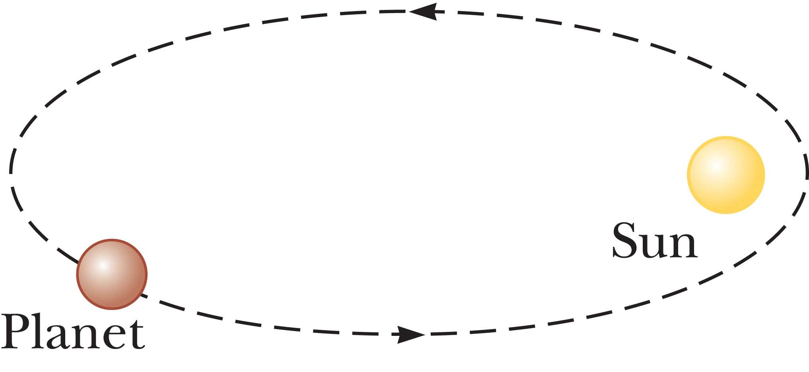
Topic Summary
Kepler’s Laws of Planetary Motion
1. 2.
3.
Notes:
Kepler’s Laws of Planetary Motion
Kepler derived the following three laws of planetary motion:
All planets move in elliptical orbits with the Sun at one of the focal points
A line drawn from the Sun to any planet sweeps out equal areas in equal time intervals.
The square of the orbital period of a planet is proportional to the cube of the average distance from the planet to the Sun. The third law can be applied to any large body and its system of satellites by replacing the Sun’s mass with the body’s mass. In particular, it can be used to determine the mass of the central body once the average distance to a satellite and its period are known.

