Slide 1
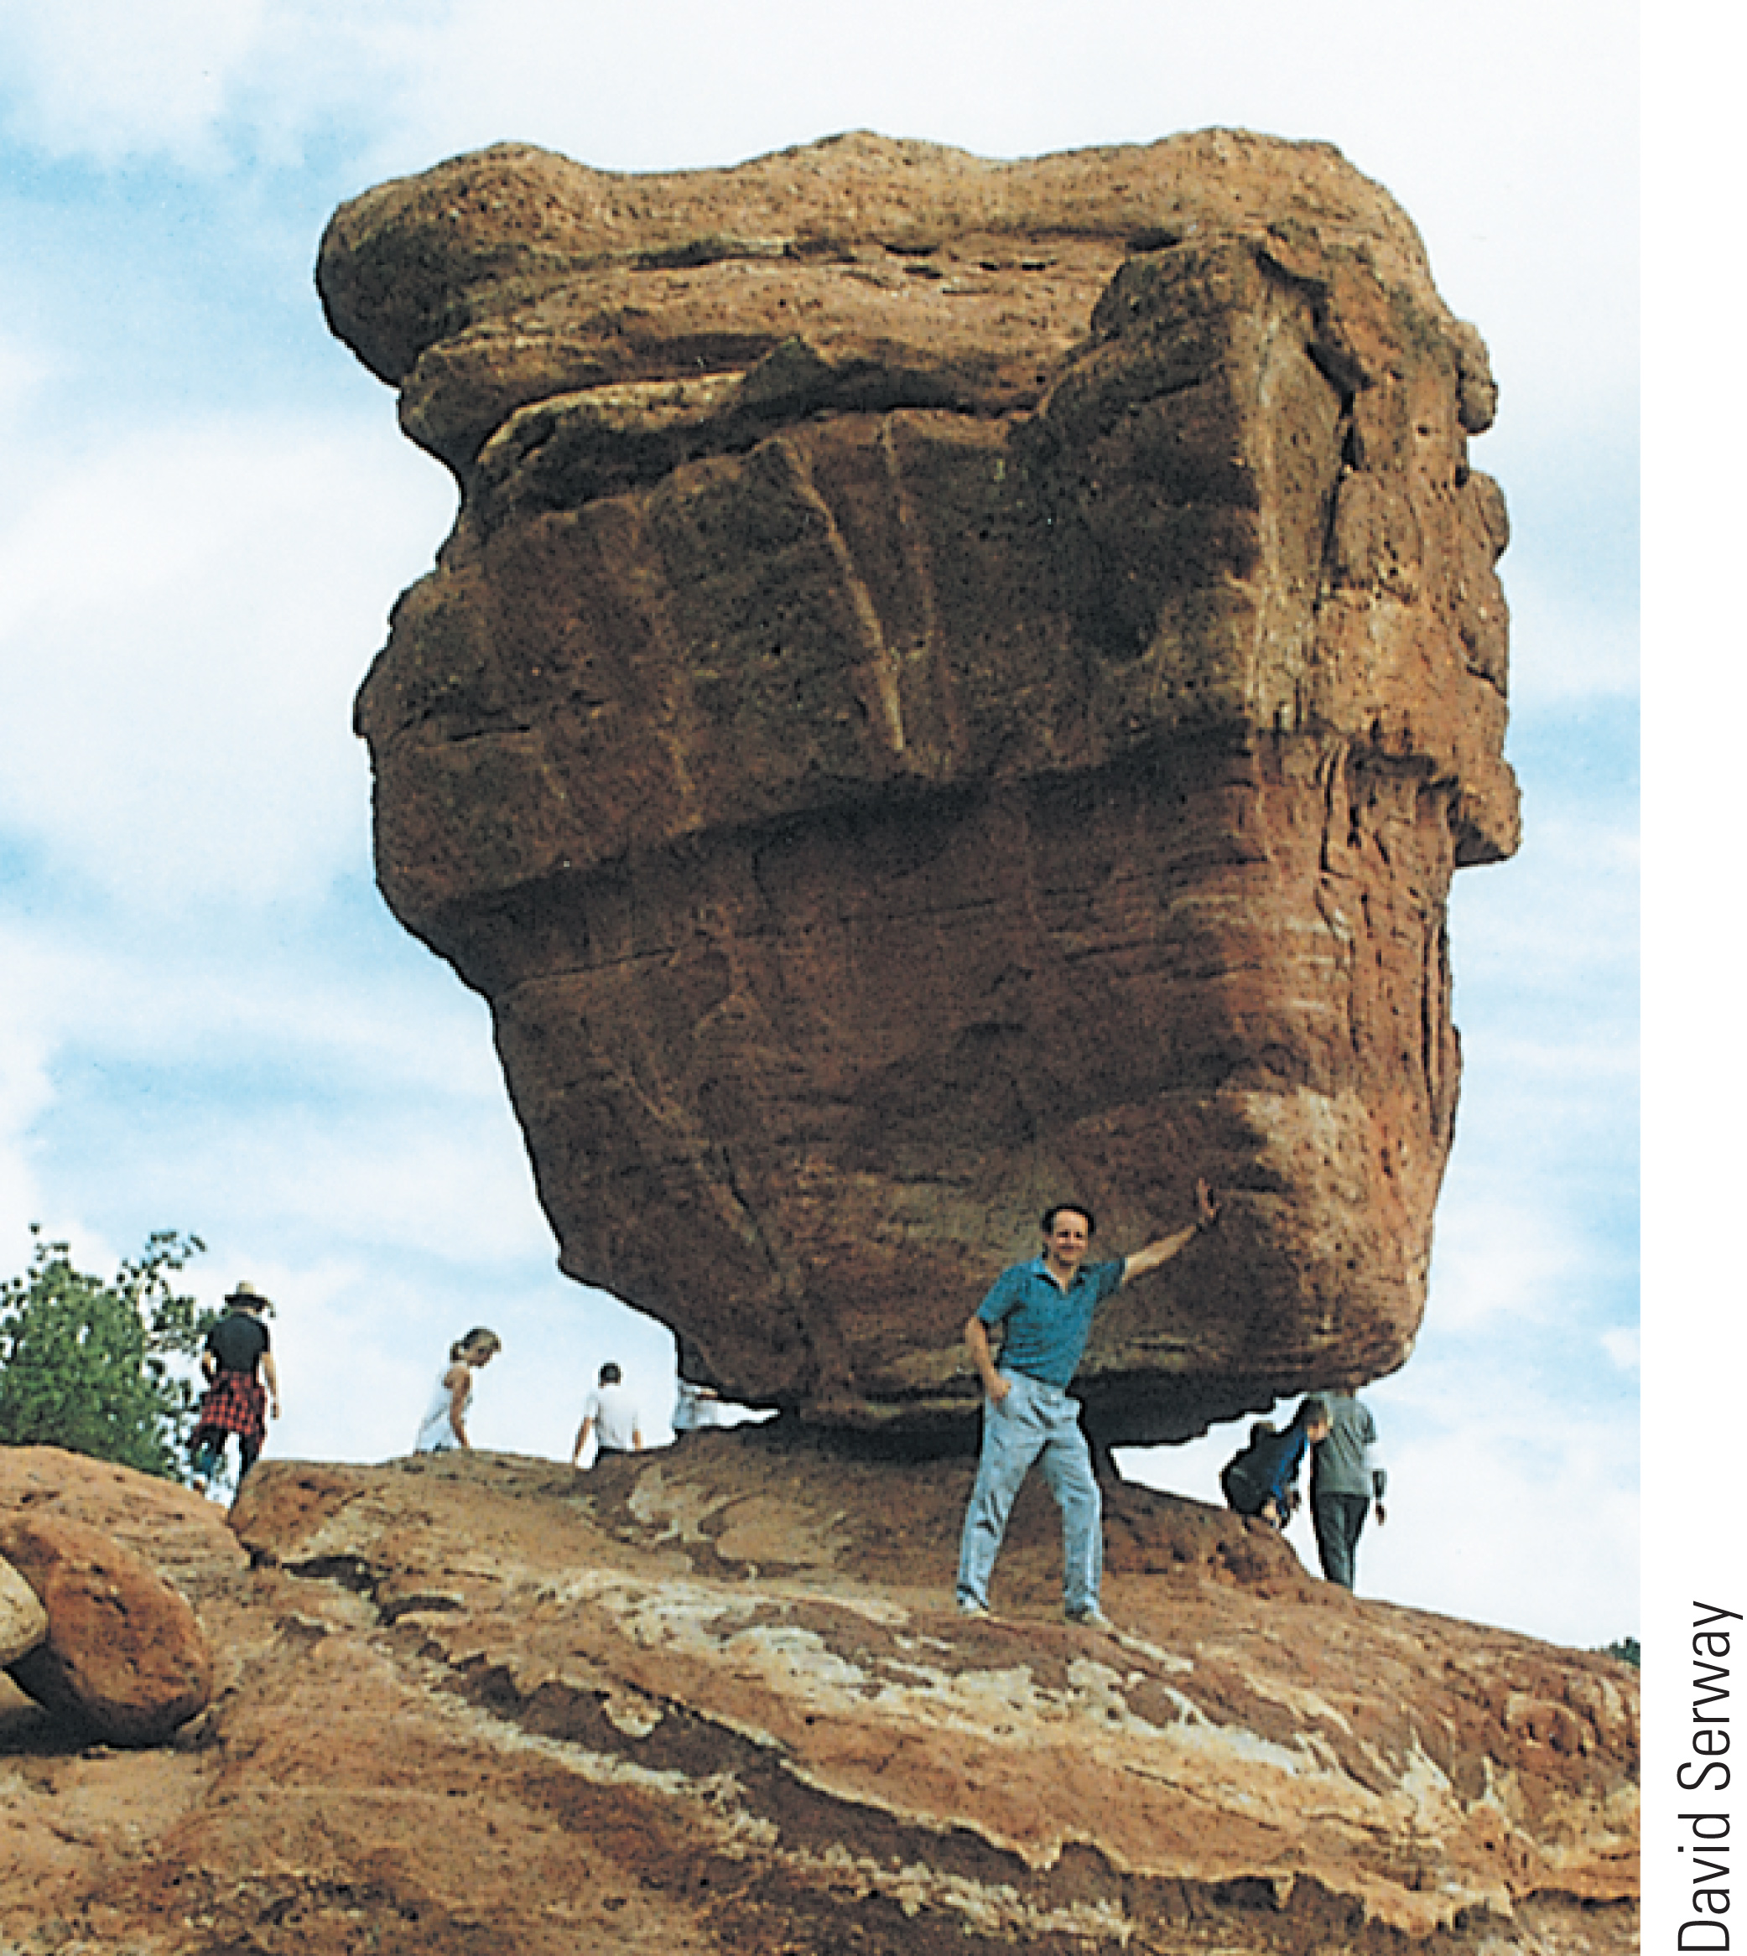

Topic 8: Rotational Equilibrium and Dynamics
College Physics, 11e
Raymond A. Serway; Chris Vuille

Slide 2
Reading Question 1-1
Which of the following screwdrivers would likely be the most effective to loosen a stubborn screw? Assume the size of the driver head is the same in each case.
one with a handle that is 8 cm long and 2 cm wide
one with a handle that is 12 cm long and 2 cm wide
one with a handle that is 8 cm long and 4 cm wide
They would all loosen the screw just as effectively.

Slide 3
Reading Question 1-1
Which of the following screwdrivers would likely be the most effective to loosen a stubborn screw? Assume the size of the driver head is the same in each case.
one with a handle that is 8 cm long and 2 cm wide
one with a handle that is 12 cm long and 2 cm wide
one with a handle that is 8 cm long and 4 cm wide
They would all loosen the screw just as effectively.

Slide 4
Reading Question 1-2
A ball rolls without slipping down incline A, starting from rest. At the same time, a box starts from rest and slides down incline B, which is identical to incline A except it is frictionless. Which has a larger translational speed at the bottom of the ramp?
They have the same translational speed at the bottom of the ramp.
the ball
the box
It is impossible to determine.

Slide 5
Reading Question 1-2
A ball rolls without slipping down incline A, starting from rest. At the same time, a box starts from rest and slides down incline B, which is identical to incline A except it is frictionless. Which has a larger translational speed at the bottom of the ramp?
They have the same translational speed at the bottom of the ramp.
the ball
the box
It is impossible to determine.

Slide 6
Reading Question 1-3
Complete the following sentence: "The moment of inertia of an object
depends on the rotational speed of the object."
will be greater for a larger-massed object than for a smaller-massed object."
is not a function of the object's mass."
is a function of the axis about which the object is spun."

Slide 7
Reading Question 1-3
Complete the following sentence: "The moment of inertia of an object
depends on the rotational speed of the object."
will be greater for a larger-massed object than for a smaller-massed object."
is not a function of the object's mass."
is a function of the axis about which the object is spun."

Slide 8
Reading Question 1-4
A skater rotates quickly on the ice. He pushes his arms out. What happens to his angular speed?
It increases.
It decreases.
It stays the same.
It is impossible to determine.

Slide 9
Reading Question 1-4
A skater rotates quickly on the ice. He pushes his arms out. What happens to his angular speed?
It increases.
It decreases.
It stays the same.
It is impossible to determine.

Slide 10
Reading Question 1-5
Someone hits a tether ball to make it spin around a pole. The cord that attaches the tether ball to the central pole then winds around the pole. What happens to the angular speed of the tether ball during this process?
It decreases.
It increases.
It remains constant.
It cannot be determined.

Slide 11
Reading Question 1-5
Someone hits a tether ball to make it spin around a pole. The cord that attaches the tether ball to the central pole then winds around the pole. What happens to the angular speed of the tether ball during this process?
It decreases.
It increases.
It remains constant.
It cannot be determined.

Slide 12
Reading Question 1-6
The center of gravity is a useful point at which to balance an object. For instance, a ruler can be balanced by placing its center on your finger. Is it possible for the center of gravity of an object to be located at a point where no material exists to balance the object?
no, never
only for very unsymmetrical objects
It is possible in theory, but no objects have been found for which this occurs.
Yes, it is possible.

Slide 13
Reading Question 1-6
The center of gravity is a useful point at which to balance an object. For instance, a ruler can be balanced by placing its center on your finger. Is it possible for the center of gravity of an object to be located at a point where no material exists to balance the object?
no, never
only for very unsymmetrical objects
It is possible in theory, but no objects have been found for which this occurs.
Yes, it is possible.

Slide 14
TOPIC Discussion
Topic 8: Rotational Equilibrium and Dynamics
Notes:
When we learned about linear motion, the objects were treated as point particles, and it didn’t matter where the force was applied on the object. But the reality is, the point of application does matter. We an use the concepts of rotational dynamics and rotational equilibrium to study extended systems. These concepts are important in disciplines as diverse as architecture and biology. Architects need to understand the forces that act on buildings, and biologists should understand the forces at work in muscles and bones and joints.
In our studies, we will find that an object remains in a state of uniform rotational motion unless acted on by a net torque. That principle is the equivalent of Newton’s first law. Also, the angular acceleration of an object is proportional to the net torque acting on it, which is the analog of Newton’s second law. A net torque acting on an object causes a change in its rotational energy. Finally, torques applied to an object through a given time interval can change the object’s angular momentum. In the absence of external torques, angular momentum is conserved, a property that explains some of the mysterious and formidable properties of pulsars, remnants of supernova explosions that rotate at equatorial speeds approaching that of light.

Slide 15
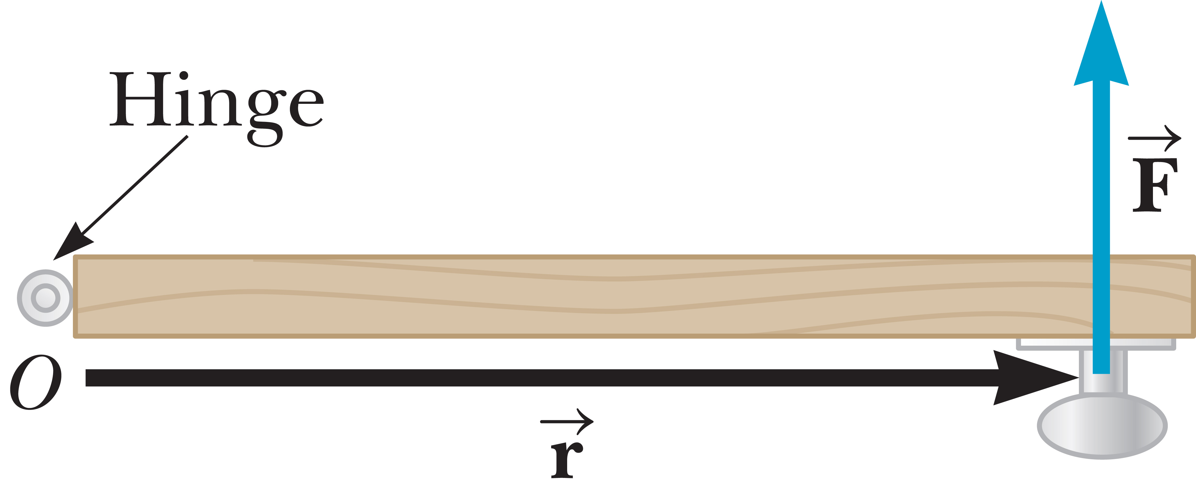
Torque
Notes:
You already know that forces cause accelerations; torques cause angular accelerations. Take a look at the figure, which is an overhead view of a door hinged at point O. Imagine the door is free to rotate around an axis perpendicular to the slide and passing through O. If a force F is applied to the door, there are three factors that determine the effectiveness of the force in opening the door:
the magnitude of the force,
the position of application of the force,
and the angle at which it is applied.
We will only be dealing with position and force vectors lying in a plane. When the applied force is perpendicular to the outer edge of the door, as it is in the figure, the door rotates counterclockwise with constant angular acceleration. Now let’s think about what happens when the same perpendicular force is applied at a point nearer the hinge—the result is a smaller angular acceleration.
In general, a larger radial distance r between the applied force and the axis of rotation results in a larger angular acceleration. Also, a larger applied force will result in a larger angular acceleration.
Let’s look at the special case of forces perpendicular to the position vector as in the figure. Let F be a force acting on an object, and let r be a position vector from a chosen point O to the point of application of the force, with F perpendicular to r. The magnitude of the torque τ exerted by the force F is given by the equation shown, [click to show equation] where r is the length of the position vector and F is the magnitude of the force.

Slide 16
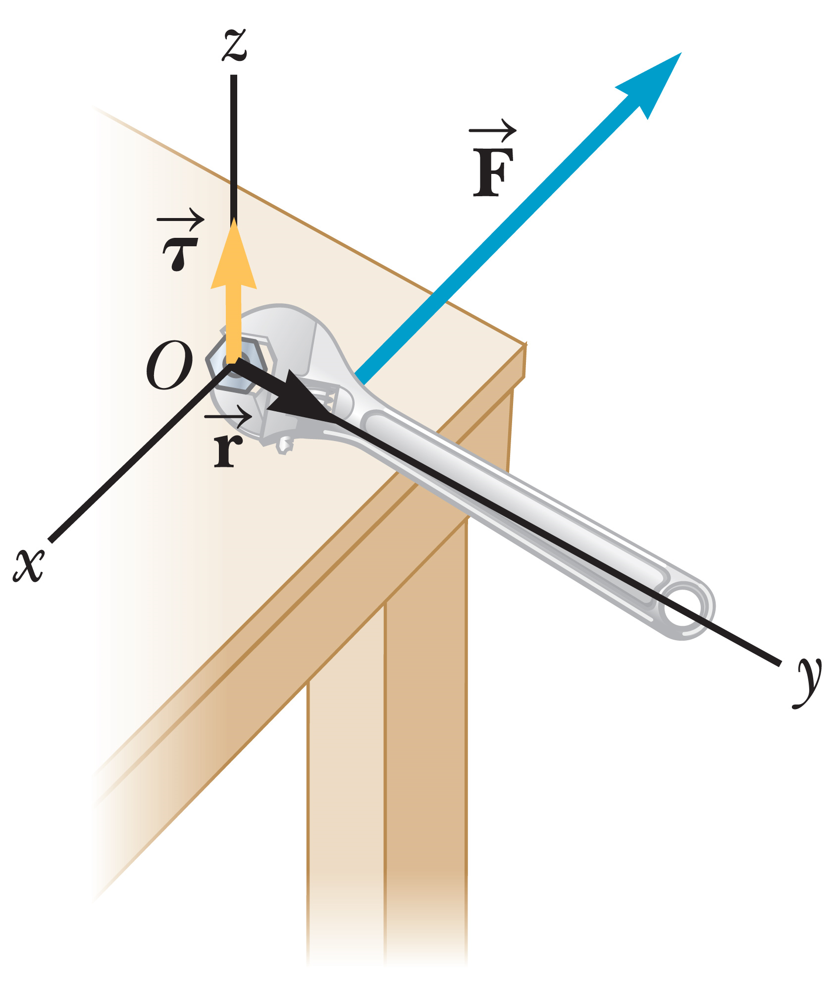
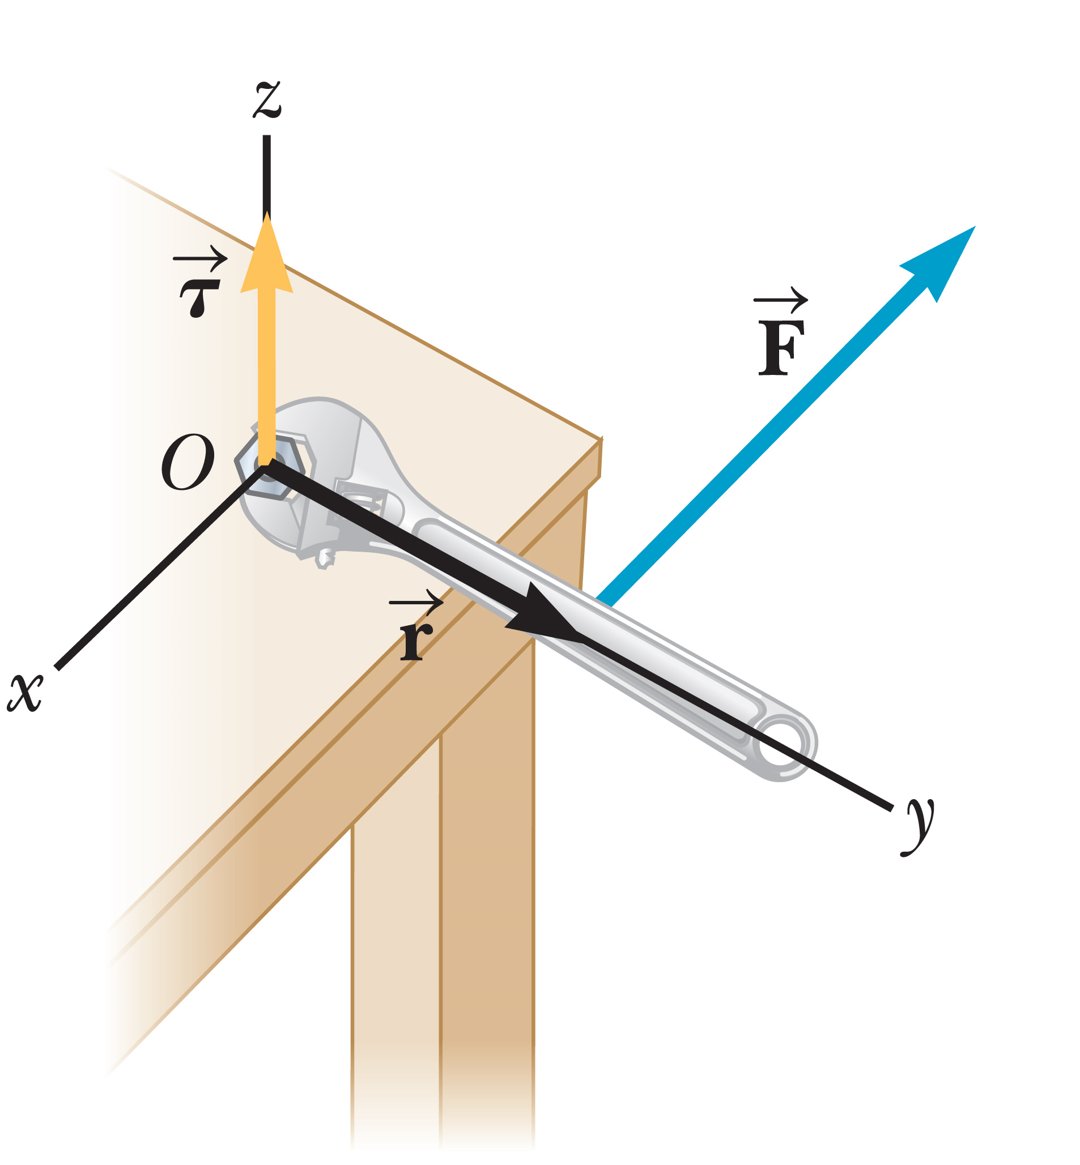
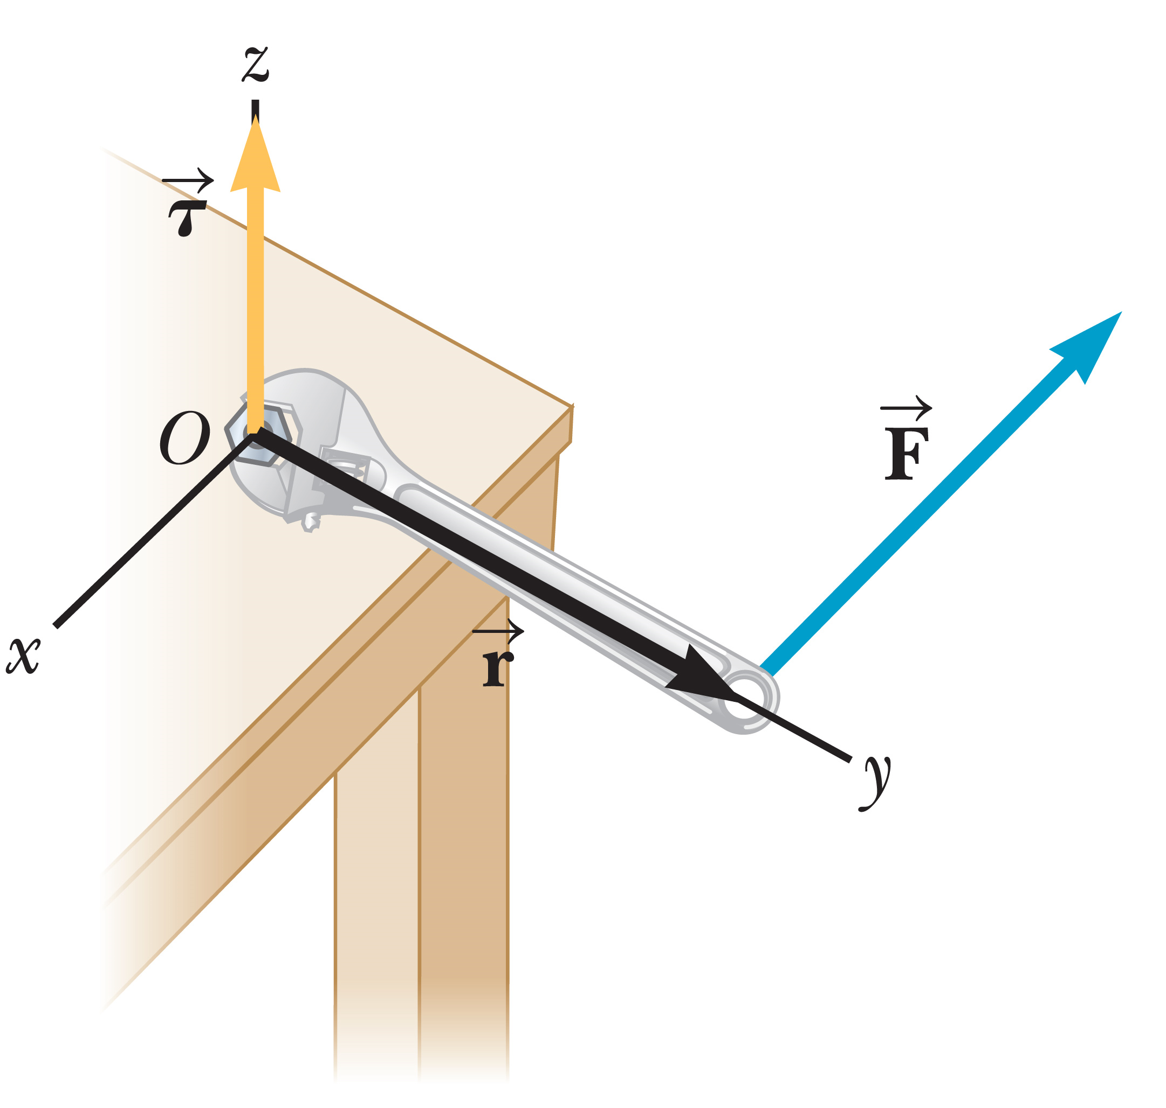
Torque
Counterclockwise → positive direction
Clockwise → negative direction
The rate of rotation of an object doesn’t change, unless the object is acted on by a net torque.
Notes:
This figure illustrates how the point of the force’s application affects the magnitude of the torque. When the force is applied farther out along the wrench in the figure, the magnitude of the torque increases. The torque is perpendicular to this plane. The point O is usually chosen to coincide with the axis the object is rotating around, for example the hinge of a door or hub of a merry-go-round. Of course, other choices are possible.
We consider only forces acting in the plane perpendicular to the axis of rotation, so for example we don’t include a force with upward component on a merry-go-round railing, which can’t affect the merry-go-round’s rotation. Under these conditions, an object can rotate around the chosen axis in one of two directions.
By convention, counterclockwise is taken to be the positive direction, clockwise the negative direction. [click to show text] When an applied force causes an object to rotate counterclockwise, the torque on the object is positive. When the force causes the object to rotate clockwise, the torque on the object is negative.
When two or more torques act on an object at rest, the torques are added. If the net torque isn’t zero, the object starts rotating at an increasing rate. If the net torque is zero, the object’s rate of rotation doesn’t change. These conditions should seem familiar to you, from Newton’s first law. In fact, we have a rotational analog to the first law: [click to show text] the rate of rotation of an object doesn’t change, unless the object is acted on by a net torque.

Slide 17
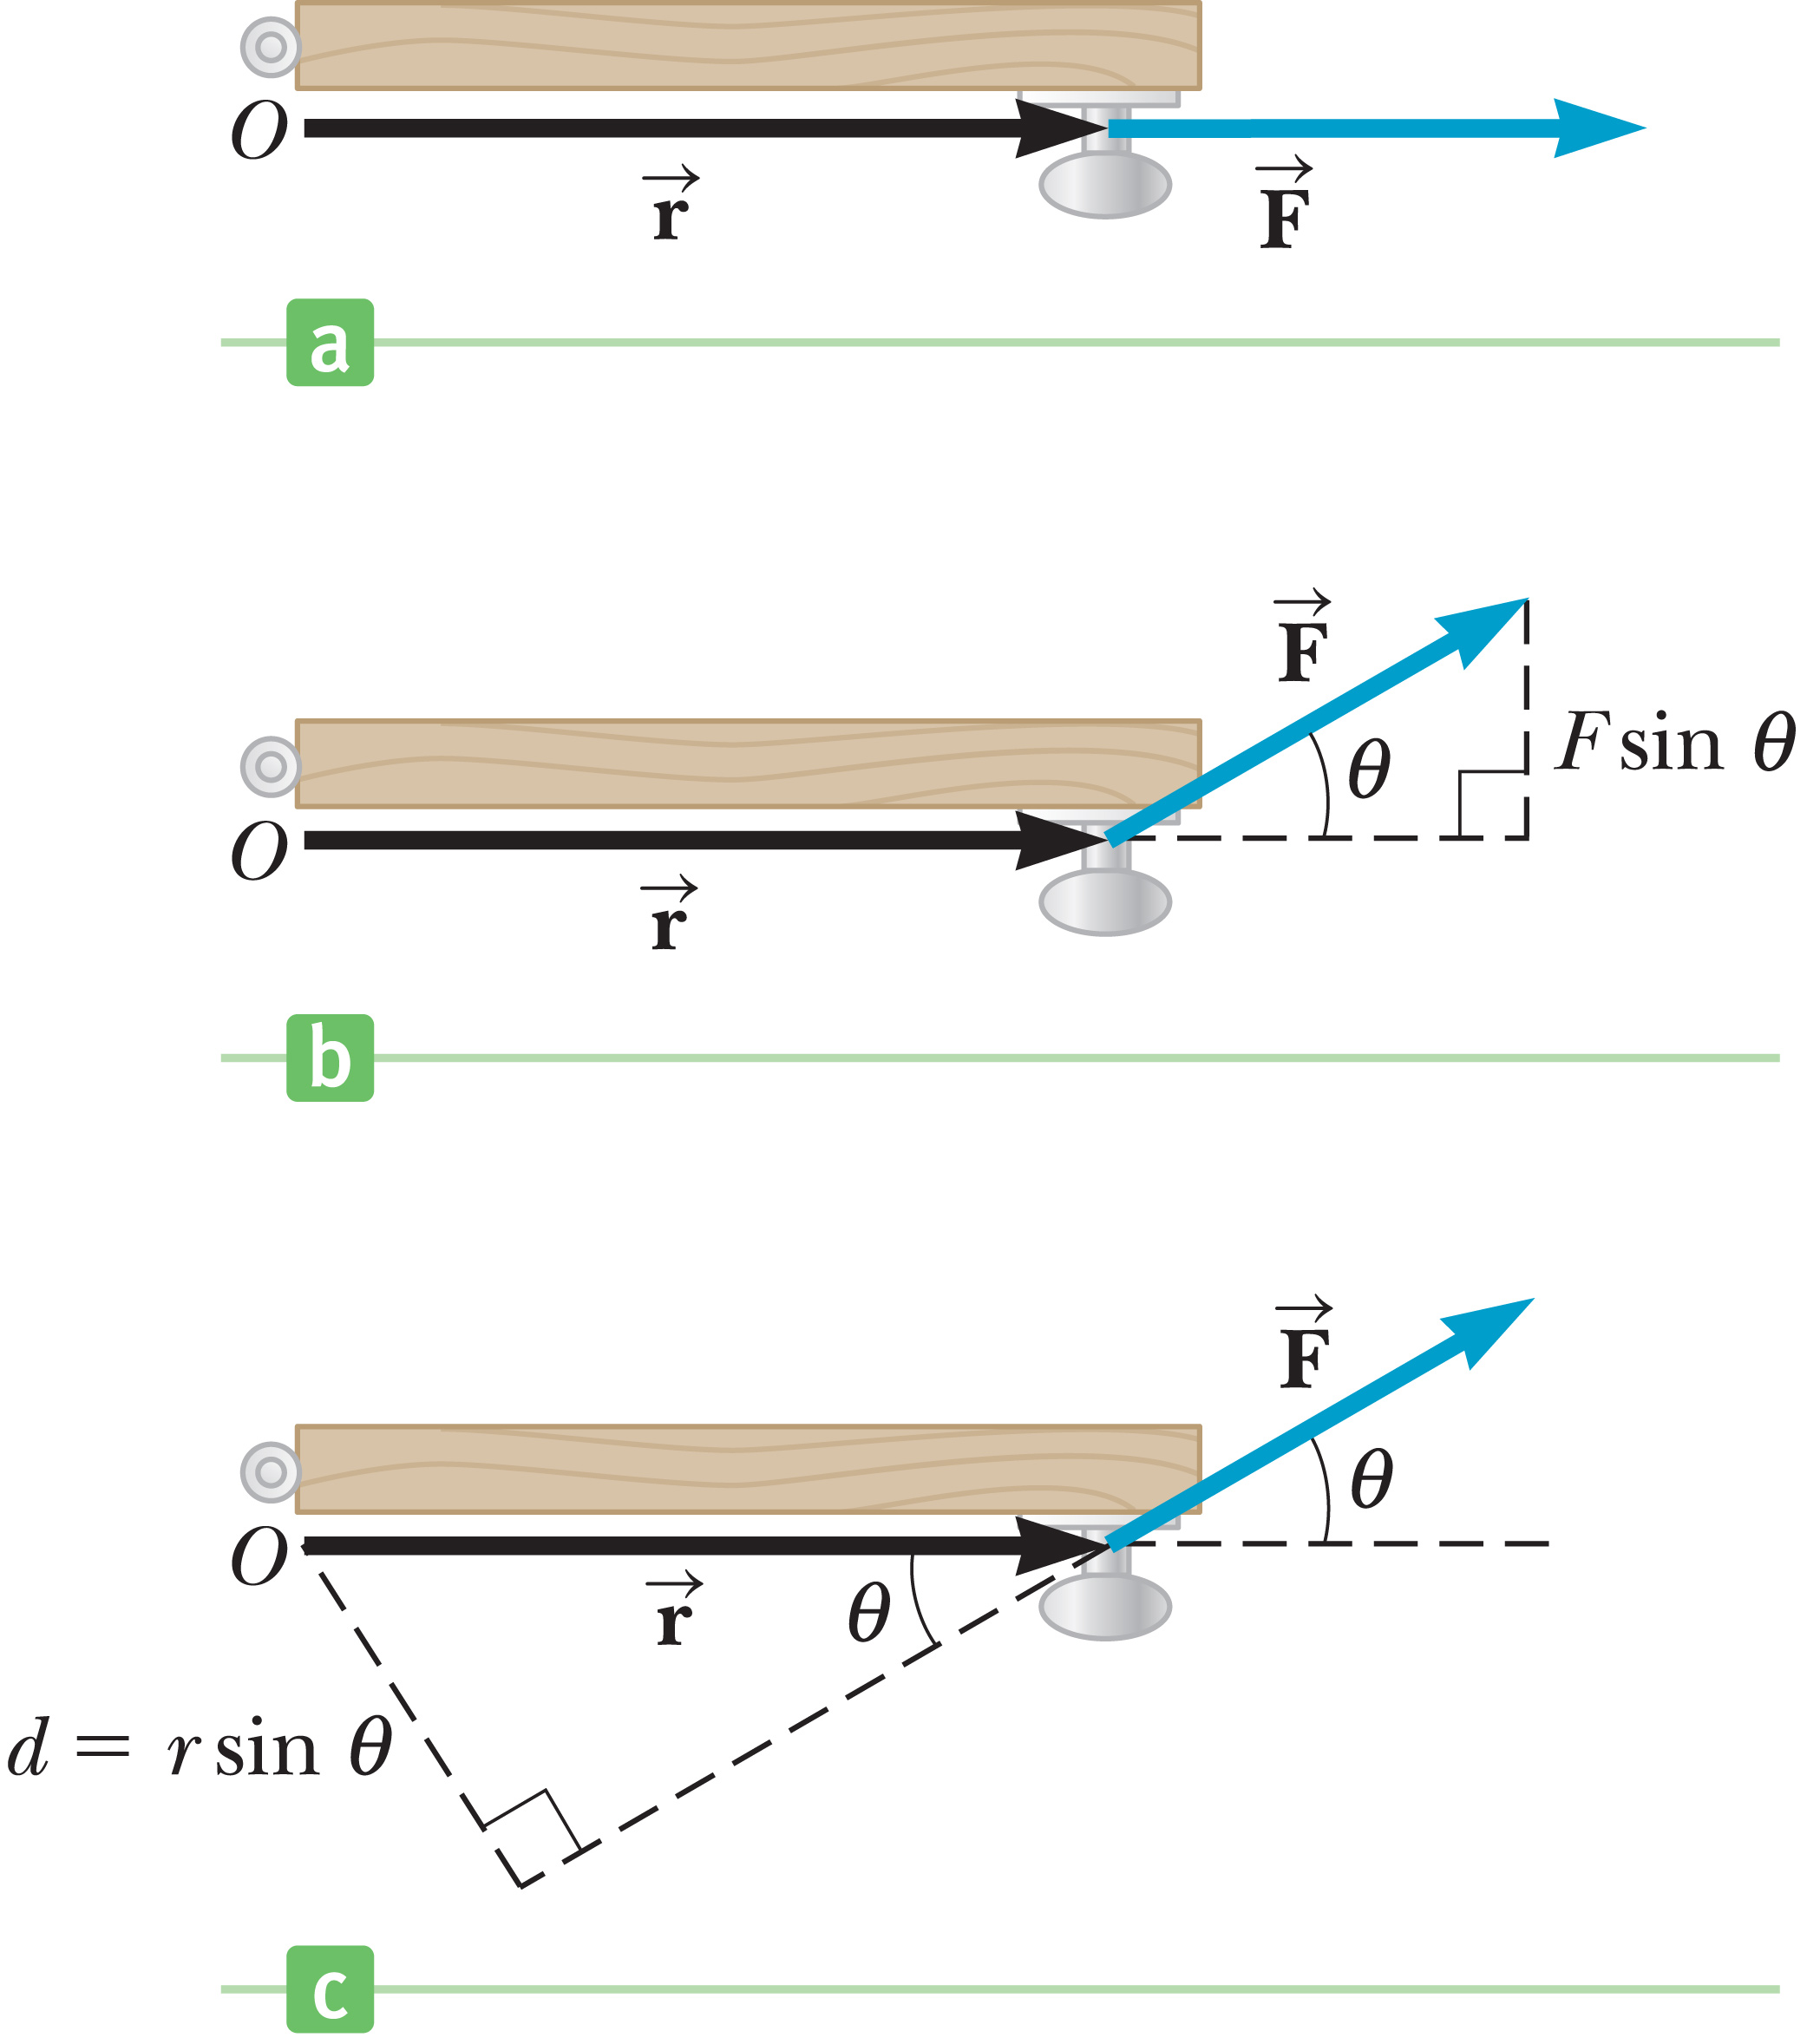
Torque
Notes:
Sometimes the applied force is not at right angles to the position vector. Imagine that a force exerted on a door is directed away from the axis, as in the top figure, say, by someone’s grasping the doorknob and pushing to the right. Exerting the force in this direction couldn’t possibly open the door. But, if the applied force acts at an angle to the door as in the middle figure, the component of the force perpendicular to the door will cause it to rotate.
The bottom figure shows that the component of the force perpendicular to the door is F sin θ, where θ is the angle between the position vector r and the force.
When the force is directed away from the axis, [click to show equation] θ = 0°, sin (0°) = 0, and F sin (0°) = 0.
When the force is directed toward the axis, [click to show equation] θ = 180° and F sin (180°) = 0.
The maximum absolute value of F sinθ occurs when F is perpendicular to r —that is, when θ = 90° or θ = 270°. [click to show equations]
Let’s put these ideas together for a more general definition of torque, [click to show equation] where F is the force acting on an object, r is a position vector from a chosen point O to the point of application of the force, and θ the angle between r and F. Again the vectors r and F lie in a plane, and for our purposes the chosen point O will usually correspond to an axis of rotation perpendicular to the plane.

Slide 18
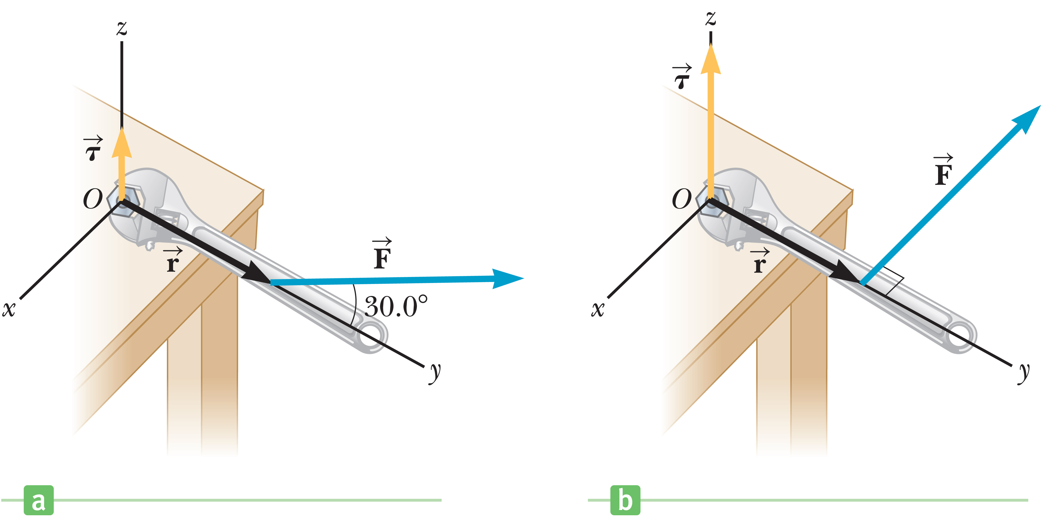
Torque
Notes:
This figures illustrate how the magnitude of the torque exerted by a wrench increases as the angle between the position vector and the force vector increases at 90°, where the torque is a maximum.

Slide 19
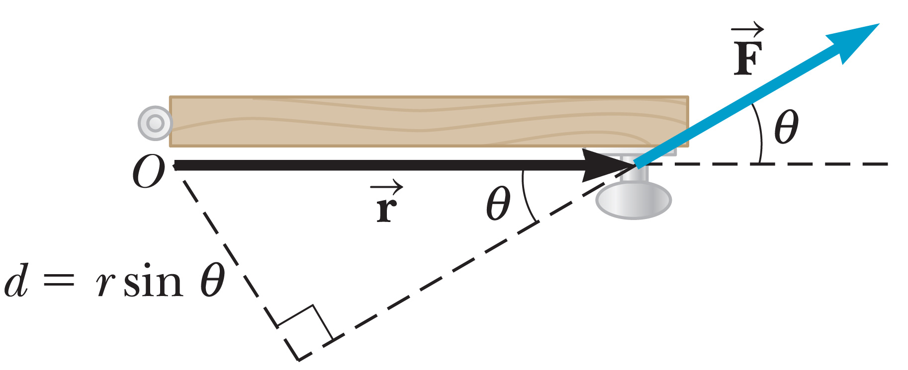
Torque
Notes:
A second way of understanding the sin θ factor is to associate it with the magnitude r of the position vector r. The quantity d = r sin θ is called the lever arm, which is the perpendicular distance from the axis of rotation to a line drawn along the direction of the force.
The value of τ depends on the chosen axis of rotation. Torques can be computed around any axis, regardless of whether there is some actual, physical rotation axis present. Once you choose your point, you must use it consistently throughout a given problem.

Slide 20
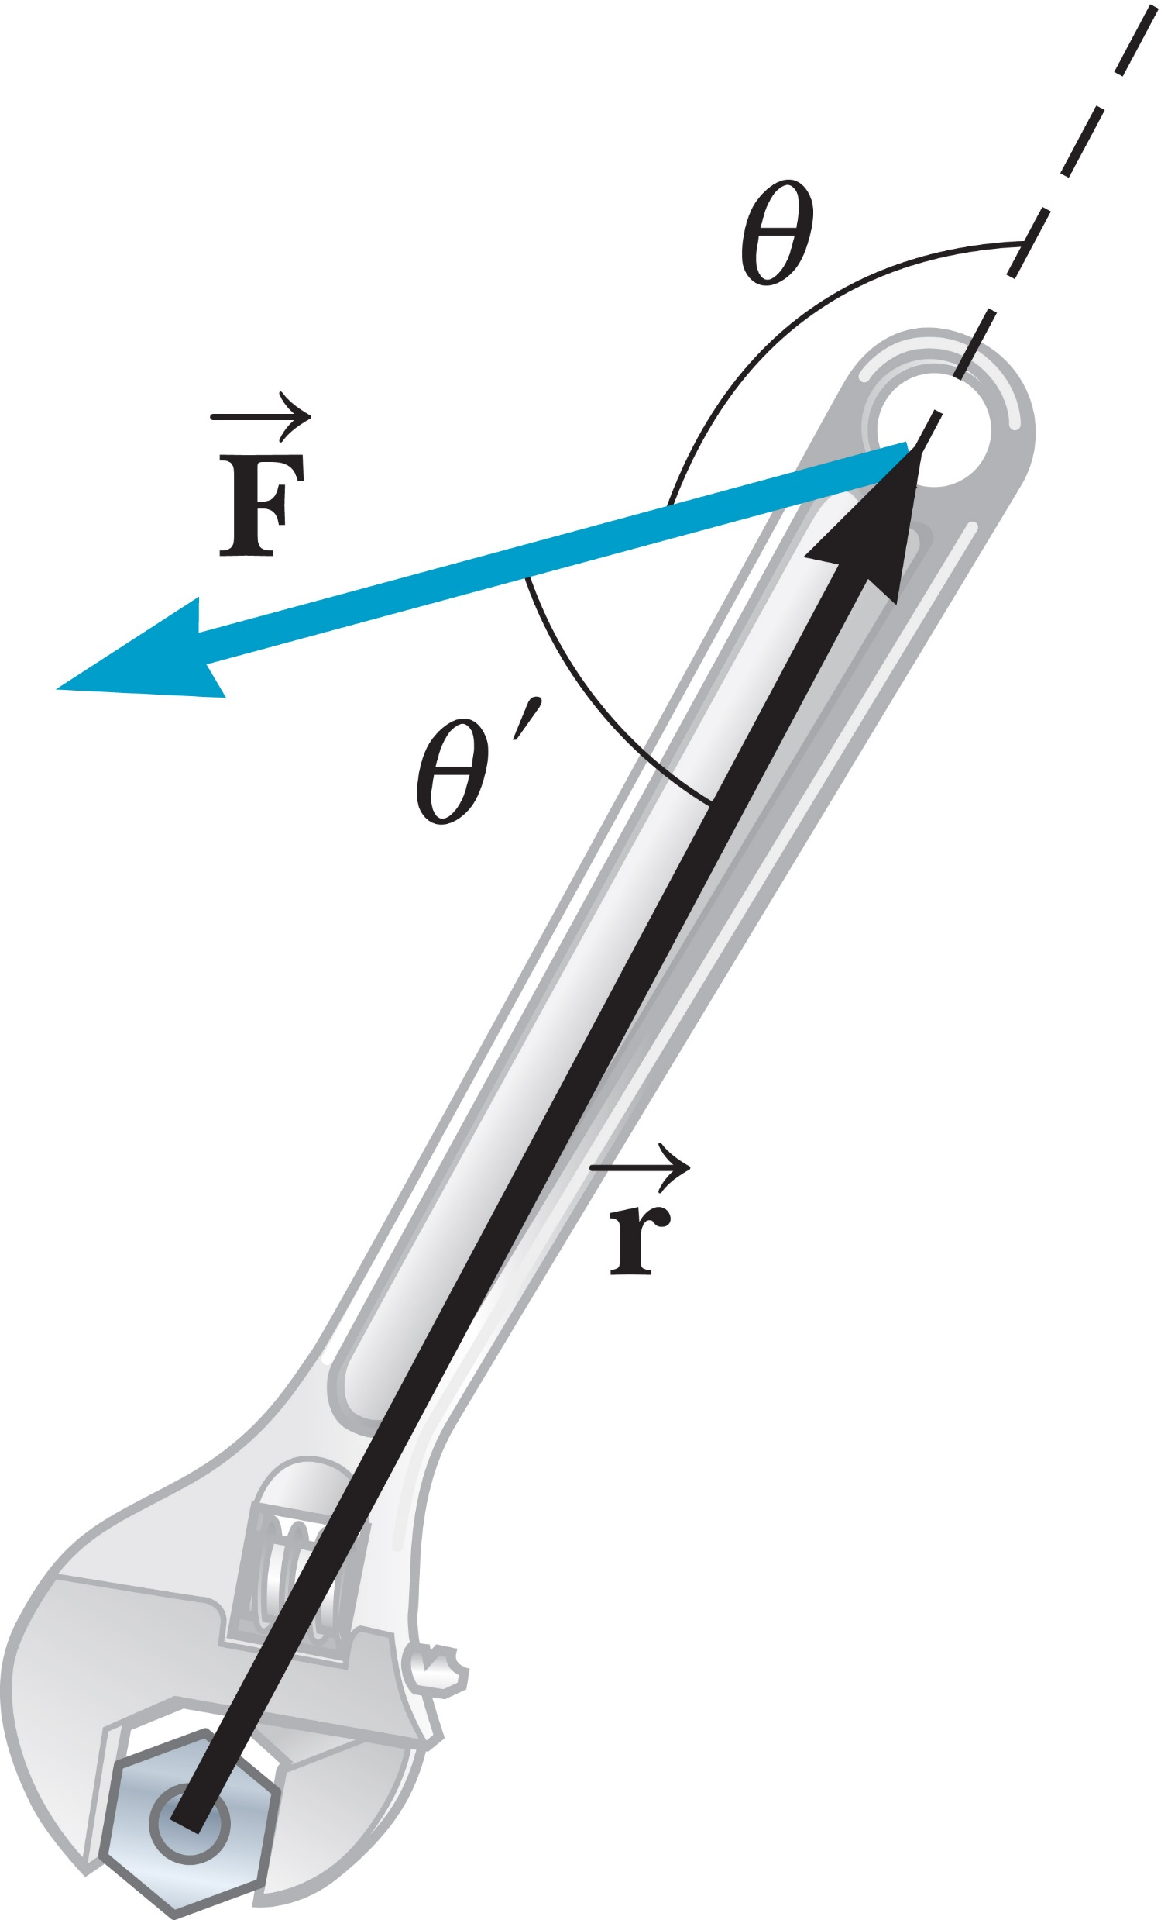
Torque
Notes:
Torque is a vector perpendicular to the plane determined by the position and force vectors, as illustrated in the figure. The direction can be determined by the right-hand rule:
Point the fingers of your right hand in the direction of r.
Curl your fingers toward the direction of vector F.
Your thumb then points approximately in the direction of the torque, in this case out of the screen.

Slide 21
Torque
Notes:
Notice that there are two choices of angle in the figure. The angle θ is the actual angle between the directions of the two vectors. The angle θ’ is literally “between” the two vectors. So which angle is correct? [click to show equations] Because sin θ = sin(180° – θ) = sin(180°)cos θ – sin θ cos(180°) = 0 – sin θ ·(–1) = sin θ either angle is correct.
The problems we will be dealing with in this course are objects rotating around an axis perpendicular to the plane containing r and F, so if these vectors are in the plane of the slide, the torque will always point either into or out of the slide, parallel to the axis of rotation. If your right thumb is pointed in the direction of a torque, your fingers curl naturally in the direction of rotation that the torque would produce on an object at rest.

Slide 22
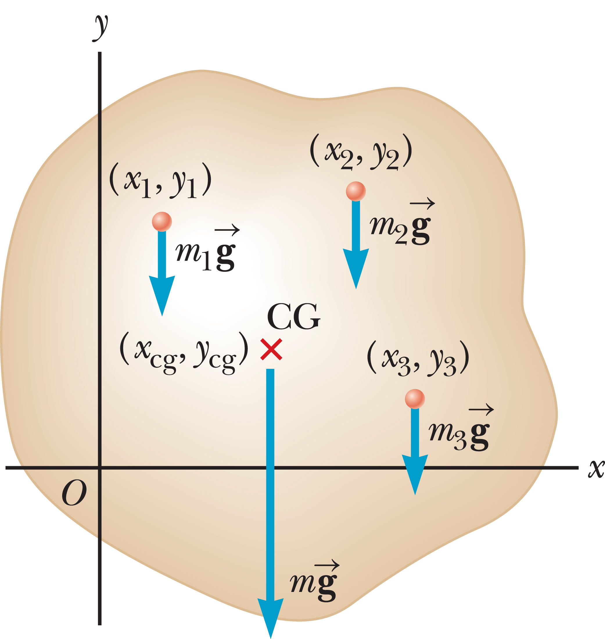
Center of Mass
Notes:
The figure shows an arbitrarily shaped object in the xy-plane. The object is divided into a large number of very small particles of weight m₁g, m₂g, m₃g, etcetera, having coordinates shown. If the object is free to rotate around the origin, each particle contributes a torque about the origin that is equal to its weight multiplied by its lever arm.
For example, the torque due to the weight m₁g [click to show equation] is m₁gx₁.
Our goal here is to find the point of application of the single force of magnitude w, [click to show equation] where M is the total weight of the object. This is the point where the effect on the rotation of the object is the same as that of all the individual particles. This point is called the object’s center of gravity.

Slide 23
Center of Mass
Notes:
Let’s equate the torque exerted by w at the center of gravity to the sum of the torques acting on the individual particles. We assume that g is the same everywhere in the object, then the g factors cancel. Here, x_{cg} is the x-coordinate of the center of gravity. The same can be done for the y-coordinate and z-coordinate of the center of gravity. [click to show equations]
These three equations are identical to the equations for a similar concept called center of mass. The center of mass and center of gravity of an object are exactly the same when g doesn’t vary significantly over the object, as will be the case with all the problems we will encounter in this course, so we will use the concepts of center of gravity and center of mass interchangeably.

Slide 24
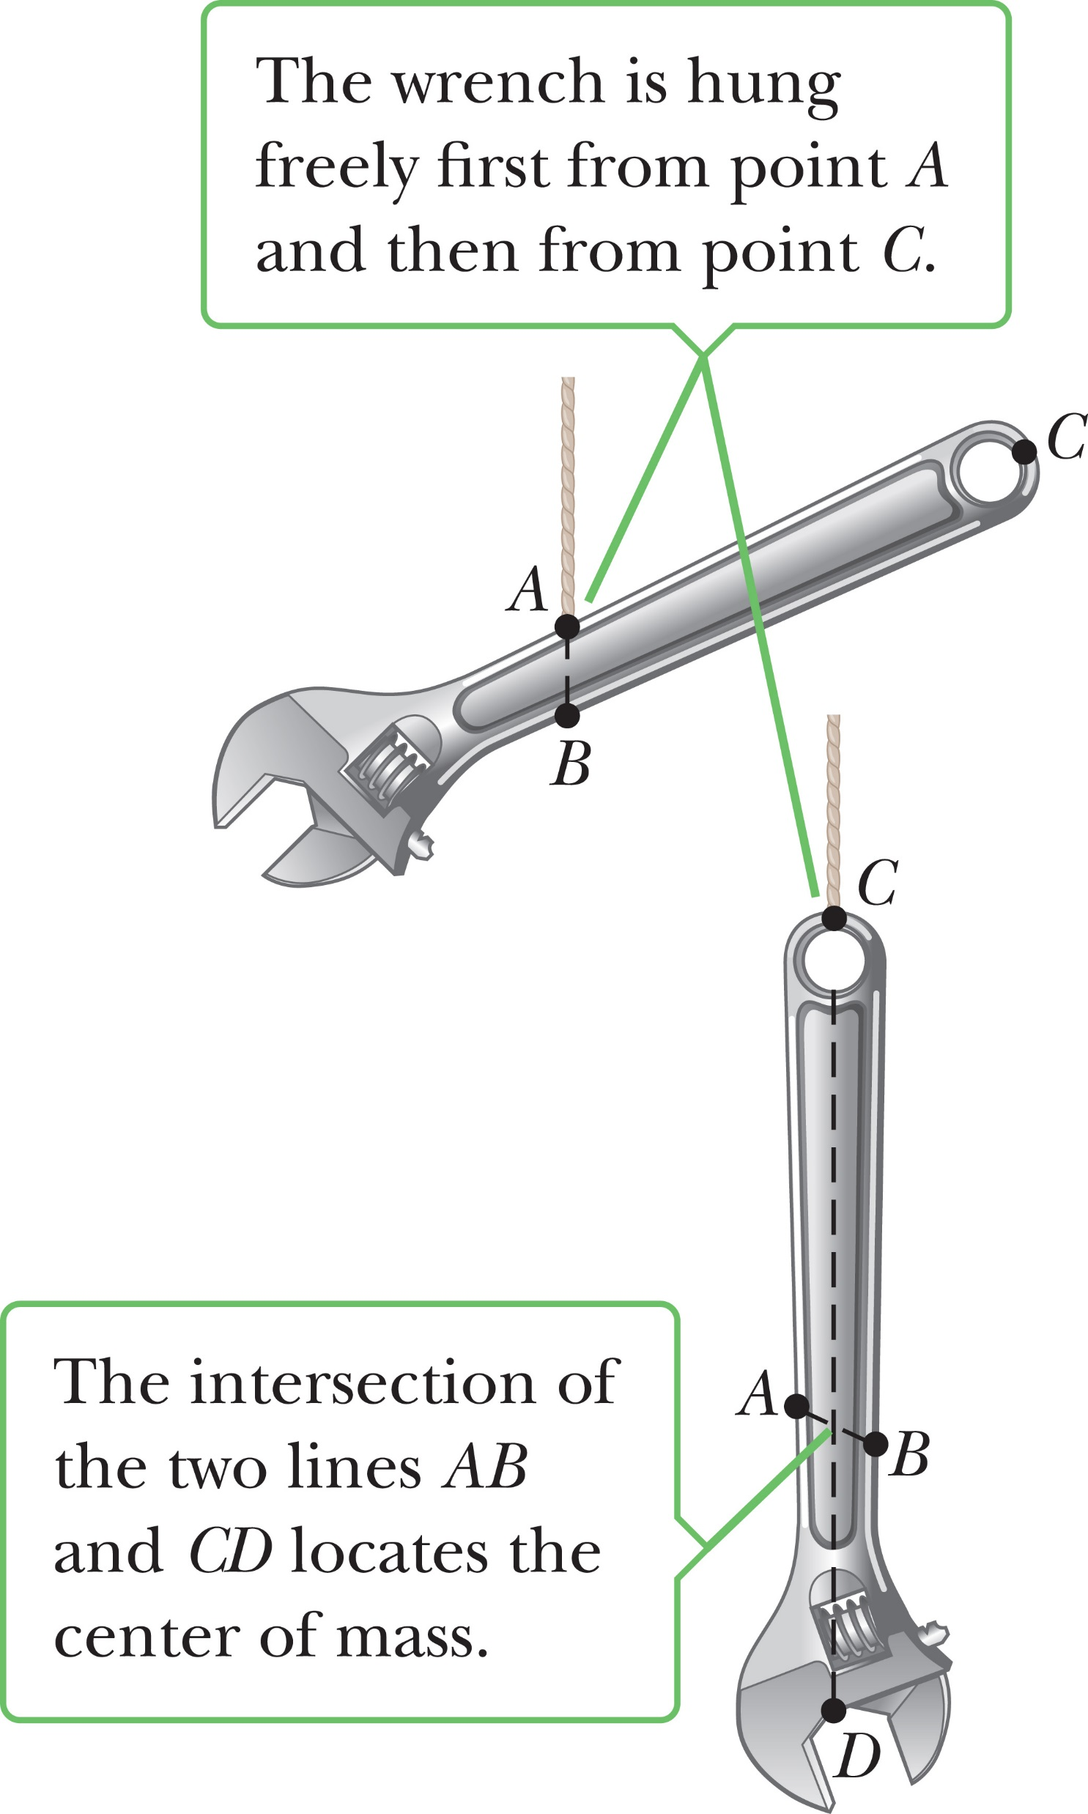
Center of Mass
Notes:
Sometimes it is possible to guess the location of the center of mass. The center of mass of a homogeneous, symmetric body must lie on the axis of symmetry. For example, the center of mass of a homogeneous rod lies midway between the ends of the rod, and the center of mass of a homogeneous sphere or a homogeneous cube lies at the geometric center of the object.
The center of mass of an irregularly shaped object, such as a wrench, can be determined experimentally by suspending the wrench from two different arbitrary points, as shown in the figure. The wrench is first hung from point A, and a vertical line AB, which can be established with a plumb bob, is drawn when the wrench is in equilibrium. The wrench is then hung from point C, and a second vertical line CD is drawn. The center of mass coincides with the intersection of these two lines. In fact, if the wrench is hung freely from any point, the center of mass always lies straight below the point of support, so the vertical line through that point must pass through the center of mass.
A rigid object in a uniform gravitational field can be balanced by a single force equal in magnitude to the weight of the object, as long as the force is directed upward through the object’s center of mass.

Slide 25
Center of Mass Motion
Notes:
We can apply Newton’s second law to a system. The total mass M_{tot} times the acceleration of the center of mass equals the sum of the forces, where ΣF_{ext} is external forces acting on the system, and ΣF_{int} includes all the internal forces acting on the system. All internal forces come as action–reaction pairs, and because the vectors in those pairs have equal magnitudes and opposite directions, they cancel out. So the second law for the center of mass may be written without internal forces. [click to show equation]
In both one and two dimensions, our equations are exactly the same as for single particles. [click to show equations] The two-dimensional equations can be written similarly.

Slide 26
Torque and the Two Conditions for Equilibrium
Notes:
An object in mechanical equilibrium must satisfy two conditions:
1. The net external force must be zero.
2. The net external torque must be zero.
The first condition is a statement of translational equilibrium: The sum of all forces acting on the object must be zero, so the object has no translational acceleration, a = 0.
The second condition is a statement of rotational equilibrium: The sum of all torques on the object must be zero, so the object has no angular acceleration, α = 0.
For an object to be in equilibrium, it must move through space at a constant speed and rotate at a constant angular speed.

Slide 27
Problem-Solving Strategy:
Objects in Equilibrium
Diagram the system
Draw a force diagram
Apply the second condition of equilibrium
Apply the first condition of equilibrium
Solve the system of equations
Notes:
Because we can choose any location for calculating torques, it’s usually best to select an axis that will make at least one torque equal to zero, just to simplify the net torque equation. Here is a general procedure for solving problems that involve objects in equilibrium.
Diagram the system. Include coordinates and choose a convenient rotation axis for computing the net torque on the object.
Draw a force diagram of the object of interest, showing all external forces acting on it. For systems with more than one object, draw a separate diagram for each object. Most problems will have a single object of interest.
Apply the second condition of equilibrium. This condition yields a single equation for each object of interest. If the axis of rotation has been carefully chosen, the equation often has only one unknown and can be solved immediately.
Apply the first condition of equilibrium. This yields two more equations per object of interest.
Solve the system of equations. For each object, the two conditions of equilibrium yield three equations, usually with three unknowns. Solve by substitution.

Slide 28
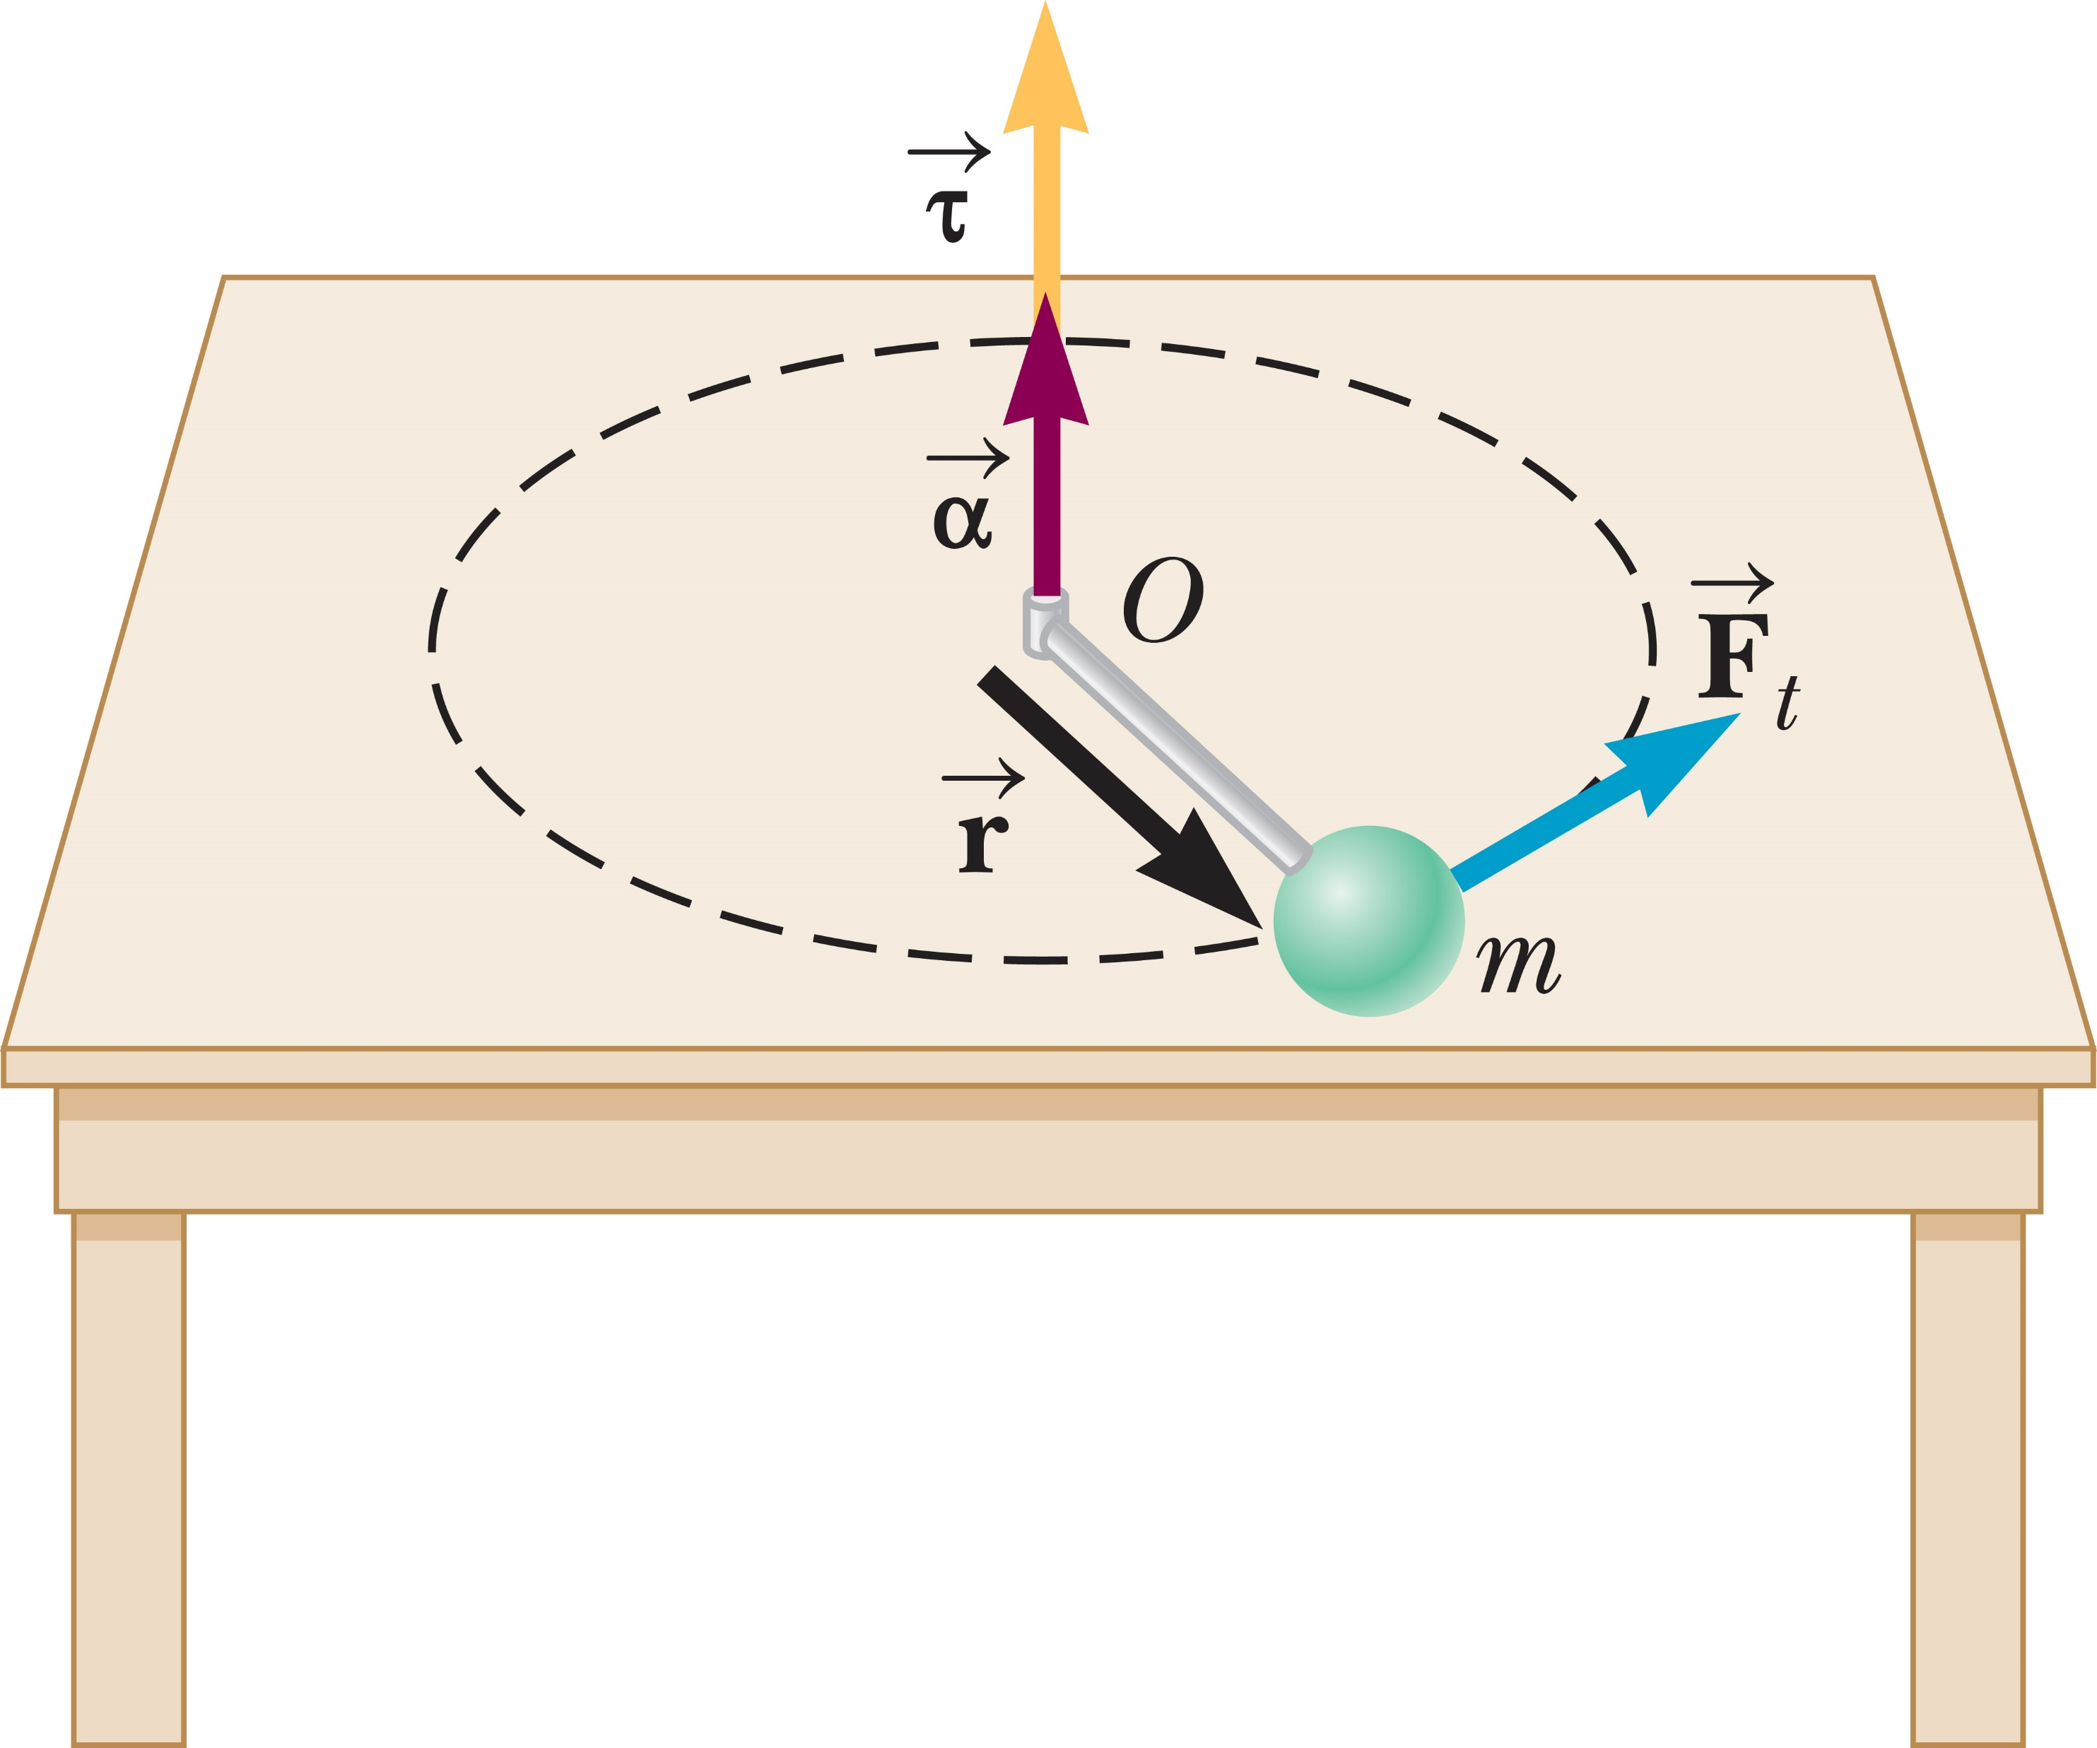
The Rotational Second Law of Motion
Notes:
When a rigid object is subject to a net torque, it undergoes an angular acceleration that is directly proportional to the net torque. This is analogous to Newton’s second law.
Let’s derive this result. The figure shows a system consisting of an object of mass m connected to a very light rod of length r. The rod is pivoted at the point O, and its movement is confined to rotation on a frictionless horizontal table. Assume that a force F_{t} acts perpendicular to the rod and so is tangent to the circular path of the object. Because there is no force to oppose this tangential force, the object undergoes a tangential acceleration a_{t} in accordance with Newton’s second law. [click to show equation]
Multiply both sides of this equation by r. [click to show equation] Substitute the equation relating tangential and angular acceleration into our expression. [click to show equation] The left side of this equation is the torque acting on the object about its axis of rotation, so we can rewrite it. This result [click to show equation] shows that the torque on the object is proportional to the angular acceleration of the object, where the constant of proportionality mr² is called the moment of inertia of the object of mass m. Notice that because the rod is very light, its moment of inertia can be neglected.
As we just discussed, torque τ is a vector perpendicular to a radial vector r and a force vector F. The angular acceleration points in the same direction as the torque, as you can see in the figure. A force exerted clockwise yields a negative torque, and a force exerted counterclockwise results in a positive torque. In a similar way, the angular velocity vector points in either the same direction as α, or in the opposite direction.

Slide 29

Think – Pair – Share
Using a screwdriver, you try to remove a screw from a piece of furniture, but can’t get it to turn. To increase the chances of success, you should use a screwdriver that
is longer.
is shorter.
has a narrower handle.
has a wider handle.
Notes:
Come up with your answer, and compare with a classmate, then let’s see what you’ve come up with in a few minutes.
Answer: has a wider handle.
Reasoning: A larger torque is needed to turn the screw. Increasing the radius of the screwdriver handle provides a
greater lever arm and hence an increased torque.

Slide 30
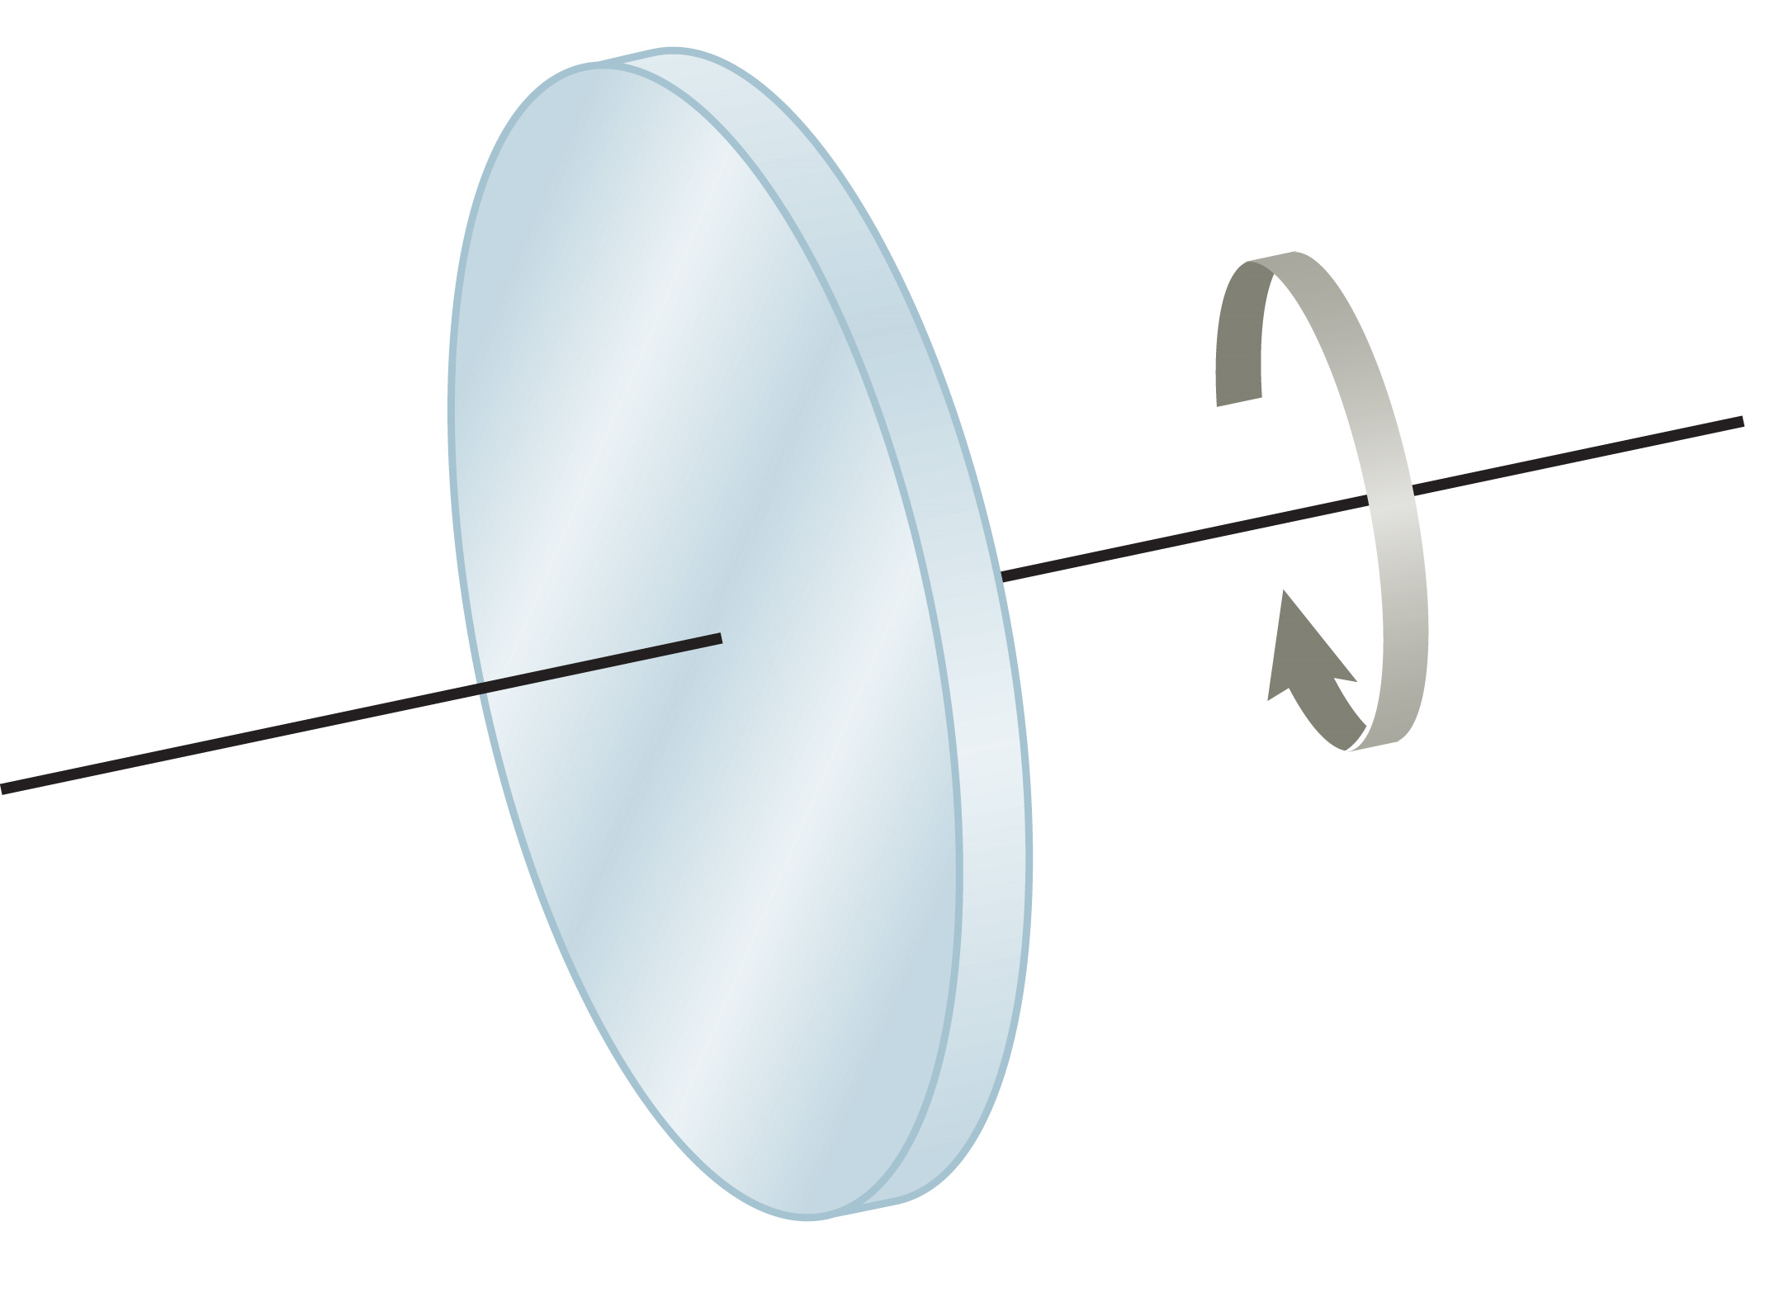
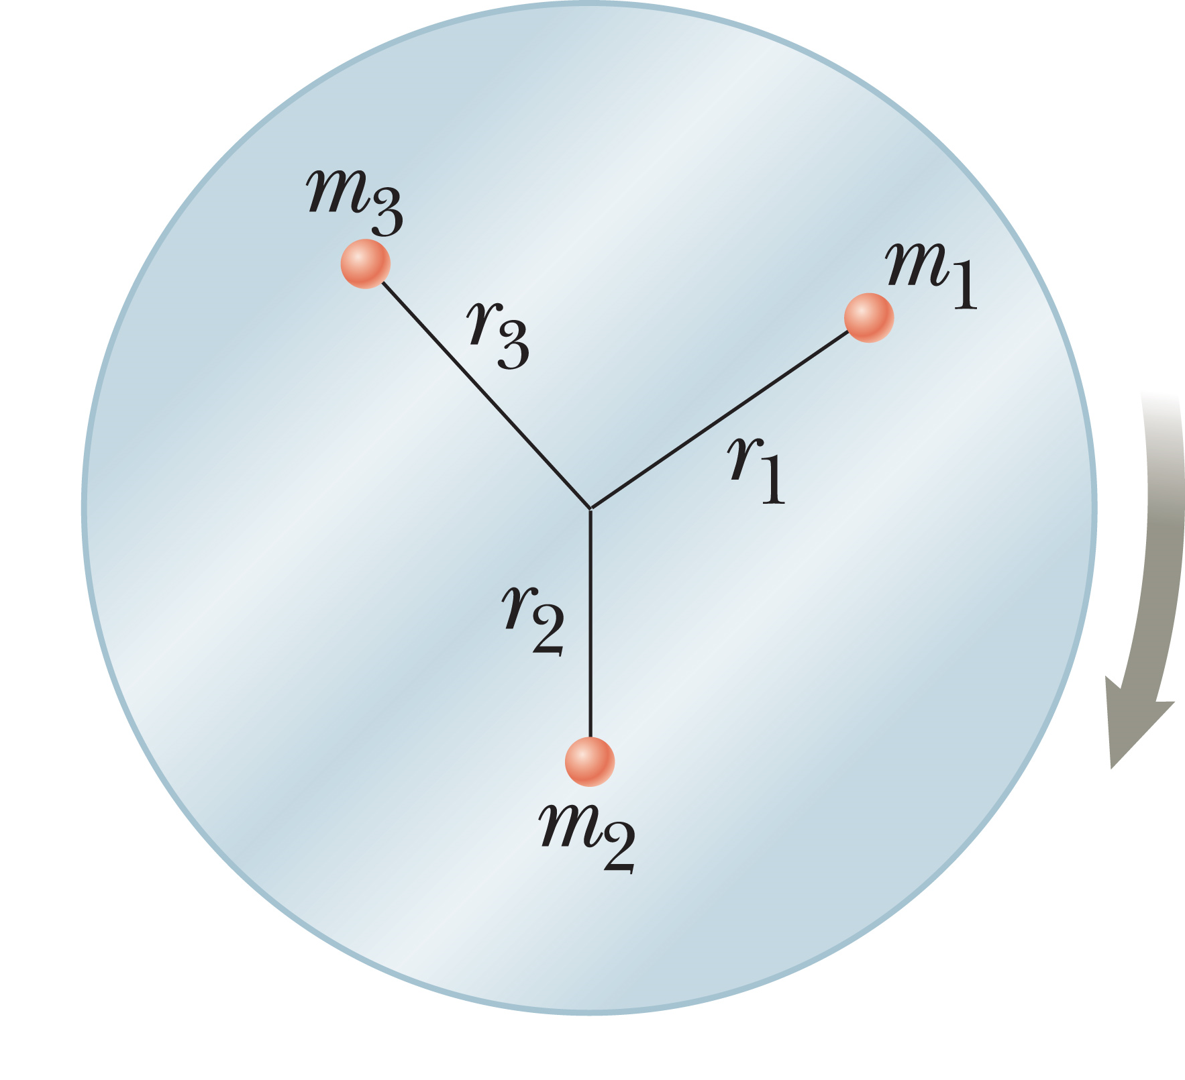
Torque on a Rotating Object
Notes:
Let’s consider a solid disk rotating about its axis as shown in the top figure. The disk consists of many particles at various distances from the axis of rotation, as you can see in the bottom figure. The torque on each one of these particles is given by our torque equation. The net torque on the disk is given by the sum of the individual torques on all the particles. [click to show equation] Because the disk is rigid, all of its particles have the same angular acceleration, so α is not involved in the sum.
From the bottom figure, we can write the equation shown here. [click to show equation] This quantity [click to show equation] is the moment of inertia, I, of the whole body. Using this, we see that the net torque on a rigid body rotating about a fixed axis is given by [click to show equation] this equation, which says that the angular acceleration of an extended rigid object is proportional to the net torque acting on it. This equation is the rotational analog of Newton’s second law of motion, with torque replacing force, moment of inertia replacing mass, and angular acceleration replacing linear acceleration.
The moment of inertia of an object is related to its mass, but there is an important difference between them. The mass m depends only on the quantity of matter in an object, whereas the moment of inertia, I, depends on both the quantity of matter and its distribution in the rigid object.

Slide 31
Think – Pair – Share
A constant net torque is applied to an object. Which one of the following will not be constant?
angular acceleration
angular velocity
moment of inertia
center of gravity
Notes:
Do your best with this, explain your thinking to a neighbor, and we’ll talk in a few minutes as a big group.
Answer: angular velocity
Reasoning: Since the object has a constant net torque acting on it, it will experience a constant angular acceleration. Thus, the angular velocity will change at a constant rate.

Slide 32
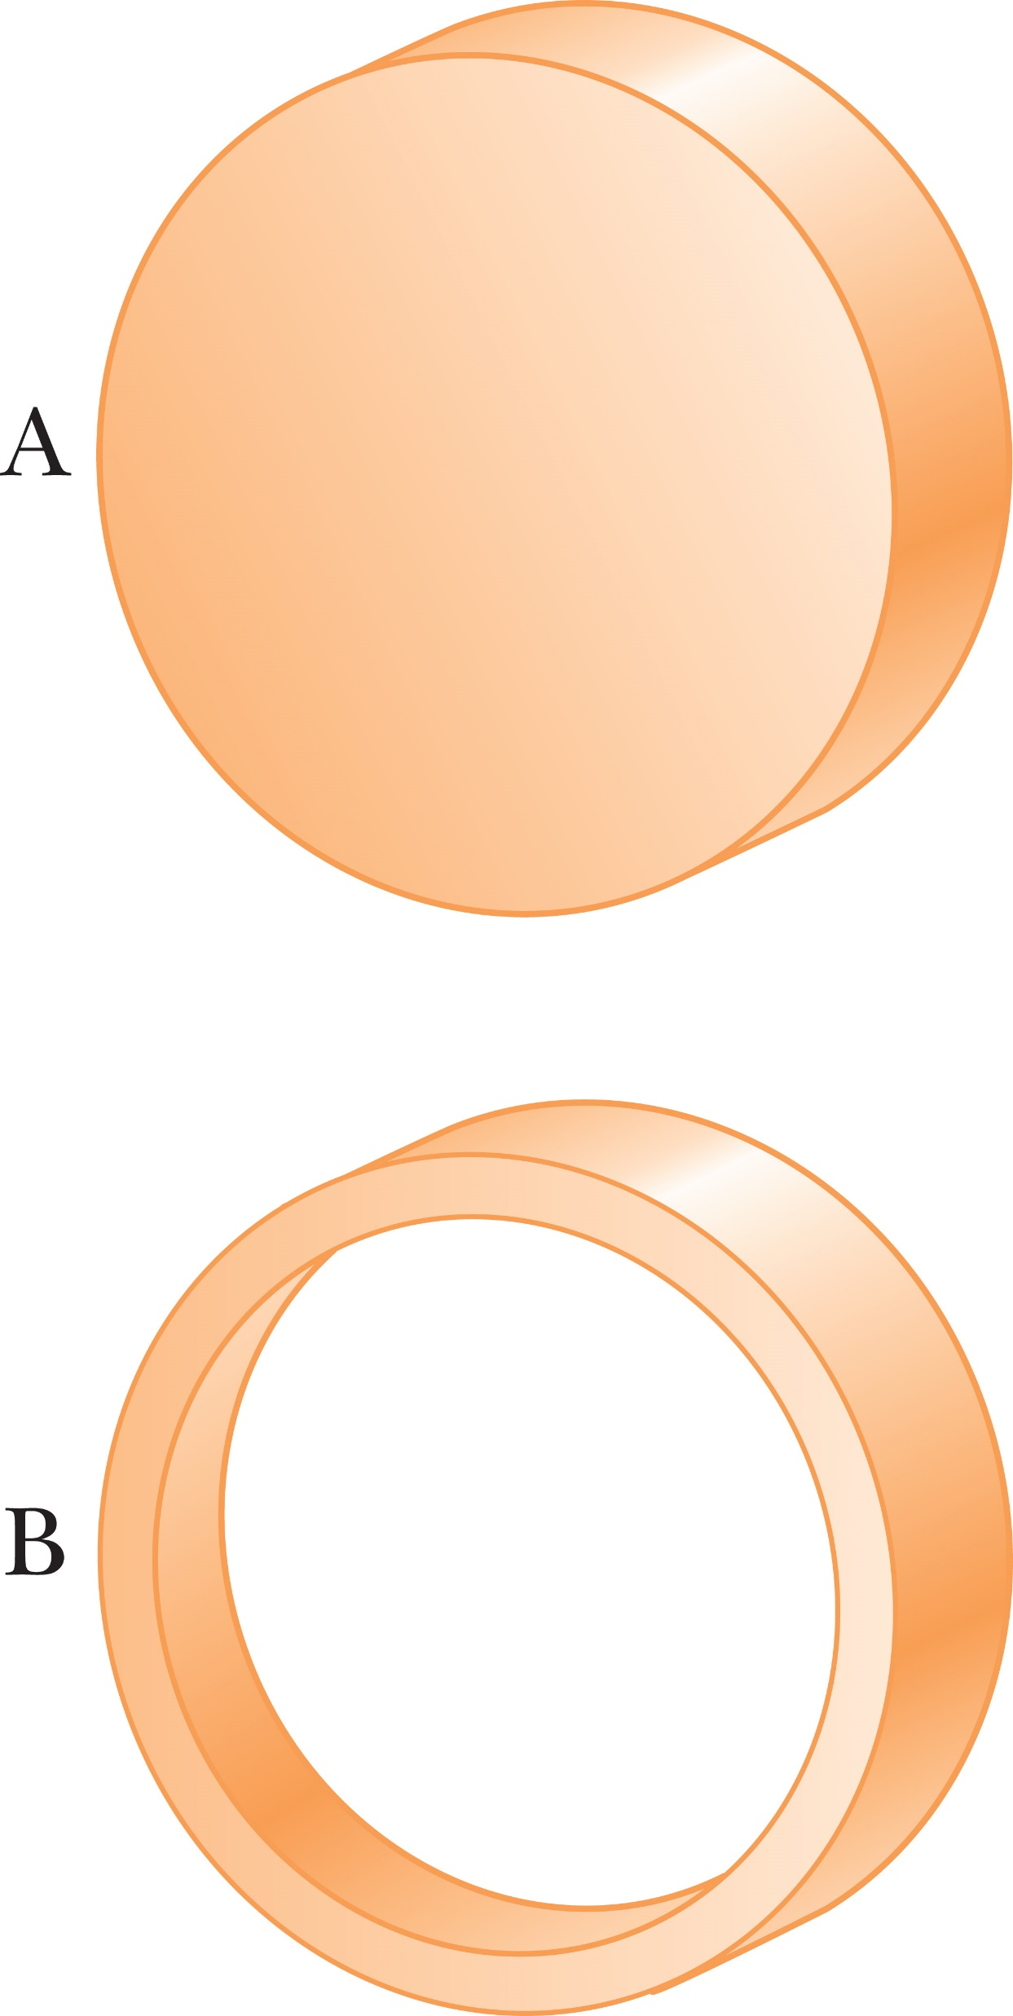
Think – Pair – Share
The two rigid objects shown in the figures have the same mass, radius, and angular speed. If the same braking torque is applied to each, which takes longer to stop?
A
B
more information is needed
Notes:
Think about it, get your own answer, and check to see if your neighbor has a similar answer. We’ll talk about it in a couple of minutes.
Answer: B
Reasoning: The hollow cylinder has the larger moment of inertia, so it will be given the smaller angular acceleration and take longer to stop.

Slide 33
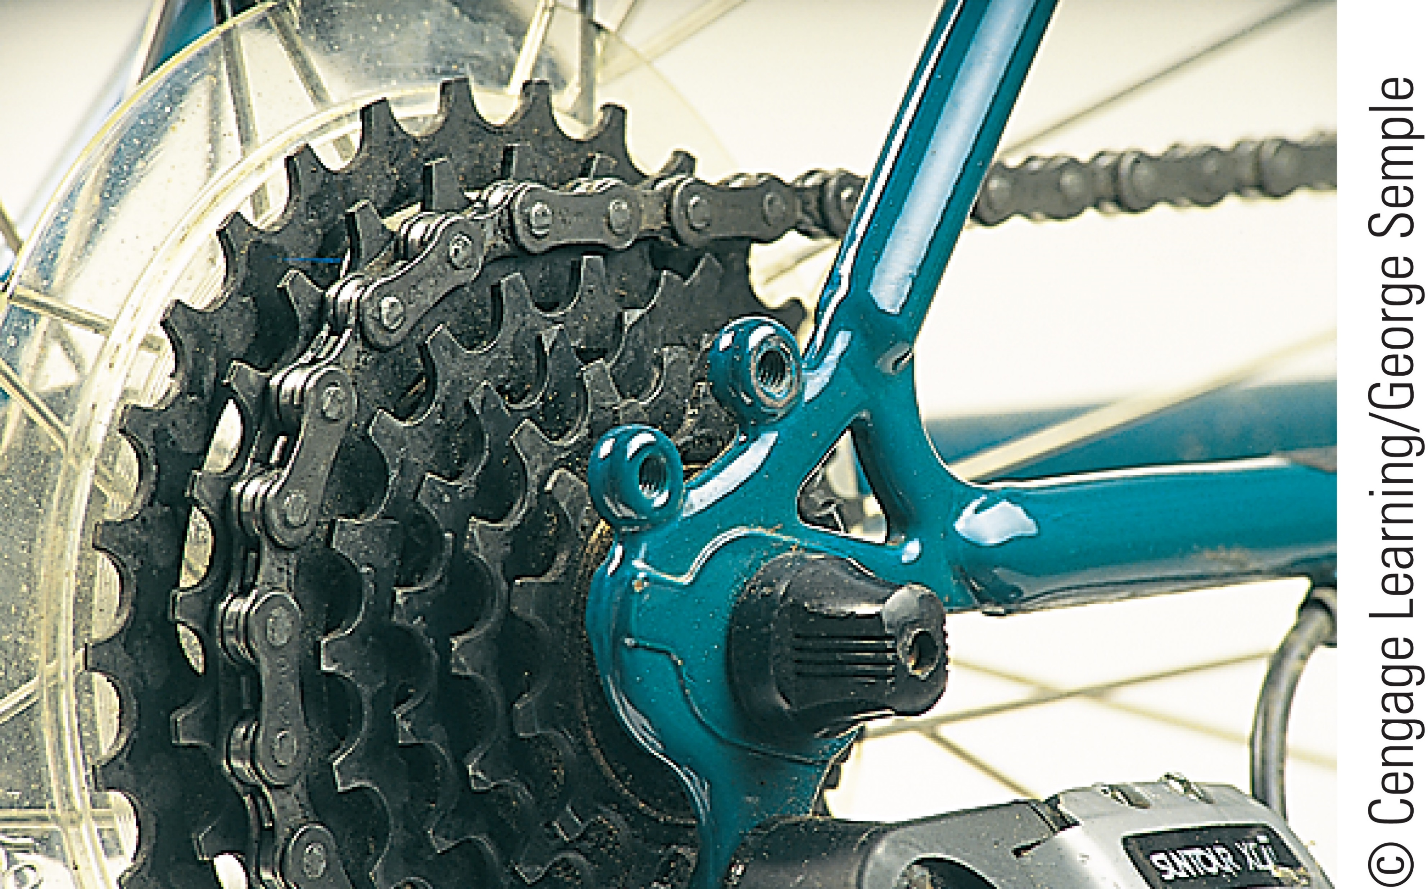
Torque on a Rotating Object
Notes:
Look at the figure of a five-speed gear system, where the drive chain can be adjusted to wrap around any of five gears attached to the back wheel. The gears, with different radii, are concentric with the wheel hub.
When the cyclist begins pedaling from rest, the chain is attached to the largest gear. Because it has the largest radius, this gear provides the largest torque to the drive wheel. A large torque is required initially, because the bicycle starts from rest. As the bicycle rolls faster, the tangential speed of the chain increases, eventually becoming too fast for the cyclist to maintain by pushing the pedals. The chain is then moved to a gear with a smaller radius, so the chain has a smaller tangential speed that the cyclist can more easily maintain. This gear doesn’t provide as much torque as the first, but the cyclist needs to accelerate only to a somewhat higher speed. This process continues as the bicycle moves faster and faster and the cyclist shifts through all five gears. The fifth gear supplies the lowest torque, but now the main function of that torque is to counter the frictional torque from the rolling tires, which tends to reduce the speed of the bicycle. The small radius of the fifth gear allows the cyclist to keep up with the chain’s movement by pushing the pedals

Slide 34
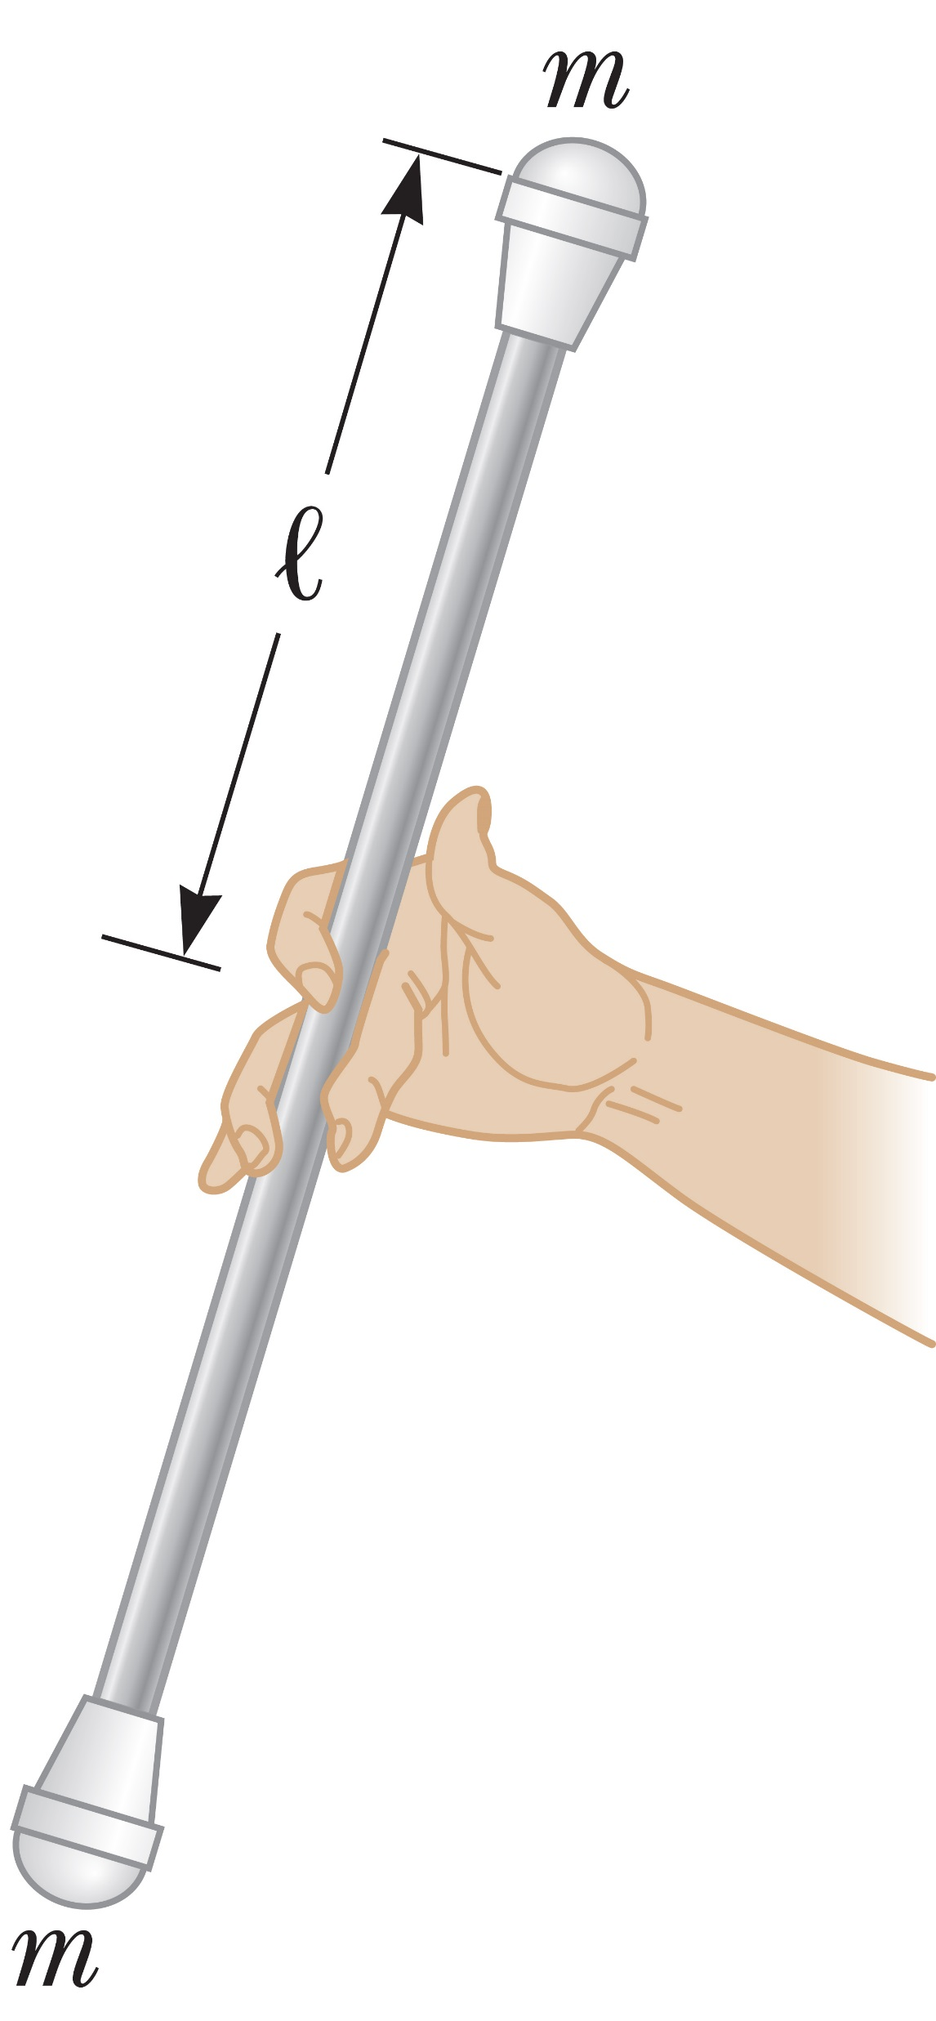
More on the Moment of Inertia
Notes:
As we have seen, a small object or a particle has a moment of inertia equal to mr² about some axis. The moment of inertia of a composite object about some axis is just the sum of the moments of inertia of the object’s components.
For example, let’s suppose a majorette twirls a baton as in the figure, and we’ll assume that the baton can be modeled as a very light rod of length 2L, with a heavy object at each end. Because we are neglecting the mass of the rod, the moment of inertia of the baton about an axis through its center and perpendicular to its length is given by our moment-of-inertia equation. [click to show equation] Because this system consists of two objects with equal masses equidistant from the axis of rotation, r = L for each object, so the sum is shown here. If we didn’t neglect the mass of the rod, we would have to include its moment of inertia to find the total moment of inertia of the baton.
We said earlier that I is the rotational counterpart of m. But there are are some important distinctions between the two. For example, mass is an intrinsic property of an object that doesn’t change, whereas the moment of inertia of a system depends on how the mass is distributed and on the location of the axis of rotation.

Slide 35
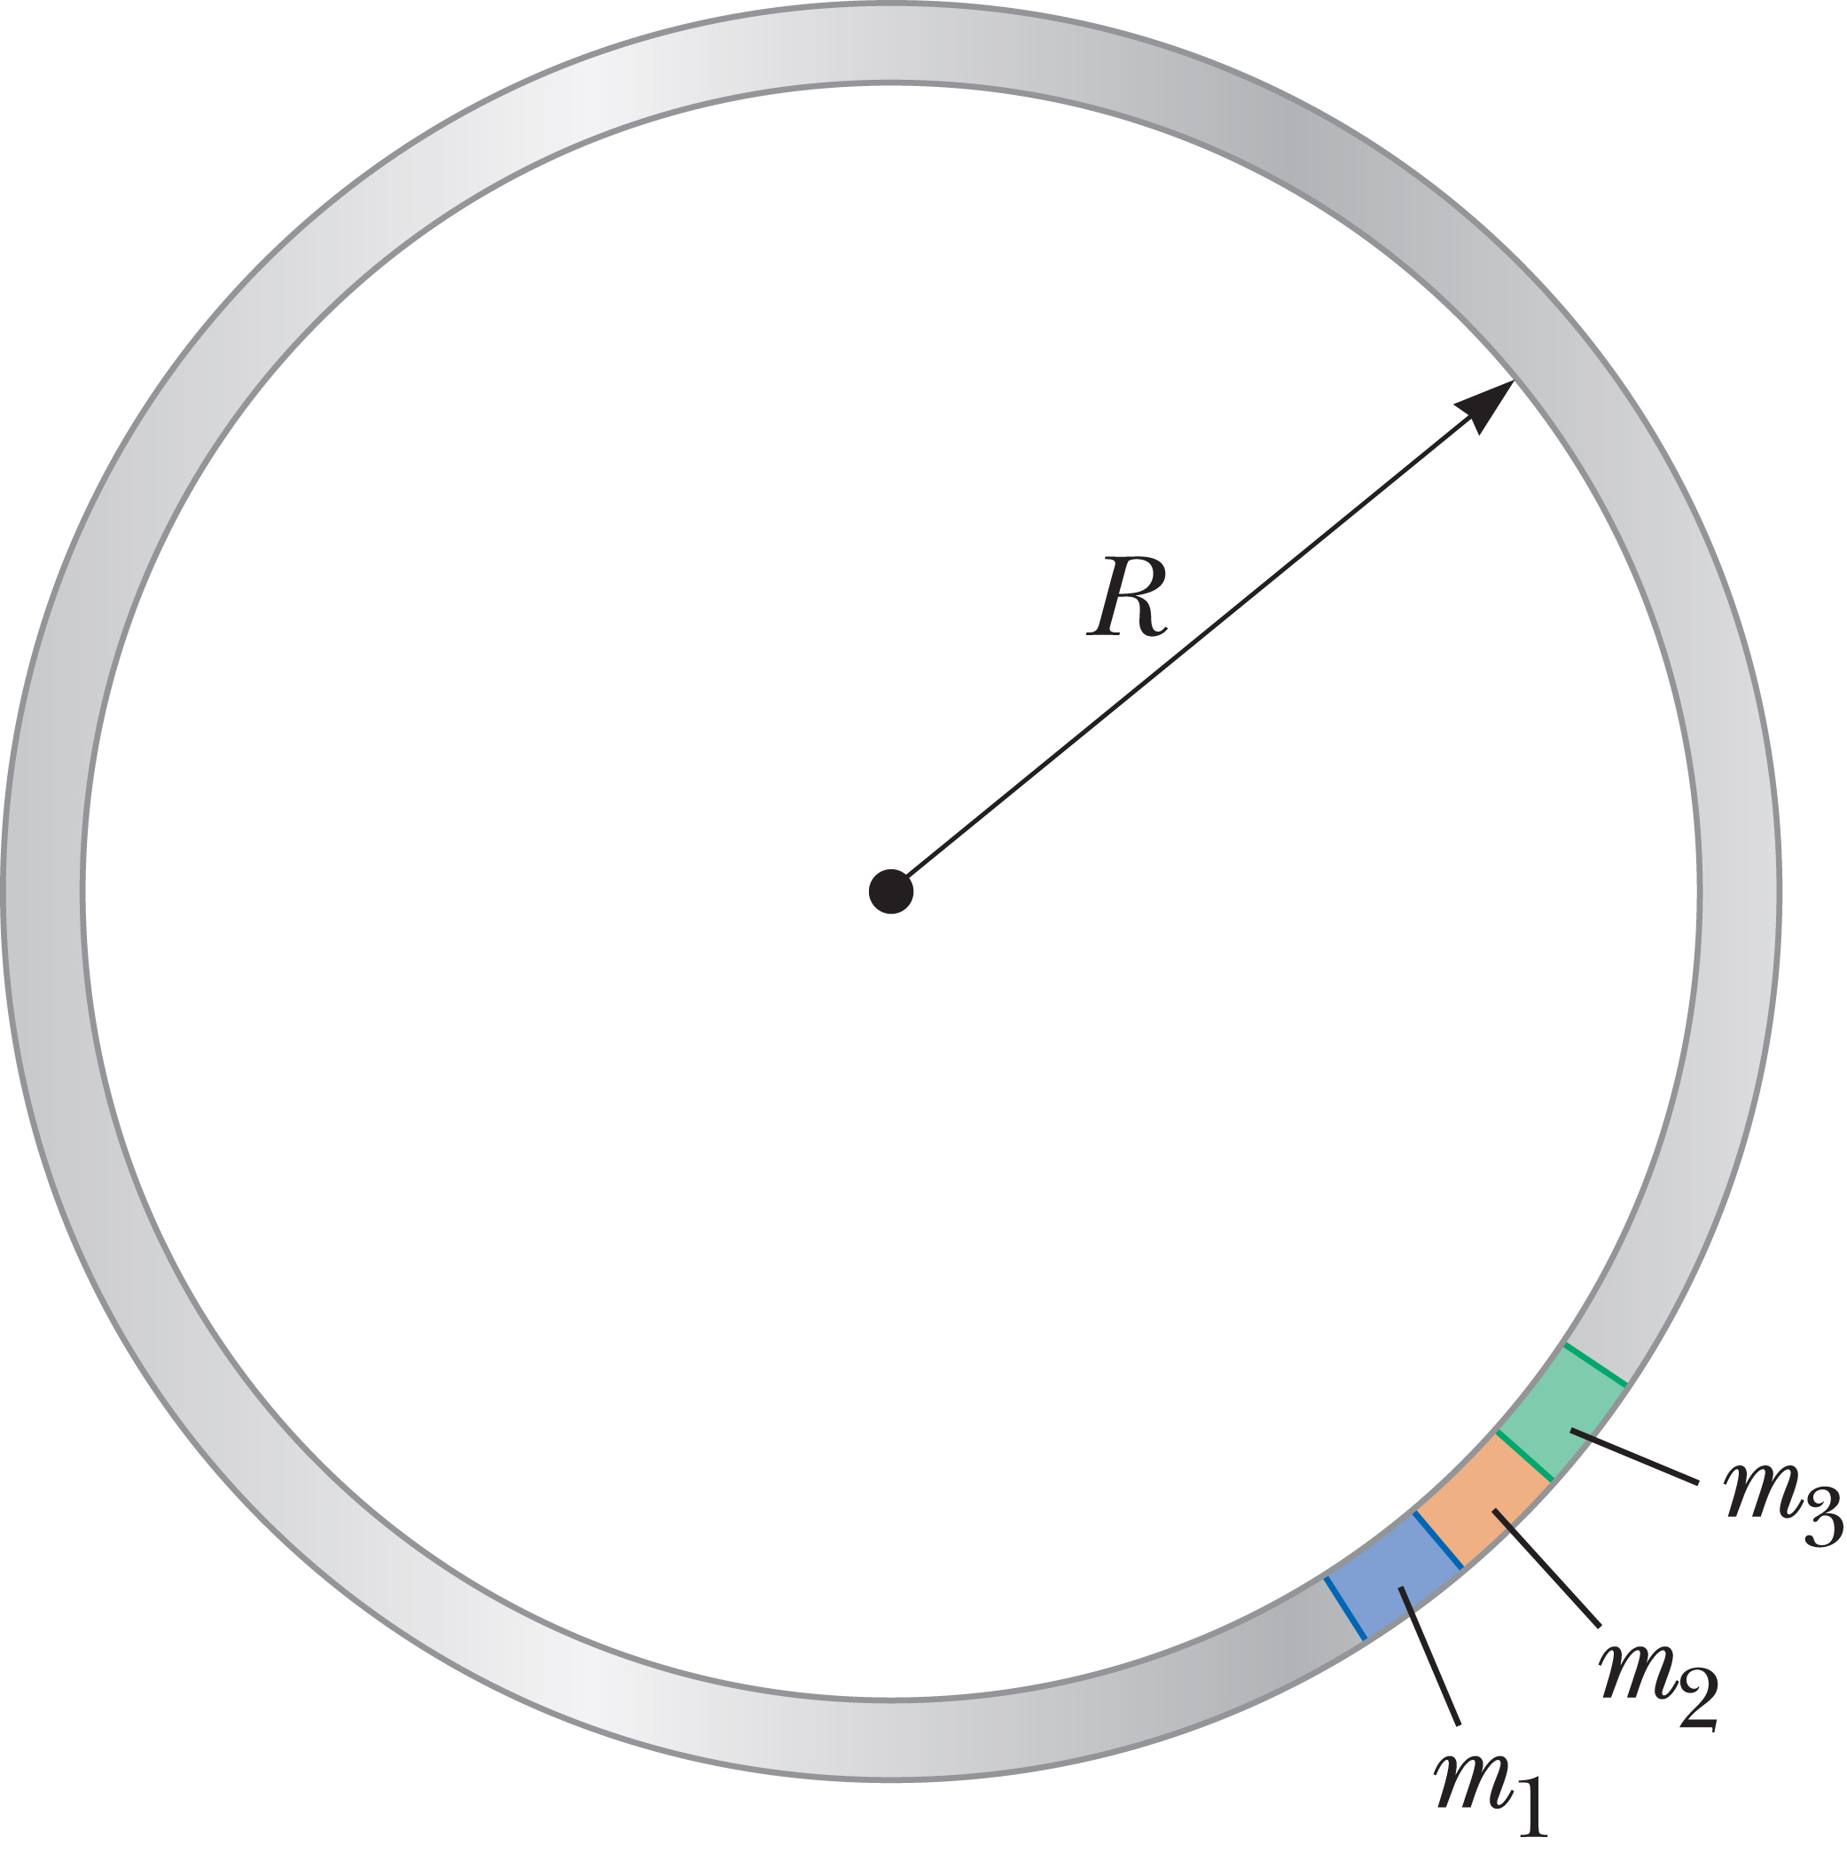
Calculations of Moments of Inertia for Extended Objects
Notes:
When we consider extended objects such as a sphere, a cylinder, or a cone, techniques of calculus are often required to calculate the moment of inertia. If, on the other hand, the object has a certain symmetry, we can find the moment of inertia without calculus.
For example, let’s think of a hoop rotating about an axis perpendicular to its plane and passing through its center, as shown in the figure. A bicycle tire, for example, would approximately fit into this category. To evaluate the moment of inertia of the hoop, we can still use our equation and imagine that the mass of the hoop M is divided into n small segments having masses m₁, m₂, m₃, all the way to m_{n}. Then the total mass M [click to show equation] is the sum of the individual masses.
Let’s rewrite our moment-of-inertia equation. [click to show equation] All of the segments around the hoop are at the same distance R from the axis of rotation, [click to show equations] so we can drop the subscripts on the distances and factor out R². This expression can be used for the moment of inertia of any ring-shaped object rotating about an axis through its center and perpendicular to its plane.
Note that the result is strictly valid only if the thickness of the ring is small relative to its inner radius.

Slide 36
Calculations of Moments of Inertia for Extended Objects
Notes:
The moments of inertia for some other common shapes are given in the table.
Our expression for the moment of inertia of a hoop can be used equally well to find the axial moment of inertia of an embroidery hoop or of a long sewer pipe. In the sam way, a door turning on its hinges is described by the same moment-of-inertia expression for a long, thin rod rotating about an axis through its end.

Slide 37
Extending the System Approach
Notes:
In the system approach, all masses in the system accelerate at the same rate under external forces. The masses are connected by internal forces, for example, tensions, which we can disregard because they come in equal and opposite pairs. When pulleys or other rotating objects are involved, there is an additional requirement that the cables causing them to rotate must not slip, so that the tangential acceleration at the point of contact is the same as the common acceleration of the masses in the system. Each rotating object then contributes an additional effective mass of I divided by r² to the total mass, or inertia, of the system. For simplicity, we won’t consider external torques, for example, torques applied with a crank, although they can be included if the conditions aren’t violated. We can then write the equation shown on the slide.
For problems involving the rotational second law of motion, we need to take both translational inertia and rotational inertia into account.

Slide 38
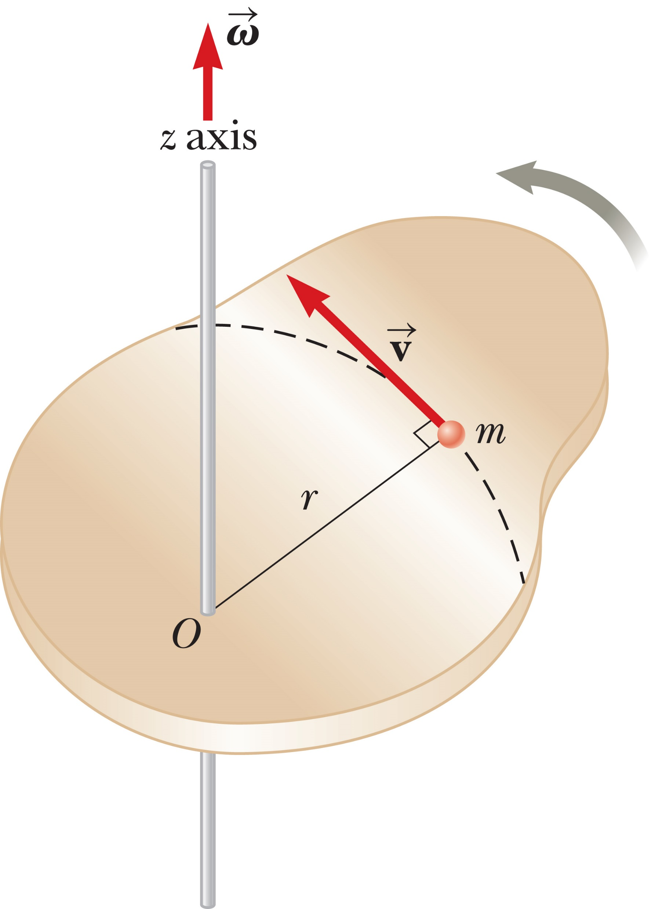
Rotational Kinetic Energy
Notes:
In Topic 5 we defined the kinetic energy of a particle moving through space with a speed v as the quantity ½ mv². In a similar way, we can define the rotational kinetic energy of an object rotating about some axis with an angular speed v.
Let’s see how we can do this. First, let’s consider the object shown in the figure, which is in the shape of a thin, rigid plate rotating around some axis perpendicular to its plane. The plate consists of many small particles, each of mass m. All these particles rotate in circular paths around the axis. If r is the distance of one of the particles from the axis of rotation, the speed of that particle is v = rω. [click to show equation]
Of course, the total kinetic energy of the plate’s rotation is the sum of all the kinetic energies associated with its particles. [click to show equations] In the last step, the ω² term is factored out because it’s the same for every particle.
Now, the quantity in parentheses is the moment of inertia of the plate in the limit as the particles become vanishingly small, so we can write our result as shown [click to show equation], where I is the moment of inertia of the plate.

Slide 39
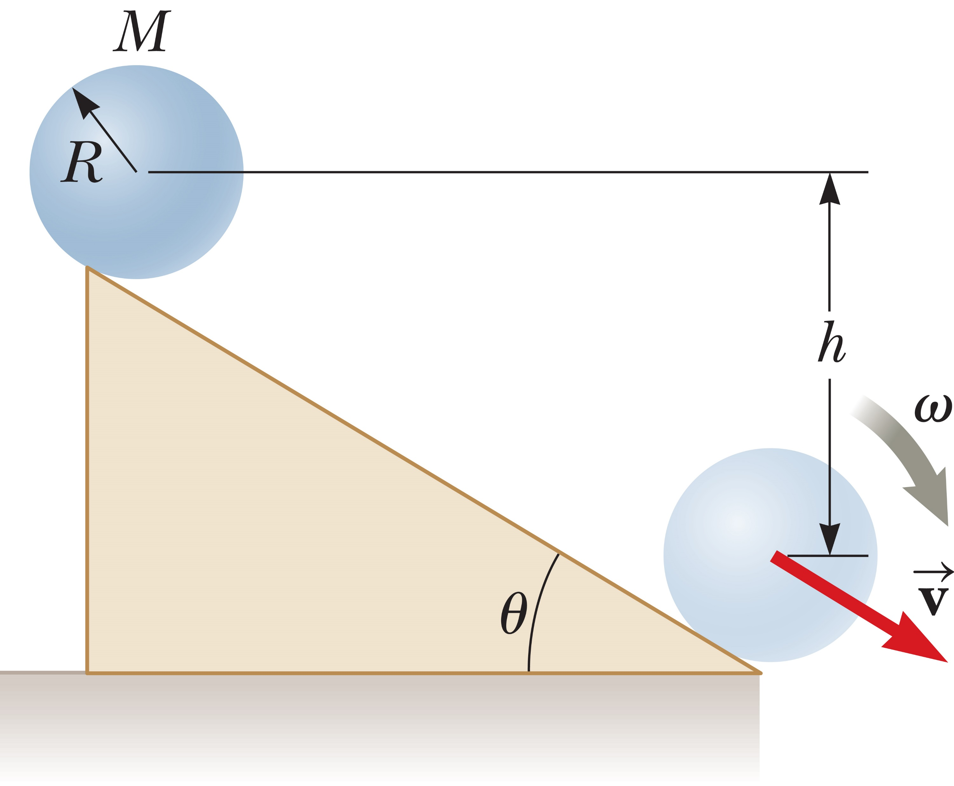
Rotational Kinetic Energy
Notes:
A system such as a bowling ball rolling down a ramp is described by three types of energy: gravitational potential energy, translational kinetic energy, and rotational kinetic energy. All these forms of energy, plus the potential energies of any other conservative forces, must be included in our equation for the conservation of mechanical energy of an isolated system, as shown, where i and f refer to initial and final values, respectively, and PE includes the potential energies of all conservative forces in a given problem. This relation is true only if we ignore dissipative forces such as friction. Otherwise, we need a generalization of the work–energy theorem. [click to show equation]

Slide 40

Problem-Solving Strategy:
Energy Methods and Rotation
Choose two points of interest
Identify forces
Write the appropriate equation:
Substitute general expressions
Use
Solve for the unknown
Notes:
To solve problems involving energy methods and rotations, you can follow this problem-solving strategy:
Choose two points of interest, one where all necessary information is known, and the other where information is desired.
Identify the conservative and non-conservative forces acting on the system being analyzed.
Write your equation: if there are non-conservative forces use the general work-energy theorem, if all the forces are conservative use conservation of energy.
Substitute general expressions for the terms in the equation.
Use v = rω to eliminate either v or ω from the equation.
Solve for the unknown

Slide 41
Think – Pair – Share
Two spheres, one hollow and one solid, are rotating with the same angular speed around an axis through their centers. Both spheres have the same mass and radius. Which sphere, if either, has the higher rotational kinetic energy?
the hollow sphere
the solid sphere
They have the same kinetic energy.
Notes:
Compare your answer to your classmate’s in about a minute, and in 2 minutes, we’ll see what you all have come up with.
Answer: the hollow sphere
Reasoning: The hollow sphere has the larger moment of inertia, so it will have the higher rotational kinetic energy, KE_{r} = ½ Iω².

Slide 42
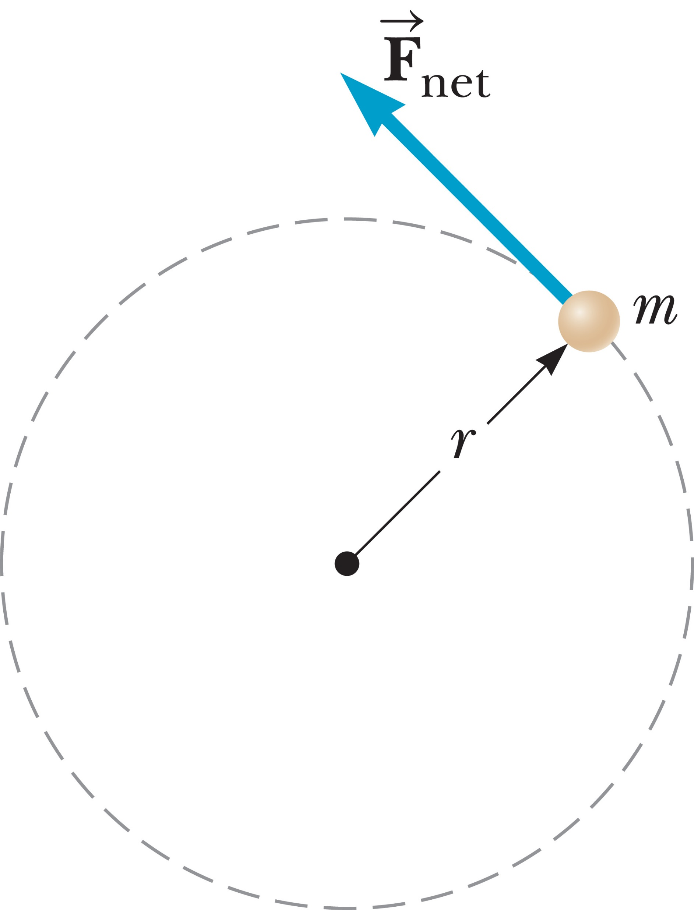
Angular Momentum
Notes:
Take a look at the figure, where an object of mass m rotates in a circular path of radius r, acted on by a net force. The resulting net torque on the object increases its angular speed from the value ω₀ to the value ω in a time interval Δt. That means we can write the equation here. [click to show equation]
Let’s define the product Iω as the angular momentum of the object. [click to show equation] Now we can write the rotational analog of Newton’s second law, [click to show equation] which states that the net torque acting on an object is equal to the time rate of change of the object’s angular momentum.

Slide 43
Angular Momentum
The mechanical energy, linear momentum, and angular momentum of an isolated system all remain constant.
Notes:
When the net external torque acting on a system is zero, we get ΔL over Δt = 0, which says that the time rate of change of the system’s angular momentum is zero. Let L_{i} and L_{f} be the angular momenta of a system at two different times, and suppose there is no net external torque, so the sum of the torques is 0. [click to show equation] That means the initial and final angular momenta are equal, [click to show equation] and angular momentum is said to be conserved.
We now have a third conservation law to add to our list: [click to show equation] conservation of angular momentum. We can now state that the mechanical energy, linear momentum, and angular momentum of an isolated system all remain constant.

Slide 44
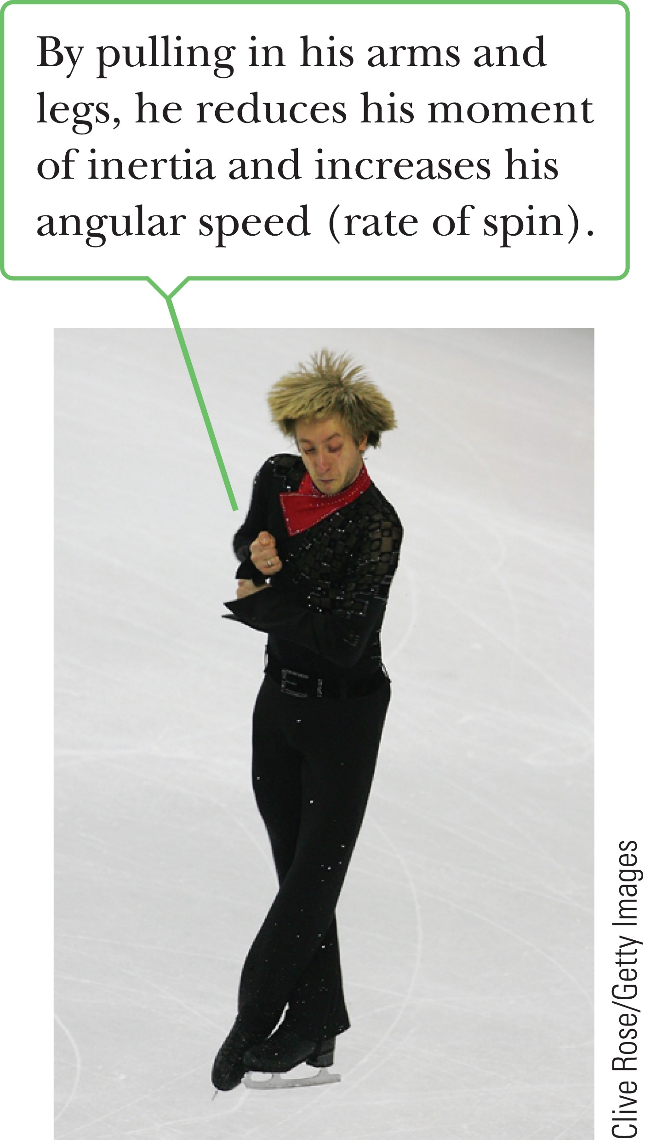
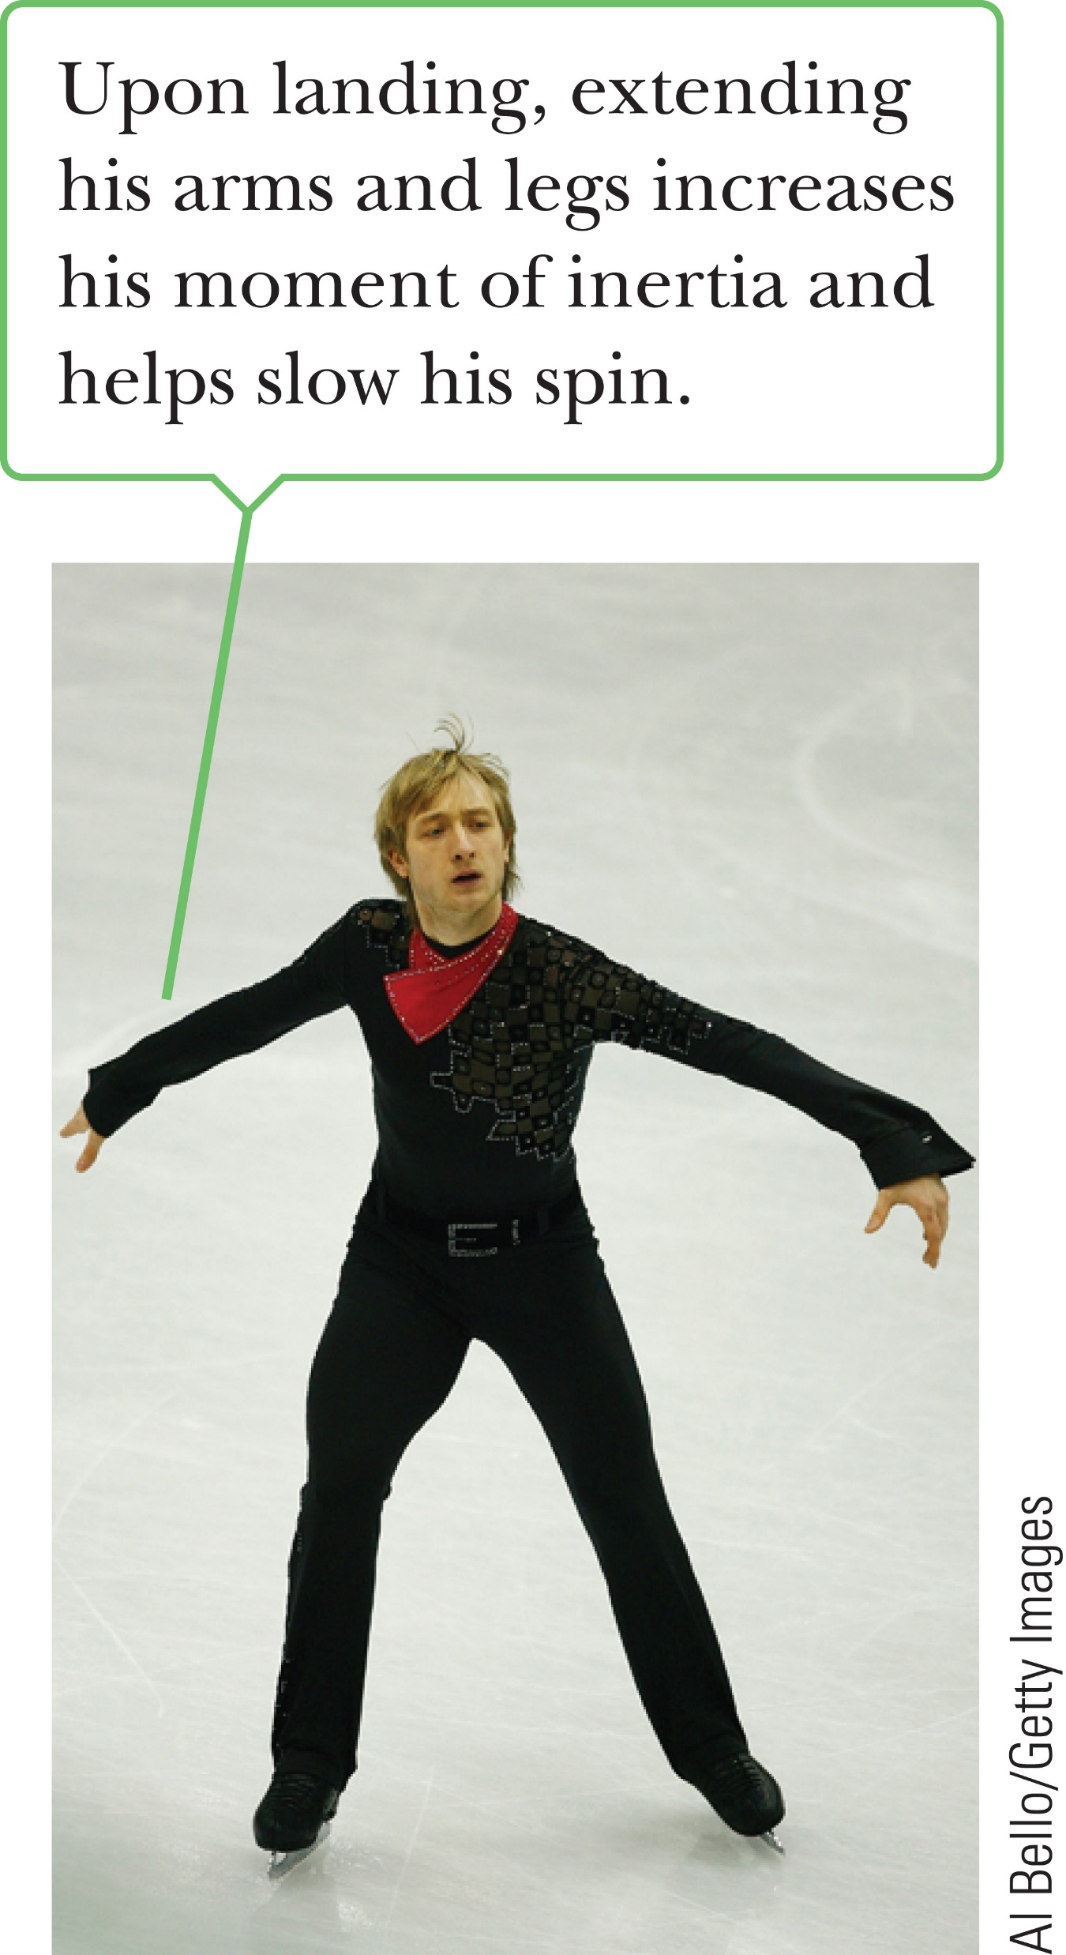
Angular Momentum
Notes:
Conservation of angular momentum applies to macroscopic objects such as planets and people, as well as to atoms and molecules. There are many examples of conservation of angular momentum.
Consider the figure skater shown. In the first photo, the skater has pulled his arms and legs close to his body, reducing their distance from his axis of rotation and so reducing his moment of inertia. By conservation of angular momentum, a reduction in his moment of inertia must increase his angular speed. Coming out of the spin in the photo on the right, he needs to reduce his angular speed, so he extends his arms and legs again, increasing his moment of inertia and slowing his rotation.

Slide 45
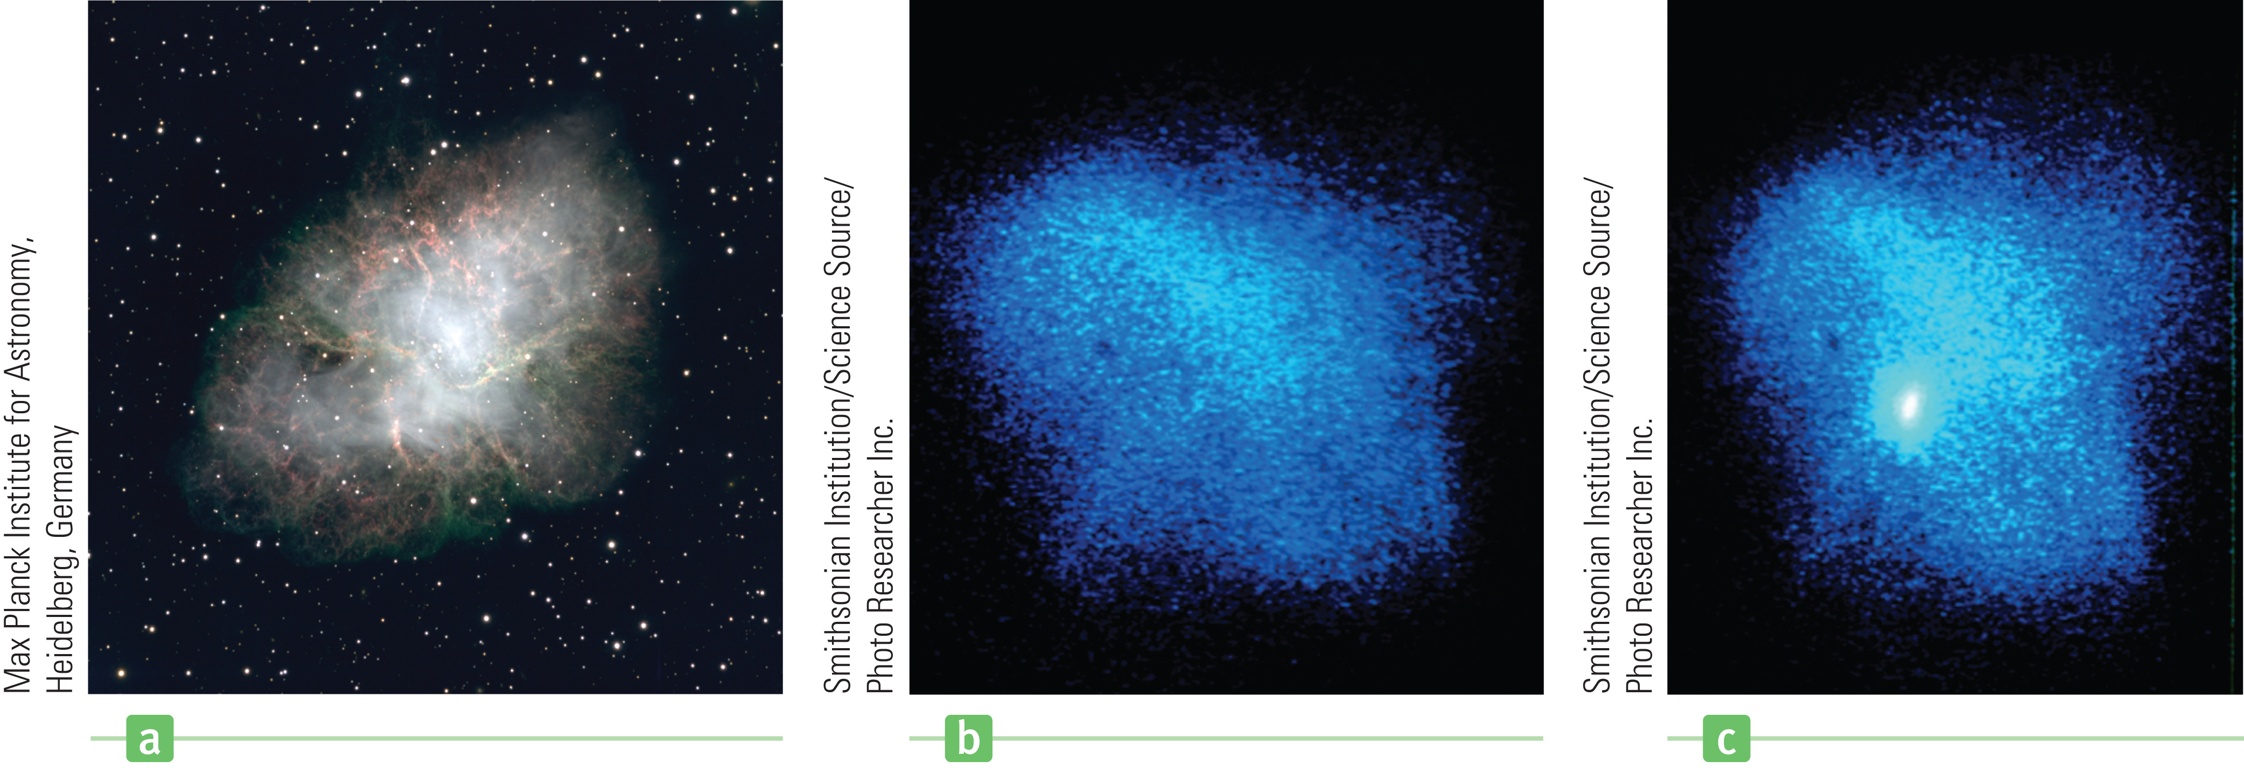
Angular Momentum
Notes:
The figures show a fascinating astrophysical example of conservation of angular momentum. At the end of its lifetime a massive star uses up all its fuel and collapses under the influence of gravitational forces, causing a gigantic outburst of energy called a supernova.
The best-studied example of a remnant of a supernova explosion is the Crab Nebula shown in the pictures here, which is a chaotic, expanding mass of gas. In a supernova, part of the star’s mass is ejected into space, where it eventually condenses into new stars and planets. Most of what is left behind typically collapses into a neutron star—an extremely dense sphere of matter with a diameter of about 10 km, which is greatly reduced from the 10⁶-km diameter of the original star, and containing a large fraction of the star’s original mass. In a neutron star, pressures become so great that atomic electrons combine with protons, becoming neutrons. As the moment of inertia of the system decreases during the collapse, the star’s rotational speed increases.
More than 700 rapidly rotating neutron stars have been identified since they were first discovered in 1967, with periods of rotation ranging from a millisecond to several seconds. The neutron star is an amazing system—an object with a mass greater than the Sun, fitting comfortably within the space of a small county and rotating so fast that the tangential speed of the surface approaches a sizable fraction of the speed of light!

Slide 46
Think – Pair – Share
A horizontal disk with moment of inertia I₁ rotates with angular speed ω₁ about a vertical frictionless axle. A second horizontal disk, with moment of inertia I₂ drops onto the first, initially not rotating but sharing the same axis as the first disk. Because their surfaces are rough, the two disks eventually reach the same angular speed ω. The ratio ω/ω₁ is equal to
I₁ / I₂
I₂ / I₁
I₁ / (I₁ + I₂)
I₂ / (I₁ + I₂)
Notes:
Think about it for yourself, then check with a classmate, and we’ll check your answer in about 1 minute.
Answer: I₁ / (I₁ + I₂)
Reasoning: Apply conservation of angular momentum to the system (the two disks) before and after the second disk is
added to get the result: I₁ω₁ = (I₁ + I₂)ω.

Slide 47
Think – Pair – Share
If global warming continues, it’s likely that some ice from the polar ice caps of the Earth will melt and the water will be distributed closer to the equator. If this occurs, would the length of the day (one rotation)
increase.
decrease.
remain the same.
Notes:
Run your explanation by a classmate or two, and listen to theirs. In about a minute, let’s hear your answers.
Answer: increase
Reasoning: Earth already bulges slightly at the Equator, and is slightly flat at the poles. If more mass moved towards the Equator, it would essentially move the mass to a greater distance from the axis of rotation, and increase the moment of inertia. Because conservation of angular momentum requires that I₁ω_{z} = constant, an increase in the moment of inertia would decrease the angular velocity, and slow down the spinning of Earth. Thus, the length of each day would increase.

Slide 48

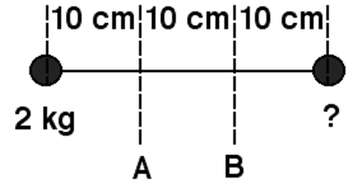
Assessing to Learn
The rotational inertia of the dumbbell (see figure) about axis A is twice the rotational inertia about axis B. The unknown mass is:
1. 4/7 kg 2. 2 kg 3. 4 kg
4. 5 kg 5. 7 kg 6. 8 kg
7. 10 kg 8. None of the above
9. Cannot be determined
10. The rotational inertia cannot be different about different axes.
Notes:
Check your result against your neighbor’s, and resolve any discrepancies. We’ll see what you come up with in a couple of minutes.
Answer: 7 kg
Question E1.01
Commentary
Purpose: To practice problem solving with rotational motion ideas.
Discussion:
Rotational inertia is not an intrinsic property of an object; its value depends on the axis about which it is calculated. In this case, the object's rotational inertia is twice as large about one axis as another.
Let's avoid numerical computations, even though we are given specific values for all known quantities. Let d = 10 cm, m = 2 kg, and M = the unknown mass. We'll solve for M in terms of the given quantities.
The rotational inertia about axis A is I_{A} = md² + M(2d)² = (m + 4M)d². The rotational inertia about axis B is I_{B} = m(2d)² + Md² = (4m + M)d². (We are treating each dumbbell as a point mass.)
We are told that the rotational inertia about axis A is twice as large as that about axis B (I_{A} = 2I_{B}), so m + 4M = 2(4m + M). (Note that d has cancelled out, and does not affect the answer.) Therefore, M = 7/2 m. Since m = 2 kg, M = 7 kg.
Key Points:
An object's rotational inertia ("moment of inertia") depends on the axis you choose to calculate it about.
The rotational of inertia of a point-like object about an axis is md², where m is the object's mass and d is its distance from the axis.
The rotational of inertia of an object composed of multiple sub-objects is just the sum of their individual rotational inertias (about the same axis).
Avoid putting numbers into calculations until the very end. Instead, define variables and work with those. (Often, some will cancel out, simplifying your calculations.)
For Instructors Only
Students can get bogged down in unnecessary calculations and computations. This problem presents a good opportunity to discuss problem-solving procedures.
Many students will translate the given relationship between rotational inertias incorrectly, and will interpret "The rotational inertia... about axis A is twice the rotational inertia about axis B" as 2I_{A} = I_{B}. Those who do this will get M = 4/7 kg. (This is a well-documented error in translating verbal to algebraic representations.)
Students should be encouraged to decide on qualitative grounds which mass is larger, so that they can check their answers for reasonability.
Source: UMass Assessing to Learn

Slide 49
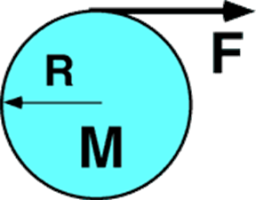
Assessing to Learn
A disk, with radius 0.25 m and mass 4 kg, lies flat on a smooth horizontal tabletop. A string wound about the disk is pulled with a force of 8 N. What is the acceleration of the disk?
0
0.5 m/s²
1 m/s²
2 m/s²
4 m/s²
None of the above.
Cannot be determined.
Notes:
Explain your thinking to a neighbor, and listen to their ideas. In a few minutes we’ll discuss it, and find out what you decided.
Answer: 2 m/s²
Question E1.02a
Commentary
Purpose: To elicit and confront the common misconception that Newton's second law is somehow invalid for objects that rotate as well as translate, or for forces that are also torques.
Discussion:
In the horizontal plane, the only force acting on the disk is the tension F from the string. (The vertical forces, gravity and the normal force of the table, balance.) Thus, according to Newton's second law, a = F / m = 2 m/s².
Yes, it's really that easy. Newton's second law is always true, whether or not rotation occurs as well as translation. If the force F were applied at the center of the disk, or anywhere else, the acceleration would still be 2 m/s². Where the force is applied will affect how the disk rotates, but not how its center of mass accelerates.
You may have difficulties with this idea. Intuitively, it may seem to you that "part of the force" is going towards making the object rotate, so that not as much is available to cause acceleration. This kind of thinking is more appropriate for quantities such as work and energy, impulse and momentum that have conservation principles. Forces don't get "used up".
It can be helpful to compare this situation to one in which all given values are the same, but the string is attached to the center of the disk rather than wound around the edge. Both disks experience the same net force, so both will have the same acceleration. However, the disk with the string wrapped around it will also have a nonzero angular acceleration, whereas the disk with the string attached to the center will not.
If this seems to be "getting something for nothing", consider that more work will be done in the first case, explaining the fact that it ends up with kinetic energy due to both translation and rotation.
Key Points:
The acceleration of a body as a whole depends on the net force acting on the body, period. It does not depend on where on the body the force acts or whether the body spins in addition to accelerating.
Newton's second law is true for bodies that spin or rotate as well as those that don't. F = ma and τ = Iα are both true, always.
For Instructors Only
This is the first in a two-question set exploring linear and angular acceleration from a force that exerts a torque.
The most prevalent misunderstanding to confront here is students' belief that somehow τ = Iα replaces F = ma, rather than augmenting it.
Students may assume that the question asks for angular acceleration. They should be cautioned against jumping to conclusions based on the superficial features of a question!
Source: UMass Assessing to Learn

Slide 50
Assessing to Learn
A disk, with radius 0.25 m and mass 4 kg, lies flat on a smooth horizontal tabletop. A string wound about the disk is pulled with a force of 8 N. What is the angular acceleration of the disk?
0
0.5 m/s²
1 m/s²
2 m/s²
4 m/s²
None of the above.
Cannot be determined.
Notes:
Think about it, talk it over with a neighbor, and then we’ll discuss it in three minutes.
Answer: 1 m/s²
Question E1.02b
Commentary
Purpose: To explore the angular acceleration of an object experiencing both angular and linear acceleration due to a force that also exerts a torque.
Discussion:
A force exerted a distance R from an axis of rotation causes a torque τ = RFsin(θ), where θ is the angle between the direction of the force and the vector from the axis to the point of application. In this case, the angle is 90°, so the torque exerted about the center of mass is 2 N·m. The rotational equivalent of Newton's second law, τ = Iα, relates a body's angular acceleration to the net torque it experiences. The moment of inertia I of the disk is MR² = 0.25 kg·m². Therefore, the angular acceleration of the disk about its center of mass is α = 8 N/kg·m = 8 rad/s². (This is true even if the disk translates.)
A common mistake is to calculate the angular acceleration from the linear acceleration (found in the previous problem) via a = αr. This relationship between linear and angular acceleration is not generally true; it describes a physical ("geometric") constraint that only applies in special circumstances, such as when a round object is rolling without slipping, or when it is rotating about a fixed axis through its center and a refers to the acceleration of a point on its rim.
Key Points:
τ = Iα describes the relationship between torque and angular acceleration the way Newton's second law describes that between force and (translational) acceleration, and is always valid.
The relationship a = αr between translational and rotational acceleration is only valid in special cases. (The same is true of v = ωr and s = θr.)
For Instructors Only
This is the second in a two-question set exploring linear and angular acceleration from a force that exerts a torque.
Some students will get the correct answer by misunderstanding the problem and thinking that the center of the disk is fixed in place. The question "Is there friction at the pivot?" indicates such a misunderstanding.
Other students will give an answer less than 8 rad/s², thinking that the translational motion somehow reduces the torque or its effect.
Source: UMass Assessing to Learn

Slide 51
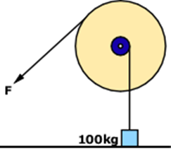
Assessing to Learn
A 100 kg crate is attached to a rope wrapped around the inner disk as shown. A person pulls on another rope wrapped around the outer disk with force F to lift the crate. What force F is needed to lift the crate 2 m?
1. about 20 N 2. about 50 N
3. about 100 N 4. about 200 N
5. about 500 N 6. about 1,000 N
7. about 2,000 N 8. about 5,000 N
9. Impossible to determine without knowing the radii
10. Impossible to determine for some other reason(s)
Notes:
Think about it for yourself, discuss it with a classmate, and be prepared to share your thoughts in about two minutes with the class.
Answer: about 200 N
Question E1.03a
Commentary
Purpose: To link force and torque ideas in the context of mechanical advantage.
Discussion:
Consider a static situation in which the crate is held motionless in the air. To support the crate, the tension in the rope attached to it must be 1,000 N (using g = 10 N/kg). The tension in the other rope is equal to F. If the disk arrangement is stationary, the torques exerted on it by the two ropes must balance.
We do not know the radii of the pulleys, so let's use r for the smaller disk and R for the larger. The rope supporting the crate is tangential to its disk, so the torque exerted by this rope is 1,000r clockwise. The other rope is also tangential to its disk, so it exerts a torque of FR counter-clockwise. The force of the pivot holding up the disks exerts zero torque, and we will assume the axle is frictionless.
For the torques to balance each other, FR = 1,000 N × r, or F = 1,000 N × r/R. In other words, the force exerted by the person is a fraction of the weight of the crate, and the fraction depends on the ratio of the disk radii.
We do not know the exact ratio r/R, but we can estimate it from the diagram. It looks to be about 1/5, so the force needed is about 200 N. That's the force required to hold the crate stationary in the air, or to lift or lower it with constant speed (no acceleration). In order to start the crate moving from rest, a slightly larger force is necessary, but it can be infinitesimally larger. (If there were friction in the pivot, the force to get it moving would have to be enough larger to support the weight of the crate and overcome static friction.)
The angle at which F is applied does not matter, as long as it acts tangentially to the disk. (It would, however, affect the force exerted on and by the pivot axle.)
Key Points:
Two different forces can exert the same torque on an object.
"Mechanical advantage" is gained by having the applied force act farther from the pivot point than the force acting on the object to be move.
The closer to the pivot point a force acts, the larger it must be to balance other torque-causing forces.
For Instructors Only
This is the first of two questions exploring the concepts of force, torque, work, and energy in this mechanical advantage situation.
Many students may say that F is impossible to determine, either because they are not given the radii and don't assume the diagram is to scale or they are not told if friction can be neglected. These are defensible responses.
Other students may say that the answer is impossible to determine for another reason, such as not knowing the speed of the crate or the angle of the rope. These are not valid reasons.
Some students will ignore units and treat 100 kg as the "weight", and therefore say that F is "about 20". Some will invert the ratio, thinking the applied force is 5,000 N, even though this does not agree with experience.
Some students, not understanding mechanical advantage, will think that a force of 1,000 N must be applied to lift the crate no matter what the radii are.
Source: UMass Assessing to Learn

Slide 52
Assessing to Learn
A 100-kg crate is attached to a rope wrapped around the inner disk as shown. A person pulls on another rope wrapped around the outer disk with force F to lift the crate. What force F is needed to lift the crate 2 m?
1. about 400 J 2. slightly less than 2,000 J
3. Exactly 2,000 J 4. slightly more than 2,000 J
5. much more than 2,000 J
Impossible to determine without knowing F
Impossible to determine without knowing the radii
Impossible to determine without knowing the mass of the pulley
Impossible to determine for two or more of the reasons given in 6, 7, and 8 above
Impossible to determine for some other reason(s)
Notes:
Think about it, share your thoughts with a neighbor to refine them, and we’ll discuss it as a class in two minutes.
Answer: Possible: (2), (3), (4), (5)
Question E1.03b
Commentary
Purpose: To link force, torque, work, and energy ideas in the context of mechanical advantage.
Discussion:
The only ambiguity here is whether or not to ignore frictional effects at the axle where the two disks are attached. If friction can be ignored, then energy conservation demands that the work done by the person is exactly equal to the work done on the crate, which is mgΔy = 2,000 J.
If friction is not ignored, then the work done by the person must be larger than the work done on the crate.
Note that even though the force F is much smaller than the weight of the crate, it acts through a much larger displacement than the crate travels. If, for example, the ratio of the disk diameters is 1 to 5, then the force F would be about 200 N and the displacement of the end of the rope would be about 10 m, even though the crate only moves up by 2 m.
Key Points:
The presence of mechanical advantage in a system does not invalidate the work-energy theorem.
A smaller force can do as much work as a larger one if it the smaller one acts through a longer distance.
For Instructors Only
This is the second of two questions exploring the concepts of force, torque, work, and energy in this mechanical advantage situation.
Some students will say that the work done is impossible to determine, because they are not told if friction can be neglected. This is a defensible response.
Other students will say that it is impossible to determine for another reason, such as not knowing the speed of the crate, the angle of the rope, the force F, the radii of the disks, or whether the diagram is to scale. These are not valid responses, since none of that information is required to answer the question.
Some students will use g = 9.8 N/kg, and get a value "slightly less than 2,000 J.“
Students who are including friction are likely to choose "slightly more than 2,000 J," perhaps assuming that friction is small. If the coefficient of friction is large enough, a valid response would be "much more than 2,000 J," though students might choose this response for other reasons as well.
Source: UMass Assessing to Learn

Slide 53
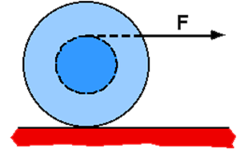
Assessing to Learn
A spool has string wrapped around its center axle and is sitting on a horizontal surface. If the string is pulled in the horizontal direction when tangent to the top of the axle, the spool will...
... roll to the right.
... not roll, only slide to the right.
... spin and slip, without moving left or right.
... roll to the left.
None of the above
The motion cannot be determined.
Notes:
Share your thoughts with a neighbor, and we’ll go over it in class in a minute or so.
Answer: roll to the right
Question E1.04a
Commentary
Purpose: To reason about a rotational system using the linear and rotational forms of Newton's second law.
Discussion:
There are four forces on the spool: (1) gravitation, down; (2) normal, up; (3) tension, right; and (4) friction, left or right. Gravitation is balanced by the normal force, and their torques balance about any origin. We don't know yet which direction friction will point.
First, imagine that the surface is frictionless. The net force is then due exclusively to the tension, producing an acceleration to the right. The net torque about the spool's center is also due exclusively to the tension, producing a clockwise angular acceleration. The spool will start to move to the right and also rotate CW. It will be rolling to the right, and perhaps slipping at the same time. (An object only rolls without slipping when its rate of rotation and translation are just right so the contact point has zero velocity.)
Now, add friction back in. A little bit of static friction will prevent the spool from slipping and cause it to roll only; this is answer (1). (If the contact point starts to slip, the friction force will oppose that, exerting a countering torque.)
If F is very large, the spool will not be able to roll without slipping, since the (static) friction force has a maximum possible value. In that case, the spool will slide to the right while rotating slightly: not an available answer.
Answer (2) is impossible, since the net torque on the spool cannot be zero. (If the spool slips at all, the torque from the friction force will supplement, not counteract, the torque from the string.)
Answer (3) is impossible, since the net force on the spool cannot be zero. If the net force were zero, the friction force would have to point to the left and have the same magnitude as the tension. But if the spool spins, the bottom surface slides to the left and the friction force must point to the right.
Answer (4) is impossible, since it would require a net force to the left and a CCW net torque, which cannot both exist. (What direction would the friction force point?)
Key Points:
When two forces are balanced (same strength, opposite directions) and co-linear (having the same line of action), their torques about any origin balance.
For rotational problems, τ = Iα and F_{net} = ma are both useful. In other words, the rotational form of Newton's 2nd law does not replace or supersede its linear form.
You can reason your way to answers by making assumptions and then checking for contradictions.
For Instructors Only
This the first of three questions using this situation. The goal of the set is to sensitize students to the dependence of torque on the choice of origin, and to the tactic of choosing the origin so that an unknown force exerts no torque.
A powerful pattern with all three of the questions is to have students predict what they believe will happen, explain why, then observe a demonstration.
This question exists largely to set up the subsequent ones. Most students will intuitively predict the correct motion. If your class generally agrees on answer (1), we recommend moving on to the next question, where intuition is not so useful. After presenting and discussing the rest of the set, you may want to return to this one and show how easily it can be analyzed by choosing an origin at the contact point.
Source: UMass Assessing to Learn

Slide 54
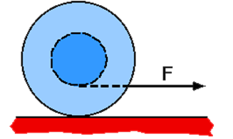
Assessing to Learn
A spool has string wrapped around its center axle and is sitting on a horizontal surface. If the string is pulled in the horizontal direction when tangent to the bottom of the axle, the spool will...
... roll to the right.
... not roll, only slide to the right.
... spin and slip, without moving left or right.
... roll to the left.
None of the above
The motion cannot be determined.
Notes:
Share your answer with a neighbor or two, and be ready to share with the class in about three minutes.
Answer: roll to the right
Question E1.04b
Commentary
Purpose: To explore the choice of origin and its effect on the torque.
Discussion:
Intuitively, it may not be obvious what will happen here. Pulling on the string seems like it might cause the spool to unwind, thus rotating counter-clockwise and perhaps rolling to the left. On the other hand, the string pulls to the right, so perhaps it will cause the spool to roll to the right (clockwise) along the surface. A more careful analysis is required.
There are four forces on the spool: (1) gravitation, down; (2) normal, up; (3) tension, right; and (4) friction, left or right. Gravitation is balanced by the normal force. Because they are balanced and co-linear, their torques also balance about any origin.
If the spool rolls to the left without slipping, the spool's center of mass accelerates to the left. Since the tension acts to the right, the static friction force must act to the left and must have a larger magnitude so that the net force acts to the left. However, if that were true the net torque about the spool's center would be clockwise, causing the spool to rotate to the right. Contradiction!
Since we don't know what direction the friction force points, let's choose an origin about which the friction force exerts no torque: the point of contact between the spool and surface. For this origin, the only force exerting a non-zero torque is the tension force, so the net torque is clockwise and the spool rotates to the right relative to the contact point. This means it rolls to the right. There is no reason the spool must necessarily slip or slide. If we pull gently enough, there will be enough static friction so that the spool rolls without slipping.
Why doesn't the spool unroll to the left? Because although the string applies a torque in the counter-clockwise direction, the static friction force exerts a larger torque in the clockwise direction. (If we yank hard enough on the string, the spool will overcome static friction and slide to the right as it spins counter-clockwise. This is not the intent, so it is not any of the answers provided.)
Key Points:
By choosing your origin carefully, you can avoid dealing with torques due to an unknown force.
The torque exerted by a force depends on the origin you calculate it about.
You do not need to choose the center of the object as the origin.
τ = Iα is true, valid, and useful in addition to, not instead of, F = ma. In other words, Newton's second law in its rotational form does not replace or supersede Newton's second law in its linear form. Both are valid and useful, and often both are needed to analyze a situation.
For Instructors Only
This the second of three questions using this situation. The goal of the set is to sensitize students to the dependence of torque on the choice of origin, and also to the strategic choice of origin to resolve conflict or inconsistency. A powerful pattern with all three of the questions is to have students predict what they believe will happen, explain why, then observe a demonstration (the predict and observe instructional tactic). As a whole, the set also demonstrates the compare and contrast tactic by varying only one feature from question to question.
This is a counterintuitive situation. Most students will have a strong intuitive belief that the spool should unroll to the left, and the demonstration will intrigue and motivate them. It is important, however, to collect explanations without comment, since most will be faulty in some way, and then show the demonstration. You can explain the result after you have shown the demonstration. Students will have great difficulty believing you if you discuss the situation before doing the demonstration.
During the demonstration, only a gentle tug on the string is needed to cause the spool to roll to the right.
Students might think that you will pull hard, which means it will move to the right while unwinding CCW. This is not the intent, so they will need to answer "None of the above".
Most students automatically use the center of the spool as the default origin. They might not realize that they can place the origin anywhere they want.
Students often abandon the linear form of Newton's second law when they start learning its rotational form. They often think that the rotational form supersedes and/or replaces the linear form. They are often not given sufficient opportunities to see that sometimes both are needed, and that the two relationships are completely separate and independent.
Students also often do not realize or fully appreciate that the rotational form is actually an infinite number of relationships, one for every possible origin. (In practice, there are a limited number of independent relationships.)
Even after observing the demonstration, many students will not understand how the net force can act to right at the same time as the net torque about the center is clockwise. The static friction force must be only slightly smaller than the tension force so that it can exert the larger torque about the center of the spool.
Source: UMass Assessing to Learn

Slide 55
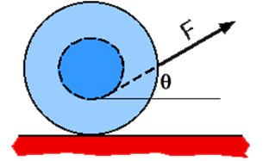
Assessing to Learn
A spool has string wrapped around its center axle and is sitting on a horizontal surface. If the string is pulled at an angle to the horizontal when drawn from the bottom of the axle, the spool will...
... roll to the right.
... not roll, only slide to the right.
... spin and slip, without moving left or right.
... roll to the left.
None of the above
The motion cannot be determined.
Notes:
Check your answer with a neighbor, and in three minutes you can share how you arrived at your result.
Answer: roll to the right
Question E1.04c
Commentary
Purpose: To explore the choice of origin and its effect on the torque.
Discussion:
There are four forces on the spool: (1) gravitation, down; (2) normal, up; (3) tension, as shown; and (4) friction.
Gravitation and the normal force exert zero torques about any origin along a vertical line through the center of the spool. (They no longer exert balancing torques, because they are no longer equal to each other in strength. The normal force is smaller than the weight, because the tension force has a component "up".) Thus, whether we choose the center of the spool or the contact point, the torques are zero.
Tension exerts a counter-clockwise torque about the center of the spool. It is hard to predict what direction the friction force will point, and therefore what direction its torque about the center of the spool will be. So, from this analysis it is not obvious what will happen.
As with the previous problem, we can choose our origin to be at the point of contact between the spool and surface, so that friction exerts zero torque. About this origin, the net torque is exerted exclusively by the tension in the string. But in what direction is that torque?
To figure that out, we need to know the "line of action" of the tension force. [See figure on next slide.] The line of action is a straight line having the same orientation as the force and passing through the point of application of the force, as shown. The torque due to F can be found by treating it as though it is applied anywhere along the line of action. Thus, the way the given diagram is drawn, the torque is clockwise. This means the spool will roll to the right.
However, the angle θ is left unspecified. If we don't assume the drawing is to scale, the angle could be anything. There is an angle for which the line of action passes through the chosen origin, in which case the net torque on the spool is zero, the net force is to the right, and the spool will slide to the right without spinning.
If the angle is even larger than this, so that the line of action passes to the right of the origin/contact point, the net torque is counter-clockwise. This would cause the spool to unroll to the left. If the tension is vertical, the spool will also unroll to the left.
Demonstrations can confirm all of these outcomes.
Thus, the motion of the spool depends upon the angle θ. The angle drawn in the figure will cause the spool to roll to the right.
Key Points:
The "line of action" is a useful concept for determining the direction of the torque exerted by a force. Each force has its own line of action. We can treat the torque as though the force is applied anywhere along the line of action.
A clever choice of origin can make torque problems much easier to analyze.
For Instructors Only
This is the last of three questions using this situations. This question drives home the idea that the choice of origin should be done with some strategic thinking and goal. It also shows the utility of the "line of action" concept.
A physical demonstration is extremely valuable here, so that students can see that the angle of the tension force critically affects the motion of the spool.
A family of diagrams showing the line of action for different angles of the tension force can help students understand the analysis and come to a better understanding of torques and lines of action.
Source: UMass Assessing to Learn

Slide 56
Assessing to Learn

Slide 57
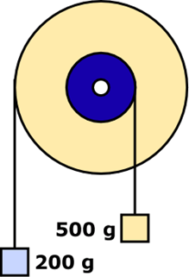
Assessing to Learn
Two blocks hang from strings wound around different parts of a double pulley as shown. Assuming the system is not in equilibrium, what happens to the system's potential energy when it is released from rest?
It remains the same.
It decreases.
It increases.
Impossible to determine without knowing the radii of the two pulleys.
Impossible to determine without knowing the ratio of the radii of the two pulleys.
Impossible to determine for some other reason.
Notes:
Think about it, talk to a classmate, and then we’ll discuss it in about four minutes.
Answer: It decreases
Question E1.06a
Commentary
Purpose: To develop qualitative reasoning and problem-solving skills by applying energy ideas in a rotational dynamics context.
Discussion:
We do not know the radii of the two pulleys, or even their ratio, so we cannot predict which block will fall and which will rise when the system is released from rest. To answer the question, however, we do not need to know any of these features.
We do know that the system is "not in equilibrium", which means that one block will start to fall and the other will start to rise, and the double pulley will begin to rotate. Thus, the kinetic energy of the system will rise.
Where will this energy come from? There are no external forces doing work on the system, so it can only come from the potential energy of the gravitational interaction between the blocks and the Earth. If the kinetic energy is increasing, the potential energy must decrease so that total mechanical energy will be conserved.
Note that we are treating the Earth as part of the "system". Properly speaking, gravitational potential energy is not a property of an object such as a block, but rather of the interaction between two objects — in this case, between each block and the Earth. (There is also gravitational potential energy between the two blocks and between each and the double pulley, but these are truly miniscule.) If we did not treat the Earth as part of the "system", we would not talk about gravitational potential energy in this question. Instead, we would talk about the work done by external forces: the gravitational force of the Earth on each of the blocks. This would just be a different way of describing the situation, and (if we were calculating numbers) would produce the same results.
Key Points:
Many questions can be answered through qualitative reasoning from general principles, without numerical calculations or solving for anything.
If the kinetic energy of a system increases, then either external forces are doing positive work on the system, or the potential energy of an interaction among parts of the system is decreasing.
To be precise, we talk about the potential energy of an interaction between objects, not the potential energy of an object.
For Instructors Only
This is the first of two questions on this situation. This one explores qualitative reasoning with energy ideas; the next is similar but applies force ideas. Although the "topics" of these two questions are conservation of energy and forces, they are useful as broader "integrating" questions that teach students to use their inventory of basic physics principles for reasoning about various situations.
The most likely stumbling block for students with this problem is that they will want to solve for the motion and will not be able to. That makes it a good context for teaching the value of qualitative, principle-based reasoning.
Treating the diagram as a scale drawing will not help students determine which way the pulley rotates, since the ratio of the radii is about 2:5, the same as the ratio of the block masses.
Source: UMass Assessing to Learn

Slide 58
Assessing to Learn
Two blocks hang from strings would around different parts of a 2 kg double pulley as shown. The pivot exerts a normal force F_{N} supporting the double pulley. Assuming the system is not in equilibrium, which statement about F_{N} is true after the system is released from rest? (Use g = 10 N/kg.)
F_{N} = 20 N
20 N < F_{N} < 27 N
F_{N} = 27 N
F_{N} > 27N
It is impossible to predict what the normal force on the double pulley will be.
Notes:
Work on it by yourself for a bit, then talk it over with your neighbor. We’ll check your answer together in a couple of minutes.
Answer: 20 N < F_{N} < 27 N
Question E1.06b
Commentary
Purpose: To develop qualitative reasoning and problem-solving skills by applying force ideas in a rotational dynamics context.
Discussion:
We do not know the radii of the two pulleys, or even their ratio, so we cannot predict which block will fall and which will rise when the system is released from rest. To answer the question, however, we do not need to know any of these features.
We do know that the center of mass of the system is falling, and in fact is accelerating downward. This means that a net force in the downward direction must be acting on the system. The only (external) forces are gravitation and the normal force exerted by the pivot, which means the normal force must be smaller than the total weight of the system (27 N).
Further, the double pulley is not accelerating, so the net force on it must be zero. There is tension in both strings pulling down, so the normal force must be larger than the weight of the double pulley (20 N).
Note that the tensions in the strings are not 2 N and 5 N, the weights of the blocks. For the falling block (whichever that turns out to be), the tension will be slightly smaller than the weight; for the rising block, the tension will be slightly larger than the weight. This is needed to satisfy Newton's 2nd law applied to each hanging mass.
In the previous question, we considered the Earth to be part of the "system" we were analyzing. In this question, it is more convenient not to, but rather to treat the gravitational force as an external force acting upon a system comprised of the double pulley, ropes, and two blocks. Reasoning about the center-of-mass motion of the system, if the Earth were included in that system, would be difficult!
Key Points:
Many questions can be answered through qualitative reasoning from general principles, without numerical calculations or solving for anything.
If the center of mass of a body or system is accelerating — even if part of it is held in place — there must be a nonzero net external force acting on one or more components of system.
If the center of mass of a body or system is not accelerating, all external forces on that body or system must sum to zero.
For Instructors Only
This is the second of two questions on this situation. This one explores qualitative reasoning with force ideas; the previous was similar but applied energy ideas. Although the "topics" of these two questions are conservation of energy and forces, they are useful as broader "integrating" questions that teach students to use their inventory of basic physics principles for reasoning about various situations. Revisiting old ideas in new contexts is valuable: it enriches the new context and helps students cross-link new and old ideas.
Students may have difficulty focusing on the pivot and the forces it exerts. They are not accustomed to applying Newton's 2nd law (linear) to situations involving pulleys and torque.
Some students will say that the force supporting the pulley is equal to the pulley's weight, 20 N, ignoring the tensions pulling down. Others will say that the tensions are 2 N and 5 N, so the force supporting the system is 27 N.
This set of two questions presents an excellent opportunity to hold a higher-level discussion about choosing a "system" as part of strategic problem solving: for example, why one would decide to include the Earth as part of the system sometimes but not others.
Note that treating the diagram as a scale drawing will not help students determine which mass falls and which rises, since the ratio of the radii is the same as the ratio of the hanging masses (2:5).
Source: UMass Assessing to Learn

Slide 59
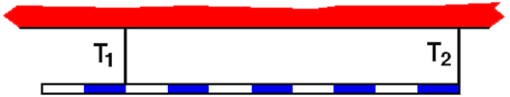
Assessing to Learn
A uniform rod of length L, mass M, is suspended by two thin strings. Which of the following statements is true regarding the tensions in the strings?
T₂ = T₁
T₂ = 2.5 T₁
T₂ = 0.6 T₁
T₂ = 0.8 T₁
None of the above
Not enough information to determine
Notes:
Think, check in with a classmate, and we’ll discuss it as a group in a few minutes.
Answer: T₂ = 0.6 T₁
Question E1.07
Commentary
Purpose: To practice determining torques in static situations, once again making the point that a good choice of pivot point can make a problem easy.
Discussion:
A consideration of forces tells us that the two tensions must add up to the bar's weight, in order to have zero net force in the y-direction. Thus, we must turn to torques to answer this. There must be zero net torque about any point on the bar if the bar is to remain static. The question is, what choice of pivot point will make the problem easiest?
Since the question doesn't require us to know the weight, choosing the center of mass as the pivot point is advantageous: gravity exerts no torque about that point. Then, our equation that states the sum of the torques equals zero will relate the two tensions, providing the answer we seek.
We need to use the markings on the rod to determine where the center of mass is and how far each string is from it. We don't know the units — how long each segment is — but it doesn't matter, since we're looking for a ratio between T₁ and T₂. Counting segments, we see that T₂ acts 5 units from the center and T₁ acts 3 units away, so T₂ must be 3/5 of T₁. Thus, answer (3) is appropriate.
Key Points:
Look for the most convenient origin about which to calculate torques.
Use all the information provided in a question, including the diagram.
If you think you need a quantity that is not given, define a variable for it and proceed. The variable will often cancel out.
For Instructors Only
If any students choose "Not enough information", we suggest asking them what it is they would need to know to make the question answerable, and why they need it. It's likely they want to know physical dimensions for the locations of the string. They may not realize they can count segments to find relative distances, or they may not be comfortable working with ratios rather than actual distances.
Source: UMass Assessing to Learn

Slide 60
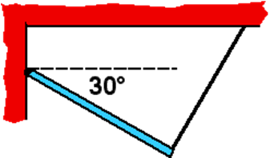
Assessing to Learn
A uniform rod is hinged to a wall and held at a 30° angle by a thin string that is attached to the ceiling and makes a 90° angle to rod. Which statement(s) must be true? (At least one of them is true and at least one is false.)
1. The hinge force is purely vertical.
2. The hinge force is purely horizontal.
3. The string tension is equal to the hinge force.
4. The string tension is smaller than the rod's weight.
5. 1 and 3 are true. 6. 2 and 3 are true.
7. 1 and 4 are true. 8. 2 and 4 are true.
9. 3 and 4 are true.
10. Three of the statements are true.
Notes:
Think about it, talk it over with a classmate, and then we’ll hear your ideas in about four minutes.
Answer: The string tension is smaller than the rod's weight.
Question E1.08
Commentary
Purpose: To help you learn to reason using forces and torques.
Discussion:
The rod is at rest, so the net force on it must be zero, and the net torque about any origin must also be zero. This yields many possible relationships, all of which are valid, but only some of which bring out relevant features of this situation. In other words, we do not need to write down every valid equation or relationship to answer this question. Rather, thoughtful choices about how to proceed will yield efficient results.
It is useful to assume nothing about the hinge force and to think of it as having a vertical and a horizontal component. These components can be treated as independent forces. (We often separate one force into two separate component forces, for example when treating the contact force between two surfaces as a normal force and a friction force.)
Let's focus on each statement and determine its truth or falsehood.
The hinge force is purely vertical. This statement is false, because the net force in the horizontal direction must be zero. The tension force has a component pulling to the right, so the hinge must pull to the left with an equal force.
The hinge force is purely horizontal. This statement is false, because the net torque about the center of mass must be zero. Both the tension force and the horizontal component of the hinge force exert CCW torques about the center of mass of the rod. Therefore, the hinge must have a vertical component to provide a balancing CW torque.
The string tension is equal to the hinge force. This statement is false, since the two forces have different directions, with the hinge pulling up and to the left and the tension pulling up and to the right. (It turns out that the two forces do have the same magnitude.)
The string tension is smaller than the rod's weight. This statement is true, since the net torque about the left end of the rod must be zero. The torque exerted by the hinge is zero (about this point), so the tension must balance the weight. The moment arm is larger for the tension, so the force must be smaller.
Key Points:
For an object at rest, all components of the net force and the net torque about any origin are zero.
Strategic choices of relationships and origins can make analysis and reasoning particularly efficient.
To isolate an unknown, choose an origin such that the torque due to the other unknown(s) is zero. You can consider the situation using several different origins if you want; τ = Iα must be true for all of them.
For Instructors Only
This question provides an excellent opportunity to explore problem-solving approaches and strategies. The equations are simple; finding the most efficient use of those equations is more difficult.
Students can be either unaware of or overwhelmed by the decision-making needed to solve statics problems. It all looks so easy when the instructor does it, yet when students are doing homework or exams, it becomes impossible, largely because they have not practiced the skill of strategic thinking.
The key to evaluating statements 1 and 2 is to focus on the other component to determine its validity. That is, to determine if the hinge force is purely vertical, one must find out whether the horizontal component is zero. (Students sometimes think that hinges only exert vertical forces.)
Some good students might figure out that the hinge force and the tension force have the same magnitude, since their horizontal components balance and their vertical components each support half the weight of the rod. They might not realize, however, that statement 3 is about vector equality, requiring magnitudes and directions to be the same. (This falls into the category of students giving the right answer to the wrong question.)
Source: UMass Assessing to Learn

Slide 61
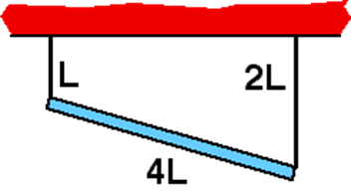
Assessing to Learn
A uniform rod of length 4L, mass M, is suspended by two thin strings, lengths L and 2L as shown. What is the tension in the string at the left end of the rod?
Mg
Mg/2
Mg/3
Mg/4
None of the above
Notes:
Figure it out for yourself, check with a neighbor, and be ready to explain your thinking in four minutes.
Answer: Mg/2
Question E1.09
Commentary
Purpose: To help you to understand the definition of torque and its application to a static situation.
Description:
This is a "statics" problem: the object has zero linear acceleration and zero angular acceleration, so the net force and the net torque on it must both be zero. Note that a torque is always determined about some origin; the net torque on the object about any origin, anywhere in space, must be zero.
If the net force must be zero, the sum of the tensions in the two strings must be Mg, so that the net force on the rod is zero. So if the strings have equal tensions, the tension in each must be Mg/2. But are the tensions equal?
Since the rod is uniform, its center of mass is at its middle. This is a particularly convenient choice of origin, since the torque due to gravitation is zero about this point. However, we are free choose any point in space as the origin to answer this question.
Let's choose the middle of the rod as the origin. Even though the rod is not perfectly horizontal, the moment arms for the two tension forces are equal. They are equal to the horizontal distance from the center of the rod to the point of attachment of the string (less than 2L), which is the same for each string. Since the net torque about any origin must be zero for an object at rest, the two tensions must exert balancing torques. Since the moment arms are the same, the tensions must be the same also. In other words, each string supports half the weight of the rod. The lengths of the strings does not matter.
Another way to solve the problem is to choose the origin to be at the right end of the rod. This is also a strategic choice, because then the torque due to the tension in the right string is zero. Two forces on the rod exert non-zero torques: the tension in the left string, which is the desired unknown, and gravitation. The moment arm for the tension is twice as large as the moment arm for gravitation. (Remember, gravitation acts "as though" the force is exerted at the center of mass.) As before, since the rod is at rest, the two torques must balance each other. Therefore, since the moment arm for the tension is twice as large, the tension must be half as large as the weight of the rod.
Key Points:
For a body in static equilibrium (i.e., that is stationary), the net force on the body and the net torque on the body about any point must both be zero.
Any origin may be chosen to analyze and solve a problem, but thoughtful, strategic choices of origin can make the analysis much simpler.
The "moment arm" of a force about an origin, used to determine the torque it exerts, is the shortest distance from the origin to the imaginary line you get by extending the line along which the force acts to infinity in both directions. It is not necessarily the distance from the origin to the point at which the force acts on the object.
Gravitation acts "as though" the force is exerted at the center of mass.
For Instructors Only
This is one of the simplest static situations we can create, yet students often cannot sort out the relevant features because of the angle of the rod.
Many conclude intuitively that the left string exerts the larger force, and thoughts of torque, center of mass, and moment arms are often neglected.
Students often have difficulty applying the concept of "moment arm" to a situation in which forces are exerted at an angle relative to the rod or object. A diagram may help many sort this out.
Students can be flustered by having to choose which point is the origin. They frequently get hung up on making the "right" choice, not realizing that all choices are correct but some are easier to work with than others. It is useful to give students opportunities to think about strategic choices of origin, and also to have students solve the problem two or more times with different origins, as this will encourage comparison of approaches. If students only see one choice for any given situation, they will (reasonably but incorrectly) conclude that there is one best (and therefore "right") choice to any problem.
Source: UMass Assessing to Learn

Slide 62
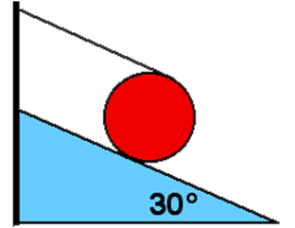
Assessing to Learn
A uniform disk with mass M and radius R sits at rest on an incline 30° to the horizontal. A string is wound around the disk and attached to the top of the incline as shown. The string is parallel to incline. What is the tension in the string?
Mg
Mg/2
2Mg/5
Mg/4
None of the above
Cannot be determined
Notes:
After you come up with your own answer, check in with a neighbor to see what he or she came up with. Decide on your partnership’s best answer, and be ready to share it with the group in about four minutes.
Answer: Mg/4
Question E1.10a
Commentary
Purpose: To develop your problem-solving skills by considering multiple approaches to a question, and explore the significance of where you choose your origin for torque calculations.
Discussion:
There are often multiple ways to solve a problem, and part of learning to "do" physics well is learning to select the easiest approach to a given problem. This statics question is conceptually straightforward to answer, but the algebra can be relatively simple or complicated depending on the coordinate system you choose.
The unknown forces acting on the disk are the tension force of the string that we seek, and the normal and friction forces of the plane. We know the direction of each of these and the location at which it acts on the disk, but not its magnitude. Gravity, whose magnitude and direction we know, also acts on the disk. So, we have three unknowns: the magnitudes of the tension, normal, and friction forces. We therefore need three independent equations in order to solve for them. Since the disk is stationary, we know it is not accelerating in the x or y directions, and that it is not rotating about any pivot point we choose to consider. This means that the net force in the x direction is zero, the net force in the y direction is zero, and the net torque about any point is zero. By writing each of these statements in terms of the actual forces (and trigonometric functions of the incline angle), we get three equations, and all we have to do is eliminate the variables we don't care about and solve for the tension. This is a classic statics problem.
The question is, in order to find the tension, what choice of coordinate system and pivot point is best? Any choice will work, but some will lead to rather ugly algebra. How to choose?
If we choose the pivot point for our torque equation to be at the point of contact between the disk and incline, then neither the normal nor friction forces exert any torque (since both act at the pivot point itself). So, the only two torques are due to gravity and the string tension; the only unknown is the magnitude of the tension, and we can solve this one equation for the tension. Simple! We don't need to use the two force equations or solve for the friction or normal forces at all.
The tension exerts a torque of 2RT out of the page. The weight acts at the center of the disk, and the component of the weight perpendicular to the vector from pivot point to the center of the disk is Mg sin(θ) (the component parallel to the plane), so the weight exerts a torque of MgR sin(θ) into the page. Thus, 2RT = MgR sin(θ), and T = (Mg/2) sin(θ). The sine of 30° is 1/2, so answer (4) is correct.
Had we chosen a different pivot point, the system of equations we'd have to solve would be significantly more complex.
Key Points:
For a body in static equilibrium, the forces on it must add to zero (vector sum, i.e., along all axes), and the torques must add to zero about any pivot point you choose.
Choosing the orientation of your coordinate axes and the pivot point for your torque equation can make the algebra of a problem easier or harder.
It's generally wise to choose a pivot point where as many forces as possible, especially unknown ones you aren't interested in solving for, exert no torque: that is, the forces act at that point, or along a line that passes through the point.
For Instructors Only
In this question, the issue is not so much which answer is right as what approach provides the easiest path to it. Many students will place their pivot point at the center of the disk or perhaps where the string attaches to the disk, and then dive into two (or three) equations in two (or three) unknowns (depending on their choice of coordinate system). When the simple solution described above is revealed during discussion, a good deal of forehead-smacking occurs, and the point is taken to heart.
We find that talking explicitly about problem-solving strategies and providing questions with multiple approaches, some clearly superior to others, helps students to become more effective, efficient, and aware problem-solvers.
Source: UMass Assessing to Learn

Slide 63
Assessing to Learn
A uniform disk with mass M and radius R sits at rest on an incline 30° to the horizontal. A string is wound around the disk and attached to the top of the incline as shown. The string is parallel to incline. What is the tension in the string?
Mg/2, down the incline
Mg/2, up the incline
Mg/4, up the incline
Mg/0.86, down the incline
None of the above
Cannot be determined
Notes:
Explain your answer to a neighbor, and listen to their ideas. Be ready to contribute to a group discussion in a few minutes.
Answer: Mg/4, up the incline
Question E1.10b
Commentary
Purpose: To develop your problem-solving skills by considering multiple approaches to a question, and explore the significance of where you choose your origin for torque calculations.
Discussion:
This question is almost identical to the last one, except it asks for the magnitude of the friction force rather than the tension. It can be solved just as easily as that problem, by choosing a pivot point where the string meets the disk (so the tension and normal forces exert no torque), setting up the torque equation, and solving for the friction force.
However, having answered the previous question, we can solve this one even more simply. We know that the net force on the disk is zero. Consider forces acting parallel to the incline. The weight component down the plane is Mg sin(θ) = Mg/2, and the tension force up the plane is one-half that (Mg/4), as we found last question. So, if there is to be no net force along the plane, friction must exert a force equal to tension (Mg/4) up the plane, so that together tension and friction can balance the parallel component of the weight. Using what we found last question, we can answer this one in our heads with no significant algebra at all.
It might bother some students that the friction force acts upward along the plane. Imagine what would happen if the plane were frictionless: the bottom of the disk would slip forward down the plane, sliding "out from under" the point attached to the string. Thus, friction must oppose this motion by pointing up the plane.
Key Points:
Again, think carefully before diving into a calculation. You might already know enough, or be able to reason enough, to answer a question without getting into the algebra. "Work smarter, not harder."
The moral of these questions isn't just to choose the best pivot point for a statics problem. It's to use all your information and knowledge to choose the easiest way to answer a question.
For Instructors Only
Some students will wade into multiple equations in multiple unknowns. Some will have taken the specific moral about choosing a pivot point carefully, and will repeat that approach here — better, but not ideal. Few are likely to use what they found last question to reason the answer, as outlined above.
We strongly suggest drawing a free-body diagram of the disk to support the argument above. Not only does this help some students grasp the argument, but it communicates by example that graphical representations such as free-body diagrams are useful problem-solving tools that should be part of students' working toolkit.
Source: UMass Assessing to Learn

Slide 64
Assessing to Learn
Which situation has the least magnitude of angular momentum about the origin?
A. A 2-kg mass travels along the line y = 3 m with speed 1.5 m/s.
B. A 1-kg mass travels in a circle of r = 4.5 m about the origin with speed 2 m/s.
C. A disk with I = 3 kg·m² rotates about its center (on origin) with ω = 3 rad/s.
1. A 2. B 3. C 4. Both A and B
5. Both A and C 6. Both B and C
7. All have the same magnitude angular momentum
Notes:
Think about it, talk it over with your neighbor, and come up with an answer. Be ready to talk about your reasoning in three minutes.
Answer: All have the same magnitude angular momentum
Question E2.01
Commentary
Purpose: To hone your understanding of angular momentum and confront a common misconception that objects traveling in a straight line must have zero angular momentum.
Discussion:
The angular momentum of a point-like object is defined by L = r × p, where r is the vector from the origin (about which angular momentum is being determined) to the object, and p is the object's momentum. For a rigid object rotating about an axis, we can use this to derive an expression for the object's total angular momentum: L = Iω, where I is the moment of inertia of the extended object about the rotation axis and ω is its angular velocity about that axis.
If we simply apply the first form to situation A we find that the angular momentum has a magnitude of 9 kg·m²/s². Note that an object does not need to be rotating or traveling in a curve to have nonzero angular momentum; it merely needs a nonzero velocity that isn't purely radial (towards or away from the origin).
If this bothers you, imagine that the mass in situation A strikes and sticks to a stationary disk free to rotate about an axis at the origin. What will happen? The disk with the mass stuck to it will begin to rotate about the axis. The final situation clearly has nonzero angular momentum. For the principle of "conservation of angular momentum" to have any meaning, the initial situation — the mass moving in a straight line — must also have nonzero angular momentum.
Similarly, we can apply the first form to situation B to find an angular momentum of 9 kg·m²/s². Alternatively, we can use the second form determining the angular velocity from the speed and the circle's circumference, and using I = mR² as the moment of inertia of a point mass a distance R from the axis. We will get the same answer.
Applying the second form to situation C also yields an angular momentum of 9 kg·m²/s². Thus, the best answer is (7).
Key Points:
Angular momentum is defined by L = r × p for a point mass.
The total angular momentum of a rigid, rotating object can be determined using L = Iω.
A mass does not need to be rotating or spinning to have nonzero angular momentum. Translating past the origin a nonzero distance away is sufficient.
For Instructors Only
Answer (1) is common, and reveals the prevalent misconception that objects traveling along a straight line have no angular momentum.
Answer (4) reveals the less prevalent misconception that only non-point, rotating objects can have a nonzero angular momentum.
The other incorrect answers are merely distractors.
This is a good problem for stressing that the angular momentum of an object depends on one's choice of origin. The mass moving linearly in situation A would have no angular momentum if one chose an origin directly along its path, rather than off to the side.
Source: UMass Assessing to Learn

Slide 65
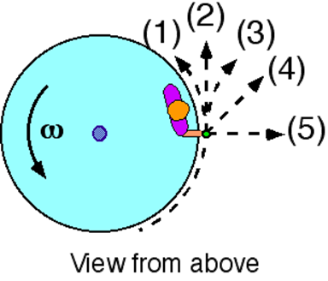
Assessing to Learn
A child is standing at the rim of a rotating disk holding a rock. The disk rotates freely without friction. If the rock is dropped at the instant shown, which of the indicated paths most nearly represents the path of the rock as seen from above the disk?
path (1)
path (2)
path (3)
path (4)
path (5)
cannot be determined
Notes:
Come up with an answer, and explain it to your neighbor to see if they follow your reasoning. We’ll talk it over as a large group in about three minutes.
Answer: path (2)
Question E2.02a
Commentary
Purpose: To check your understanding of Newton's first law in a rotational context.
Discussion:
We interpret the word "drop" in the question statement to mean that the rock is released without delivering any impulse to it.
At the instant shown, the rock's velocity is straight forward, tangential to the disk: direction (2). When the rock is released, the only forces acting on the rock are gravity and air resistance. Gravity will accelerate it downwards (into the slide, as seen from above), and air resistance will tend to slow it down but not change its direction. Thus, there are no forces that provide an acceleration to the left or right, and the rock must continue along path (2) as seen from above. (Seen from the side, the rock would follow a parabola as it continues traveling forward while accelerating downward.) This is a consequence of Newton's first law: an object maintains its existing velocity — speed and direction — unless an external force acts upon it.
You may think that the "velocity" of the rock before it is dropped is curved. We often use a curved arrow to represent the angular velocity of something, but this does not mean that the (linear) velocity is curved. Velocity is always a vector representing the speed and direction of an object at one point in time, and can be indicated by a (straight) arrow. If the object follows a curved path, the velocity at any point is tangent to the curve.
Path (3) might be what the trajectory of the rock would look like to the child who dropped it. In other words, the child is moving away from the path of the rock, and therefore, the rock looks like it is curving away. This is an illusion, however, because the child is accelerating (moving in a circle); the child's frame of reference is a non-inertial (invalid) frame.
You might think that the rock travels along path (1), that the velocity changes direction because the rock experiences a "centripetal acceleration", and that this acceleration is caused by the "centripetal force". Centripetal force is not a real force. Rather, it is a component of the net force. The "centripetal force" is whatever component points radially inward when all the actual forces, caused by interactions with other objects, are summed. In this situation, the only forces acting on the rock after it is released are gravity and air resistance, so the net force has no component in the radial direction. Thus, the "centripetal force" is zero.
You might think that the rock travels along paths (3), (4), or (5) because it is acted upon by the "centrifugal force". There is no such force. "Centrifugal force" is an illusion experienced within an accelerated (non-inertial) reference frame. To the child, it feels like something is pulling the rock outward from her hand; that is the illusory centrifugal force. In reality, the rock's inertia is just carrying it in a straight line according to Newton's first law, and the child must exert a force radially inward on it to make it travel in a circle (until she drops it).
Key Points:
Newton's first law says that an object travels with constant velocity unless a force acts upon it to change its speed and/or direction.
An object travels along a circular path only if some interaction with another object pulls it towards the center of that circle; when that interaction ceases, the object stops moving in a curve and continues in a straight line.
"Centripetal force" is not a real force like tension, gravity, and the like, but is a way of talking about one component of the sum of all forces.
"Centrifugal force" is an illusion experienced in an accelerating reference frame, not a real force.
For Instructors Only
This is the first of three questions about this situation. Later questions explore conservation of angular momentum and energy; this question sets those up by clarifying the situation, establishing students' understanding of the rock's actual trajectory. It also provides a valuable refresher on Newton's first law, and reveals stubborn misconceptions about circular motion.
You may be surprised by how many misconceptions this question can reveal, and how tenaciously students cling to them. This question, and others integrating rotational and linear ideas, deserve extended discussion time.
To stimulate productive discussion, you may wish to pose questions such as: What path would the child see? What is the velocity of the rock just before and just after it is dropped? What would the path of the rock have been if the child continued to hold it? Do you expect the path to be the same or different when the child drops it?
Source: UMass Assessing to Learn

Slide 66
Assessing to Learn
A child is standing at the rim of a freely rotating disk holding a rock. The disk rotates without friction. The rock is dropped at the instant shown. As a result of dropping the rock, what happens to the angular velocity of the child and disk?
increases
stays the same
decreases
cannot be determined
Notes:
Think about your answer, and be able to explain your choice. Run it by a classmate, and consider their choice, and make sure your reasoning is sound. We’ll discuss this in three minutes.
Answer: stays the same
Question E2.02b
Commentary
Purpose: To check your understanding of angular momentum and rotational inertia.
Discussion:
The angular momentum of a system is conserved when the system experiences no net torque. When the child drops the rock, no external forces are acting on the child and disk that could exert a net torque, so the angular momentum of the child and disk must remain constant. (Internal forces cannot exert a net torque.) Thus, their angular velocity cannot change.
To put it another way, in the process of dropping the rock, no angular impulse is delivered to the child and disk, so no change in angular momentum occurs.
Key Points:
If a system experiences no net torque, its angular momentum will remain constant.
Only forces external to a system can exert a net force or a net torque on it.
If a system's angular momentum does not change and its mass distribution remains constant, its angular velocity must also remain constant.
For Instructors Only
This is the second of three questions about this situation. The first question established the trajectory of the rock following its release; this one establishes the behavior of the child and disk when the rock is dropped.
This question makes a good context for discussing the concept of "angular impulse".
Students may confuse themselves on this question by applying angular momentum conservation incorrectly. They may, for example, believe that the angular momentum of the disk-child-rock system must be constant, and that the rock has no angular momentum after it is released, so the angular momentum of the disk and child must increase. This confusion may be addressed in the context of discussion about the next question in the set.
Source: UMass Assessing to Learn

Slide 67
Assessing to Learn
A child is standing at the rim of a freely rotating disk holding a rock. The disk rotates without friction. The rock is dropped at the instant shown. Which of the following statements is true about the process of dropping the rock?
Angular momentum is conserved, mechanical energy increases.
Angular momentum is conserved, mechanical energy decreases.
Angular momentum increases, mechanical energy is conserved.
Angular momentum decreases, mechanical energy is conserved.
Both angular momentum and mechanical energy are conserved.
Both angular momentum and mechanical energy increase.
Angular momentum decreases, mechanical energy increases.
Angular momentum increases, mechanical energy decreases.
Both angular momentum and mechanical energy decrease.
The conserved quantities cannot be determined.
Notes:
Think about it, share your thoughts with another classmate, and in about four minutes we’ll all talk it through together.
Answer: Both angular momentum and mechanical energy are conserved.
Question E2.02c
Commentary
Purpose: To develop your understanding of energy and angular momentum conservation in a rotational context.
Discussion:
The angular momentum of a system is conserved when no net torque acts on it. A net torque must come from external forces, since internal interactions cannot apply a net force or a net torque.
The mechanical energy of a system is conserved when no external forces or non-conservative internal forces do work on it. (If conservative internal forces do work on it, kinetic energy is exchanged for potential energy, but the total mechanical energy remains constant. If conservative external forces do work, kinetic energy is exchanged for potential, but the potential energy gained or lost is not part of the "system".)
If we take the system to be the rock, the child, and the merry-go-round, and we interpret "drop" to mean that the child releases the rock without doing any work on it, then there is no net torque on the system and also no work done by non-conservative forces. Thus, both angular momentum and mechanical energy are conserved.
In the previous question, we established that the angular momentum and angular velocity of the child and disk do not change when the rock is dropped. If the total angular momentum of the disk-child-rock system is also conserved, then the rock itself must have the same angular momentum before and after it is released. This is possible because an object moving in a straight line can have nonzero angular momentum about a point that is not on that line. (Refer to the definition of angular momentum in terms of linear momentum to see why.)
Note that as the rock is falling, its kinetic energy is increasing due to the gravitational force of the Earth. Therefore, if the Earth is not part of the "system" under consideration, the system's mechanical energy does increase while the rock is falling towards the ground. However, this is after the "process" the question asks about.
Key Points:
The angular momentum of a system is conserved whenever no net torque is exerted upon it.
Only external forces can exert a net torque.
An object moving in a straight line can have angular momentum about a point not on that line.
The mechanical energy of a system is conserved whenever no external or non-conservative internal forces do work on it.
Whether angular momentum or mechanical energy is conserved for a system depends what one includes in the "system".
For Instructors Only
This is the last of three questions involving this situation, which ask about similar situations in which the child throws the rock radially or tangentially rather than dropping it. By using these two question sets together, you can draw students' attention to the significance of that facet.
Some students will say that mechanical energy and/or angular momentum is lost when the rock is dropped because it is no longer part of the system.
Students generally understand angular momentum as "spinning" or "rotating", and have great difficulty understanding how something moving in a straight line can have nonzero angular momentum. Reconciling their intuition and concept of angular momentum with L = r × p (the definition of angular momentum) will be difficult. It may be helpful to make a connection by considering the constituent "particles" of an extended, rigid, rotating body.
To stimulate productive discussion, you may wish to pose questions such as: What is the "system" before the rock is dropped? How about afterwards? What exactly is the "process" we are looking at? When does it start and end? Does the rock have angular momentum (or mechanical energy) just before it is dropped? How about just afterwards? If energy is "lost", what happens to it? If angular momentum changes, what torques act on the system to change it?
Source: UMass Assessing to Learn

Slide 68
Assessing to Learn
A child is standing at the rim of a disk holding a rock. The disk rotates freely without friction. At the instant shown, the child throws the rock radially outward. Which of the indicated paths most nearly represents the trajectory of the rock as seen from above?
path (1)
path (2)
path (3)
path (4)
path (5)
none of the above
cannot be determined
Notes:
Jot down your answer, and check to see if your neighbor thought about it the same way. We’ll talk about it in three minutes.
Answer: path (4)
Question E2.03a
Commentary
Purpose: To revisit velocity and vector addition in the context of rotational motion.
Discussion:
Just before the rock is thrown, it is moving in a circle, and its instantaneous linear velocity points directly up the screen (tangential to the circle of motion). If the child merely dropped the rock, it would continue in a straight line along path (2). However, when the child throws the rock radially outwards, she delivers an impulse in direction (5), so it now has a velocity component in that direction as well as its original velocity component in direction (2). As a result, the rock moves in direction (4).
After it has been released, the rock experiences no forces except gravity and air resistance, and neither of those act in a direction that would change its direction left or right. So, seen from above, the rock continues along path (4).
You may be tempted to put yourself in the frame of the child, to imagine throwing or dropping the rock. This is dangerous, because the frame of the child is accelerating and is not a proper inertial reference frame. Newton's laws do not hold in a non-inertial frame, so it is best to avoid using one to analyze situations.
Key Points:
At any point in time, an object traveling along a curved path has a linear velocity tangential to the curve.
If an object is moving in one direction and receives an impulse in another direction, its resulting motion will be a combination of those two directions. (The exact direction can be found from the vector addition of its original momentum and the applied impulse.)
An object does not continue moving along a curve when the force causing it to follow that curve has ceased.
For Instructors Only
This is the first of three related questions.
Some students may answer (5) because they interpret the question to mean that the rock is thrown so that it travels directly outward. In discussing and resolving this ambiguity, students can learn more than if the misinterpretation had been prevented by careful problem wording.
Students may also choose (5) because they think of the rock as "at rest" before it is thrown, looking at it from the child's frame.
Presenting students with an analogous situation may be helpful. For example, imagine a ball rolling along the floor in one direction and receiving a kick sideways. What direction does it roll after the kick? (This is suitable for a demonstration.)
Additional questions to ask during discussion: What is the radial component of the velocity if the rock follows path (2)? Is it possible to throw the rock in such a way that it follows path (5)?
Source: UMass Assessing to Learn

Slide 69
Assessing to Learn
A child is standing at the rim of a rotating disk, and throws a rock radially outward at the instant shown. The disk rotates freely without friction. Which of the following statements is correct about the disk-child-rock system as the rock is thrown?
Angular momentum is conserved, mechanical energy increases.
Angular momentum is conserved, mechanical energy decreases.
Angular momentum increases, mechanical energy is conserved.
Angular momentum decreases, mechanical energy is conserved.
Both angular momentum and mechanical energy are conserved.
Both angular momentum and mechanical energy increase.
Angular momentum decreases, mechanical energy increases.
Angular momentum increases, mechanical energy decreases.
Both angular momentum and mechanical energy decrease.
The conserved quantities cannot be determined.
Notes:
Justify your choice, and explain it to your neighbor. We’ll talk it over in three minutes or so.
Answer: Angular momentum is conserved; mechanical energy increases.
Question E2.03b
Commentary
Purpose: To hone your understanding of energy and angular momentum conservation in a rotational context.
Discussion:
The angular momentum of a system is conserved when no net torque acts on it. A net torque must come from external forces, since internal interactions cannot apply a net force or a net torque.
The mechanical energy of a system is conserved when no external forces or non-conservative internal forces do work on it. (If conservative internal forces do work on it, kinetic energy is exchanged for potential energy, but the total mechanical energy remains constant. If conservative external forces do work, kinetic energy is exchanged for potential, but the potential energy gained or lost is not part of the "system".)
Any forces between the child and rock during the act of throwing are internal to the system, and therefore cannot exert a torque on the system. No other forces are present that can exert a torque, so no net torque exists, and the system's angular momentum is conserved. (After the rock is thrown, it still has angular momentum even though it is traveling in a straight line.)
Internal forces between the child and rock are doing work, however. The kinetic energy of the rock increases. Furthermore, these are non-conservative forces, and so the total mechanical energy of the system increases during the throwing.
Key Points:
The angular momentum of a system is conserved whenever no net torque is exerted upon it.
Only external forces can exert a net torque.
The mechanical energy of a system is conserved whenever no external or non-conservative internal forces do work on it.
Non-conservative internal forces can do work on and increase the mechanical energy of a system.
For Instructors Only
This is the second of three related questions.
Students who answer that mechanical energy is conserved (3, 4, or 5) may be expressing their belief that "energy is always conserved", without appreciating that this does not require the mechanical energy of a particular system to always be conserved. Leading these students to realize that the kinetic energy of the moving rock comes from chemical energy in the tissues of the child's muscles, which is not considered "mechanical energy", may be helpful.
Other students who answer that mechanical energy is conserved may not realize that internal forces can do work on the system. Discussing analogous situations may be helpful: for example, an accelerating bicycle or automobile, in which internal forces provide the energy (but static friction provides the impulse).
Students who answer that mechanical energy decreases (2, 8, or 9) may think that the thrown rock is no longer part of the "system", and so its kinetic energy is removed from the system's mechanical energy.
Students may be surprised to encounter a system whose mechanical energy increases; most of their experience is with forces that dissipate, rather than add, energy.
Additional Questions:
1. If the rock is thrown instead in direction (2), (a) would the angular momentum of the system increase, decrease, or stay the same, and (b) would the angular momentum of the rock increase, decrease, or stay the same?
The child throws the rock such that it is moving in direction (5) with the same speed as before. (a) Explain how this is possible. (b) What is the angular momentum of the rock afterwards? (c) What quantities must change for the disk-child system during this process? How do they change? Explain.
Source: UMass Assessing to Learn

Slide 70
Assessing to Learn
A child is standing at the rim of a rotating disk holding a rock, and throws a rock in direction (2) at the instant shown. The disk rotates freely without friction. What happens to the angular speed of the disk?
increases
remains the same
decreases
impossible to determine
Notes:
Think about it yourself, talk it over with a classmate, and then we’ll hear from you in a couple of minutes.
Answer: increases
Question E2.03c
Commentary
Purpose: To hone and relate the concepts of angular velocity, angular momentum, angular impulse, and torque.
Discussion:
The angular momentum of a system is conserved when no net torque acts on it. A net torque must come from external forces, since internal interactions cannot apply a net force or a net torque. For the system consisting of the disk, child, and rock, any forces between the child and rock during the act of throwing are internal and cannot exert a net torque on the system (as a whole). If no net torque exists, no angular impulse is delivered, so the angular momentum of the system cannot change.
However, this does not tell us whether the angular velocity of the disk and child changes. Let's consider the "system" consisting of the disk and child, but not the rock. During the act of throwing, the child must exert a force on the rock in the direction the rock is being thrown: direction (2). According to Newton's third law, the rock must be exerting a force of equal magnitude on the child's hand, pointing back in the opposite direction. As far as the child and disk are concerned, this is an external force, and exerts a torque in the clockwise direction. This torque causes an angular impulse, changing the angular momentum of the child and disk. Since the torque is in the opposite direction of the rotation, the angular velocity of the disk and child decrease.
How is it possible for the angular momentum of the child and disk to decrease if the angular momentum of the child, disk, and rock together is conserved? Because the angular momentum of the rock increases as it is thrown. Recall that an object traveling in a straight line can have nonzero angular momentum about a point not on that line, according to the definition of angular momentum (L = r × p). The rock's linear momentum increases as it is thrown, so its angular momentum about the center of the disk does as well.
Key Points:
The angular momentum of a system is conserved whenever no net torque is exerted upon it.
Only external forces can exert a net torque on a system.
An object traveling in a straight line has nonzero angular momentum about a point not on that line.
Choosing your "system" wisely makes analyzing situations and answering questions easier.
For Instructors Only
This is the third of three related questions. This question differs from the others in that the rock is thrown tangentially rather than radially, drawing students' attention to the significance of that change.
This question is useful for relating several different concepts: force, torque, momentum, angular momentum, impulse, angular impulse, velocity, and angular velocity. We encourage you to lead a discussion that explores the situation and question from many angles, helping students to fit these ideas together and resolve apparent contradictions.
For example, many students will still most likely have difficulty with the idea that an object traveling in a straight line can have angular momentum, but that is crucial to understanding how the system as a whole can conserve angular momentum when the disk and child alone do not.
Many students may choose the correct answer based on intuition or vague heuristic reasoning, and should be encouraged to formalize or defend this with rigorous analysis.
Note that the kinetic energy of the system has increased, even though the angular speed of the disk-child system has decreased.
Source: UMass Assessing to Learn

Slide 71
Assessing to Learn
An ice skater begins a spin in the middle of a large rink, but then starts to spin faster by pulling her arms in. Which of the following statements is true?
Both kinetic energy and angular momentum are conserved.
Kinetic energy is conserved; angular momentum increases.
Kinetic energy is conserved; angular momentum decreases.
Kinetic energy increases; angular momentum is conserved.
Kinetic energy decreases; angular momentum is conserved.
Both kinetic energy and angular momentum increase.
Kinetic energy increases; angular momentum decreases.
Kinetic energy decreases; angular momentum increases.
Both kinetic energy and angular momentum decrease.
Impossible to determine.
Notes:
Do your best with this, explain your thinking to a neighbor, and we’ll talk in a few minutes as a big group.
Answer: Kinetic energy increases; angular momentum is conserved.
Question E2.04
Commentary
Purpose: To improve your understanding of conservation laws and internal forces.
Discussion:
If we treat the ice as frictionless, only two external forces act on the skater: gravitation (down) due to the Earth and a normal force (up) due to the ice. Neither of these exerts a torque about the skater's center of mass, so her angular momentum is conserved. By pulling in her arms, however, she has decreased her rotational inertia, so her angular velocity must increase: L = Iω.
Her kinetic energy, however, must increase. If angular momentum is conserved, I₁ω₁ = I₂ω₂. This means that if her rotational inertia I has decreased by a factor we'll call f (so that I₂ = I₁/f), her angular speed must increase by that same factor: fω₁. Her kinetic energy must therefore increase by a factor of f: K₂ = I₂ω₂²/2 = fI₁ω₁²/2 = fK₁.
Where does the additional energy come from? As the skater pulls her arms in, she is applying a force through a displacement and thus doing work on the system. She is converting chemical energy stored in her body to kinetic energy.
Key Points:
If a system experiences no net external torque, its angular momentum does not change.
Internal forces can do work on a system and increase its kinetic energy.
Angular momentum can remain constant while angular speed increases (or decreases), if rotational inertia decreases (or increases) by the same factor.
If angular speed changes but angular momentum does not, kinetic energy from rotation must also change.
For Instructors Only
Students who indicate that angular momentum decreases (3, 7, or 9) may be taking friction into account. They are not incorrect; they are merely not making the "expected" assumption.
Students may claim that angular momentum increases (2, 6, or 8) because they associate larger angular speed with larger angular momentum, ignoring the role of rotational inertia or not realizing that it decreases sufficiently in this situation.
Some students may correctly believe that kinetic energy increases, but without understanding how this arises from the interplay between I and ω.
Students indicating that kinetic energy decreases (5, 8, or 9) may think that kinetic energy would be conserved except for the effect of friction.
Source: UMass Assessing to Learn

Slide 72
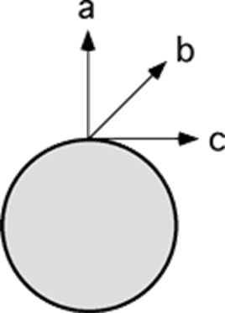
Assessing to Learn
Two masses m₁ and m₂, having m₁ > m₂, are launched with the same speed in the direction a. Which mass reaches the greatest height?
m₁
m₂
Both reach the same height.
Notes:
Think about it, get your own answer, and check to see if your neighbor has a similar answer. We’ll talk about it in a couple of minutes.
Answer: Both reach the same height.
Question F1.03a
Commentary
Purpose: To extend your understanding of energy conservation and projectile motion into the realm of "universal gravitation".
Discussion:
Under the assumptions of "local gravity", the maximum height a projectile reaches does not depend on the object's mass, only on its launch direction and speed. This problem inquires whether that is also true under universal gravitation, thus stimulating you to generalize your understanding of projectile motion and work with universal gravitation ideas.
Assuming each projectile's launch speed is less than its escape velocity, it will rise straight up, gradually slow, stop momentarily, and fall back down. Its maximum height thus occurs when the kinetic energy is zero. Initially, a projectile has some positive kinetic energy and some negative potential energy. (Under universal gravitation, all gravitational potential energy is negative; the closer one is to the source of attraction, the more negative it becomes.) At the highest point, it has only negative potential energy. Since all forces are conservative, total mechanical energy is conserved, initial energy is equal to final energy, and by writing the appropriate expressions for kinetic and potential energy, we can solve for the projectile's height.
We don't, however, actually have to solve for the height here. Note that the expressions for kinetic and potential energy are both proportional to the projectile's mass m: K = mv²/2 and U = –GmM_{Earth}/r. Thus, the mass cancels out of the equation, meaning that the maximum height achieved is independent of the mass. (The same argument applies to the analogous problem in local gravitation, though the equation for potential energy is different.)
It may be tempting to argue qualitatively that the heavier object has more initial kinetic energy, and therefore will have more final potential energy, and thus must go higher; this argument overlooks the fact that the heavier object also requires more energy to reach a given height.
Key Points:
Object masses often drop out of gravitational problems, for both local and universal gravitation.
Understanding the reasoning behind facts and derived results helps you to know whether they are valid in new circumstances (e.g., universal gravitation vs. local gravitation).
For Instructors Only
This question is an example of the "extend the context" pattern, presenting a familiar question in a novel circumstance: in this case, a common projectile-motion question in a situation requiring universal rather than local gravitation.
Do not stop after finding out whether students provide the correct answer; persevere to find out their reasoning. Some students will get the right answer by erroneously applying "the square root of 2gh" or similar rules memorized during local gravitation, and this must be detected and challenged.
Source: UMass Assessing to Learn

Slide 73
Assessing to Learn
Two masses m₁ and m₂, having m₁ > m₂, are launched with the same speed in the direction b. Which mass reaches the greatest height?
m₁
m₂
Both reach the same height.
Notes:
Decide for yourself, work up an explanation, and check in with your neighbor. We will hear some of your thoughts in about four minutes.
Answer: Both reach the same height.
Question F1.03b
Commentary
Purpose: To help you integrate angular momentum and energy ideas in universal gravitation problems.
Discussion:
In the previous question, a projectile launched directly upwards reached its apogee (maximum height) when its speed was zero. In this question, the projectiles are launched at an angle and therefore have a nonzero speed even at apogee. In order to apply the principle of conservation of energy to find the maximum height, we need to know how much kinetic energy each projectile will have at the top.
If we were doing this problem with local gravity (a "flat Earth" with constant gravitational force), the trajectory of a projectile would be a parabola, the horizontal component of the velocity would be constant, and by finding the initial horizontal velocity we would know it at all times and could find the kinetic energy at apogee (when the vertical component of the velocity is zero). With this problem, however, the projectile will follow an elliptical orbit rather than a parabola, and the horizontal velocity (in a coordinate system fixed at the launch point) is not constant.
What is constant? The angular momentum of the projectile around the center of the Earth is conserved, since the only force acting upon it is central (points toward the center of the Earth) and thus exerts no torque. We can relate the angular momentum to the "horizontal" (tangential) velocity component v_{t} as follows: L = r × p = r × mv → L = mrv_{t}. Since the kinetic energy at apogee K_{a} is mv_{t}²/2 (since the radial component of velocity v_{r} is zero), we can write K_{a} in terms of the angular momentum: K_{a} = L² / (2mr_{a}²) (where r_{a} is the radius of the projectile — its height above the center of the Earth — at apogee).
Since the angular momentum is constant, we can find its value at the moment of launch: L = mrv_{t} = mR_{E}v₀cos(θ) where θ is the launch angle (above horizontal) and v₀ the launch speed. Now, if we substitute this into our expression for K_{a}, we get K_{a} = mR_{E}²v₀²cos(θ)² / 2r²). In other words, we find that the kinetic energy at apogee is proportional to the projectile's mass.
Since kinetic energy at launch and potential energy at launch and apogee are all also proportional to the mass (as discussed in the previous question), mass cancels out of the conservation of energy equation, and we find that the maximum height does not depend on mass. Thus, both projectiles must reach the same maximum height. In other words, the same argument applies to this question as to the previous one, but in this case we had to do a little more work to demonstrate that the argument does apply.
Intuition might suggest to you that the mass does not matter, but part of physics is learning to back up your intuition with a solid argument.
Key Points:
For orbit problems and universal gravitation, much of what you've learned about parabolic trajectory problems does not apply, or applies only with significant modification.
Angular momentum is a powerful concept for reasoning about gravitation and orbit problems.
For an orbiting body, a certain amount of energy is "locked up" in preserving the body's angular momentum and cannot be converted to potential energy; the rest of the energy moves between potential and kinetic as the object orbits farther from and then closer to the object attracting it.
For Instructors Only
This, once again, is an example of "extending the context": this problem focuses students' attention on the significance of having an initial horizontal component.
Students may very easily select the correct answer based on incorrect or insufficient reasoning; the point of this question is therefore to motivate discussion about why that answer is correct. Playing the Devil's Advocate can be useful here.
This is a hard question, but it provides fertile ground for exploring the application of energy and angular momentum ideas to universal gravitation and orbit problems. It can serve as the "anchor" and motivator for an extended exploration of the topics.
Source: UMass Assessing to Learn

Slide 74
Assessing to Learn
A mass m is launched from the surface of the Earth with speed v. The diagram shows three possible launch directions; order them according to the maximum height the projectile will reach, from greatest height to least height.
a = b = c
a < b = c
a < b < c
a < c < b
a > b = c
a > b > c
a > c > b
b > a > c
b > a = c
Not enough information.
Notes:
Figure out your answer, share it with your neighbor, and see what they say. We’ll talk it through as a big group in around three or four minutes.
Answer: a > b > c
Question F1.03c
Commentary
Purpose: To develop your understanding of the role angular momentum plays in the motion of an object under universal gravitation.
Discussion:
If you understood the reasoning behind the previous question, this one should be fairly straightforward: the question compares projectiles with different launch directions rather than with different masses, but the ideas are the same.
Angular momentum must be conserved; the more angular momentum a projectile has, the more kinetic energy is "locked up“, preserving that angular momentum and the less is available to convert to gravitational potential energy, so the lower the projectile's maximum height will be. A projectile launched in direction a has no angular momentum about the center of the Earth; that path must therefore produce the greatest maximum height. Direction c will produce the greatest angular momentum, and so will cause the least maximum height of the three paths. Thus, a > b > c is the best ranking.
Key Points:
Angular momentum is a powerful concept for reasoning about gravitation and orbit problems.
For an orbiting body, a certain amount of energy is "locked up" in preserving the body's angular momentum and cannot be converted to potential energy; the rest of the energy moves between potential and kinetic as the object orbits farther from and then closer to the object attracting it.
For Instructors Only
Asking students to rank order situations according to some quantity is a good way to foster qualitative analysis skills and check for conceptual understanding of an idea.
If students seem to be comfortable with this problem, you might challenge them by asking to rank order the escape velocity required for the three launch directions. The escape velocity is in fact the same for all three, but to students this can seem to contradict the reasoning they've just used for this question. Exploring and resolving the apparent contradiction pushes students to further refine their understanding of escape velocity and the relationship between angular momentum and energy in orbit problems.
Source: UMass Assessing to Learn

Slide 75
TOPIC summary
Topic 8: Rotational Equilibrium and Dynamics

Slide 76
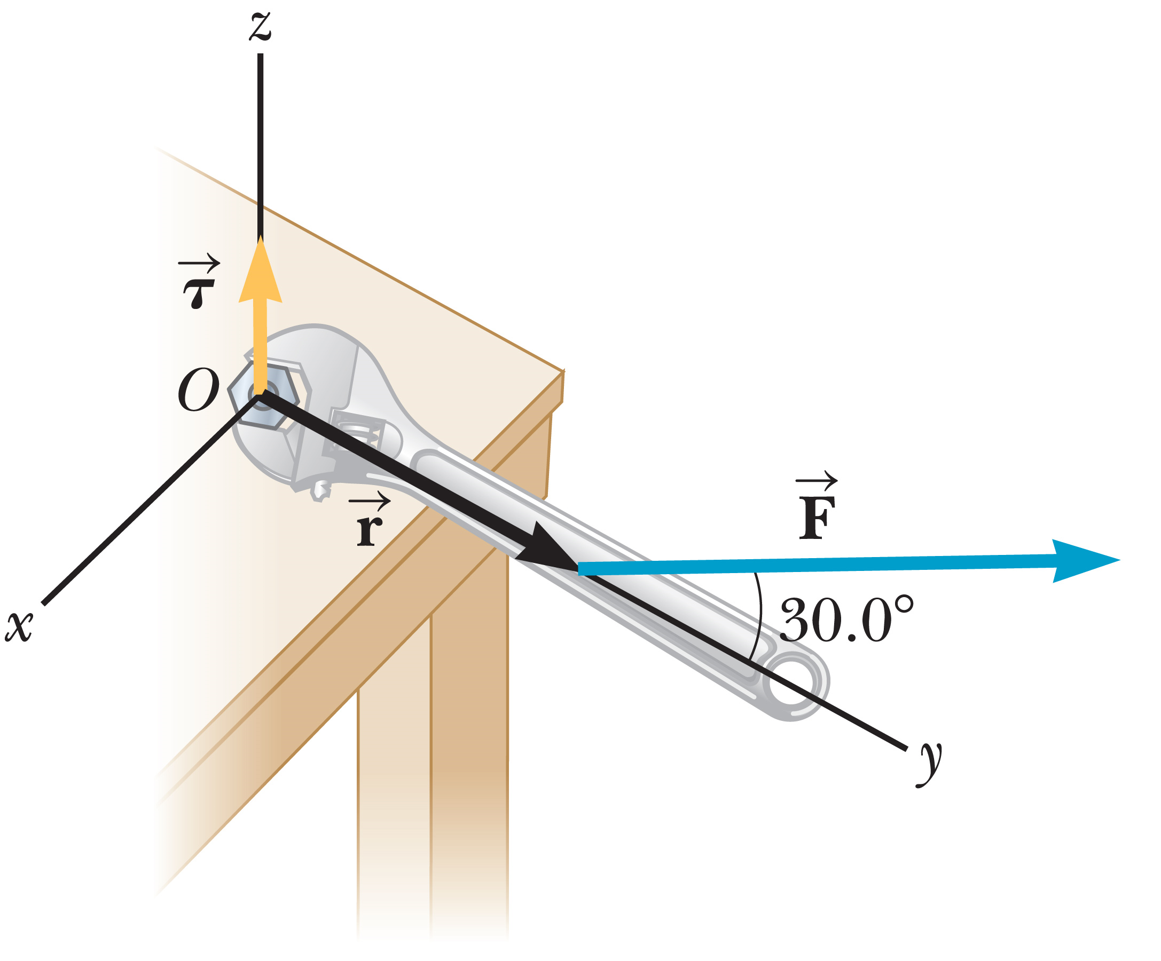
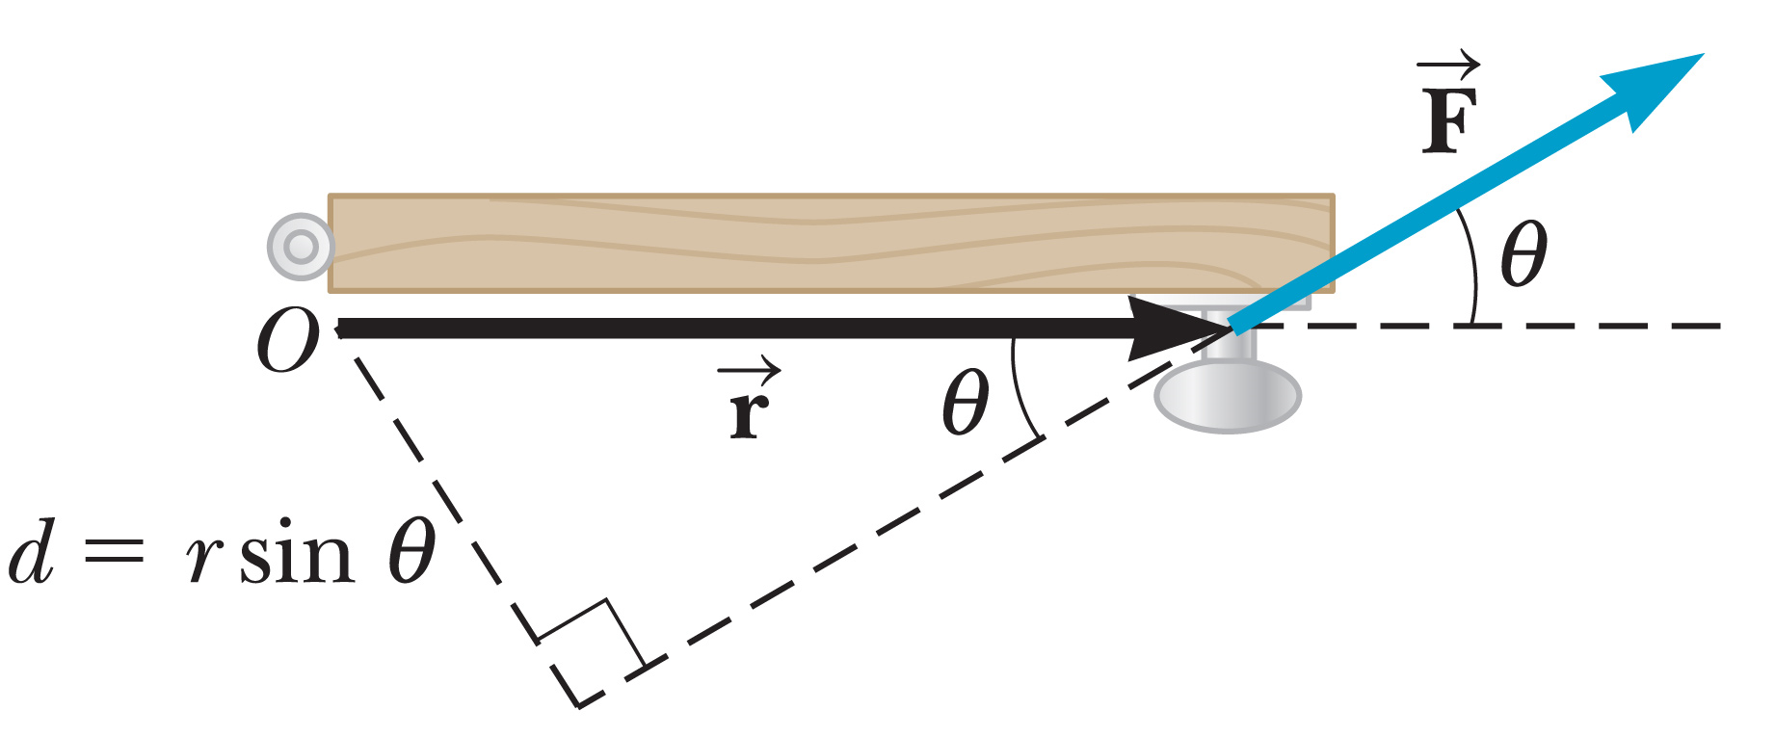
Topic Summary
Torque
Center of Mass and Its Motion
Notes:
Torque
Let F be a force acting on an object, and let r be a position vector from a chosen point O to the point of application of the force. Then the magnitude of the torque of the force F is given by the equation shown, where r is the length of the position vector, F the magnitude of the force, and θ the angle between F and r. The quantity d is called the lever arm of the force.
Center of Mass and Its Motion
The torque of an object’s weight can be calculated using a single force applied at the object’s center of gravity. The x-, y-, and z-of an object’s center of gravity are shown here. The center of mass and center of gravity are exactly the same when g doesn’t vary significantly over the object, which is the case for all objects in this topic

Slide 77
Topic Summary
Torque and the Two Conditions for Equilibrium
The Rotational Second Law of Motion
Notes:
Torque and the Two Conditions for Equilibrium
An object in mechanical equilibrium must satisfy the following two conditions:
The net external force must be zero.
The net external torque must be zero.
These two conditions, used in solving problems involving rotation in a plane—result in three equations and three unknowns—two from the first condition (corresponding to the x- and y-components of the force) and one from the second condition, on torques. These equations must be solved simultaneously.
The Rotational Second Law of Motion
The moment of inertia of a group of particles is defined as shown. If a rigid object free to rotate about a fixed axis has a net external torque acting on it, then the object undergoes an angular acceleration α. This equation is the rotational equivalent of the second law of motion. Problems are solved by using this torque equation together with Newton’s second law and solving the resulting equations simultaneously. The relation between a and α is often key in relating the translational equations to the rotational equations.

Slide 78
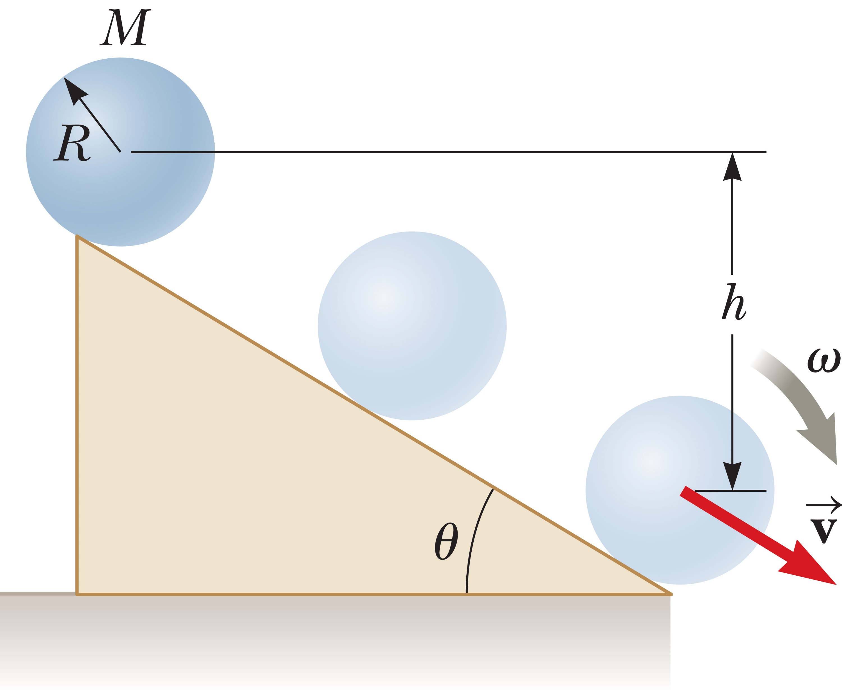
Topic Summary
Rotational Kinetic Energy
Notes:
Rotational Kinetic Energy
If a rigid object rotates about a fixed axis with angular speed v, its rotational kinetic energy is defined as shown, where I is the moment of inertia of the object around the axis of rotation.
A system involving rotation is described by three types of energy: potential energy, translational kinetic energy, and rotational kinetic energy. All these forms of energy must be included in the equation for conservation of mechanical energy for an isolated system, where i and f refer to initial and final values, respectively.
When nonconservative forces are present, it’s necessary to use a generalization of the work–energy theorem.

Slide 79
Topic Summary
Angular Momentum
Notes:
Angular Momentum
The angular momentum of a rotating object is defined as shown.
Angular momentum is related to torque in the given equation.
If the net external torque acting on a system is zero, the total angular momentum of the system is constant and is said to be conserved.
Solving problems usually involves substituting into the expression shown and solving for the unknown.

