Slide 1
Circular Motion and Gravitation

Slide 2
Vector fields
https://www.youtube.com/watch?v=GllBa9Mosos

Slide 3
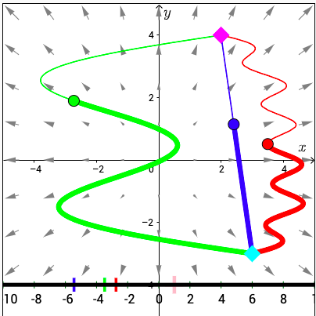
In a conservative vector field the Work done is independent of the path
Gravity, and electricity and magnetism
in the absence of friction are conservative vector fields.
If friction is considered then field is not conservative (the work done will differ based on the path chosen)
Work in a vector field can be computed by a line integral. (in MV Calculus)

Slide 4
Four Fundamental Forces
Gravity.
The weak force.
Electromagnetism.
The strong force.

Slide 5
Gravity (possibly mediated by Gravitons)
Gravity is the attraction between two objects that have mass or energy, whether this is seen in dropping a rock from a bridge, a planet orbiting a star or the moon causing ocean tides. Gravity is probably the most intuitive and familiar of the fundamental forces, but it's also been one of the most challenging to explain.
Isaac Newton was the first to propose the idea of gravity, supposedly inspired by an apple falling from a tree. He described gravity as a literal attraction between two objects. Centuries later, Albert Einstein suggested, through his theory of general relativity, that gravity is not an attraction or a force. Instead, it's a consequence of objects bending space-time. A large object works on space-time a bit like how a large ball placed in the middle of a sheet affects that material, deforming it and causing other, smaller objects on the sheet to fall toward the middle.

Slide 6
The weak force (Mediated by W and Z Bosons)
The weak force, also called the weak nuclear interaction, is responsible for particle decay. This is the literal change of one type of subatomic particle into another. So, for example, a neutrino that strays close to a neutron can turn the neutron into a proton while the neutrino becomes an electron.

Slide 7
Electromagnetic Force (mediated by photons)
The electromagnetic force, also called the Lorentz force, acts between charged particles, like negatively charged electrons and positively charged protons. Opposite charges attract one another, while like charges repel. The greater the charge, the greater the force. And much like gravity, this force can be felt from an infinite distance (albeit the force would be very, very small at that distance).
As its name indicates, the electromagnetic force consists of two parts: the electric force and the magnetic force. At first, physicists described these forces as separate from one another, but researchers later realized that the two are components of the same force.

Slide 8
Strong Force (mediated by Gluons)
The strong nuclear force, also called the strong nuclear interaction, is the strongest of the four fundamental forces of nature. It's 6 thousand trillion trillion trillion (that’s 39 zeroes after 6!) times stronger than the force of gravity, according to the HyperPhysics website. And that's because it binds the fundamental particles of matter together to form larger particles. It holds together the quarks that make up protons and neutrons, and part of the strong force also keeps the protons and neutrons of an atom's nucleus together.
Much like the weak force, the strong force operates only when subatomic particles are extremely close to one another. They have to be somewhere within 10^-15 meters from each other, or roughly within the diameter of a proton, according to the HyperPhysics website.

Slide 9
Gravitational Mass vs Inertial Mass
Inertial mass measures an object's resistance to being accelerated by a force (represented by the relationship F = ma).
Active gravitational mass measures the gravitational force exerted by an object.
Passive gravitational mass measures the gravitational force exerted on an object in a known gravitational field.

Slide 10
Measuring Mass/ Equivalence Principle
Inertial mass is a measure of an object's resistance to acceleration when a force is applied. It is determined by applying a force to an object and measuring the acceleration that results from that force. ...
Passive gravitational mass is a measure of the strength of an object's interaction with a gravitational field.
https://www.youtube.com/watch?v=P55SaeTvXT8
https://www.youtube.com/watch?v=eU2hGIrBULA

Slide 11
Gravity and Electric Force

Slide 13
Free body diagrams for circular motion
https://www.youtube.com/watch?v=GWn5LNMDb2k
Note: Centripetal Force is not listed as a separate force on a free body diagram.
The cause of the force is what appears on the diagram.

Slide 14
Relationship between acceleration velocity

